Slide 1
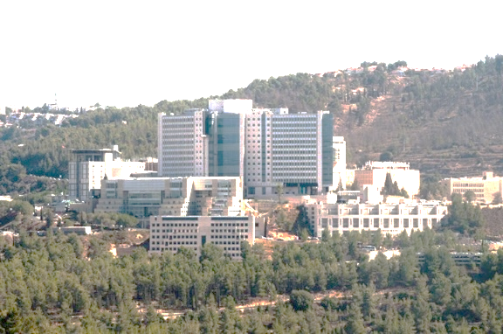



The DNA of medieval Ashkenazi Jews from Erfurt, Germany
Shai Carmi
The Hebrew University of Jerusalem
scarmilab.org
@ShaiCarmi
November 2022

Slide 2


Collaborators
Hebrew University: Shamam Waldman
  Daniel Backenroth, Hila Fridman
Harvard: David Reich
  Éadaoin Harney, Ali Akbari, Nadin Rohland, Iñigo Olalde, Swapan Mallick, and others
Erfurt: Karin Sczech, Maria Stürzebecher, Maike Lämmerhirt, Stefan Flohr
Isotopes: Keith Pruffer, Virginie Renson, Nadia Neff, Gina Buckley
Population genetics: Harald Ringbauer, Stephan Schiffels, Yosef Maruvka
Uniparental markers: Leo Cooper, Josh Lipson, Ariel Lomes
History: Leonard Rutgers, Alexander Beider
Acknowledgements: Ephraim Shoham Steiner, Rabbi Ze’ev Litke

Slide 3
Outline
Introduction
The Erfurt study
Ancestry
Founder event
Summary

Slide 4
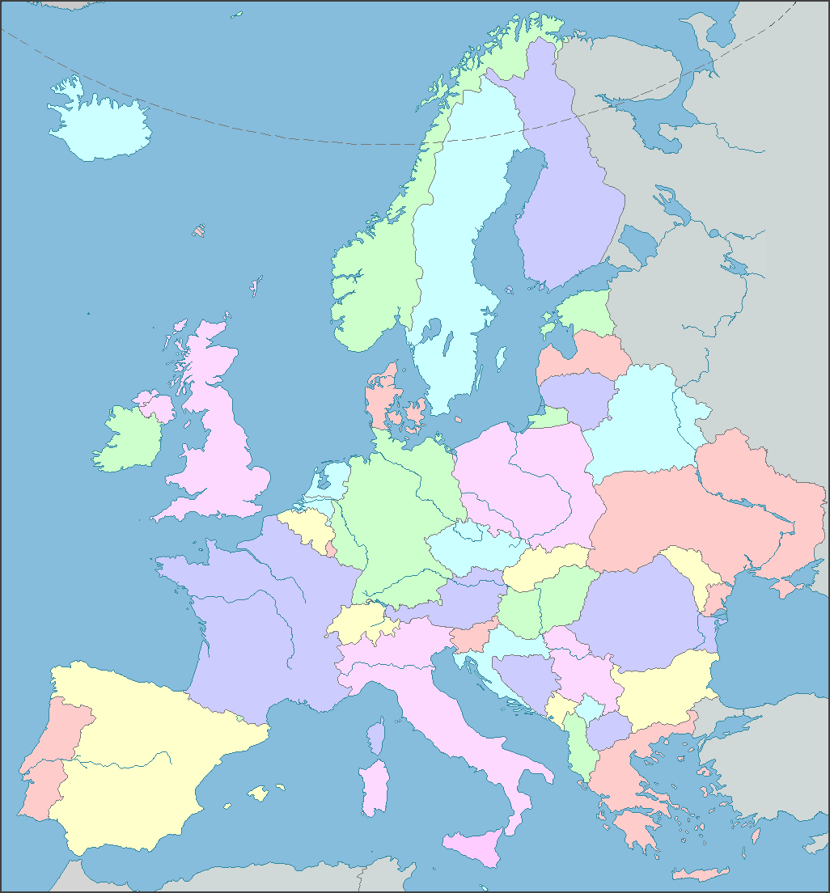
Early Ashkenazi Jewish (AJ) history
Early origin: Eastern Mediterranean?
The first AJ appeared in Germany/France only in ≈1000 CE
The population expanded rapidly in Eastern Europe
Where did they come from?
When did they move East?
When/where/did they intermarry?

Slide 5
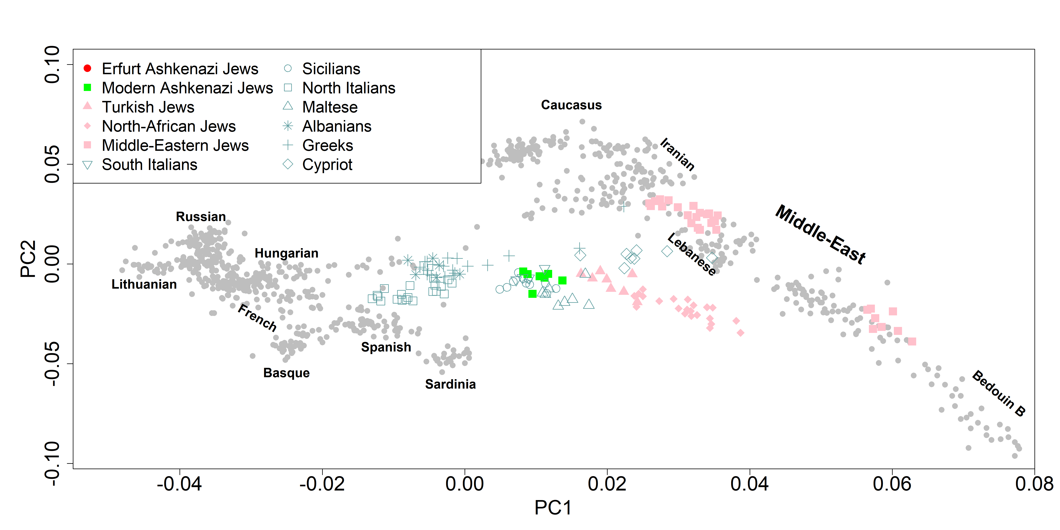
Ashkenazi genetic ancestry
Iraqi/Irani Jews
Italian/Greek
Turkish Jews
Ashkenazi Jews
Yemenite Jews
Europe
North-African Jews

Slide 6
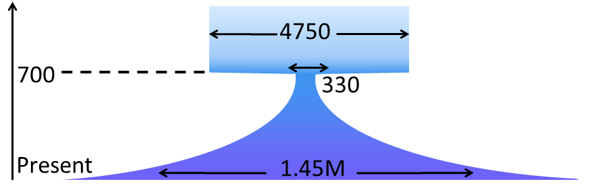
The AJ founder event/bottleneck
Genetic evidence:
  High frequency of pathogenic variants
  Four mitochondrial haplogroups in 40% of AJ
  Identical genomic blocks in unrelated individuals
Current model (effective population size):
Time (years)
Carmi et al, Nat Commun, 2014

Slide 7
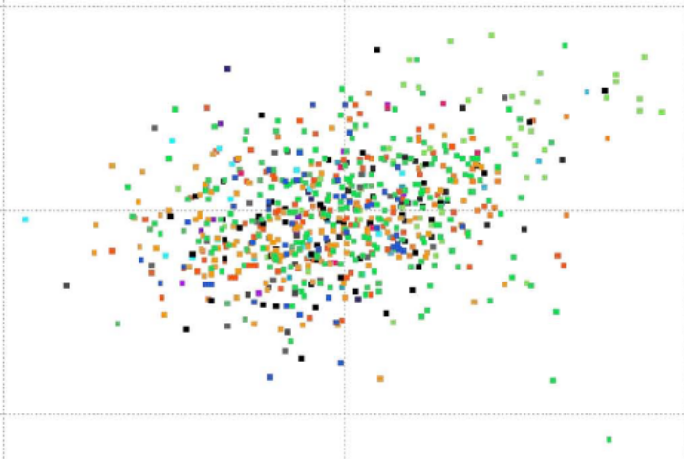

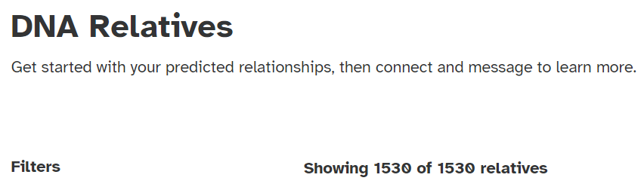

The population today
Colors by geographic origin
Very large population (census size ≈10M)
Genetically very homogenous
Random individuals related as 3rd/4th cousins
Can we learn more about AJ origins
from ancient DNA?
PC2
PC1
Guha et al, Genome Biol, 2012

Slide 8
Outline
Introduction
The Erfurt study
Ancestry
Founder event
Summary

Slide 9
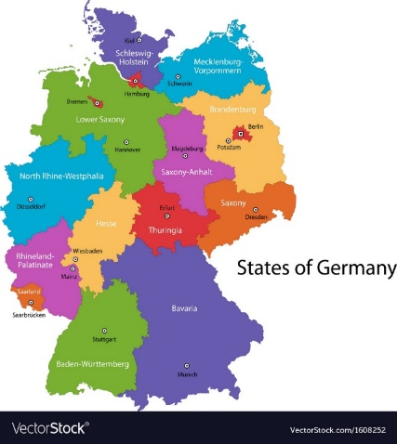
The Erfurt Jewish community
Late 11th century: first records of Jewish settlement
1349: the community is destroyed in a pogrom
1354: the second community
1453: all Jews are expelled
Late 19th century: the new community (irrelevant to us)
https://juedisches-leben.erfurt.de/jl/en/middle-ages/jcommunity

Slide 10
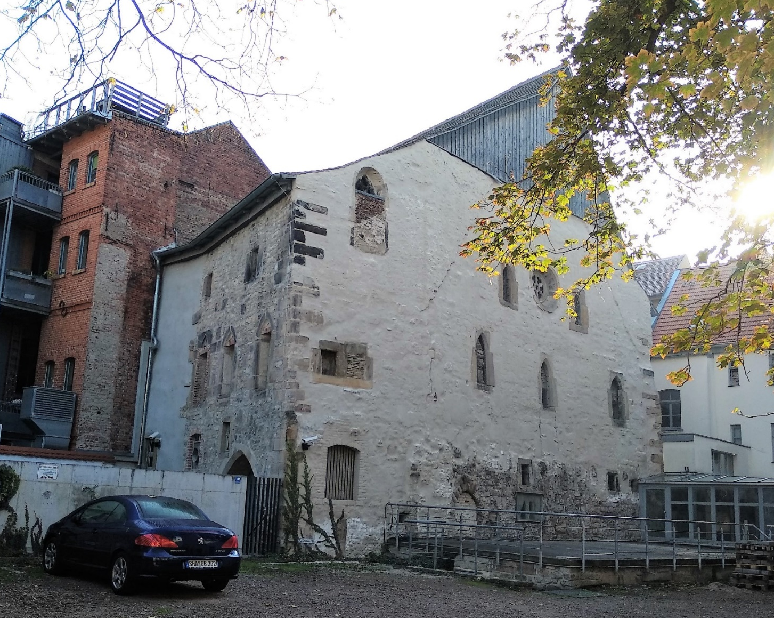
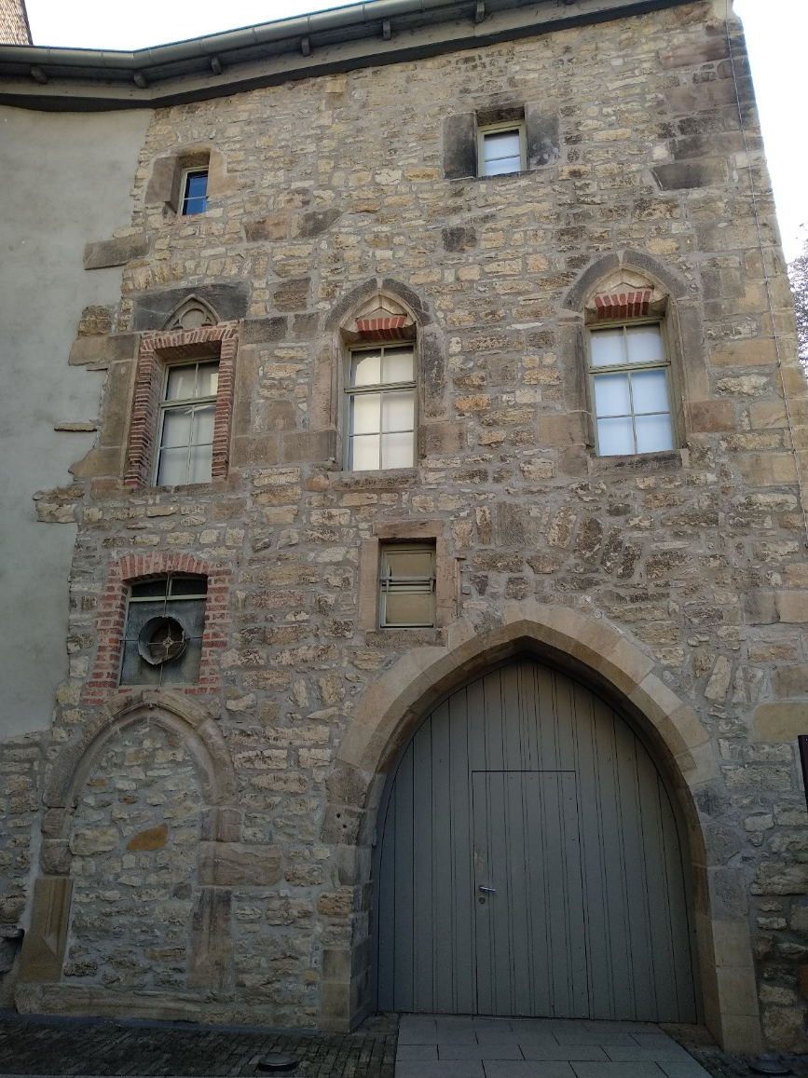
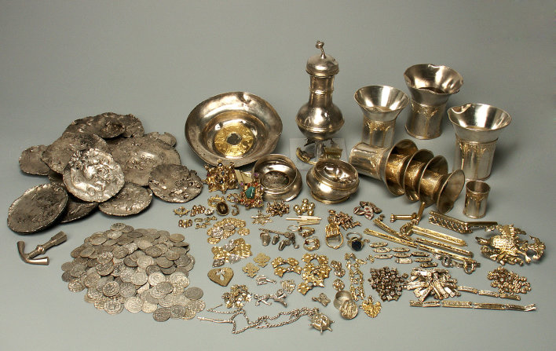
The medieval Erfurt Jewish community
The old synagogue
The Erfurt treasure

Slide 11
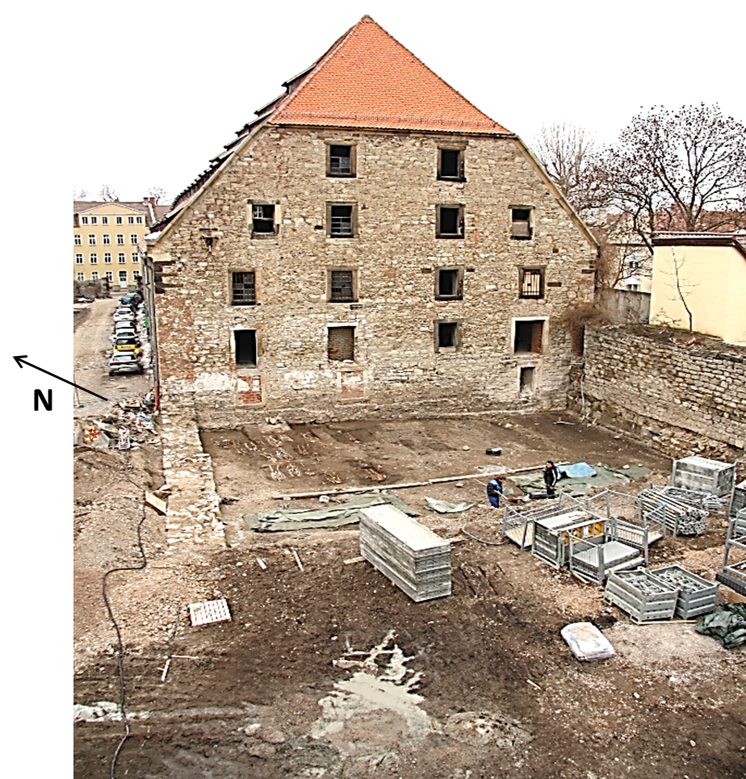
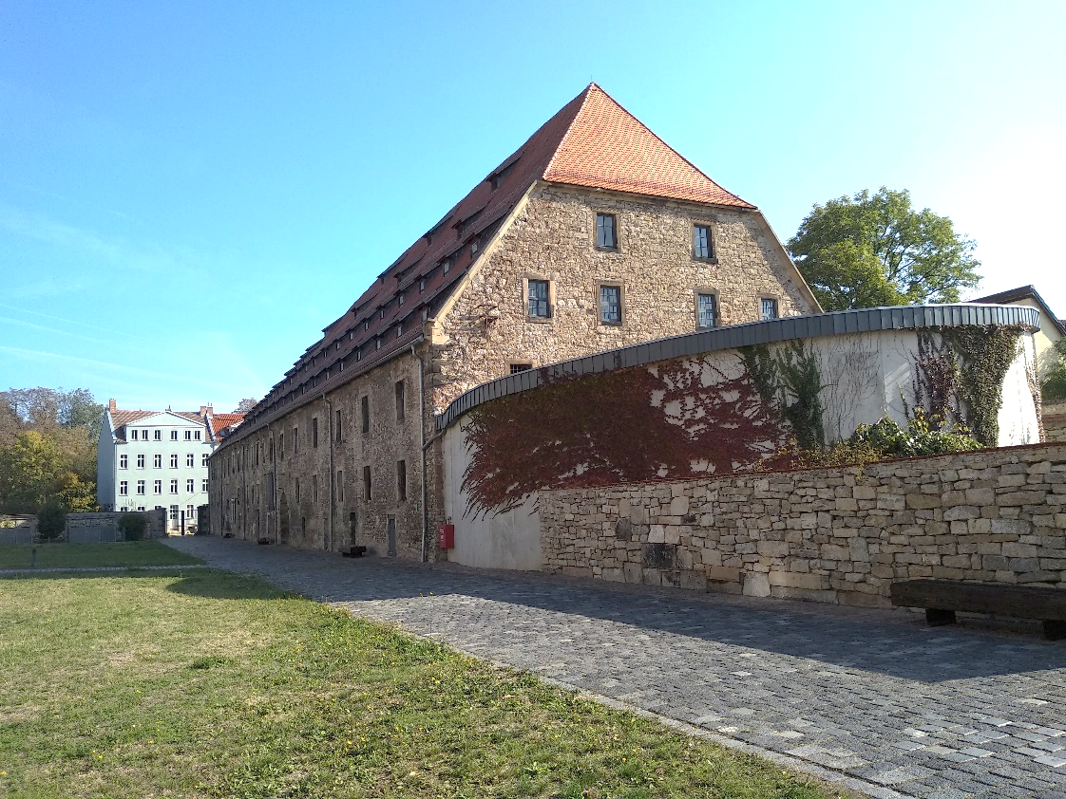
The medieval Jewish cemetery
Photo: Karin Sczech
A granary was built on top of the medieval Jewish cemetery
Then converted to a parking lot

Slide 12
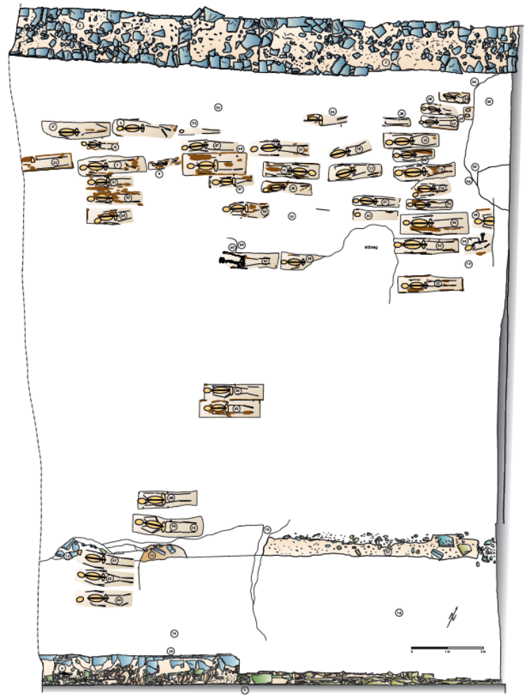
The excavation
2013: Rescue excavation
2017: Contact archaeologists
2018: Rabbinical approval to study DNA (detached teeth only + reburial)
2019: DNA extraction and sequencing
2021: Reburial

Slide 13




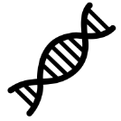
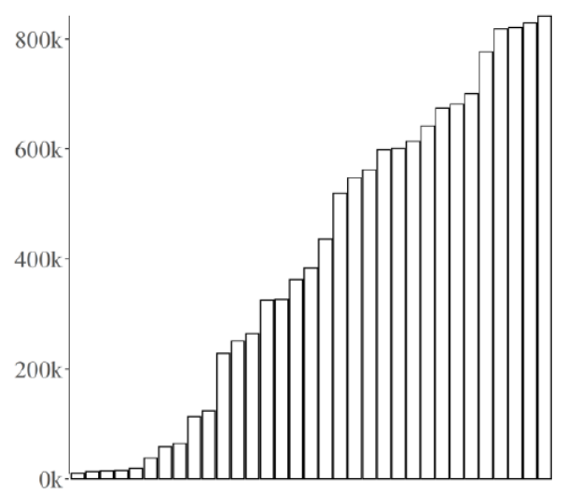
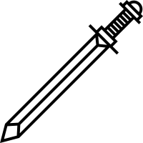

The initial data
33 genomes
19 females
14 males
14/33 younger than 20
Family A
Family B
Cause of death:
One individual killed violently
No traces of Yersinia pestis
(Almost) no grave goods
Radiocarbon (¹⁴C) dating:
1270-1400 CE
(all individuals)
Genetic data:
Mean number of markers: 402k

Slide 14
Outline
Introduction
The Erfurt study
Ancestry
Founder event
Summary

Slide 15
Erfurt genetic ancestry
Iraqi/Irani Jews
Italian/Greek
Turkish Jews
Ashkenazi Jews
Yemenite Jews
Europe
North-African Jews

Slide 16
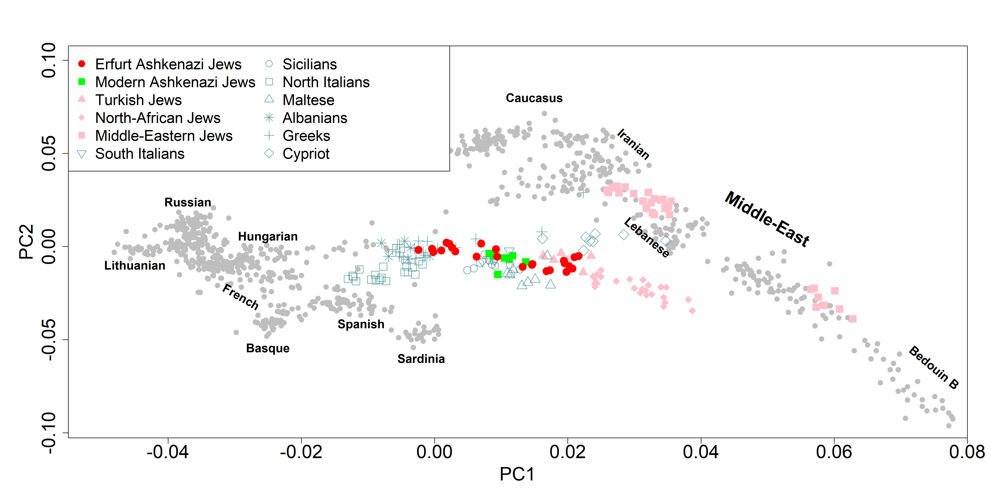
Erfurt genetic ancestry
Iraqi/Irani Jews
Italian/Greek
Turkish Jews
Erfurt
Yemenite Jews
Ashkenazi Jews
Europe
North-African Jews

Slide 17
Erfurt genetic ancestry
Zoom-in on Erfurt?
Iraqi/Irani Jews
Italian/Greek
Turkish Jews
Erfurt
Yemenite Jews
Ashkenazi Jews
Europe
North-African Jews
Erfurt Jews and modern AJ are genetically the same population
“In-conversion” in the past 600 years: 2-4%

Slide 18
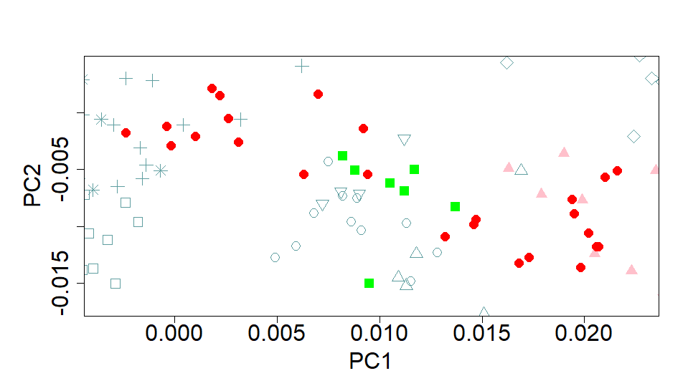
Genetic variation within Erfurt
Erfurt Jews clearly more diverse than modern AJ
Are there two distinct groups?
Statistical testing of the PCA results and population genetic simulations support two groups
Erfurt
Erfurt-EU
Erfurt-ME
Modern Ashkenazi Jews

Slide 19
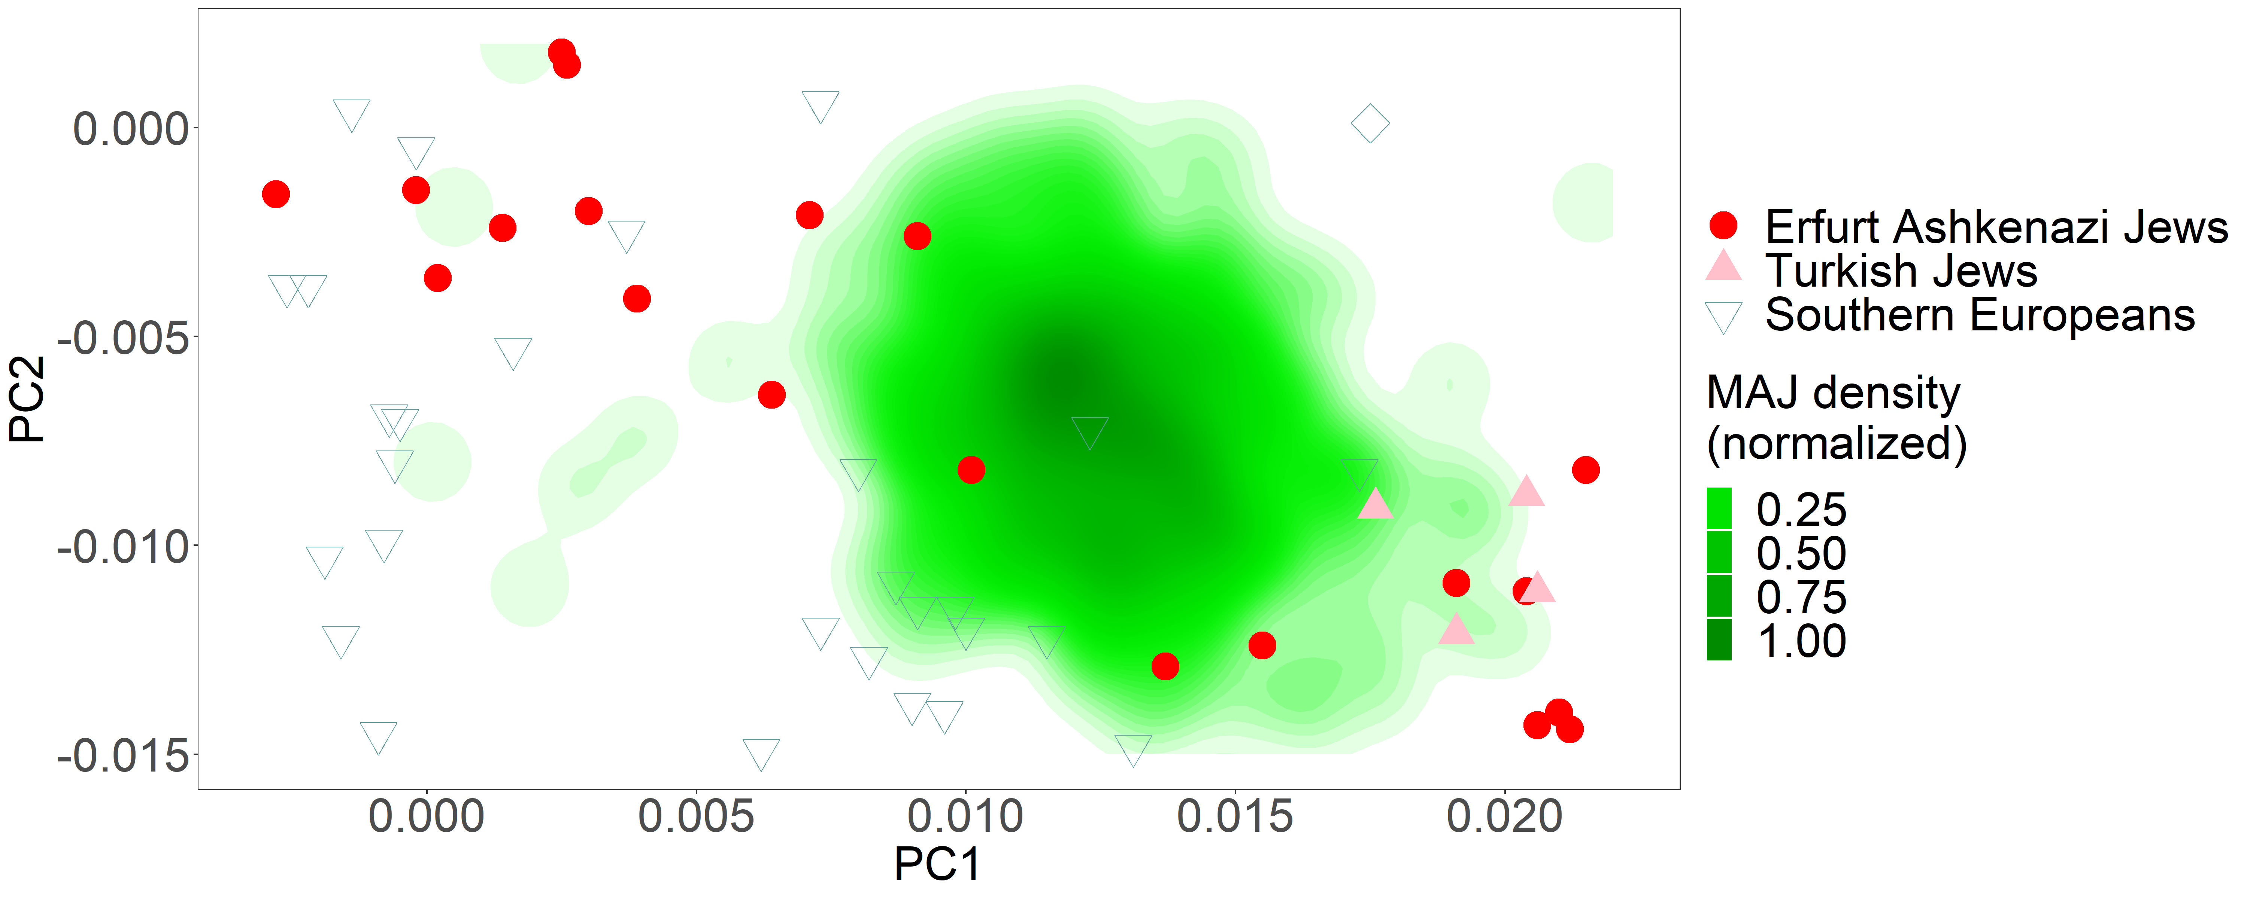
PCA with more modern AJ (n=544)

Slide 20
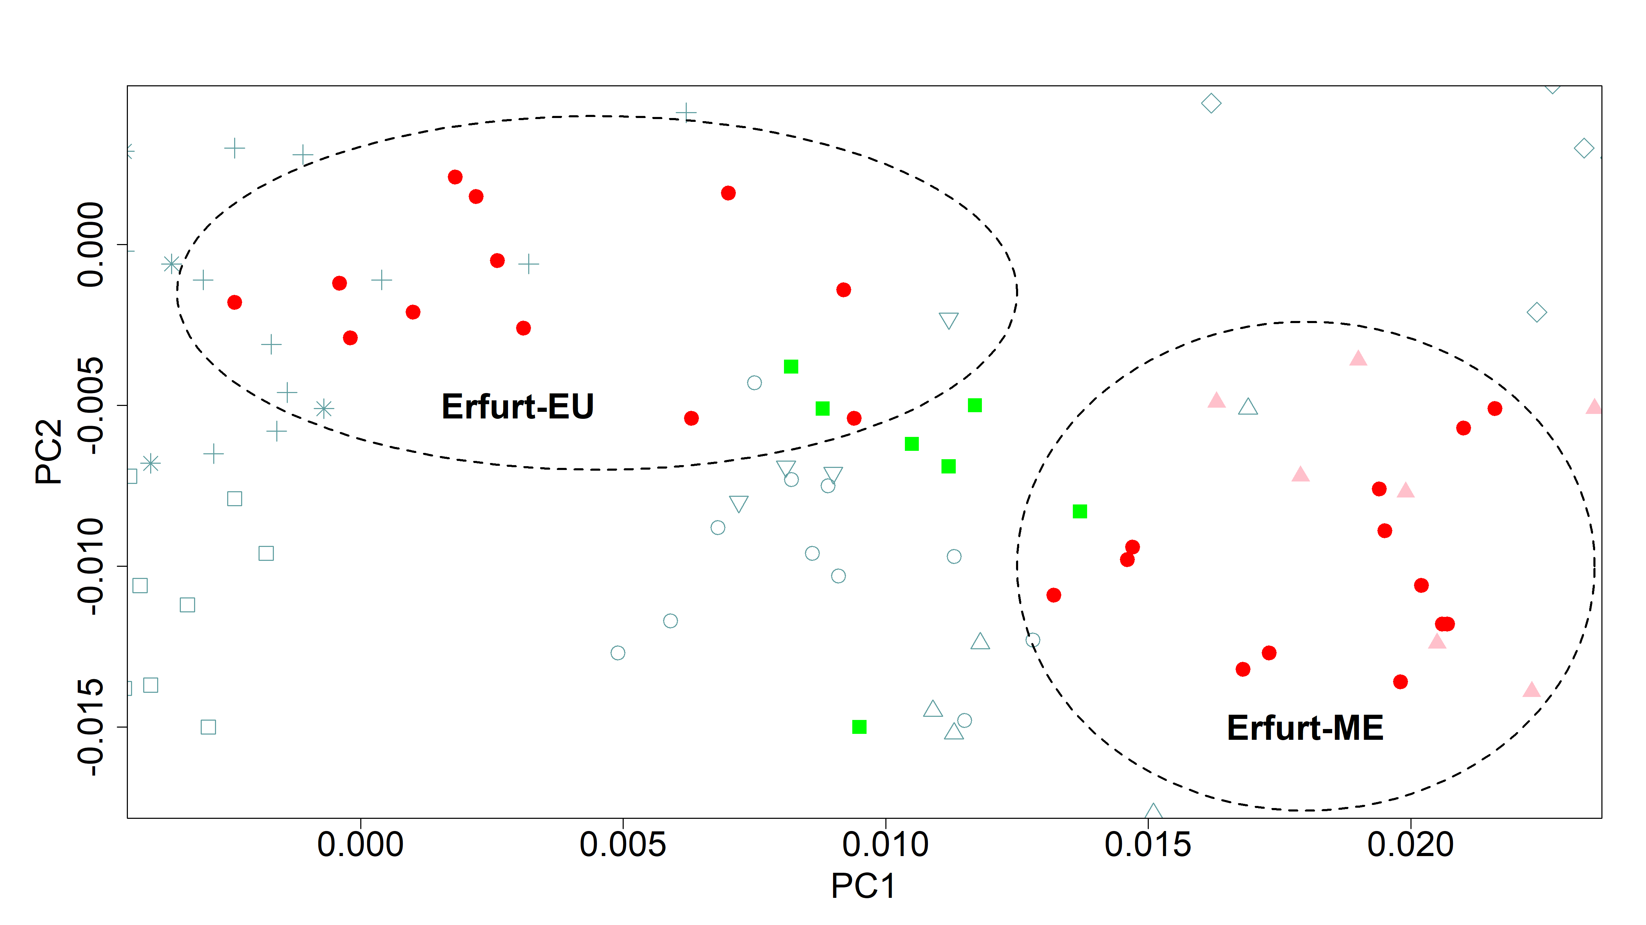
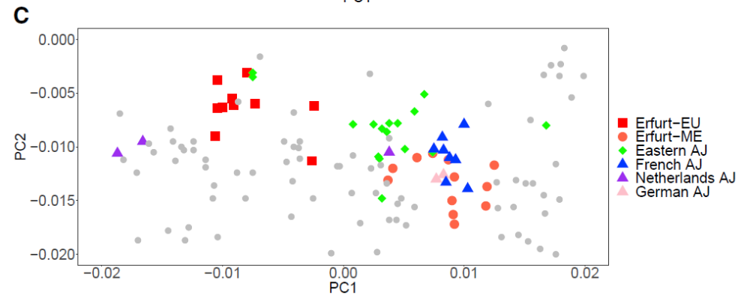
Erfurt-ME
Turkish Jews
Overlaps with Turkish (Sephardi) Jews
Overlaps with modern AJ from France/Germany
Also supported by mitochondrial DNA

Slide 21
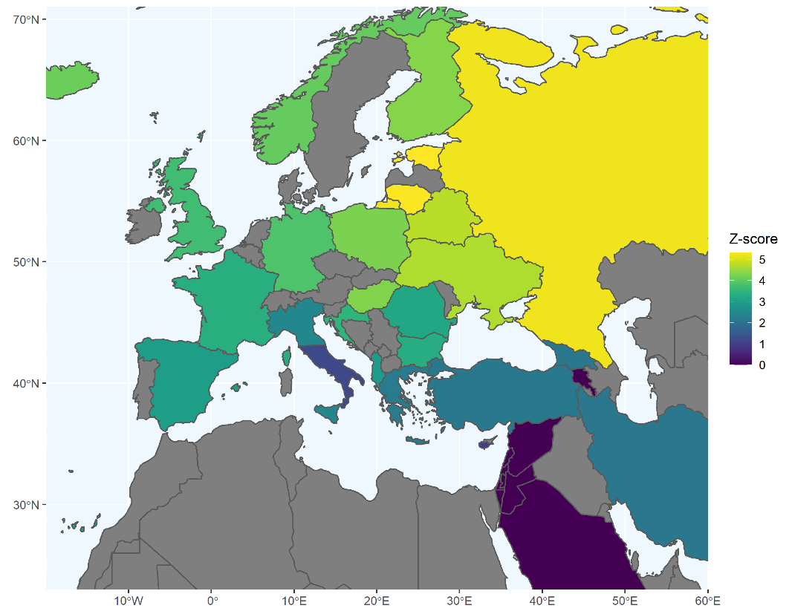
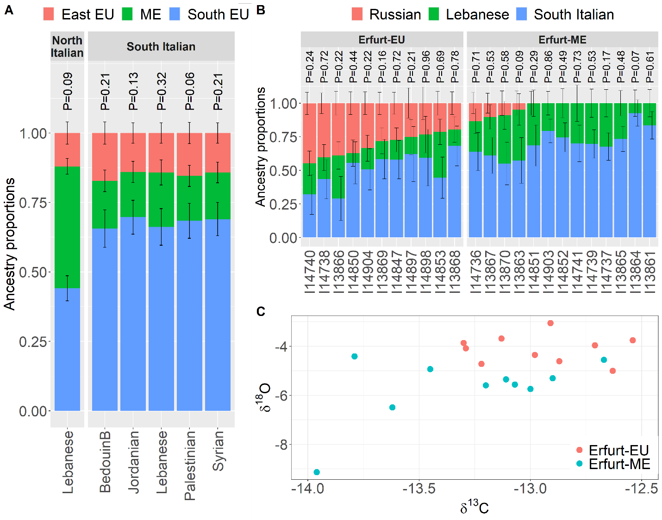
Erfurt-EU
Affinity with Erfurt-EU vs Erfurt-ME
f4(E-EU,E-ME;
X, chimp)
Eastern-European-related ancestry
Difference in carbon/oxygen isotope levels: different geographic origins

Slide 22
A model for the early origins of Erfurt Jews
The East-EU ancestry is present mostly in Erfurt-EU
Average contributions:
  65% Southern Italy
  20% Middle East
  15% Eastern Europe
Caution: other models may fit too; modern sources may be non-representative

Slide 23
Historical model for early AJ
Early origins in Southern Europe (Italy?), possibly absorbing ME migrants
Two early groups:
Western (“Rhineland”) group, Erfurt-ME
  Culturally dominant
  Some unmixed descendants
Eastern group, Erfurt-EU
  Slavic names and possibly local mixing
  Linguistically dominant
Erfurt: “cosmopolitan” border city
  No segregation in burial
Later: (nearly even) mixing
Erfurt

Slide 24
Outline
Introduction
The Erfurt study
Ancestry
Founder event
Summary

Slide 25
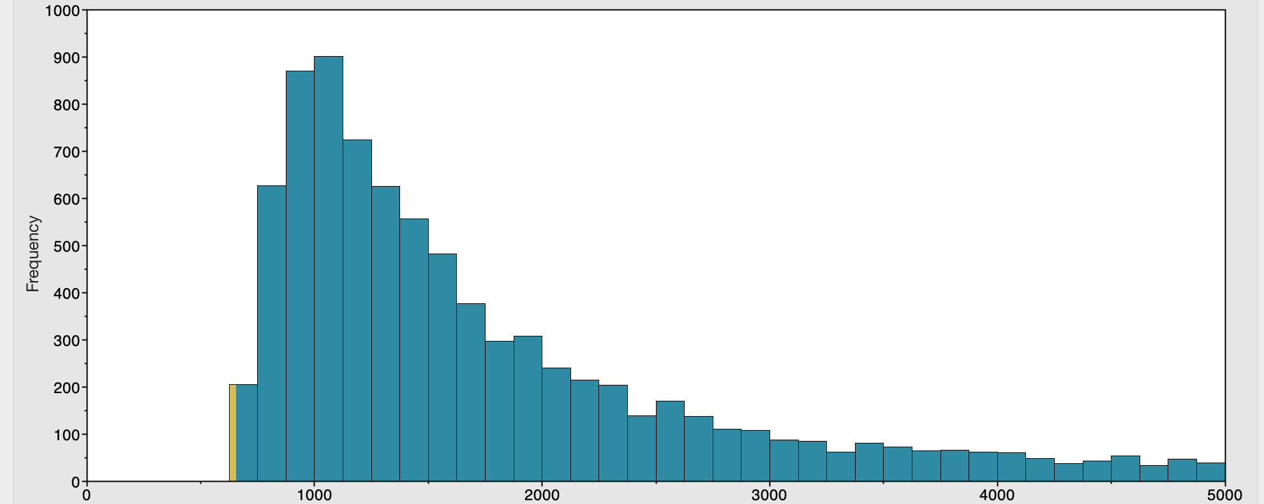
Mitochondrial types
Erfurt Jews carry similar mitochondrial haplogroups to modern AJ
Supporting a shared “bottleneck”
K1a1b1a carriers
11 ancient and 107 modern
Haplogroup | Modern AJ | Erfurt
K1a1b1a | 20% | 11/31
N1b1b1 | 9% | 1/31
K1a9 | 6% | 2/31
K2a2a | 5% | 0/31
BEAST2
Most recent common ancestor (years ago)

Slide 26
Runs of homozygosity
Maternal chromosome:
AGACTGGGCAGTATACTATACTACGAGCATAGTCACCCT
Paternal chromosome:
ATGCCGAGCAGTATACTATACTACGAGCATAGACGTCCA

Slide 27
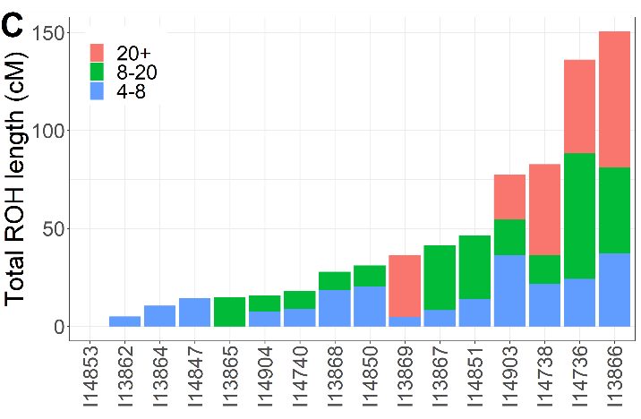
Runs of homozygosity
Maternal chromosome:
AGACTGGGCAGTATACTATACTACGAGCATAGTCACCCT
Paternal chromosome:
ATGCCGAGCAGTATACTATACTACGAGCATAGACGTCCA
Run of homozygosity
Parents related nearly as 1st-cousins
Homozygosity indicates parental relatedness
The very high levels in Erfurt are likely due to the bottleneck
(not consanguinity)

Slide 28
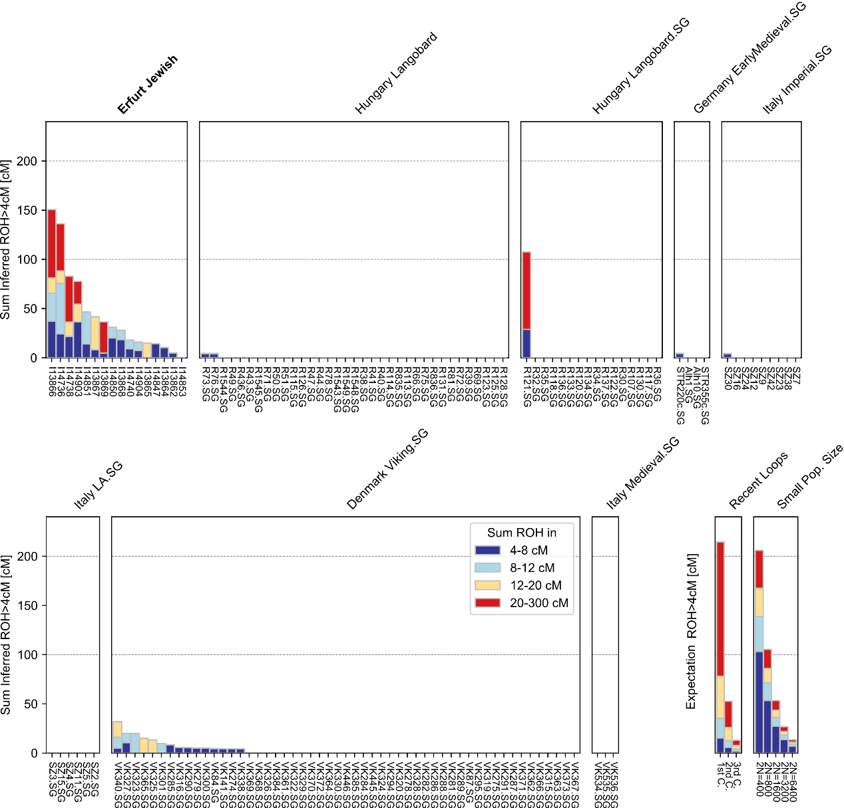
ROH levels
ROH levels in Erfurt are higher compared to other European populations of the past ≈2000 years

Slide 29
Imputation
Haplotype | SNP 1 | SNP 2 | SNP 3 | SNP 4 | SNP 5 | SNP 6 | SNP 7
1 | 1 | 0 | 1 | 1 | 0 | 0 | 1
2 | 0 | 1 | 1 | 1 | 0 | 0 | 1
3 | 0 | 0 | 1 | 1 | 1 | 0 | 0
4 | 0 | 1 | 1 | 0 | 0 | 0 | 1
5 | 1 | 0 | 1 | 0 | 0 | 1 | 0
6 | 1 | 1 | 0 | 1 | 1 | 0 | 0
Sequenced haplotypes (“reference”)
0: major allele
1: minor allele
Haplotype | SNP 1 | SNP 2 | SNP 3 | SNP 4 | SNP 5 | SNP 6 | SNP 7
1 | 0 | ? | 1 | 0 | ? | ? | 1
2 | 1 | ? | 1 | 0 | ? | ? | 0
Genotyped
(microarray)

Slide 30
Imputation
Haplotype | SNP 1 | SNP 2 | SNP 3 | SNP 4 | SNP 5 | SNP 6 | SNP 7
1 | 1 |  | 1 | 1 |  |  | 1
2 | 0 |  | 1 | 1 |  |  | 1
3 | 0 |  | 1 | 1 |  |  | 0
4 | 0 |  | 1 | 0 |  |  | 1
5 | 1 |  | 1 | 0 |  |  | 0
6 | 1 |  | 0 | 1 |  |  | 0
Sequenced haplotypes (“reference”)
Haplotype | SNP 1 | SNP 2 | SNP 3 | SNP 4 | SNP 5 | SNP 6 | SNP 7
1 | 0 | ? | 1 | 0 | ? | ? | 1
2 | 1 | ? | 1 | 0 | ? | ? | 0
Genotyped
(microarray)

Slide 31
Imputation
Haplotype | SNP 1 | SNP 2 | SNP 3 | SNP 4 | SNP 5 | SNP 6 | SNP 7
1 | 1 | 0 | 1 | 1 | 0 | 0 | 1
2 | 0 | 1 | 1 | 1 | 0 | 0 | 1
3 | 0 | 0 | 1 | 1 | 1 | 0 | 0
4 | 0 | 1 | 1 | 0 | 0 | 0 | 1
5 | 1 | 0 | 1 | 0 | 0 | 1 | 0
6 | 1 | 1 | 0 | 1 | 1 | 0 | 0
Sequenced haplotypes (“reference”)
Haplotype | SNP 1 | SNP 2 | SNP 3 | SNP 4 | SNP 5 | SNP 6 | SNP 7
1 | 0 | 1 | 1 | 0 | 0 | 0 | 1
2 | 1 | ? | 1 | 0 | ? | ? | 0
Genotyped
(microarray)

Slide 32
Imputation in ancient DNA
Haplotype | SNP 1 | SNP 2 | SNP 3 | SNP 4 | SNP 5 | SNP 6 | SNP 7
1 | 1 | 0 | 1 | 1 | 0 | 0 | 1
2 | 0 | 1 | 1 | 1 | 0 | 0 | 1
3 | 0 | 0 | 1 | 1 | 1 | 0 | 0
4 | 0 | 1 | 1 | 0 | 0 | 0 | 1
5 | 1 | 0 | 1 | 0 | 0 | 1 | 0
6 | 1 | 1 | 0 | 1 | 1 | 0 | 0
Sequenced haplotypes
In pseudo-haploid data, a single (random) allele is reported in each SNP
Haplotype | SNP 1 | SNP 2 | SNP 3 | SNP 4 | SNP 5 | SNP 6 | SNP 7
1 | 0 | 1 | 1 | 0 | 0 | 0 | 1
2 | 1 | 0 | 1 | 0 | 0 | 1 | 0
True ancient genome
Haplotype | SNP 1 | SNP 2 | SNP 3 | SNP 4 | SNP 5 | SNP 6 | SNP 7
1/2 | 1 | ? | ? | 0 | ? | ? | 0
Pseudo-haploid

Slide 33
New method
Imputation is typically implemented with a hidden Markov model
  Li and Stephens, Genetics, 2003; Lawson et al, PLOS Genet, 2012
Our extension: Pseudo-Haploid ChromoPainter (PHCP)
Target haplotype | G | C | C | T | T | G | A
Hidden state | 2 | 2 | 2 | 4 | 4 | 1 | 1
Index of reference haplotype most similar in each SNP
Pseudo-hap | G | C | C | T | T | G | A
Hidden state | 2/5 | 2/5 | 2/5 | 4/5 | 4/3 | 1/3 | 1/3

Slide 34
Pathogenic variants typical in AJ
Disease | Gene | Variant
Retinitis pigmentosa 59 | DHDDS | c.124A>G
Gaucher disease, type 1 | GBA | c.84dupG
Usher syndrome, type 3 | CLRN1 | p.N48K
Factor XI deficiency | F11 | p.F301L
Cystic fibrosis | CFTR | p.G542X
Acyl CoA dehydrogenase deficiency | ACADS | c.319C>T
Glycogen storage disease, type 1A | G6PC | p.R83C
Breast/ovarian cancer predisposition | BRCA1 | c.68_69delAG
Directly sequenced

Slide 35
Pathogenic variants typical in AJ
Disease | Gene | Variant | Frequency AJ | Frequency EUR
Retinitis pigmentosa 59 | DHDDS | c.124A>G | 0.52% | 0.004%
Gaucher disease, type 1 | GBA | c.84dupG | 0.08% | 0.002%
Usher syndrome, type 3 | CLRN1 | p.N48K | 0.58% | 0.008%
Factor XI deficiency | F11 | p.F301L | 2.4% | 0.03%
Cystic fibrosis | CFTR | p.G542X | 0.15% | 0.04%
Acyl CoA dehydrogenase deficiency | ACADS | c.319C>T | 1.9% | 0.02%
Glycogen storage disease, type 1A | G6PC | p.R83C | 0.66% | 0.05%
Breast/ovarian cancer predisposition | BRCA1 | c.68_69delAG | 0.41% | 0.009%
Conclusion: Erfurt Jews have already experienced the AJ bottleneck

Slide 36
Outline
Introduction
The Erfurt study
Ancestry
Founder event
Summary

Slide 37
Conclusions
Genetic isolation of AJ during the past ≈600 years
Substantial Southern-European-related ancestry
Two sub-groups of medieval AJ co-living in Erfurt
  May represent origins in Western and Eastern Europe
  Modern AJ is a mixture of these groups
The Erfurt population already experienced the founder event
Well-known pathogenic variants already present

Slide 38
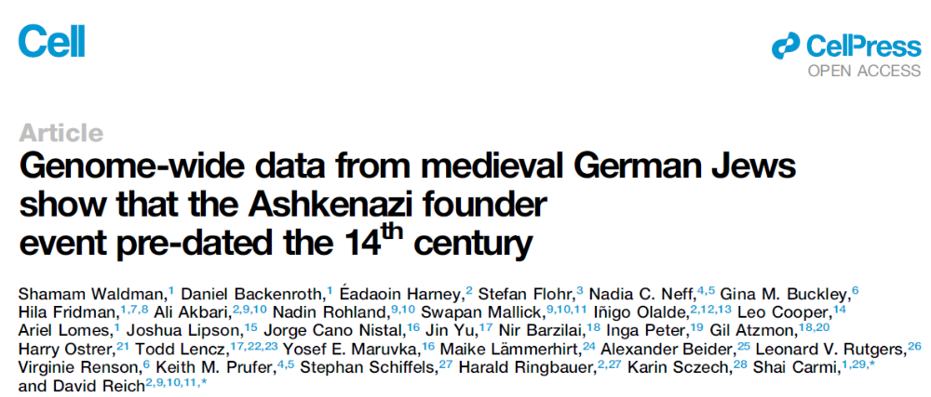
For more details
https://www.cell.com/cell/fulltext/S0092-8674(22)01378-2
https://reich.hms.harvard.edu/datasets
https://www.ebi.ac.uk/ena/browser/view/PRJEB53475

Slide 39
The current demographic model
Time (generations ago)
Xue, et al, PLOS Genet, 2017
Ancestral Middle-Eastern population
Southern EU admixture
Replacing ≈35-60%
600-1300 ya
≈25-50
Eastern EU admixture
Bottleneck
Replacing ≈15-25%
600-900 ya
≈25-35
250-500 ya
≈10-20
Population size

Slide 40
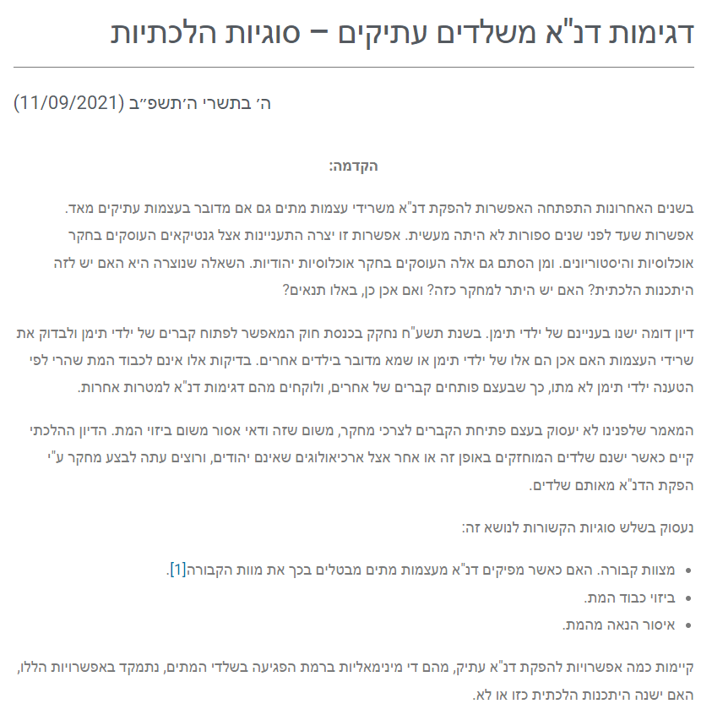
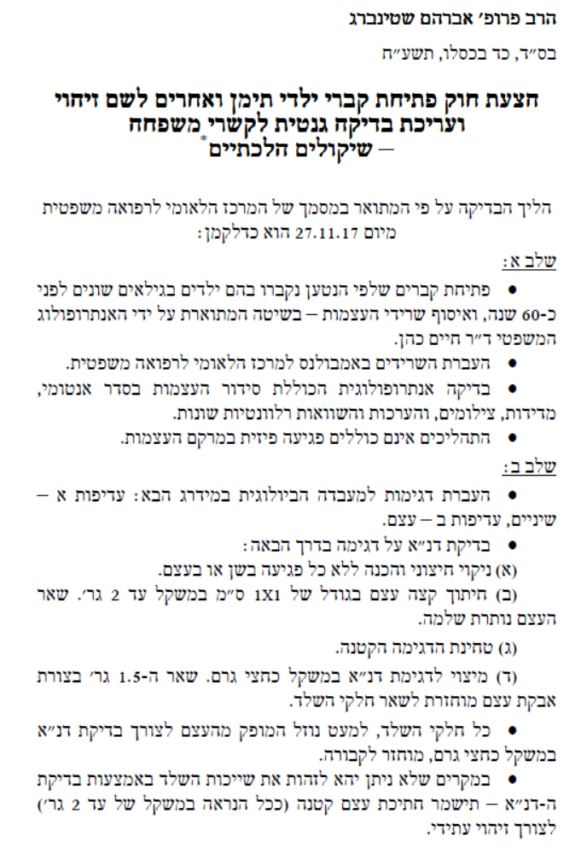
הרב זאב ליטקה, https://din.org.il/
אסיא קטו-קטז, תש"פ, עמ' 111-116

Slide 41
AJ founder (neutral) variants
Europeans
n=7,718 (gnomAD)
Modern AJ
We found 15/216 AJ founder alleles in Erfurt
Based on binomial simulations, the expected 95% CI: [14,32]
8/11 individuals carrying founder variants were also K1a1b1a carriers (P=0.005)
n=145 (gnomAD)
Frequency < 0.01%
Frequency > 0.5%
Founder variants
n=216
Middle-Eastern
<=1 copy
n=221

Slide 42
Imputation
Haplotype | SNP 1 | SNP 2 | SNP 3 | SNP 4 | SNP 5 | SNP 6 | SNP 7
1 | 1 |  | 1 | 1 |  |  | 1
2 | 0 |  | 1 | 1 |  |  | 1
3 | 0 |  | 1 | 1 |  |  | 0
4 | 0 |  | 1 | 0 |  |  | 1
5 | 1 |  | 1 | 0 |  |  | 0
6 | 1 |  | 0 | 1 |  |  | 0
Sequenced haplotypes (“reference”)
Haplotype | SNP 1 | SNP 2 | SNP 3 | SNP 4 | SNP 5 | SNP 6 | SNP 7
1 | 0 | 1 | 1 | 0 | 0 | 0 | 1
2 | 1 | ? | 1 | 0 | ? | ? | 0
Genotyped
(microarray)

Slide 43
Imputation
Haplotype | SNP 1 | SNP 2 | SNP 3 | SNP 4 | SNP 5 | SNP 6 | SNP 7
1 | 1 | 0 | 1 | 1 | 0 | 0 | 1
2 | 0 | 1 | 1 | 1 | 0 | 0 | 1
3 | 0 | 0 | 1 | 1 | 1 | 0 | 0
4 | 0 | 1 | 1 | 0 | 0 | 0 | 1
5 | 1 | 0 | 1 | 0 | 0 | 1 | 0
6 | 1 | 1 | 0 | 1 | 1 | 0 | 0
Sequenced haplotypes (“reference”)
Haplotype | SNP 1 | SNP 2 | SNP 3 | SNP 4 | SNP 5 | SNP 6 | SNP 7
1 | 0 | 1 | 1 | 0 | 0 | 0 | 1
2 | 1 | 0 | 1 | 0 | 0 | 1 | 0
Genotyped
(microarray)

Slide 44
Accuracy of the new method
Mendelian inconsistency is low
Mask and impute: false-negative rate <25%, false positive rate <0.5%
Concordance with another method on selected variants: 12/13
AA
BB
2.13%
0.59%
0.23%
0.19%
Family A
Family B

Slide 45



IBD segments
Siblings
First cousins
Proportion: 12.5%
Mean length: 25cM
Proportion: 50%
Mean length: 50cM
Identical-by-descent (IBD) segment
IBD segment

Slide 46


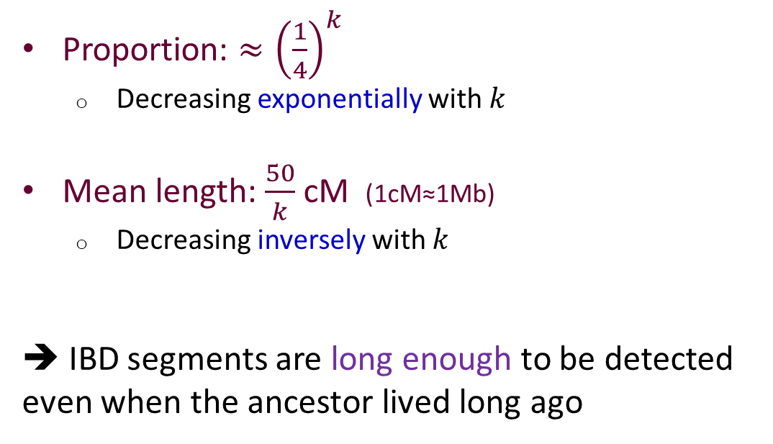

Remote relatives
$k$^{th}-generation cousins
Proportion: ${≈\left(\frac{1}{4}\right)}^{k}$
  Decreasing exponentially with $k$
Mean length: $\frac{50}{k}$ cM (1cM≈1Mb)
  Decreasing inversely with $k$
➔ IBD segments are long enough to be detected even when the ancestor lived long ago
$$k$$
IBD segment

Slide 47

IBD segments and demographic modeling
How to infer the past population size history?
No recent coalescence
Past
Population size
TGGCCTGATAGTGTACTATACGACAAGCATAGTCG
AGGATTGGCGGTATATTATATTACGAGGATAATCA
Coalescence during the bottleneck
Coalescence
AGGCTTGGCAGTATACTATACTACGAGCATAGTCA
ATGCCTAGCAGTATACTATACTACGAGCATAGACG
Bottleneck
Identical-by-descent (IBD) segment
More remote coalescence: shorter IBD segment due to pruning by recombination
Smaller population size: more IBD segments from the time period
Present

Slide 48
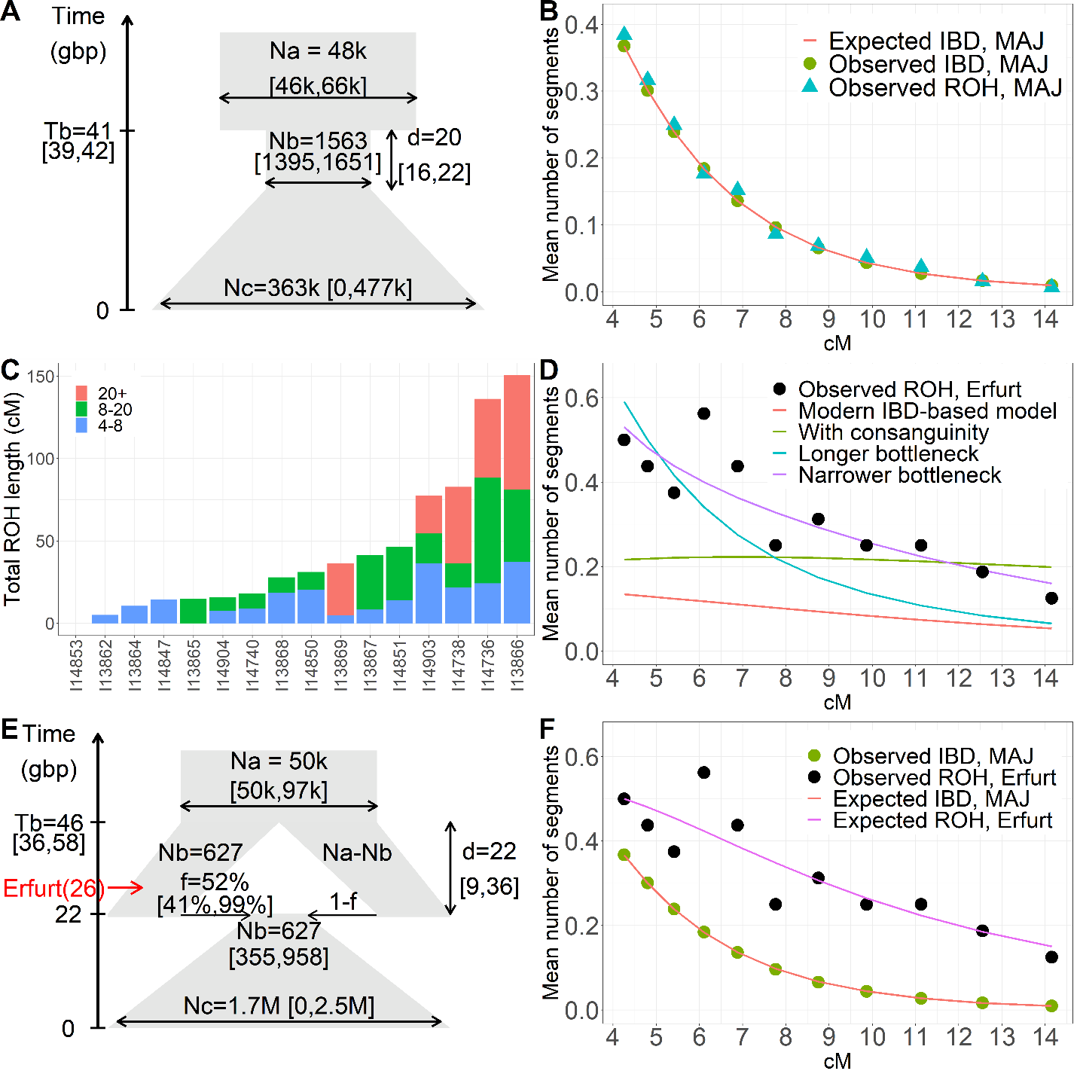
Demographic modeling
Goal: find a demographic model that matches the number of segments of different lengths
Can ancient genomes refine the parameter estimates?

Slide 49
Problem
IBD detection in not reliable in ancient genomes
But ROHs are just IBD segments between the parents
More ROH than expected based on the modern model
The Erfurt bottleneck must have been longer/narrower

Slide 50
A “structured” demographic model
Good fit to both modern and ancient data
A simpler model could be rejected, but other complex models may fit too

Slide 51



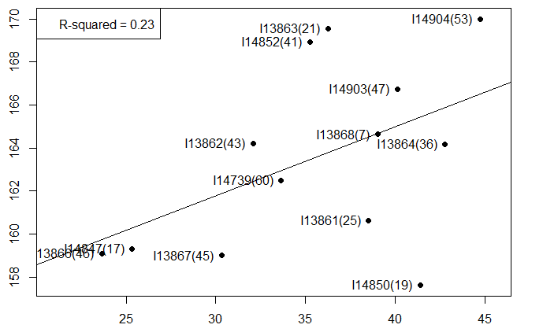
Phenotypes
Phenotype | Allele | Frequency in Erfurt | Frequency in modern AJ
Lactase persistence | rs4988235 | 22% [12-39] | 19%
Blue eyes | rs12913832 | 30% [18-45] | 30%
Red hair | rs1805007, rs1805008, rs1805009 | 0.7% [0.1,3.3] | 1.5%
One individual had red hair carrying rs201326893
Estimated height (osteological estimate, cm, sex-adjusted)
Polygenic score for height

