Slide 1




Predicting the utility of screening human IVF embryos with polygenic risk scores for complex diseases
Shai Carmi
Public Health
The Hebrew University of Jerusalem
scarmilab.org
@ShaiCarmi
ESHRE Annual Meeting
June 2021
Notes:
In my talk, I will tell you about screening IVF embryos with polygenic risk scores. I will describe what are polygenic scores? Why would IVF clinics use them? And what are the expected outcomes.

Slide 2
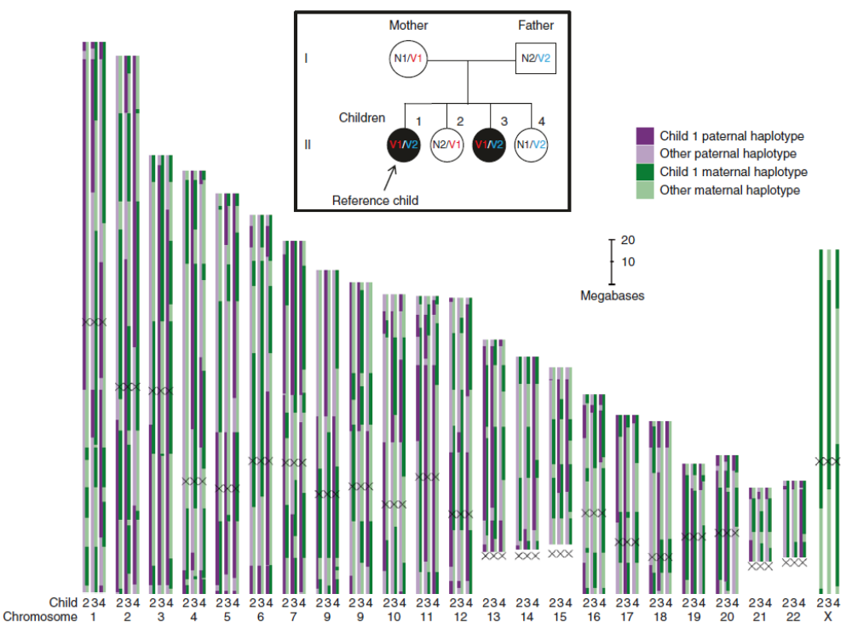
Preimplantation genetic testing (PGT)
New methods:
low-cov seq or microarrays
Universal, fast, low-cost, accurate
Backenroth et al, Genet Med, 2019, 2021; Yan et al, PNAS, 2015; Zamani-Esteki, AJHG, 2015; Masset et al, Hum Reprod, 2019; Natesan et al, Genet Med, 2015; Kumet et al, Genome Med, 2015; Xu et al, Clin Chem, 2015
Notes:
The field of preimplantation genetic testing, or PGT, has evolved rapidly in the past few years. New methods for PGT are based on low-coverage sequencing or microarrays. With the help of statistical imputation methods, it is now feasible and affordable to reconstruct the entire genome of each embryo.
Here, I show a figure from one of our recent papers. For each chromosome, I show which paternal and maternal haplotypes were transmitted to each embryo in each position. There were many similar papers by other labs.

Slide 3
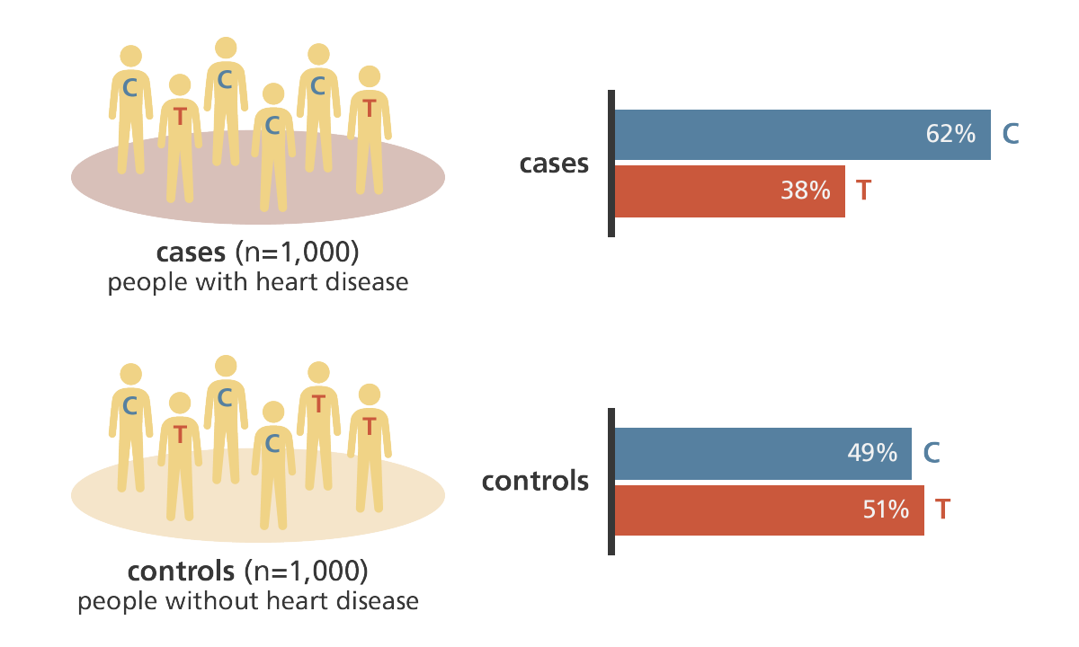
Complex traits and diseases
Genome-wide association study (GWAS)
Current PGT indications:
  Mendelian disease mutations
  Recurrent pregnancy loss/implantation failure
But what about complex (“polygenic”) diseases?
SNP: single nucleotide polymorphism
Genome Research Ltd.
Notes:
PGT is indicated when the parents carry Mendelian, or monogenic, disease mutations. Or, when there is a suspicion of an aneuploidy, or other large structural variants. But PGT is not currently indicated for reducing the risk of complex, or polygenic, diseases, such as cancers, diabetes, cardiovascular diseases, Parkinson’s, Crohn’s, or psychiatric disorders.
To study a polygenic disease, geneticists use a “genome-wide association study”, or a GWAS. The idea is simple: recruit a large number of cases and controls, genotype them in hundreds of thousands of markers, or SNPs – single nucleotide polymorphisms, and search for alleles that are associated with disease status.
Numerous GWASs were performed over the last decade. By now, GWASs for common diseases have very very large sample sizes, and they result in hundreds of high quality associations.
But what can we do with these associations?

Slide 4
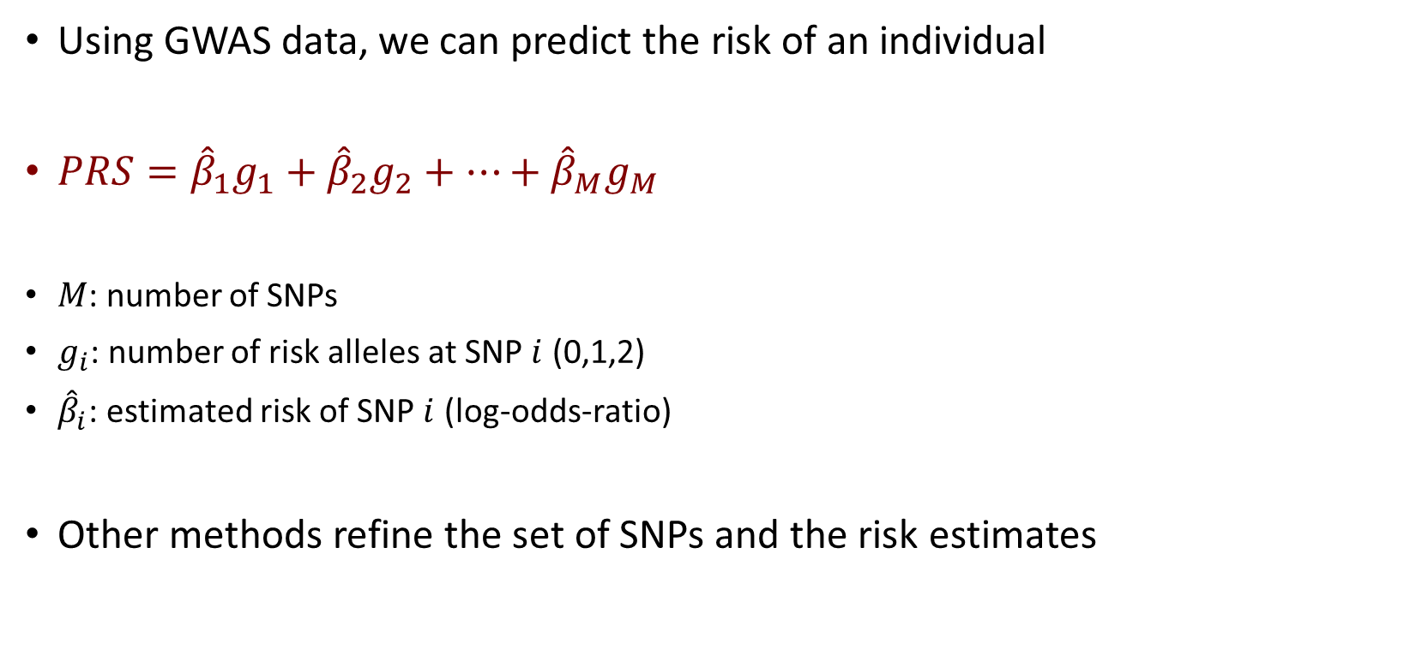
Polygenic risk scores
Using GWAS data, we can predict the risk of an individual
$PRS={\hat{β}}_{1}g_{1}+{\hat{β}}_{2}g_{2}+…+{\hat{β}}_{M}g_{M}$
$M$: number of SNPs
$g_{i}$: number of risk alleles at SNP $i$ (0,1,2)
${\hat{β}}_{i}$: estimated risk of SNP $i$ (log-odds-ratio)
Other methods refine the set of SNPs and the risk estimates
Notes:
One of the key applications of recent GWASs is risk prediction. The idea is as follows. Suppose that for a new individual, we have the genotypes at all SNPs. Can we use the GWAS results to predict the risk of the individual to develop a certain disease?
It turns out that increasingly accurate prediction can be achieved using polygenic scores.
We compute the polygenic risk score, or PRS, using the following sum. We go over the list of associated SNPs. For each SNP, we add the count of how many risk alleles are carried by the individual, which can be 0, 1, or 2. This is g_i. But we don’t just add the counts. Instead, we multiply each allele count by its risk, indicated here by beta_i. The risk is estimated from the GWAS, as the log of the odds ratio. In other words, if the individual has no risk alleles, we add nothing to the score. If the individual is heterozygous, we add beta_i. If the individual is homozygous to the risk allele, we add two beta_i.
There are sophisticated methods that build on this representation to improve the PRS, by identifying the most relevant SNPs for inclusion and by refining the risk estimates. But the basic idea is the same.

Slide 5
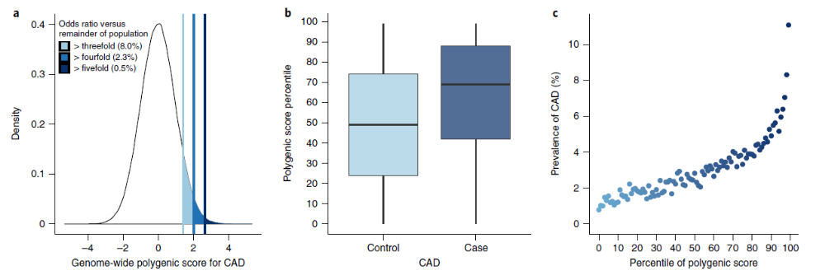
Predicting cardiovascular disease risk
Khera et al, Nat Genet, 2018
Notes:
Let us look at the ability of polygenic scores to predict disease risk. This is an example of predicting the risk of coronary artery disease. On the left side you can see box plots for the distribution of the PRS in cases and controls. Clearly, cases have higher PRSs, but there is also considerable overlap. On the right side is an important figure. It shows the disease risk as a function of the PRS percentile of an individual. As expected, the risk increases with increasing percentiles. However, the most dramatic effect appears at the very top scores. Individuals with PRS at the top 1% or 2% have risk about 4 to 5 times higher compared to the rest of the population.

Slide 6
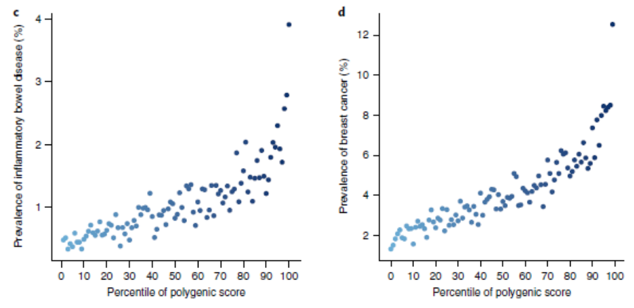
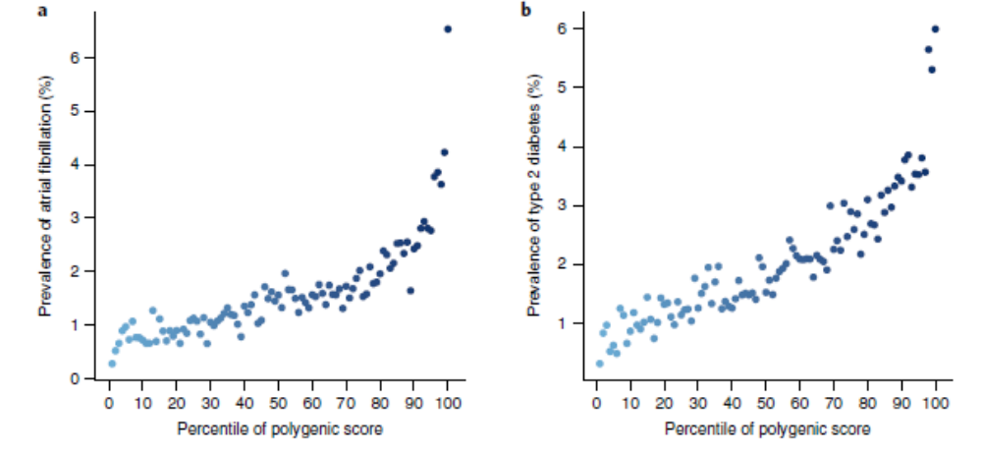
Predicting risk of other diseases
Inflammatory bowel disease
Breast cancer
Atrial fibrillation
T2 diabetes
Khera et al, Nat Genet, 2018
Notes:
This behavior is not specific to heart diseases, and it was observed for essentially all common diseases. Here are more examples from the same paper, across very different diseases. These are always the individuals at the top 1% or so who are at a substantially increased risk.

Slide 7
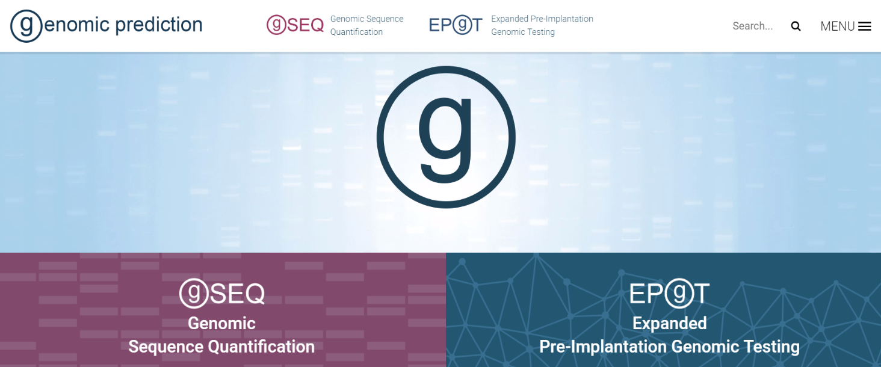
Implications: polygenic embryo screening (PES)
New PGT technologies → technically feasible to compute PRSs of embryos
If embryos are prioritized based on PRS, will it lower disease risk?
There are companies already offering such tests, but no independent assessment
Notes:
Now let’s go back to PGT. With the new technologies, it is now feasible to genotype IVF embryos across the entire genome. We can then easily compute the PRS of each embryo for any desired disease. With this information, we may proceed to prioritize the embryos based on their scores. For example, we may wish to transfer the embryo who is at the lowest risk of developing a certain disease.
In fact, there are already a few companies offering screening of IVF embryos for polygenic risk scores. The most well known is Genomic Prediction, also called LifeView., whose test is already commercially available.
However, with the exception of papers published by Genomic Prediction, I am not aware of any published, independent assessment of this technology. Specifically, if we prioritize embryos based on PRS, what does that imply on the risk of the future child? And how does it depend on the number of embryos, or the accuracy of the score, or the disease status of the parents?

Slide 8
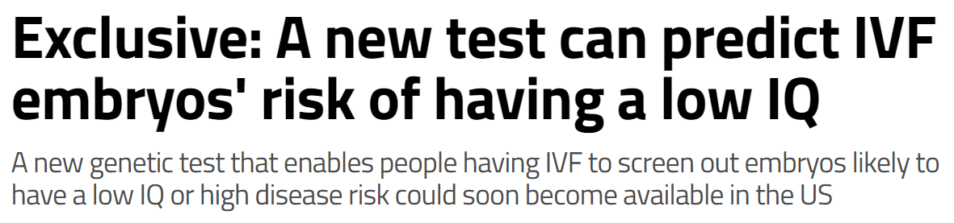
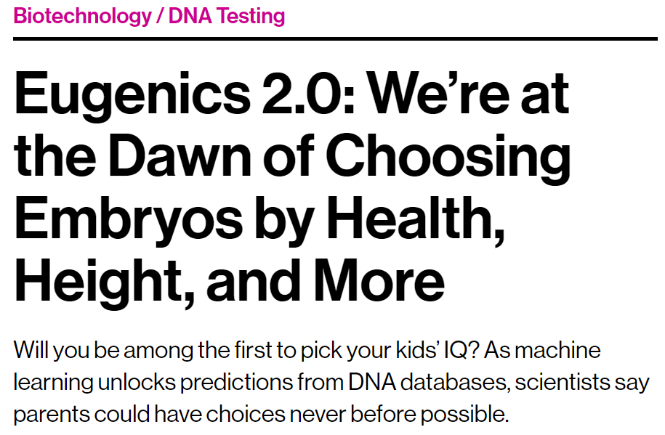
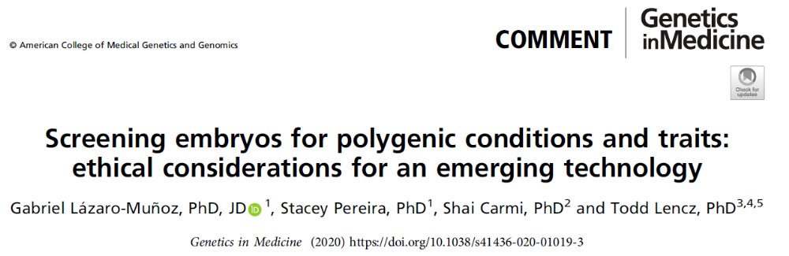
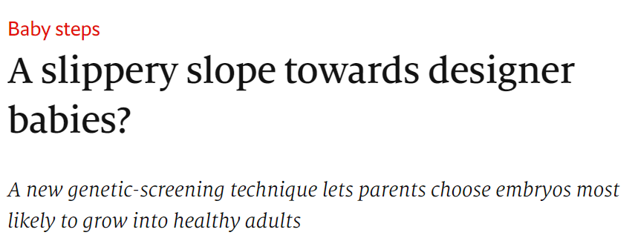
Obviously, ethical concerns
MIT Technology Review, 2017
New Scientist, 2018
The Economist, 2018
Goal here: provide statistical assessment of the expected outcomes of PES
Notes:
Before I move on to describe the results, it is important to mention that there are several ethical problems with polygenic embryo screening. Some are obvious, like eugenics, and some are more subtle, like equity, stigmatization, and choice overload. Concerns were raised already since 2017, as you can see in these titles. Voices against the practice intensified recently, with the founding of additional companies. We have recently published a short comment describing the main ethical considerations regarding polygenic embryo screening. However, in the talk just before me, Prof. Julian Savulescu may have presented additional opinions. I will not cover additional ethics implications here. Rather, in the rest of my talk, I will describe our statistical assessment of the technology, from the point of view of the potential to reduce disease risk in the children.

Slide 9
Selection strategies (single disease)
High-Risk Exclusion
Polygenic risk score
Select at random
High risk cutoff
Lowest-risk Prioritization
Polygenic risk score
Risk reduction
Selected
Average risk
Notes:
I this talk, I will only discuss selection of embryos based on a PRS for a single disease. Our first step must be to define how we select an embryo for transfer. We call this the “selection strategy”. Recall this figure, which shows the prevalence of coronary artery disease vs the percentile of the PRS. As I mentioned earlier, the focus is usually on the top percentiles, as only in these percentiles the relative risk is particularly large. Following the same logic, a reasonable selection strategy would be to exclude any embryo with a PRS above a threshold. For example, we could exclude all embryos who have PRS at the top 2%. Other than the excluded embryos, selection is random, or at least makes no use of polygenic scores. We call this strategy “high-risk exclusion”.
An alternative strategy, which we call “lowest-risk prioritization”, is to specifically select the embryo with the lowest PRS, namely the embryo with the lowest risk to develop the disease. In the following, we will determine the expected risk of the implanted embryo according to either strategy.

Slide 10
Calculating the risk: the liability threshold model
Model:
A disease has an underlying continuous liability
Affected individuals have liability>threshold
Liability = genetics + environment
All components are normal
Healthy
Sick
Distribution of the liability
The prevalence
Liability
Disease threshold
Notes:
To compute the risk, we use a well known model from statistical genetics, called the liability threshold model. A disease is assumed to have an underlying, unobserved, continuous liability. An individual is affected whenever his or her liability is above a threshold. We model the liability as a sum of two components: genetic, and environmental, both of which are assumed to be normally distributed. The model is illustrated in the figure. As you can see, only individuals with liability above the threshold are affected.

Slide 11
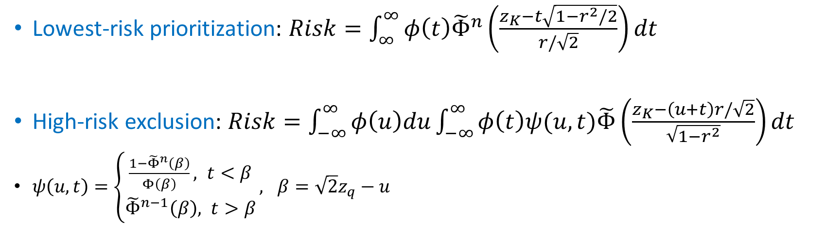
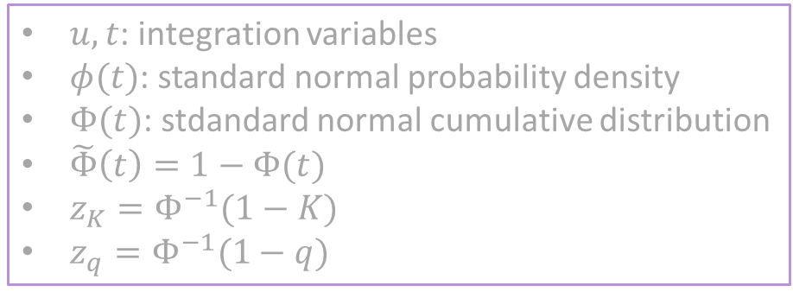
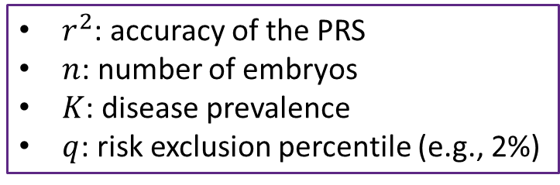
Computing the risk of the selected embryo
Lowest-risk prioritization: $Risk=\int_{∞}^{∞}{φ\left(t\right){\tilde{Φ}}^{n}\left(\frac{z_{K}−t\sqrt{1−r^{2}/2}}{r/\sqrt{2}}\right)dt}$
High-risk exclusion: $Risk=\int_{−∞}^{∞}{φ\left(u\right)du}\int_{−∞}^{∞}{φ\left(t\right)ψ(u,t)\tilde{Φ}\left(\frac{z_{K}−\left(u+t\right)r/\sqrt{2}}{\sqrt{1−r^{2}}}\right)dt}$
$ψ\left(u,t\right)=\left\{\begin{aligned}\frac{1−{\tilde{Φ}}^{n}\left(β\right)}{Φ\left(β\right)}, t<β \\ &{\tilde{Φ}}^{n−1}\left(β\right), t>β\end{aligned}\right., β=\sqrt{2}z_{q}−u$
$u,t$: integration variables
$φ(t)$: standard normal probability density
$Φ(t)$: stdandard normal cumulative distribution
$\tilde{Φ}\left(t\right)=1−Φ(t)$
$z_{K}=Φ^{−1}(1−K)$
$z_{q}=Φ^{−1}(1−q)$
$r^{2}$: accuracy of the PRS
$n$: number of embryos
$K$: disease prevalence
$q$: risk exclusion percentile (e.g., 2%)
Notes:
With the liability model, we can now derive mathematical results for the risk of the selected embryo, according to either selection strategy. Unfortunately, the results can only be presented as integrals involving special functions. The important parameters are shown in the box below. r^2 is a measure of the accuracy, or predictive power, of the PRS. Technically, it is the proportion of variance in liability explained by the PRS. We can determine the value of r^2 from studies that compare the PRS between cases and controls. The next parameter is n, the number of embryos. Next, K is the disease prevalence, which can be estimated from epidemiological data. Finally, q is the cutoff percentile for the high-risk exclusion strategy. For example, if we’re excluding embryos with PRS at the top 2%, q is equal to 0.02. Other parameters represent special functions related to the normal distribution and are less relevant for our purposes here. The important point is that we can compute the risk numerically using software such as R. Once we have the risk of each embryo, we can proceed to compute the risk reduction, as I explain next.

Slide 12
Defining the risk reduction
Absolute risk reduction (ARR) = Prevalence — [Risk of selected embryo]
Relative risk reduction (RRR) = ARR / Prevalence
Example: Prevalence=5%, Risk of selected embryo=3%
ARR: 2% (points), RRR: 40%
Notes:
The absolute risk reduction is defined as the prevalence of the disease, minus the risk of an embryo selected based on its PRS. The relative risk reduction is the same, but normalized by the prevalence.
These are standard definitions. To give a simple example, suppose that the prevalence of a disease is 5%. In other words, the risk of a random individual to be affected is 5%. Suppose now that the risk of an embryo selected based on its PRS is lower, at 3%. The absolute risk reduction is 2 percentage points. The relative risk reduction is 40%.
Now we have all the definitions we need, so let’s see what the risk reduction looks like.

Slide 13
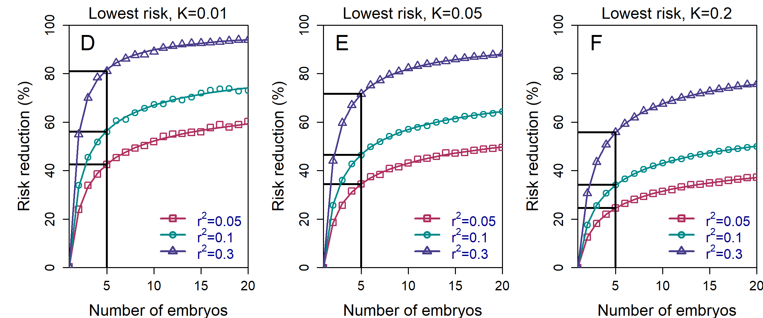
Results: lowest-risk prioritization
Substantial relative risk reductions can be achieved, even with just 5 embryos
Notes:
This figure is our main result. The figure shows the relative risk reduction for the lowest-risk prioritization strategy – in which we select the embryo with the lowest PRS. Let me walk you through the various components of the figure. The y-axis shows the relative risk reduction. The x-axis shows the number of embryos we’re selecting from. The black lines highlight the case n=5, which is an achievable number of embryos for young couples. (I will discuss this parameter in more depth later.) The solid curves correspond to the equations I showed two slides ago, and the symbols are the results of simulations. In this figure, the prevalence is equal to 1%. I’m showing three curves, corresponding to three values of r^2, which is a measure of the accuracy of the PRS. Realistic values of r^2 for common diseases range between 0.05 and 0.1. r^2 of 0.3 is not currently achievable, but is a plausible upper bound on the future accuracy.
Let us now examine the results, focusing on the red curve, for r^2=0.05, and the green curve, for 0.1. For five embryos, the expected relative risk reduction is quite large, at around 50%. Having more embryos will of course increase the risk reduction. However, the returns are quickly diminishing. In contrast, with less than five embryos, the risk reduction decreases sharply.
Next we asked, what does this figure look like for other values of the prevalence?

Slide 14
Results: lowest-risk prioritization
Notes:
Here, we show the same graphs, but now we added prevalences of 5% and 20%. The relative risk reduction somewhat decreases for the more prevalent diseases. However, it is still large at 30 to 40%. And we also need to have in mind that the more common the disease, the larger is the absolute risk reduction. In other words, a larger number of diseases are prevented.
This figure is for selecting the lowest risk embryo. But what is the risk reduction for other strategies?

Slide 15
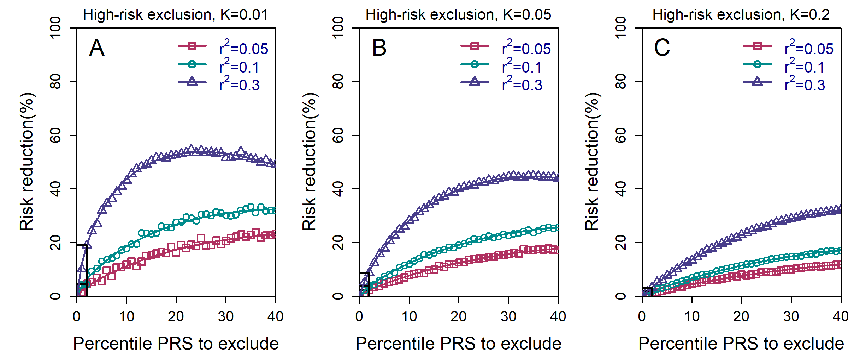
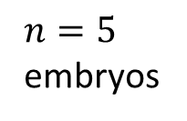
Results: high-risk exclusion
When only excluding high risk embryos, the risk reduction is minimal
$n=5$ embryos
Notes:
In this slide, I show results for the high-risk exclusion strategy, in a way similar to previous slides. Here too, we start with disease prevalence of 1%. The y-axis shows the relative risk reduction. However, here we fix the number of embryos to 5, and the x-axis now shows the threshold for excluding embryos, in percentiles. For example, at 10, embryos with PRS at the top 10% of the PRS distribution will be excluded, and a random embryo will be selected from among the remaining embryos. As before, we show three curves for three different values of r^2, and we focus on r^2=0.05 or 0.1. The black lines indicate the exclusion of embryos with PRS at the top 2%, as inspired by observations in clinical genetics.
The key result is that here, the risk reduction is very very small, at less than 5%. This is in sharp contrast to relative risk reductions around 50% when selecting the embryo with the lowest PRS.

Slide 16
Results: high-risk exclusion
$n=5$ embryos
Notes:
Here we add results for more prevalent diseases, showing relative risk reductions that are even smaller.

Slide 17
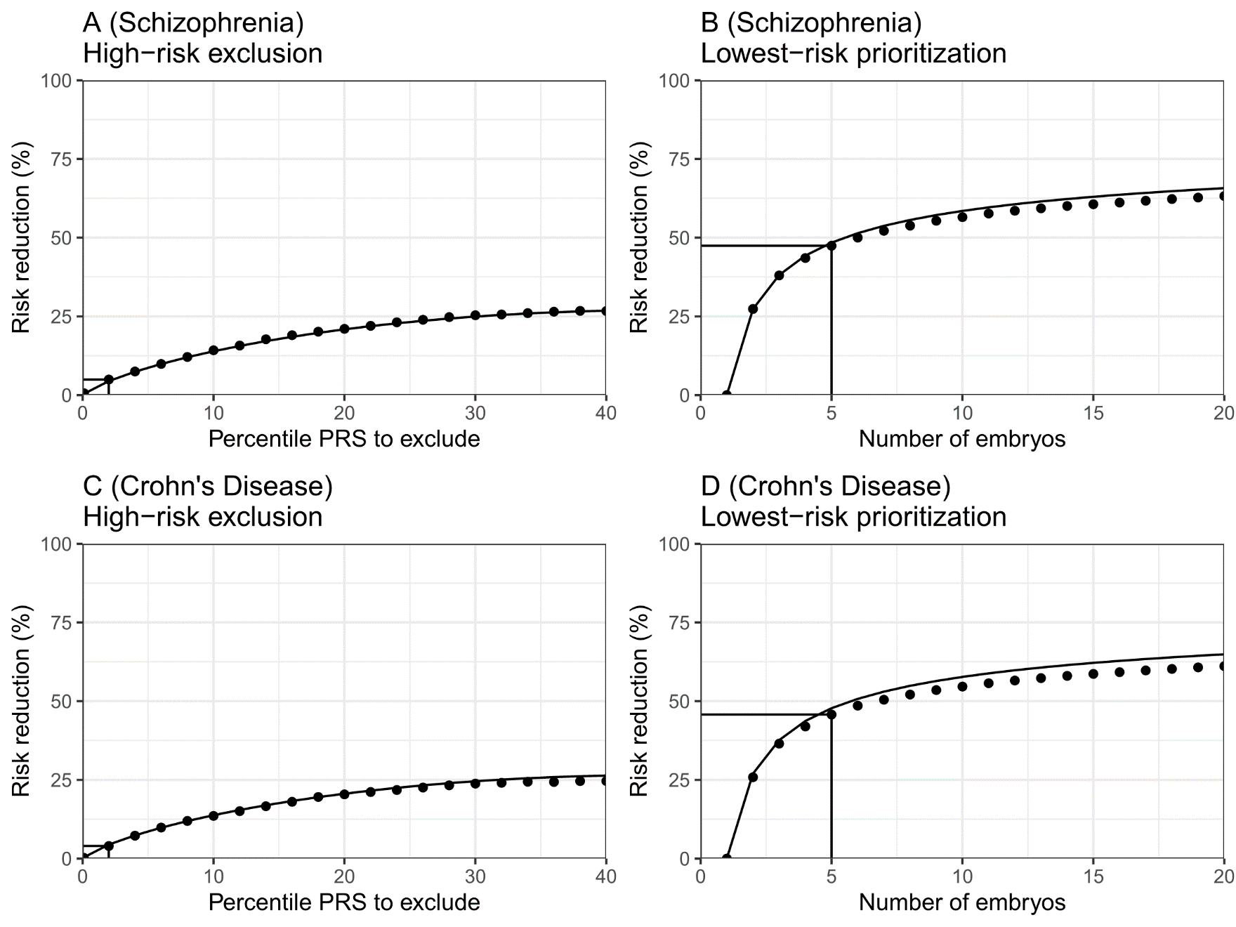
Simulations with real genomic data
Schizophrenia:
897 cases, 1629 controls
Ashkenazi ancestry
Lencz et al, Nat Commun, 2013
Crohn’s disease:
154 cases, 103 controls
European ancestry
Judy Cho, Mt Sinai
Notes:
To validate that our model is relevant to real genomic data, we performed simulations of “virtual couples”. Here is the main idea. We used real genomes from case-controls studies, of either schizophrenia or Crohn’s disease. We randomly sampled pairs of individuals and designated them as “couples”. For each couple, we simulated the genomes of up to 20 embryos and computed their PRSs. We then used these PRSs to guide embryo selection. In the figure, panels A and B are for schizophrenia, and panels C and D are for Crohn’s disease. We show the relative risk reduction under both the high-risk exclusion strategy and the lowest-risk prioritization strategy. Dots are simulation results, and lines correspond to our theoretical predictions. Indeed, our theory fits the simulation results very well. Specifically, we confirm that selecting the lowest risk embryo out of five embryos will reduce the risk of either disease by almost 50%.

Slide 18


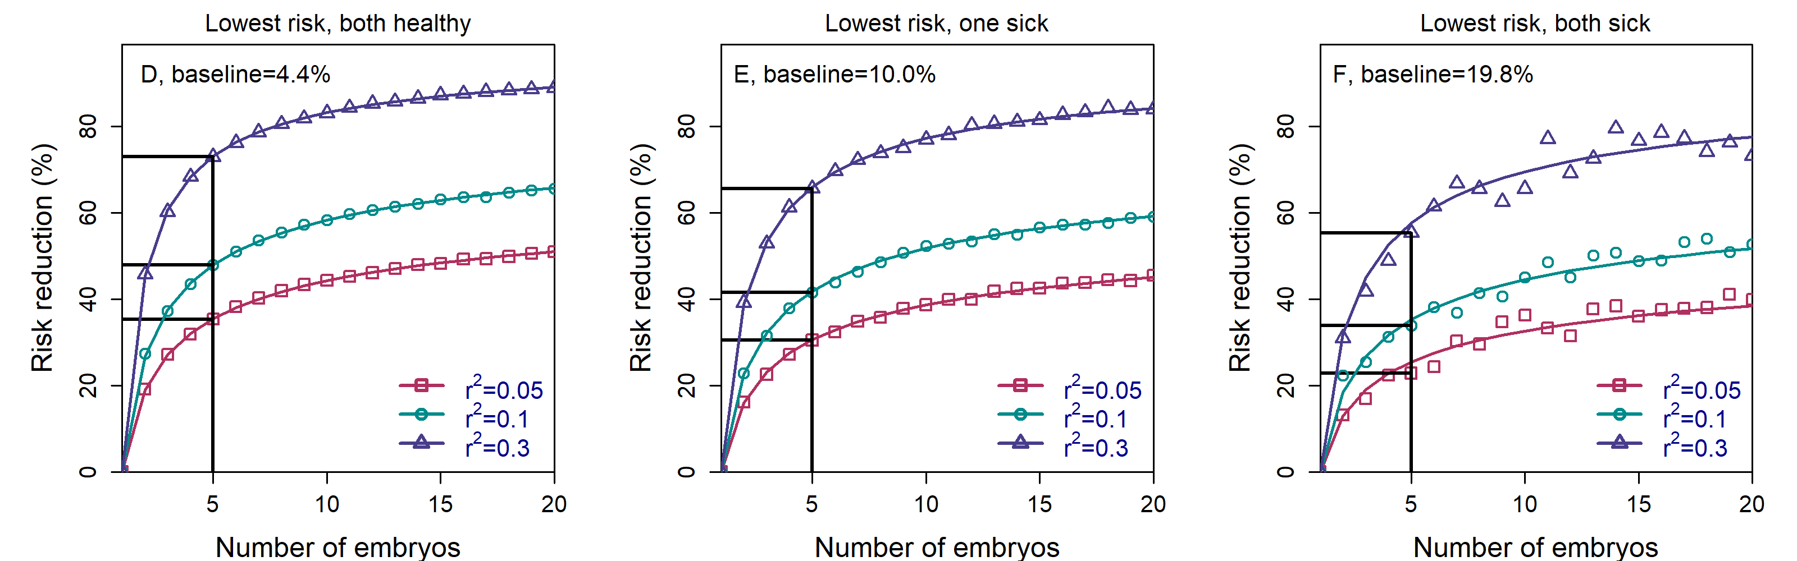


Parents with known disease status
Risk reductions are stable vs parental disease status
When one parent affected, can restore risk to nearly normal levels
Notes:
The last result I will show is for the case when the parents have known disease status. Here, I’m showing the relative risk reduction, either when both parents are healthy, or when one parent is affected, or when both are affected. The relative risk reduction is about the same in all settings. However, the baseline risk can be very different. For example, if a disease has prevalence of 5%, the baseline risk when one parent is affected is about 10%. With nearly 50% relative risk reduction, polygenic embryo screening has the potential to restore the risk of the child to nearly normal levels.

Slide 19
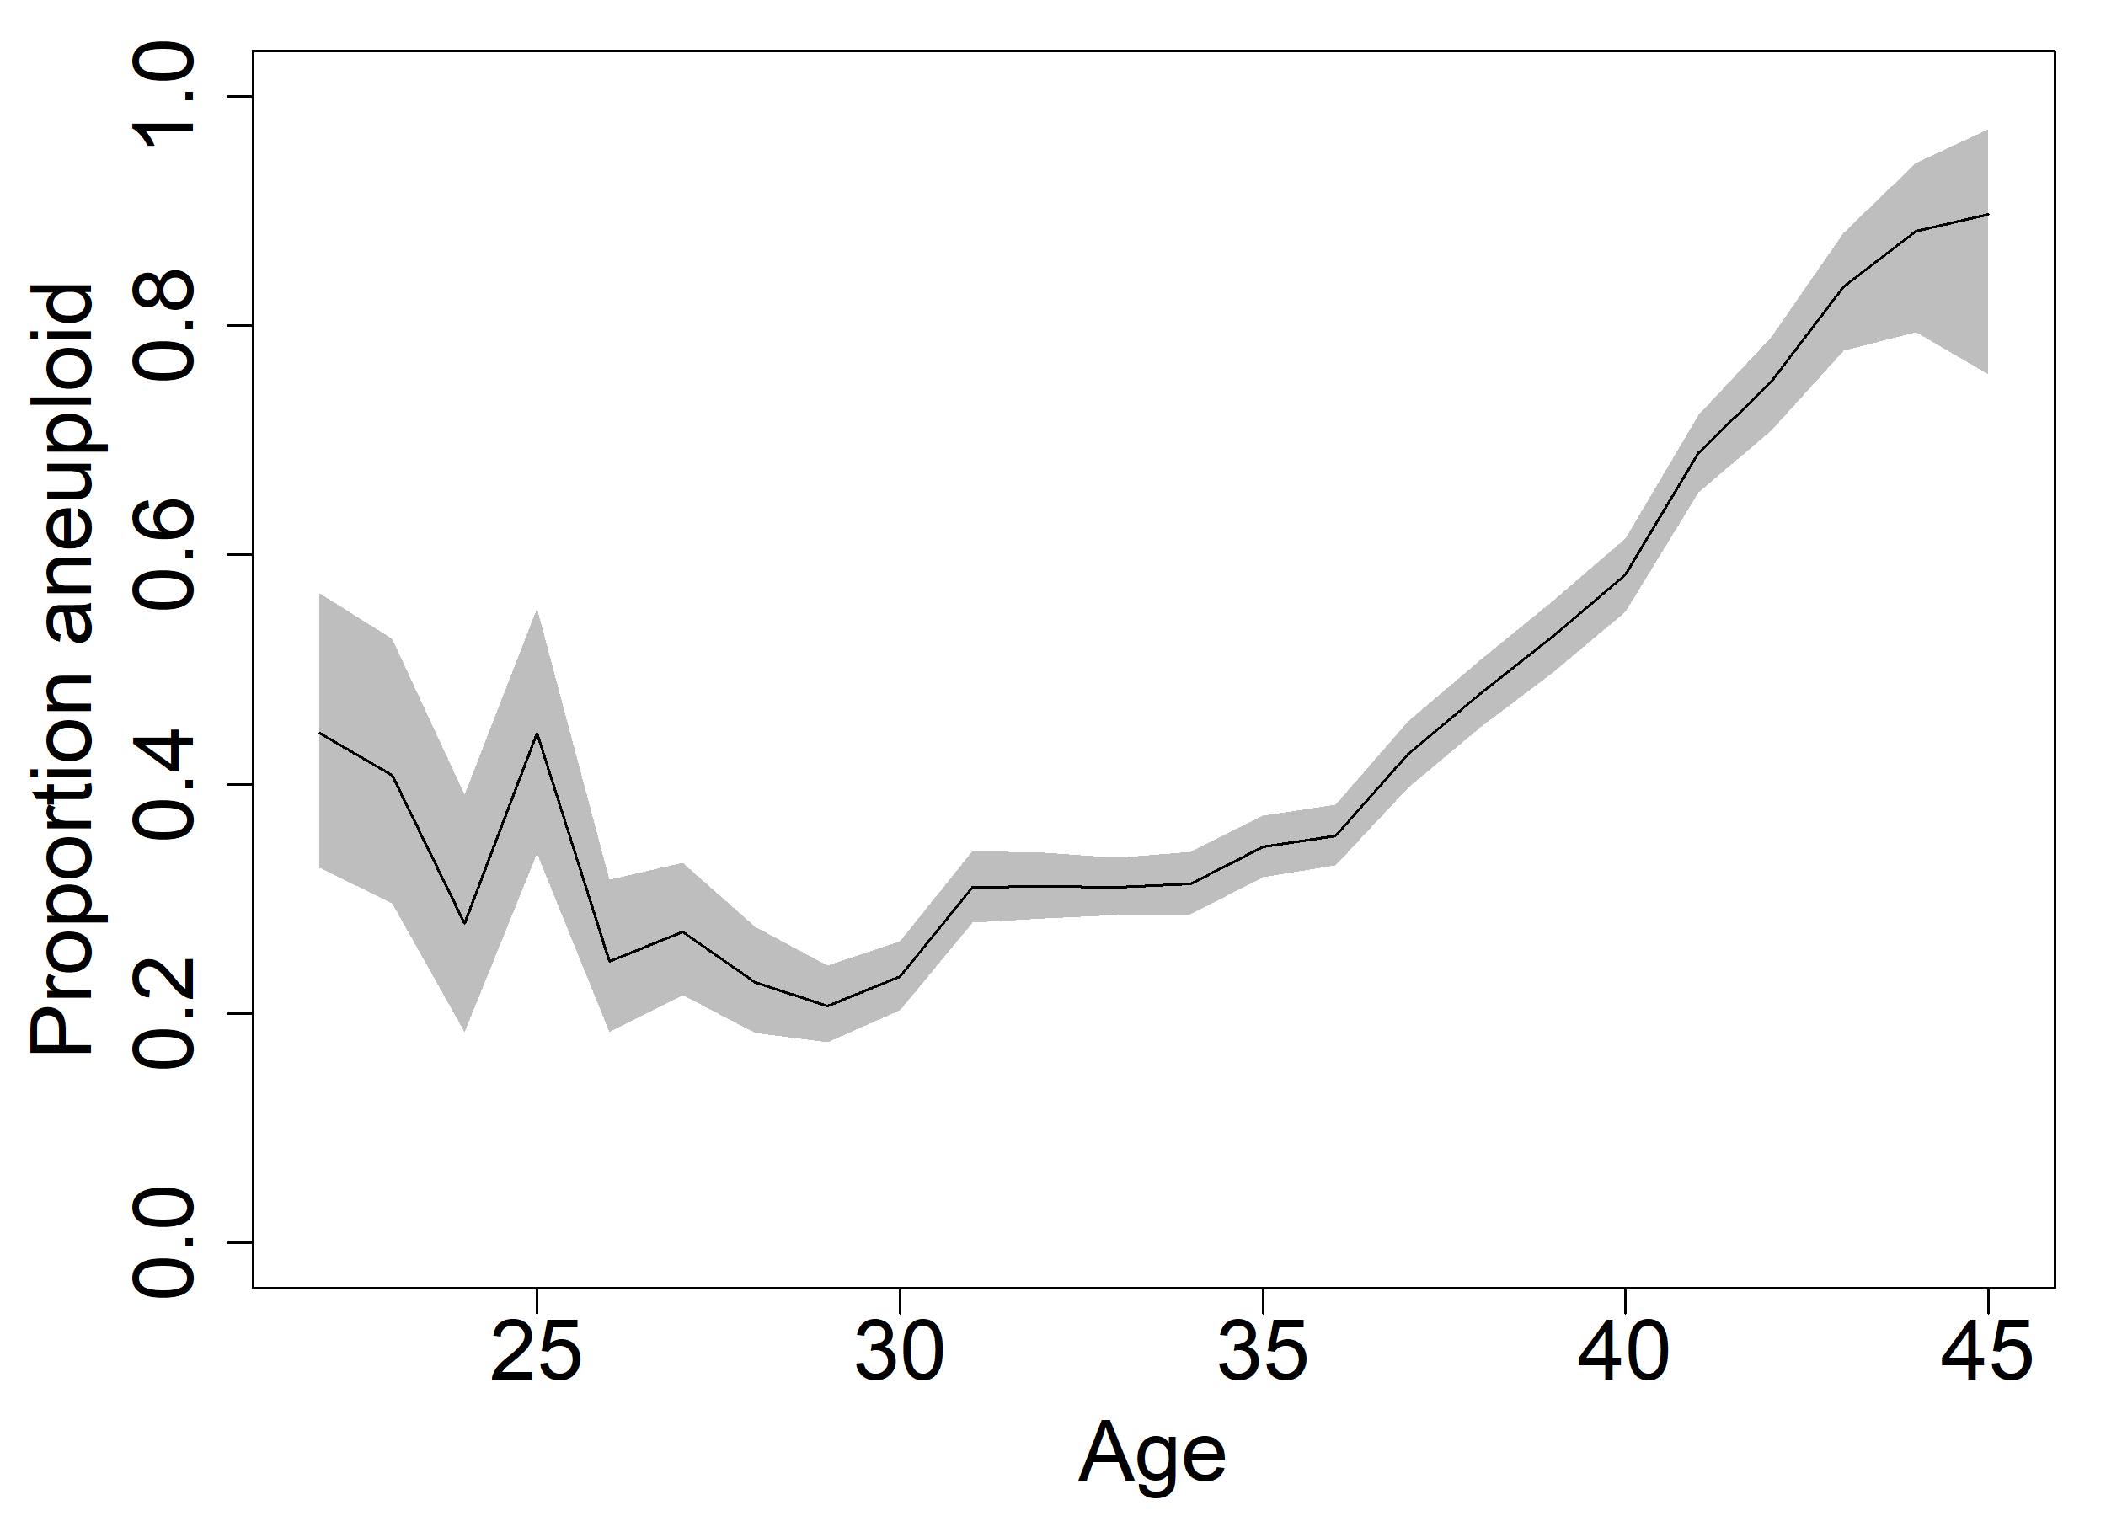
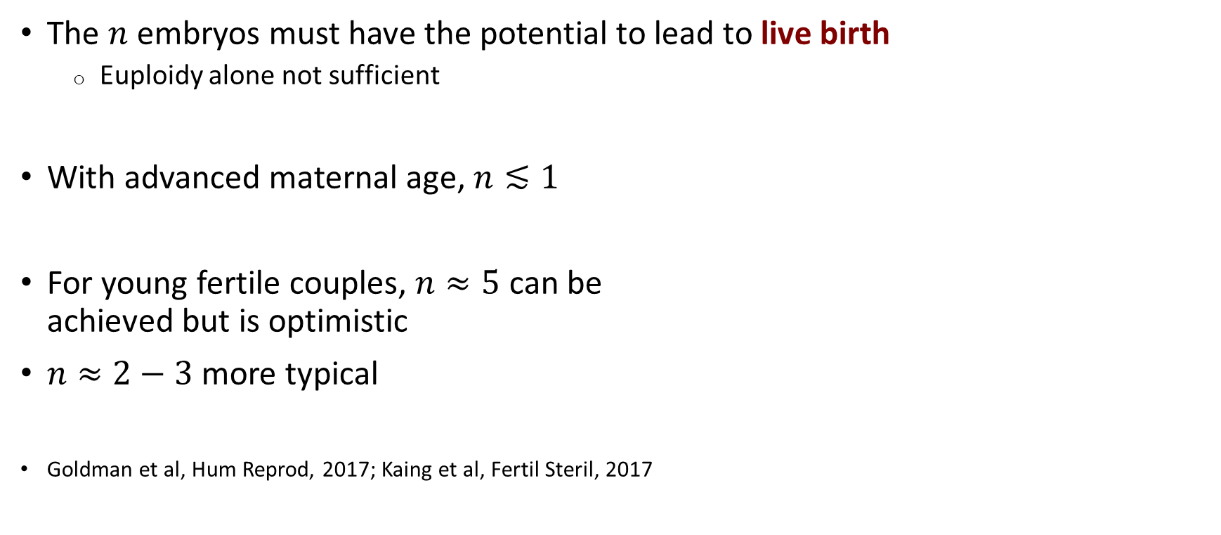
Limitations: how many embryos are available?
The $n$ embryos must have the potential to lead to live birth
  Euploidy alone not sufficient
With advanced maternal age, $n≲1$
For young fertile couples, $n≈5$ can be
achieved but is optimistic
$n≈2−3$ more typical
Goldman et al, Hum Reprod, 2017; Kaing et al, Fertil Steril, 2017
From Franasiak et al, Fertil Steril, 2014
Notes:
At face value, our data suggests that large relative risk reductions can be achieved with embryo screening. However, this is the best-case scenario. There are multiple practical limitations that will reduce the realized risk reduction, and I will review them in the following three slides.
First, we need to be more precise about what it means that we have a certain number of embryos. Crucially, all of these embryos must lead to live birth if implanted. In other words, these embryos must not only reach the blastocyst stage and be euploid, but they also need to lead to pregnancy and live birth.
For older women, IVF cycles often lead to no live birth at all. And rarely do they lead to more than one live birth. Thus, polygenic embryo screening is impractical for older couples.
However, if the technology is adopted by young and fertile couples, having five embryos that would lead to live birth based on one oocyte retrieval cycle is not impossible. However, typical numbers are lower, at around 2 or 3 embryos. That said, I found it very difficult to find good estimates of these numbers, and I’ll appreciate any feedback.

Slide 20
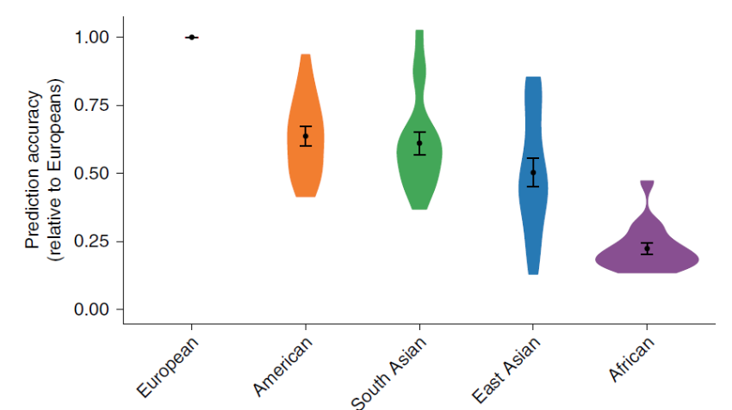
Limitations: PRS accuracy
Polygenic scores have lower accuracy in non-EUR populations
  Martin et al, Nat Genet, 2019; and others
Genotyping embryos may be less
accurate than bulk DNA
Prediction accuracy is lower when comparing sibs,
in particular for cognitive traits
PRSs may be less predictive decades from now
Martin et al, Nat Genet, 2019
Notes:
Next, the PRS itself is very often not as accurate as reported in the initial publications. There are a few reasons. First, PRSs were typically developed in cohorts of individuals of European ancestry. Consequently, PRSs have lower accuracy in non-European populations, in particular in Africans, as can be seen in the figure.
Second, the accuracy of a PRS is typically measured in cohorts where DNA is obtained from blood or saliva. When the genotypes are inferred from an embryo biopsy, errors can be introduced, leading to less accurate PRSs. However, this can be overcome, at least to some degree, by increasing the sequencing depth.
Third, the embryos are full-siblings. However, the accuracy of PRSs tends to be lower when comparing siblings, for several reasons I will not cover here. This is particularly important for cognitive traits.
Finally, current PRSs are mostly based on studies in relatively old individuals. It is unclear whether these PRSs will remain predictive also in the distant future.

Slide 21
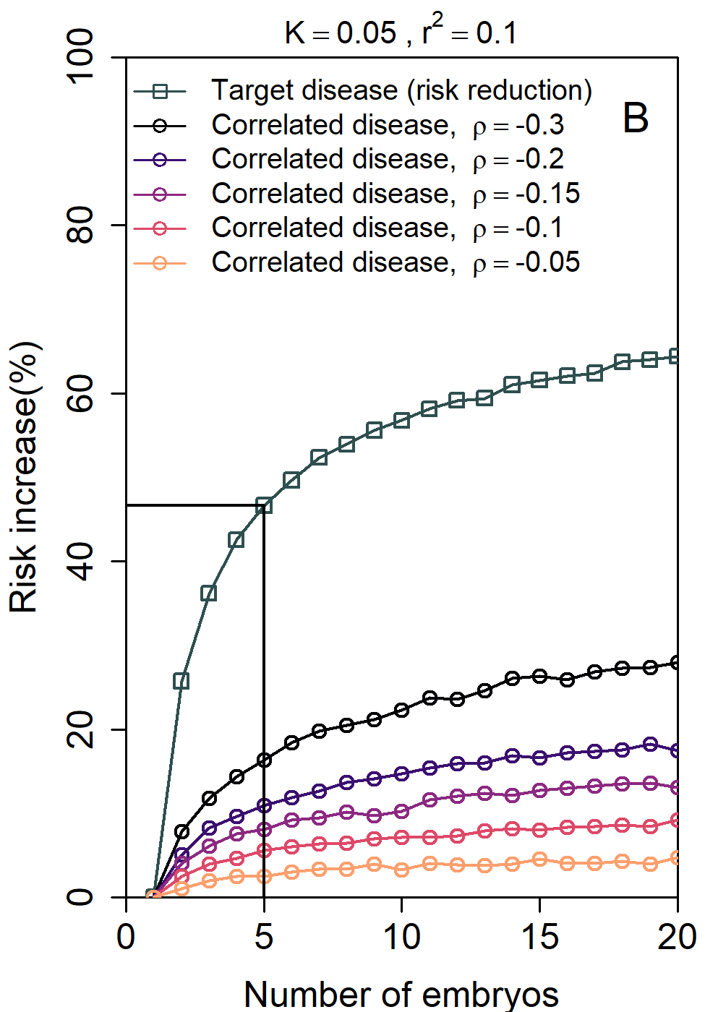
Limitations: multiple diseases/pleiotropy
Selection based on one trait/disease may increase risk of known and unknown diseases
When selecting based on multiple traits, the gain
per trait decreases
Karavani et al, Cell, 2019
To be completed: selection against multiple diseases
Notes:
The last difficulty I’d like to mention is pleiotropy, or the genetic correlation between traits. When selecting an embryo based on one trait or disease, we may be inadvertently selecting for higher prevalence of another disease. In animal breeding, it is well known that selecting animals based on a single trait, for example, milk production, can lead to very serious diseases in subsequent generations. This is not expected to be a common problem in humans, as most common diseases are genetically positively correlated. However, the figure here shows that in the worst-case scenario, selecting an embryo based on having the lowest risk for one disease, can increase the risk of another disease by about 10%.
Finally, what will happen if the embryo will be selected based on a low PRS for multiple diseases? In our previous paper, we showed that when selecting an embryo based on a combination of traits, the gain per trait decreases. We assume that the risk reduction per disease will decrease similarly. However, the gain in overall health may increase.
Unfortunately, our study of embryo selection based on multiple PRSs is still ongoing.

Slide 22
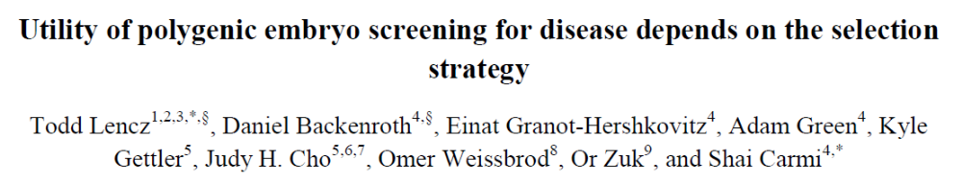
Summary
Large relative risk reductions possible, but it depends on how the embryo is selected
We have good understanding of how outcomes depend on PRS accuracy,
#embryos, and parental disease status
Expected outcomes may be difficult to properly communicate (ARR/RRR, limitations)
Discussion of ethical/social/regulatory issues
urgently needed
Acknowledgements:
Todd Lencz, Northwell
Key contribution:
Daniel Backenroth, Or Zuk, HUJI
Gabriel Lazaro-Munoz, Stacey Pereira, Baylor
Other: Ehud Karavani, Adam Green, Einat Granot-Hershkovitz, HUJI; David Zeevi, UCLA;
Omer Weissbrod, Harvard; Max Lam, Northwell; others for data
https://www.biorxiv.org/content/10.1101/2020.11.05.370478v3
Notes:
Let me summarize the main takeaways.
First, it is in theory possible to achieve large relative risk reductions, up to 50% for common diseases. However, this relies crucially on selecting the embryo with the lowest risk.
Second, our model allows us to predict the outcomes given parameters such as the number of embryos, the accuracy of the score, and so on. This could be very useful for future discussions of the technology.
Third, the outcomes depend on many additional factors, many of which are not easy to either measure or communicate to patients.
So in summary, given that the technology is already available, we call the relevant professional societies to urgently discuss the ethical and social issues that emerge by our results.
To read more, please see our preprint on bioRxiv.

