Slide 1




Prediction of traits and disease risk with polygenic scores:
Applications in medicine and social sciences, limitations, and screening of embryos
Shai Carmi
Public Health
The Hebrew University of Jerusalem
scarmilab.org
@ShaiCarmi
April 2020

Slide 2
Outline
Complex traits genetics and polygenic scores
Limitations of polygenic scores
Selecting embryos for traits

Slide 3
Questions
How to find the genetic basis of traits and diseases?
What was discovered?
What did we learn about the biology?
What can we do with the results?

Slide 4
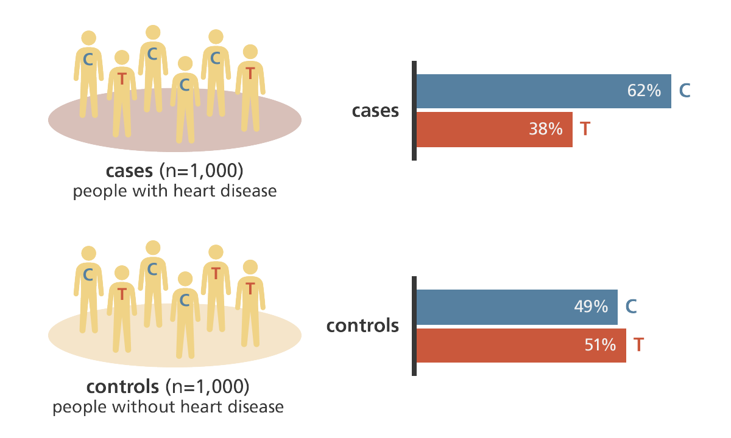
Genome-wide association studies
SNP: single nucleotide polymorphism
Phenotype can be binary (case/control) or quantitative
Genome Research Ltd.

Slide 5
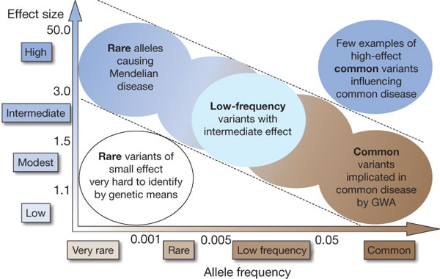
Study design
CFTR
APOE
Negative selection
Traditional family-based linkage studies;
consanguineous families
GWAS is useful
No power
Manolio et al., 2009

Slide 6
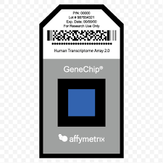
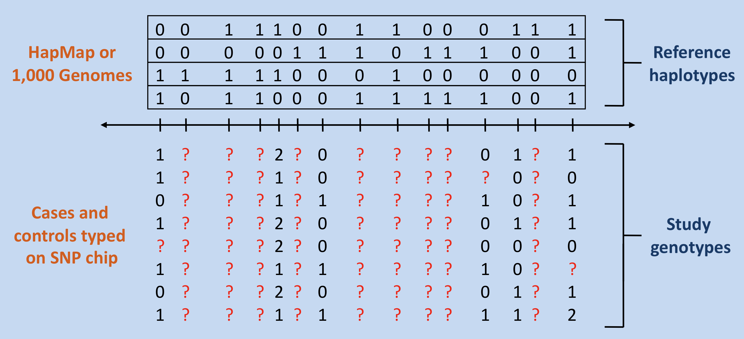
Study design: technology
Genotyping technology: mostly microarrays
  500k-1M common polymorphisms
  Markers “tag” causal alleles via linkage disequilibrium
  Cheap: $50-100 per sample
  Almost entire genome can be reconstructed with imputation
Exome/genome sequencing: detect association of rare variants, mostly coding
IMPUTE2

Slide 7
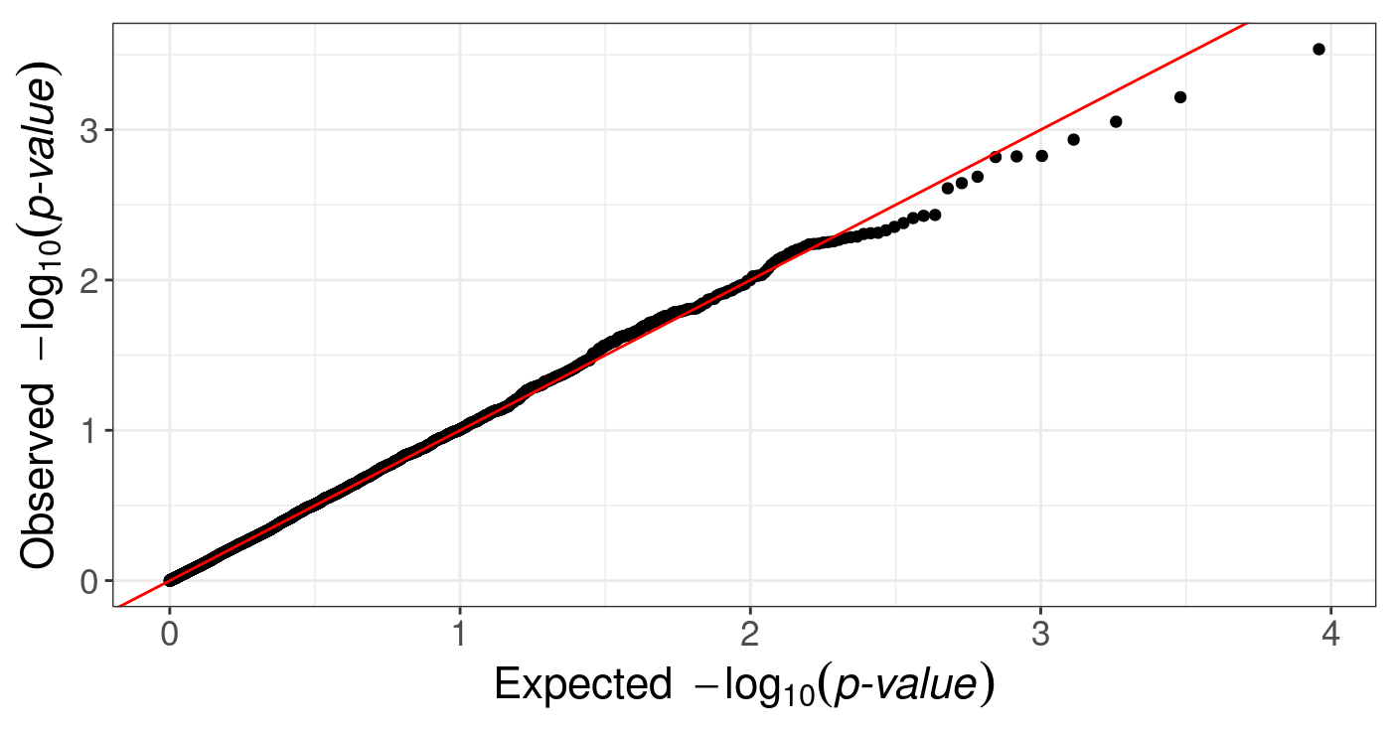
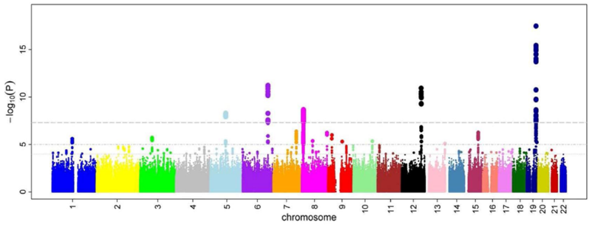
Study design: statistical issues
Strict Bonferroni correction: P-value of 5·10⁻⁸ required
P-value “inflation” must be visually and statistically evaluated
Population structure correction:
Account for ancestry differences between cases and controls
Manhattan plot
Florian Prive

Slide 8
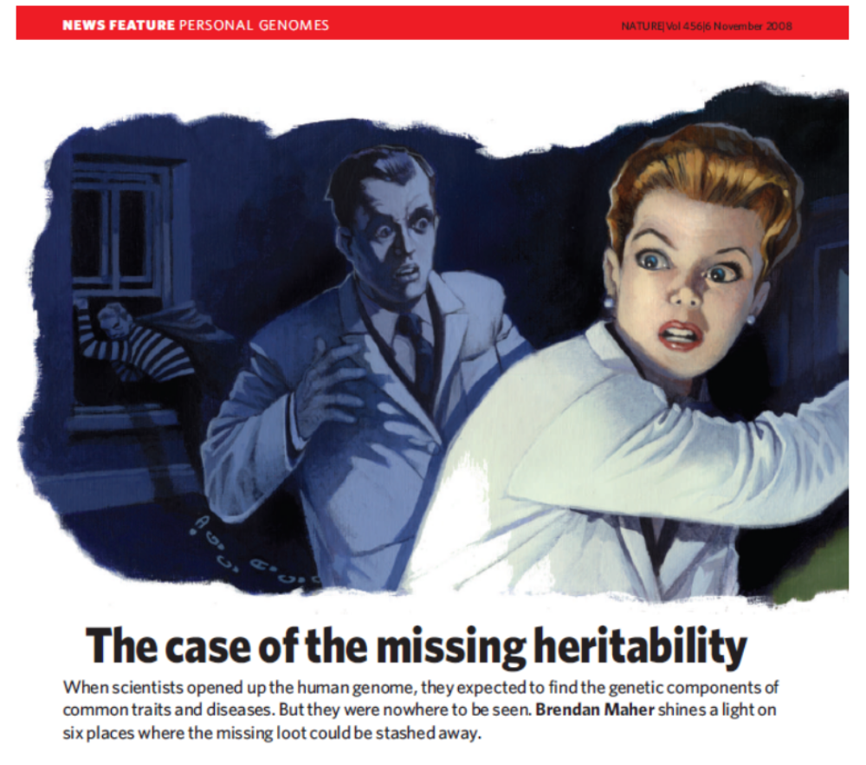
2009: no results
Heritability:
Proportion of variance in trait explained by genetics
Height:
  Heritability: 80%
  40 loci associated
  5% of the variance
Conjecture: larger sample sizes needed

Slide 9
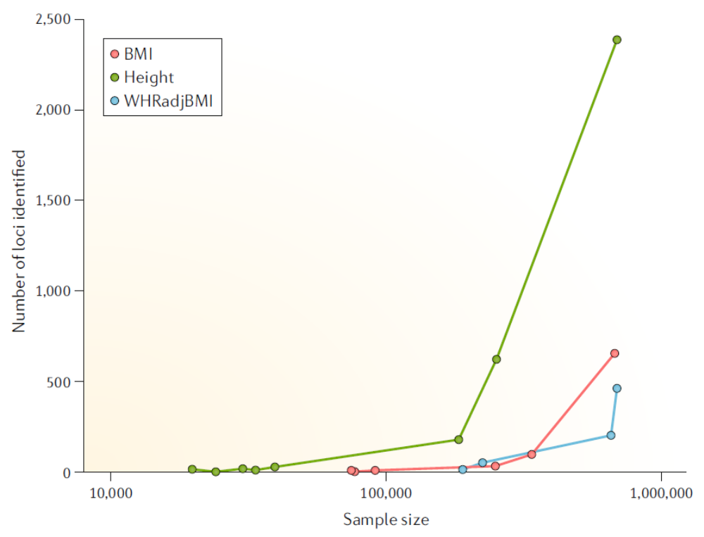
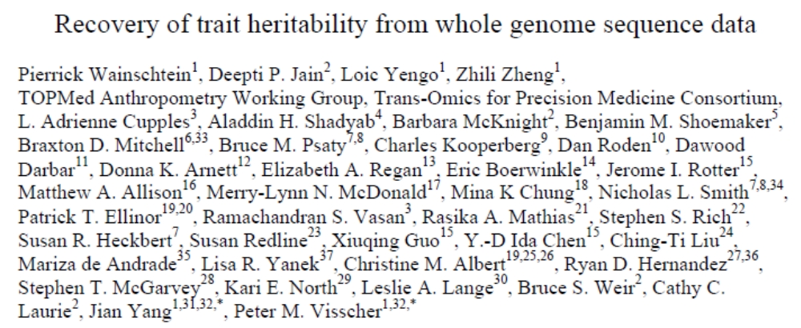
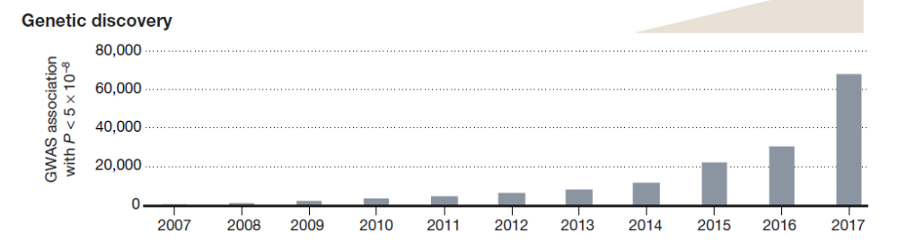
2019: heritability explained
Tam et al., 2019
March 2019; height
Claussnitzer et al., 2020

Slide 10
What is now known?
Trait | # loci
Number of children | 31,600
Schizophrenia | 13,800
College | 12,000
Morning person | 10,500
Age at first birth | 9,800
Neuroticism | 9,800
Cardiovascular disease | 6,500
Blood pressure | 6,500
BMI | 6,000
Inflammatory bowel disease | 4,000
Height | 3,600
Age at menarche | 3,000
Asthma | 1,300
Alzheimer’s disease | 800
T2 diabetes | 700
Almost all complex traits/diseases are highly polygenic, in particular cognitive/behavioral traits
Most associated loci are non-coding
Pleiotropy is common: genetic correlation between traits
Negative selection reduces frequency of effect alleles
From O’connor et al., 2019

Slide 11
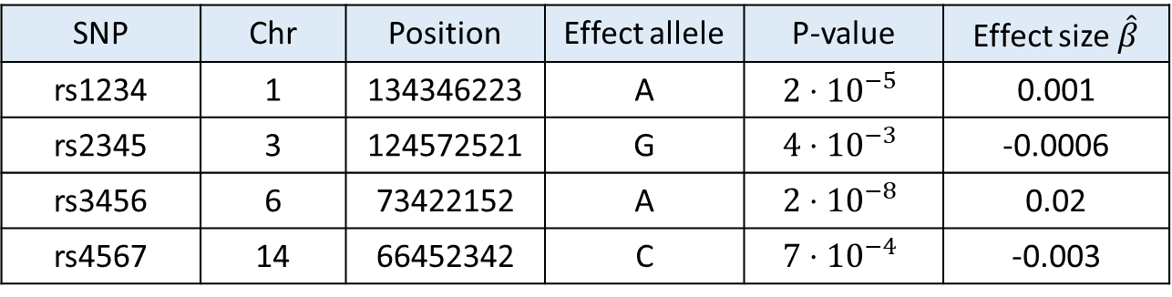

Discovery ➔ prediction
Trait
Summary statistics are publicly/freely available
Effect size:
Quantitative traits: increase in trait with each allele (regression slope)
Disease (binary) traits: log-odds ratio
$$β$$
Allele count
0
1
2
SNP | Chr | Position | Effect allele | P-value | Effect size $\hat{β}$
rs1234 | 1 | 134346223 | A | $$2⋅{10}^{−5}$$ | 0.001
rs2345 | 3 | 124572521 | G | $$4⋅{10}^{−3}$$ | -0.0006
rs3456 | 6 | 73422152 | A | $$2⋅{10}^{−8}$$ | 0.02
rs4567 | 14 | 66452342 | C | $$7⋅{10}^{−4}$$ | -0.003

Slide 12
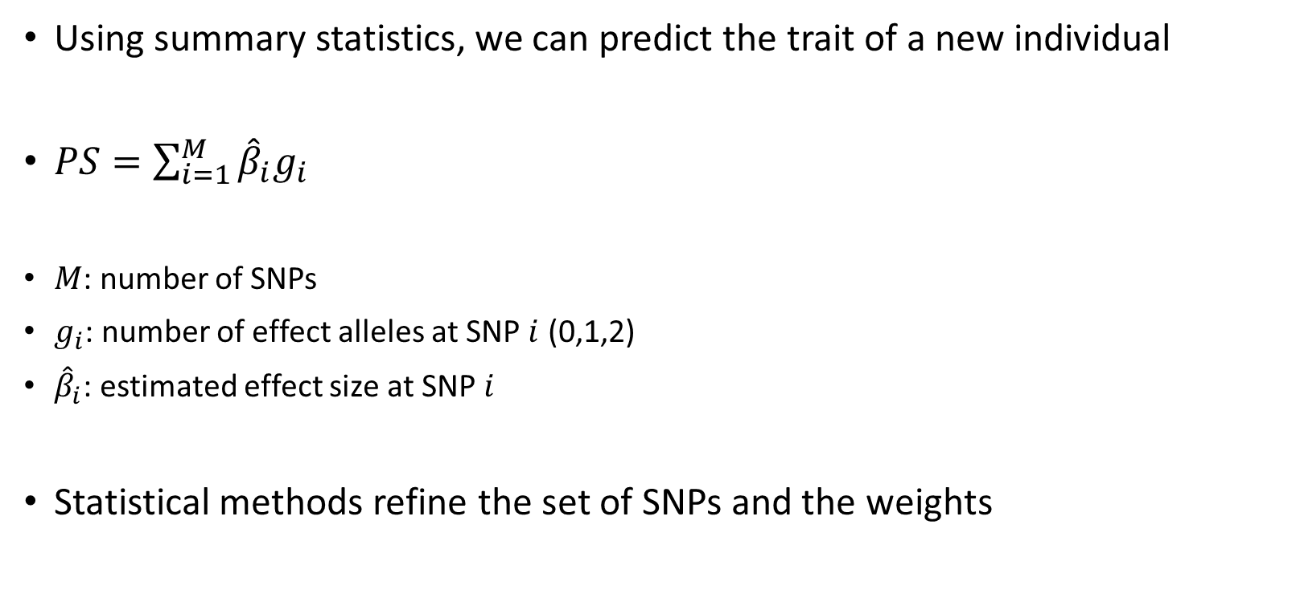
Polygenic scores (PS)
Using summary statistics, we can predict the trait of a new individual
$PS=\sum_{i=1}^{M}{{\hat{β}}_{i}g_{i}}$
$M$: number of SNPs
$g_{i}$: number of effect alleles at SNP $i$ (0,1,2)
${\hat{β}}_{i}$: estimated effect size at SNP $i$
Statistical methods refine the set of SNPs and the weights

Slide 13

SNP selection
It is usually advisable to remove correlated SNPs (in linkage disequilibrium)
Should we use all SNPs or just significantly associated SNPs?
Significant SNPs
All SNPs
Avoid noise
Use just the most relevant SNPs
Increase power by including SNPs whose evidence for association is weak only due to the finite sample size

Slide 14
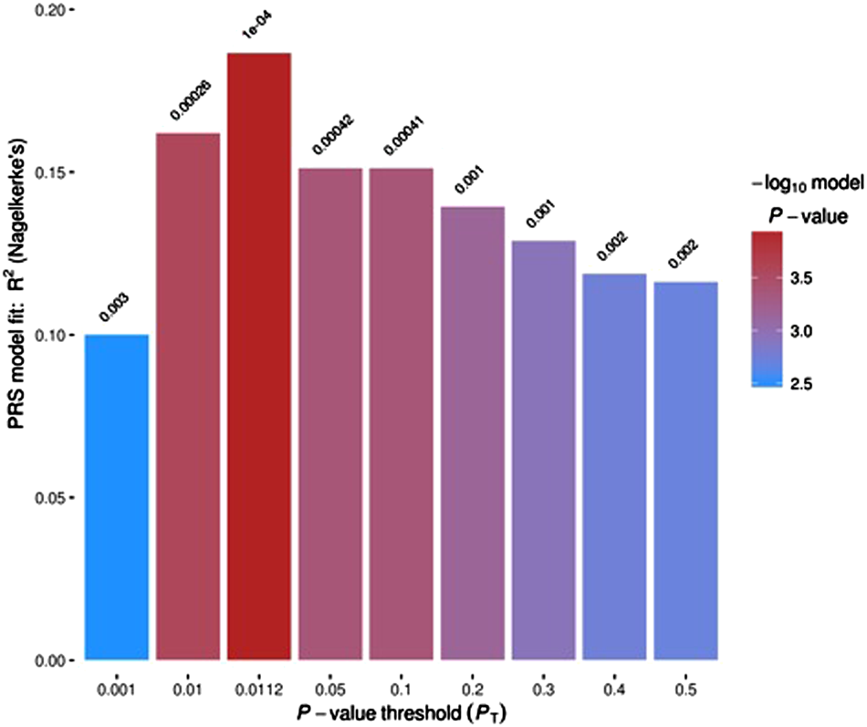


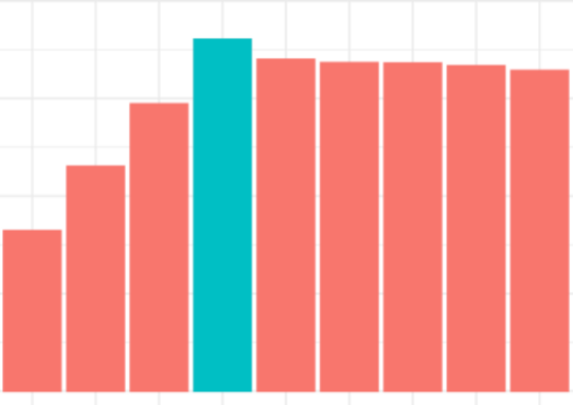
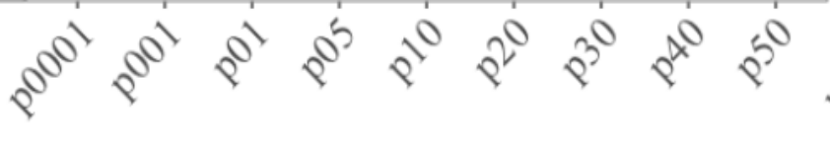
SNP selection
Use cross-validation to find the optimal P-value threshold
Psychosis
Alcohol dependence
Barr et al., 2019
Santoro et al., 2018

Slide 15
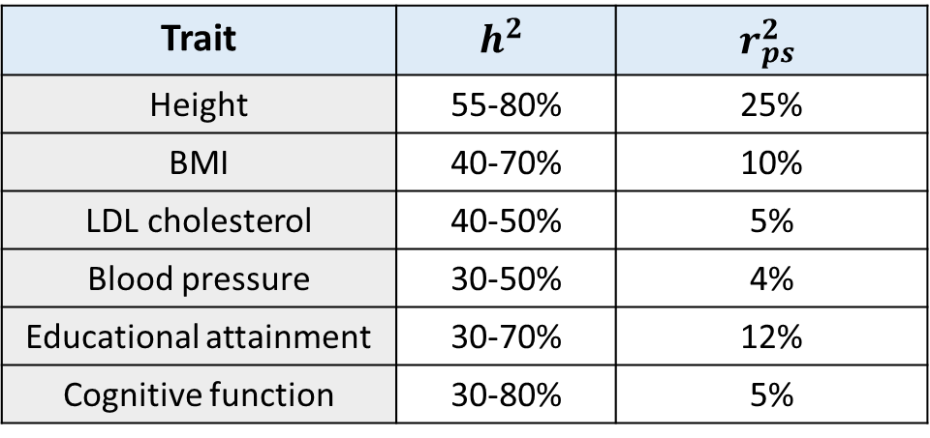
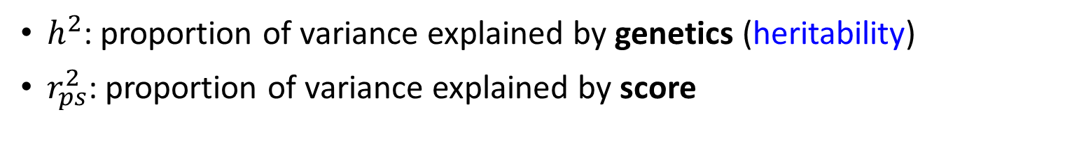

Performance of polygenic scores
$h^{2}$: proportion of variance explained by genetics (heritability)
$r_{ps}^{2}$: proportion of variance explained by score
$${r_{ps}^{2}<h}^{2}<1$$
Trait | $$h^{2}$$ | $$r_{ps}^{2}$$
Height | 55-80% | 25%
BMI | 40-70% | 10%
LDL cholesterol | 40-50% | 5%
Blood pressure | 30-50% | 4%
Educational attainment | 30-70% | 12%
Cognitive function | 30-80% | 5%

Slide 16
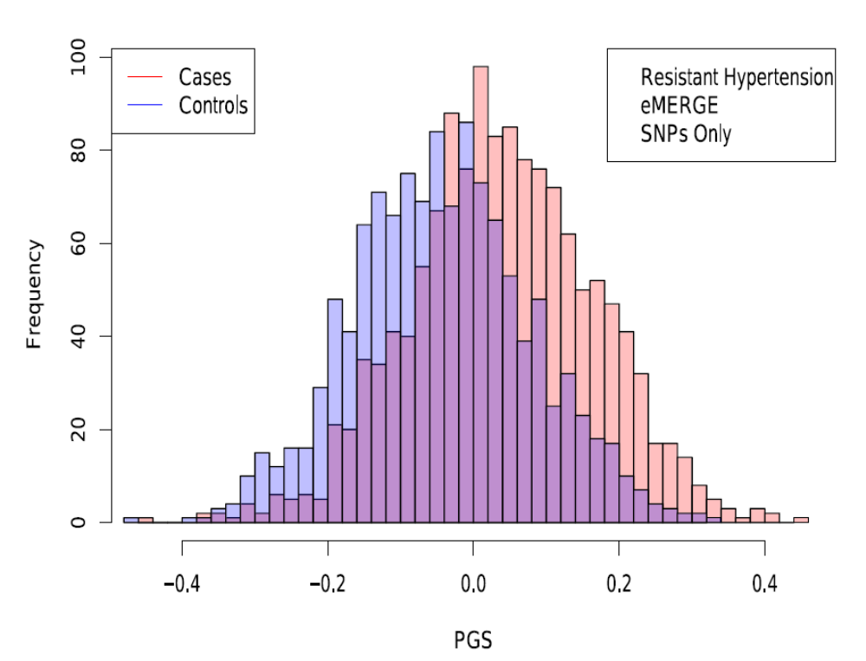
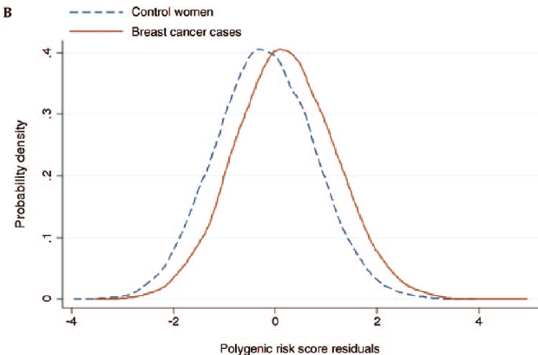
Separation of cases and controls
Lello et al., 2019
Mavaddat et al., 2015

Slide 17
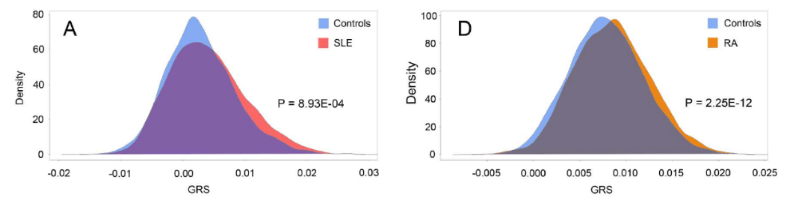
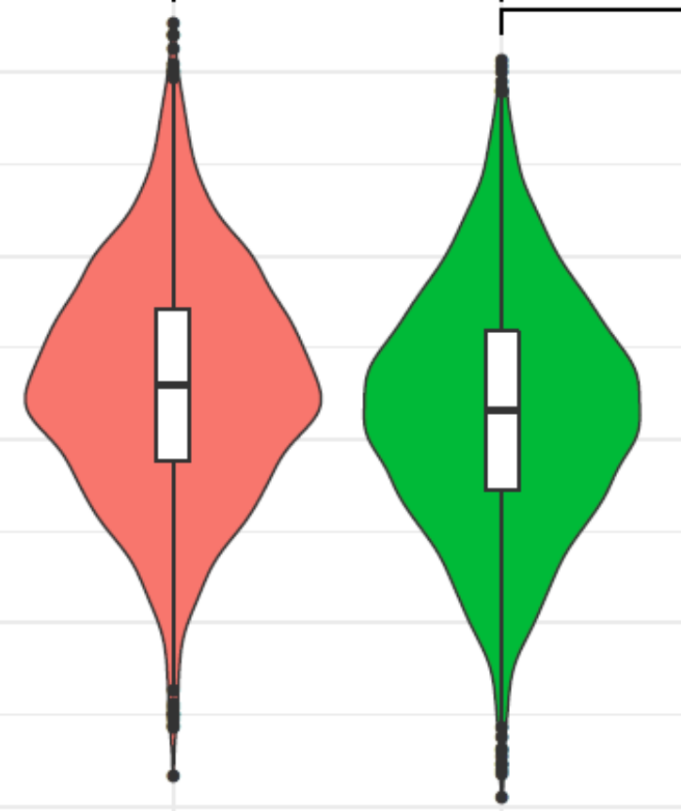
Separation of cases and controls
Alzheimer’s disease
Marquez et al., 2016
Fulton-Howard et al., 2020
Cases
Controls

Slide 18
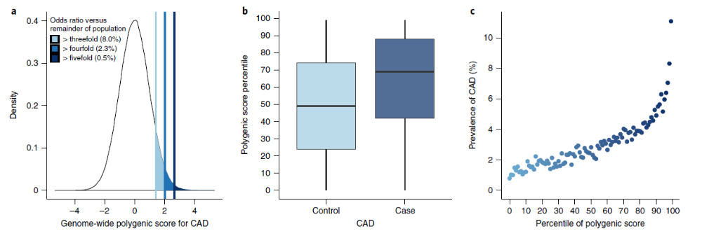
Predicting cardiovascular disease risk
Khera et al., 2018

Slide 19
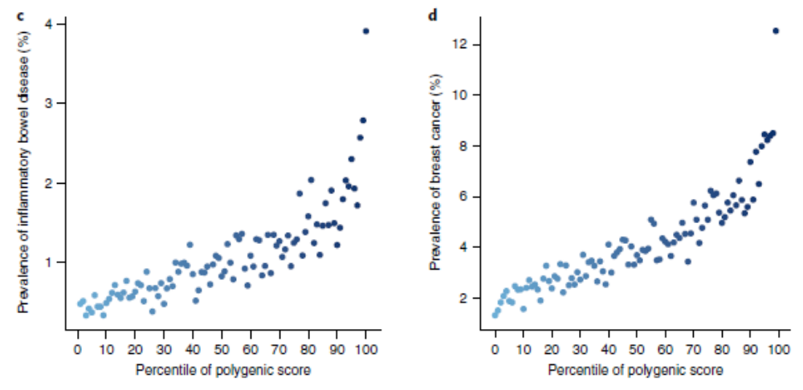
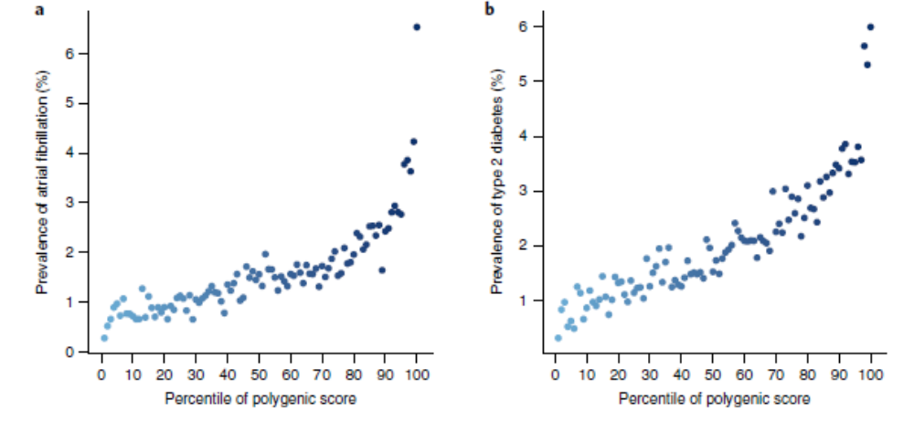
More diseases
Inflammatory bowel disease
Breast cancer
Atrial fibrillation
T2 diabetes
Khera et al., 2018

Slide 20
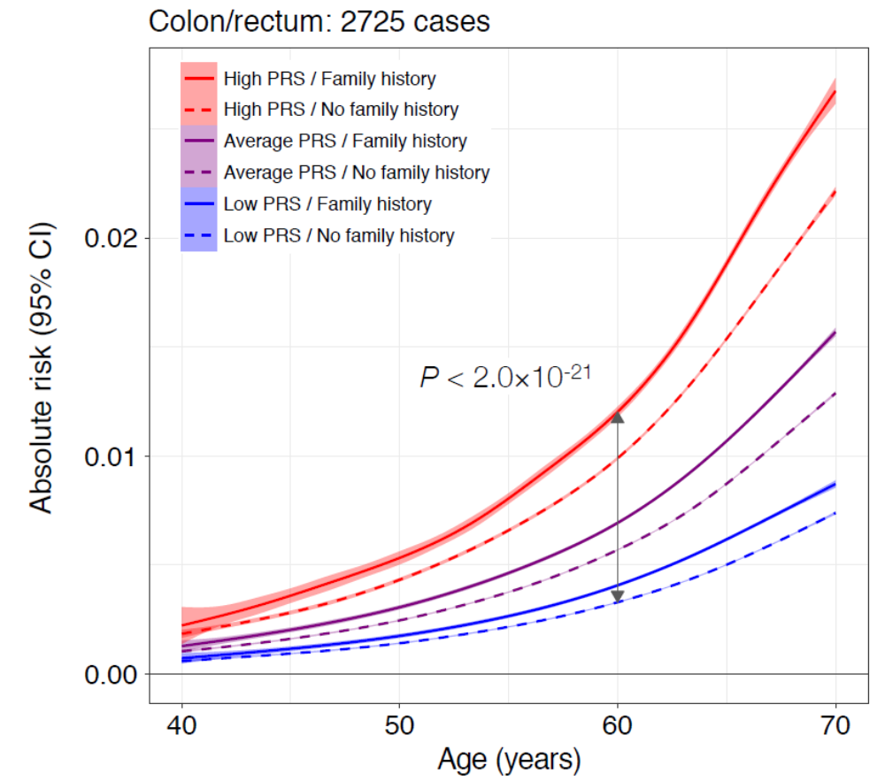
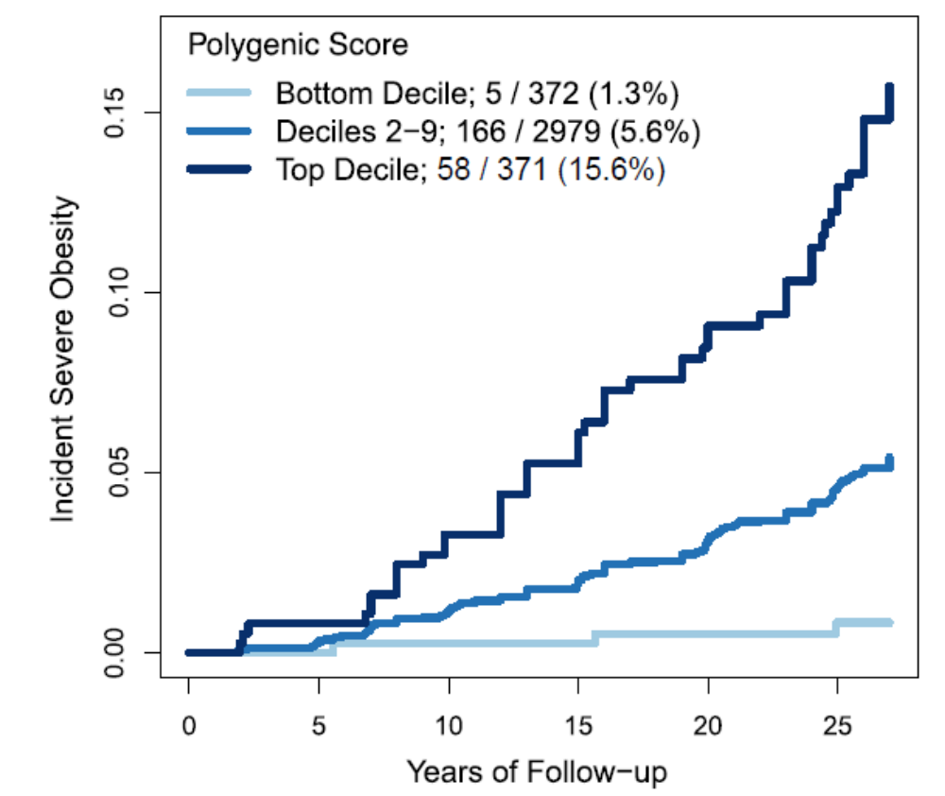
More phenotypes
Kachuri et al., 2020
Severe obesity
Khera et al., 2019

Slide 21
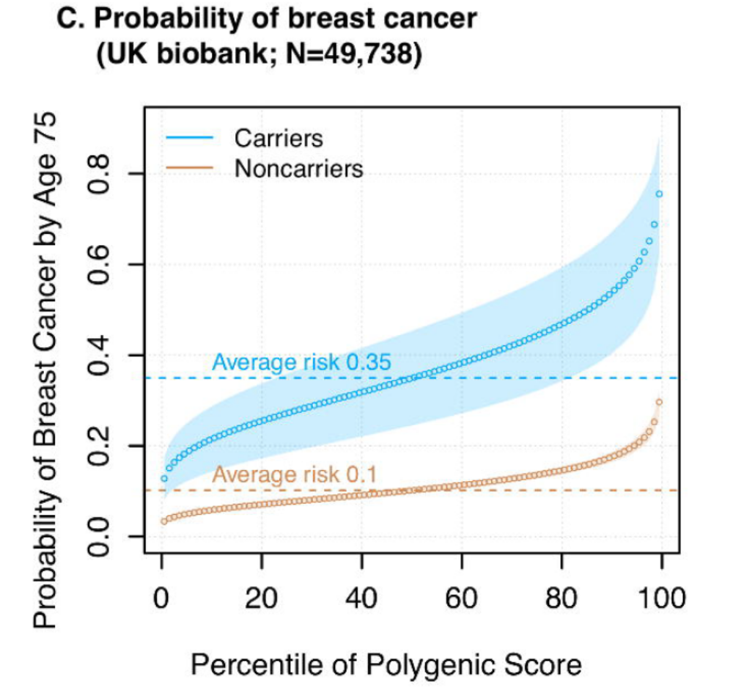
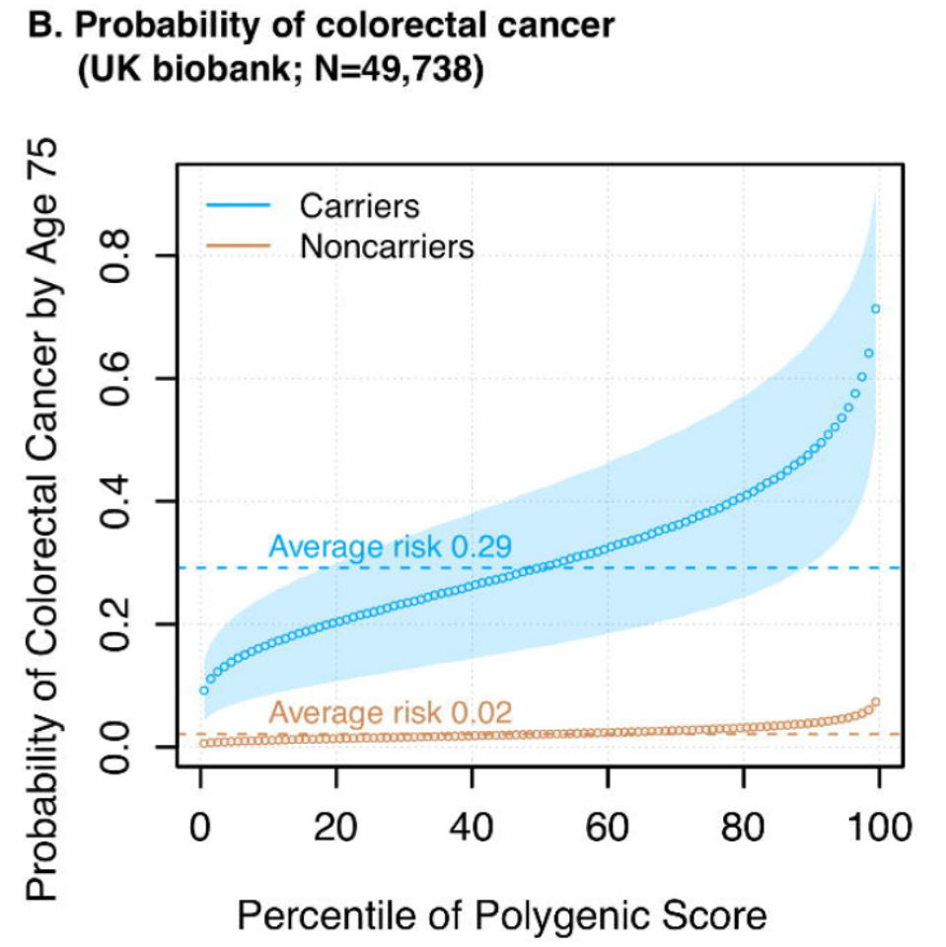
Scores also relevant to Mendelian mutations carriers
MLH1, MSH2/6, PMS2
BRCA1/2
Fahed et al., 2019

Slide 22
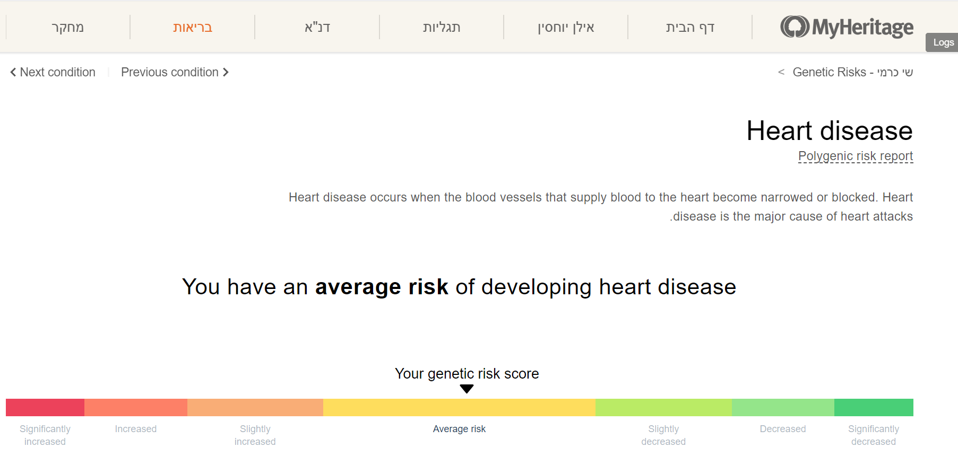
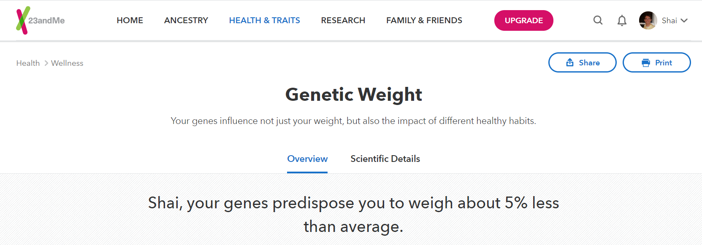
Commercial use

Slide 23
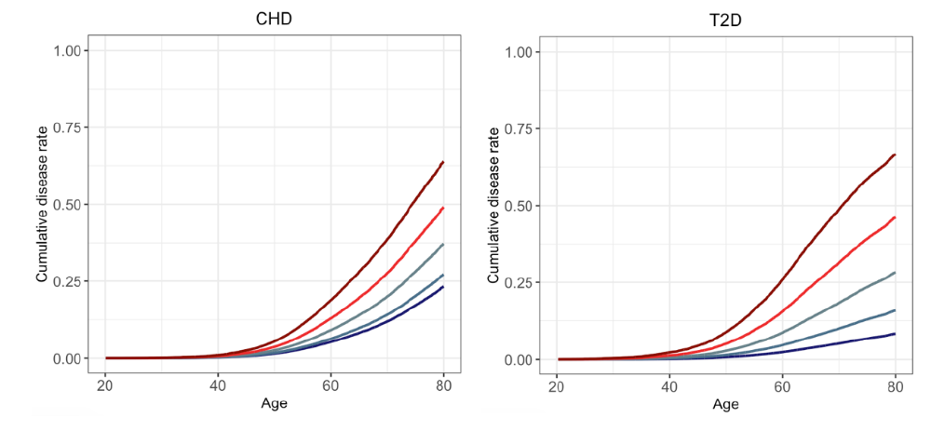
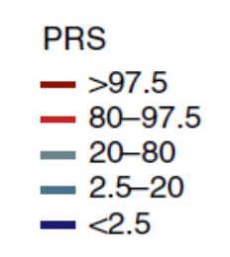
Other key applications
Polygenic scores were shown to predict age of onset, severity of disease, and response to treatment
The predictive power of the scores often depends on the environment, indicating GxE interaction
Mars et al., 2020; Finland

Slide 24
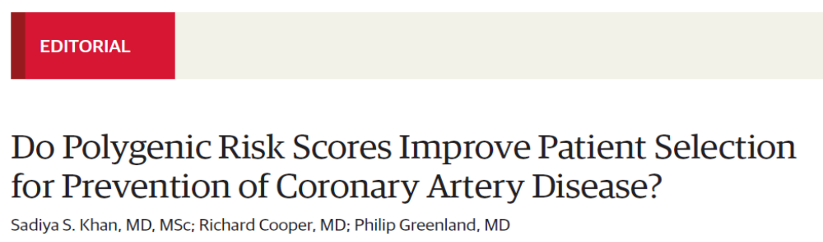
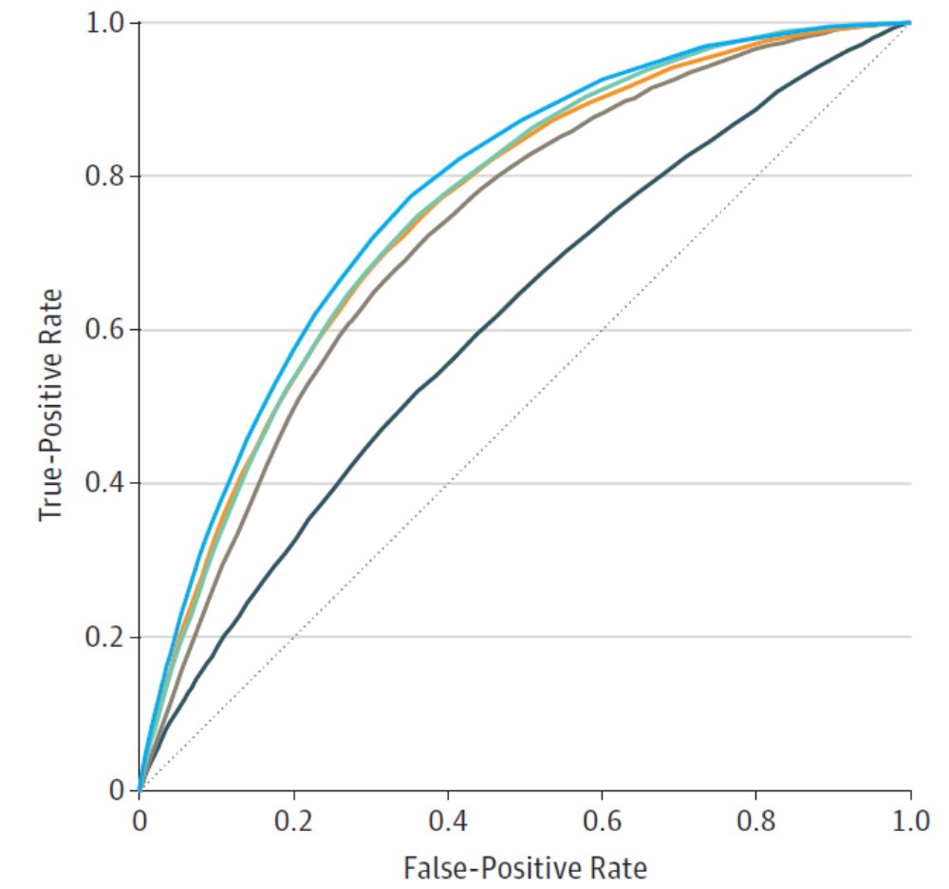
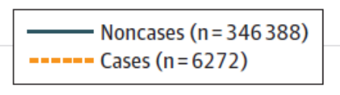
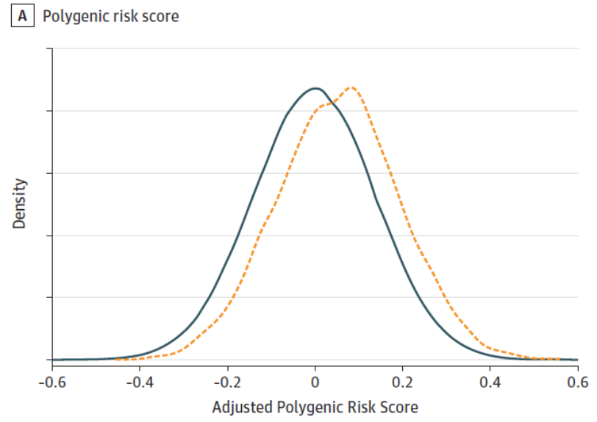
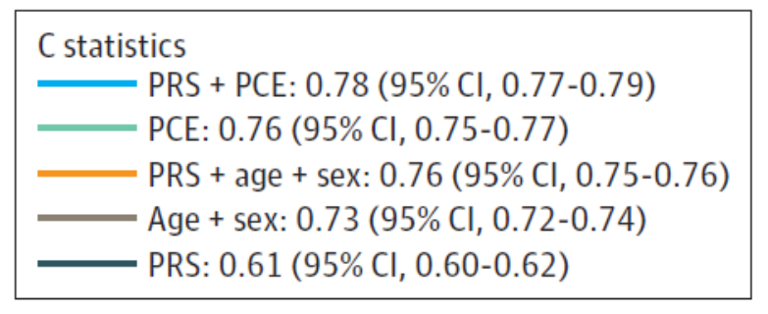
Is there clinical utility?
JAMA, 2020
Elliott et al., 2020

Slide 25
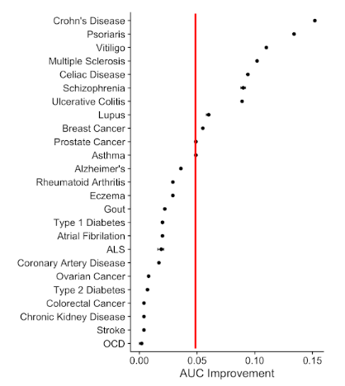
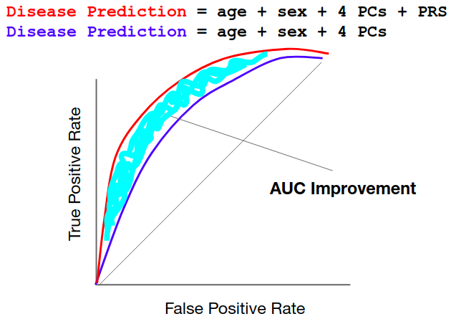
Is there clinical utility?
A comparison of polygenic scores for 25 diseases using the UK Biobank
Kulm et al., 2020

Slide 26
Intermediate summary
Polygenic scores associate significantly with common traits/diseases
The distribution of scores in cases/controls is distinct
Individuals at the highest score percentile have 3-5x higher risk
Scores are additive to family history and Mendelian mutations
BUT,
Prediction accuracy is overall poor
Most of the population has intermediate non-informative scores
Some scores add little benefit beyond standard risk factors

Slide 27
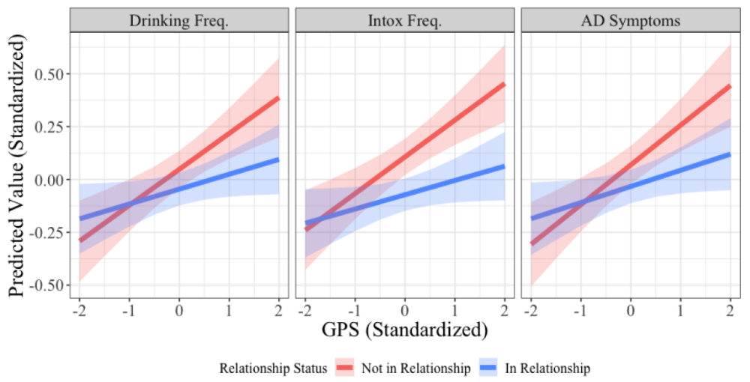
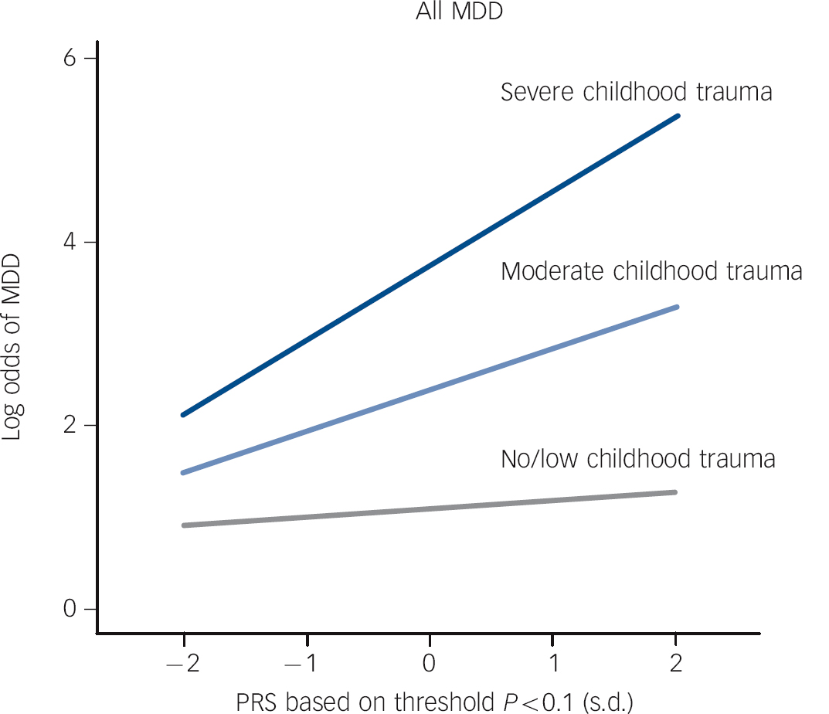
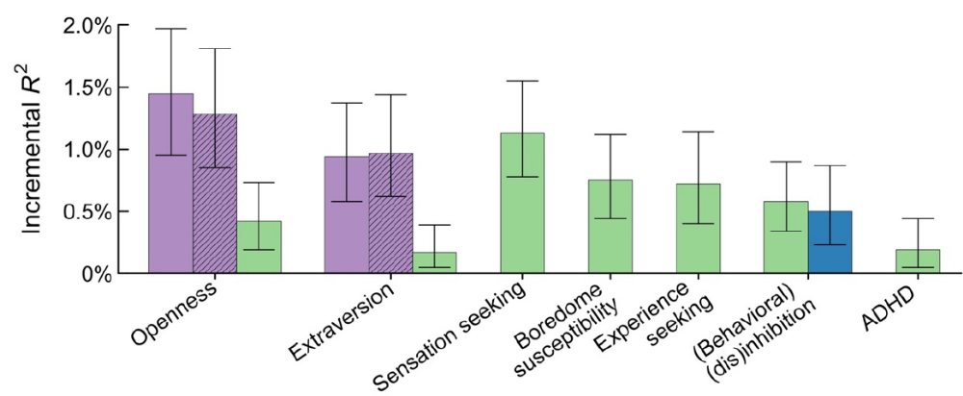
Personality and behavioral traits
Karlsson Linnér et al., 2019
Bar et al., 2019
Peyrot et al., 2014

Slide 28
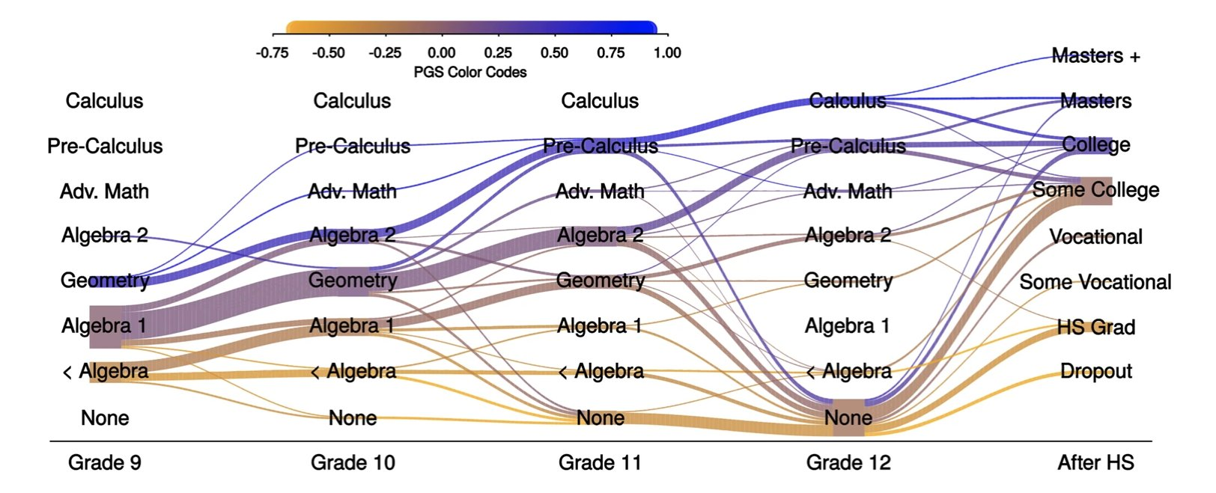
Interesting results for education scores
Harden et al., 2020

Slide 29
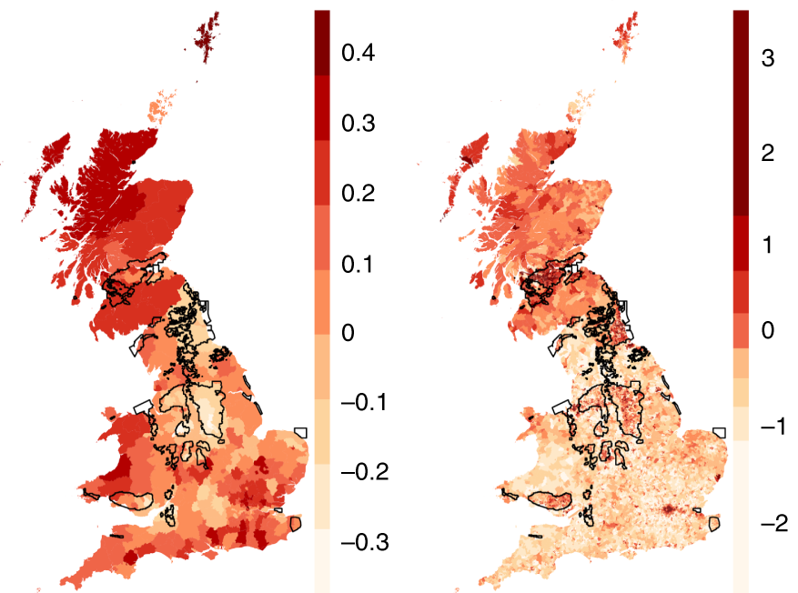
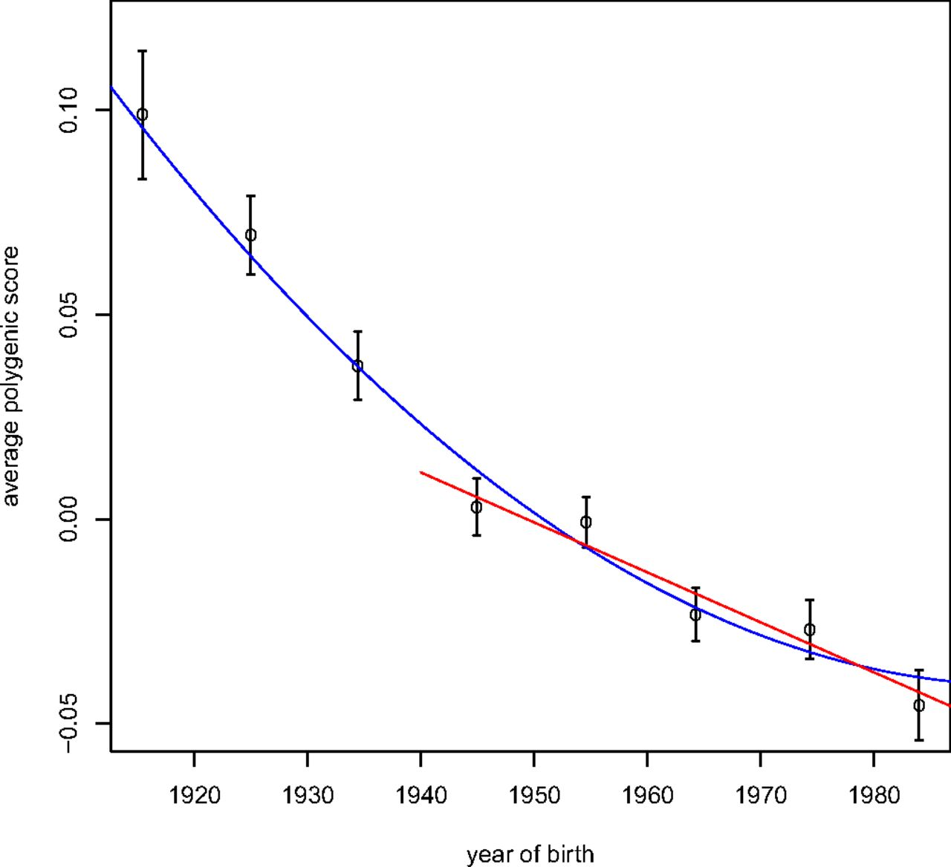
Interesting results for education scores
Polygenic scores
Townsend Deprivation index
Kong et al., 2017
Average polygenic score
Year of birth
Abdellaoui et al., 2019

Slide 30
Outline
Complex traits genetics and polygenic scores
Limitations of polygenic scores
Selecting embryos for traits

Slide 31
Problems with polygenic scores
Problems when comparing scores across populations
Low predictive accuracy in non-European populations
Low predictive power within families
Variable predictive power across age, calendar year, and population subgroups

Slide 32
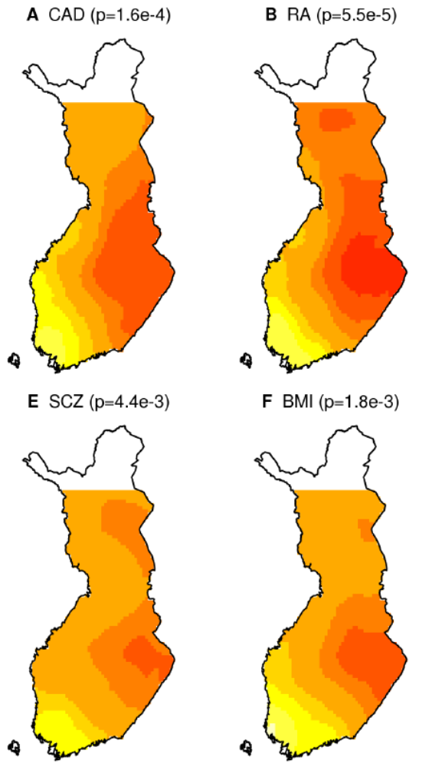
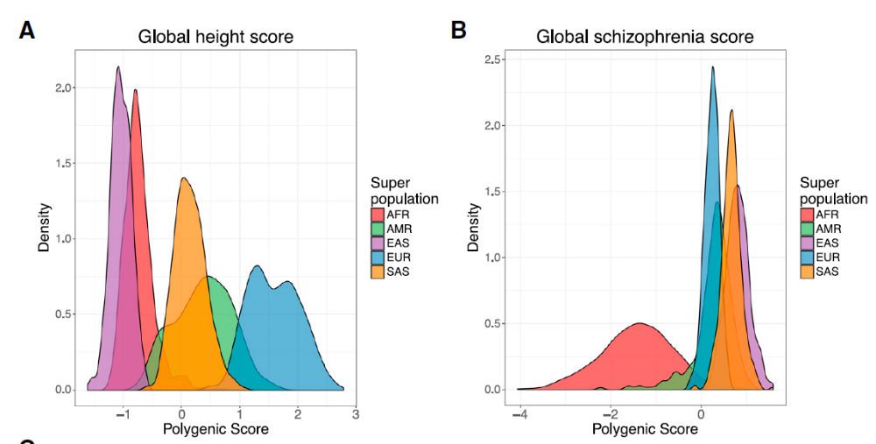
Differences between populations
Finland
Martin et al., 2017
Kerminen et al., 2018

Slide 33
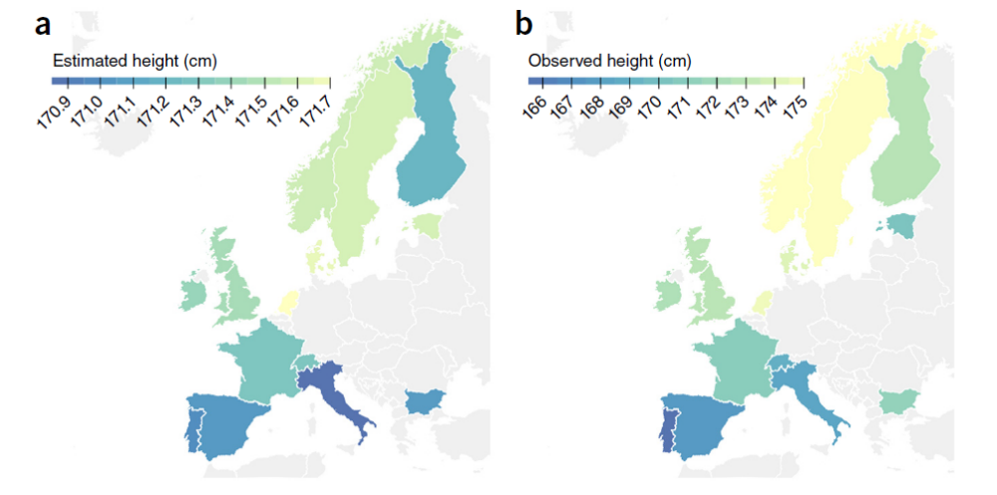
Are those differences indicative of selection?
Robinson et al., 2015

Slide 34
The problem of population structure
Cases
In large genetic studies, we often sample across multiple populations
Sampling may be uneven, due to purely environmental/cultural reasons
Any variant with a different frequency between populations (due to neutral genetic drift) will seem associated
Controls
Sub-population 1
Sub-population 2

Slide 35
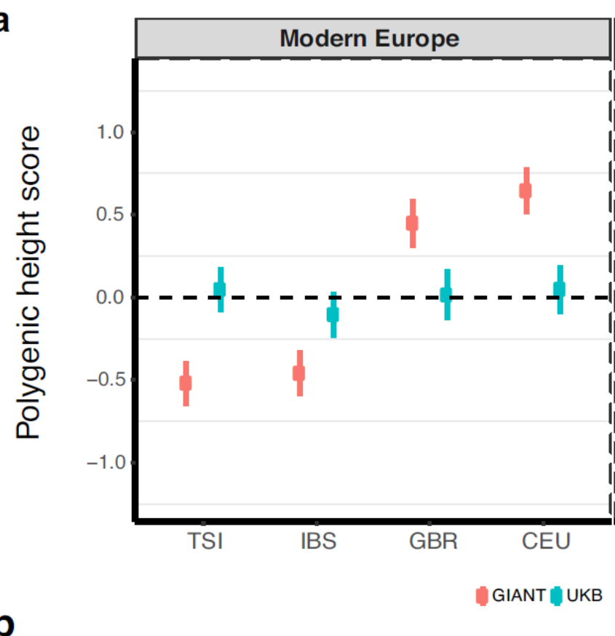
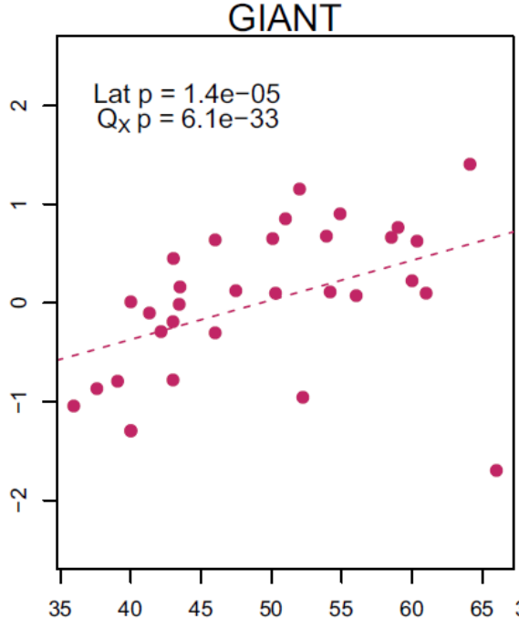

Most selection signal is false
World-wide study
UK biobank
Polygenic score
Italy Spain UK NW-Eur
Latitude
Latitude
World-wide study
UK biobank
Berg et al., 2019; Sohail et al., 2019

Slide 36



Population structure is a pervasive problem
Educational attainment score (2016)

Slide 37

Lower prediction quality in non-Europeans
22 quantitative anthropometric and blood-panel traits
Martin et al., 2019

Slide 38



Lower prediction accuracy within families
Own genotype
Parental genotype
Home environment
Own education
Higher score
Higher score
50% shared
Education supporting
Cheesman et al., 2019
Educational attainment
Unrelateds
Within-family
Young et al., 2019
SNP heritability
Polygenic prediction

Slide 39



Variable predictive power across sex, age, and SES
Mostafavi, Harpak, et al., 2020

Slide 40



Variable accuracy across time, location, and age
Predicting educational attainment before and after communism
+1SD change in score
Belsky et al., 2016
Ujma et al., 2020

Slide 41
Outline
Complex traits genetics and polygenic scores
Limitations of polygenic scores
Selecting embryos for traits

Slide 42


Genetic screening of embryos
Why?
  Mendelian disease mutations
  Recurrent pregnancy loss
How?
  Grow IVF embryos for 3-5 days
  Amplify DNA from a single cell
What?
  Traditionally: single mutations, aneuploidy
  Now: whole-genome haplotypes, CNVs
  Universal, fast, accurate, low cost

Slide 43



How could it be possible?
Parents (microarray)
Embryos are a mosaic of the parents
Only need to infer crossover locations
(Up to de-novo mutations)
Embryo 1
Embryo 2
Embryo 3
Array/low-coverage sequencing

Slide 44

Implications
Screening embryos for complex traits now feasible
At least one company is already offering the test

Slide 45



Screening embryos for complex traits now feasible
From GP website:
  Type 1 and Type 2 Diabetes
  Coronary Artery Disease, Heart Attack Risk, Hypercholesterolemia, Hypertension
  Breast Cancer, Testicular Cancer, Prostate Cancer, Malignant Melanoma, Basal Cell Carcinoma
  Intellectual Disability
  Idiopathic Short Stature
December 2019
April 2019

Slide 46




Obviously, ethical concerns
MIT Technology Review
November 2017
Antonio Regalado
The Economist, November 2018
New Scientist, November 2018
The Times, November 2018

Slide 47
No data!
Does it work? What are the expected outcomes?
So far: economic analysis, no empirical data (Shulman and Bostrom, 2014)
Our approach:
Simulations based on real data
Quantitative genetic model
Large nuclear families

Slide 48

Simulations overview
Predicted
trait
Start with real genomes
Pair individuals (randomly/real couples)
Gain
Simulate $n$ offspring
Avg
Compute PS and predict trait of offspring
Gain = (prediction of top-scoring embryo) $−$ (average prediction)

Slide 49
Traits/cohorts
Gil Atzmon, Nir Barzilai
Einstein College of Medicine
Height
102 couples, 700k SNPs
Ashkenazi Jews, a longevity study (Sathyan et al., 2018)
Cognitive ability (IQ)
919 young males, 480k SNPs
Greek schizophrenia study (Stefanis et al., 2004)
Nikos Stefanis, Alex Hatzimanolis, Nikolaos Smyrnis, Dimitrios Avramopoulos, University of Athens

Slide 50

Experiments ($n=10$ embryos)
Gain in height: 2-4 cm
Real/random families behave similarly
Gain in IQ: 2-4 points
Height (random couples)
Height (real couples)
IQ
Density

Slide 51





More/less embryos?
$n=50$: gain is ≈4.5 cm/IQ points
$n=5$: gain is ≈2.5 cm/IQ points
Height random
Height real
IQ
Gain (cm)
Gain (cm)
Gain (points)
# embryos $n$
# embryos $n$
# embryos $n$

Slide 52
A statistical genetic model
$$E\left(Gain\right)∝r_{ps}⋅\sqrt{\log{n}}$$
Accuracy of the score
The number of embryos
More embryos: very slow growth in the gain
More accurate score: rapid growth
Up to the heritability

Slide 53



The actual gain is uncertain
IQ
Embryos are random
Non-score genetic factors
Non-genetic factors
No selection
[72,128]
Selection
[83,124]
$n=10$, $h^{2}=0.5$, $r_{ps}^{2}=4.3\%$

Slide 54

But what about an actual experiment?...
Ethical issues + too long
But we can consider large nuclear families
28 Ultra-orthodox Jewish families (Israel/US)
9.6 adult children per family (range: 3-20)
Genotype + height available!
Danny Zeevi, Leonid Kruglyak, UCLA

Slide 55


An “experiment”
Top-scoring embryo ($n=7$) is:
  Tallest: 32% of families
  Shorter than the average: 16% of families
  ≈3cm shorter than the tallest (on average)
Danny Zeevi, Leonid Kruglyak, UCLA

Slide 56


Many practical limitations
Prediction accuracy lower within families and across populations, assortative mating
Advanced maternal age: less viable embryos
Selection for multiple traits
  Gain decreases by $\sqrt{T}$-fold
Risk of unknown health issues
From Franasiak et al., 2014

Slide 57


Summary
Current gain: ≈2-3 cm/IQ points
Improved predictors will increase the gain substantially ($∝r_{ps}$, but only up to the heritability)
More embryos will not ($∝\sqrt{\log{n}}$)
Actual gain uncertain and practically limited
Acknowledgements:
Ehud Karavani, HUJI
Or Zuk, HUJI
Danny Zeevi, UCLA
Todd Lencz, Northwell
Abisch-Frenkel Foundation

