Slide 1
Advanced Topics in Data Analysis
Shai Carmi

Slide 2
Introduction to machine learning
Basic concepts
Supervised learning: classifiers
  K-nearest neighbors
  Logistic regression
  Measuring accuracy
  The perceptron and neural networks
Unsupervised learning: clustering and dimension reduction

Slide 3
Unsupervised learning
Clustering: introduction and k-means
Hierarchical clustering
Dimension reduction

Slide 4
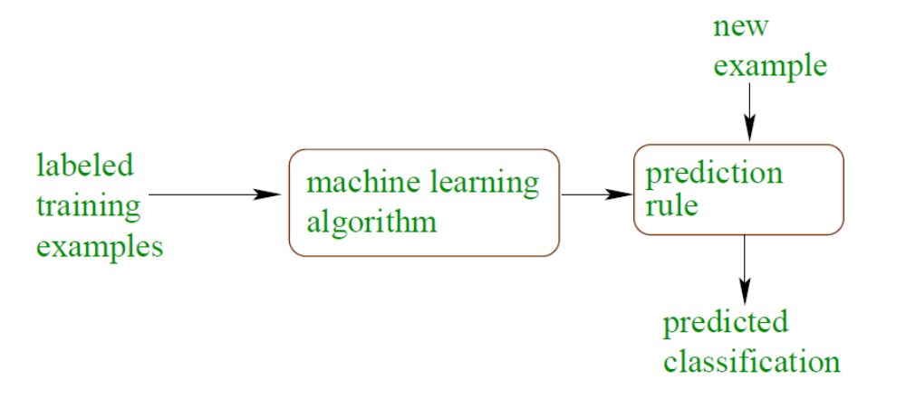
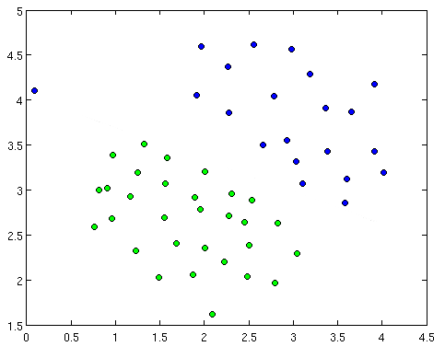
Supervised learning (classification)
Features: temperature, blood pressure (d=2)
Label: sick/healthy
Training data: N=52
learning
Sick
?
Healthy
?
?
Temperature
A machine learning classifier divides the space into the different classes
We can then assign a label to each new point
Class separation line
?
?
Blood pressure

Slide 5
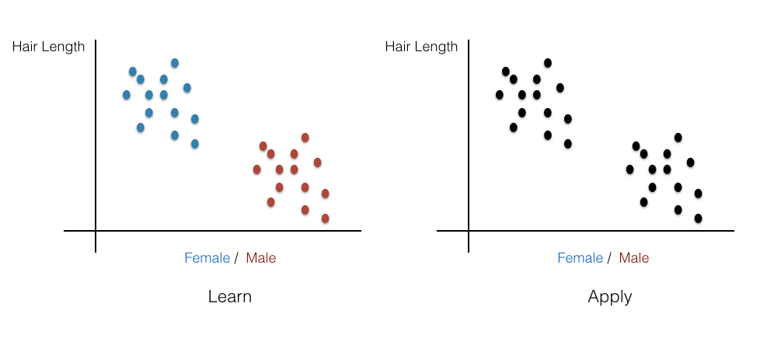
Unsupervised learning: Clustering
No labels available
Need to automatically identify groups of nearby points
Main goals: identify “populations” of data points, inspect clusters to determine possible biological/medical meaning

Slide 6
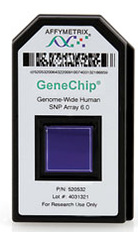
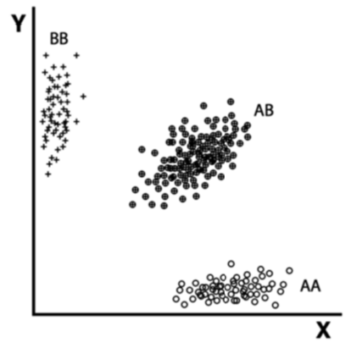
Clustering in genetics
Microarrays are used for genotyping SNPs
A Single Nucleotide Polymorphism (SNP) is a position in the genome where some people have one allele (A) and some have another (B)
Whenever a probe on a microarray hybridizes with DNA having an A allele, it emits red light
Whenever it hybridizes with a B allele, it emits green light
Each data point in the red/green space corresponds to the genotype of one individual
How to call the genotypes?
Green fluorescence
Red fluorescence

Slide 7
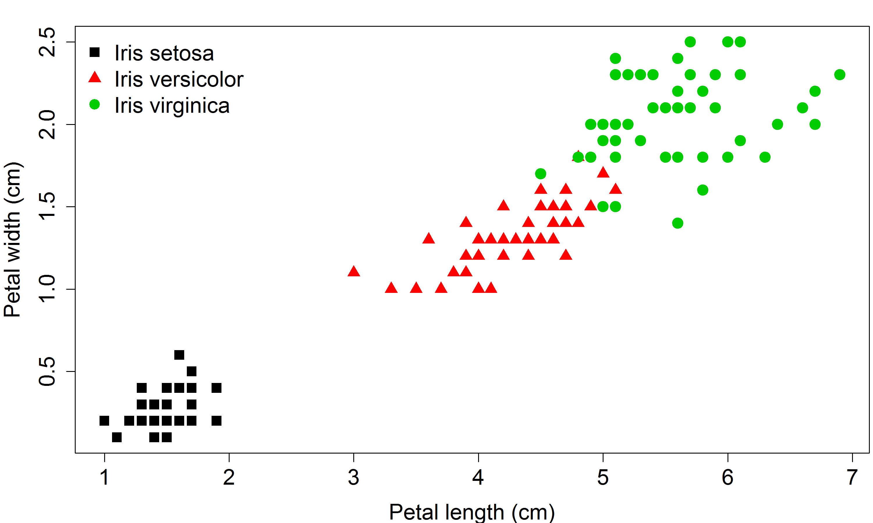

Clustering: The Iris dataset

Slide 8
Clustering: Motivation
An exploratory analysis for understanding the data
Sometimes the groups are known and we can guess the labels from the clusters
Find sub-groups in data that may be heterogeneous
  Subjects of medical study
  Subtypes of cancer tissues
Information on cluster locations can be useful

Slide 9
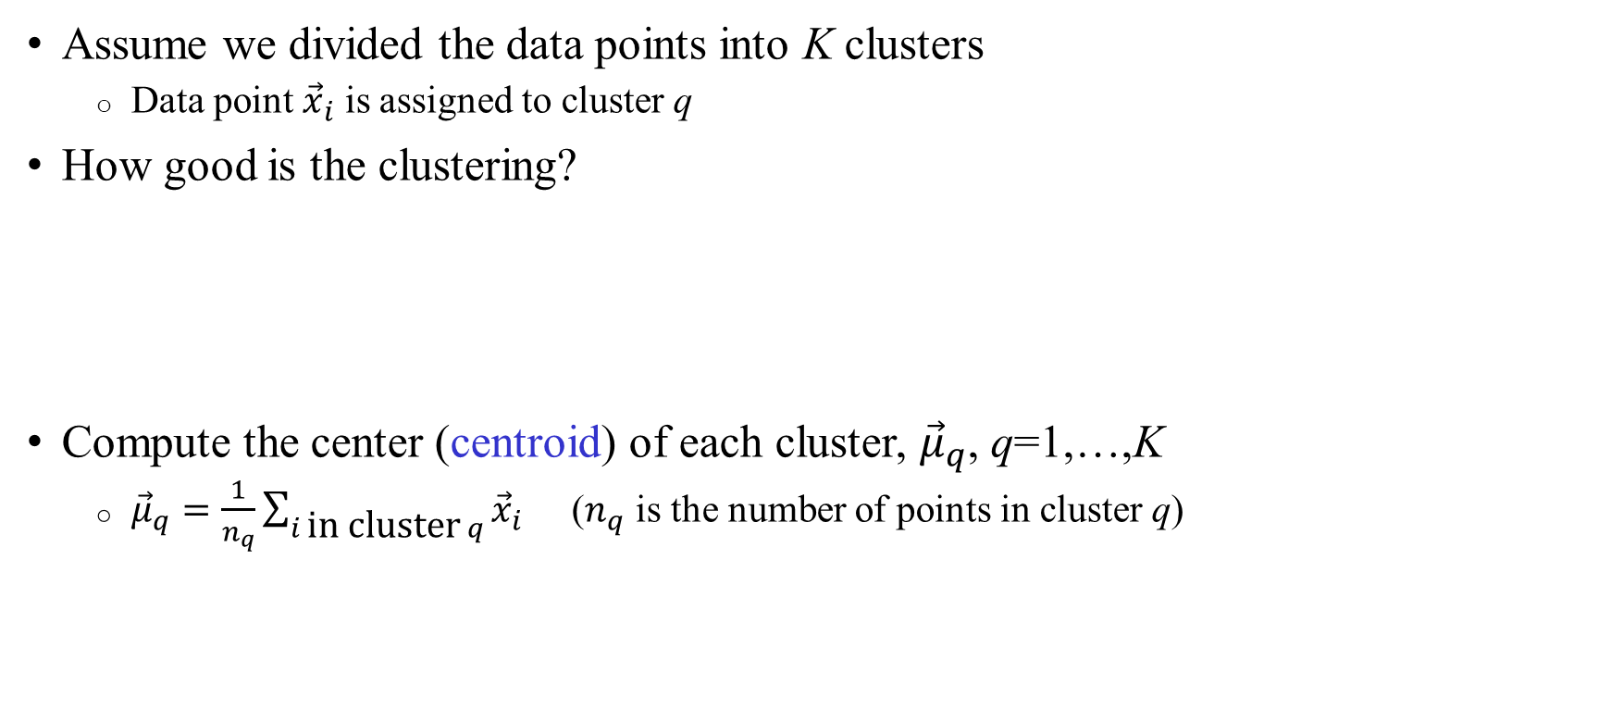
What is good clustering?
Assume we divided the data points into K clusters
  Data point ${\vec{x}}_{i}$ is assigned to cluster q
How good is the clustering?
Compute the center (centroid) of each cluster, ${\vec{μ}}_{q}$, q=1,…,K
  ${\vec{μ}}_{q}=\frac{1}{n_{q}}\sum_{i \text{in} \text{cluster} q}{{\vec{x}}_{i}}$ ($n_{q}$ is the number of points in cluster q)
Red “centroid”
Green “centroid”
x
x
x
o
o
x
x
x

Slide 10
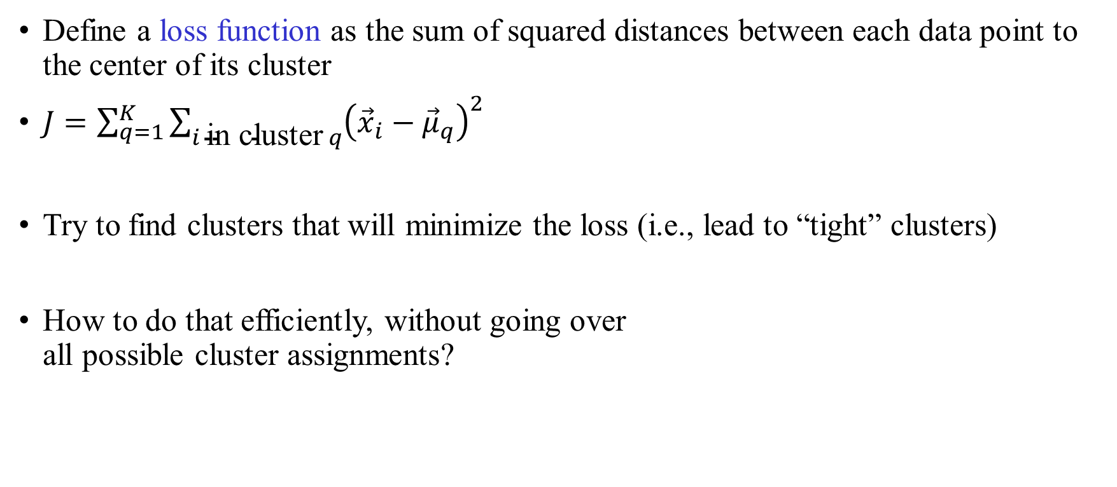
What is good clustering?
Define a loss function as the sum of squared distances between each data point to the center of its cluster
$J=\sum_{q=1}^{K}{\sum_{i \text{in} \text{cluster} q}{{\left({\vec{x}}_{i}−{\vec{μ}}_{q}\right)}^{2}}}$
Try to find clusters that will minimize the loss (i.e., lead to “tight” clusters)
How to do that efficiently, without going over
all possible cluster assignments?
x
x
x
o
o
x
x
x

Slide 11
The K-means algorithm
Simplest algorithm
Fix the number of clusters K
Initialization: Assign each data point to a random cluster
Update step: Compute the center of each cluster
Assignment step: Assign each data point to the cluster with the nearest center
Repeat until convergence (=no change in cluster assignment)

Slide 12
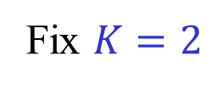
K-means: Example
Update: Compute the centroid of each cluster; Assignment: Assign each data point to the nearest centroid
Fix $K=2$
Red “centroid”
Green “centroid”
x
x
x
x
x
x
x
x
x
x
x
x
x
x
x
o
o
x
o
o
x
x
x
x
x
x
x
x
Original data
Random assignment
Update step
Assignment step (a)
Red “centroid”
Green “centroid”
No change in assignment: STOP
x
x
x
x
x
x
x
x
x
o
x
x
o
x
x
x
x
x
x
o
x
x
o
x
x
x
x
x
Assignment step (b)
Update step
Assignment step (a)
Assignment step (b)

Slide 13
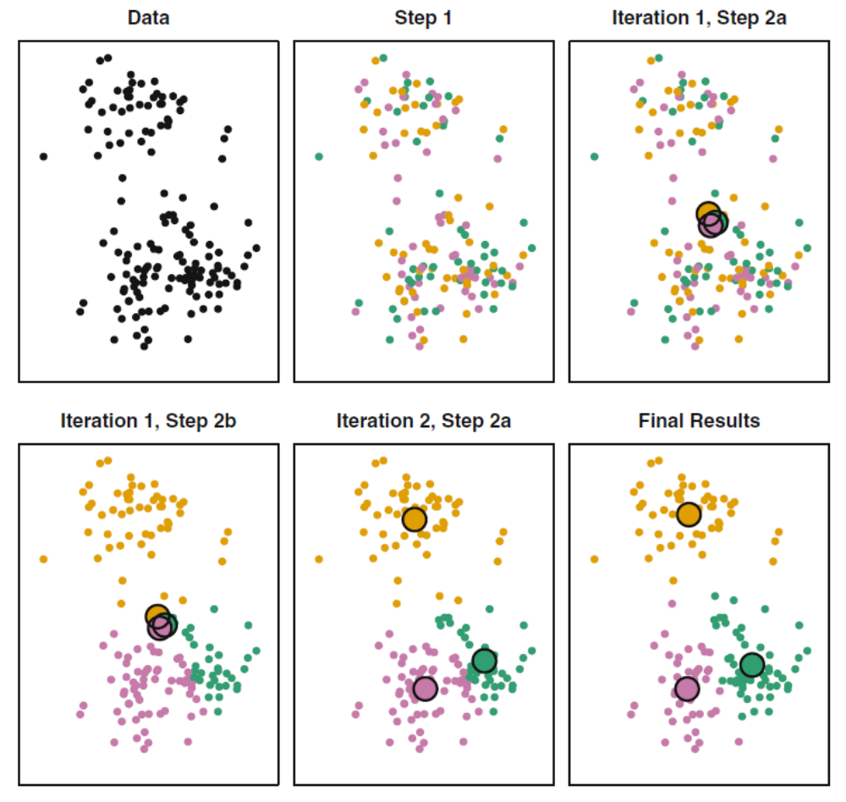
K-means: Example

Slide 14
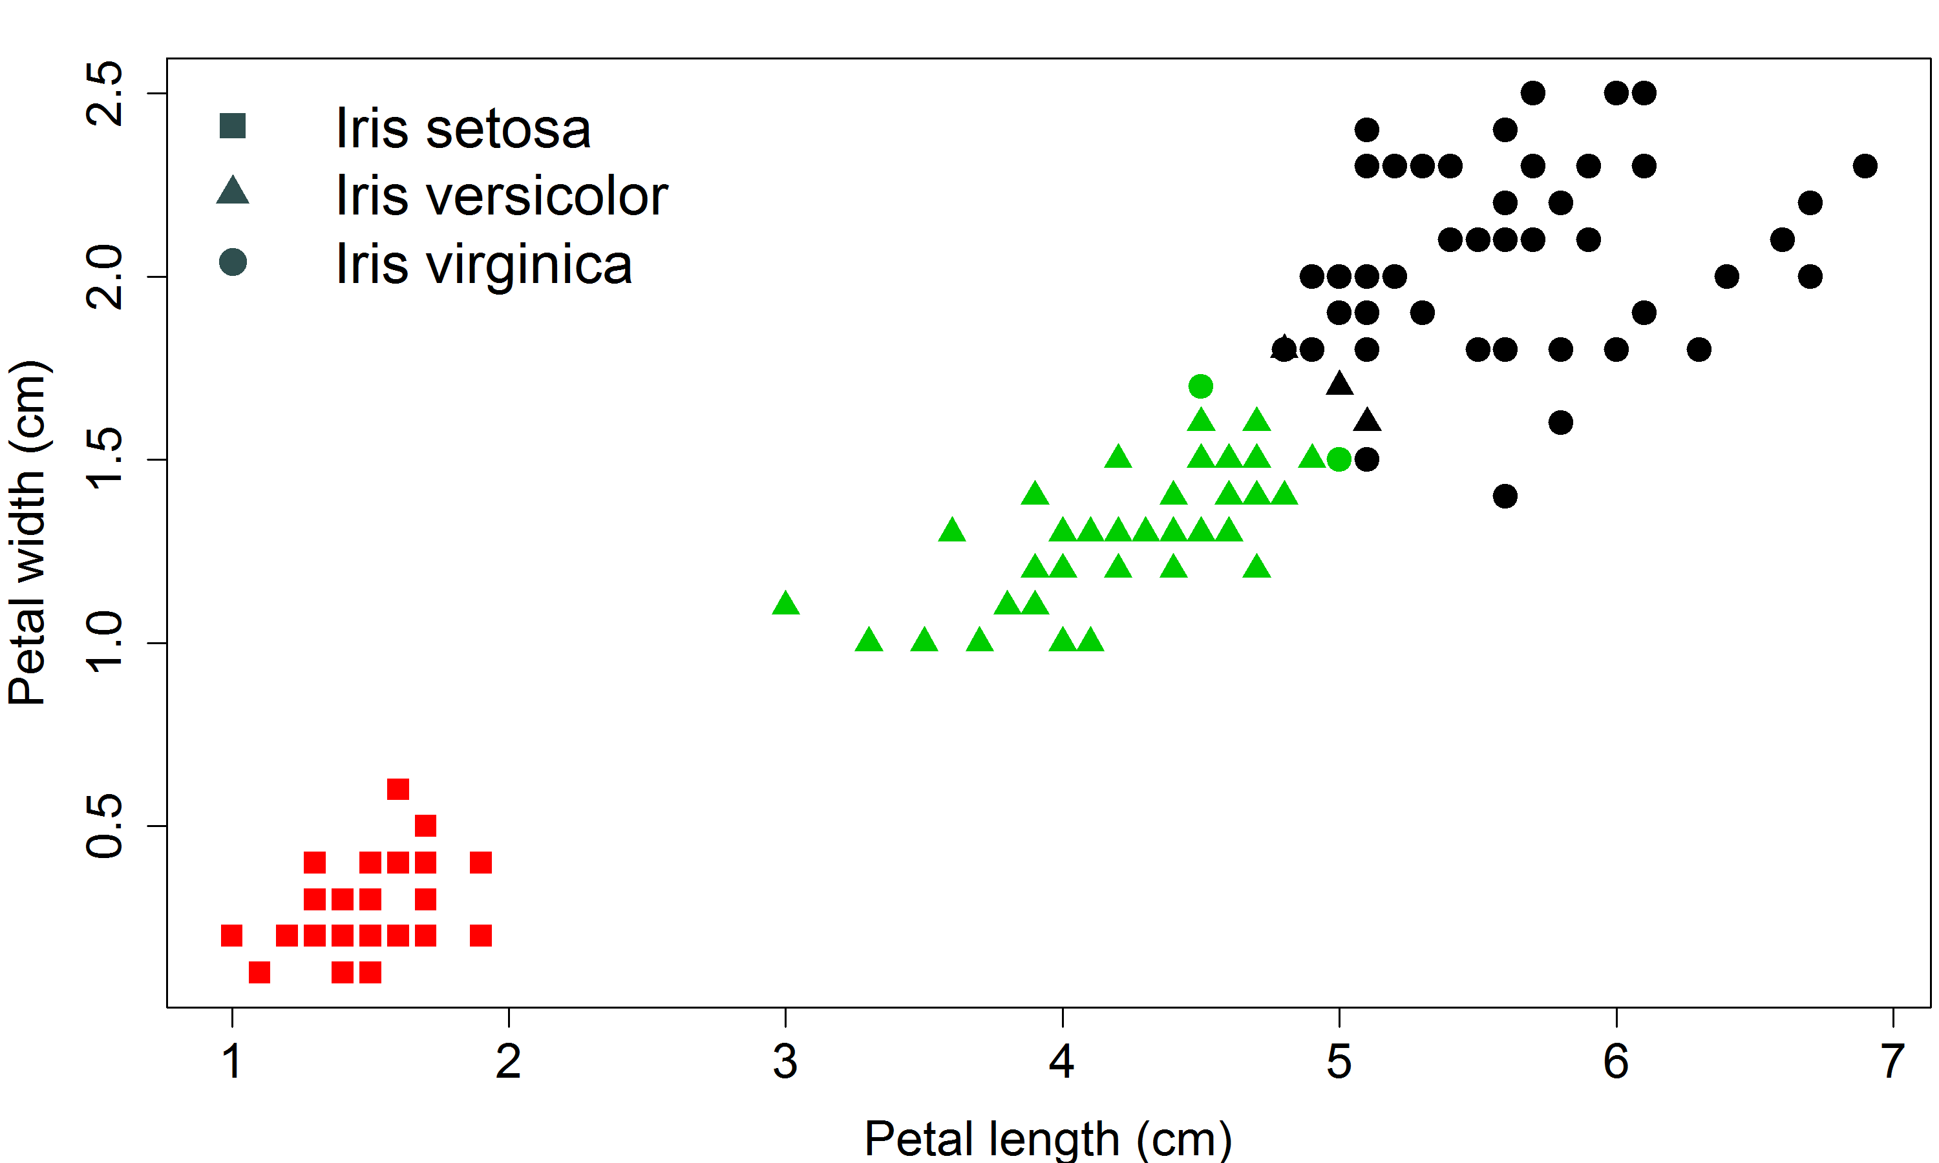
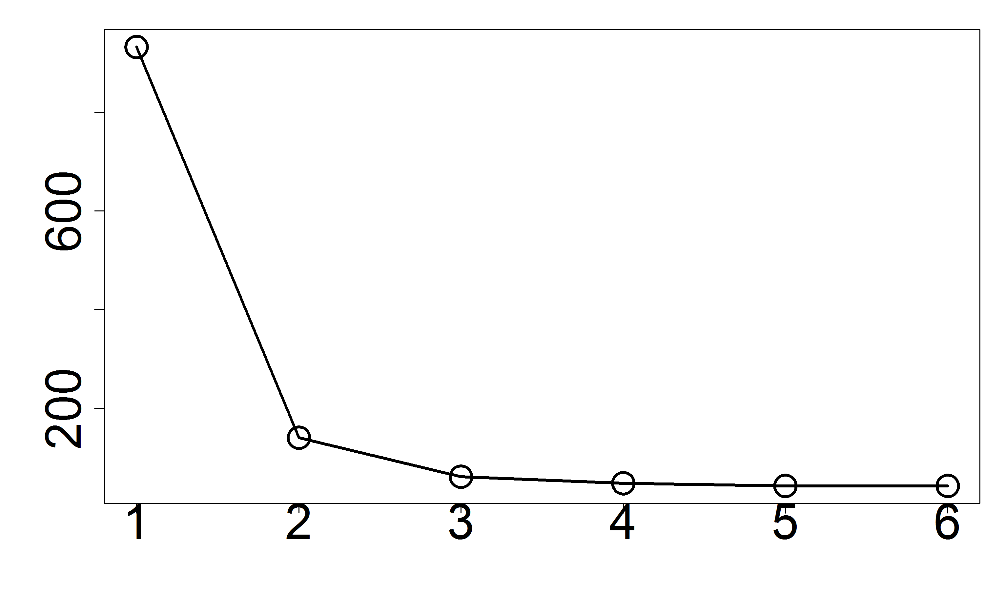
K-means: The Iris dataset
Loss function vs iteration #
K=3

Slide 15
K-means: Properties
The algorithm is guaranteed to converge: each iteration reduces (or does not change) the loss function J
Solution is locally optimal, but global optimum not guaranteed
(Very difficult to find the exact solution)
Good practice:
  Run multiple times with different starting
  points and take the best solution
Global optimum
Loss function
Local optimum
Clustering assignments

Slide 16
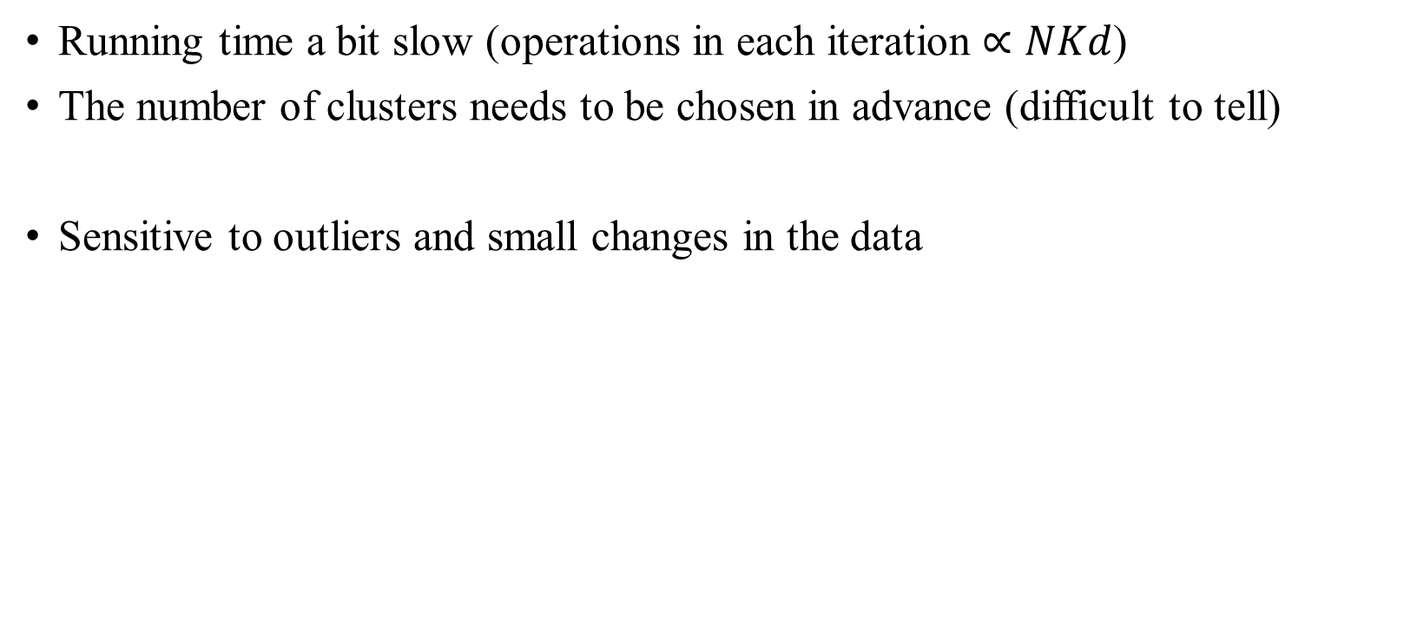
K-means: Issues
Running time a bit slow (operations in each iteration $∝NKd$)
The number of clusters needs to be chosen in advance (difficult to tell)
Sensitive to outliers and small changes in the data
x
x
x
x
x
x
x
x
x
x
x
x
x

Slide 17
K-means: Issues
It is common to standardize the data such that every feature has zero mean and unit SD
This way we do not give excess importance to features that are simply numerically large
20000
x
x
2
x
x
10000
x
x
x
x
1
x
x
x
x
1
2
1
2

Slide 18
K-means: Variants
K-means forces each point to be assigned to exactly one cluster
It will be useful to give the probability of each point to be assigned to each of the possible clusters
The Expectation-Maximization algorithm is able to compute such probabilities (very important method but complicated for this class)

Slide 19
Unsupervised learning
Clustering: introduction and k-means
Hierarchical clustering
Dimension reduction

Slide 20
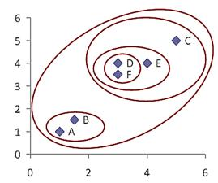
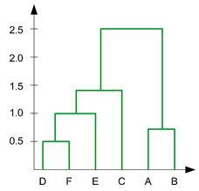
Hierarchical clustering
Sometimes, the number of clusters is unknown
A hierarchy is often useful, where we can look either at a coarse partitioning (few clusters) or at a high resolution (many clusters)
Dendrogram
Examples:
Sick vs healthy
Extremely sick vs sick vs healthy

Slide 21
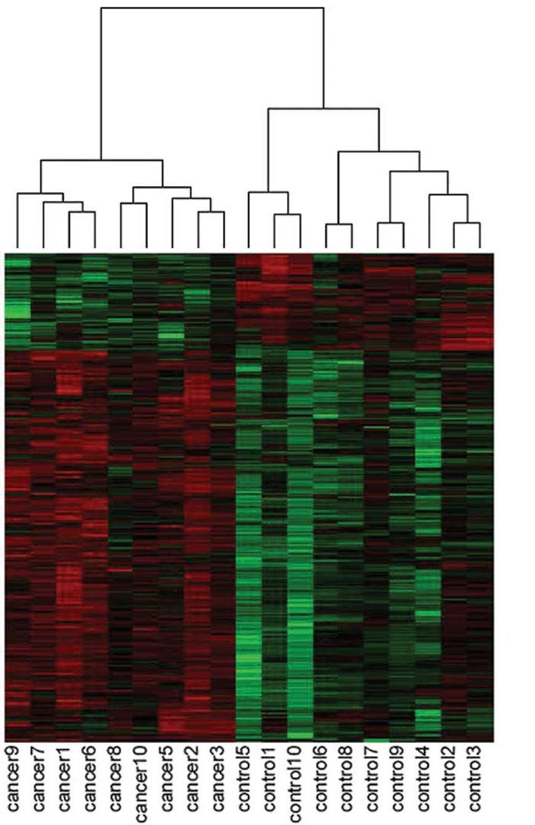
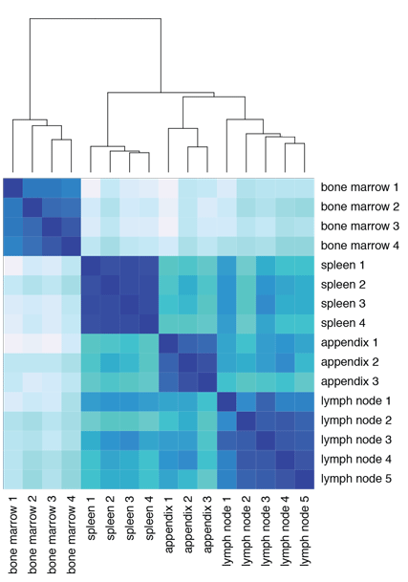
Hierarchical clustering: Molecular biology
Similarity of gene expression over multiple tissues or cancers:
Two methods of presentation
Each row is one gene

Slide 22
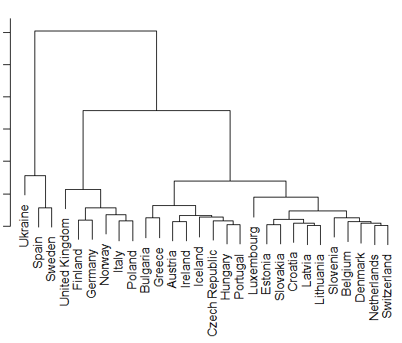
Hierarchical clustering: Countries
Each country has demographic and economic information:
GDP, inflation, unemployment, life expectancy, population growth, …
How to read the dendrogram?
The distance between any two
countries is represented by the height
of the node where they meet
The height of the label plays no role
CIA World Factbook

Slide 23
UPGMA: Unweighted Pair Group Method with Arithmetic Mean
Preliminary step: Compute the distance between all pairs
Initialize: each data point is its own cluster
At each step, combine the nearest two clusters into a higher-level cluster

Slide 24
UPGMA: Nearest clusters
How do we know which two clusters are the nearest?
We need a measure of distance between clusters
Definition: The distance between two clusters is the average distance between all pairs of data points in those clusters
Other choices also possible

Slide 25
UPGMA: Full description
Preliminary step: Compute the distance between all pairs
Initialize: each data point is its own cluster
At each step, combine the nearest two clusters into a higher-level cluster
The node height is the distance between the clusters
Re-compute the distance between the new cluster and all other clusters
Node

Slide 26
UPGMA: Example
Original distance matrix
 | A | B | C | D
A |  | 1.5 | 2.5 | 4
B | 1.5 |  | 1 | 3
C | 2.5 | 1 |  | 3
D | 4 | 3 | 3
C
A
B
D
Original data
Height
Updated distance matrix
 | A | BC | D
A |  | 2 | 4
BC | 2 |  | 3
D | 4 | 3
1
A
B
C
D

Slide 27
UPGMA: Example
Current distance matrix
 | A | BC | D
A |  | 2 | 4
BC | 2 |  | 3
D | 4 | 3
C
A
B
D
Original data
Height
When computing the distance from ABC to D, we cannot just average over the distance A-D and BC-D
We need to take into account that
BC has two points and D has one
ABC-D=(2∙BC-D + 1∙A-D) / 3=3.33
Updated distance matrix
2
 | ABC | D
ABC |  | 3.33
D | 3.33
1
A
B
C
D

Slide 28
UPGMA: Example
Current distance matrix
 | ABC | D
ABC |  | 3.33
D | 3.33
C
A
B
D
Original data
Height
3.33
Final tree
2
1
A
B
C
D

Slide 29
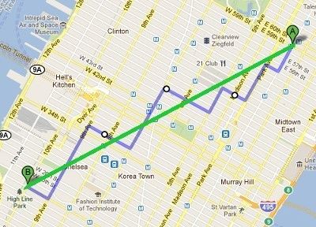
Hierarchical clustering: Remarks
We build the tree from the bottom-up (agglomerative)
The distance between points can be Euclidean, 1-correlation, Manhattan, …
  Correlation is more useful if patterns in the data are more important than absolute differences
  It is common here too to standardize each variable to zero mean and unit variance

Slide 30
Hierarchical clustering: Remarks
Beyond “Average”, other choices are available for the way distances are calculated between clusters
Most popular are Complete (max distance), Single (min distance)
It is common to consider multiple choices for the clustering parameters
And to compare the clustering on different subsets of the data

Slide 31
Unsupervised learning
Clustering: introduction and k-means
Hierarchical clustering
Dimension reduction

Slide 32
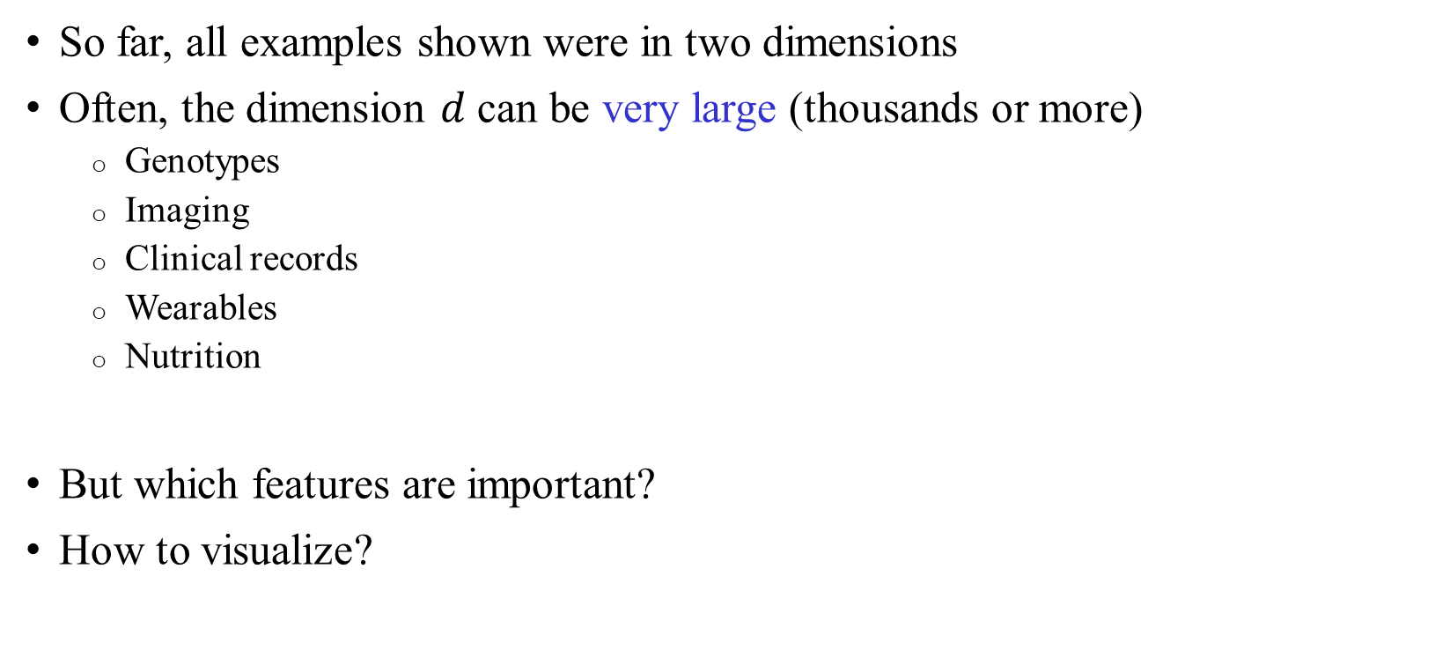
Dimension reduction
So far, all examples shown were in two dimensions
Often, the dimension $d$ can be very large (thousands or more)
  Genotypes
  Imaging
  Clinical records
  Wearables
  Nutrition
But which features are important?
How to visualize?

Slide 33
Dimension reduction
x
x
x
x
x
x
x
x
Does this dataset really need to be represented in two dimensions?
At the cost of a little loss of information, we can use just the horizontal (rotated) axis
x
x
x
x
x
x
x
x
x
x
x
x
x
x
Most of the variation is along this axis
x
x
x
x
x
x
x
x
x
x
x
x
x
x
x
x
x
x
x
x
x
x
x
x
x
x
x
x
x
x
x
x
x
x
x
x
x
x
x
x
x
x
x
x
x
x
x
x
x
x
x
x
x
x
x
x
x
x
x
x
x
x
x
x
x
x
Little variation along this axis

Slide 34
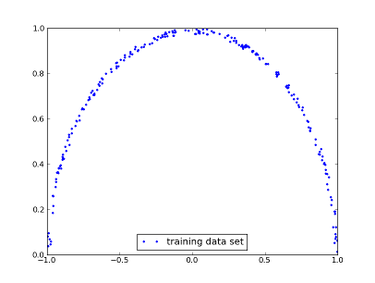
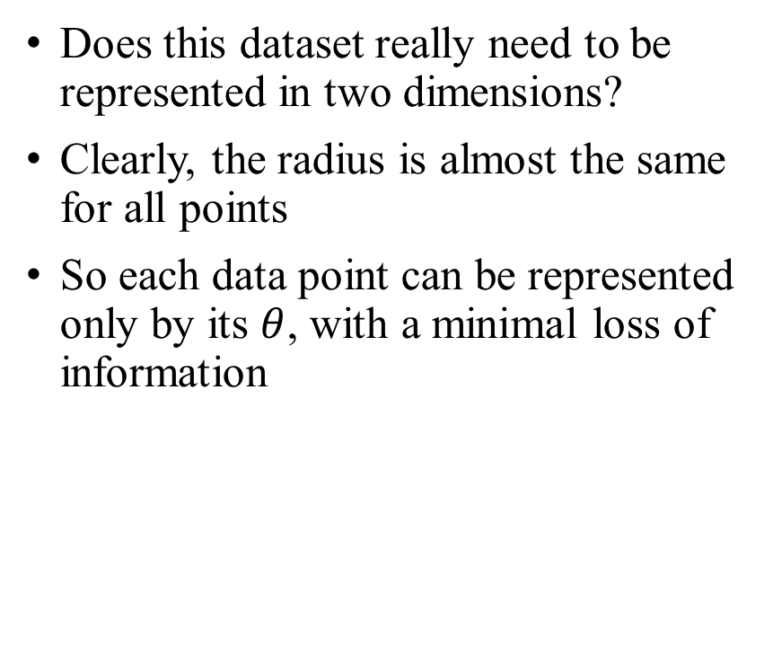
Dimension reduction
Does this dataset really need to be represented in two dimensions?
Clearly, the radius is almost the same for all points
So each data point can be represented only by its $θ$, with a minimal loss of information
θ

Slide 35
The variance in the data
We would like to identify the axes
along which the variance is the largest
These axes are most “interesting”
➔ They contribute more to difference between
data points
Axes with little variation look the same for all data points,
and are thus less interesting
➔ Could be removed without a significant loss
Most of the variation is along this axis
x
x
x
x
x
x
x
x
x
x
x
x
x
x
x
x
x
x
x
x
x
x
Little variation along this axis

Slide 36
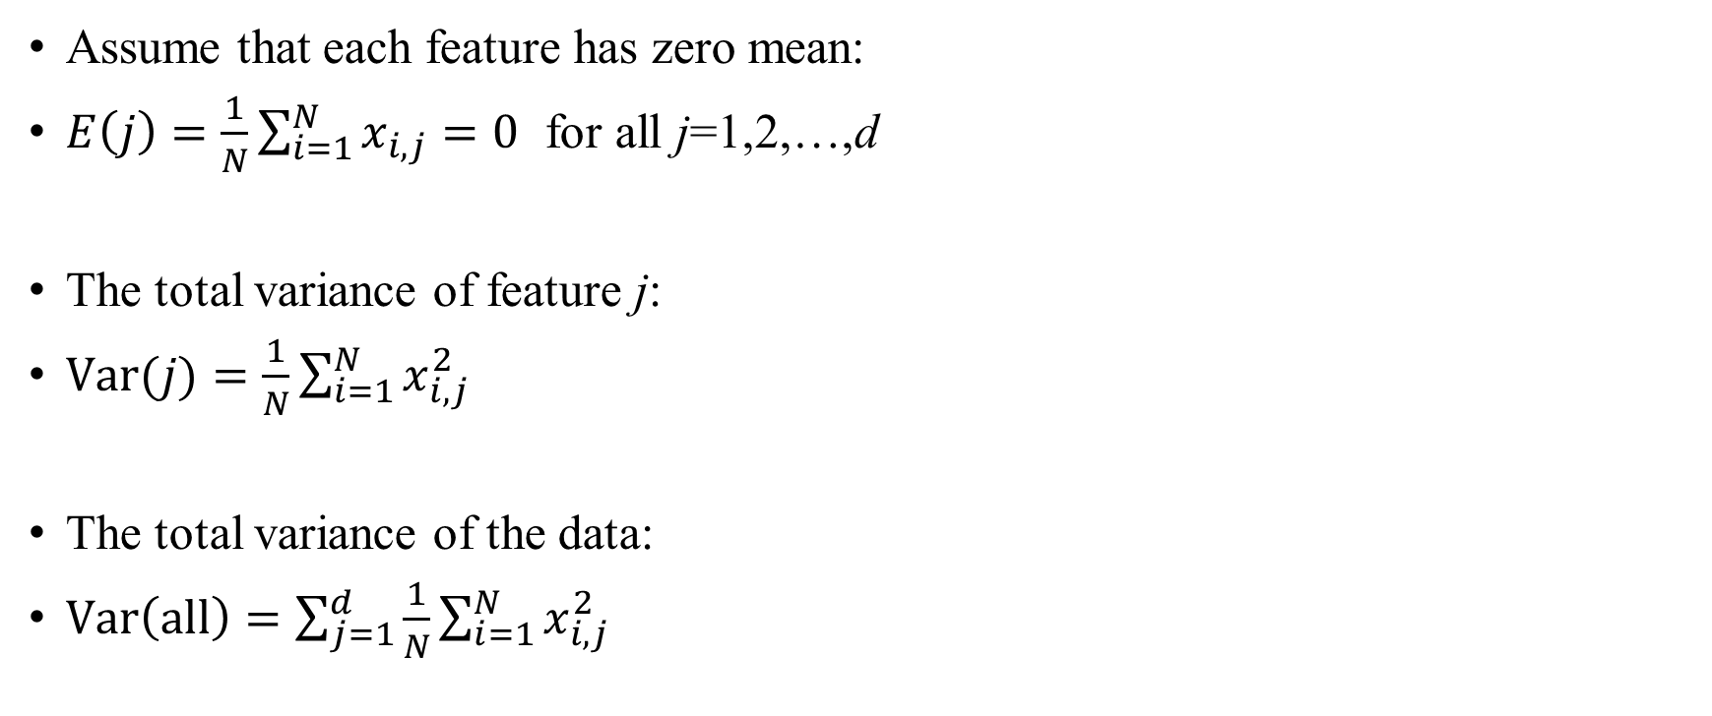
The variance
Assume that each feature has zero mean:
$E\left(j\right)=\frac{1}{N}\sum_{i=1}^{N}{x_{i,j}}=0$ for all j=1,2,…,d
The total variance of feature j:
$\text{Var}(j)=\frac{1}{N}\sum_{i=1}^{N}{x_{i,j}^{2}}$
The total variance of the data:
$\text{Var}\left(\text{all}\right)=\sum_{j=1}^{d}{\frac{1}{N}\sum_{i=1}^{N}{x_{i,j}^{2}}}$

Slide 37
How to reduce the dimension?
We would like to identify axes along which the data is most variable
We could then keep them and remove the other axes
The most important and popular method of dimension reduction is
Principal Component Analysis (PCA)

Slide 38
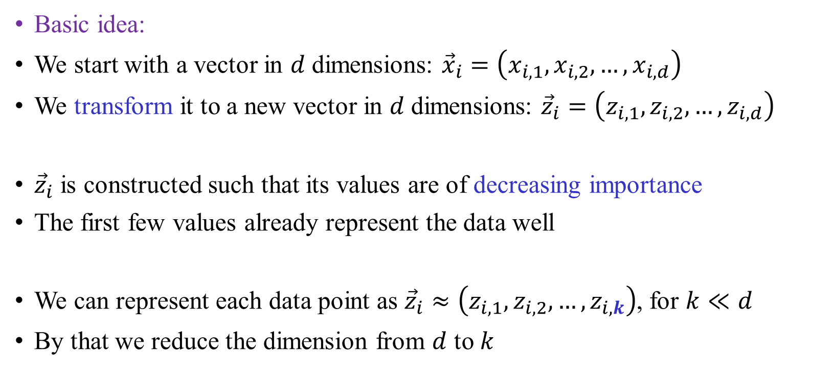
Principal Component Analysis (PCA)
Basic idea:
We start with a vector in $d$ dimensions: ${\vec{x}}_{i}=\left(x_{i,1},x_{i,2},…,x_{i,d}\right)$
We transform it to a new vector in $d$ dimensions: ${\vec{z}}_{i}=\left(z_{i,1},z_{i,2},…,z_{i,d}\right)$
${\vec{z}}_{i}$ is constructed such that its values are of decreasing importance
The first few values already represent the data well
We can represent each data point as ${\vec{z}}_{i}≈\left(z_{i,1},z_{i,2},…,z_{i,k}\right)$, for $k≪d$
By that we reduce the dimension from $d$ to $k$

Slide 39
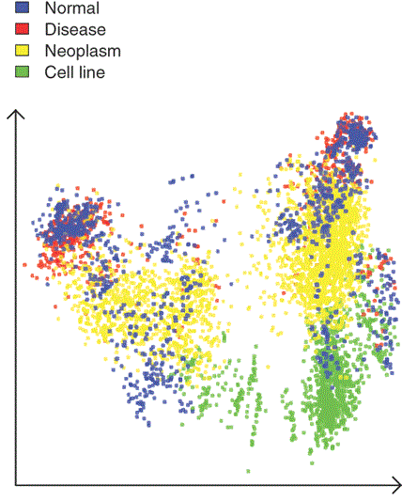
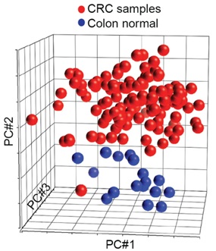
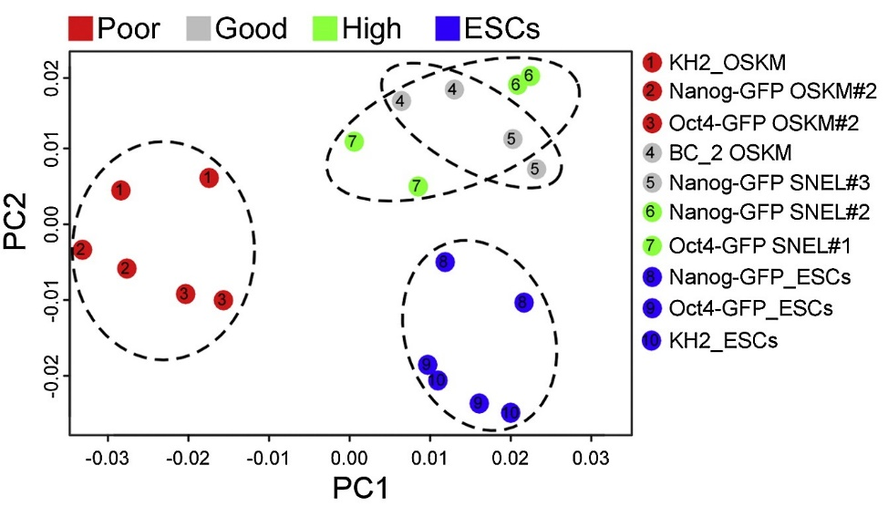
PCA: Molecular biology and medicine
Gene expression in cancers
Gene expression in induced pluripotent vs embryonic stem cells (Buganim lab)

Slide 40
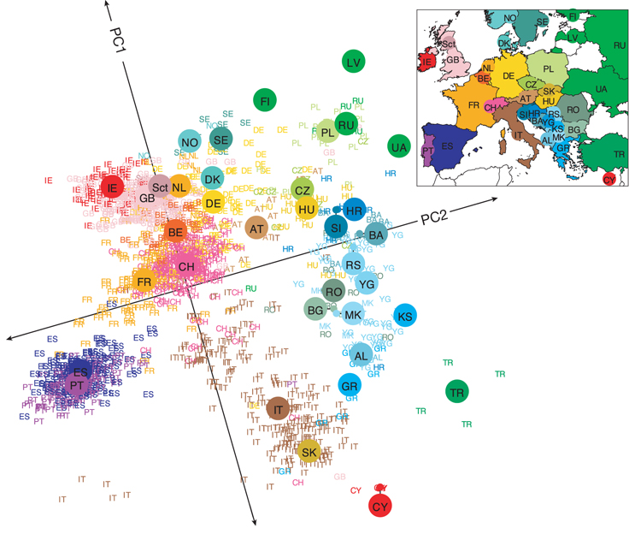
PCA: Human genetics
3,000 European individuals were genotyped at 0.5M markers
PCA shows that individuals cluster according to their geography
AL, Albania; AT, Austria; BA, Bosnia-Herzegovina; BE, Belgium; BG, Bulgaria; CH, Switzerland; CY, Cyprus; CZ, Czech Republic; DE, Germany; DK, Denmark; ES, Spain; FI, Finland; FR, France; GB, United Kingdom; GR, Greece; HR, Croatia; HU, Hungary; IE, Ireland; IT, Italy; KS, Kosovo; LV, Latvia; MK, Macedonia; NO, Norway; NL, Netherlands; PL, Poland; PT, Portugal; RO, Romania; RS, Serbia and Montenegro; RU, Russia, Sct, Scotland; SE, Sweden; SI, Slovenia; SK, Slovakia; TR, Turkey; UA, Ukraine; YG, Yugoslavia
Novembre et al., Nature, 2008, Genes mirror geography within Europe

Slide 41
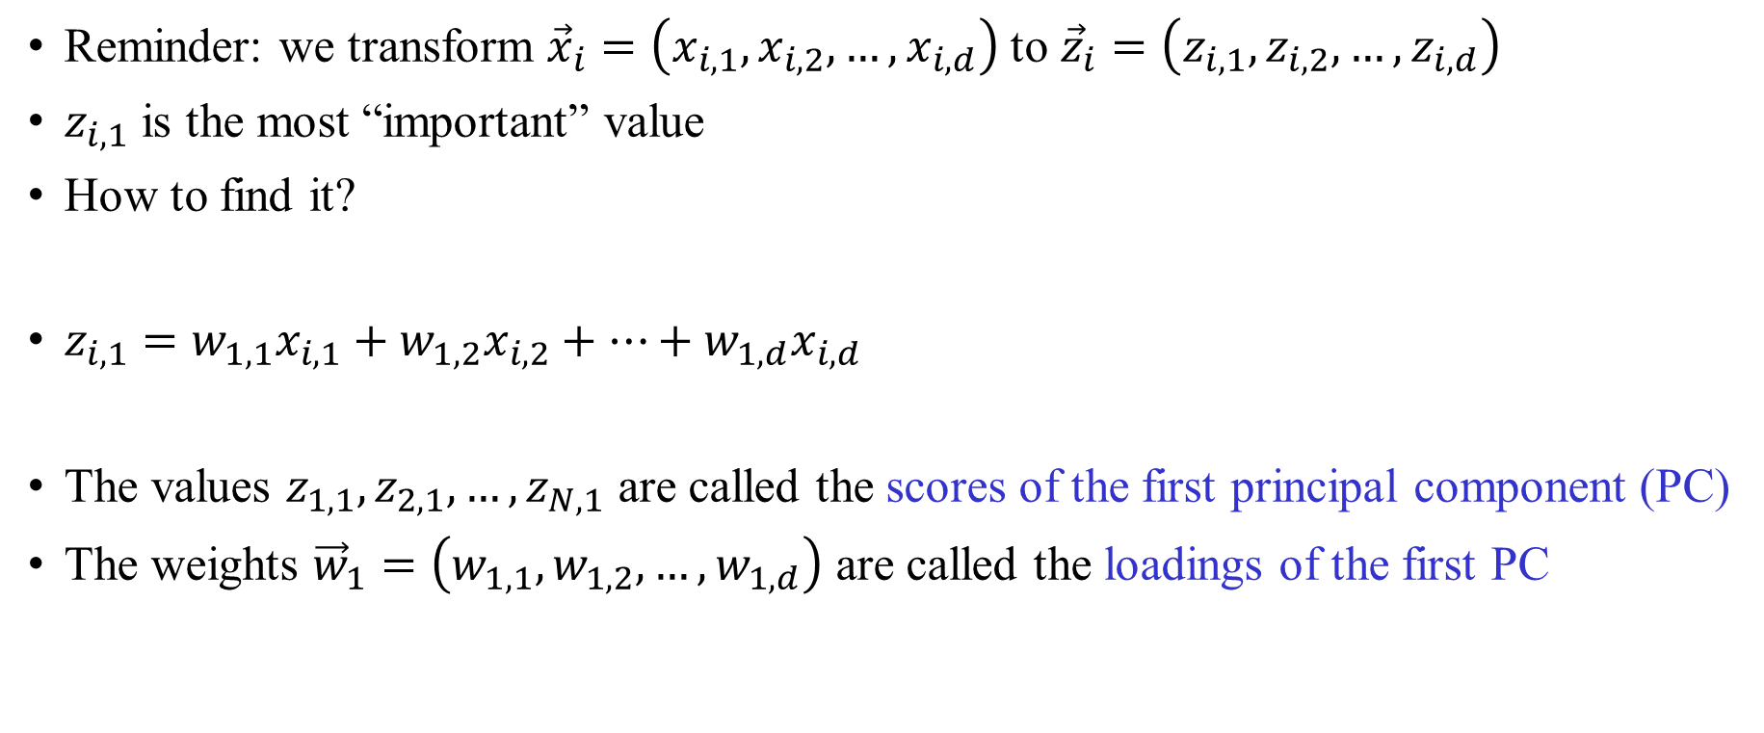
PCA: First step
Reminder: we transform ${\vec{x}}_{i}=\left(x_{i,1},x_{i,2},…,x_{i,d}\right)$ to ${\vec{z}}_{i}=\left(z_{i,1},z_{i,2},…,z_{i,d}\right)$
$z_{i,1}$ is the most “important” value
How to find it?
$z_{i,1}=w_{1,1}x_{i,1}+w_{1,2}x_{i,2}+…+w_{1,d}x_{i,d}$
The values $z_{1,1},z_{2,1},…,z_{N,1}$ are called the scores of the first principal component (PC)
The weights ${\vec{w}}_{1}=\left(w_{1,1},w_{1,2},…,w_{1,d}\right)$ are called the loadings of the first PC

Slide 42
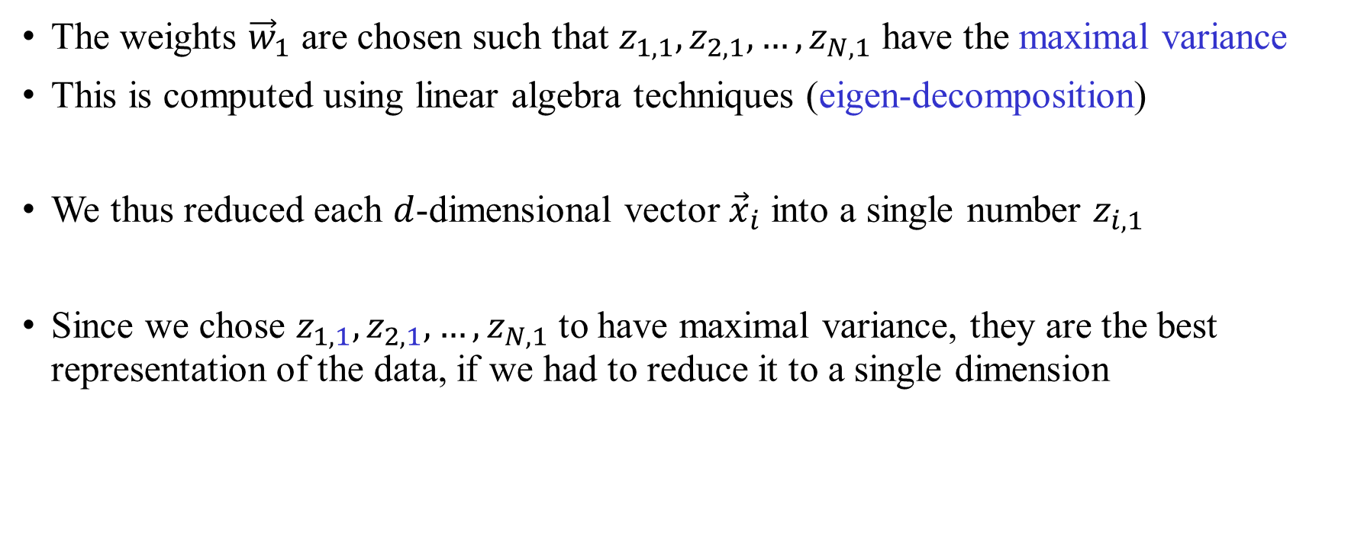
Computing the first PC
The weights ${\vec{w}}_{1}$ are chosen such that $z_{1,1},z_{2,1},…,z_{N,1}$ have the maximal variance
This is computed using linear algebra techniques (eigen-decomposition)
We thus reduced each $d$-dimensional vector ${\vec{x}}_{i}$ into a single number $z_{i,1}$
Since we chose $z_{1,1},z_{2,1},…,z_{N,1}$ to have maximal variance, they are the best representation of the data, if we had to reduce it to a single dimension

Slide 43
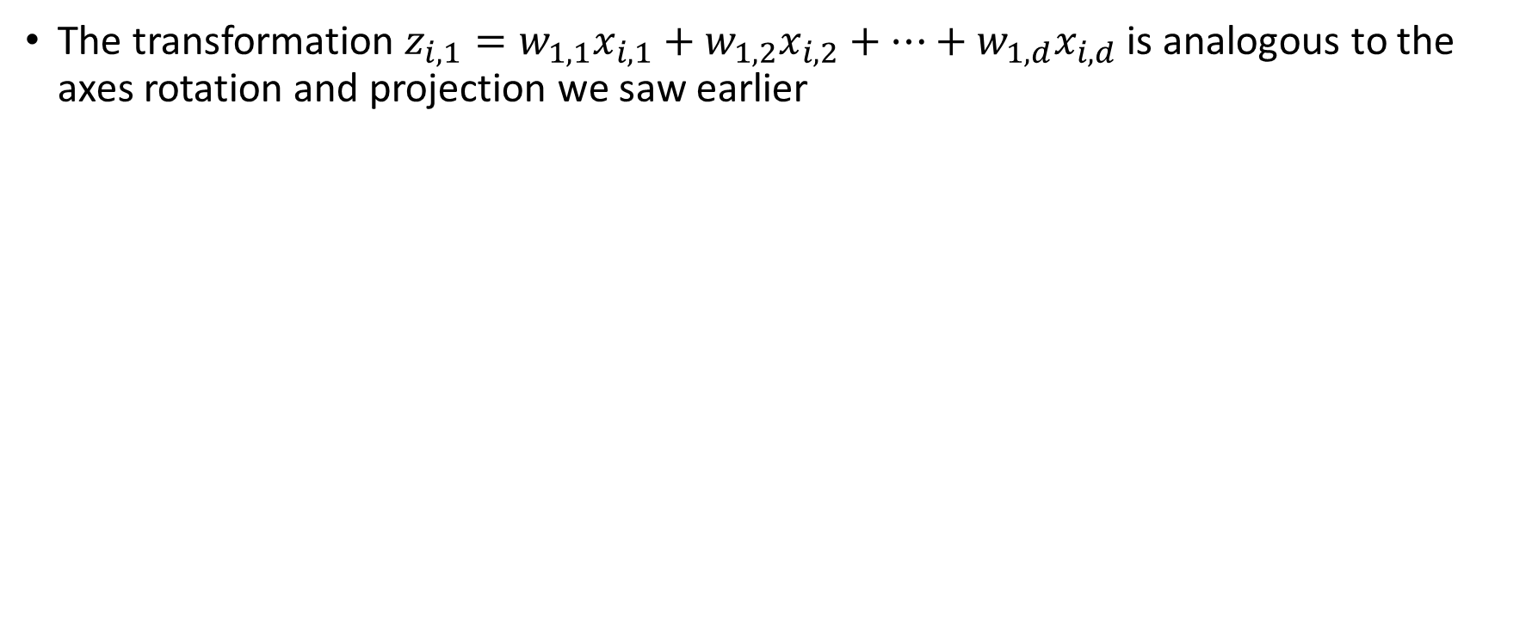
The first PC
The transformation $z_{i,1}=w_{1,1}x_{i,1}+w_{1,2}x_{i,2}+…+w_{1,d}x_{i,d}$ is analogous to the axes rotation and projection we saw earlier
x
The transformation
x
x
x
x
x
x
x
x
x
x
x
x
x
x
x
x
x
x
x
x
x
x
x
x
x
x
x
x
x
x
x
x
x
x
x
x
x
x
x
x
x
x
x
The coordinates along the new x-axis are the numbers $z_{i,1}$

Slide 44
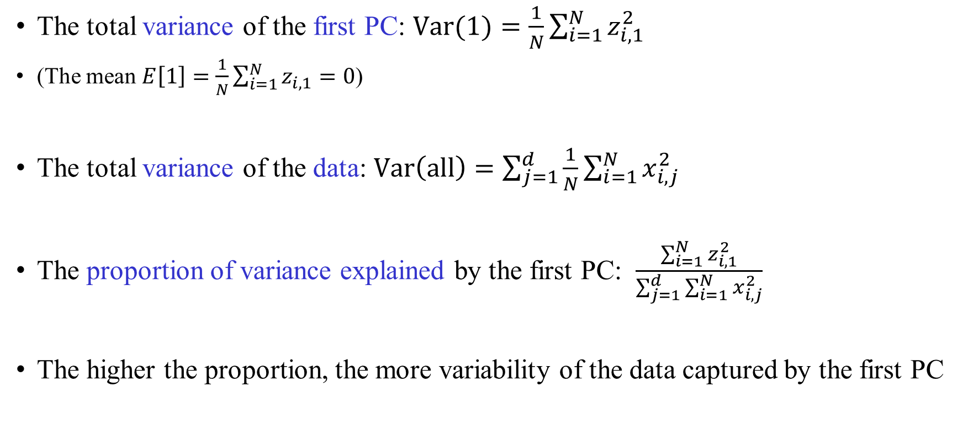
The variance explained by the first PC
The total variance of the first PC: $\text{Var}(1)=\frac{1}{N}\sum_{i=1}^{N}{z_{i,1}^{2}}$
(The mean $E\left[1\right]=\frac{1}{N}\sum_{i=1}^{N}{z_{i,1}}=0$)
The total variance of the data: $\text{Var}\left(\text{all}\right)=\sum_{j=1}^{d}{\frac{1}{N}\sum_{i=1}^{N}{x_{i,j}^{2}}}$
The proportion of variance explained by the first PC: $\frac{\sum_{i=1}^{N}{z_{i,1}^{2}}}{\sum_{j=1}^{d}{\sum_{i=1}^{N}{x_{i,j}^{2}}}}$
The higher the proportion, the more variability of the data captured by the first PC

Slide 45
The second principal component
We already found an axis (for PC1) that represents the maximal variance
What to do with the remaining variance?
We would like to find an axis along which
the remaining variance is maximal
x
x
x
x
x
x
x
x
x
x
x
x
x
x
x
x
x
x
x
x
x
x
Variability remains along the y-axis

Slide 46
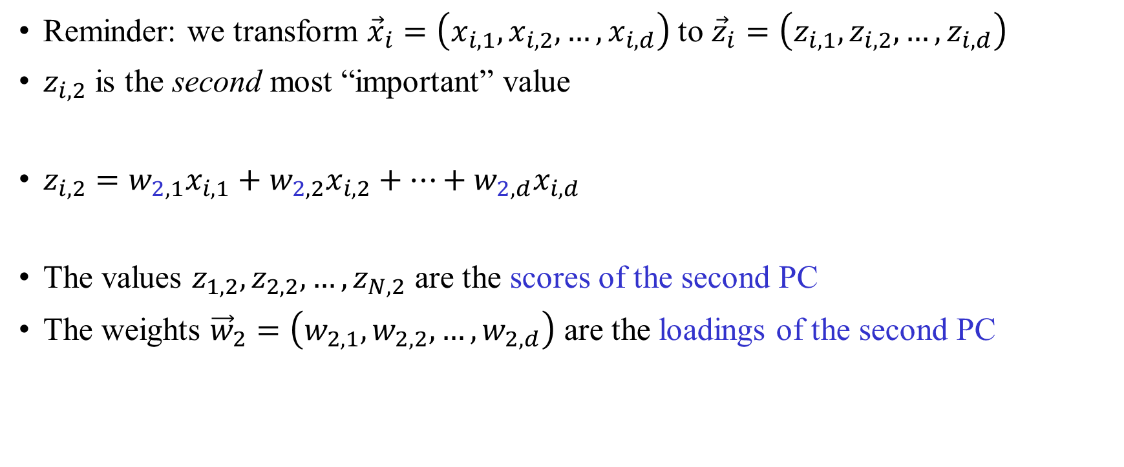
The second PC
Reminder: we transform ${\vec{x}}_{i}=\left(x_{i,1},x_{i,2},…,x_{i,d}\right)$ to ${\vec{z}}_{i}=\left(z_{i,1},z_{i,2},…,z_{i,d}\right)$
$z_{i,2}$ is the second most “important” value
$z_{i,2}=w_{2,1}x_{i,1}+w_{2,2}x_{i,2}+…+w_{2,d}x_{i,d}$
The values $z_{1,2},z_{2,2},…,z_{N,2}$ are the scores of the second PC
The weights ${\vec{w}}_{2}=\left(w_{2,1},w_{2,2},…,w_{2,d}\right)$ are the loadings of the second PC

Slide 47
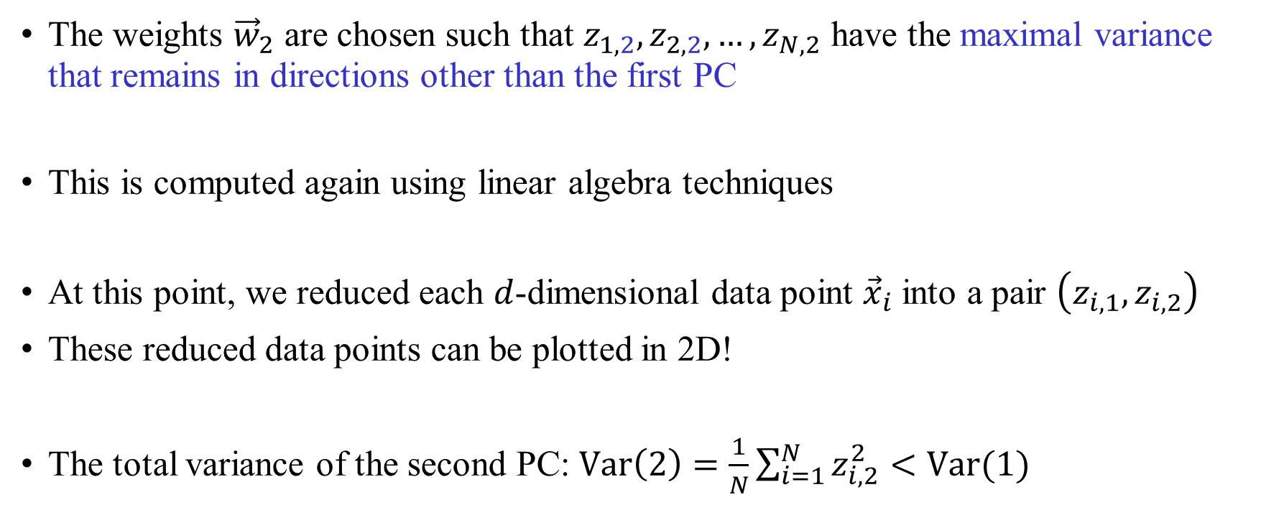
The second PC
The weights ${\vec{w}}_{2}$ are chosen such that $z_{1,2},z_{2,2},…,z_{N,2}$ have the maximal variance that remains in directions other than the first PC
This is computed again using linear algebra techniques
At this point, we reduced each $d$-dimensional data point ${\vec{x}}_{i}$ into a pair $\left(z_{i,1},z_{i,2}\right)$
These reduced data points can be plotted in 2D!
The total variance of the second PC: $\text{Var}\left(2\right)=\frac{1}{N}\sum_{i=1}^{N}{z_{i,2}^{2}}<\text{Var}(1)$
This was by definition the maximal variance

Slide 48
An interactive visualization
http://setosa.io/ev/principal-component-analysis/

Slide 49
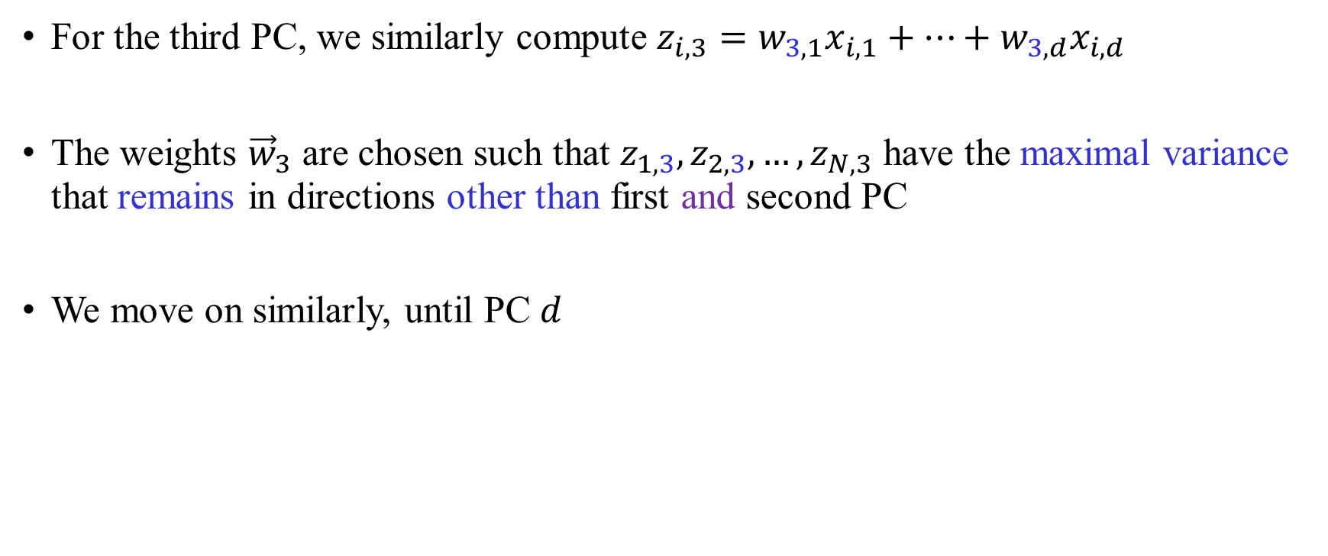
Higher PCs
For the third PC, we similarly compute $z_{i,3}=w_{3,1}x_{i,1}+…+w_{3,d}x_{i,d}$
The weights ${\vec{w}}_{3}$ are chosen such that $z_{1,3},z_{2,3},…,z_{N,3}$ have the maximal variance that remains in directions other than first and second PC
We move on similarly, until PC $d$

Slide 50
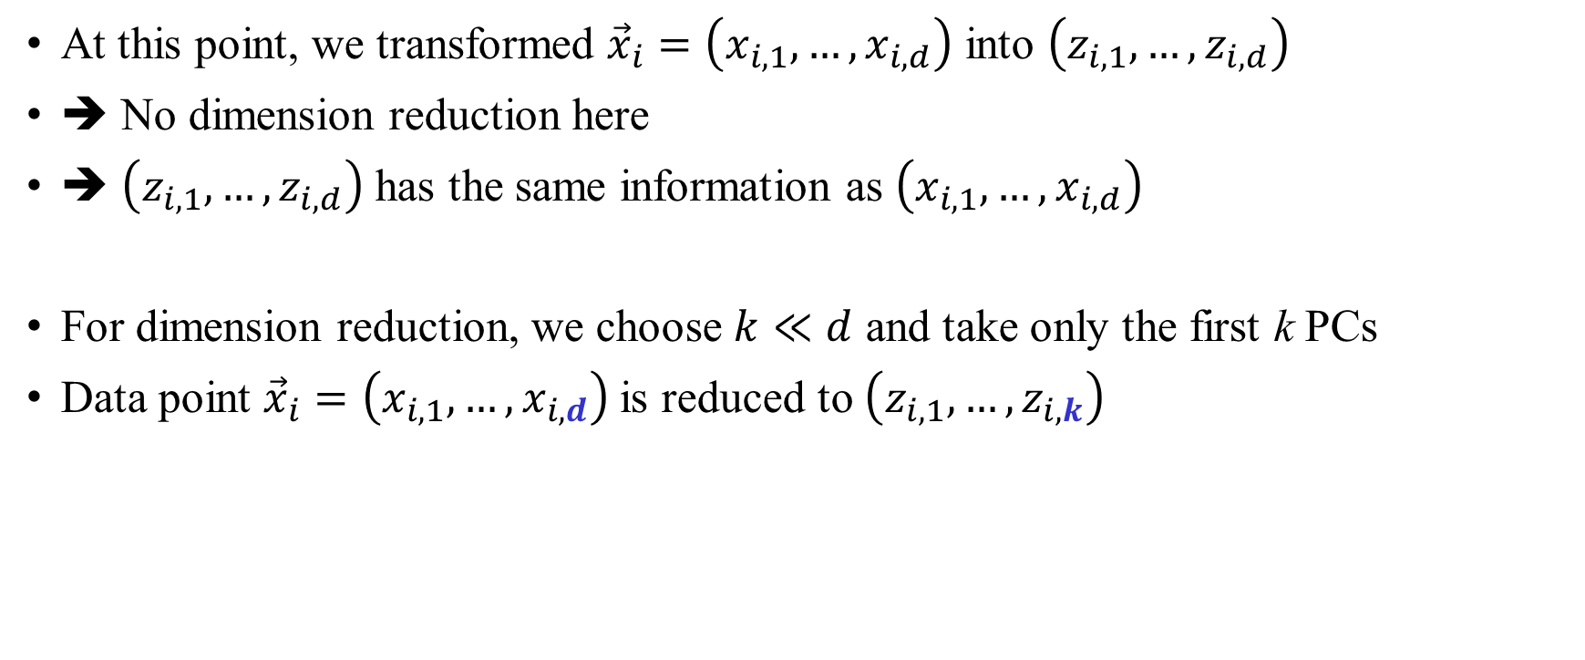
Higher PCs
At this point, we transformed ${\vec{x}}_{i}=\left(x_{i,1},…,x_{i,d}\right)$ into $\left(z_{i,1},…,z_{i,d}\right)$
➔ No dimension reduction here
➔ $\left(z_{i,1},…,z_{i,d}\right)$ has the same information as $\left(x_{i,1},…,x_{i,d}\right)$
For dimension reduction, we choose $k≪d$ and take only the first k PCs
Data point ${\vec{x}}_{i}=\left(x_{i,1},…,x_{i,d}\right)$ is reduced to $\left(z_{i,1},…,z_{i,k}\right)$

Slide 51
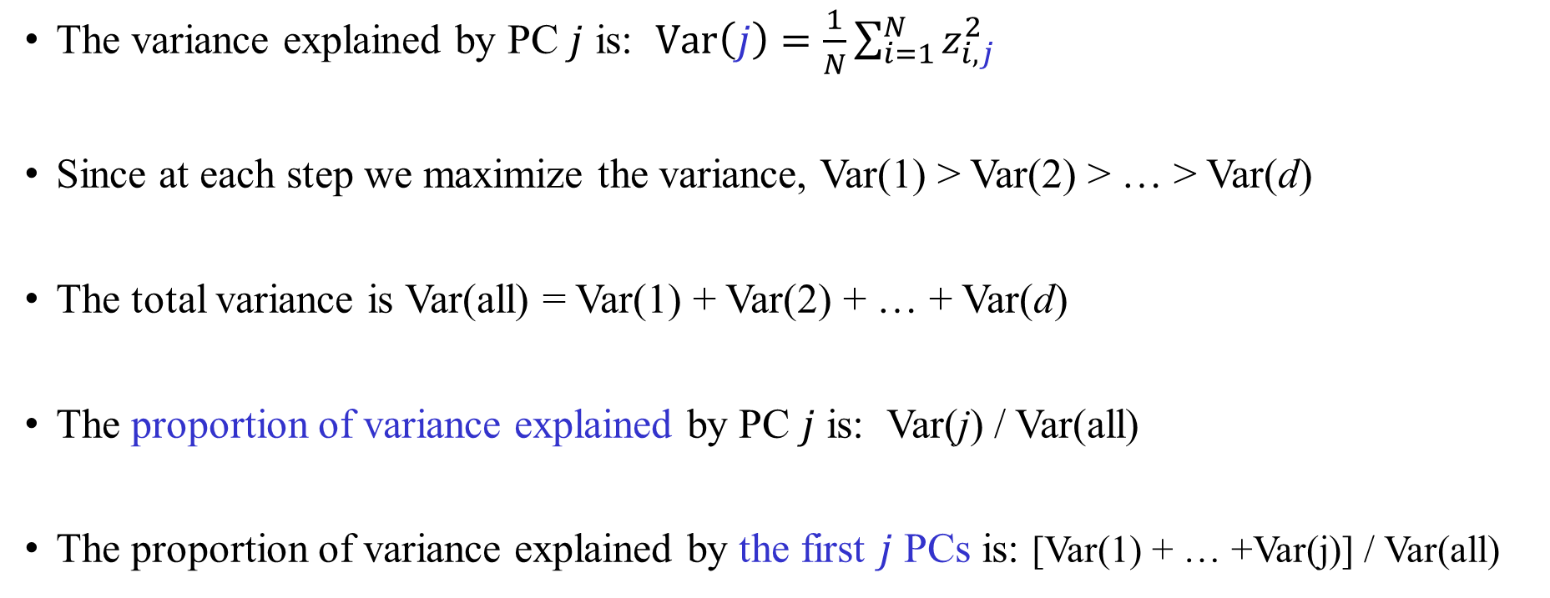
The variance explained
The variance explained by PC $j$ is: $\text{Var}\left(j\right)=\frac{1}{N}\sum_{i=1}^{N}{z_{i,j}^{2}}$
Since at each step we maximize the variance, Var(1) > Var(2) > … > Var(d)
The total variance is Var(all) = Var(1) + Var(2) + … + Var(d)
The proportion of variance explained by PC $j$ is: Var(j) / Var(all)
The proportion of variance explained by the first $j$ PCs is: [Var(1) + … +Var(j)] / Var(all)

Slide 52
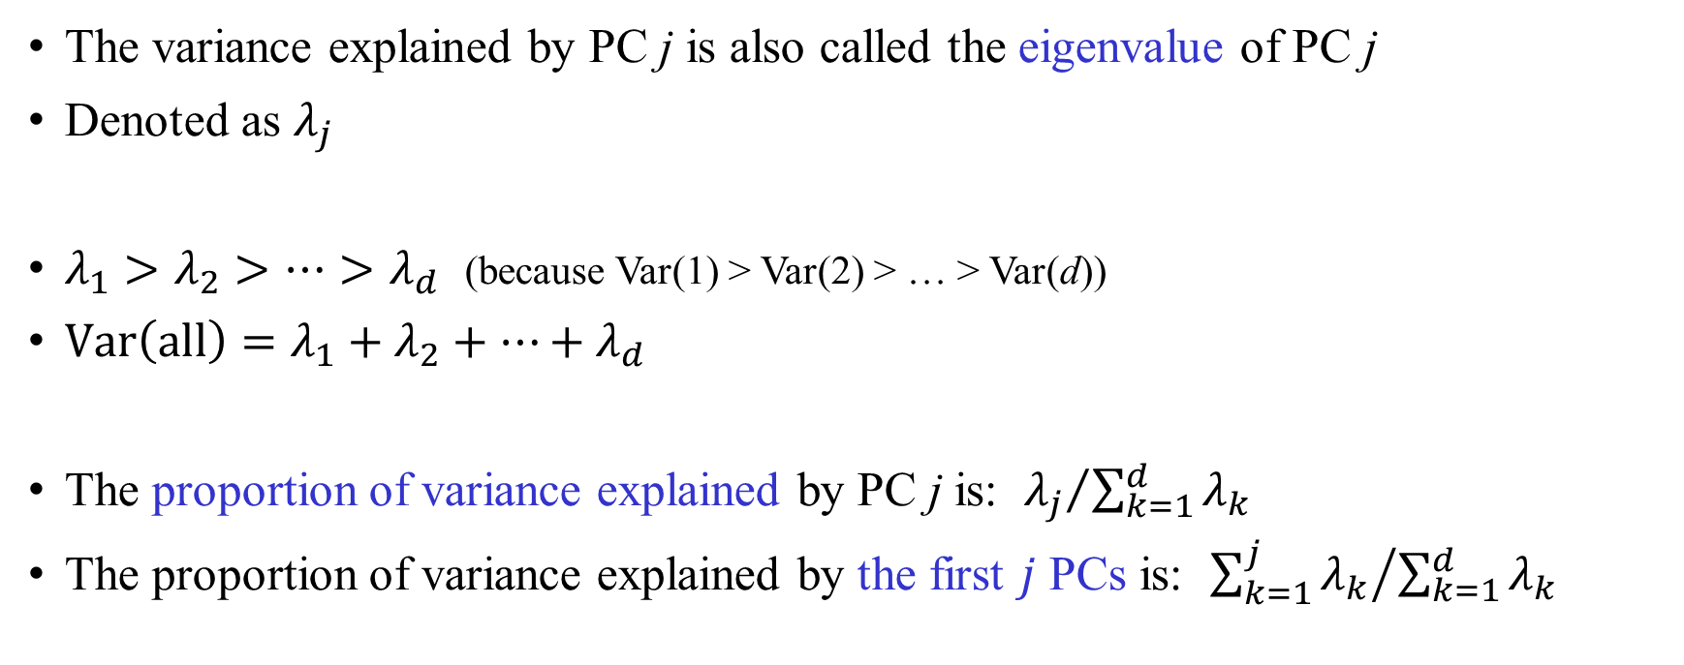
The variance explained: Remark
The variance explained by PC j is also called the eigenvalue of PC j
Denoted as $λ_{j}$
$λ_{1}>λ_{2}>…>λ_{d}$ (because Var(1) > Var(2) > … > Var(d))
$\text{Var}\left(\text{all}\right)=λ_{1}+λ_{2}+…+λ_{d}$
The proportion of variance explained by PC j is: ${λ_{j}}/{\sum_{k=1}^{d}{λ_{k}}}$
The proportion of variance explained by the first $j$ PCs is: ${\sum_{k=1}^{j}{λ_{k}}}/{\sum_{k=1}^{d}{λ_{k}}}$

Slide 53
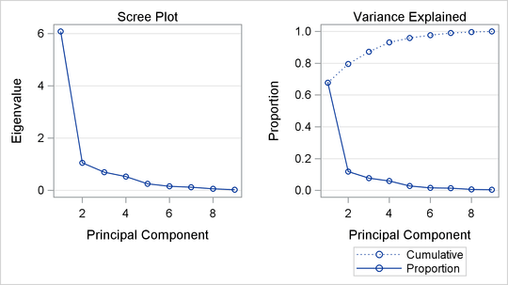
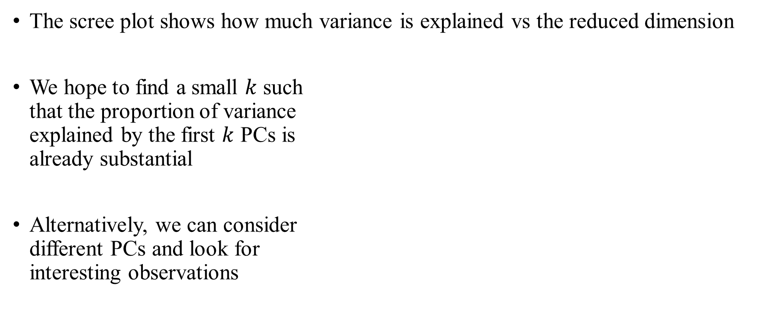
The scree plot
The scree plot shows how much variance is explained vs the reduced dimension
We hope to find a small $k$ such
that the proportion of variance
explained by the first $k$ PCs is
already substantial
Alternatively, we can consider
different PCs and look for
interesting observations

Slide 54
PCA: Remarks
Sensitive to the scale of the data points (i.e., different magnitudes of features)
Sensitive to imbalance between groups sizes, outliers
Usages:
Mostly for exploratory analysis
Sometimes in regression/classification/clustering, to avoid the “curse of dimensionality”
Can also be used as a means of data compression

Slide 55
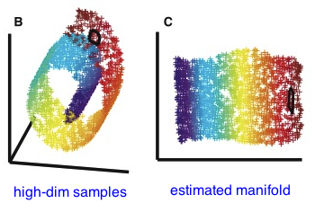
Other dimension reduction methods
Many PCA variants and extensions exist
Other linear methods:
  Factor analysis
  Non-negative matrix factorization
Many algorithms allow non-linear transformations
  Also called “manifold learning”
  Multidimensional scaling
  t-distributed stochastic neighbor embedding (t-SNE)
  Laplacian eigenmaps
  UMAP

