Slide 1
Personal Genomics
Selection and adaptation
Shai Carmi
School of Public Health

Slide 2
What does selection mean?
Fitness = survival + reproduction = #offspring
Selection happens when one allele has higher fitness than another
The beneficial allele will tend to rise in frequency
Generation 1
p_{red}=0.5, p_{blue}=0.5
Generation 2
p_{red}=0.6, p_{blue}=0.4
Generation 3
…
p_{red}=0.8, p_{blue}=0.2
Fixation
p_{red}=1, p_{blue}=0
Adapted from Melissa Gymrek

Slide 3
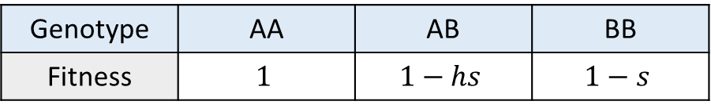

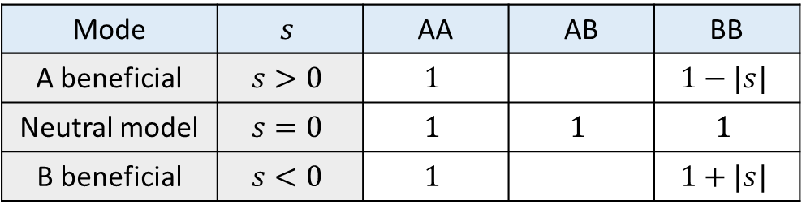
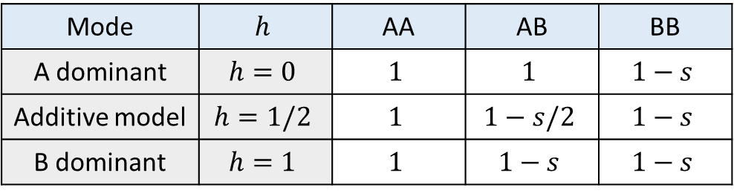
Definitions
$s$: selection coefficient
$h$: dominance coefficient
Genotype | AA | AB | BB
Fitness | $$1$$ | $$1−hs$$ | $$1−s$$
Mode | $$s$$ | AA | AB | BB
A beneficial | $$s>0$$ | $$1$$ |  | $$1−|s|$$
Neutral model | $$s=0$$ | $$1$$ | $$1$$ | $$1$$
B beneficial | $$s<0$$ | $$1$$ |  | $$1+|s|$$
Or A “deleterious”
Mode | $$h$$ | AA | AB | BB
A dominant | $$h=0$$ | $$1$$ | $$1$$ | $$1−s$$
Additive model | $$h=1/2$$ | $$1$$ | $$1−s/2$$ | $$1−s$$
B dominant | $$h=1$$ | $$1$$ | $$1−s$$ | $$1−s$$

Slide 4
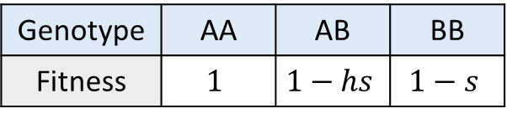
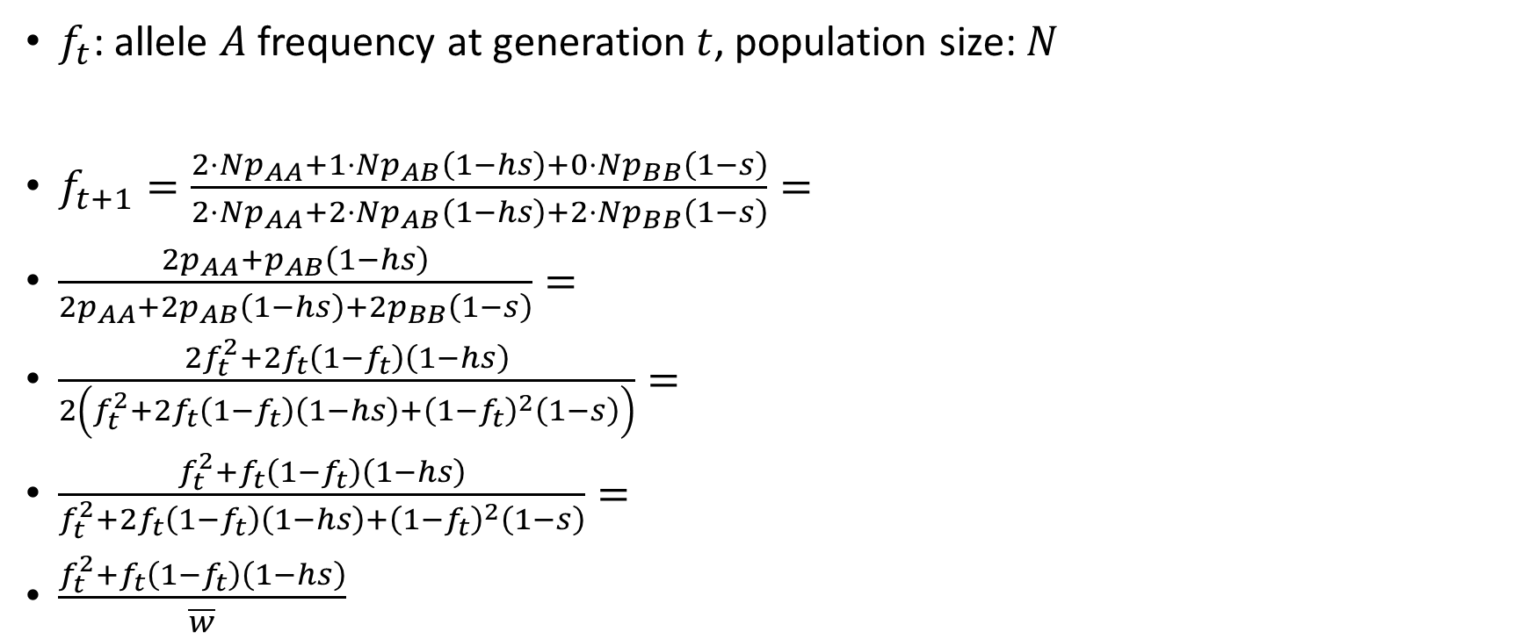
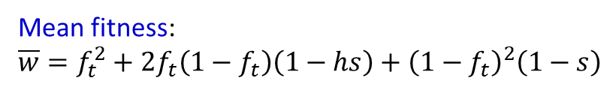
What does selection do?
$f_{t}$: allele $A$ frequency at generation $t$, population size: $N$
$f_{t+1}=\frac{2⋅Np_{AA}+1⋅Np_{AB}\left(1−hs\right)+0⋅Np_{BB}\left(1−s\right)}{2⋅Np_{AA}+2⋅Np_{AB}\left(1−hs\right)+2⋅Np_{BB}\left(1−s\right)}=$
$\frac{2p_{AA}+p_{AB}\left(1−hs\right)}{2p_{AA}+2p_{AB}\left(1−hs\right)+2p_{BB}\left(1−s\right)}=$
$\frac{2f_{t}^{2}+2f_{t}\left(1−f_{t}\right)\left(1−hs\right)}{2\left(f_{t}^{2}+2f_{t}\left(1−f_{t}\right)\left(1−hs\right)+{\left(1−f_{t}\right)}^{2}\left(1−s\right)\right)}=$
$\frac{f_{t}^{2}+f_{t}\left(1−f_{t}\right)\left(1−hs\right)}{f_{t}^{2}+2f_{t}\left(1−f_{t}\right)\left(1−hs\right)+{\left(1−f_{t}\right)}^{2}\left(1−s\right)}=$
$\frac{f_{t}^{2}+f_{t}\left(1−f_{t}\right)\left(1−hs\right)}{\overline{w}}$
Number of A allele copies
----------------------------------
Total number of alleles
Hardy-Weinberg equilibrium
Mean fitness:
$$\overline{w}=f_{t}^{2}+2f_{t}\left(1−f_{t}\right)\left(1−hs\right)+{\left(1−f_{t}\right)}^{2}\left(1−s\right)$$
Genotype | AA | AB | BB
Fitness | $$1$$ | $$1−hs$$ | $$1−s$$

Slide 5
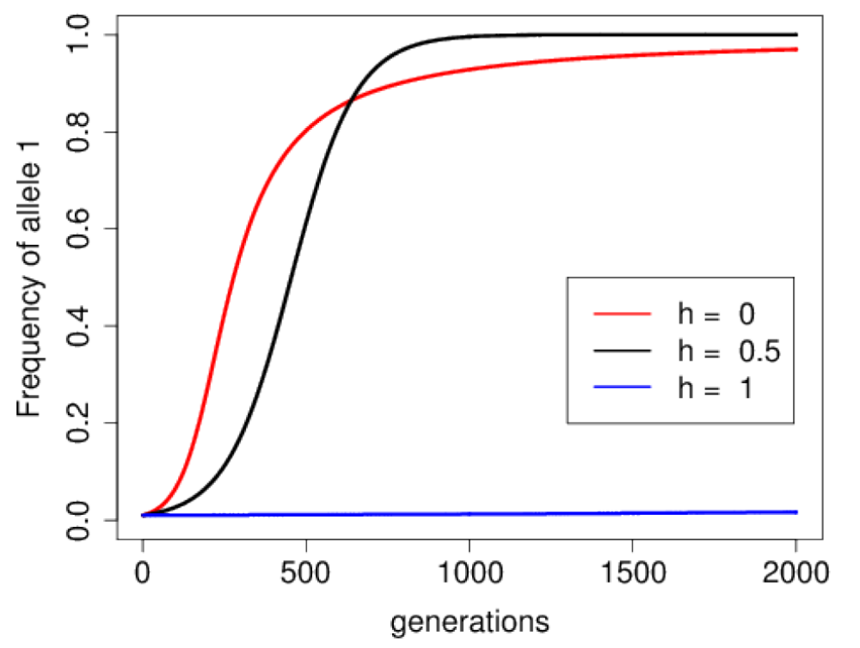
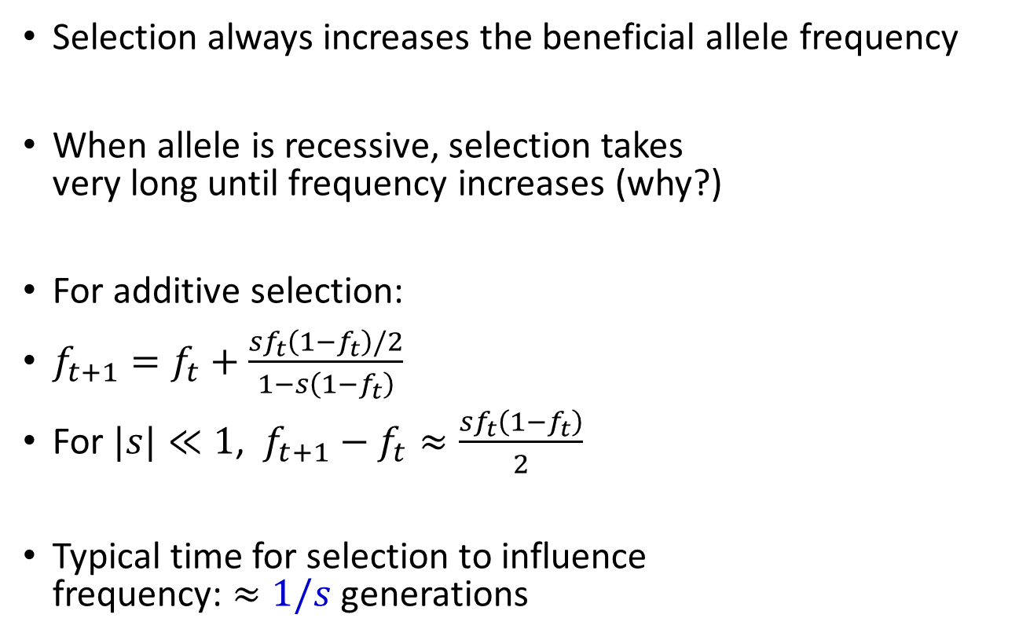

What does selection do?
Selection always increases the beneficial allele frequency
When allele is recessive, selection takes
very long until frequency increases (why?)
For additive selection:
$f_{t+1}=f_{t}+\frac{sf_{t}\left(1−f_{t}\right)/2}{1−s\left(1−f_{t}\right)}$
For $|s|≪1$, $f_{t+1}−f_{t}≈\frac{sf_{t}\left(1−f_{t}\right)}{2}$
Typical time for selection to influence
frequency: $≈1/s$ generations
Initial frequency: 0.01, $s=0.01$
Dominant
Additive
Recessive
Graham Coop

Slide 6
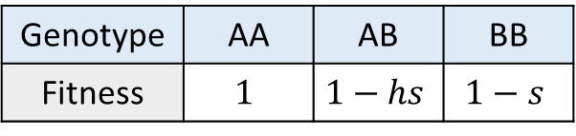
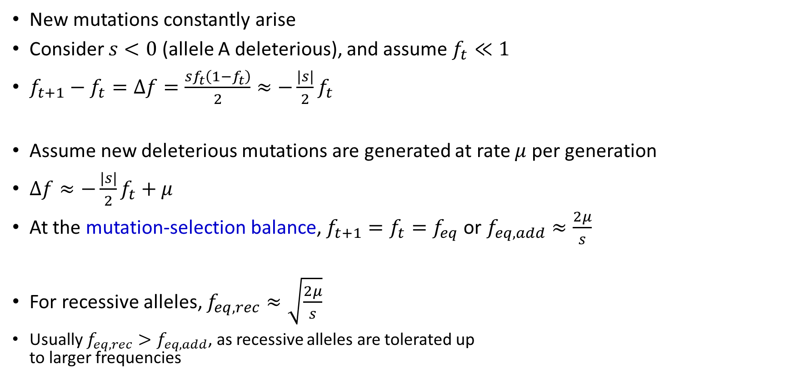
Why is there genetic variation left?
New mutations constantly arise
Consider $s<0$ (allele A deleterious), and assume $f_{t}≪1$
$f_{t+1}−f_{t}=Δf=\frac{sf_{t}\left(1−f_{t}\right)}{2}≈−\frac{\left|s\right|}{2}f_{t}$
Assume new deleterious mutations are generated at rate $μ$ per generation
$Δf≈−\frac{\left|s\right|}{2}f_{t}+μ$
At the mutation-selection balance, $f_{t+1}=f_{t}=f_{eq}$ or $f_{eq,add}≈\frac{2μ}{s}$
For recessive alleles, $f_{eq,rec}≈\sqrt{\frac{2μ}{s}}$
Usually $f_{eq,rec}>f_{eq,add}$, as recessive alleles are tolerated up
to larger frequencies
Genotype | AA | AB | BB
Fitness | $$1$$ | $$1−hs$$ | $$1−s$$

Slide 7
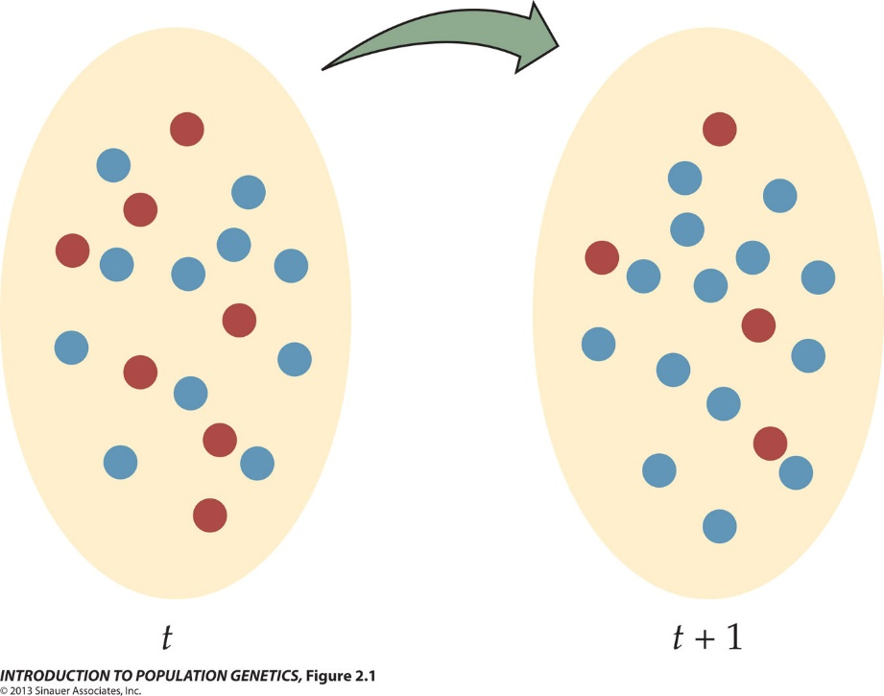
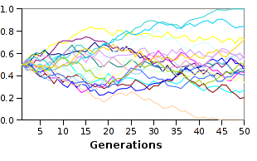
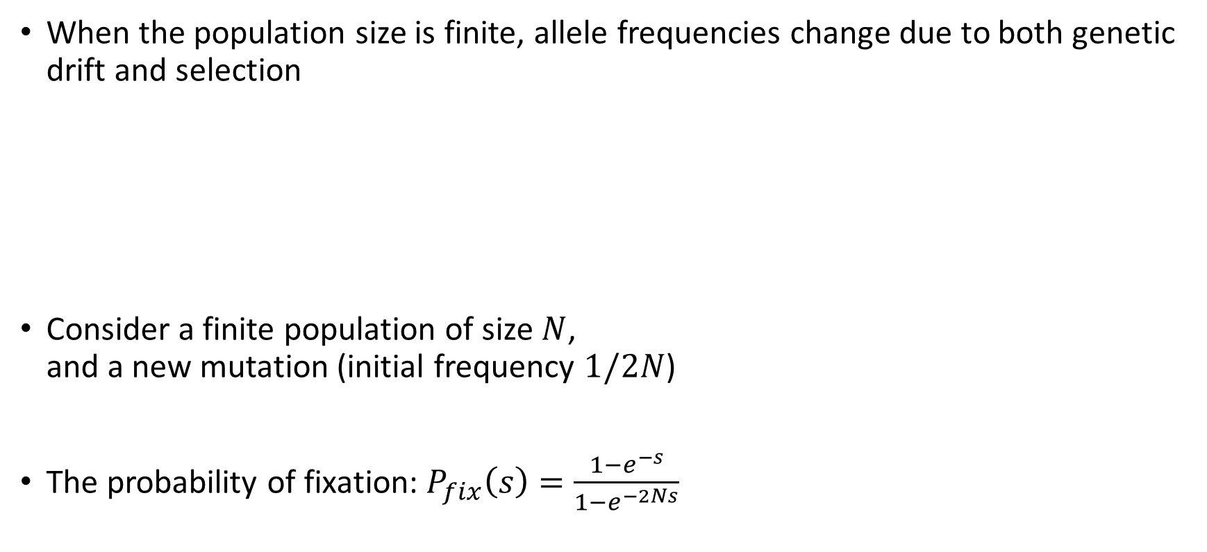
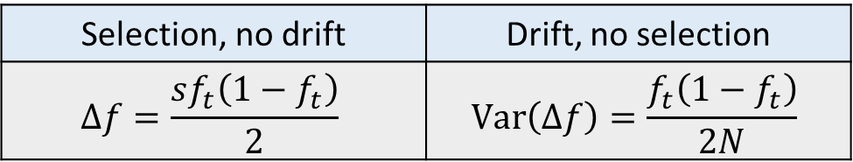
Genetic drift
When the population size is finite, allele frequencies change due to both genetic drift and selection
Consider a finite population of size $N$,
and a new mutation (initial frequency $1/2N$)
The probability of fixation: $P_{fix}\left(s\right)=\frac{1−e^{−s}}{1−e^{−2Ns}}$
Selection, no drift | Drift, no selection
$$Δf=\frac{sf_{t}\left(1−f_{t}\right)}{2}$$ | $$\text{Var}\left(Δf\right)=\frac{f_{t}\left(1−f_{t}\right)}{2N}$$
Allele frequency
Wikipedia

Slide 8
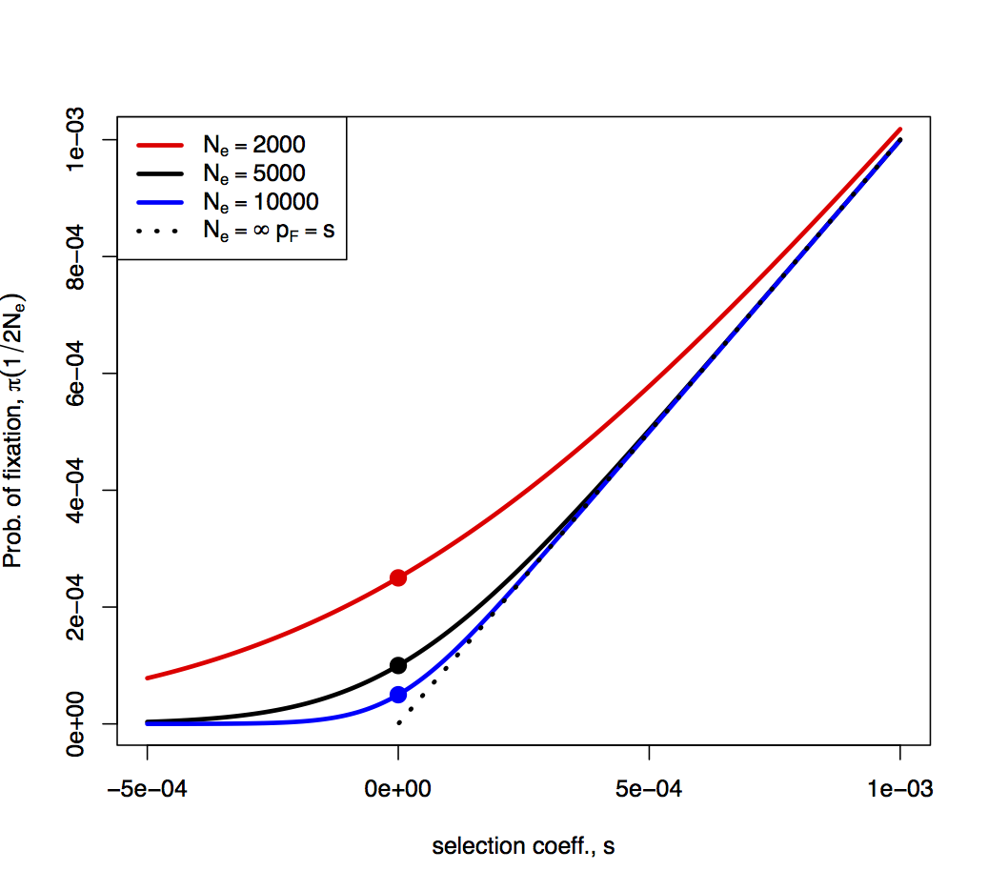
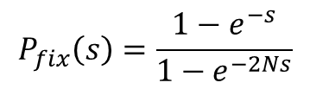
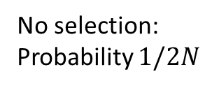
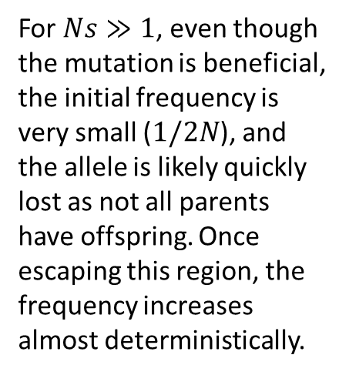
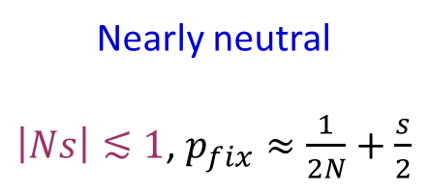
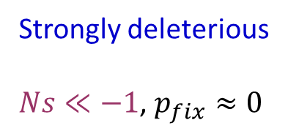
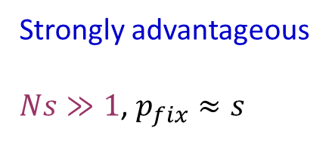
Probability of fixation
Graham Coop
Additive model
Probability of fixation is higher in smaller populations, as drift makes it easier to fix by chance
For $Ns≫1$, even though the mutation is beneficial, the initial frequency is very small ($1/2N$), and the allele is likely quickly lost as not all parents have offspring. Once escaping this region, the frequency increases almost deterministically.
No selection:
Probability $1/2N$
Slightly deleterious alleles can fix too, due to drift (small probability)
$$P_{fix}\left(s\right)=\frac{1−e^{−s}}{1−e^{−2Ns}}$$
Strongly deleterious
$Ns≪−1$, $p_{fix}≈0$
Nearly neutral
$\left|Ns\right|≲1$, $p_{fix}≈\frac{1}{2N}+\frac{s}{2}$
Strongly advantageous
$Ns≫1$, $p_{fix}≈s$

Slide 9
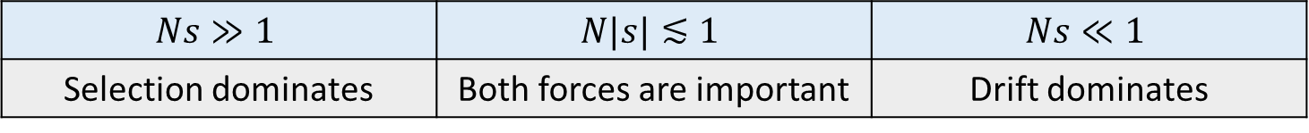
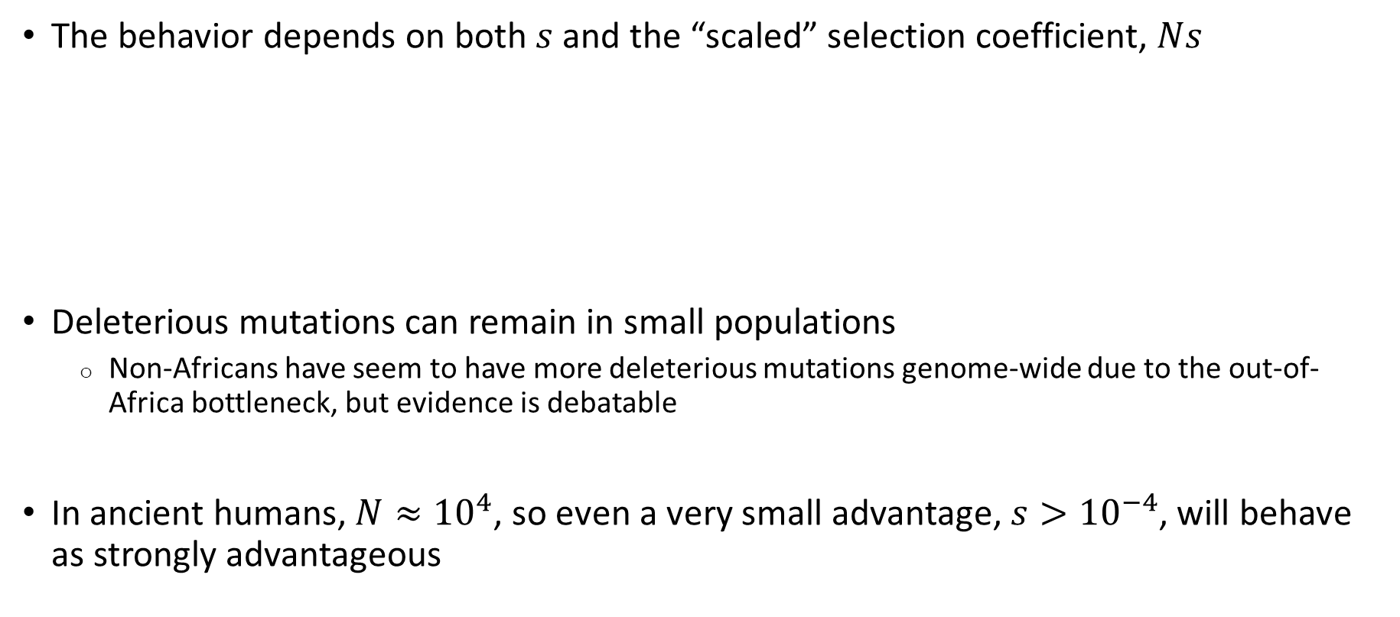
Selection vs drift
The behavior depends on both $s$ and the “scaled” selection coefficient, $Ns$
Deleterious mutations can remain in small populations
  Non-Africans have seem to have more deleterious mutations genome-wide due to the out-of-Africa bottleneck, but evidence is debatable
In ancient humans, $N≈{10}^{4}$, so even a very small advantage, $s>{10}^{−4}$, will behave as strongly advantageous
$$Ns≫1$$ | $$N|s|≲1$$ | $$Ns≪1$$
Selection dominates | Both forces are important | Drift dominates

Slide 10
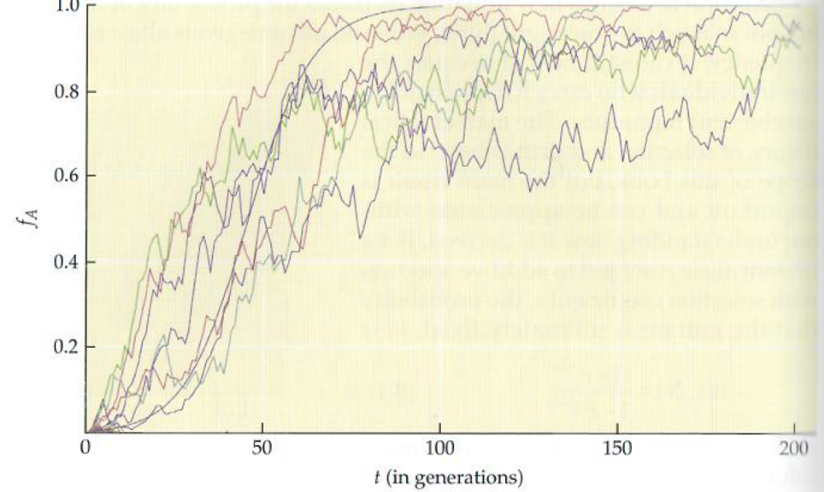
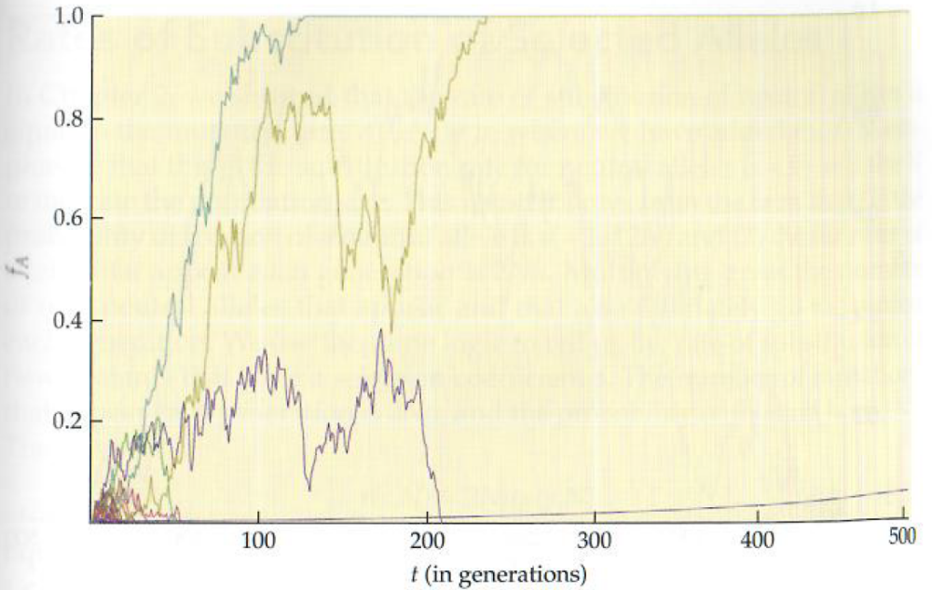
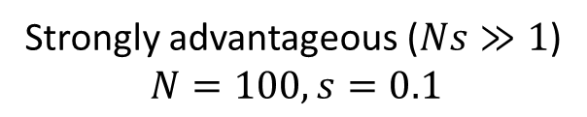
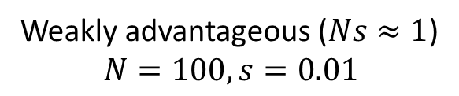
Trajectories
Nielsen and Slatkin, An Introduction to Population Genetics, 50 trajectories
Surviving alleles fix/lost at different times
No drift
Surviving alleles increase almost deterministically
Most alleles are lost
Most alleles are lost
Strongly advantageous ($Ns≫1$)
$$N=100, s=0.1$$
Weakly advantageous ($Ns≈1$)
$$N=100, s=0.01$$

Slide 11
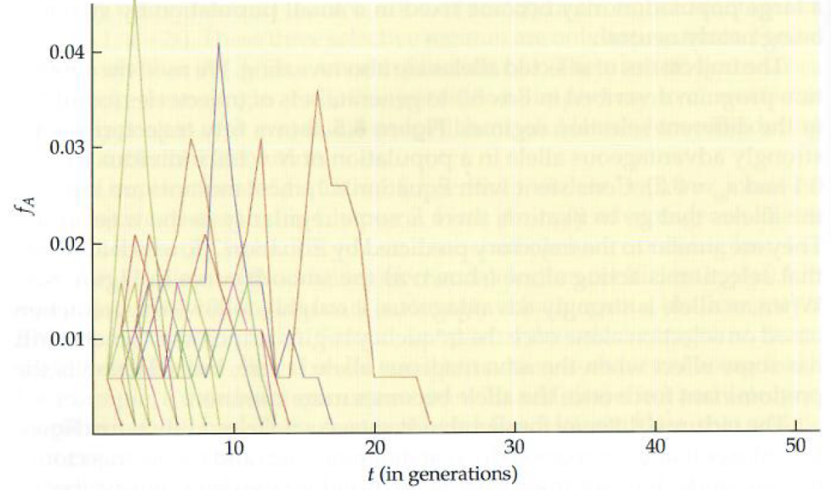
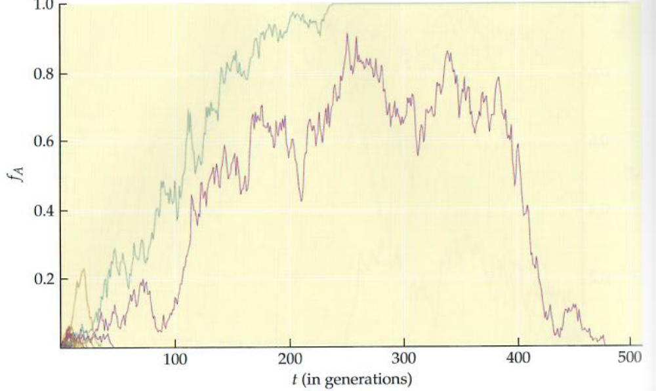
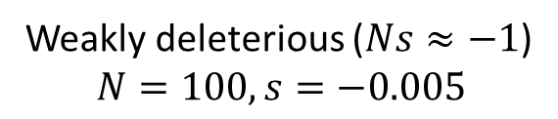
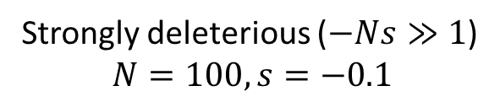
Trajectories
Nielsen and Slatkin, An Introduction to Population Genetics, 50 trajectories
Rarely, an allele can become fixed
All alleles are lost
Nearly all alleles are lost
Strongly deleterious ($−Ns≫1$)
$$N=100, s=−0.1$$
Weakly deleterious ($Ns≈−1$)
$$N=100, s=−0.005$$

Slide 12
Types of selection
Positive/adaptive selection: rise in frequency of beneficial alleles
Negative/purifying selection: removal of deleterious alleles
Directional
Balancing/stabilizing
Disruptive/diversifying
Fitness
Fitness
Fitness
BB
AB
AA
BB
AB
AA
BB
AB
AA
Genotype
Genotype
Genotype

Slide 13
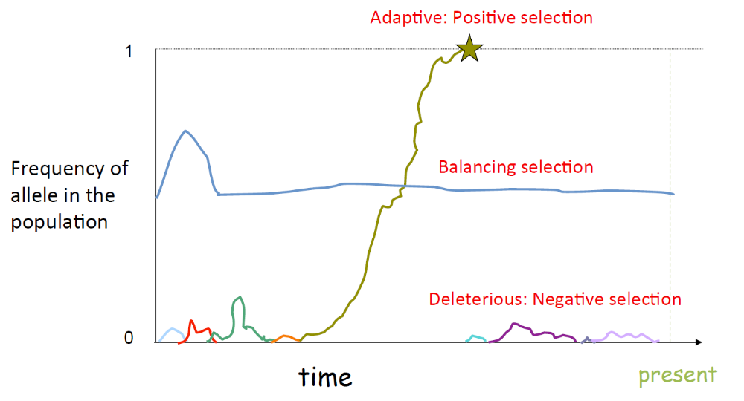
Types of selection
Disruptive selection
(directional)
(directional)
Priya Moorjani

Slide 14
The neutral theory of molecular evolution
Kimura, 1968
Most mutations are neutral or nearly-neutral
  Makes sense given the repetitive nature of genomes
Changes between species, populations, or individuals are mostly due to mutation and genetic drift; positive selection is rare
Still considered the dominating theory, but interesting exceptions exist

Slide 15
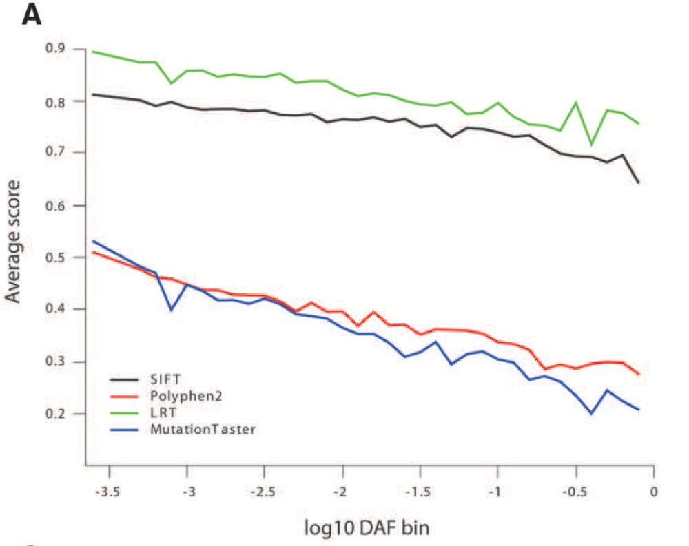
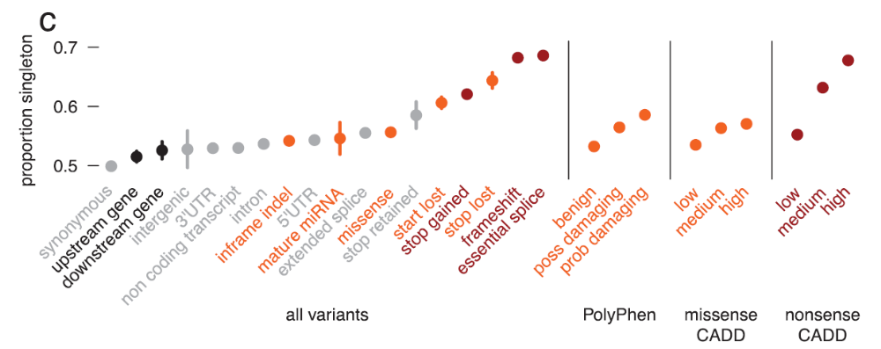
Evidence for negative selection
The more functional the mutation is, the lower we expect its frequency to be
Analysis of 2,440 exomes (ESP)
Tennessen et al., Science, 2012
Analysis of 60,706 exomes (ExAC)
Lek et al., Nature, 2016

Slide 16
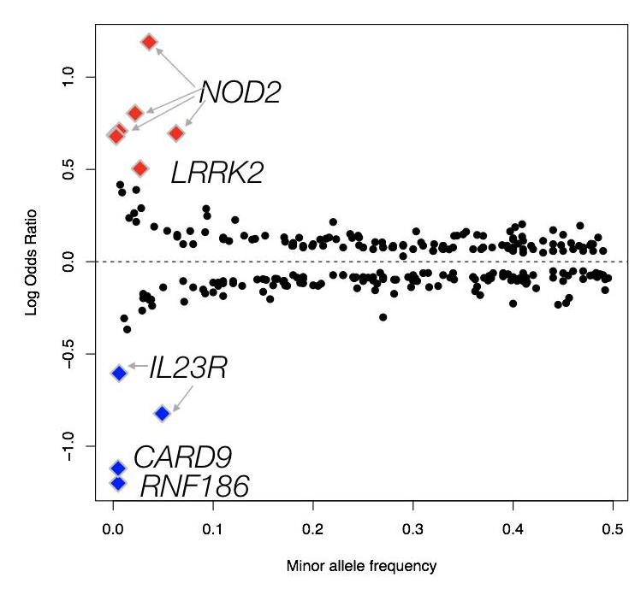
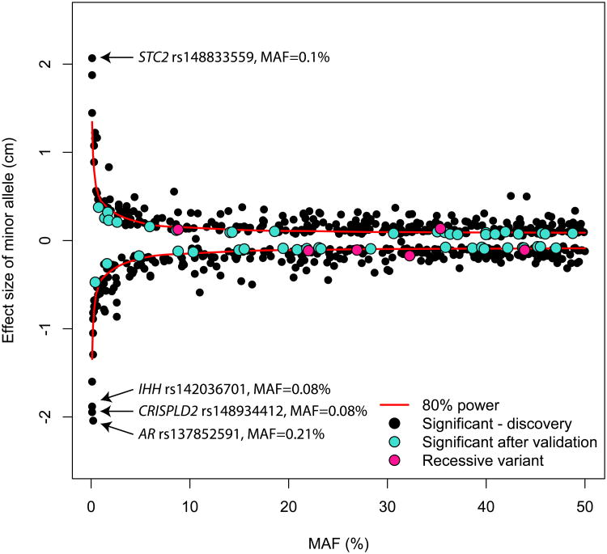
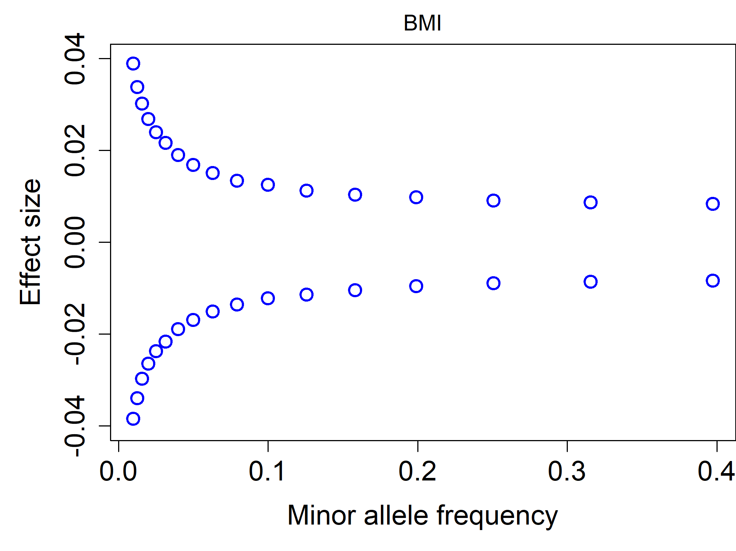
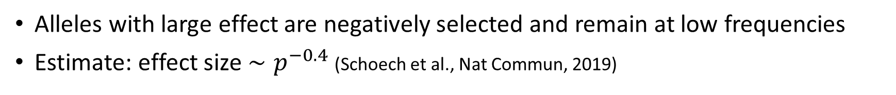
Negative selection in complex traits
Alleles with large effect are negatively selected and remain at low frequencies
Estimate: effect size $∼p^{−0.4}$ (Schoech et al., Nat Commun, 2019)
Crohn’s disease
Height
Marouli et al., Nature, 2017
UK Biobank, P<0.05
Manuel Rivas, 2019

Slide 17
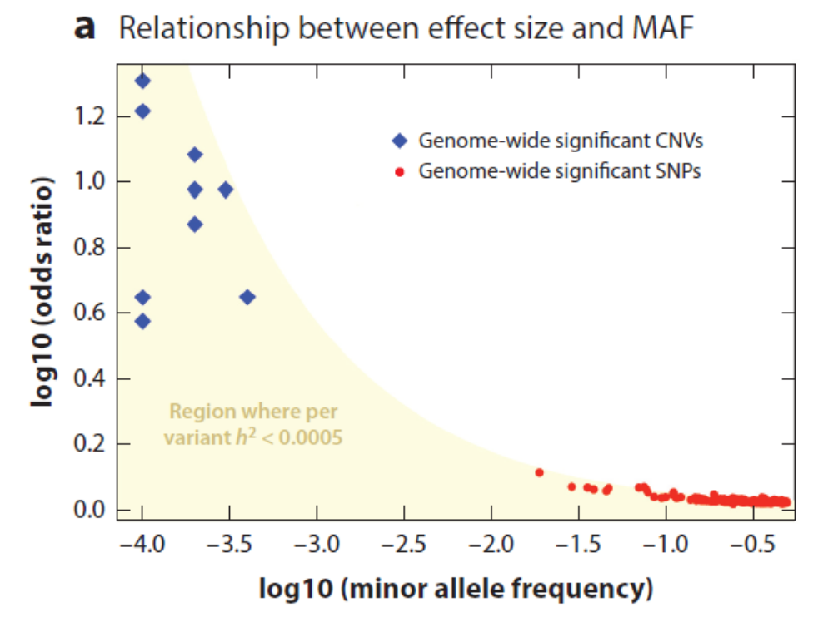
In diseases
Crohn’s disease
Schizophrenia
Height
Marouli et al., Nature, 2017
Manuel Rivas, 2019
Keller, Annu Rev Clin Psychol, 2018

Slide 18
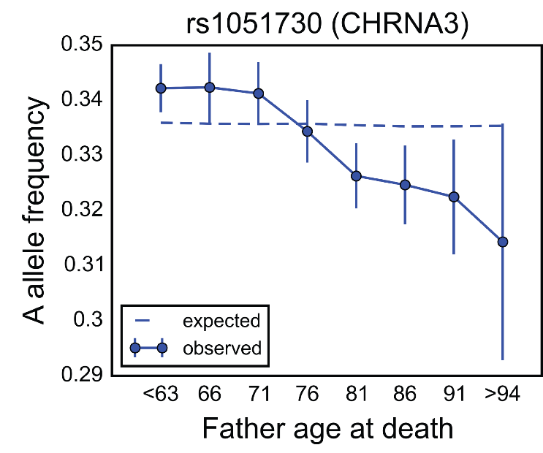
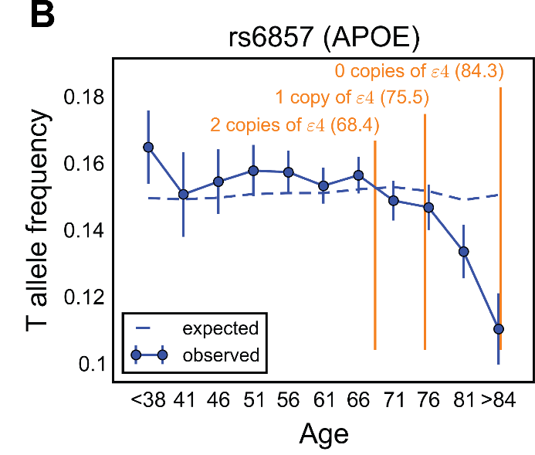
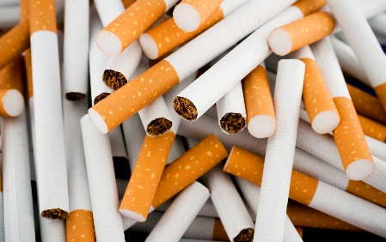
Can we directly observe variants that affect survival?
Searched in the UKBiobank for variants associated with age
Two variants were found, affecting late onset (post-reproductive) phenotypes
Other variants must have been selected against (grandparental effect?)
APOE may have remained due to unknown past advantage
APOE ε4 carriers (allele freq 10-15%) have 2x risk for Alzheimer’s disease, homozygotes have 8x risk (23andMe)
89,000 British
Carriers of A allele at CHRNA3 (nicotinic receptor gene) smoke ≈1 more cigarette per day (Nat Genet, 2010)
58,000 Europeans
Age of onset
Mostafavi et al., PLOS Biol, 2017

Slide 19
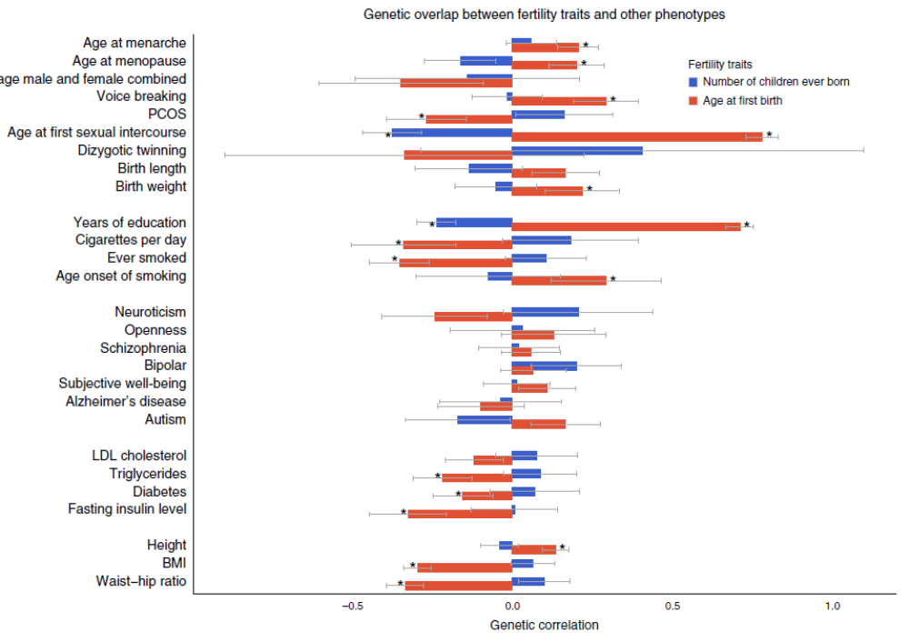
Can we directly observe variants that affect reproduction?
Genome-wide association study for age at first birth and number of children ever born
n=251k, 343k
Detected 12 loci
Barban et al., Nat Genet, 2016

Slide 20
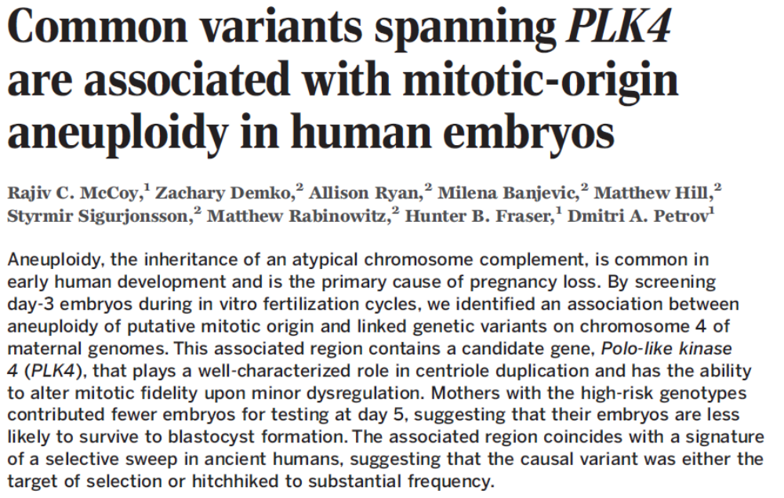
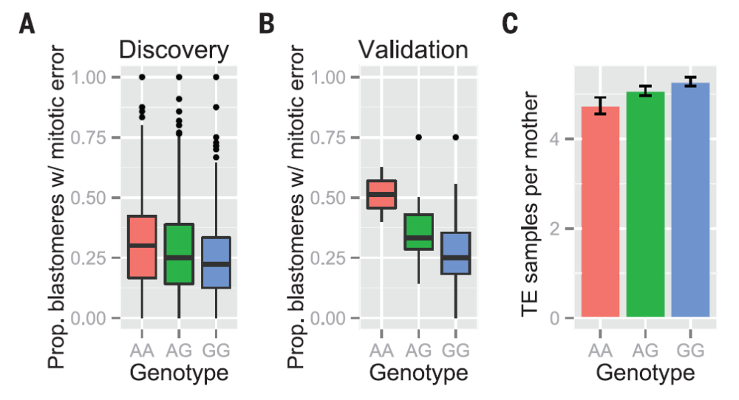
Can we directly observe variants that affect reproduction?
Science, 2015
A study of 2362 IVF cycles
Mitotic-origin aneuploidy detected in 5438 embryos (early divisions)
An association was detected at PLK4
  rs2305957, frequency 20-45%
Strangely, the variant seems to have been positively selected
  Absent in Neanderthals
Increase paternal investment?

Slide 21
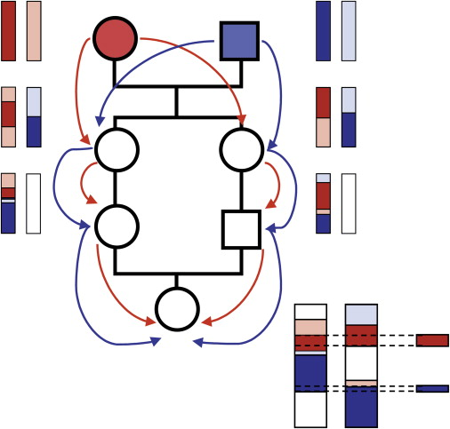
Inbreeding depression
Offspring of cousins have long runs of homozygosity
Rare deleterious mutations are “exposed”
as homozygous
Leads to reduced fitness
Well known in royal families
Decrease of ≈4% in survival to age 10
  (For offspring of first cousins; Bittles and Black, PNAS, 2010)
≈100 cases found in the UKBB where parents are
1st/2nd-degree relatives (Yengo et al., Nat Commun, 2019)
McQuillan et al., AJHG, 2008

Slide 22
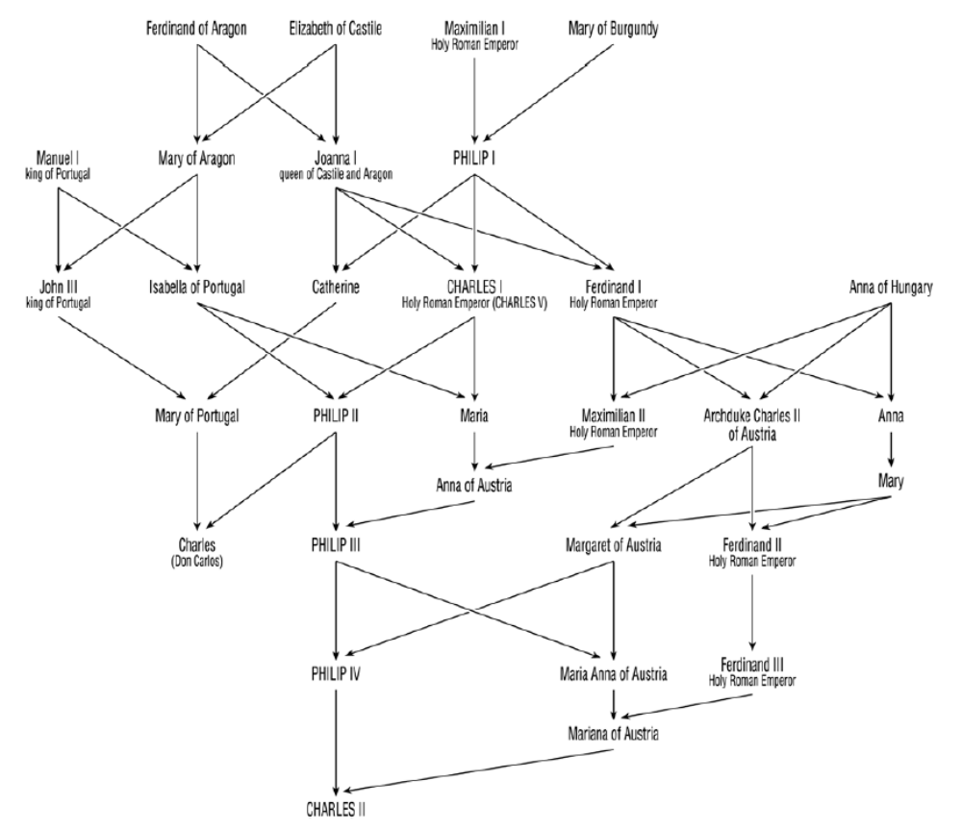
Effect on royal families
Spanish Habsburg kings
The last survival was homozygous along a quarter of the genome
First-cousin marriage reduced survival by ≈18%
A Neanderthal was a (likely) daughter of half-sibs
  Pruffer et al., Nature, 2014
Surely didn’t help their survival!
Alvarez et al., PLOS One, 2009

Slide 23
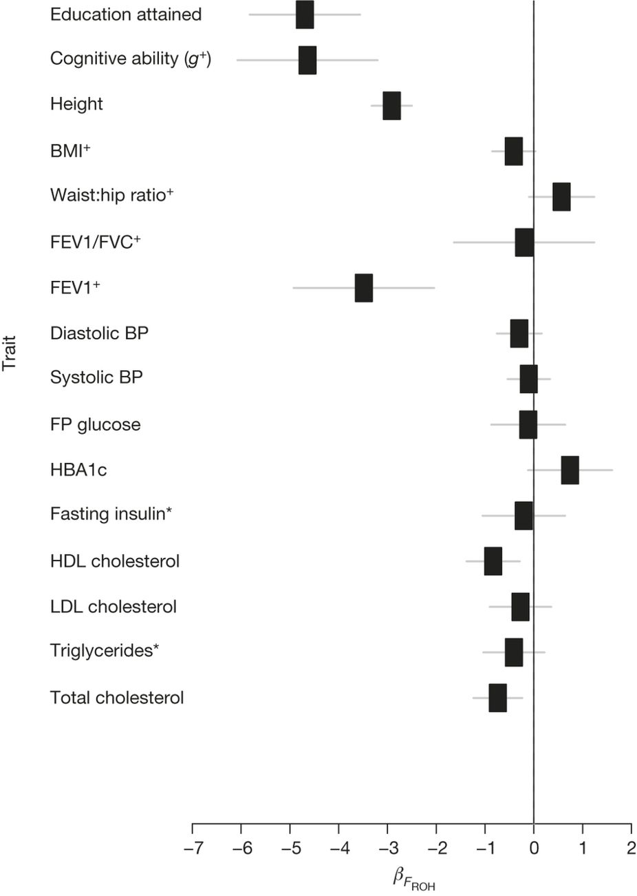
Recent examples with complex traits
Offspring of first cousins are ≈1.2 cm shorter and have ≈10 months less education
Effect seen also in forced expiratory lung volume
Studies with up to n=1.3M found associations with many traits/diseases, including age at first sex
  Yengo et al., PNAS, 2017; Johnson et al., PLOS Genetics, 2018; Ceballos et al., Nat Rev Genet, 2018; Clark et al., submitted
Offspring of first cousins show ≈55% decrease in the odds of having children (also for married)
Joshi et al., Nature, 2015

Slide 24
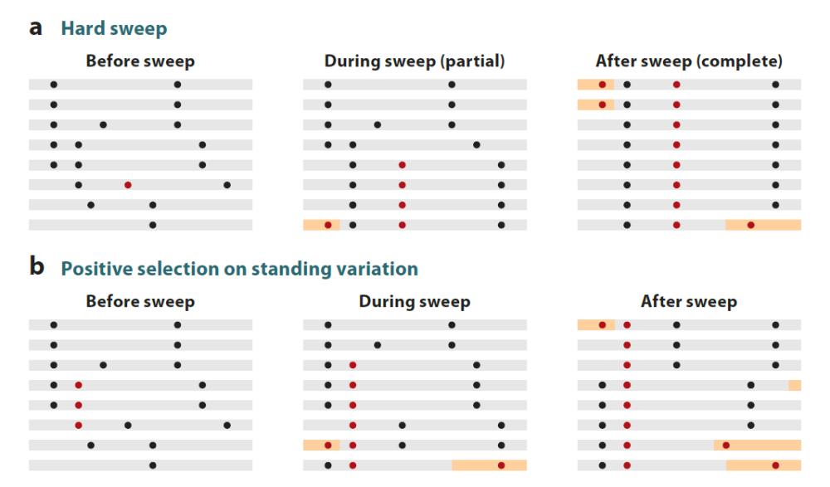
What happens around the selected site?
The beneficial allele increases in frequency along with an entire haplotype: hitchhiking
Hard sweep:
A single new advantageous allele
Soft sweep:
Selection on standing variation
  E.g., if selection pressures change
Or multiple advantageous mutations
Sweep can be complete or partial
  = allele fixed or not
Recombination can break the selected haplotype with time
Fu et al., Ann Rev Genet, 2013

Slide 25
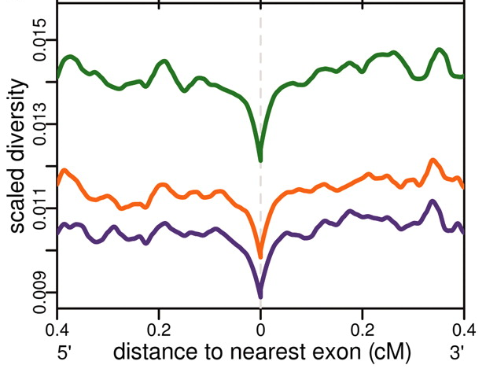

Background selection
When deleterious mutations are removed from the population, linked neutral alleles are also removed
Genetic diversity is reduced around functional sites
AFR
EUR
ASIA
Hernandez et al., Science, 2011
Josephs and Wright, PLOS Genet, 2016

Slide 26

Polygenic selection
Height can be predicted based on the contribution of hundreds of mutations
Predicted + actual heights are higher in Northern Europe
Evidence also exists
for selection
Support from ancient DNA
  Mathieson et al., Nature, 2015
However …. several recent
studies suggest this is an artifact
Robinson et al., Nat Genet, 2015

Slide 27


Hallmarks of positive selection
High allele frequency on top of very long haplotypes
Population differences
Nearby alleles arise and are
initially rare
Genealogies are distorted
Vitti et al., Ann Rev Genet, 2013
Neutral
Selection
EHH: extended haplotype homozygosity
Measure of similarity of haplotypes

Slide 28


Results of genome-wide scans
These genes often represent adaptation
= Response to changing environment
What were the key adaptations in human history?
Field et al., Science, 2016
Speidel et al., 2019
Europeans
East-Asians

Slide 29
Key adaptations
Food
  Milk (lactose), starch, omega 3/6
Immune system
  MHC, Malaria, Sleeping sickness, blood groups (ABO/Rh)
Pigmentation
  Skin, eye
Sweat (?)
Extreme environments
  Arctic, highlands, diving

Slide 30

Lactase persistence
Lactase persistence (LP): the ability to digest lactose (a sugar in milk) during adulthood
Humans were initially lactose intolerant
Persistence requires the continuous expression of the lactase (LCT) gene into adulthood
Itan et al., BMC Evol Biol, 2010

Slide 31

Why is LP needed?
LP is measured by drinking 50g of lactose (1L of cow milk)
Measure glucose in blood (LP), or hydrogen in breath (non-LP), or intestinal symptoms (non-LP)
Segurel and Bon, Ann Rev Gen, 2017

Slide 32

LP mutations
C/T-13910 (rs4988235) is dominant in Europeans (also found in Asians and some Africans)
Frequency from 80% in Northern Europe to 10% in Italy and Ashkenazi Jews
Africans have different mutations
All mutations are in the enhancer of LCT
Tishkoff et al., Nat Genet, 2007
Causal variants in Africans/Middle-East
Linked variant in Europeans
Causal variant in Europeans

Slide 33
Textbook evolution story?
Before the agricultural revolution, humans did not drink milk past weaning
Farm animals were domesticated ≈10k years ago
Individuals with the mutation were able to drink cow milk in adulthood
They received more nutrients ➔ higher survival rates ➔ higher fitness
➔ The LP mutations rose to high frequency
The LCT haplotype is extremely long, and appears in all genome scans
Selection coefficient estimated as 0.01-0.1 – among the largest genome-wide!
  Segurel and Bon, Ann Rev Gen, 2017
  Most recent estimates: 0.02 (Stern et al., 2019), 0.035 (Vicente et al., 2019)

Slide 34

Problem 1: known alleles don’t explain all phenotypes
Many differences between lactose persistence and known LP allele frequency
Central Asian populations drink milk but have no known mutation
Itan et al., BMC Evol Biol, 2010

Slide 35

Problem 2: C/T-13910 only arose recently
No mutation found >5000 years ago
Rise in frequency only started ≈2-3k ya!
The C/T-13910 haplotype is also present in high frequency in East-Asia, but without the C/T mutation!
  Antelope et al., Hum Biol, 2019
Iain Mathieson, 2019

Slide 36
Problem 3: is milk important for fitness?
Lactase intolerant individuals can gain the same amount of proteins/fat from low-lactose “derived” products (e.g., yogurt, cheese, butter)
Same for calcium, vitamin D
Derived products provide less calories, but this is only important during famines, when livestock cannot be fed
Segurel and Bon, Ann Rev Gen, 2017

Slide 37
What could reconcile these findings?
How can humans drink milk without the mutation?
Humans may have been able to drink milk due to having different microbiome
  Some conjecture that the more we drink milk, the better the microbiome adapts
Symptoms may be mild with moderate amounts
Data on lactose intolerance is not reliable, particularly not self-reports of symptoms (only glucose test is reliable)
Other mutations can lead to LP?
Selection on other mutations in the same haplotype?
Bottom line: the precise selection pressure is still unknown

Slide 38

Other responses to changes in diet
Amylase in saliva/pancreas can break down starch (e.g., rice, potatoes) into sugar
Human have wide distribution of the number of copies of salivary amylase (AMY1)
Populations with high-starch diets have more AMY1 copies
Hypothesis: selection due to diet change?
Still open: some claim salivary amilase copy number
does not affect starch digestion
  Fernandez and Wiley, Am J Phys Anthropol, 2017
Ancient DNA: selection pre-dated agriculture
  Mathieson and Mathieson, Mol Biol Evol, 2019
Perry et al., Nat Genet, 2007

Slide 39

Other responses to changes in diet
Omega3/6 (long chain polyunsaturated fatty acids) are important for brain development
Sufficient amounts in animal-based diet, but not plant-based
FADS1/2 genes are responsible for omega3/6 biosynthesis
Could selection have changed their expression in response to diet change?
Complex picture of selection:
multiple periods and places
  Mathieson and Mathieson, Mol Biol Evol, 2018; 2019
Back and forth between high/low expression alleles
  Low expression: early non-Africans, Inuit in Greenland
  High expression: Africans, Europeans, South Asians
Connection to agriculture not established
FADS1/2 variants affect cholesterol

Slide 40

Major histocompatibility complex
In humans, called HLA: human leukocyte antigen
Responsible for presenting antigens
HLA genotype much match between donor and recipient of organ transplantation
Associated with autoimmune diseases
  Type 1 diabetes, Celiac disease, lupus,…
Under strong balancing selection
Large number of alleles

Slide 41



Selection for malaria resistance
“Haldane’s malaria hypothesis” (1948): genetic red blood cells disorders are due to mutations protective against malaria
Sickle-cell anemia: homozygocity to the HbS allele of the HBB gene (hemoglobin subunit beta)
Pain, fatigue, infections, stroke, …
Piel et al., Nat Commun, 2010

Slide 42

Selection for malaria resistance
This is the classic example of balancing selection with heterozygote advantage
SS genotype: sickle-cell anemia
AA genotype: sensitive to malaria
  Plasmodium falciparum
  Infects humans by taking over red blood cells
AS genotype: resistant to malaria
  No adverse health effect
  Advantage!
A single base mutation (rs334), arose once
in African ≈7000 years ago
Fitness of AS: ≈1.16 compared to AA
Shriner and Rotimi, AJHG, 2018
Aidoo et al., Lancet, 2002; Kenya

Slide 43


Selection for malaria resistance: other genes/diseases
β-thalassemia: mutations in HBB leading to low expression
α-thalassemia: mutations in the HBA1 or HBA2 genes (hemoglobin subunit alpha)
G6PD deficiency: mutations in the X-linked G6PD gene, lead to red blood cell breakdown, in particular due to some infections and drugs, and fava beans
  Common in certain parts of Africa, Asia, the Mediterranean,
  and the Middle East + Kurdish Jews (≈60%)
All recessive
Hets have some
malaria resistance

Slide 44


Selection for malaria resistance: Duffy
DARC gene: Duffy antigen receptor
The protein is located on the surface of red blood cells, and is the receptor of (among other molecules) the malarial parasite Plasmodium vivax
Polymorphisms in this gene are the basis of the Duffy blood group system
A mutation for Duffy-negativity (no expression) increases resistance to P. vivax
Frequency in sub-Saharan Africa nearly 100%, which explains why P. vivax is nearly absent there
Selection coefficient ≈4%
Gething et al., PLOS Neg Trop Dis, 2012
McManus et al., PLOS Genet, 2017

Slide 45




Sleeping sickness
African-Americans have higher rates of kidney diseases than European Americans
Mutations in APOL1 are associated with end-stage kidney disease (OR≈10)
The same mutations can break down trypanosomes, the agent of the sleeping sickness; strong selection signal
Beckerman et al., Trends Mol Med, 2018

Slide 46


ABO blood group: balancing selection
The A/B antigens exist in 17 primates
  O is a frameshift deletion only in humans
The two mutations defining A vs B (ABO gene) are the same in all primates
Segurel et al., PNAS, 2012
Polymorphism has been maintained for >20 million years due to balancing selection
The nature of selection pressure unclear, probably immune

Slide 47

Frequency dependent selection
Another form of balancing selection: the fitness depends on the frequency
The deleterious allele is never lost, because when rare it becomes beneficial
Left-handedness classic example: advantage in fight, only when rare
  Support from sports and violent traditional societies
  But worse health, at least in the past
Faurie and Raymond, Proc Biol Sci, 2004
B allele common
B allele rare
Allele frequency
Fitness
Fitness
BB
AB
AA
BB
AB
AA
Genotype
Genotype
Time

Slide 48
Frequency dependent selection: sex ratio
Suppose an allele is responsible for high male/female sex ratio
Say the allele is initially in low frequency, so less males
Males have an advantage, so the allele increases in frequency
Same argument if initially in high frequency; equilibrium at 50% (Ronald Fisher)
Allele frequency
50%
Time

Slide 49

Disruptive selection
Very rare in humans (see next)
Famous example is Darwin’s finches:
Large beaks: large seeds
Small beaks: small seeds
Medium beaks: no seeds (low fitness)
Disruptive/diversifying
Fitness
BB
AB
AA
Genotype

Slide 50

Rhesus factor
Name is historical (first identified in rhesus monkeys), now called Rh factor
A blood group system with many alleles (RHD gene), most important are Rh+/Rh-
  The +/- after A/B/O
Rh+ individuals have the antigen,
and thus do not consider it foreign
Rh- individuals do not have it, and develop an
immune response (hemolysis) when exposed
Genotype | +/+ | +/- | -/-
Phenotype | + | + | -

Slide 51

Rh factor
Rh factor must be matched in blood transfusion (same as ABO)
Hemolytic disease of the newborn: negative mother with positive fetus
Antibodies develop after birth of first child
  Or during pregnancy due to bleeding, miscarriage, etc.
Antibodies break down the fetus’ red blood cells in the second pregnancy
In modern medicine, mothers receive antibodies during pregnancy to bind antigen and avoid immune response
 |  | Mother
 |  | +/+ | +/$−$ | $−$/$−$
Father | +/+
 | +/$−$
 | $−$/$−$

Slide 52

Rh factor: disruptive selection and … ?
Suppose the Rh- allele is rare
  Almost all fathers are Rh+
  Thus, Rh- mothers (genotype -/-) suffer from lower fitness
  Rh- allele will decline in frequency and disappear
If the Rh- allele is very common, the Rh+ allele will have lower fitness and disappear
Selection pressure (e.g., het advantage) must have existed to keep both alleles
Rh- Allele frequency
 |  | Mother
 |  | +/+ | +/$−$ | $−$/$−$
Father | +/+
 | +/$−$
 | $−$/$−$
100%
0
Time

Slide 53

Pigmentation
Pigmentation in the skin, eye, and hair is determined by the amount of the melanin pigment (more melanin – darker color)
Eye color: rs12913832/C in OCA2 enhancer causes
blue eyes in Europeans, nearly recessive
Unclear whether there was selection pressure
  Jablonski et al., PTRSB, 2017
  Yang et al., Nat Genet, 2012
  Ancient DNA (Mathieson et al., Nature, 2015)
Hair color also not showing selection pressure

Slide 54

Skin pigmentation
High levels of melanin are protective against UV radiation, and protect folate from photolysis
But lead to vitamin D deficiency in higher latitudes (rickets and other diseases)
Light pigmentation evolved multiple times
In Europeans, variants in SLC24A5, SLC45A2
are nearly fixed (low frequency elsewhere)
Other genes: OCA2, MC1R (also hair color),
TYR, TYRP1, DCT, KITLG
SLC24A5
HGDP browser; Razib Khan

Slide 55

Complex selection picture
Selection likely happened at different periods for each gene/mutation
Some SNPs selected recently, some at out-of-Africa
Stern et al., 2019
British

Slide 56



Skin pigmentation in Africans: complex picture again
The European mutations explain little variation, many more genes to be found
However, rs1426654 at SLC24A5 (lighter skin) has reached high frequency in KhoeSan
Arrived there from East-Africa <2000 years ago, and expanded rapidly ($s≈0.05$)
Selection pressure unclear (sexual?)
Lin et al, PNAS, 2018
Melanin
Martin et al., Cell, 2019
Household in South Africa

Slide 57


Selection in East-Asians
EDAR:370V>A has one of the strongest signals of selection in humans
  Associated with hair thickness and number of sweat glands
  Selection pressure unclear, maybe thermoregulation, maybe changes to the mammary gland to transfer more vitamin D to infants (Hlusko et al., PNAS, 2018)
  Strangely, the mutation appears in 8kya Swedish hunter-gatherers (Mathieson et al., Nature, 2015)
Mutations in alcohol metabolizing enzymes (ADH*)
  Under strong selection in East Asia, pressure unclear
    Lower mortality (Sakaue et al., EJHG, 2019)
  Lead to much lower alcohol consumption
  rs1229984 also found in Ashkenazi Jews (27%)
Grossman et al., Cell, 2013
Chinese
Okada et al., Nat Commun, 2018
Japanese

Slide 58
Extreme environments
Arctic environment
High altitudes
Sea diving
Illardo and Nielsen, Curr Opin Gen Dev, 2018
Beall, Ann Rev Anthrop, 2014

Slide 59


Arctic environment
Siberians, Inuit (America), Sami (Lapland)
Adaptations are either to cold temperatures or to marine-based (high fat) diet
Genes: CPT1A, FADS, PLA2G2A, PLIN1, ANGPTL8 (Hallmark et al., Mol Biol Evol, 2018)
Energy homeostasis, lipid metabolism
Clemente et al., AJHG, 2014; CPT1A c.1436C>T
Mutation is >4kya (from ancient DNA)
Origin is East-Asia
Mutation increases infant mortality, so must have strong benefit

Slide 60


Arctic environment
TRPM8 is the only human thermal sensor and regulator
Expressed in pain and temperature-sensitive neurons
Key et al., PLOS Genet, 2018
rs10166942
Allele originated and evolved neutrally in Africa
Selection started ≈25kya; frequency was already high 8kya
Allele increases risk to migraine, so selection must be strong
Current through channel varies with temperature

Slide 61

High altitudes
How can several human populations live at altitude >4000m?
Tibetans
Amhara
Andeans

Slide 62

High altitudes
Low oxygen at high altitudes leads to response to hypoxia (acclimatization)
More red blood cells are generated, and hemoglobin concentration rises
However, blood viscosity increases, impairing blood flow
  The response can also lead to pregnancy complications
  May lead to chronic mountain sickness
In Tibetans and Amhara, there is little increase
in levels of hemoglobin
Key genes in Tibetans: EPAS1 and EGLN1
The mutations are highly diverged between
Tibetans and nearby Chinese
Yi et al., Science, 2010

Slide 63


High altitudes
(e.g., EPAS1)
Andeans do not lower hemoglobin and have different physiology
EGLN1 may be involved + other genes
Adaptation is focused on cardiovascular health, possibly rescuing the negative effects of hypoxia response
Crawford et al., AJHG, 2017
The adaptation in Amhara is not clear
Several other candidate genes found

Slide 64

Sea diving
Bajau: “sea nomads” from Malaysia, the Philippines, and Indonesia
>1000 years of diving for fishing and gathering corals
Spend >4 hours a day underwater, up to minutes each time
Bajau’s spleens 50% larger than land-based neighbors
  Spleen contraction supplies extra oxygen when diving
Key gene: PDE10A, which affects thyroid activity,
and in turn affects spleen size (in mice)
Ilardo et al., 2018

Slide 65



Selection against Neanderthal alleles
Some regions in the genome show complete absence of Neanderthal alleles
In particular on X and near testes-expressed genes, suggesting male infertility
No Neanderthal mtDNA and Y chr haplogroups survived to modern humans
  Sex specific admixture could explain just one of them!
Similar picture with Denisovan alleles
Sankararaman et al., Nature, 2014
Curr Biol, 2016
Europeans
Asians
Importance (high→low)

Slide 66



Selection against Neanderthal alleles
Neanderthals had a smaller population size than modern humans
Hypothesis: selection was not effective ($Ns$ small) in Neanderthals, thus they had many deleterious alleles (Harris and Nielsen, Genetics, 2016)
Consequence: Neanderthals did not go extinct,
they merged with moderns at proportion 1:10
Their alleles were selected against
in moderns, thus the current
genomic proportion is ≈2%
But see Petr et al., PNAS, 2019
Fu et al., Nature, 2016
Harris and Nielsen, Genetics, 2016

Slide 67

Beneficial archaic introgression
The haplotype carrying the adaptation at EPAS1 in Tibetans is ~identical to the Denisova haplotype
Idea: archaic humans evolved in new environments (generally out-of-Africa), and developed adaptations, in particularly to new pathogens
Modern humans were initially not adapted
But “gained” adaptations by mating with the archaic humans
Denisova
Huerta-Sanchez et al., Nature, 2014
Chen et al., Nature, 2019:
A 160,000 old Denisovan bone found in Tibet (≈3300m)
Dannemann et al., Curr Opin Gene Dev, 2018
Racimo et al., Nat Rev Genet, 2015

Slide 68


Other examples
Archaic alleles positively selected are involved in immunity, metabolism, and response to environment (temperature, sunlight, altitude)
Neanderthal alleles are associated with several diseases and traits
  Williams et al., Nature, 2014 (Type 2 diabetes); Simonti et al., Science, 2016; Dannemann and Kelso, AJHG, 2017
  Importance/role of selection unclear
TLR6-TLR1-TLR10 innate immunity genes, which detect pathogens and elicit immune response (Dannemann et al., Deschamps et al., AJHG, 2016)
Neanderthal/Denisovan haplotypes found
at high frequency (≈2%→≈10-50%)
Association with reduced H. pylori in blood
and susceptibility to allergies
Orange/green: Neanderthal; blue: non-archaic

