Slide 1
Advanced Topics in Data Analysis
2019
Shai Carmi

Slide 2
Outline
The general idea
Using the bootstrap samples
Examples and properties
Other subjects

Slide 3
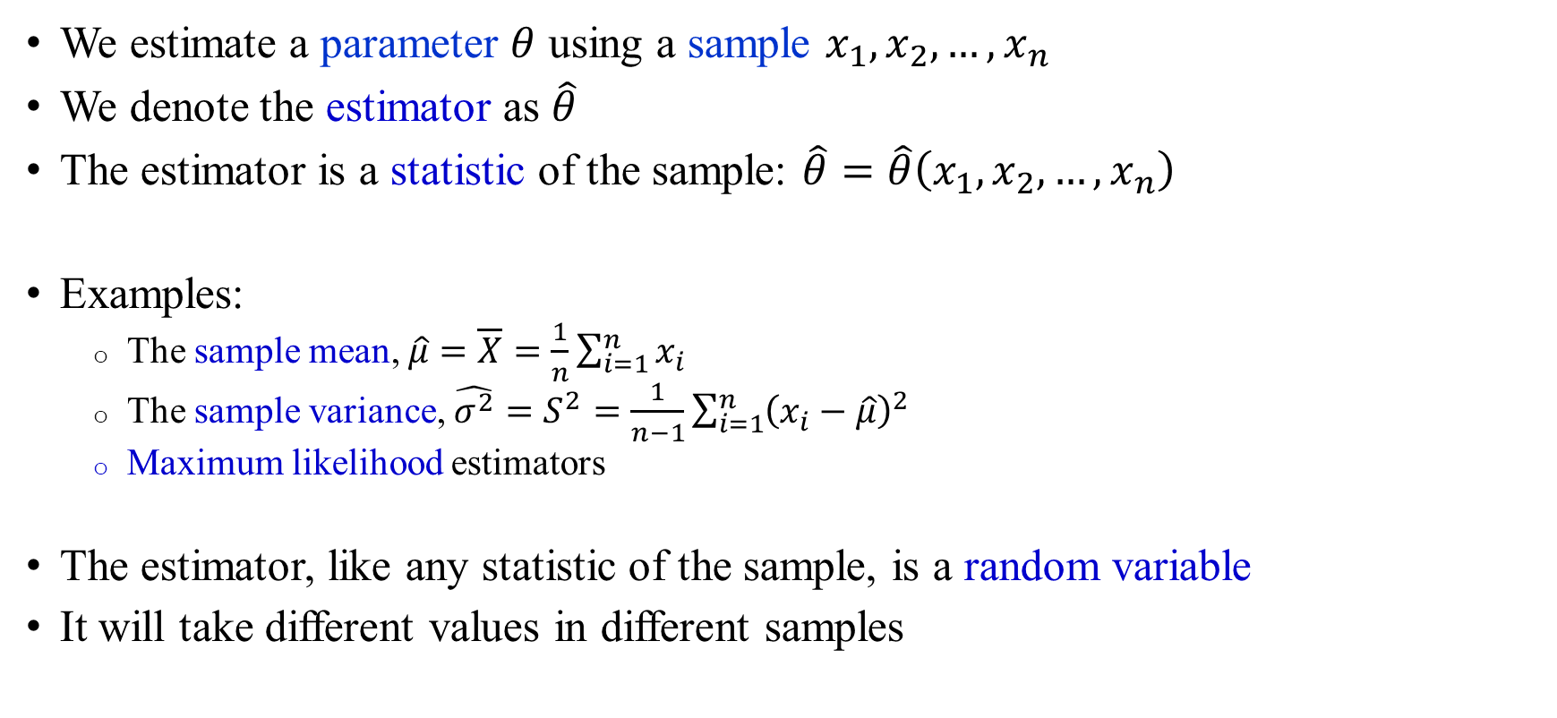
Reminder: estimation
We estimate a parameter $θ$ using a sample $x_{1},x_{2},…,x_{n}$
We denote the estimator as $\hat{θ}$
The estimator is a statistic of the sample: $\hat{θ}=\hat{θ}\left(x_{1},x_{2},…,x_{n}\right)$
Examples:
  The sample mean, $\hat{μ}=\overline{X}=\frac{1}{n}\sum_{i=1}^{n}{x_{i}}$
  The sample variance, $\hat{σ^{2}}=S^{2}=\frac{1}{n−1}\sum_{i=1}^{n}{{\left(x_{i}−\hat{μ}\right)}^{2}}$
  Maximum likelihood estimators
The estimator, like any statistic of the sample, is a random variable
It will take different values in different samples

Slide 4
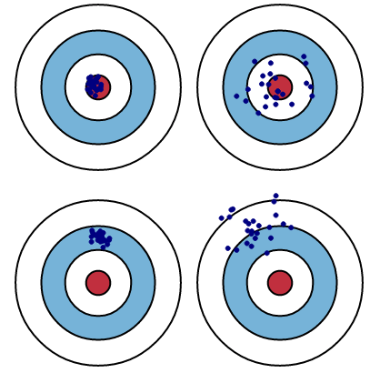
Reminder: bias and variance
Small bias
Small variance
Small bias
Large variance
Large bias
Small variance
Large bias
Large variance

Slide 5
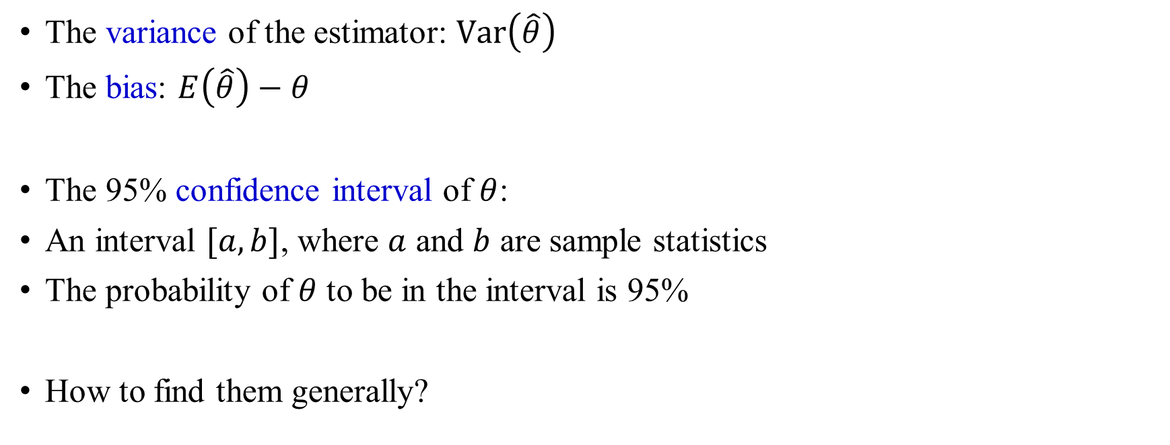
Notation
The variance of the estimator: $\text{Var}\left(\hat{θ}\right)$
The bias: $E\left(\hat{θ}\right)−θ$
The 95% confidence interval of $θ$:
An interval $[a,b]$, where $a$ and $b$ are sample statistics
The probability of $θ$ to be in the interval is 95%
How to find them generally?

Slide 6
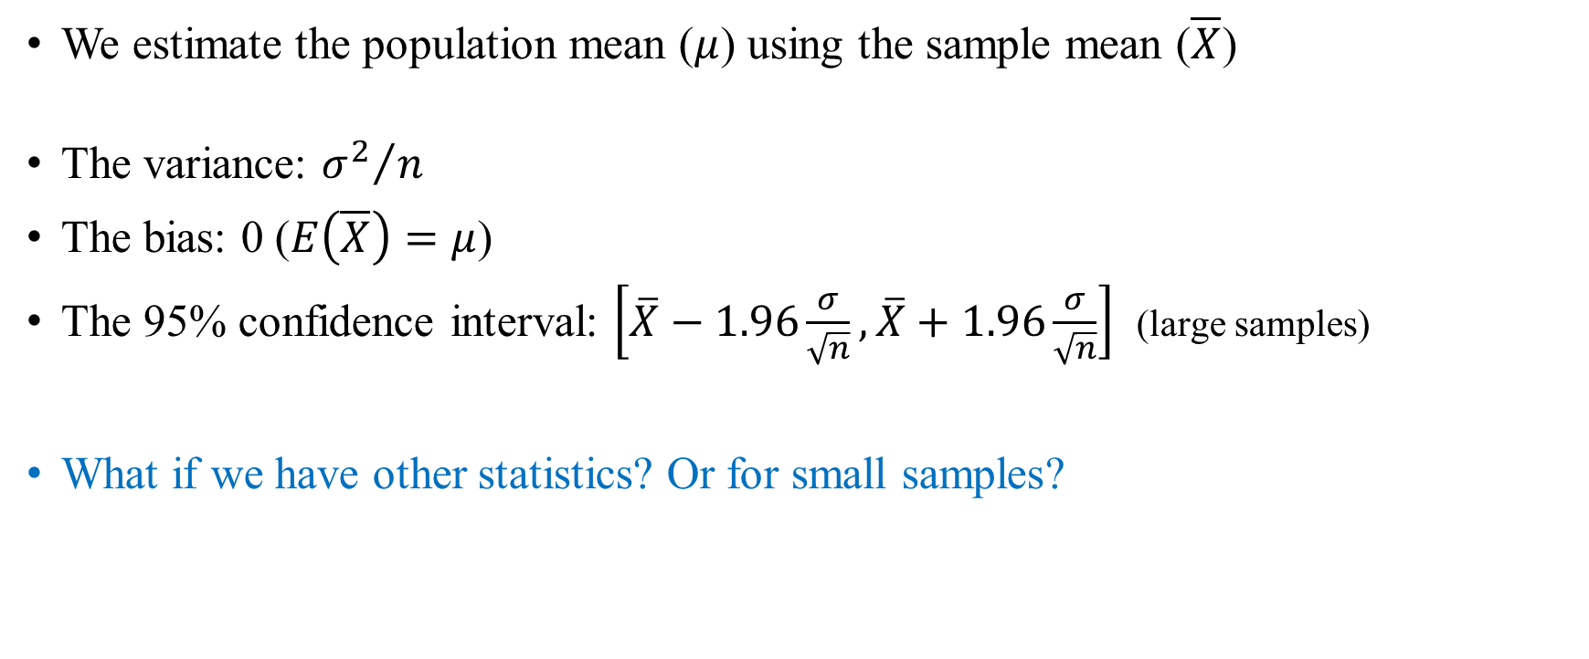
A simple problem
We estimate the population mean ($μ$) using the sample mean ($\overline{X}$)
The variance: ${σ^{2}}/n$
The bias: 0 ($E\left(\overline{X}\right)=μ$)
The 95% confidence interval: $\left[\overline{X}−1.96\frac{σ}{\sqrt{n}},\overline{X}+1.96\frac{σ}{\sqrt{n}}\right]$ (large samples)
What if we have other statistics? Or for small samples?

Slide 7
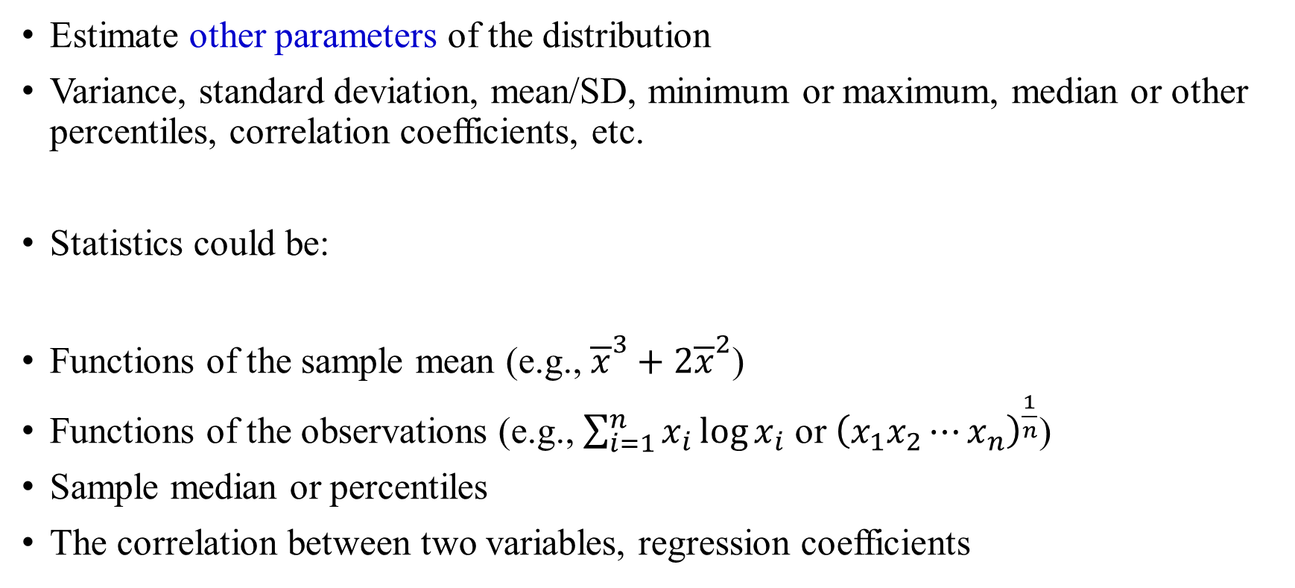
Examples of other statistics
Estimate other parameters of the distribution
Variance, standard deviation, mean/SD, minimum or maximum, median or other percentiles, correlation coefficients, etc.
Statistics could be:
Functions of the sample mean (e.g., ${\overline{x}}^{3}+2{\overline{x}}^{2}$)
Functions of the observations (e.g., $\sum_{i=1}^{n}{x_{i}\log{x_{i}}}$ or ${\left(x_{1}x_{2}⋯x_{n}\right)}^{\frac{1}{n}}$)
Sample median or percentiles
The correlation between two variables, regression coefficients

Slide 8
Problem ☹
We do not know the distribution of those estimators, so we cannot compute their variance/bias/confidence intervals

Slide 9
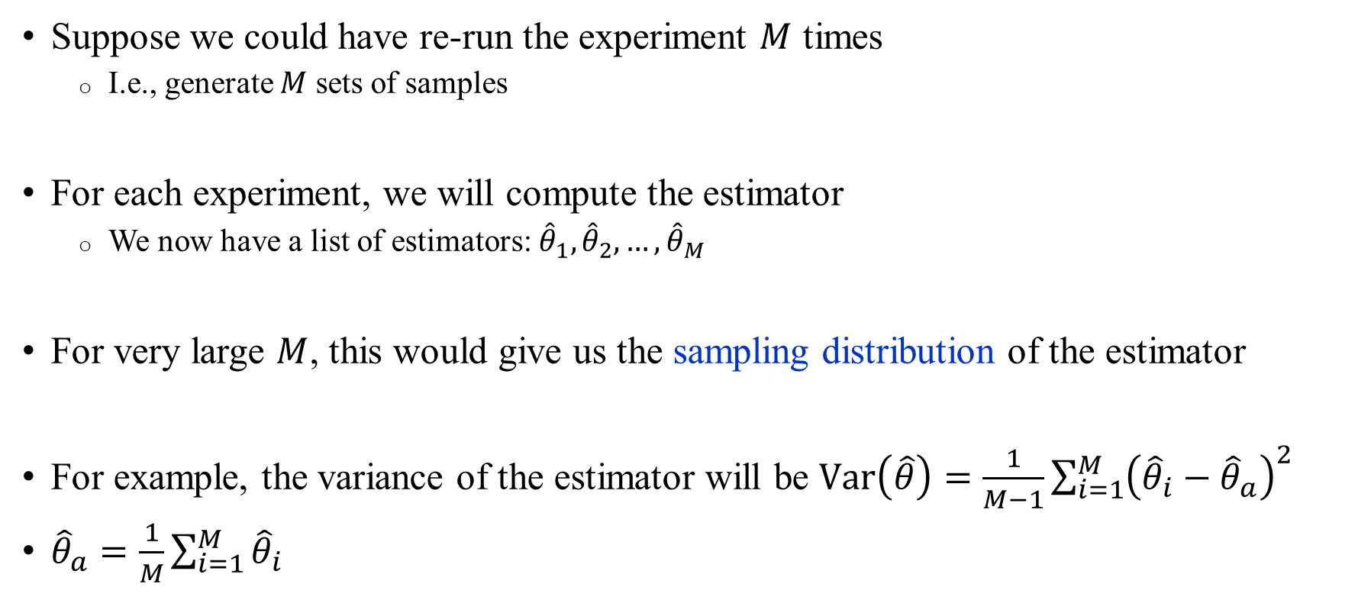
Solution? ☺
Suppose we could have re-run the experiment $M$ times
  I.e., generate $M$ sets of samples
For each experiment, we will compute the estimator
  We now have a list of estimators: ${\hat{θ}}_{1},{\hat{θ}}_{2},…,{\hat{θ}}_{M}$
For very large $M$, this would give us the sampling distribution of the estimator
For example, the variance of the estimator will be $\text{Var}\left(\hat{θ}\right)=\frac{1}{M−1}\sum_{i=1}^{M}{{\left({\hat{θ}}_{i}−{\hat{θ}}_{a}\right)}^{2}}$
${\hat{θ}}_{a}=\frac{1}{M}\sum_{i=1}^{M}{{\hat{θ}}_{i}}$

Slide 10
Problem ☹
What if we cannot re-run the experiment again many times?
  The experiment is very expensive
  It will take an extremely long time
  We ran out of patients/participants
  The sample is historical, and we cannot reproduce past conditions

Slide 11
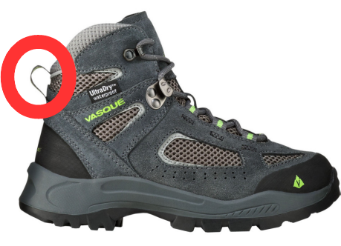
Solution ☺
The bootstrap method allows us to generate a large number of samples, without re-running the experiment
There is an expression: “to pull oneself up by one's bootstraps”
  Attributed (probably mistakenly) to The Adventures of Baron Munchausen, who rescued himself out of a swamp by pulling his own bootstraps
Bradley Efron, 1979
How does this “miracle” work?

Slide 12
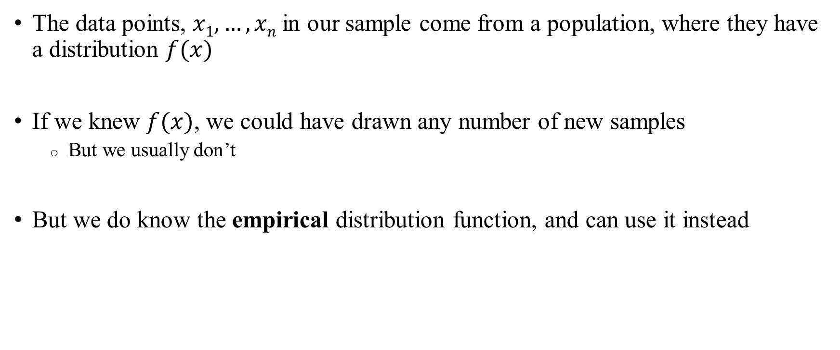
The empirical cumulative distribution function
The data points, $x1,…,xn$ in our sample come from a population, where they have a distribution $f(x)$
If we knew $f(x)$, we could have drawn any number of new samples
  But we usually don’t
But we do know the empirical distribution function, and can use it instead

Slide 13

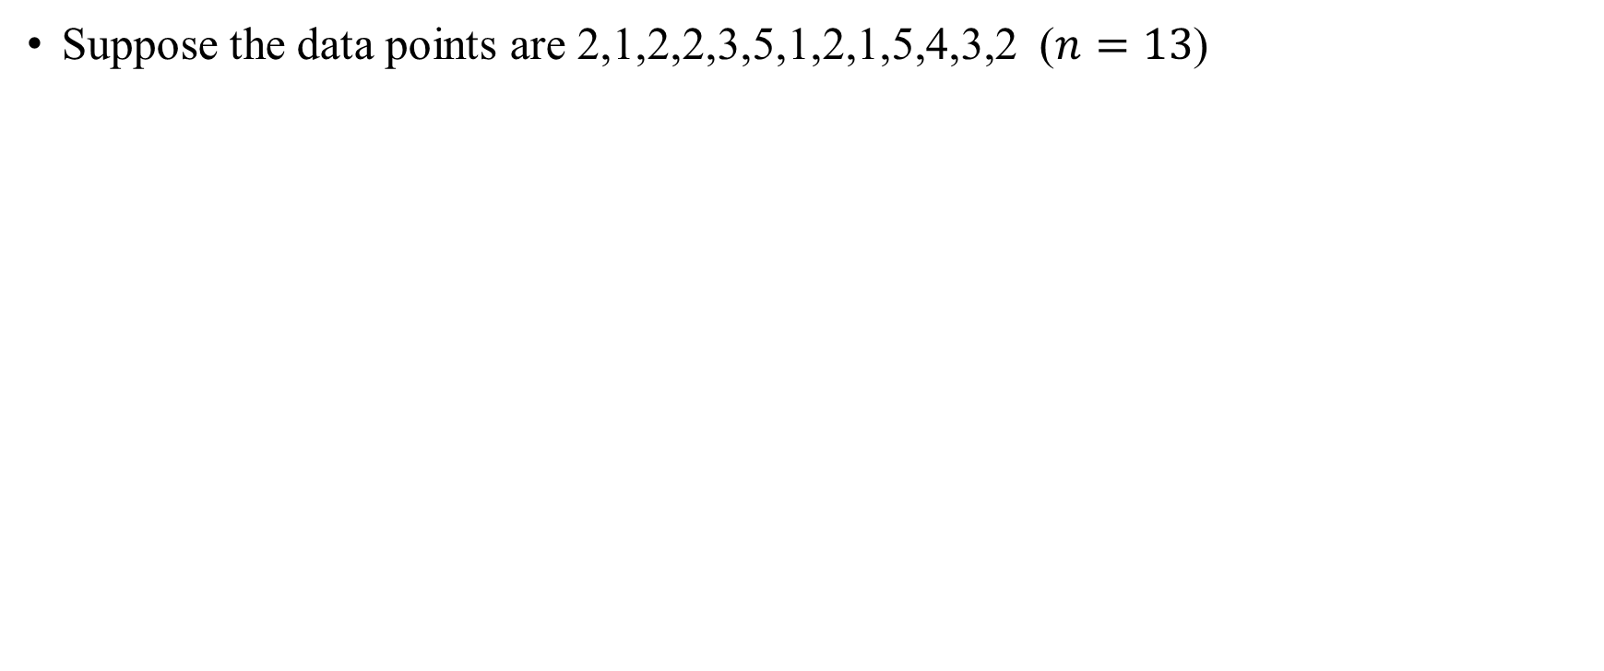
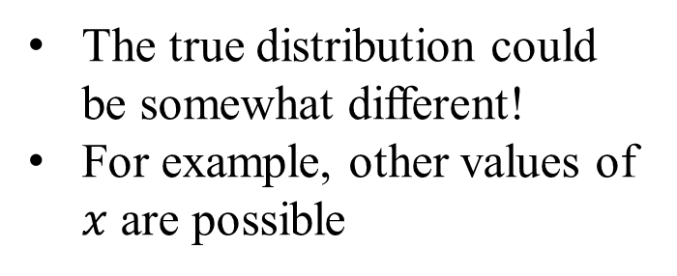
The empirical distribution: example
Suppose the data points are 2,1,2,2,3,5,1,2,1,5,4,3,2 ($n=13$)
Empirical distribution
The true distribution could be somewhat different!
For example, other values of $x$ are possible
5/13
4/13
3/13
2/13
1/13
1
2
3
4
5
$$x$$

Slide 14
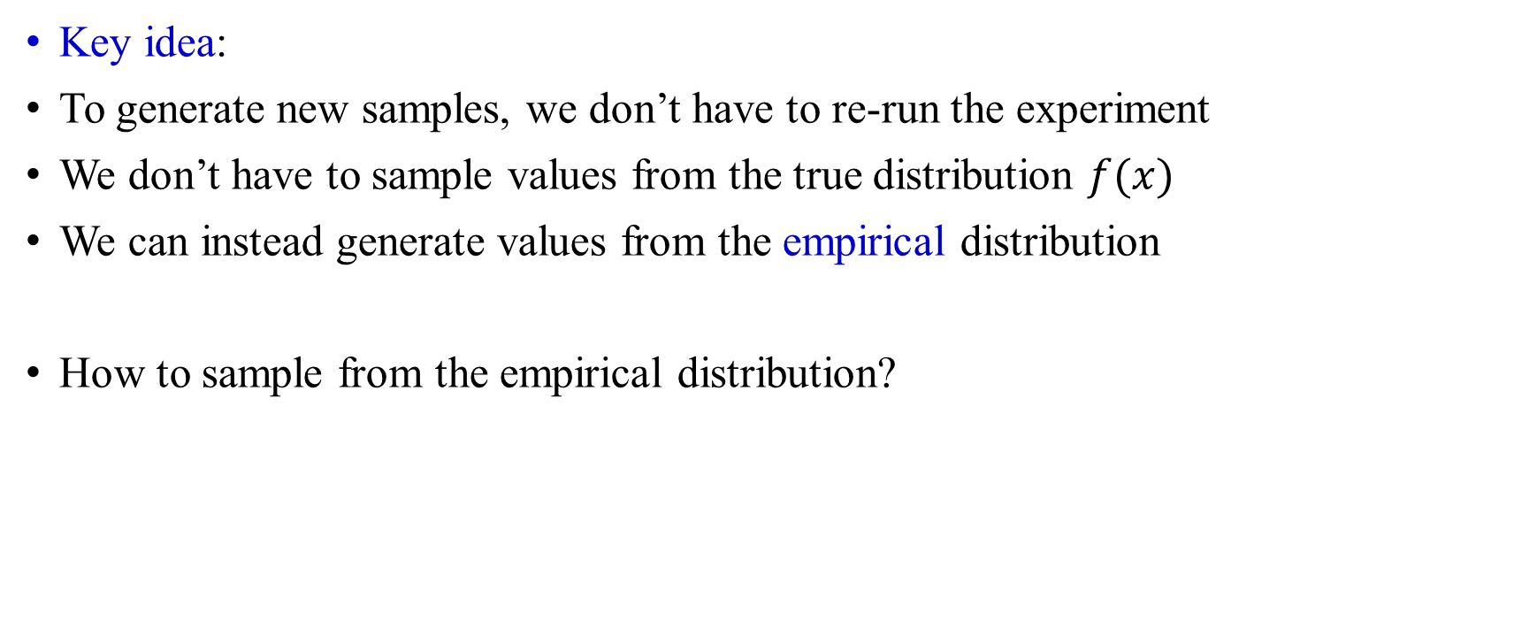
Generating new samples under the bootstrap
Key idea:
To generate new samples, we don’t have to re-run the experiment
We don’t have to sample values from the true distribution $f(x)$
We can instead generate values from the empirical distribution
How to sample from the empirical distribution?

Slide 15
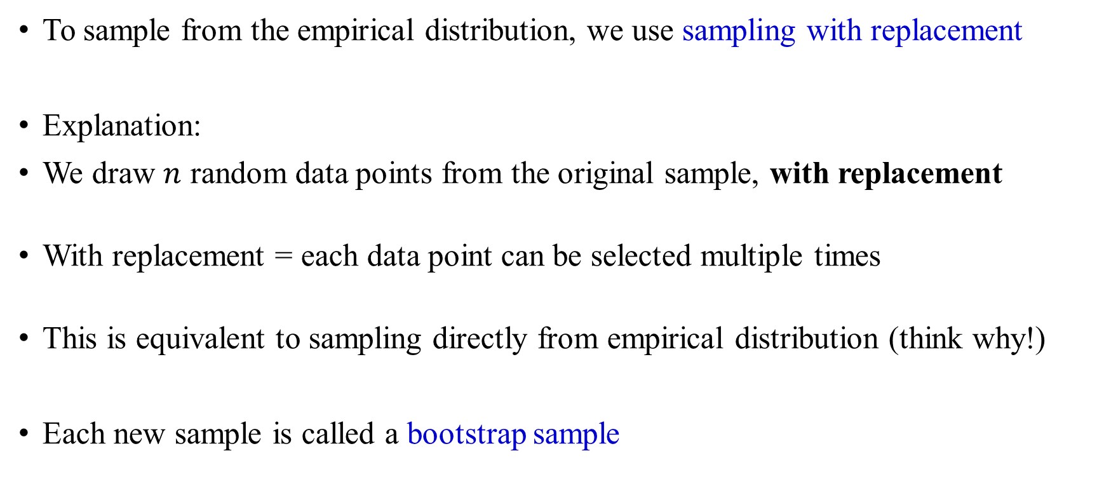
Generating new samples under the bootstrap
To sample from the empirical distribution, we use sampling with replacement
Explanation:
We draw $n$ random data points from the original sample, with replacement
With replacement = each data point can be selected multiple times
This is equivalent to sampling directly from empirical distribution (think why!)
Each new sample is called a bootstrap sample

Slide 16
Example
Suppose our original sample is x₁,x₂,x₃,x₄,x₅
Possible bootstrap samples:
  x₄,x₃,x₁,x₄,x₂
  x₂,x₂,x₃,x₅,x₅
  x₅,x₄,x₂,x₁,x₃
  x₁,x₃,x₁,x₃,x₃
  x₄,x₅,x₁,x₂,x₁

Slide 17
Outline
The general idea
Using the bootstrap samples
Examples and properties
Other subjects

Slide 18
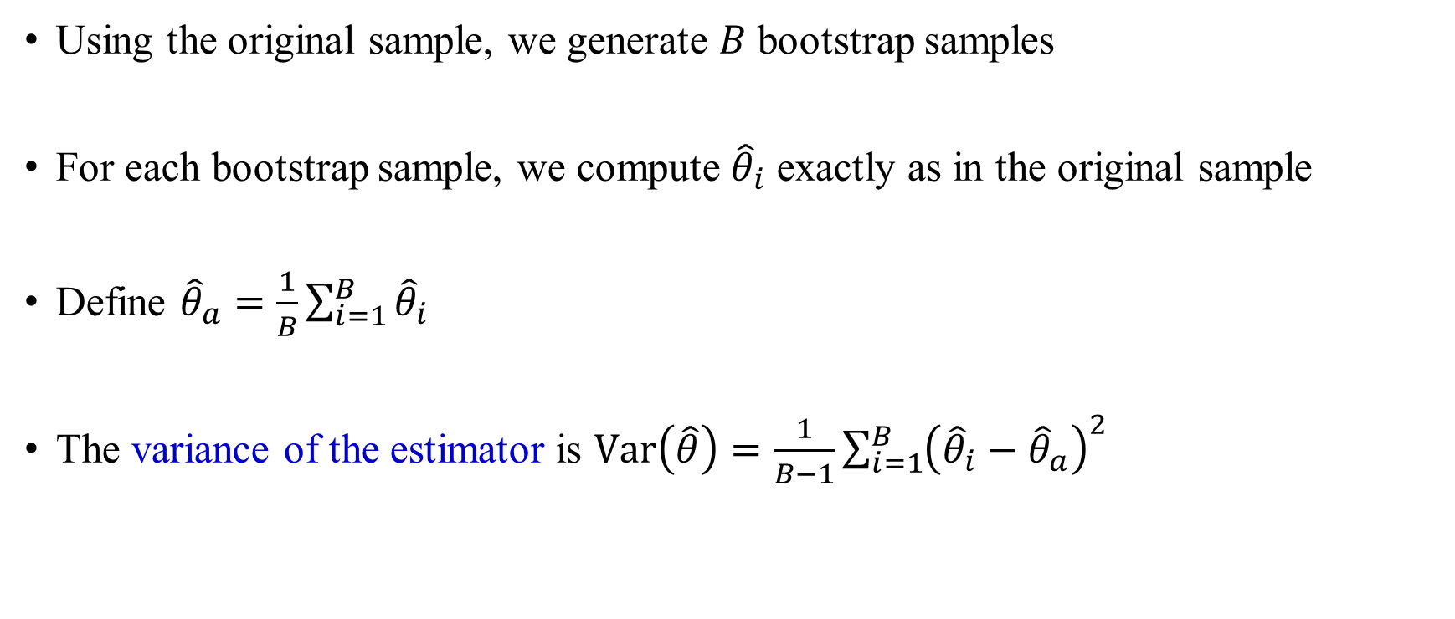
Using the bootstrap samples: variance
Using the original sample, we generate $B$ bootstrap samples
For each bootstrap sample, we compute ${\hat{θ}}_{i}$ exactly as in the original sample
Define ${\hat{θ}}_{a}=\frac{1}{B}\sum_{i=1}^{B}{{\hat{θ}}_{i}}$
The variance of the estimator is $\text{Var}\left(\hat{θ}\right)=\frac{1}{B−1}\sum_{i=1}^{B}{{\left({\hat{θ}}_{i}−{\hat{θ}}_{a}\right)}^{2}}$

Slide 19
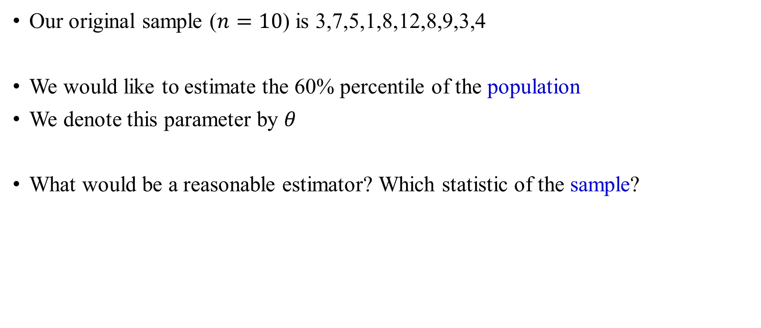
Example
Our original sample ($n=10$) is 3,7,5,1,8,12,8,9,3,4
We would like to estimate the 60% percentile of the population
We denote this parameter by $θ$
What would be a reasonable estimator? Which statistic of the sample?

Slide 20
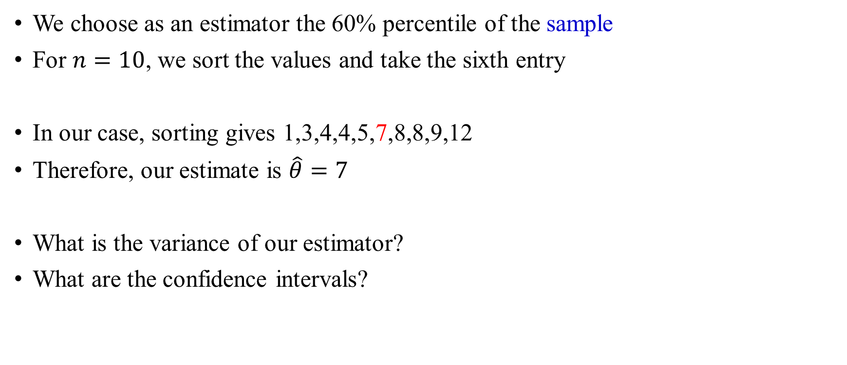
Example
We choose as an estimator the 60% percentile of the sample
For $n=10$, we sort the values and take the sixth entry
In our case, sorting gives 1,3,4,4,5,7,8,8,9,12
Therefore, our estimate is $\hat{θ}=7$
What is the variance of our estimator?
What are the confidence intervals?

Slide 21
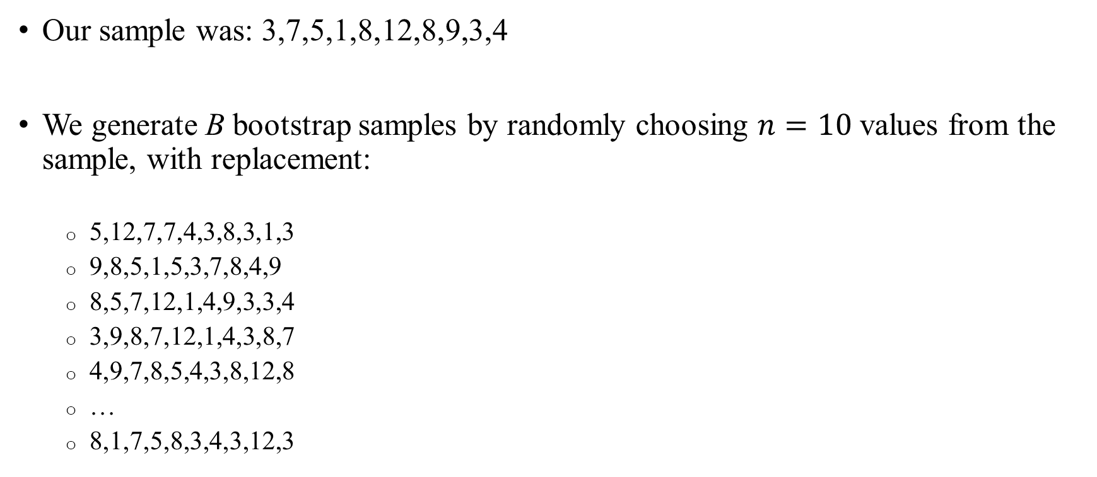
Example
Our sample was: 3,7,5,1,8,12,8,9,3,4
We generate B bootstrap samples by randomly choosing $n=10$ values from the sample, with replacement:
  5,12,7,7,4,3,8,3,1,3
  9,8,5,1,5,3,7,8,4,9
  8,5,7,12,1,4,9,3,3,4
  3,9,8,7,12,1,4,3,8,7
  4,9,7,8,5,4,3,8,12,8
  …
  8,1,7,5,8,3,4,3,12,3

Slide 22
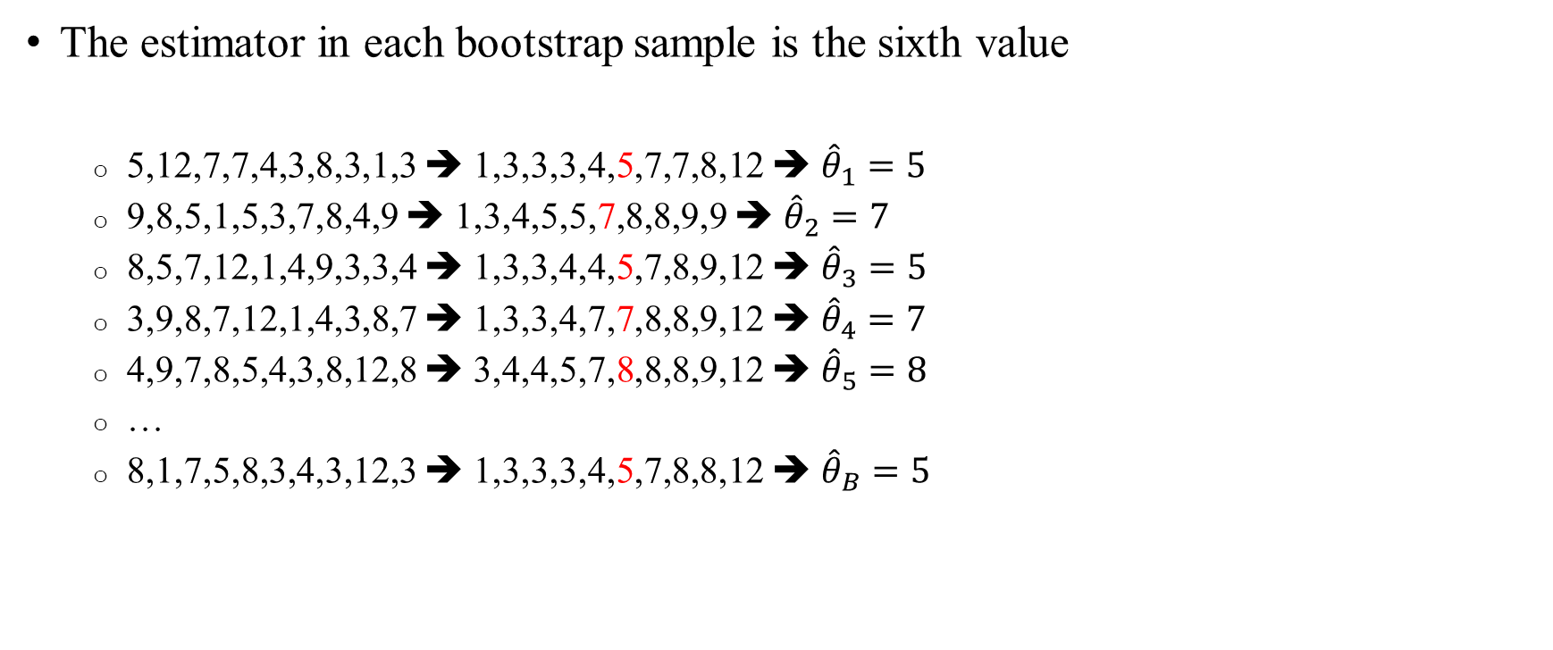
Example
The estimator in each bootstrap sample is the sixth value
  5,12,7,7,4,3,8,3,1,3 ➔ 1,3,3,3,4,5,7,7,8,12 ➔ ${\hat{θ}}_{1}=5$
  9,8,5,1,5,3,7,8,4,9 ➔ 1,3,4,5,5,7,8,8,9,9 ➔ ${\hat{θ}}_{2}=7$
  8,5,7,12,1,4,9,3,3,4 ➔ 1,3,3,4,4,5,7,8,9,12 ➔ ${\hat{θ}}_{3}=5$
  3,9,8,7,12,1,4,3,8,7 ➔ 1,3,3,4,7,7,8,8,9,12 ➔ ${\hat{θ}}_{4}=7$
  4,9,7,8,5,4,3,8,12,8 ➔ 3,4,4,5,7,8,8,8,9,12 ➔ ${\hat{θ}}_{5}=8$
  …
  8,1,7,5,8,3,4,3,12,3 ➔ 1,3,3,3,4,5,7,8,8,12 ➔ ${\hat{θ}}_{B}=5$

Slide 23
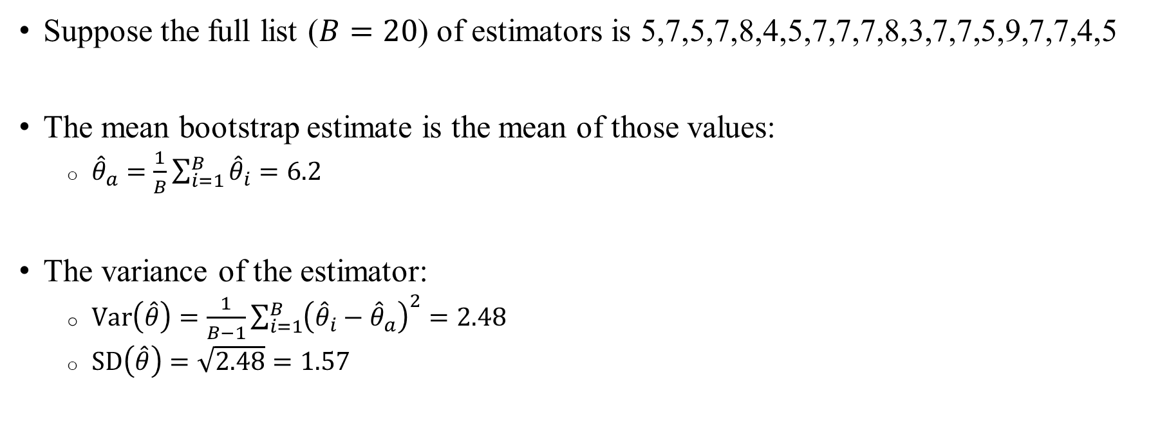
Example
Suppose the full list ($B=20$) of estimators is 5,7,5,7,8,4,5,7,7,7,8,3,7,7,5,9,7,7,4,5
The mean bootstrap estimate is the mean of those values:
  ${\hat{θ}}_{a}=\frac{1}{B}\sum_{i=1}^{B}{{\hat{θ}}_{i}}=6.2$
The variance of the estimator:
  $\text{Va}\text{r}\left(\hat{θ}\right)=\frac{1}{B−1}\sum_{i=1}^{B}{{\left({\hat{θ}}_{i}−{\hat{θ}}_{a}\right)}^{2}}=2.48$
  $\text{SD}\left(\hat{θ}\right)=\sqrt{2.48}=1.57$

Slide 24
Intuition
The bootstrap samples are drawn from the original samples, not the population
So why does bootstrapping work?
Bootstrapping uses the original data as a representative of the population
Even the original data has information on the variability of the population
This allows us to determine the “sampling noise” of the estimator

Slide 25
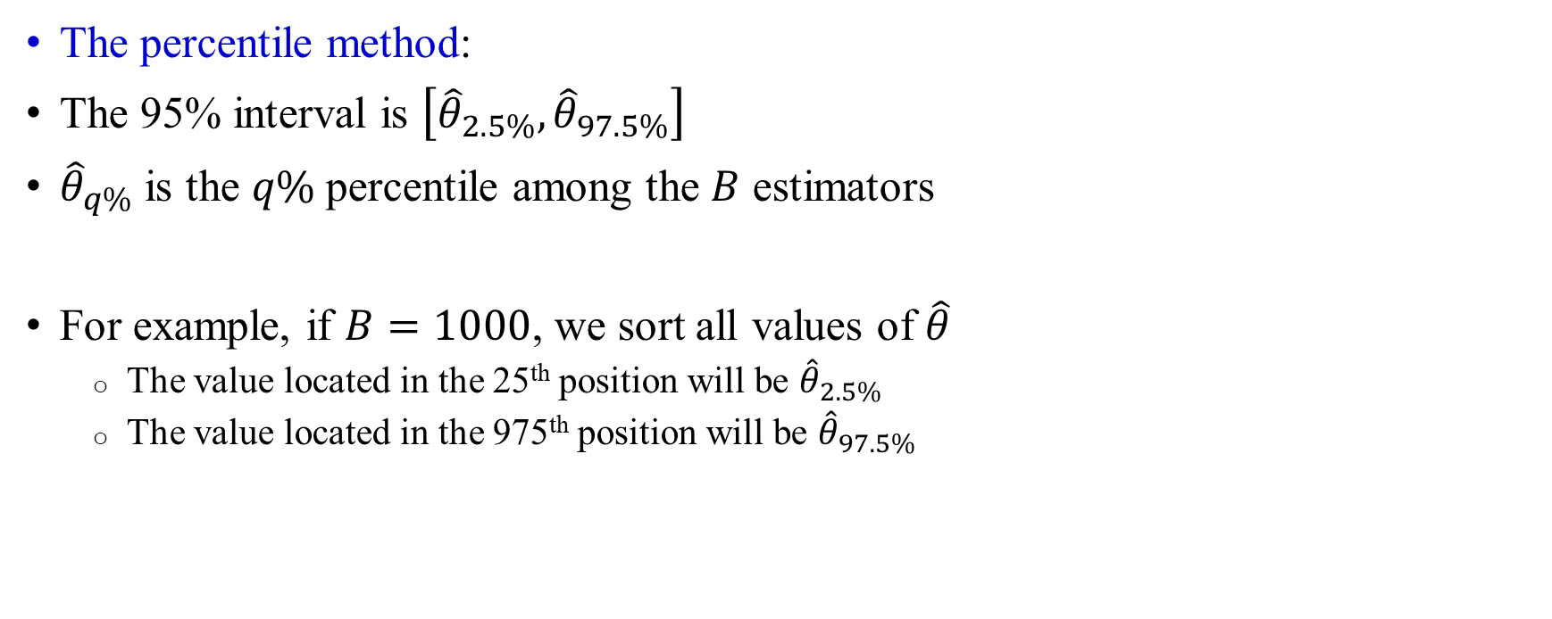
Confidence intervals
The percentile method:
The 95% interval is $\left[{\hat{θ}}_{2.5\%},{\hat{θ}}_{97.5\%}\right]$
${\hat{θ}}_{q\%}$ is the $q\%$ percentile among the $B$ estimators
For example, if $B=1000$, we sort all values of $\hat{θ}$
  The value located in the 25th position will be ${\hat{θ}}_{2.5\%}$
  The value located in the 975th position will be ${\hat{θ}}_{97.5\%}$

Slide 26
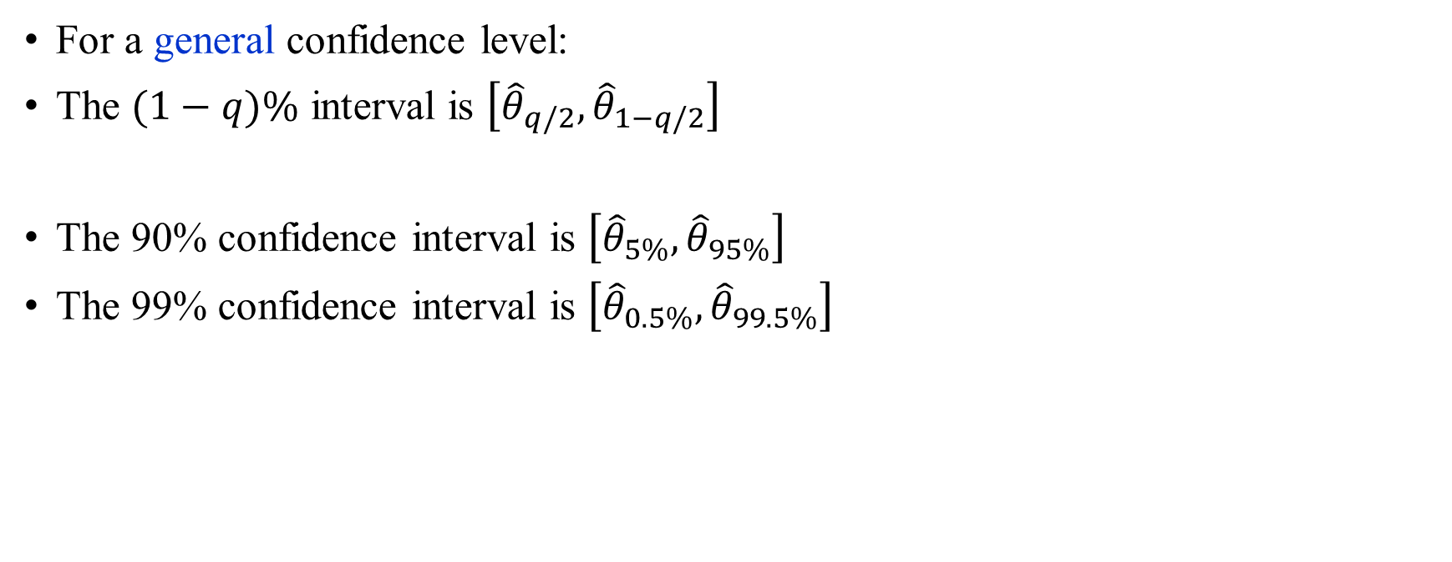
General confidence intervals
For a general confidence level:
The $(1−q)\%$ interval is $\left[{\hat{θ}}_{q/2},{\hat{θ}}_{1−q/2}\right]$
The 90% confidence interval is $\left[{\hat{θ}}_{5\%},{\hat{θ}}_{95\%}\right]$
The 99% confidence interval is $\left[{\hat{θ}}_{0.5\%},{\hat{θ}}_{99.5\%}\right]$

Slide 27
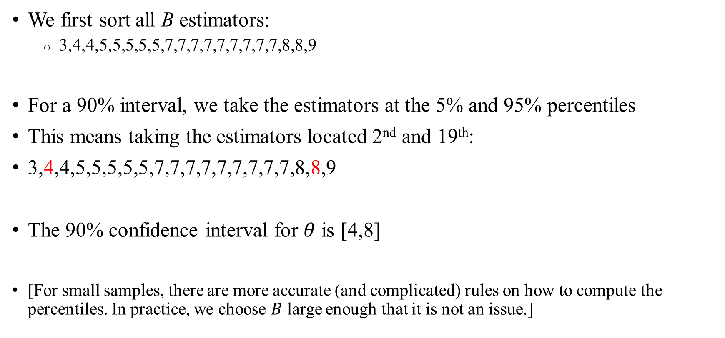
Example
We first sort all B estimators:
  3,4,4,5,5,5,5,5,7,7,7,7,7,7,7,7,7,8,8,9
For a 90% interval, we take the estimators at the 5% and 95% percentiles
This means taking the estimators located 2nd and 19th:
3,4,4,5,5,5,5,5,7,7,7,7,7,7,7,7,7,8,8,9
The 90% confidence interval for $θ$ is [4,8]
[For small samples, there are more accurate (and complicated) rules on how to compute the percentiles. In practice, we choose $B$ large enough that it is not an issue.]

Slide 28
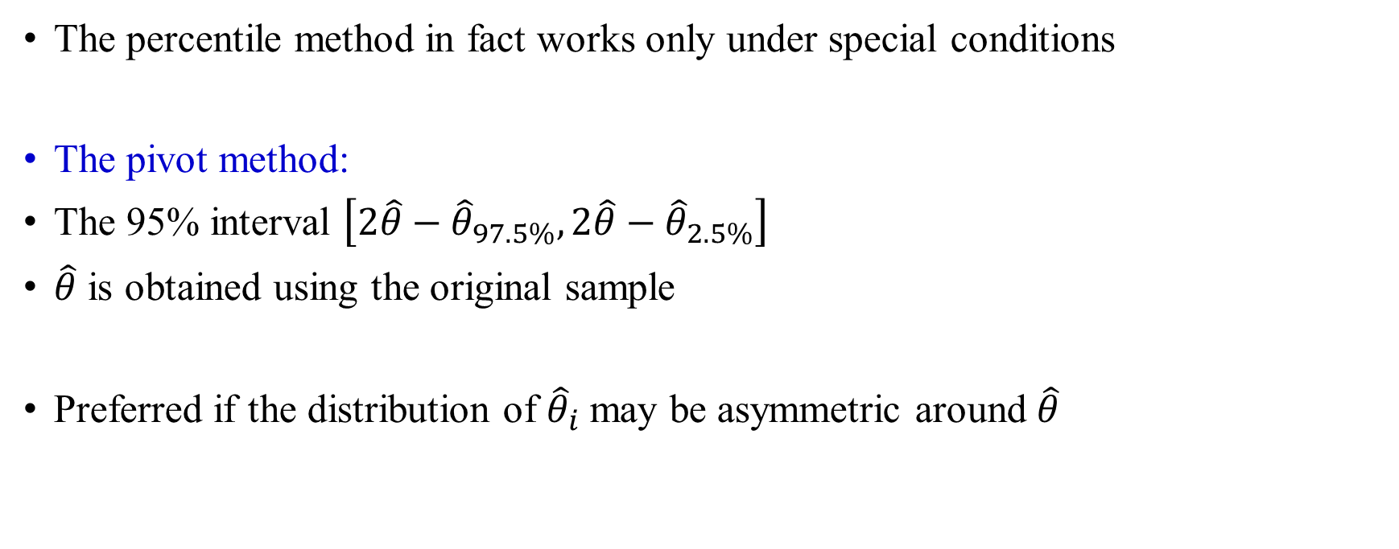
Confidence intervals: refinement
The percentile method in fact works only under special conditions
The pivot method:
The 95% interval $\left[{2\hat{θ}−\hat{θ}}_{97.5\%},2\hat{θ}−{\hat{θ}}_{2.5\%}\right]$
$\hat{θ}$ is obtained using the original sample
Preferred if the distribution of ${\hat{θ}}_{i}$ may be asymmetric around $\hat{θ}$

Slide 29
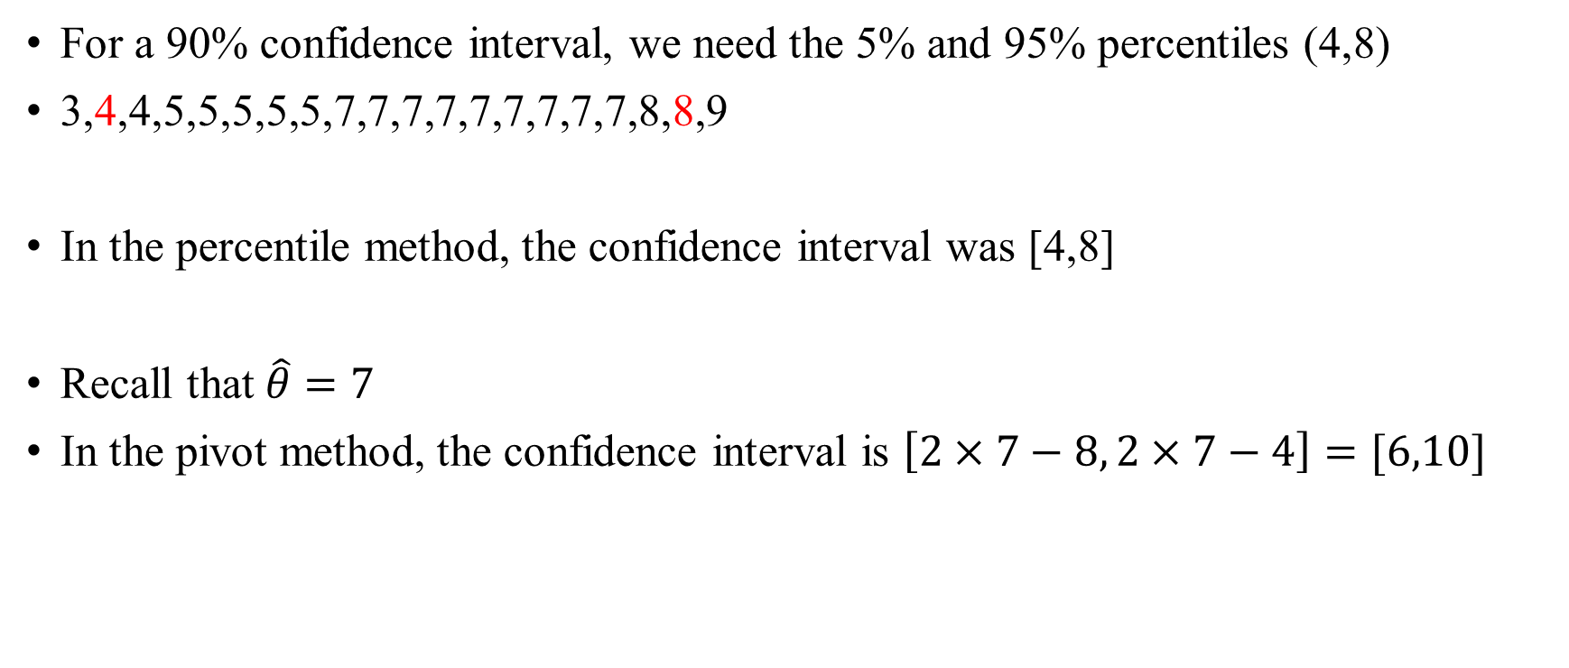
Example
For a 90% confidence interval, we need the 5% and 95% percentiles (4,8)
3,4,4,5,5,5,5,5,7,7,7,7,7,7,7,7,7,8,8,9
In the percentile method, the confidence interval was [4,8]
Recall that $\hat{θ}=7$
In the pivot method, the confidence interval is $\left[2×7−8, 2×7−4\right]=[6,10]$

Slide 30
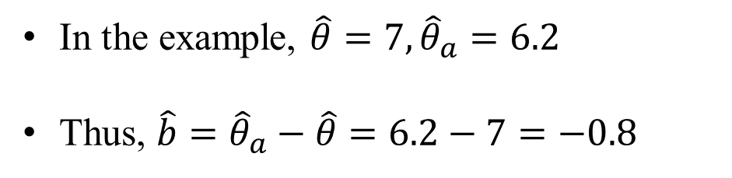
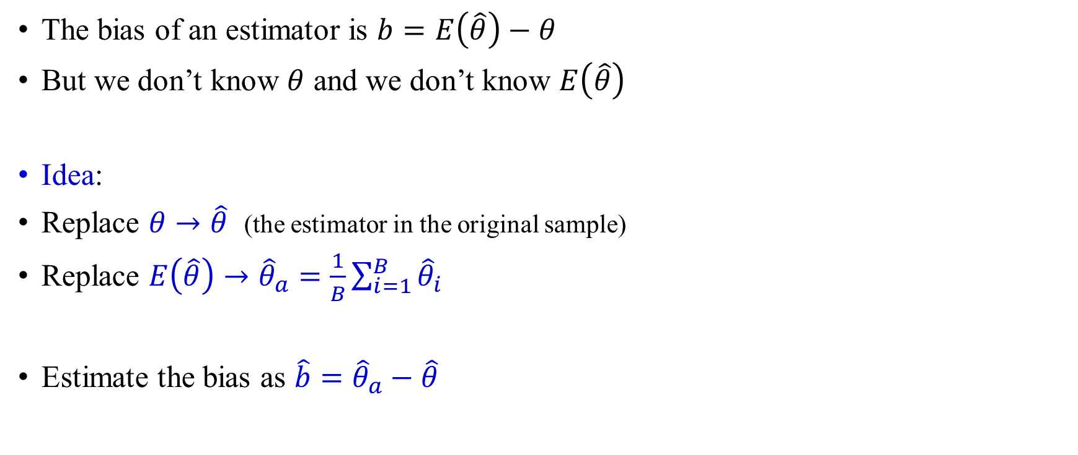
The bias
The bias of an estimator is $b=E\left(\hat{θ}\right)−θ$
But we don’t know $θ$ and we don’t know $E\left(\hat{θ}\right)$
Idea:
Replace $θ→\hat{θ}$ (the estimator in the original sample)
Replace $E\left(\hat{θ}\right)→{\hat{θ}}_{a}=\frac{1}{B}\sum_{i=1}^{B}{{\hat{θ}}_{i}}$
Estimate the bias as $\hat{b}={\hat{θ}}_{a}−\hat{θ}$
In the example, $\hat{θ}=7, {\hat{θ}}_{a}=6.2$
Thus, $\hat{b}={\hat{θ}}_{a}−\hat{θ}=6.2−7=−0.8$

Slide 31
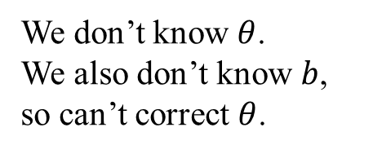


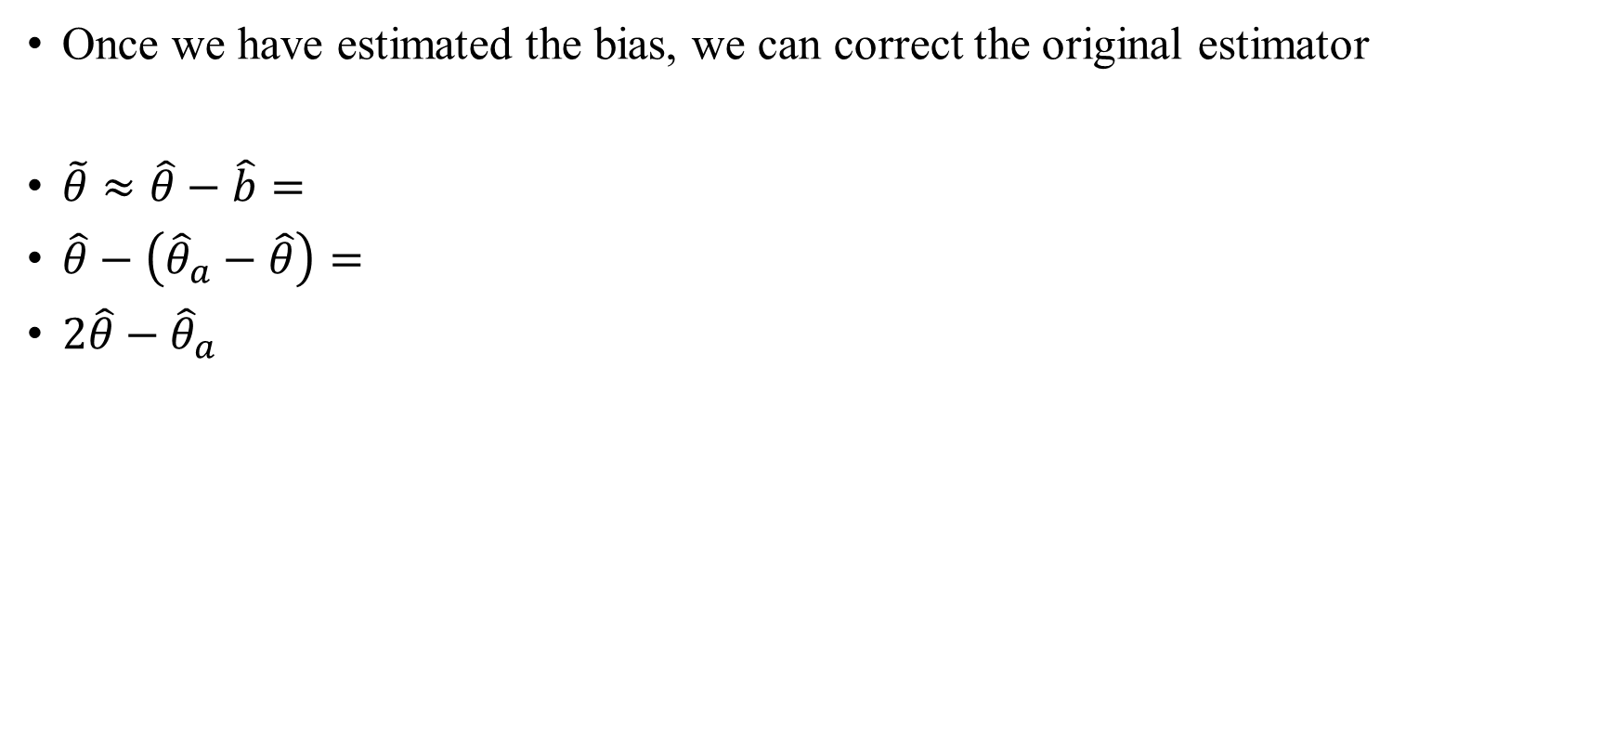



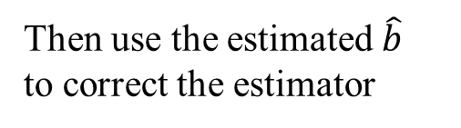

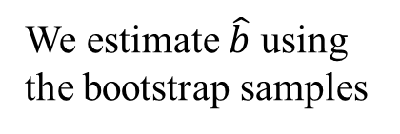
The bias
Once we have estimated the bias, we can correct the original estimator
$\tilde{θ}≈\hat{θ}−\hat{b}=$
$\hat{θ}−\left({\hat{θ}}_{a}−\hat{θ}\right)=$
$2\hat{θ}−{\hat{θ}}_{a}$
$$b$$
$$\hat{b}$$
Parameter values
$$θ$$
$$\hat{θ}$$
$${\hat{θ}}_{a}$$
$$\tilde{θ}$$
We estimate $\hat{b}$ using the bootstrap samples
We don’t know $θ$.
We also don’t know $b$, so can’t correct $θ$.
Then use the estimated $\hat{b}$ to correct the estimator

Slide 32
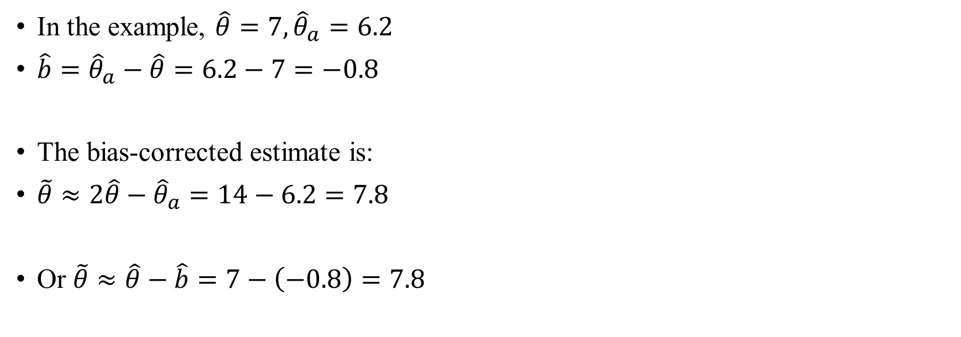
Example
In the example, $\hat{θ}=7, {\hat{θ}}_{a}=6.2$
$\hat{b}={\hat{θ}}_{a}−\hat{θ}=6.2−7=−0.8$
The bias-corrected estimate is:
$\tilde{θ}≈2\hat{θ}−{\hat{θ}}_{a}=14−6.2=7.8$
Or $\tilde{θ}≈\hat{θ}−\hat{b}=7−\left(−0.8\right)=7.8$

Slide 33
Outline
The general idea
Using the bootstrap samples
Examples and properties
Other subjects

Slide 34
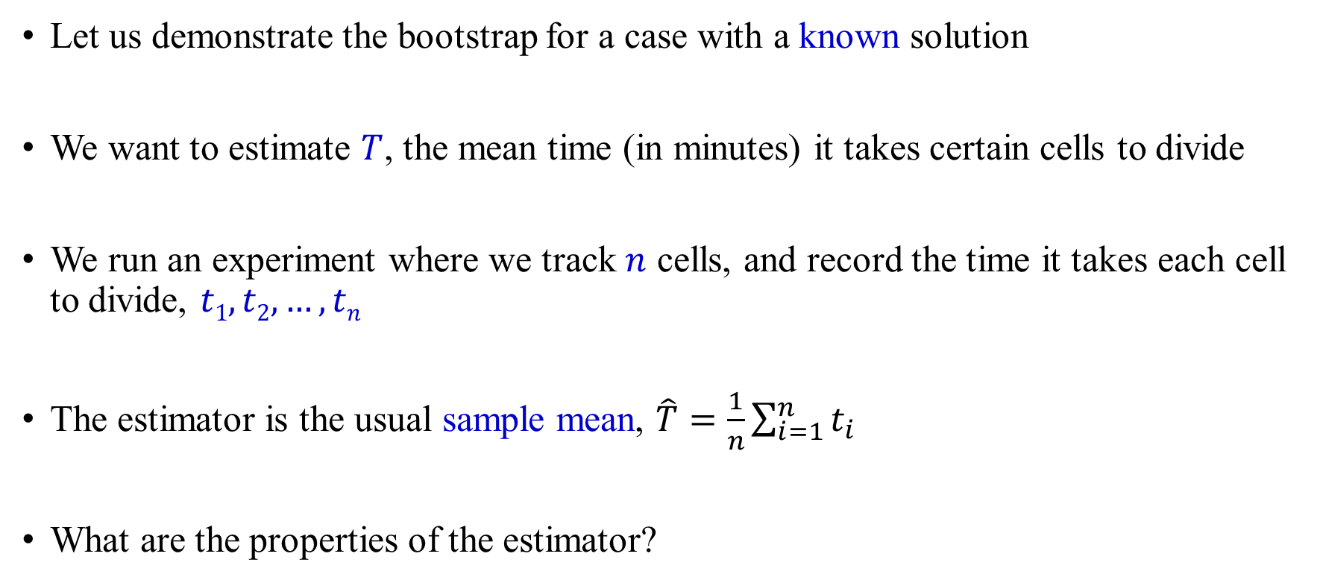
Example
Let us demonstrate the bootstrap for a case with a known solution
We want to estimate $T$, the mean time (in minutes) it takes certain cells to divide
We run an experiment where we track $n$ cells, and record the time it takes each cell to divide, $t1, t2, …, tn$
The estimator is the usual sample mean, $\hat{T}=\frac{1}{n}\sum_{i=1}^{n}{t_{i}}$
What are the properties of the estimator?

Slide 35
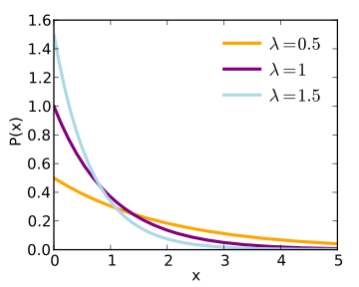
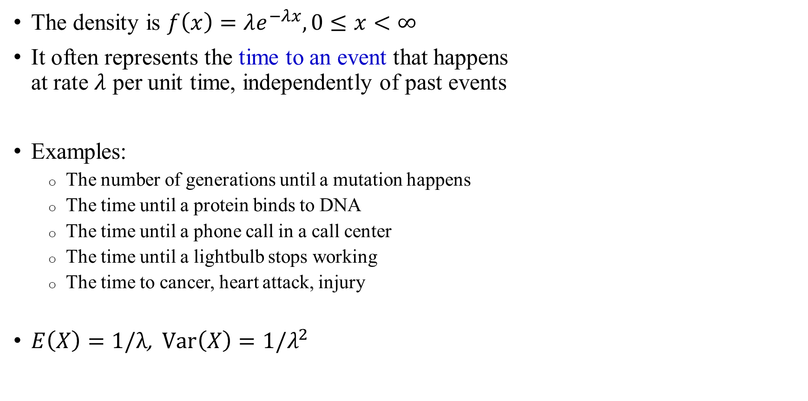
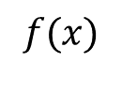
An exponential random variable
The density is $f\left(x\right)=λe^{−λx}, 0≤x<∞$
It often represents the time to an event that happens
at rate $λ$ per unit time, independently of past events
Examples:
  The number of generations until a mutation happens
  The time until a protein binds to DNA
  The time until a phone call in a call center
  The time until a lightbulb stops working
  The time to cancer, heart attack, injury
$E\left(X\right)=1/λ$, $\text{Var}\left(X\right)=1/λ^{2}$
$$f(x)$$

Slide 36
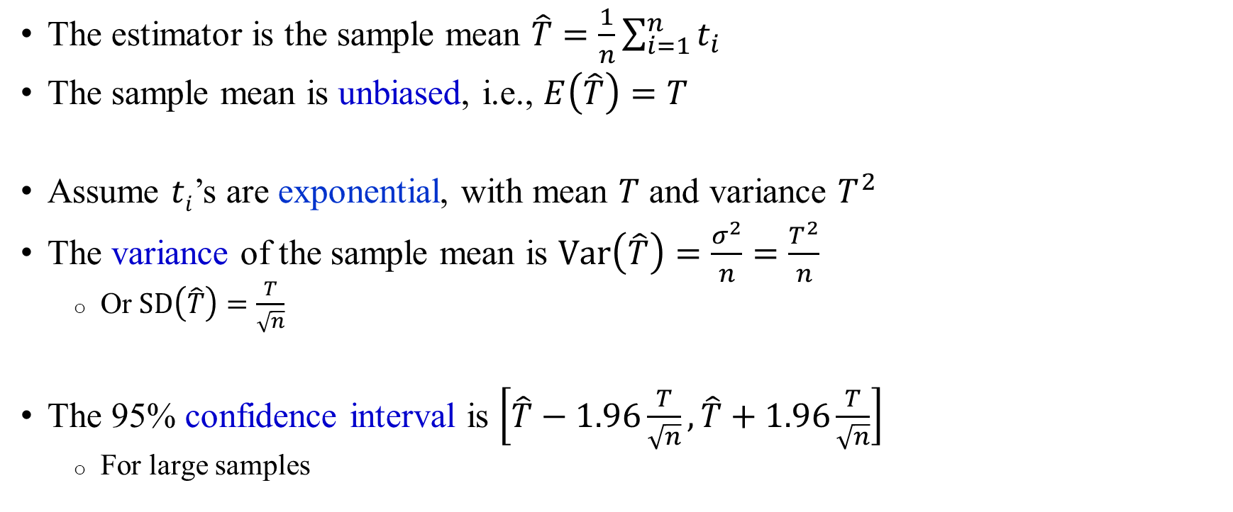
The sample mean: theory
The estimator is the sample mean $\hat{T}=\frac{1}{n}\sum_{i=1}^{n}{t_{i}}$
The sample mean is unbiased, i.e., $E\left(\hat{T}\right)=T$
Assume $ti$’s are exponential, with mean $T$ and variance $T^{2}$
The variance of the sample mean is $\text{Var}\left(\hat{T}\right)=\frac{σ^{2}}{n}=\frac{T^{2}}{n}$
  Or $\text{SD}\left(\hat{T}\right)=\frac{T}{\sqrt{n}}$
The 95% confidence interval is $\left[\hat{T}−1.96\frac{T}{\sqrt{n}},\hat{T}+1.96\frac{T}{\sqrt{n}}\right]$
  For large samples

Slide 37
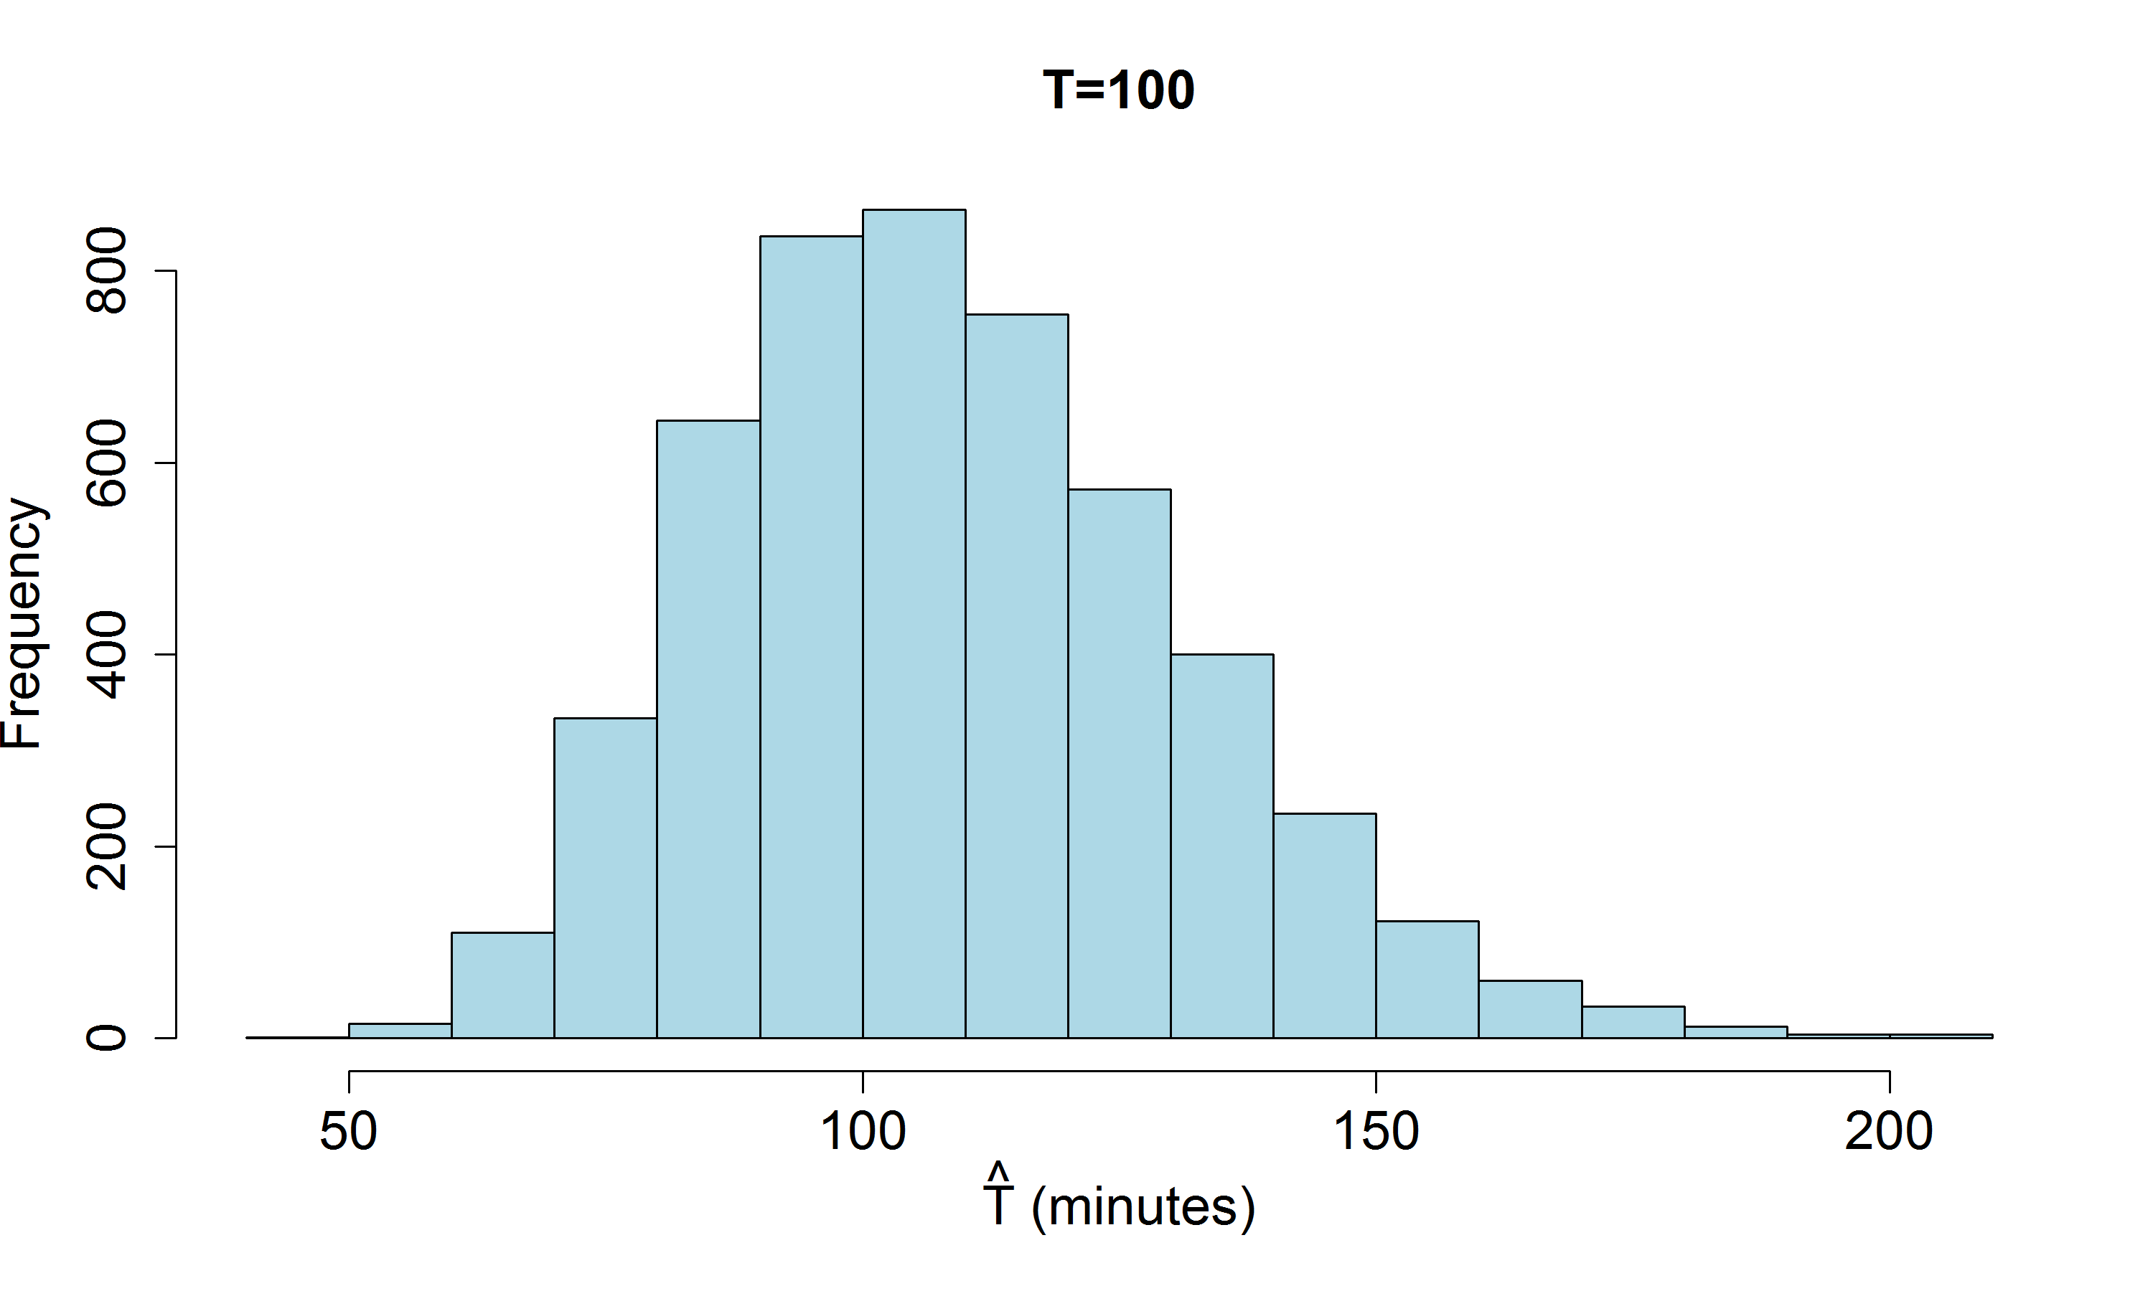
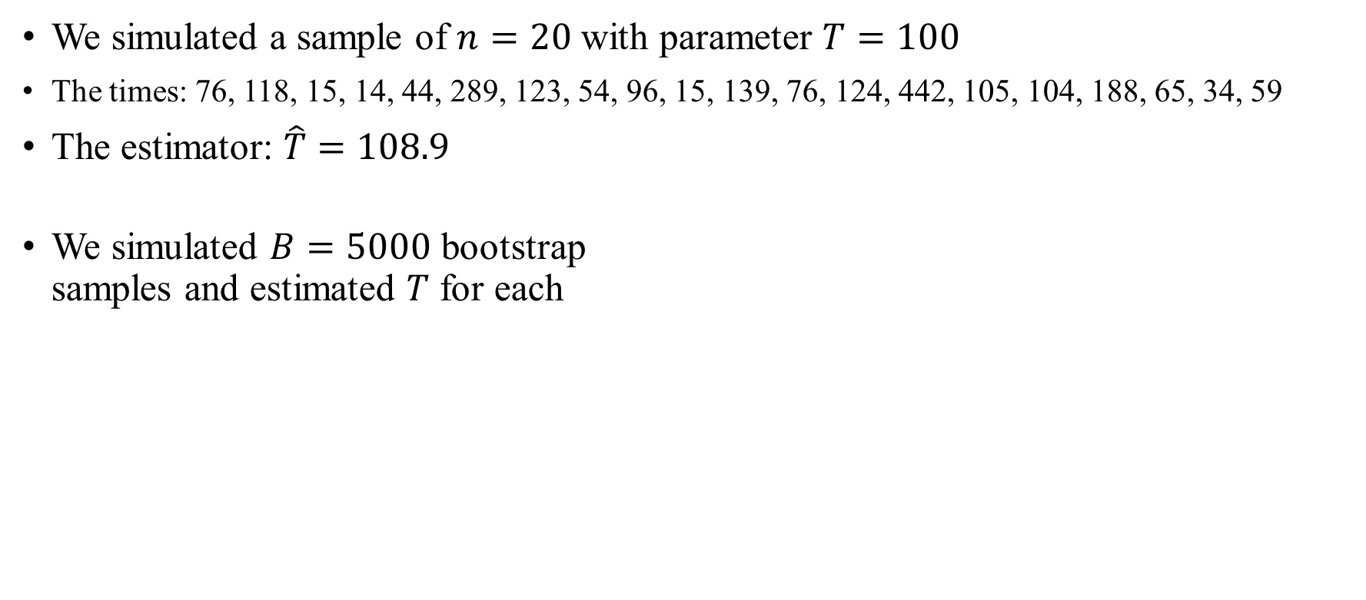
The distribution of the bootstrap estimators
We simulated a sample of $n=20$ with parameter $T=100$
The times: 76, 118, 15, 14, 44, 289, 123, 54, 96, 15, 139, 76, 124, 442, 105, 104, 188, 65, 34, 59
The estimator: $\hat{T}=108.9$
We simulated $B=5000$ bootstrap
samples and estimated $T$ for each
Histogram of values of estimators

Slide 38
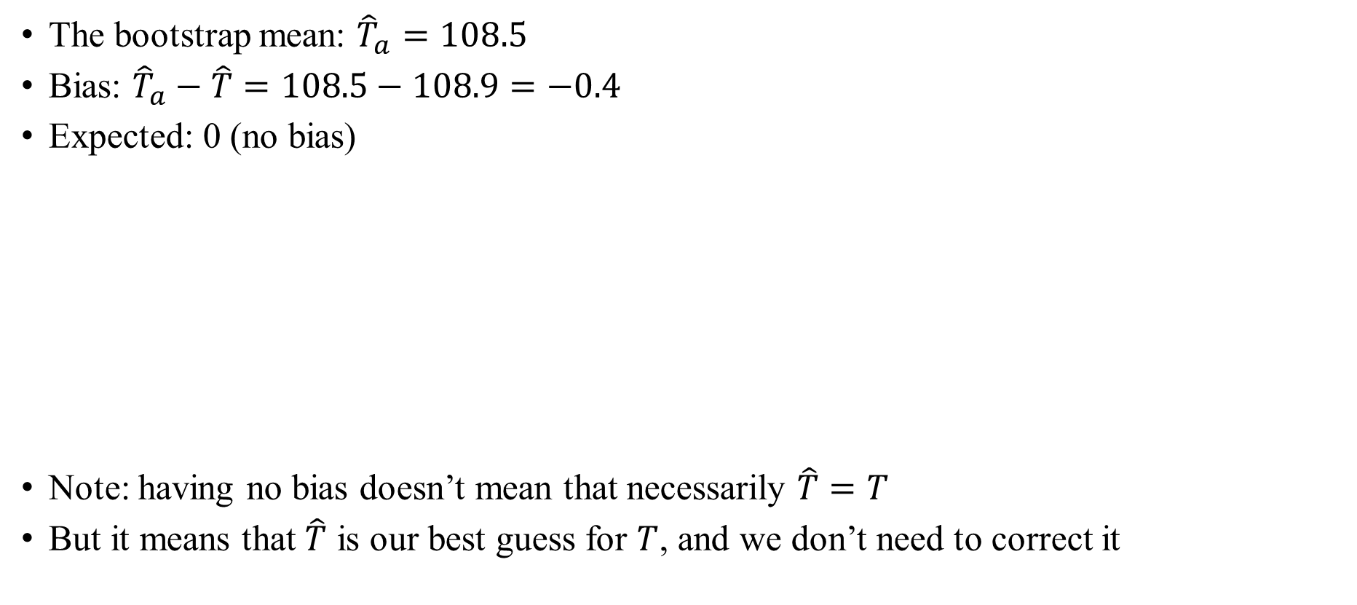


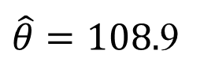

The bias
The bootstrap mean: ${\hat{T}}_{a}=108.5$
Bias: ${\hat{T}}_{a}−\hat{T}=108.5−108.9=−0.4$
Expected: 0 (no bias)
Note: having no bias doesn’t mean that necessarily $\hat{T}=T$
But it means that $\hat{T}$ is our best guess for $T$, and we don’t need to correct it
$$\hat{b}=−0.4$$
Parameter values
$$θ=100$$
$\hat{θ}=108.$9
$${\hat{θ}}_{a}=108.5$$

Slide 39
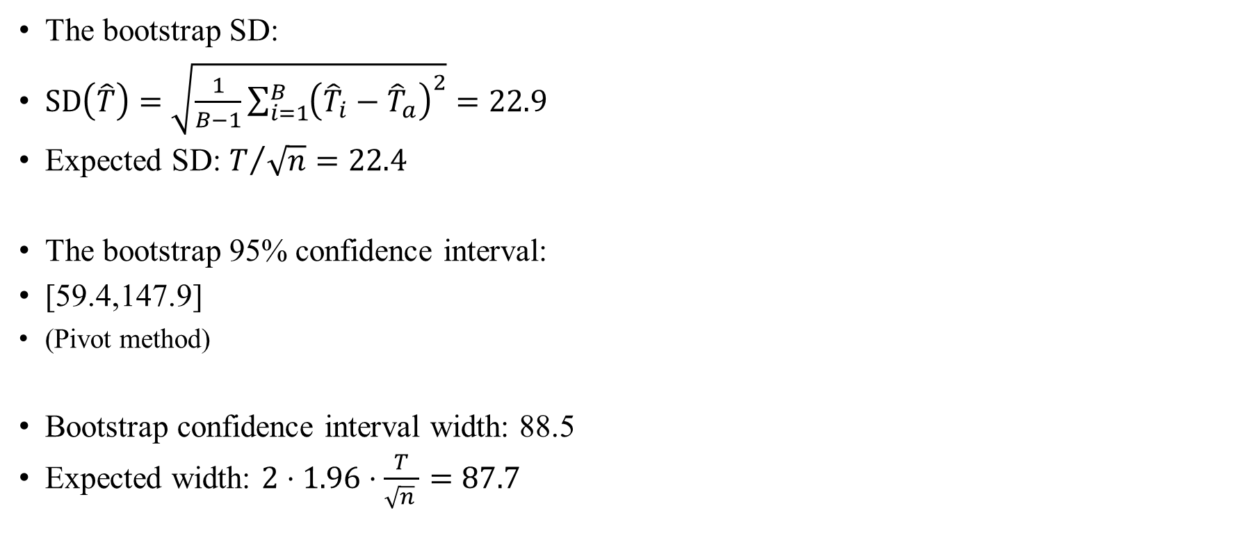
The SD and confidence interval
The bootstrap SD:
$\text{SD}\left(\hat{T}\right)=\sqrt{\frac{1}{B−1}\sum_{i=1}^{B}{{\left({\hat{T}}_{i}−{\hat{T}}_{a}\right)}^{2}}}=22.9$
Expected SD: $T/{\sqrt{n}}=22.4$
The bootstrap 95% confidence interval:
[59.4,147.9]
(Pivot method)
Bootstrap confidence interval width: 88.5
Expected width: $2⋅1.96⋅\frac{T}{\sqrt{n} }=87.7$

Slide 40
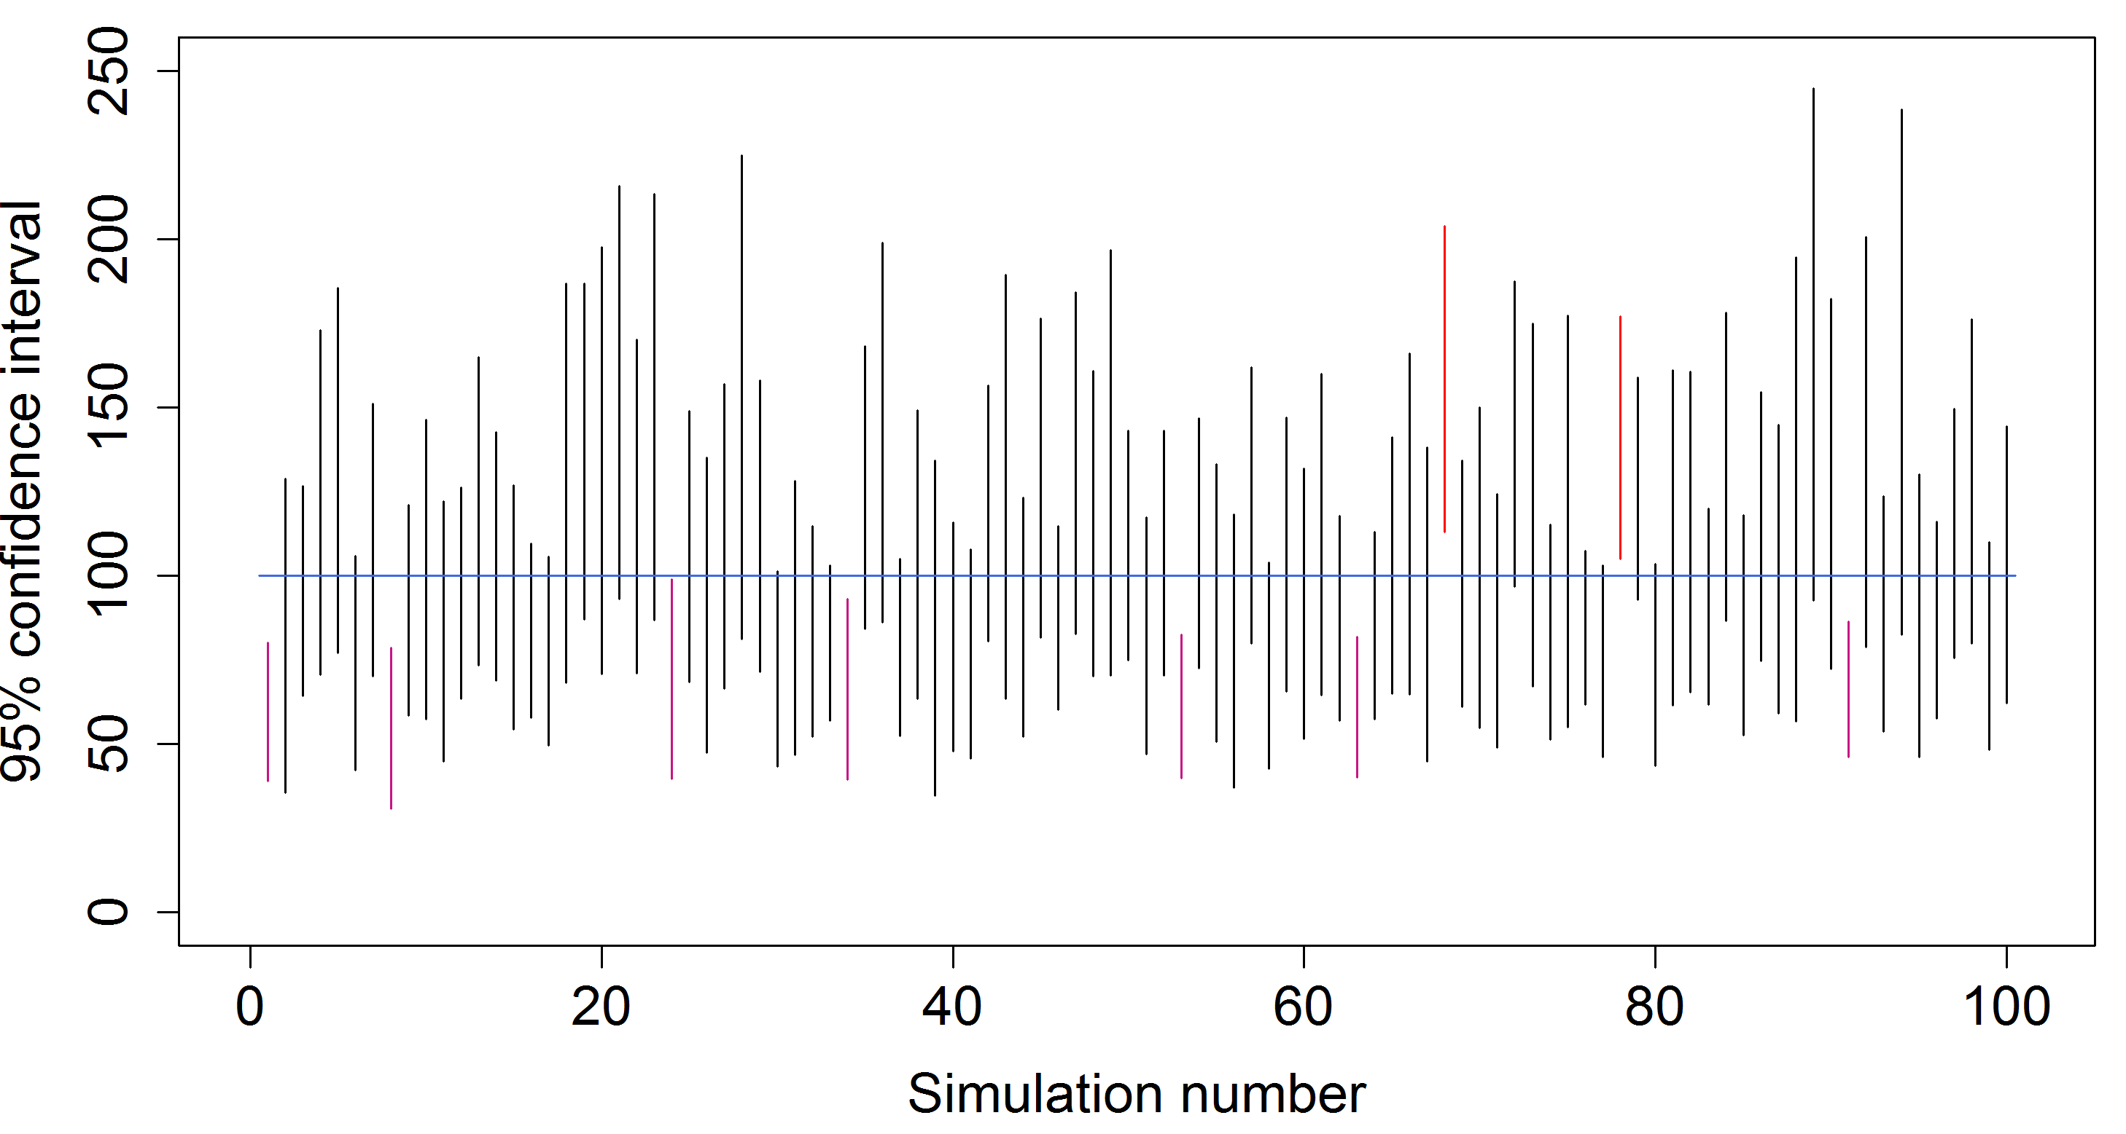
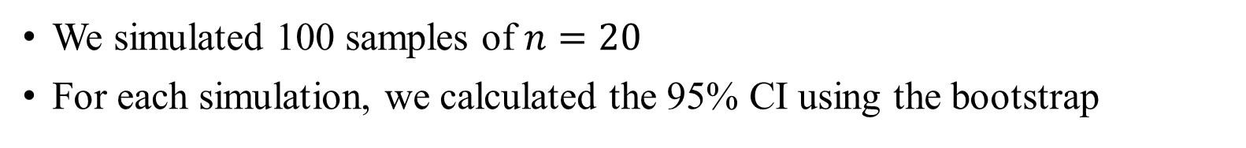
The confidence intervals
We simulated 100 samples of $n=20$
For each simulation, we calculated the 95% CI using the bootstrap

Slide 41
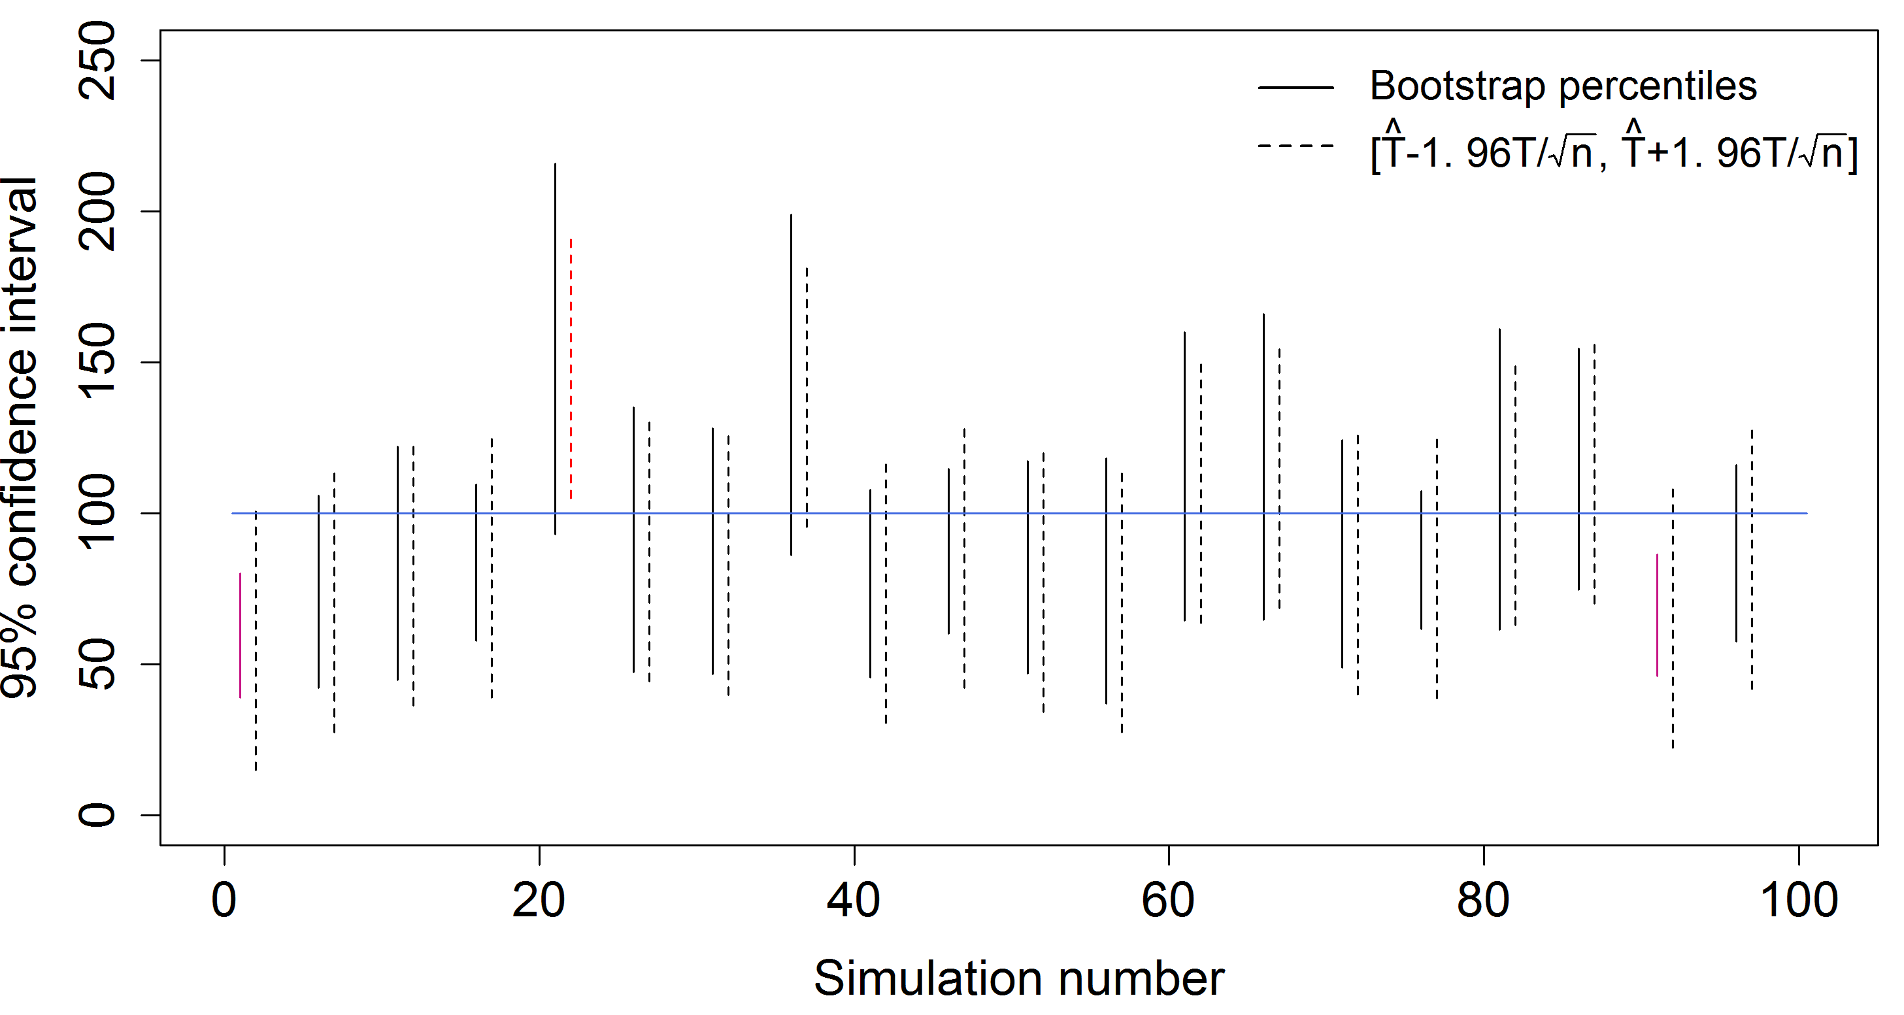
The confidence intervals
Theory: the 95% confidence intervals should be $\left[\hat{T}−\frac{1.96T}{\sqrt{n}},\hat{T}+\frac{1.96T}{\sqrt{n}}\right]$

Slide 42
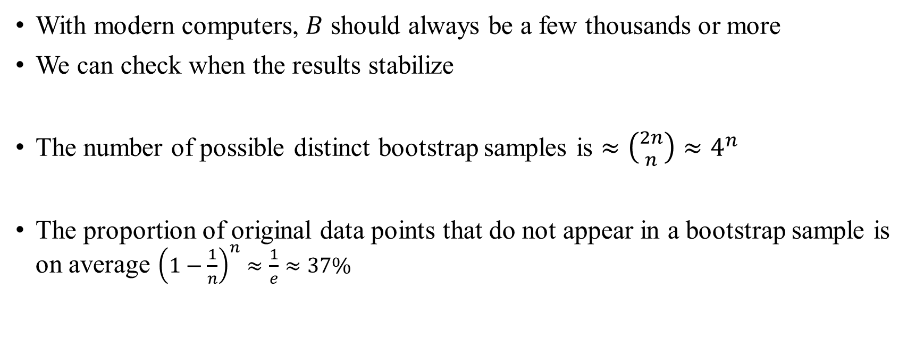
How many bootstrap samples are needed?
With modern computers, $B$ should always be a few thousands or more
We can check when the results stabilize
The number of possible distinct bootstrap samples is $≈\left({2n \atop n}\right)≈4^{n}$
The proportion of original data points that do not appear in a bootstrap sample is on average ${\left(1−\frac{1}{n}\right)}^{n}≈\frac{1}{e}≈37\%$

Slide 43
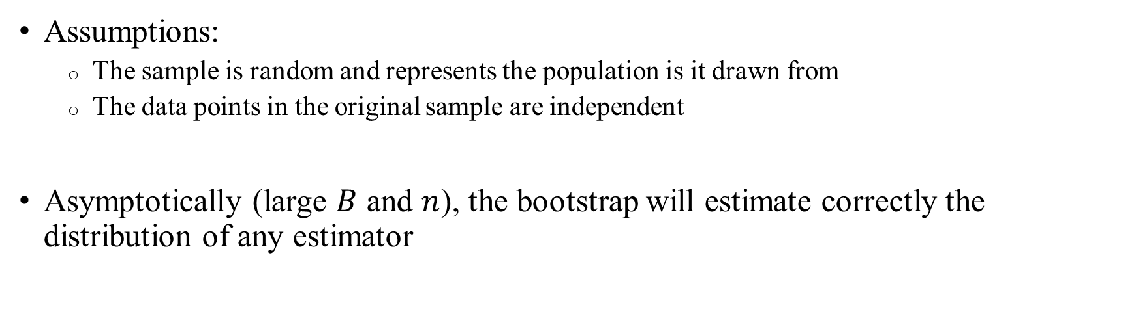
Theoretical properties of the bootstrap estimators
Assumptions:
  The sample is random and represents the population is it drawn from
  The data points in the original sample are independent
Asymptotically (large $B$ and $n$), the bootstrap will estimate correctly the distribution of any estimator

Slide 44
Advantages and disadvantages
Very simple
Does not require any problem-specific knowledge or mathematical analysis
Easy and affordable to generate a very large number of bootstrap samples
Very popular
Samples must be independent
Works less well for extreme value statistics (e.g., sample maximum)
Not all theoretical properties are fully understood
Need to interpret with caution when the sample size is very small
Bootstrap cannot fix or estimate non-random errors like systematic exclusion of samples, estimating the “wrong” quantity, assuming that certain parameters are known, etc.

Slide 45
Outline
The general idea
Using the bootstrap samples
Examples and properties
Other subjects

Slide 46

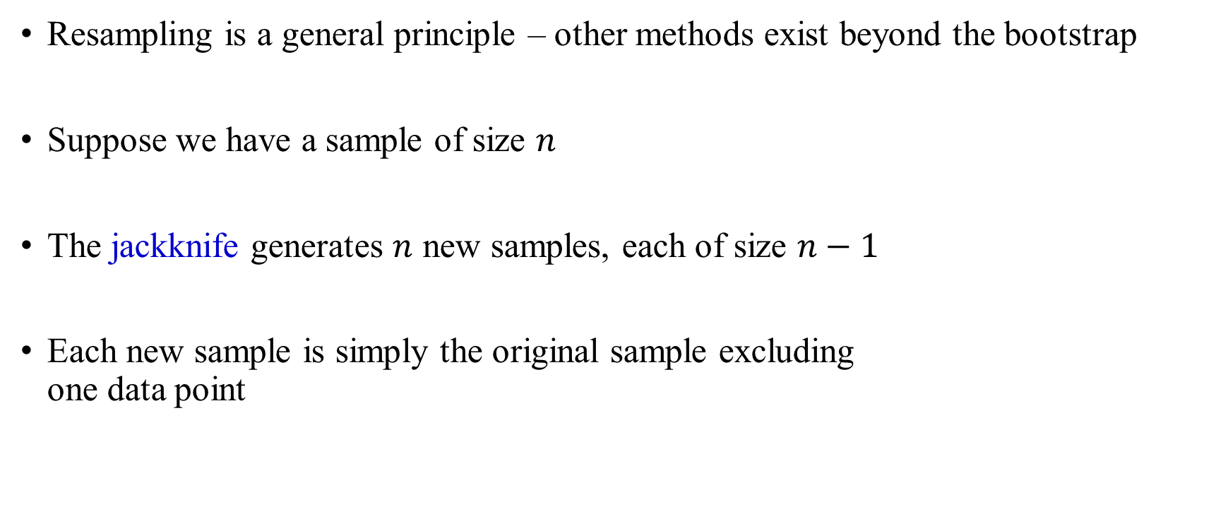
The jackknife
Resampling is a general principle – other methods exist beyond the bootstrap
Suppose we have a sample of size $n$
The jackknife generates $n$ new samples, each of size $n−1$
Each new sample is simply the original sample excluding
one data point

Slide 47
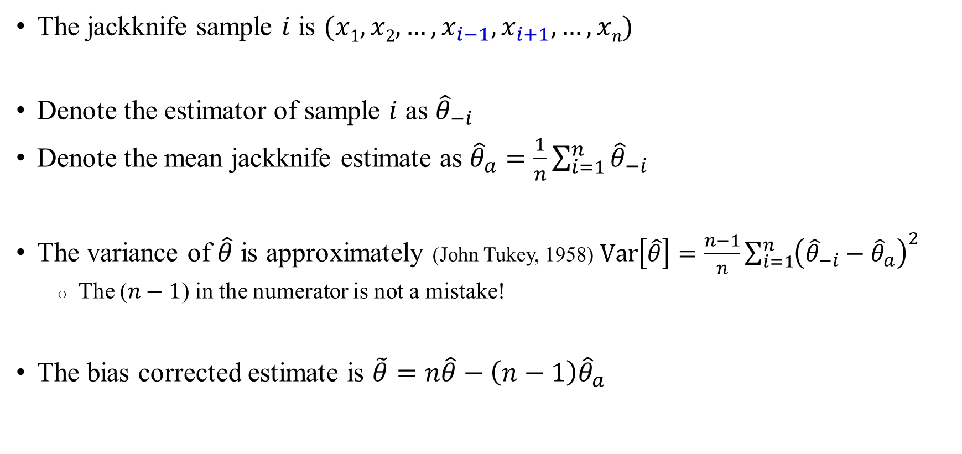
The jackknife
The jackknife sample $i$ is $(x1,x2,…,x_{i−1},x_{i+1},…,xn)$
Denote the estimator of sample $i$ as ${\hat{θ}}_{−i}$
Denote the mean jackknife estimate as ${\hat{θ}}_{a}=\frac{1}{n}\sum_{i=1}^{n}{{\hat{θ}}_{−i}}$
The variance of $\hat{θ}$ is approximately (John Tukey, 1958) $\text{Var}\left[\hat{θ}\right]=\frac{n−1}{n}\sum_{i=1}^{n}{{\left({\hat{θ}}_{−i}−{\hat{θ}}_{a}\right)}^{2}}$
  The ($n−1$) in the numerator is not a mistake!
The bias corrected estimate is $\tilde{θ}=n\hat{θ}−\left(n−1\right){\hat{θ}}_{a}$

Slide 48
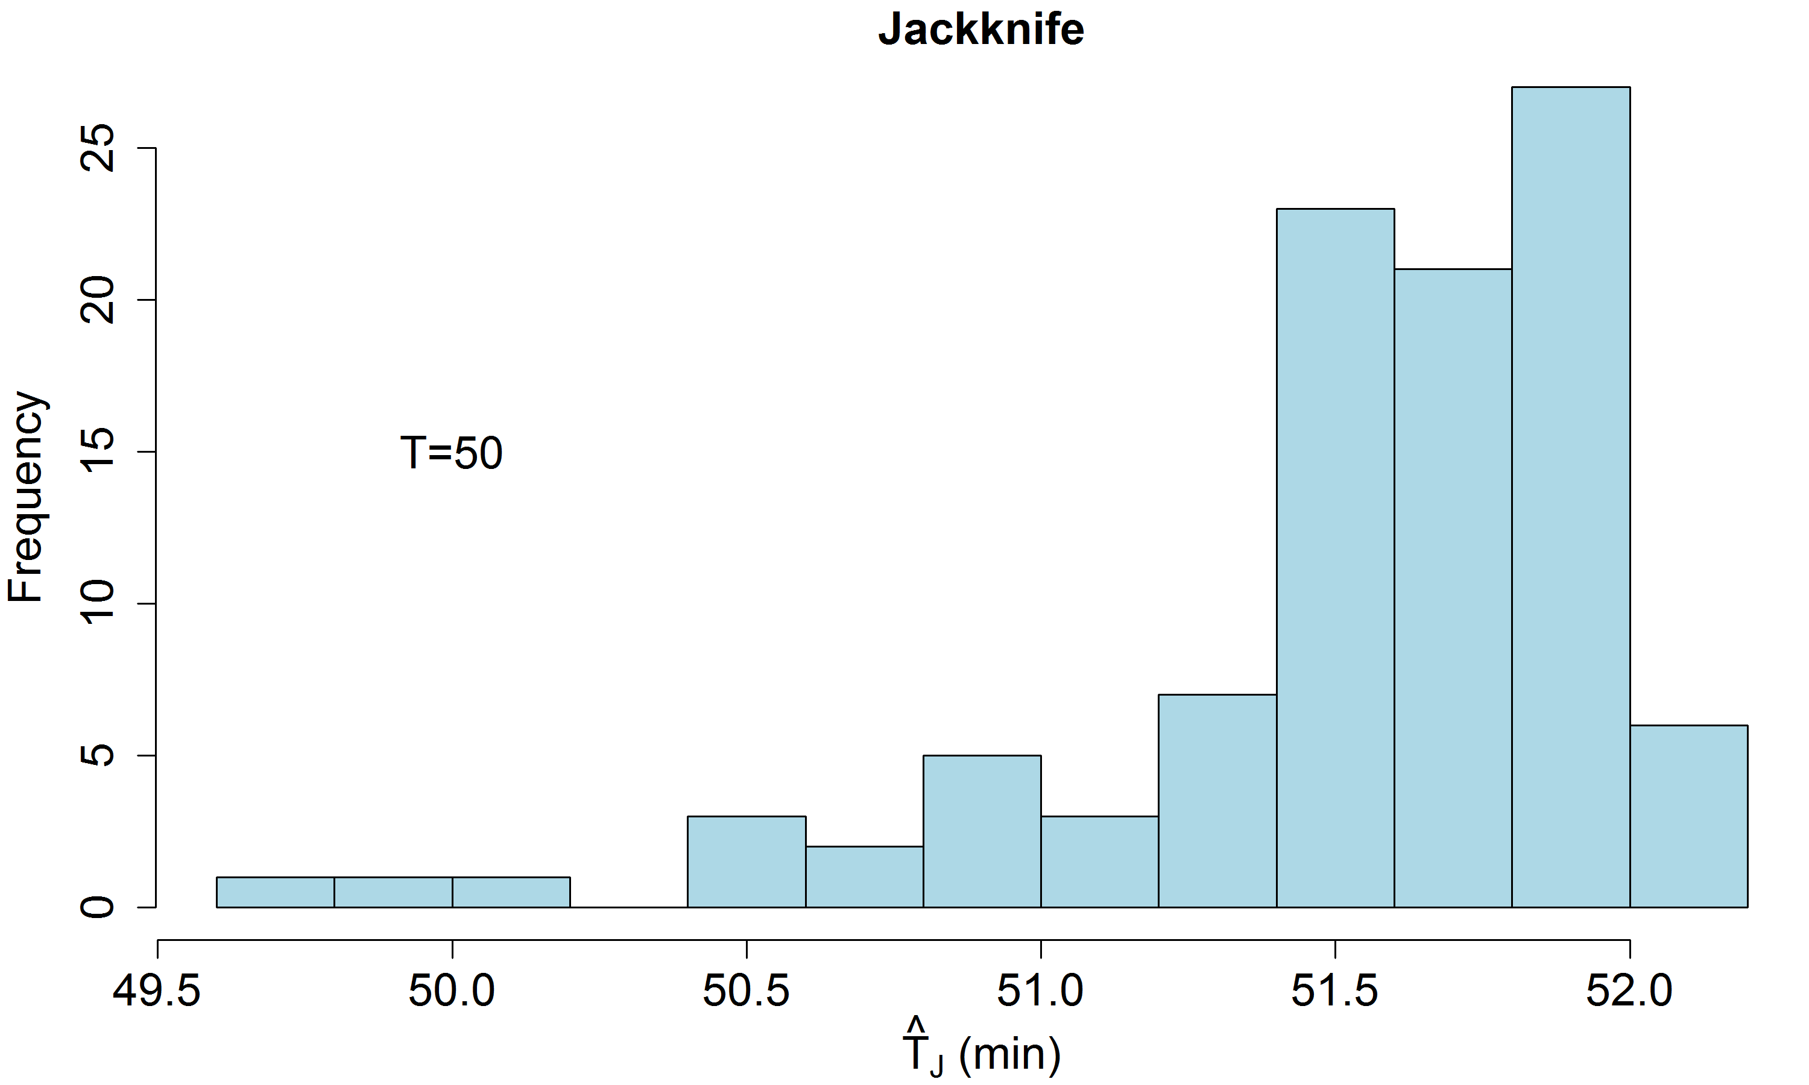
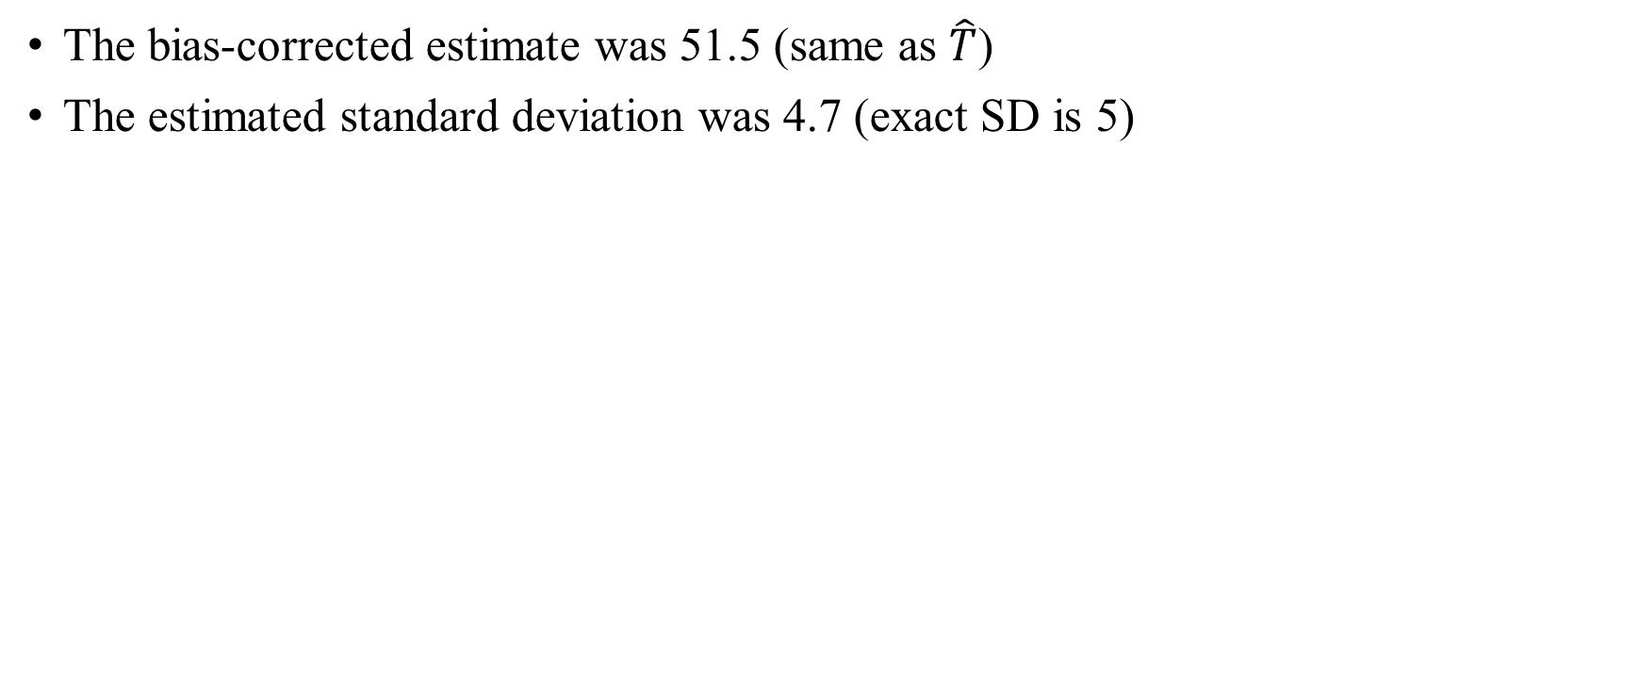
Example: Doubling time
The bias-corrected estimate was 51.5 (same as $\hat{T}$)
The estimated standard deviation was 4.7 (exact SD is 5)
n = 100
T = 50
set.seed(1)
x = rexp(n,1/T)
That = mean(x)
Thatj = numeric(n)
for (i in 1:n)
Thatj[i] = mean(x[-i])
Thata = mean(Thatj)
corr_That=n*That-(n-1)*Thata
sd_That=sqrt(sum((Thatj-Thata)^2)*(n-1)/n)

Slide 49
Jackknife vs bootstrap
The jackknife was invented many years before the bootstrap
Requires less computation
But the bootstrap provides the entire distribution and is more robust, thus is now more commonly used

Slide 50
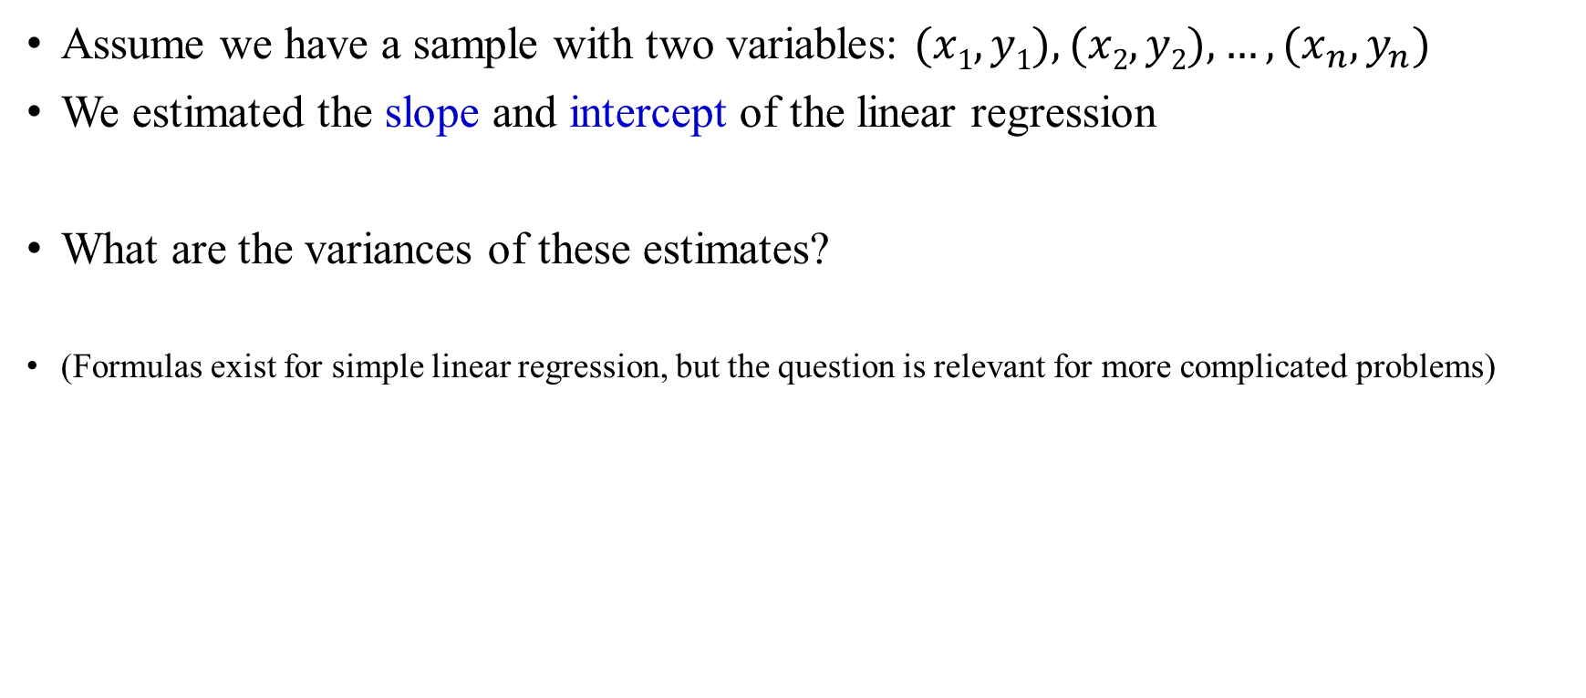
Linear regression
Assume we have a sample with two variables: $(x1,y1), (x2,y2), …, (x_{n},y_{n})$
We estimated the slope and intercept of the linear regression
What are the variances of these estimates?
(Formulas exist for simple linear regression, but the question is relevant for more complicated problems)

Slide 51

Linear regression
How to generate bootstrap samples?
Method 1: Sample $(x,y)$ pairs with replacement
  For example, for $n=6$, a bootstrap sample could be $(x3,y3),(x5,y5),(x6,y6),(x3,y3),(x1,y1),(x5,y5)$
Method 2: Sample random residuals
  Step 1: Run regression and calculate the predicted ${\hat{y}}_{i}=\hat{a}x_{i}+\hat{b}$ for each data point
  Step 2: Calculate the residuals: $ε_{i}=y_{i}−{\hat{y}}_{i}$
  Step 3: Generate a new sample by setting $y_{i}={\hat{y}}_{i}+ε_{j}$ for a randomly selected j

Slide 52



Example
$$X$$ | $$Y$$ | $$\hat{Y}$$ | $$ε$$
1 | 2.2 | 2.02 | 0.18
2 | 3.9 | 4.05 | -0.15
3 | 5.8 | 6.08 | -0.28
4 | 8.4 | 8.11 | 0.29
5 | 10.1 | 10.14 | -0.04
Linear regression analysis estimates the slope as $\hat{a}=2.03$ and the intercept as $\hat{b}=−0.01$
What is $\text{Var}\left(\hat{a}\right)$?

Slide 53




Example
$$X$$ | $$Y$$ | $$\hat{Y}$$ | $$ε$$
1 | 2.2 | 2.02 | 0.18
2 | 3.9 | 4.05 | -0.15
3 | 5.8 | 6.08 | -0.28
4 | 8.4 | 8.11 | 0.29
5 | 10.1 | 10.14 | -0.04
Linear regression analysis estimates the slope as $\hat{a}=2.03$ and the intercept as $\hat{b}=−0.01$
$$B=5000$$
The exact SD of $\hat{a}$ is 0.09
The SD using by bootstrapping:
  Resampling points: 0.12
  Resampling residuals: 0.07

Slide 54
Block bootstrap
What if the data points are not independent?
  Examples: time series, points along the genome
Divide the data points into blocks
Instead of data points, sample blocks with replacement
  There are some methods for determining the block size
*************
*************
*************
*************
*************
*************
*************
*************
*************
*************

Slide 55

Parametric bootstrap
In some cases, we are using the data points to estimate the parameters of a mathematical model with parameter $θ$
  Examples: diffusion coefficient of a molecule, growth rate of a population
Instead of resampling the data points, we can simulate a model with parameter $\hat{θ}$, and repeat $B$ times to generate the bootstrap samples
It can be more accurate (in particular for small samples), but we need to be confident that the model is appropriate

Slide 56

Example
We have $n$ cells, and we record the time it took each cell to divide: $t1, t2, …, tn$ (min)
We assume that the doubling time is exponential with mean T (minutes)
We estimate the doubling time as $\hat{T}=\frac{1}{n}\sum_{i=1}^{n}{t_{i}}$
What is the variance of $\hat{T}$?

Slide 57

Example
Simulate the following model $B$ times:
Generate doubling times $t1, t2, …, tn$ from an exponential distribution with mean $\hat{T}$
Compute the estimator${\hat{T}}_{i}=\frac{1}{n}\sum_{i=1}^{n}{t_{i}}$
The variance of the estimator is
$\text{Var}\left[\hat{T}\right]=\frac{1}{B−1}\sum_{i=1}^{B}{{\left({\hat{T}}_{i}−\frac{1}{B}\sum_{j=1}^{B}{{\hat{T}}_{j}}\right)}^{2}}$

Slide 58


Example
We used $T=50$ (min), $n=100$, $B=5000$
The estimator using the original sample was $\hat{T}=51.5$
The non-parametric bootstrap estimators
were 51.5±4.6 (mean±SD)
The parametric bootstrap estimators
were 51.6±5.2 (mean±SD)
Theoretical SD: $\frac{T}{\sqrt{n}}=5$

