Slide 1
Personal Genomics
Genomic projects and new technologies
Shai Carmi
School of Public Health

Slide 2
Major whole-genome/exome sequencing projects
Sequencing:
  1000 Genomes, Simons Genome Diversity Project, Estonian BioCentre*
  TopMed*, Personal Genome Project, Human Longevity (Venter)*
  1KJPN, GoNL, Sardinia*, Denmark, Finland*, Iceland*, Singapore, Ashkenazi Jews, Qatar
  African Genome Variation Project
Exome sequencing:
  ExAC, UK10K*, Exome Sequencing Project, Greater Middle-East, UK Biobank*, Regeneron-Geisinger*
* Extensive phenotypes

Slide 3
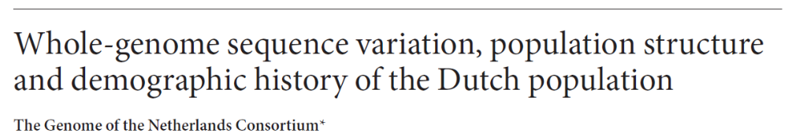
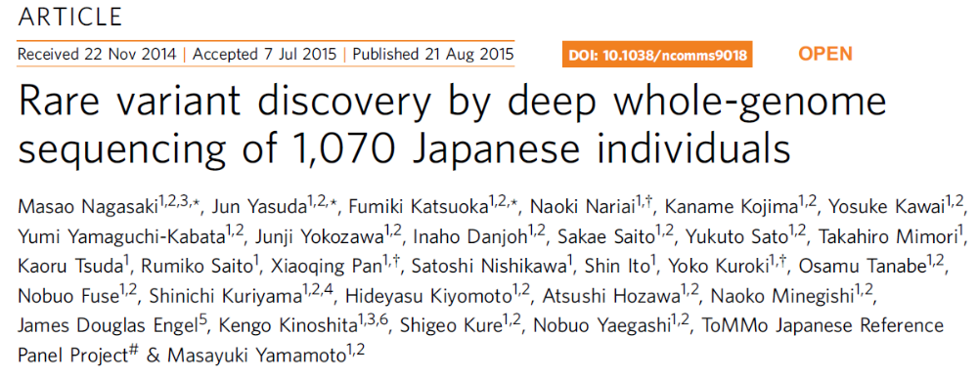
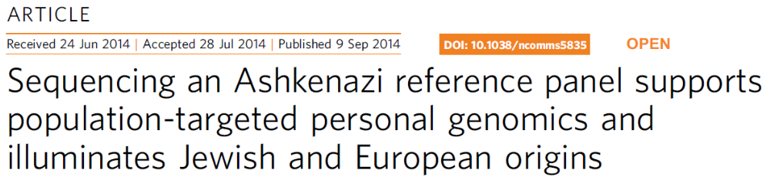
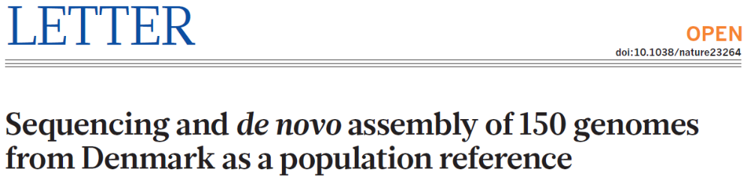
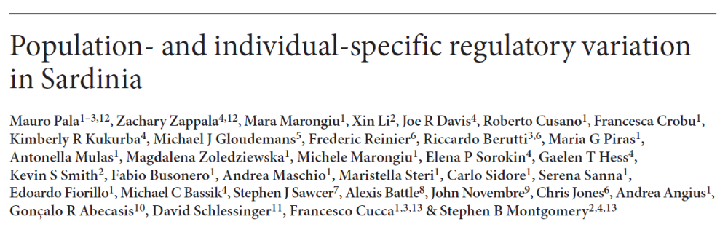
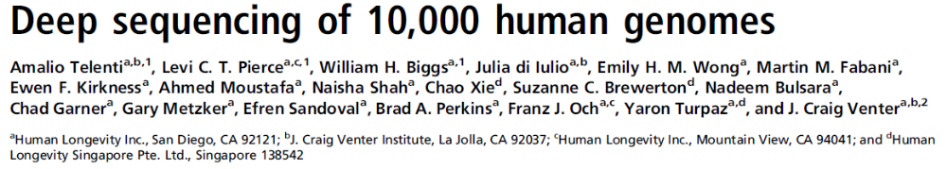
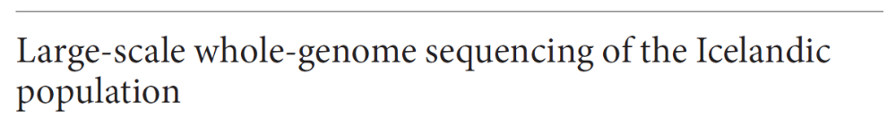
Major whole-genome/exome sequencing projects

Slide 4
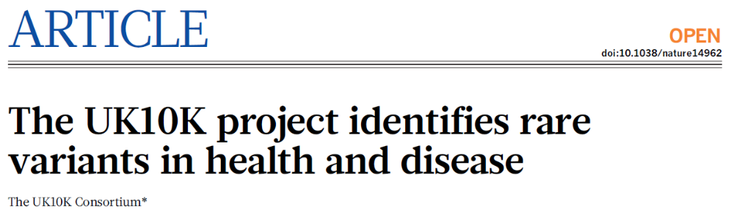
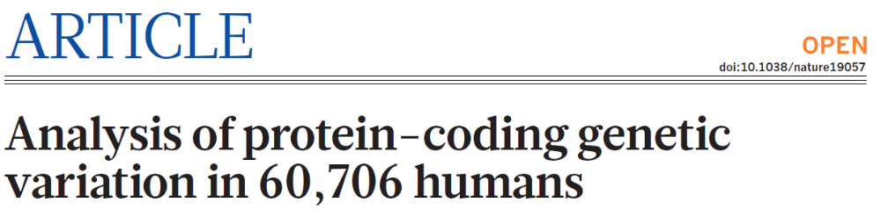
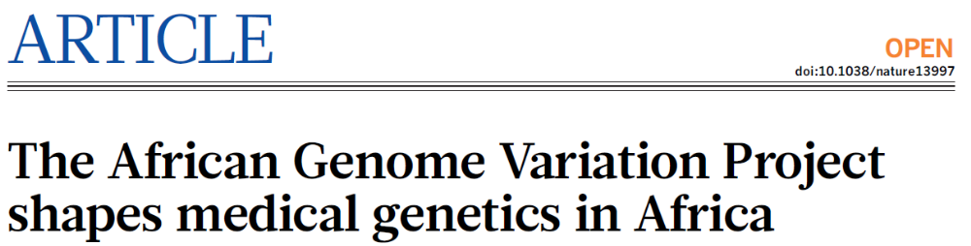
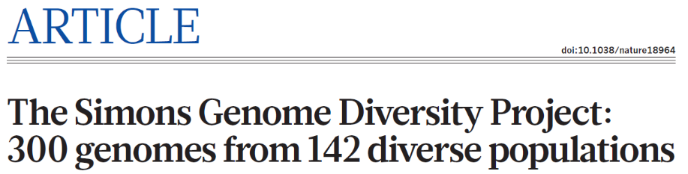
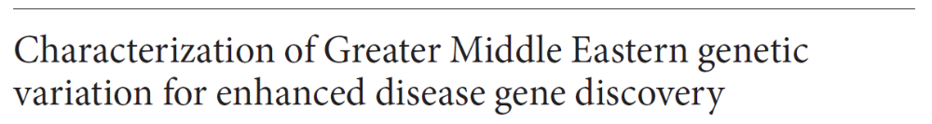
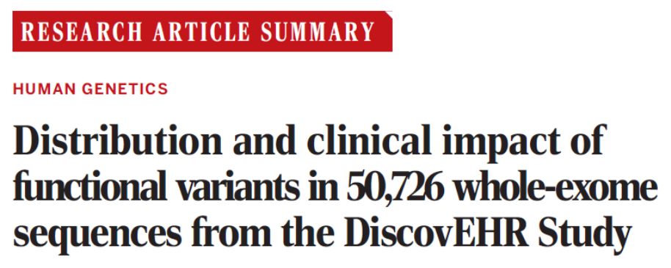
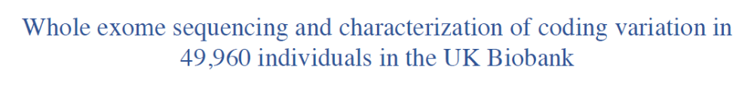
Major whole-genome/exome sequencing projects

Slide 5
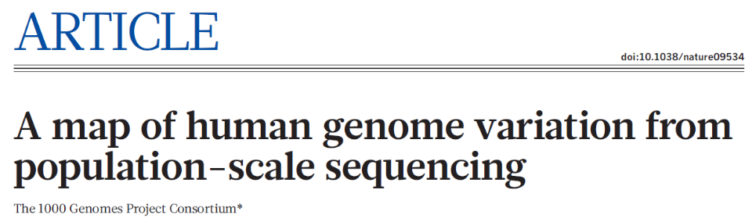
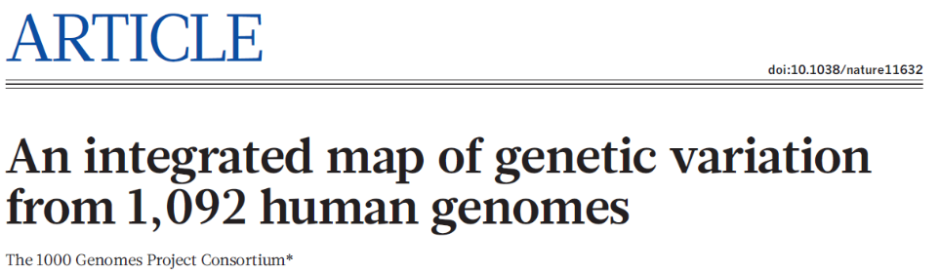
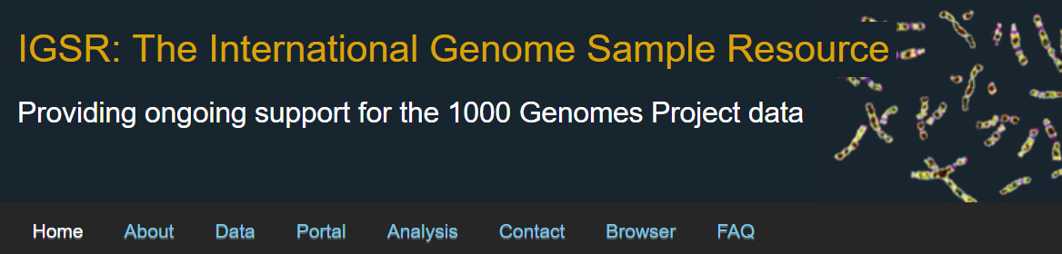
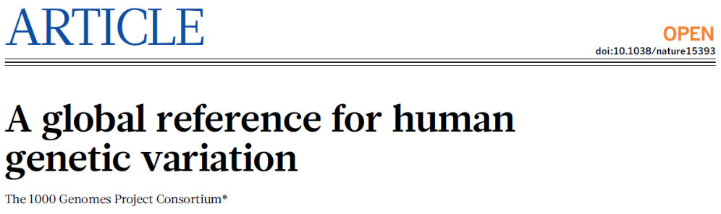
The 1000 Genomes Project
Started at 2008, at the onset of NGS, as an extremely ambitious project
2010, Pilot phase
2012, Phase 1
2015, Phase 3 and final
Data freely available!

Slide 6
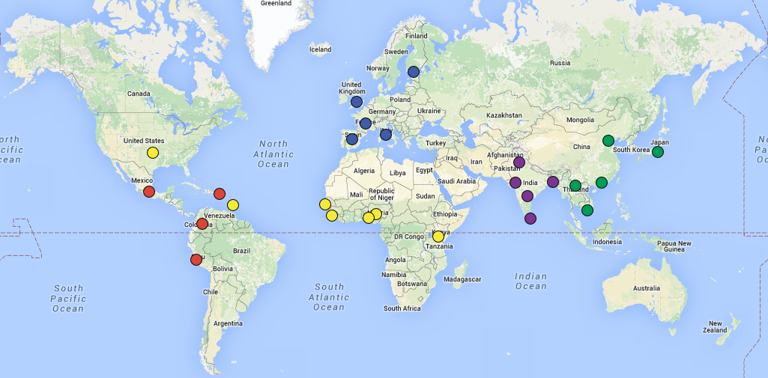
The 1000 Genomes Project
The project set the standards and tools for next generation sequencing
Based on relatively low-coverage sequencing (≈7x)
Total: 2504 individuals from 26 population

Slide 7
The populations
CHB | Han Chinese in Beijing, China | EAS
JPT | Japanese in Tokyo, Japan | EAS
CHS | Southern Han Chinese | EAS
CDX | Chinese Dai in Xishuangbanna, China | EAS
KHV | Kinh in Ho Chi Minh City, Vietnam | EAS
CEU | Utah Residents (CEPH) with Northern and Western European Ancestry | EUR
TSI | Toscani in Italia | EUR
FIN | Finnish in Finland | EUR
GBR | British in England and Scotland | EUR
IBS | Iberian Population in Spain | EUR
YRI | Yoruba in Ibadan, Nigeria | AFR
LWK | Luhya in Webuye, Kenya | AFR
GWD | Gambian in Western Divisions in the Gambia | AFR
MSL | Mende in Sierra Leone | AFR
ESN | Esan in Nigeria | AFR
ASW | Americans of African Ancestry in SW USA | AFR
ACB | African Caribbeans in Barbados | AFR
MXL | Mexican Ancestry from Los Angeles USA | AMR
PUR | Puerto Ricans from Puerto Rico | AMR
CLM | Colombians from Medellin, Colombia | AMR
PEL | Peruvians from Lima, Peru | AMR
GIH | Gujarati Indian from Houston, Texas | SAS
PJL | Punjabi from Lahore, Pakistan | SAS
BEB | Bengali from Bangladesh | SAS
STU | Sri Lankan Tamil from the UK | SAS
ITU | Indian Telugu from the UK | SAS

Slide 8
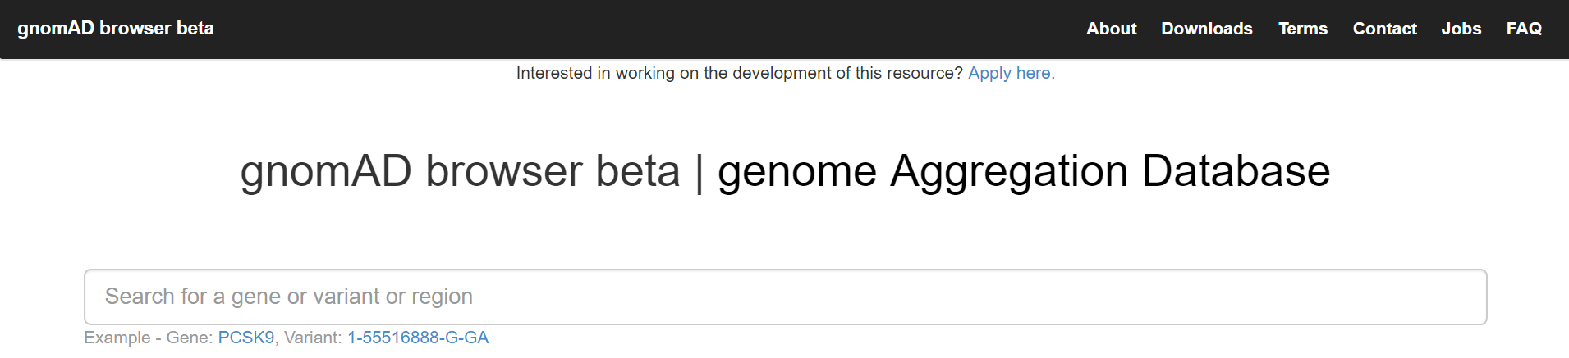
gnomAD
Genome Aggregation Database
125,748 exomes, 15,708 whole-genomes
Unrelated individuals from various disease and population genetic studies
Allele frequencies freely available

Slide 9

TOPMed
Trans-Omics for Precision Medicine projects of the NIH
53,831 whole-genomes (38x coverage) released 03/2019; 145k expected
>80 studies of heart, blood, and other phenotypes
82% from the US (40% European, 32% African, 16%, Hispanic/Latino, 10% Asian)
Allele frequencies available

Slide 10
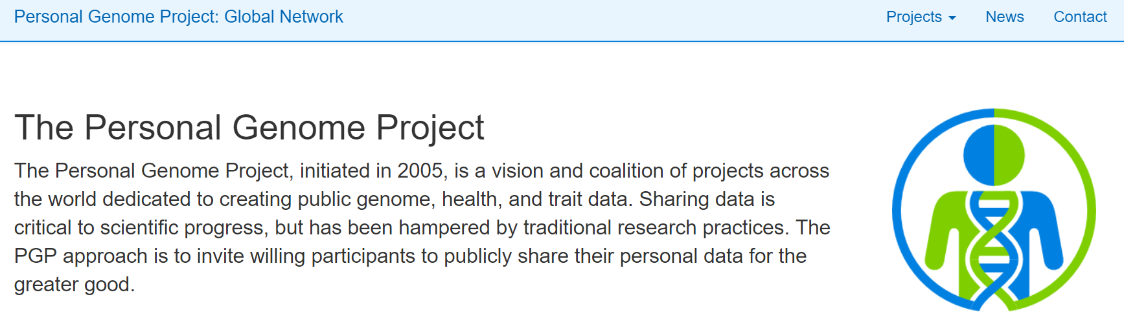
Personal Genome Project
Initiated by George Church, one of the genomics pioneers
Contains ≈1000 Genomes + microarray, microbiome, demographic data, and for many individuals, also phenotypes and medical records
All data is completely free and immediately accessible

Slide 11
Major genotyping projects
HapMap, Human Genome Diversity Project, PopRes
UKBioBank
Iceland (deCODE)
Specific populations: Jewish, Finland, India, French Canadians, Greek, …
Disease consortia: GIANT, Psychiatric Genome Consortium, GERA, CHARGE, ARIC, HRS, ALSPAC, EGG, GLGC, CARDIoGRAMplusC4D, SIGMA, T2D-GENES, GoT2D, Vanderbuilt BioVU…
Industry: 23andMe, Ancestry DNA, FamilyTree DNA, MyHeritage

Slide 12
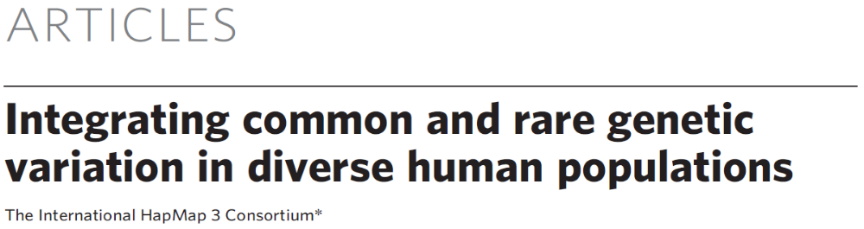
HapMap
The first large-scale, international project for population-scale genotyping
Third phase concluded in 2010
Eleven populations, 1184 individuals, 1.44M SNPs
  A subset of the 1000 Genomes samples
The data was and is still considered a gold-standard and one of the most useful resources in population and medical genetics
2010

Slide 13
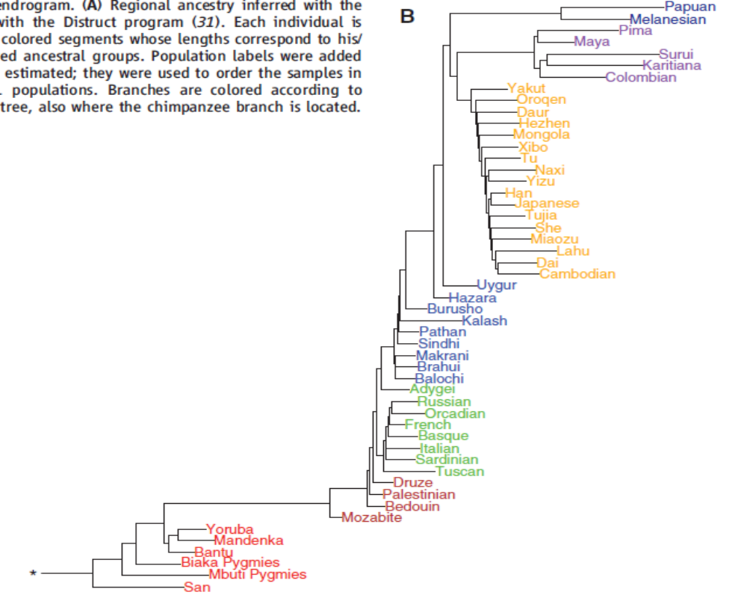
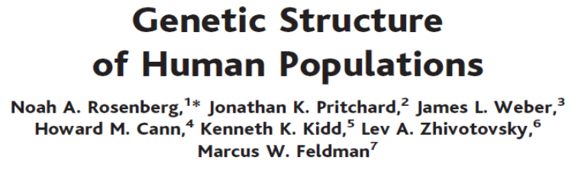
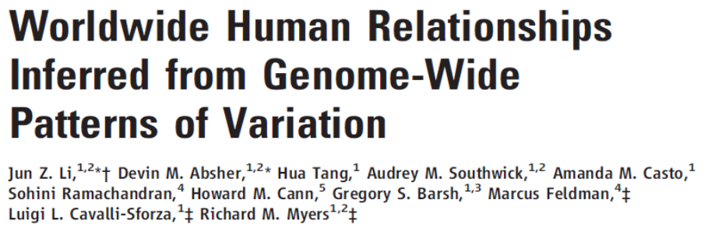
Human Genome Diversity Project (HGDP)
Was a major effort to collect DNA from in order to capture the most genetic diversity worldwide
  2002: 1056 individuals, 52 populations, 377 STRs
  2008: 938 individuals, 51 populations, 660k SNPs
Still an important dataset for population genetics
  Data freely available
Science 2002
Science 2008
Israeli populations

Slide 14
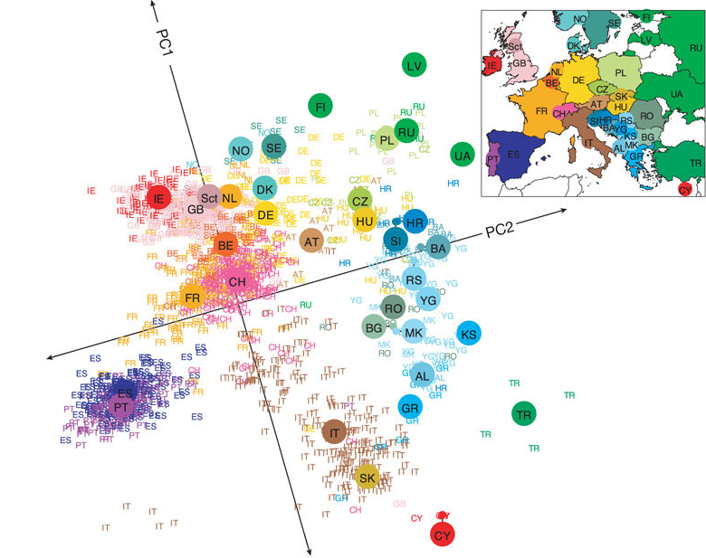
PopRes
A major project also focusing on capturing world-wide genetic diversity
≈6,000 subjects of African-American, East Asian, South Asian, Mexican, and European origin
Data available but requires an application (dbGaP)
Genes mirror geography within Europe, Nature, 2008

Slide 15

The UK BioBank
A study of 500,000 volunteers of ages 40-69
  Recruitment started in 2006, follow up expected for 30 years
  Questionnaires and interviews on lifestyle, medical history, nutritional habits, etc.
  Height, weight, blood pressure, cognitive ability, visual acuity, etc. were measured
  Blood and urine samples collected, blood biomarkers available
  Additional medical data is continuously collected
2015: Microarray genotypes for ≈150,000 participants
2017: Microarray genotypes for ≈500,000 participants
2019: Exome sequencing for ≈50,000 participants

Slide 16
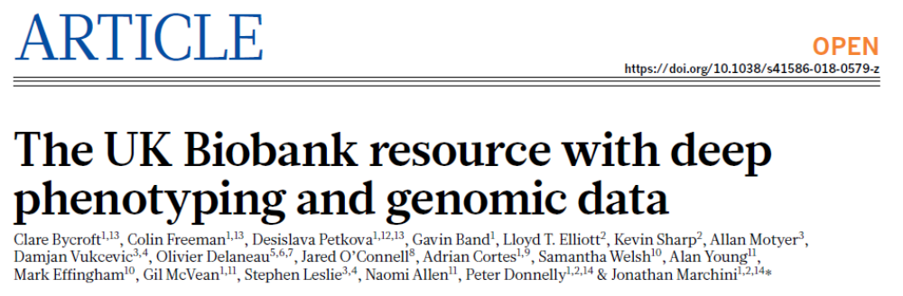
The UK BioBank
The data is available for all researchers for a fee (≈$2000s) and an application
Currently the most important genetic resource for medical genetics and statistical genetics in general
Hundreds of publications since data release
Inspired national biobanks in other countries, including the US (All of Us) and Israel (PSIFAS)
2018

Slide 17
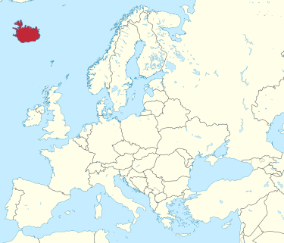

deCODE genetics
The population of Iceland has been mostly isolated for its ≈1000 years existence
The populations size is only ≈350,000
deCODE has genotyped nearly half the population, and sequenced 1000s
Very detailed genealogies and medical records are available
deCODE has discovered risk factors for numerous diseases
Many important papers on mutation and recombination
But the data is not publicly available

Slide 18
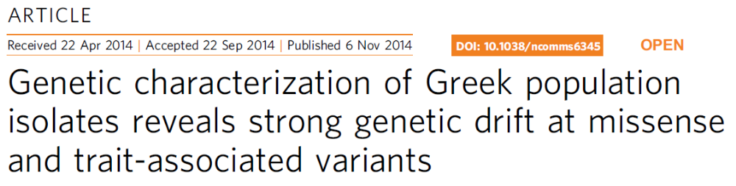
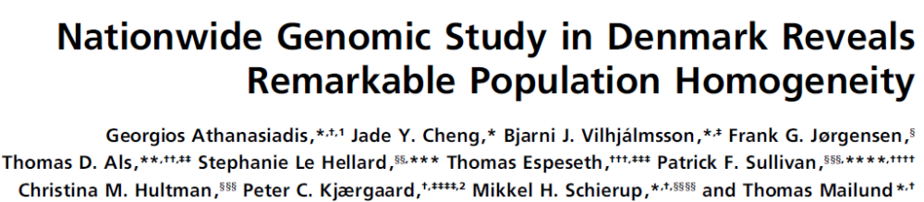
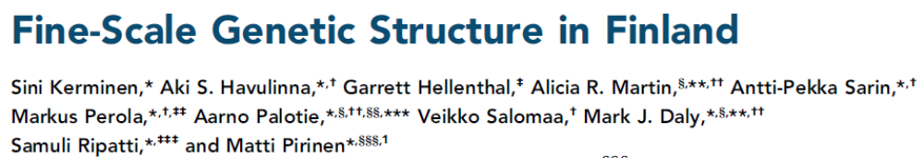
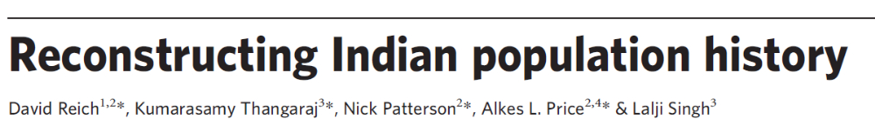
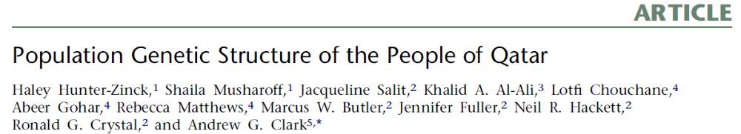
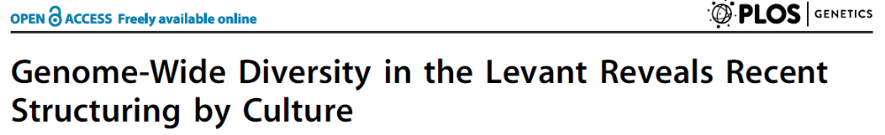
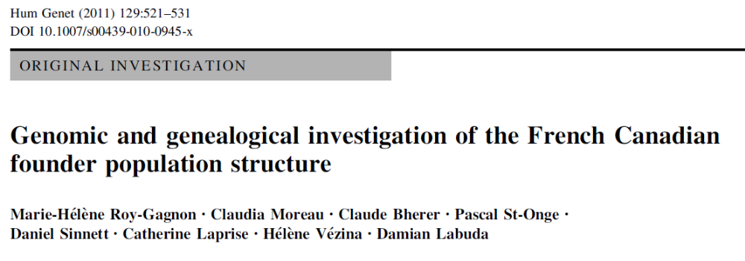
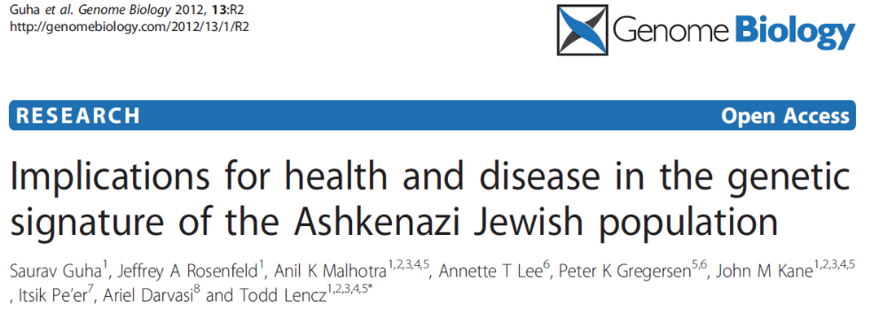
Genotyping projects of various ethnic groups

Slide 19
Emerging technologies: long read sequencing
The main problem with current sequencing technologies is that they begin by breaking the DNA into short fragments
  Mapping reads to (or assembling) repetitive regions is thus very difficult
  A large proportion (≈10-20%) of the genome remains low-quality
  The accuracy of calling structural variants is low
  Phasing is difficult
  Sequencing entire microbial genomes in an ecological community is impossible
➔ Key to technology development: longer reads
But keep low the base call error rate (currently ≈10⁻³) and the cost…
New technologies sometime called third generation sequencing

Slide 20
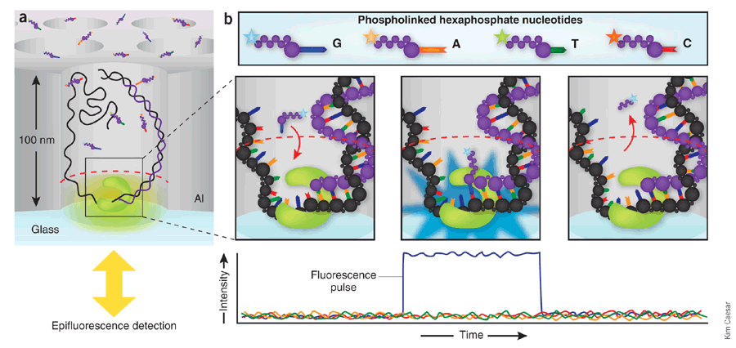
Pacific Biosciences
Technology called Single-Molecule Real Time Sequencing (SMRT)
  https://www.youtube.com/watch?v=v8p4ph2MAvI
  https://www.youtube.com/watch?v=WMZmG00uhwU

Slide 21
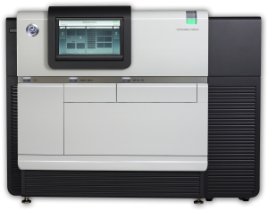
Pacific Biosciences
Read lengths of ≈20kb
Unbiased coverage (e.g., vs GC-content), because of no amplification
Per base error rate of ≈10%, but errors are not systematic
Can generate ≈5-10Gb of sequence in a few hours
Costs around ≈$1000 or a little less
  An accurate human genome for ≈$20-30k
  But quality is even better than the reference!
And the instrument costs hundreds of thousands of dollars

Slide 22
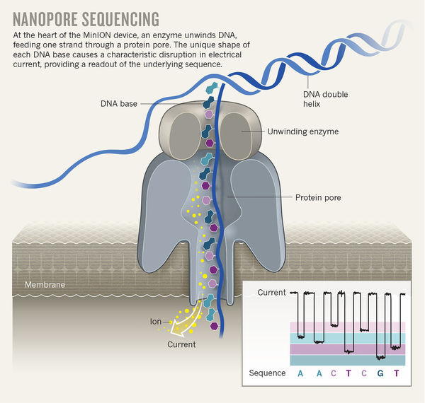
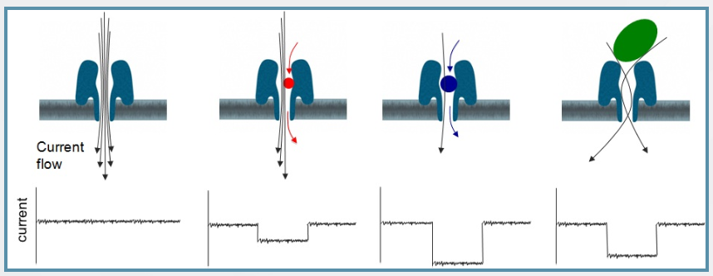
Oxford nanopore sequencing
DNA strand goes through a pore
Changes in current correspond to sequence
Read lengths are up to hundreds of kb
A sequencing device has a dense array of pores
https://nanoporetech.com/applications/dna-nanopore-sequencing

Slide 23
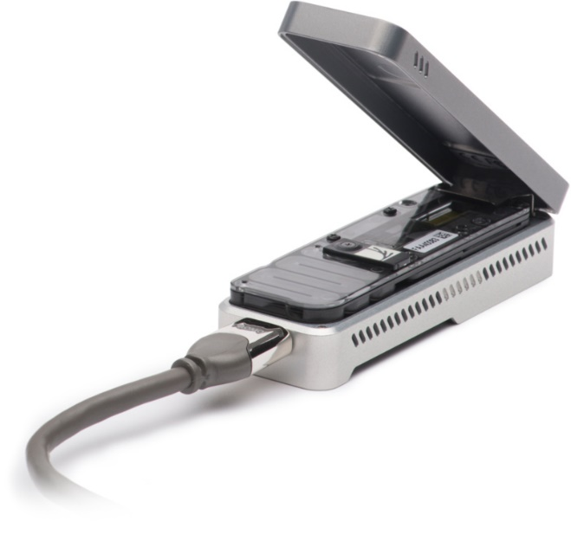

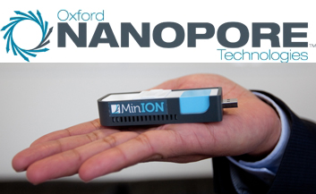
The minION
A truly portable sequencing device
Preparation and sequencing time <1 hour
Cost is ≈$1000 per run for ≈1x human genome coverage
https://nanoporetech.com/products/minion

Slide 24
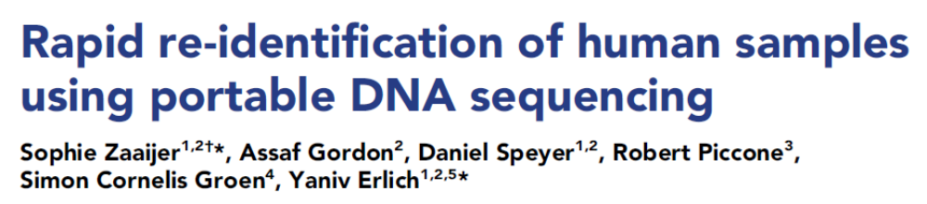
Oxford nanopore sequencing
What is it useful for?
  Forensics – quick identification of subjects
  Sequencing entire microbial organisms
  Sequencing microbial DNA in the field for ecology and medicine
  No large initial investment is needed
  Can run until enough results collected
But per base error rate is relatively high (≈10%)
https://vimeo.com/182592328

Slide 25
Synthetic long reads
Another approach is to generate long reads using current shotgun technology
Key idea:
Separate very long DNA fragments into isolated compartments
Then fragment into short pieces but barcode each compartment separately
After short-read sequencing, reconstruct long fragments using the barcodes
Leading technologies: 10x Genomics, Illumina TruSeq, Previously: Complete Genomics Long Fragment Read (LFR)

Slide 26
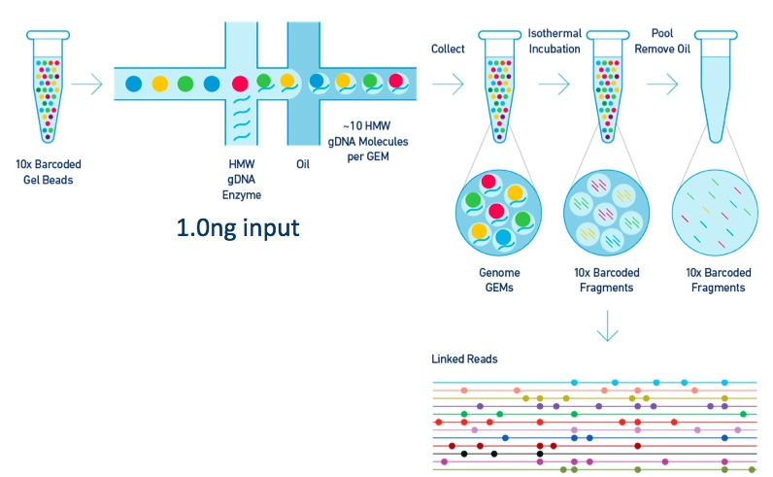
10x Genomics
The key point:
Multiple long fragments can be barcoded jointly, as long as the probability of the two homologous chromosomes to both be present in the same compartment is very small
Standard short-read sequencing can be used, with its advantages (standardization, cost, existing equipment)

Slide 27
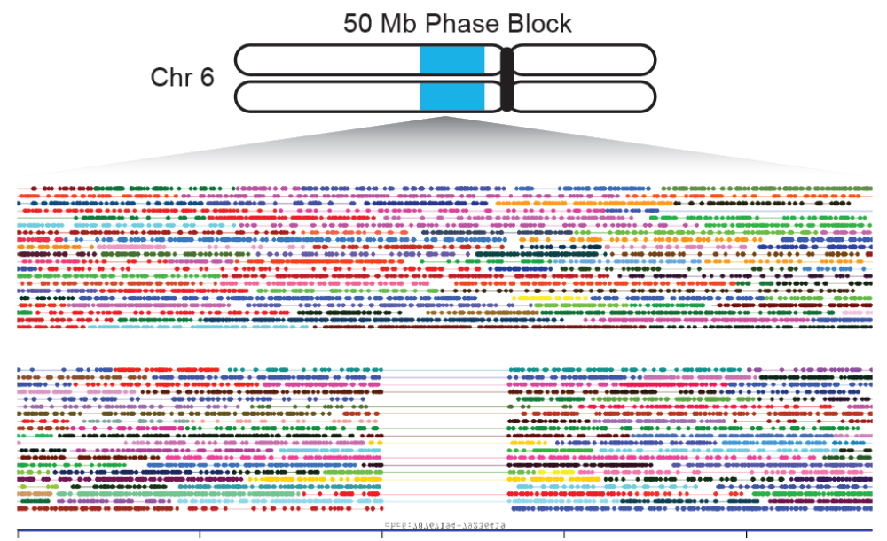
10x Genomics
https://www.10xgenomics.com/solutions/genome/
https://www.10xgenomics.com/technology/

Slide 28
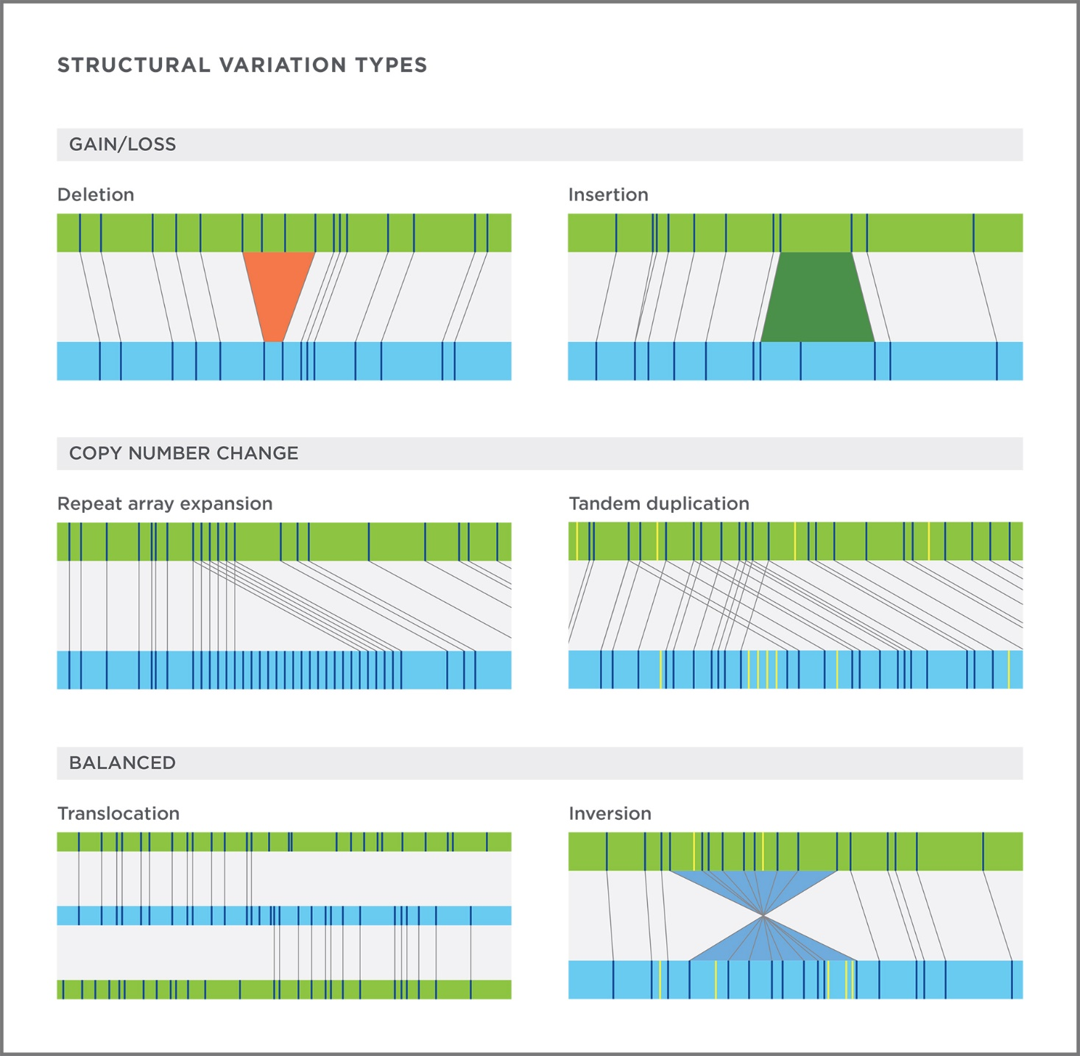
Bionano
Specialized device for genotyping structural variants (>500bp)
  Insertions, deletions, translocations (balanced/unbalanced), duplications
Based on fluorescently labeling restriction sites and then mapping them across genomes
No sequencing!
Cost per genome: $500, but machine is expensive
https://www.youtube.com/watch?v=0-NFpOPADiQ

Slide 29
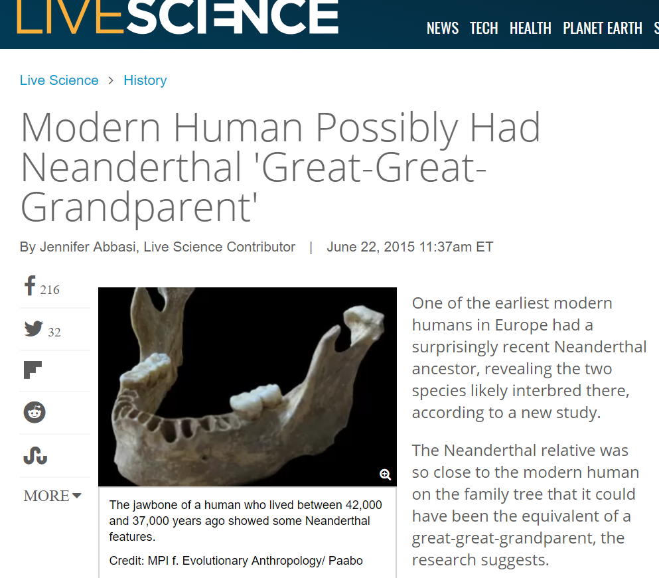
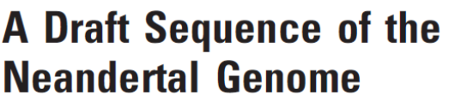

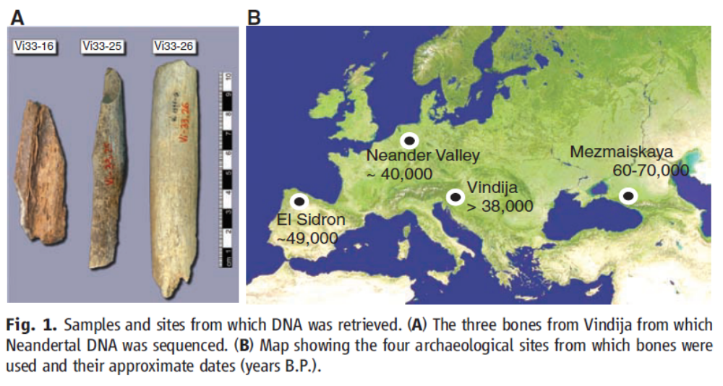
Emerging technologies: ancient DNA
Since about 2010, it is possible to sequence entire DNA genomes from long deceased individuals
Most striking success was the sequencing of the Neanderthal genome in 2010
The results demonstrated unambiguously that all humans outside Africa have about ≈2% Neanderthal genes

Slide 30
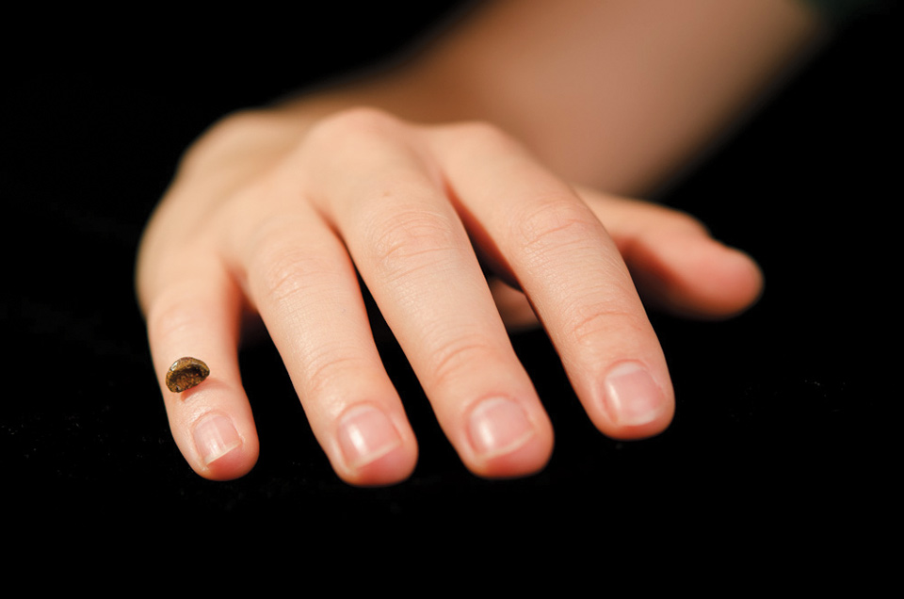


The Denisova human subspecies
In 2010, a new human sub-species was defined based on the DNA of one fragment
of a pinky bone
The first ever species to be characterized by its DNA alone!
Denisovans are sister species of Neanderthals, and have contributed ≈5% to the ancestry of modern Southeast Asians (mostly Melanesians and Aboriginal Australians)
Nature, 2019
160,000 old, identified as Denisova by protein sequence

Slide 31

Complex relationships of human subspecies
Kuhlwilm, Gronau, et al., Nature, 2016

Slide 32

“Ghost” human populations
Evidence for introgression from a “ghost” archaic population
Into Africa around 30-40kya
Possibly another wave just before out of Africa
Ragsdale and Gravel, PLOS Genet, 2019; Hammer et al., PNAS, 2011
Harris and Nielsen, PLOS Genet, 2013; Durvasula and Sankararaman, 2019
Hsieh et al., Genome Res, 2016; Lachance et al., Cell, 2012
Skoglund et al., Cell, 2017
Introgression of Denisova was from 2-3 groups
Mondal et al., Nat Commun, 2018
Browning et al., Cell, 2018; Jacobs et al., Cell, 2019
Hubisz et al., 2019

Slide 33





Implications of the archaic genomes
Neanderthal-derived regions can be identified in the genomes of all modern individuals
Neanderthal/Denisovan variants associated with diseases and traits

Slide 34
Issues with ancient DNA
Most DNA degrades quickly (hundreds of years), and fragments are very short (tens of bp)
High rate of C→U replacement, leading to C→T errors near read ends
Contamination by bacteria and other humans
  Need to sequence lots of bacterial DNA to get little authentic ancient human DNA
Low DNA yield from most bones

Slide 35

Solutions for working with ancient DNA
Sample petrous bones: high DNA yield
Specialized library preparation
Treatment with uracil–DNA–glycosylase (UDG), to repair C→U errors
Since the treatment does not work on fragment ends, it allows identification of authentic ancient DNA
A specialized microarray is used to capture authentic human DNA, which is then sequenced using NGS
Ancient DNA can now be genotyped in thousands

Slide 36





Successes of ancient DNA
Callaway, Nature News, 2018

Slide 37


Ötzi the Iceman
A body was found in 1991 under the snow in the Alps mountains
It was extremely well-preserved – a natural mummy (even soft tissues)
He was dated to 5,300 years ago (Chalcolothic period)
His DNA showed Sardinian ancestry

Slide 38

Unprecedented discoveries of ancient migrations

Slide 39

Unprecedented discoveries of ancient migrations
Nielsen et al., Nature, 2017

Slide 40

Emerging technologies: single cell sequencing
NGS technologies work on “bulk” DNA, i.e., DNA molecules from many cells
To sequence a single DNA molecule, the genome must be amplified
Applications:
  Genetic testing of embryos
  Somatic changes (e.g., brain, cancer) and reconstructing the cell lineage
  Direct examination of gametes

Slide 41






Single cell sequencing of gametes
May 2, 2019

Slide 42




Single cell sequencing of somatic cells

