Slide 1
Personal Genomics
Phasing and imputation
Shai Carmi
School of Public Health

Slide 2
Phasing
The natural units of genetic material are haploid chromosomes or haplotypes
However, genotyping/sequencing gives us diploid genotypes
Can we resolve the actual haplotypes?
Called phasing
Genotypes
CC, GG, AG, CC, GG, CT, AA, CC
Haplotype
?
CGGCGCAC
CGACGTAC
CGACGCAC
CGGCGTAC

Slide 3
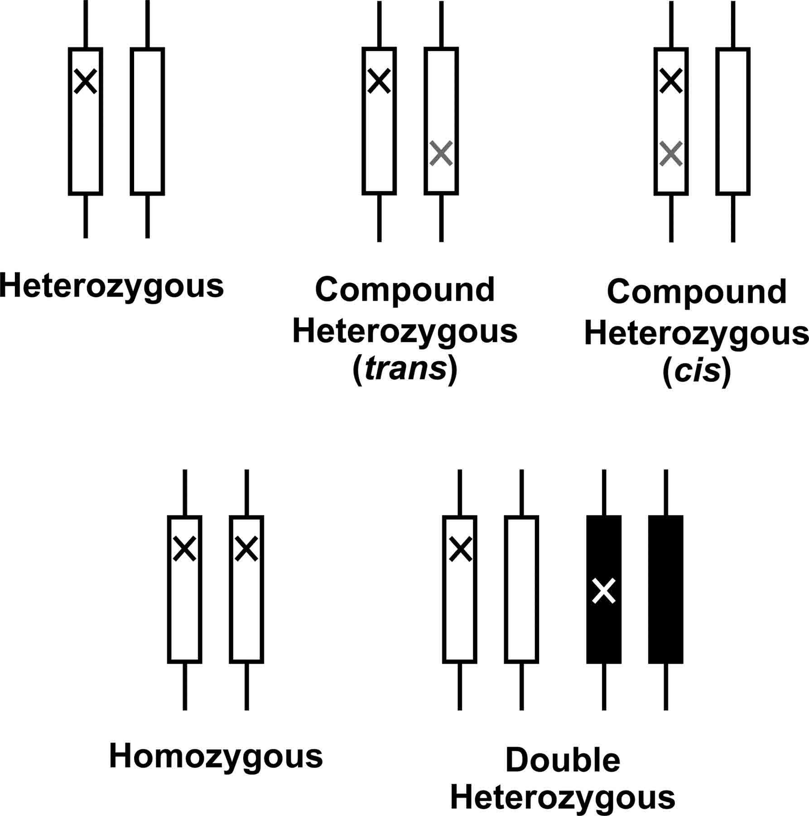
Why phasing?
Test whether a specific combination of alleles is associated with a disease
Look for compound heterozygosity
Look for shared haplotypes
  Detect close relatives
  Detect remote relatives (and thereby historical population demography)
  Determine the ancestry of chromosomes
  Identify historical recombination events
  Detect haplotypes under selection
Healthy
Sick
Healthy
Sick
Consider a gene that needs at least one functional copy to work

Slide 4
Types of phasing
Family phasing
Statistical phasing
Experimental (“physical”, or “read-based”) phasing

Slide 5


Family phasing
Usually we consider trios: mother, father, and child
At the child, we resolve paternal and maternal haplotypes
At the parents, we resolve transmitted and non-transmitted haplotypes
AA
AB
AA
AB
AB
AB
AA
BB
AA
AB
AA
AB
Mother transmitted | A | A | A | A
Mother non-trans | A | A | B | A
Father transmitted | A | B | A | B
Father non-trans | B | A | B | B
Child maternal | A | A | A | A
Child paternal | A | B | A | B

Slide 6
Trio phasing
Trio phasing is considered “gold standard”
Phasing can improve with additional family members (e.g., siblings)
But the phase can remain ambiguous even with trios or larger families
AB
AB
AB
AB
AB

Slide 7
Statistical phasing
For each single target genome, no information is available to allow phasing
But we can look for other individuals who are homozygous to the same haplotypes!
Homozygous individuals have two copies of the same haplotype, so no ambiguity
Even when there is one het, there is no ambiguity
The presence of a haplotype in one individual does not guarantee that the same haplotype will be found in another
But it is quite likely, due to linkage disequilibrium (correlation along the genome)
  More later

Slide 8
Basic statistical phasing
Clark’s Algorithm
Divide the genome into windows
Example:
Haplotype “bank”: ACGG, AGGG
How to phase individual 3?
 | SNP 1 | SNP 2 | SNP 3 | SNP 4
Ind 1 hap 1 | A | C | G | G
Ind 1 hap 2 | A | C | G | G
Ind 2 hap 1 | A | C | G | G
Ind 2 hap 2 | A | G | G | G
Ind 3 | AT | CT | GG | GG
Ind 4 | AA | CT | GG | GT
 | SNP 1 | SNP 2 | SNP 3 | SNP 4
Ind 1 | AA | CC | GG | GG
Ind 2 | AA | CG | GG | GG
Ind 3 | AT | CT | GG | GG
Ind 4 | AA | CT | GG | GT

Slide 9
Basic statistical phasing
Individual 3 could be (ACGG, TTGG) or (ATGG, TCGG)
ACGG is already in the “bank”, so first option is chosen
The updated bank: ACGG, AGGG, TTGG
Haplotype “bank”: ACGG, AGGG
 | SNP 1 | SNP 2 | SNP 3 | SNP 4
Ind 1 hap 1 | A | C | G | G
Ind 1 hap 2 | A | C | G | G
Ind 2 hap 1 | A | C | G | G
Ind 2 hap 2 | A | G | G | G
Ind 3 | AT | CT | GG | GG
Ind 4 | AA | CT | GG | GT
 | SNP 1 | SNP 2 | SNP 3 | SNP 4
Ind 1 hap 1 | A | C | G | G
Ind 1 hap 2 | A | C | G | G
Ind 2 hap 1 | A | C | G | G
Ind 2 hap 2 | A | G | G | G
Ind 3 hap 1 | A | C | G | G
Ind 3 hap 2 | T | T | G | G
Ind 4 | AA | CT | GG | GT

Slide 10
Basic statistical phasing
Individual 4 could be (ACGG, ATGT) or (ACGT, ATGG)
ACGG is already in the “bank”, so first option is chosen
Bank: ACGG, AGGG, TTGG
 | SNP 1 | SNP 2 | SNP 3 | SNP 4
Ind 1 hap 1 | A | C | G | G
Ind 1 hap 2 | A | C | G | G
Ind 2 hap 1 | A | C | G | G
Ind 2 hap 2 | A | G | G | G
Ind 3 hap 1 | A | C | G | G
Ind 3 hap 2 | T | T | G | G
Ind 4 | AA | CT | GG | GT
 | SNP 1 | SNP 2 | SNP 3 | SNP 4
Ind 1 hap 1 | A | C | G | G
Ind 1 hap 2 | A | C | G | G
Ind 2 hap 1 | A | C | G | G
Ind 2 hap 2 | A | G | G | G
Ind 3 hap 1 | A | C | G | G
Ind 3 hap 2 | T | T | G | G
Ind 4 hap 1 | A | C | G | G
Ind 4 hap 2 | A | T | G | T

Slide 11
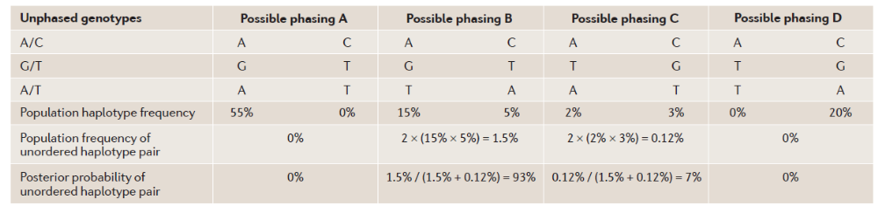
Advanced statistical phasing
Clark’s algorithm can get stuck, if none of the possible haplotypes is in the bank
It could be that in both options, the haplotypes exist in the bank
It also does not distinguish between frequent and rare haplotypes
Assume known
Browning and Browning, 2011

Slide 12
Advanced statistical phasing
A useful idea is to estimate haplotypes iteratively
Make a rough guess of all haplotypes except one
Then estimate the target haplotypes based on the current guess
Re-iterate through all genomes
Current popular methods: Beagle, Shapeit, Eagle, Mach

Slide 13

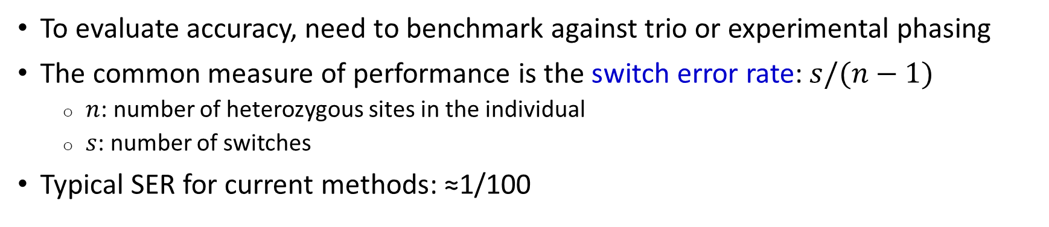

Measuring phasing errors
To evaluate accuracy, need to benchmark against trio or experimental phasing
The common measure of performance is the switch error rate: $s/(n−1)$
  $n$: number of heterozygous sites in the individual
  $s$: number of switches
Typical SER for current methods: ≈1/100
True haplotypes
A G T C T A G G G A T C C A A G C A A A C T
C G A C T T C C A A T G C G A C T G A G C C
$$n=13$$
Inferred haplotypes
A G T C T A C C A A T G C G A G C A A A C T
C G A C T T G G G A T C C A A C T G A G C C
$$s=2$$

Slide 14
Experimental phasing
In microarrays, each SNP is genotyped independently
In sequencing, the basic unit is a read (≈50-100bp)
In some cases, two or more hets fall on the same read
Other approaches:
Sequence gametes (oocytes/sperm)
Molar pregnancy
True haplotypes
A G T C T A G G G A T C C A A G C A A A C T
C G A C T T C C A A T G C G A C T G A G C C
Reads
A G G G A T C C A A G
T C T A G G G A
C G A C T T C C A
C C A A T G C G
C C A A G C A A A C T

Slide 15
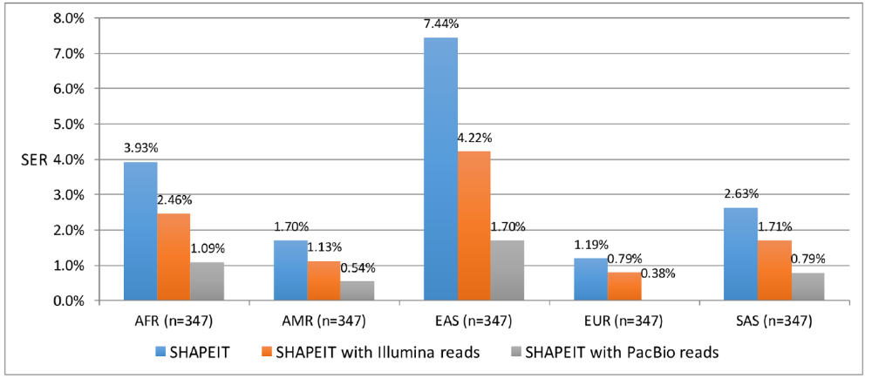
Experimental phasing
Experimental phasing is particularly important for rare variants
When paired-end reads are available, accuracy improves significantly
About a third of pairs of het sites can be phased using standard WGS
The longer the reads, the higher the
accuracy of experimental phasing
In the extreme, entire chromosomes
are sequenced individually, by physically
separating the two chromosomes in
each cell (more later)
Choi et al., PLOS Genet, 2018

Slide 16
What about the missing variants?
Microarrays are ≈20x cheaper than WGS, but only cover ≈1M sites out of ≈3B
While the selection is educated (polymorphic/important sites), many variants remain uncovered
Fortunately, this is in many cases good enough!
The genotyped SNPs are linked to ungenotyped SNPs
Linkage = correlation
Also called linkage disequilibrium (LD)

Slide 17
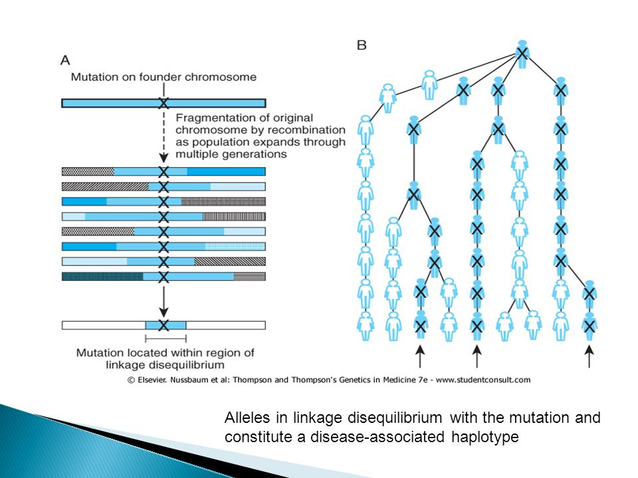
Why linkage disequilibrium?
Mutations that remain on the same haplotype throughout the generations are in LD
LD is usually incomplete: two alleles appear together more than by chance, but not always
LD is lost with time and distance between SNPs

Slide 18
Why is it important?
We often search for variants that increase the risk of disease
Even if the causal variant is uncovered by the array, if it is in LD (=correlated) with an array SNP, an association with the disease will be detected
The detected SNP is called a tag SNP
In fact, if we have full sequence reference data, it is possible to infer the genotypes of uncovered variants
Called imputation

Slide 19
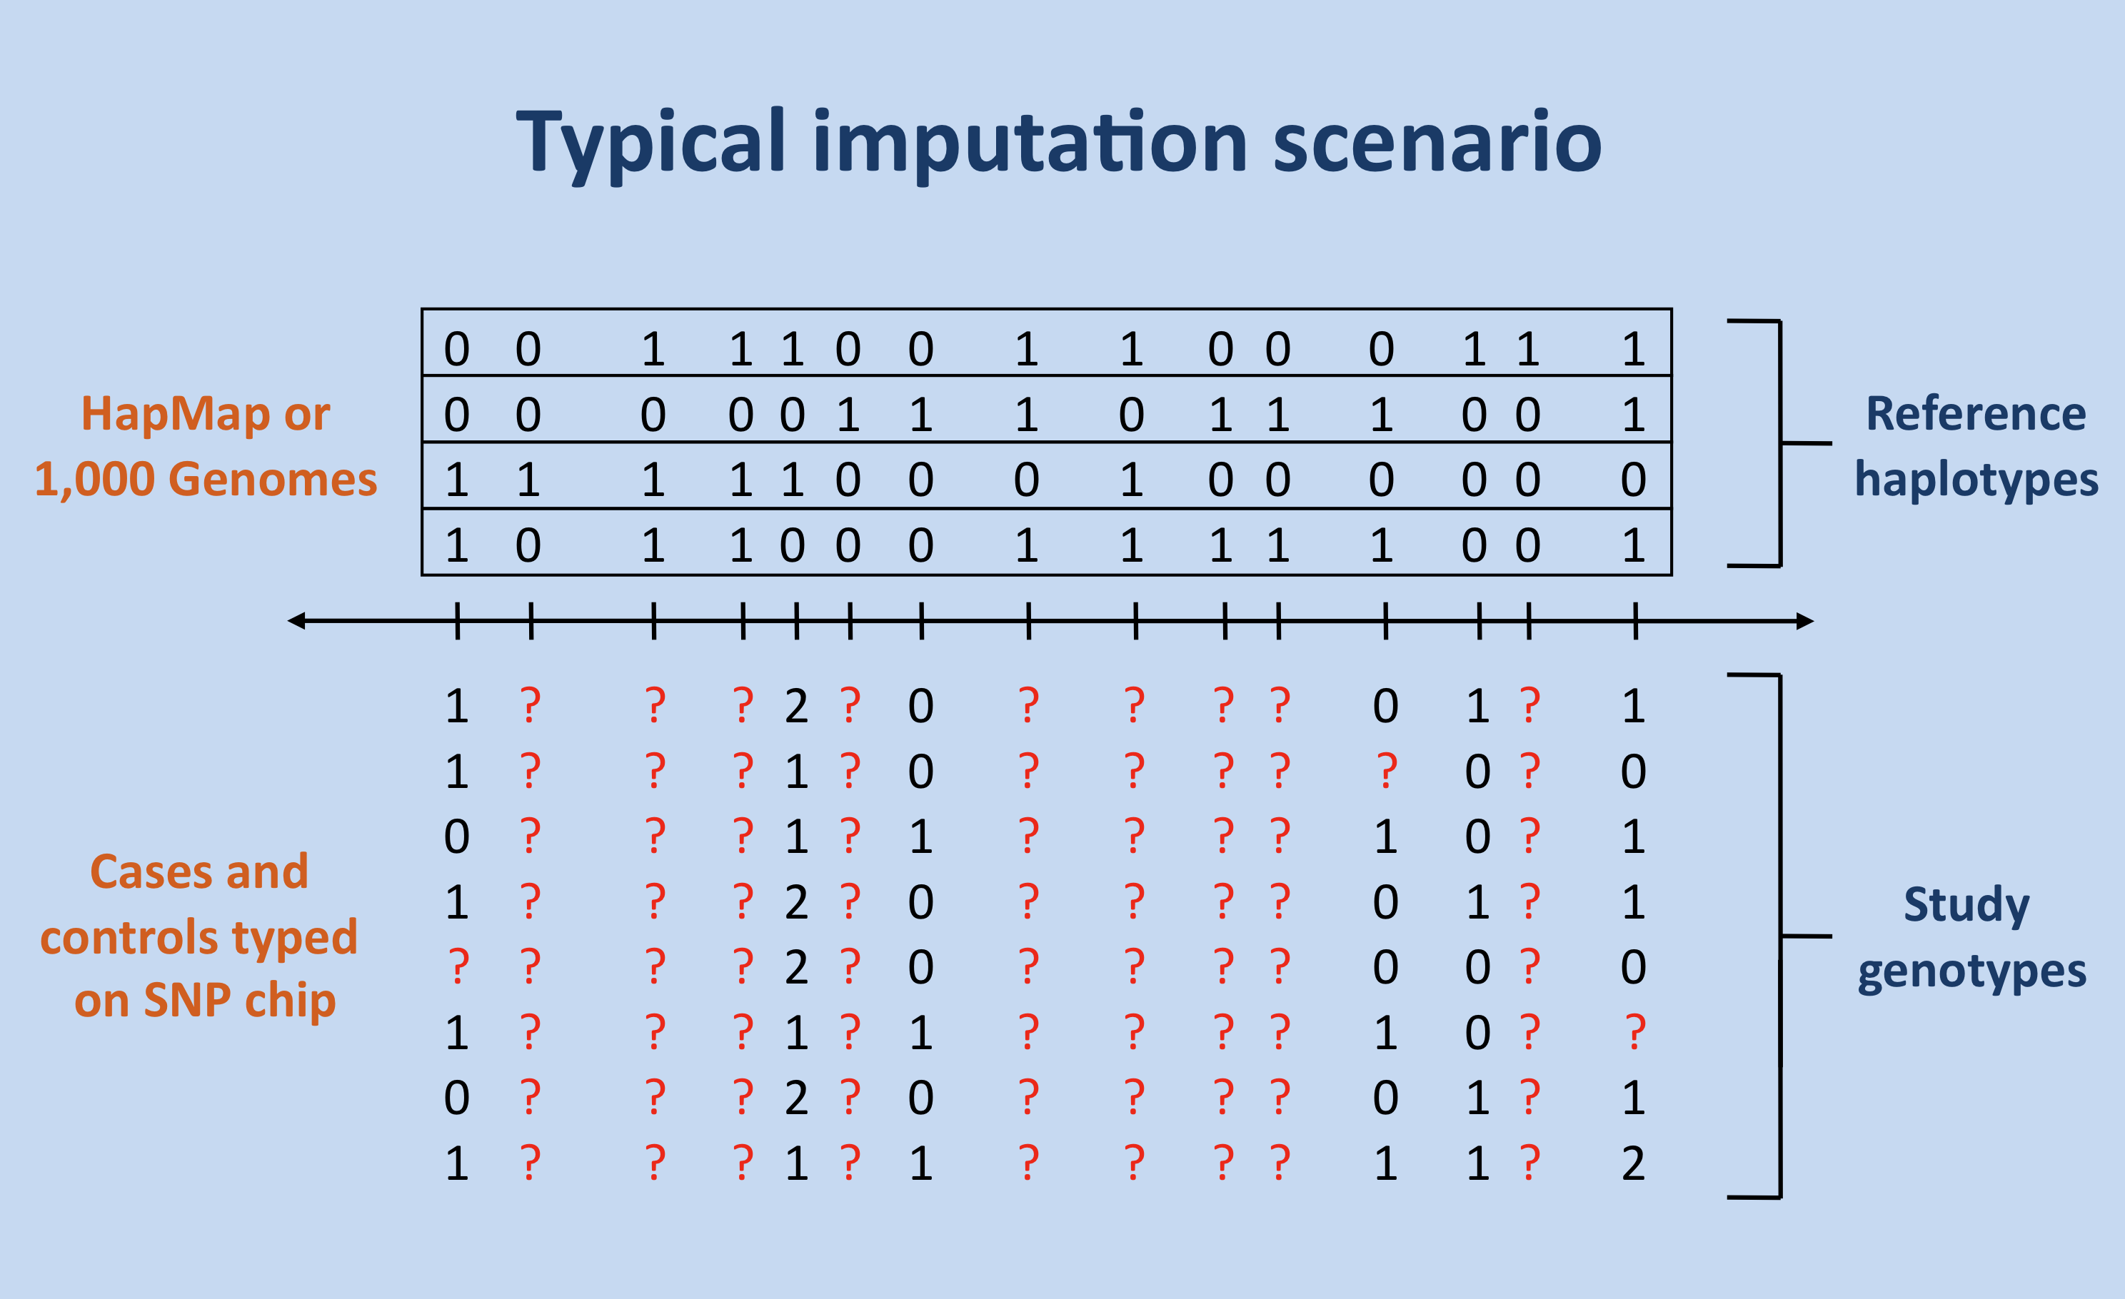
Imputation

Slide 20
Basic idea
Divide the genome into windows
Collect a set of previously phased fully sequenced reference haplotypes
For each window, detect the reference haplotype most similar to the target genome, only based on the array SNPs
Infer the genotypes at ungenotyped SNPs according to the reference sequence

Slide 21
Basic idea
Haplotype | SNP 1 | SNP 2 | SNP 3 | SNP 4 | SNP 5 | SNP 6 | SNP 7
1 | 1 | 0 | 1 | 1 | 0 | 0 | 1
2 | 0 | 1 | 1 | 1 | 0 | 0 | 1
3 | 0 | 0 | 1 | 1 | 1 | 0 | 0
4 | 0 | 1 | 1 | 0 | 0 | 0 | 1
5 | 1 | 0 | 1 | 0 | 0 | 1 | 0
6 | 1 | 1 | 0 | 1 | 1 | 0 | 0
Sequenced and phased
reference haplotypes
0: ref allele
1: alt allele
Haplotype | SNP 1 | SNP 2 | SNP 3 | SNP 4 | SNP 5 | SNP 6 | SNP 7
1 | 0 | ? | 1 | 0 | ? | ? | 1
2 | 1 | ? | 1 | 0 | ? | ? | 0
Genotyped
(microarray)

Slide 22
Basic idea
Haplotype | SNP 1 | SNP 2 | SNP 3 | SNP 4 | SNP 5 | SNP 6 | SNP 7
1 | 1 |  | 1 | 1 |  |  | 1
2 | 0 |  | 1 | 1 |  |  | 1
3 | 0 |  | 1 | 1 |  |  | 0
4 | 0 |  | 1 | 0 |  |  | 1
5 | 1 |  | 1 | 0 |  |  | 0
6 | 1 |  | 0 | 1 |  |  | 0
Sequenced and phased
reference haplotypes
Haplotype | SNP 1 | SNP 2 | SNP 3 | SNP 4 | SNP 5 | SNP 6 | SNP 7
1 | 0 | ? | 1 | 0 | ? | ? | 1
2 | 1 | ? | 1 | 0 | ? | ? | 0
Genotyped

Slide 23
Basic idea
Haplotype | SNP 1 | SNP 2 | SNP 3 | SNP 4 | SNP 5 | SNP 6 | SNP 7
1 | 1 | 0 | 1 | 1 | 0 | 0 | 1
2 | 0 | 1 | 1 | 1 | 0 | 0 | 1
3 | 0 | 0 | 1 | 1 | 1 | 0 | 0
4 | 0 | 1 | 1 | 0 | 0 | 0 | 1
5 | 1 | 0 | 1 | 0 | 0 | 1 | 0
6 | 1 | 1 | 0 | 1 | 1 | 0 | 0
Sequenced and phased
reference haplotypes
Haplotype | SNP 1 | SNP 2 | SNP 3 | SNP 4 | SNP 5 | SNP 6 | SNP 7
1 | 0 | 1 | 1 | 0 | 0 | 0 | 1
2 | 1 | ? | 1 | 0 | ? | ? | 0
Genotyped

Slide 24
Basic idea
Haplotype | SNP 1 | SNP 2 | SNP 3 | SNP 4 | SNP 5 | SNP 6 | SNP 7
1 | 1 |  | 1 | 1 |  |  | 1
2 | 0 |  | 1 | 1 |  |  | 1
3 | 0 |  | 1 | 1 |  |  | 0
4 | 0 |  | 1 | 0 |  |  | 1
5 | 1 |  | 1 | 0 |  |  | 0
6 | 1 |  | 0 | 1 |  |  | 0
Sequenced and phased
reference haplotypes
Haplotype | SNP 1 | SNP 2 | SNP 3 | SNP 4 | SNP 5 | SNP 6 | SNP 7
1 | 0 | 1 | 1 | 0 | 0 | 0 | 1
2 | 1 | ? | 1 | 0 | ? | ? | 0
Genotyped

Slide 25
Basic idea
Haplotype | SNP 1 | SNP 2 | SNP 3 | SNP 4 | SNP 5 | SNP 6 | SNP 7
1 | 1 | 0 | 1 | 1 | 0 | 0 | 1
2 | 0 | 1 | 1 | 1 | 0 | 0 | 1
3 | 0 | 0 | 1 | 1 | 1 | 0 | 0
4 | 0 | 1 | 1 | 0 | 0 | 0 | 1
5 | 1 | 0 | 1 | 0 | 0 | 1 | 0
6 | 1 | 1 | 0 | 1 | 1 | 0 | 0
Sequenced and phased
reference haplotypes
Haplotype | SNP 1 | SNP 2 | SNP 3 | SNP 4 | SNP 5 | SNP 6 | SNP 7
1 | 0 | 1 | 2 | 2 | 0 | 0 | 1
2 | 1 | 0 | 1 | 0 | 0 | 1 | 0
Genotyped

Slide 26
Imputation practice
Imputation is not exact!
We may not have a close enough haplotype in the reference
Different rare variants may accumulate on the different branches
Imputation accuracy usually decreases with the minor allele frequency
Common tools: IMPUTE2, Minimach

Slide 27
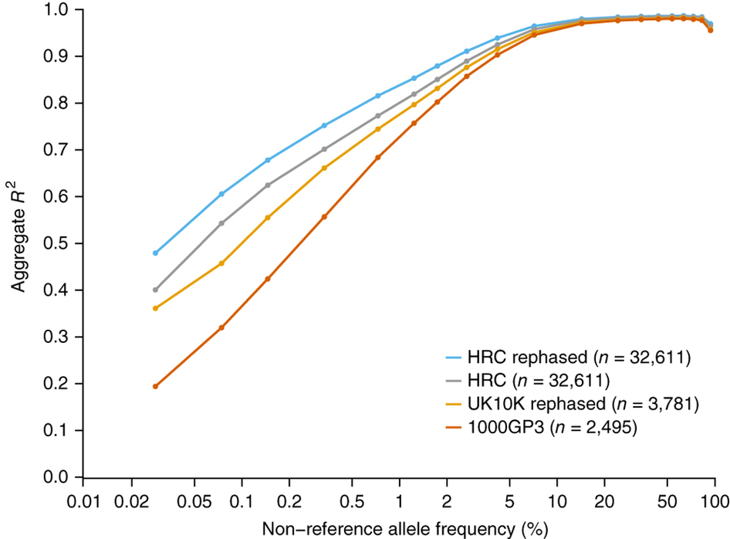
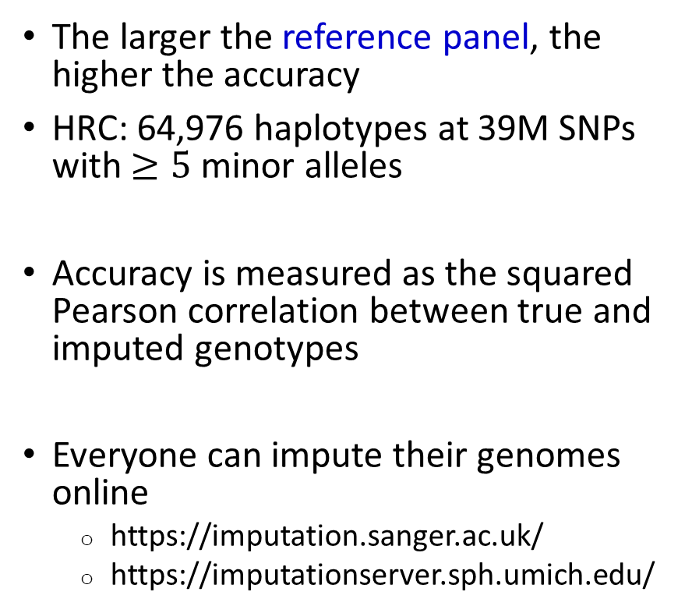
The Haplotype Reference Consortium (HRC)
The larger the reference panel, the higher the accuracy
HRC: 64,976 haplotypes at 39M SNPs with $≥5$ minor alleles
Accuracy is measured as the squared Pearson correlation between true and imputed genotypes
Everyone can impute their genomes online
  https://imputation.sanger.ac.uk/
  https://imputationserver.sph.umich.edu/

Slide 28
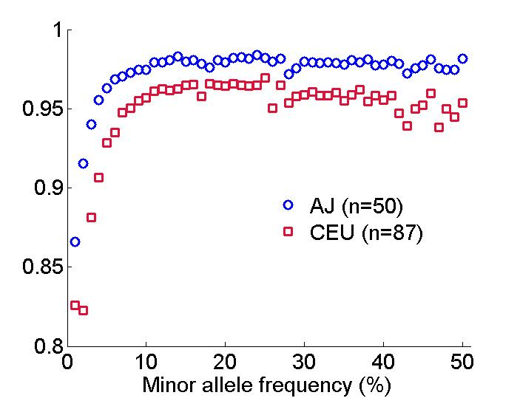
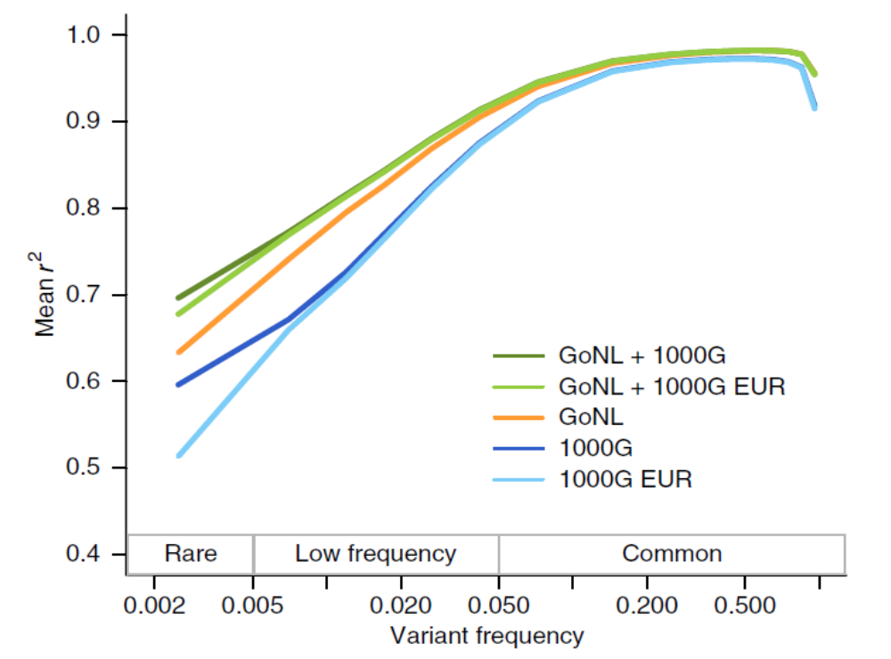
Matching ancestries
It was shown that imputation is much more accurate if the reference panel contains genomes with ancestry matched to the target
Ashkenazi Jews
Netherlands

Slide 29
What’s still missing?
All the algorithms we have so far described work by dividing the genome into windows
But...
How to choose the window size and boundaries?
How to avoid discontinuities between windows?
It is better to avoid windows altogether, using Hidden Markov Models (HMM)

Slide 30
Hidden Markov Models
Idea: at each time point, the system is in one of a number of states
We can’t see the states, but we see observations that depend on the state
0.05
0.7
0.95
0.3
Normal
Depressed
0.1
0.3
0.5
0.6
0.4
0.1
Juice
Beer
Vodka

Slide 31
Hidden Markov Models
Suppose we are bartenders, and we observe the drink ordered each day:
  Beer, Juice, Juice, Vodka, Beer, Vodka, Beer, Vodka, Juice, Juice, Beer, Juice
Can we estimate what was the state each day, based on the observations?
Can we say whether one sequence of drinks is more likely than another?
  Is it likely to have Juice, Vodka, Juice, Vodka, Juice, Vodka, …
Can we estimate the probabilities of states and observations given a sequence?

Slide 32
Definitions
Probabilities to move between states: transition probabilities
Probabilities of observations given states: emission probabilities
0.05
0.7
0.95
0.3
Transition probabilities
Normal
Depressed
0.1
0.3
0.5
0.6
0.4
0.1
Emission probabilities
Juice
Beer
Vodka

Slide 33
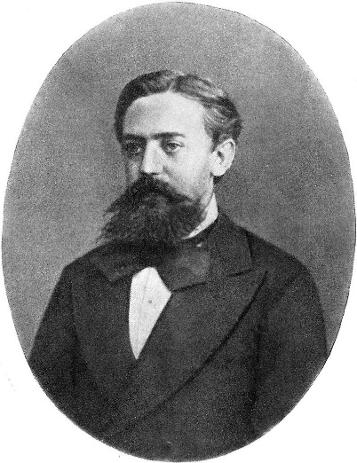
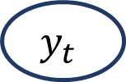
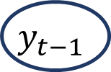
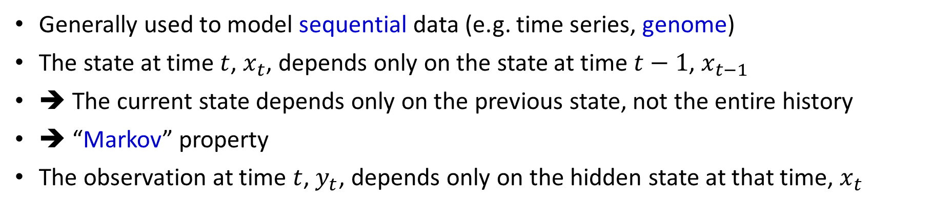



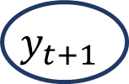
Why Markov?
…
$$x_{t−1}$$
$$x_{t}$$
$$x_{t+1}$$
…
States (hidden)
Data (observed)
…
$$y_{t−1}$$
$$y_{t}$$
$$y_{t+1}$$
…
Generally used to model sequential data (e.g. time series, genome)
The state at time $t$, $x_{t}$, depends only on the state at time $t−1$, $x_{t−1}$
➔ The current state depends only on the previous state, not the entire history
➔ “Markov” property
The observation at time $t$, $y_{t}$, depends only on the hidden state at that time, $x_{t}$

Slide 34
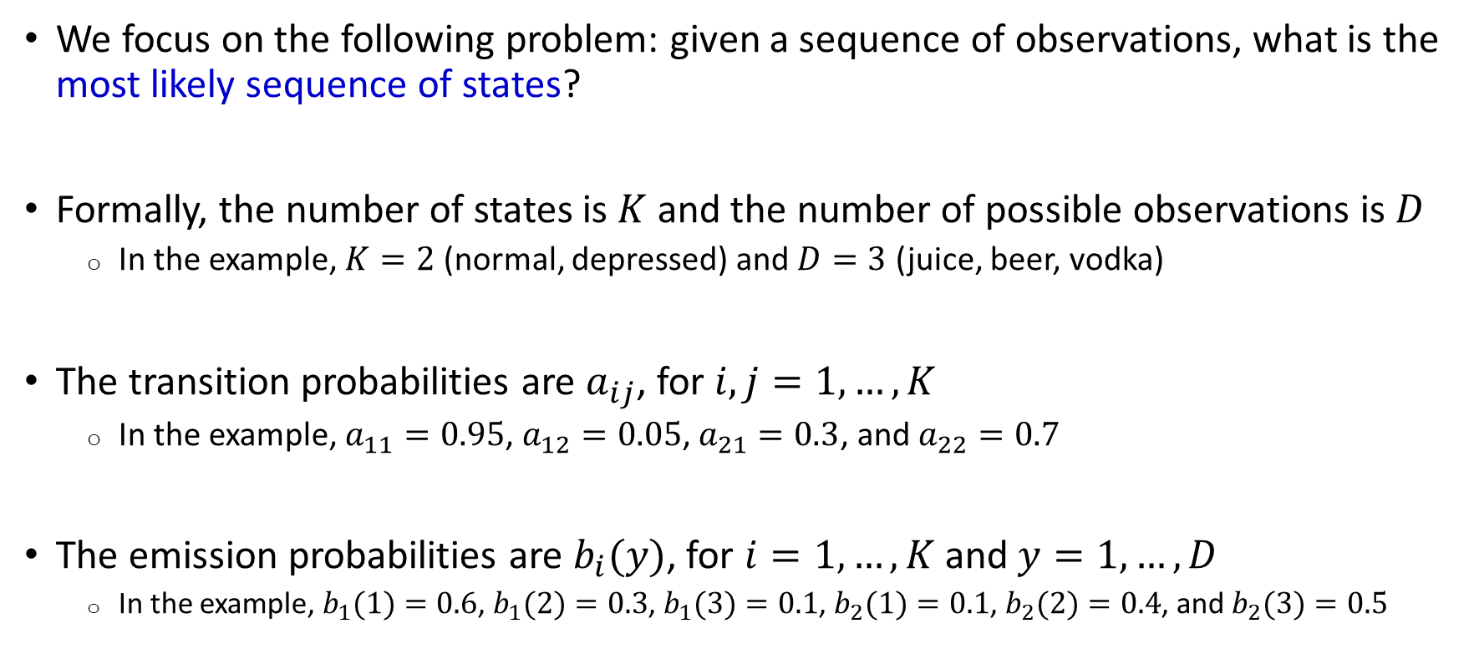
Definitions
We focus on the following problem: given a sequence of observations, what is the most likely sequence of states?
Formally, the number of states is $K$ and the number of possible observations is $D$
  In the example, $K=2$ (normal, depressed) and $D=3$ (juice, beer, vodka)
The transition probabilities are $a_{ij}$, for $i,j=1,…,K$
  In the example, $a_{11}=0.95$, $a_{12}=0.05$, $a_{21}=0.3$, and $a_{22}=0.7$
The emission probabilities are $b_{i}(y)$, for $i=1,…,K$ and $y=1,…,D$
  In the example, $b_{1}(1)=0.6$, $b_{1}(2)=0.3$, $b_{1}(3)=0.1$, $b_{2}(1)=0.1$, $b_{2}(2)=0.4$, and $b_{2}(3)=0.5$

Slide 35
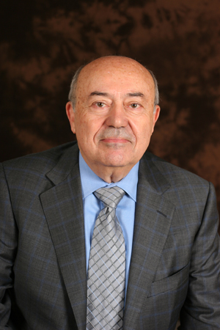
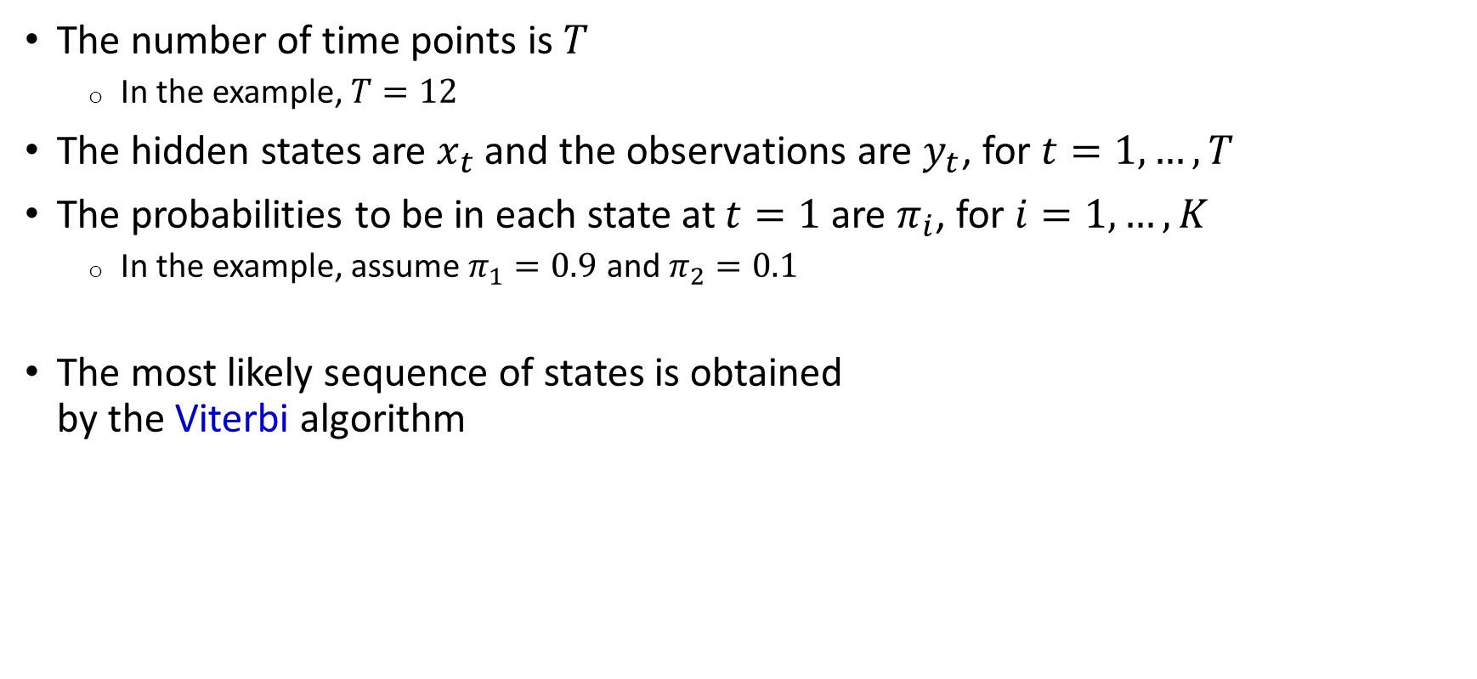
Definitions
The number of time points is $T$
  In the example, $T=12$
The hidden states are $x_{t}$ and the observations are $y_{t}$, for $t=1,…,T$
The probabilities to be in each state at $t=1$ are $π_{i}$, for $i=1,…,K$
  In the example, assume $π_{1}=0.9$ and $π_{2}=0.1$
The most likely sequence of states is obtained
by the Viterbi algorithm

Slide 36
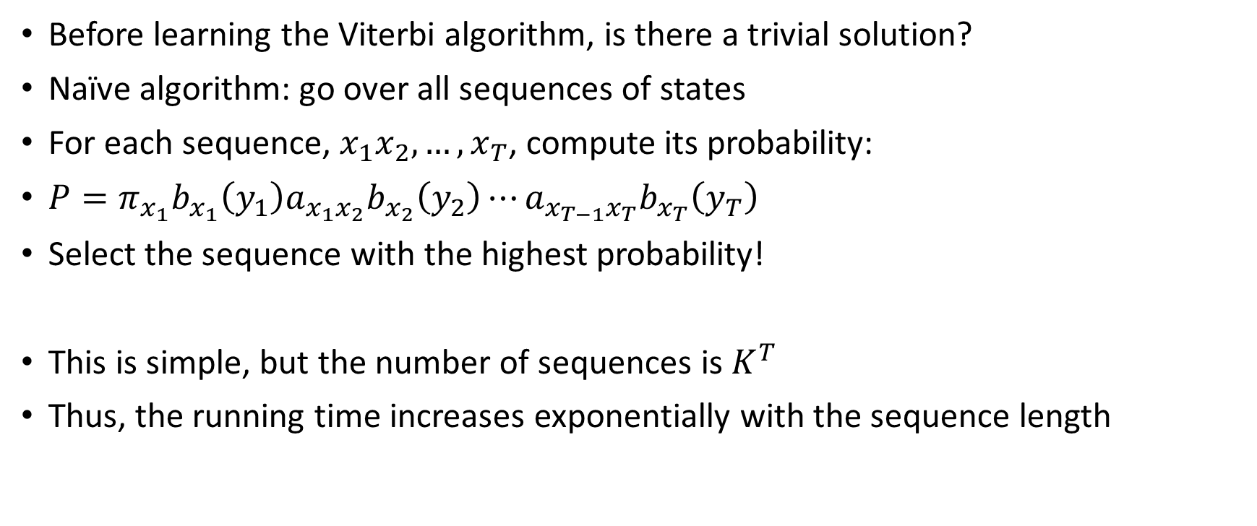
The naïve solution
Before learning the Viterbi algorithm, is there a trivial solution?
Naïve algorithm: go over all sequences of states
For each sequence, $x_{1}x_{2},…,x_{T}$, compute its probability:
$P=π_{x_{1}}b_{x_{1}}\left(y_{1}\right)a_{x_{1}x_{2}}b_{x_{2}}\left(y_{2}\right)⋯a_{x_{T−1}x_{T}}b_{x_{T}}\left(y_{T}\right)$
Select the sequence with the highest probability!
This is simple, but the number of sequences is $K^{T}$
Thus, the running time increases exponentially with the sequence length

Slide 37
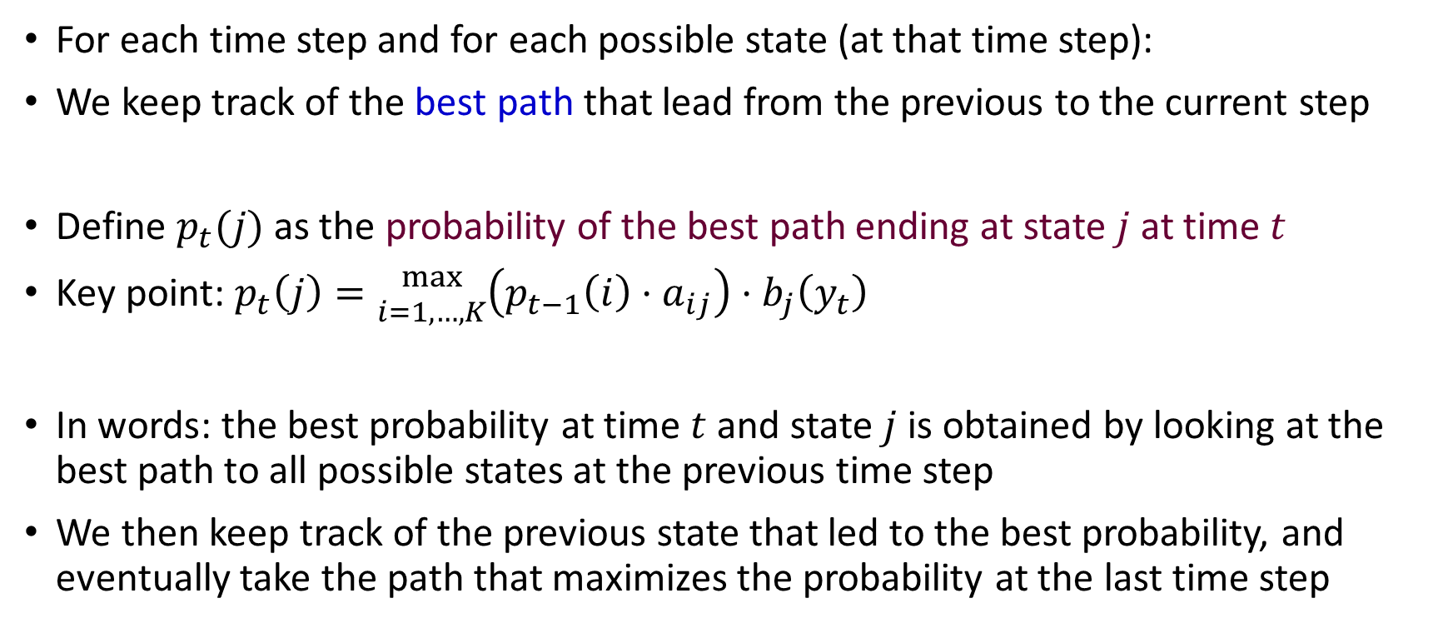
The Viterbi algorithm
For each time step and for each possible state (at that time step):
We keep track of the best path that lead from the previous to the current step
Define $p_{t}(j)$ as the probability of the best path ending at state $j$ at time $t$
Key point: $p_{t}\left(j\right)={max \atop i=1,…,K}\left(p_{t−1}\left(i\right)⋅a_{ij}\right)⋅b_{j}\left(y_{t}\right)$
In words: the best probability at time $t$ and state $j$ is obtained by looking at the best path to all possible states at the previous time step
We then keep track of the previous state that led to the best probability, and eventually take the path that maximizes the probability at the last time step

Slide 38
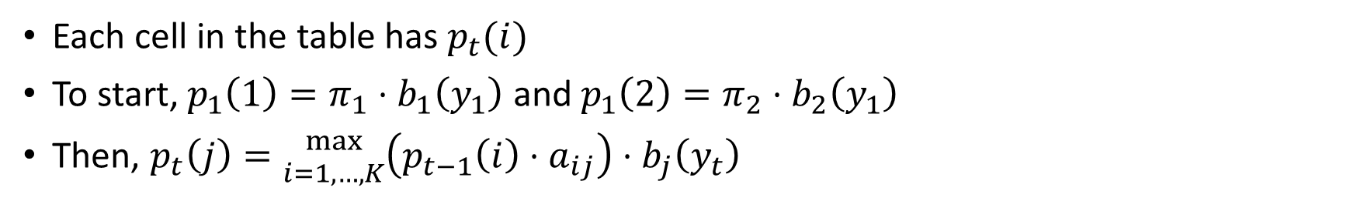
Example
Each cell in the table has $p_{t}(i)$
To start, $p_{1}\left(1\right)=π_{1}⋅b_{1}\left(y_{1}\right)$ and $p_{1}\left(2\right)=π_{2}⋅b_{2}\left(y_{1}\right)$
Then, $p_{t}\left(j\right)={max \atop i=1,…,K}\left(p_{t−1}\left(i\right)⋅a_{ij}\right)⋅b_{j}\left(y_{t}\right)$
Time | 1 | 2 | 3
Observation | B | J | J
State N | 0.9*0.3=0.27 | 0.27*0.95*0.6=0.1539 (0.27*0.95>0.04*0.3) | 0.1539*0.95*0.6=0.0877 (0.1539*0.95>0.0028*0.3)
State D | 0.1*0.4=0.04 | 0.04*0.7*0.1=0.0028 (0.27*0.05<0.04*0.7) | 0.1539*0.05*0.1=0.0008 (0.1539*0.05>0.0028*0.7)

Slide 39
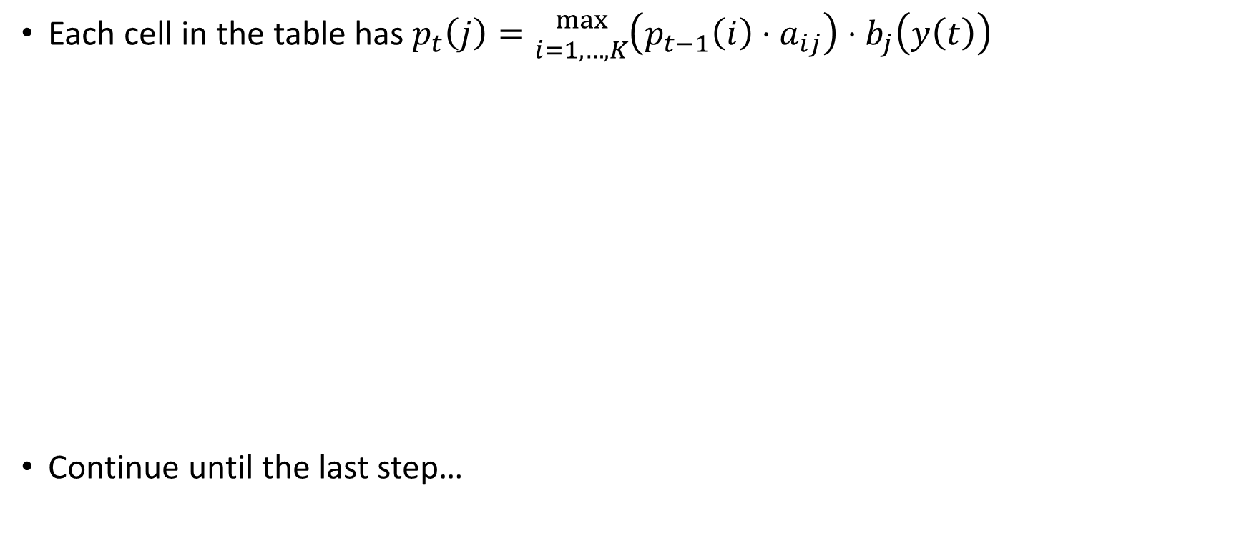
Example
Each cell in the table has $p_{t}\left(j\right)={max \atop i=1,…,K}\left(p_{t−1}\left(i\right)⋅a_{ij}\right)⋅b_{j}\left(y\left(t\right)\right)$
Continue until the last step…
Time | 3 | 4 | 5
Observation | J | V | B
State N | 0.0877 | 0.0877*0.95*0.1=0.0083 (0.0877*0.95>0.0008*0.3) | 0.0083*0.95*0.3=0.0024 (0.008*0.95>0.002*0.3)
State D | 0.0008 | 0.0877*0.05*0.5=0.0022 (0.0877*0.05>0.0008*0.7) | 0.0022*0.7*0.4=0.0006 (0.0083*0.05<0.0022*0.7)

Slide 40
Example
Time | 10 | 11 | 12
Observation | J | B | J
State N | 2.16∙10⁻⁶ | 6.16∙10⁻⁷ | 3.51∙10⁻⁷
State D | 1.03∙10⁻⁷ | 4.32∙10⁻⁸ | 3.08∙10⁻⁹
At the last time step, start from the state with the highest probability, and walk back along the arrows to generate the best path

Slide 41
Example
Time | 1 | 2 | 3 | 4 | 5 | 6 | 7 | 8 | 9 | 10 | 11 | 12
Observation | B | J | J | V | B | J | B | V | J | J | B | J
State N
State D
Viterbi path | N | N | N | D | D | D | D | D | N | N | N | N
The reconstructed path is called the Viterbi path, and it has the highest probability among all paths
The diagram is also called “Trellis diagram”

Slide 42
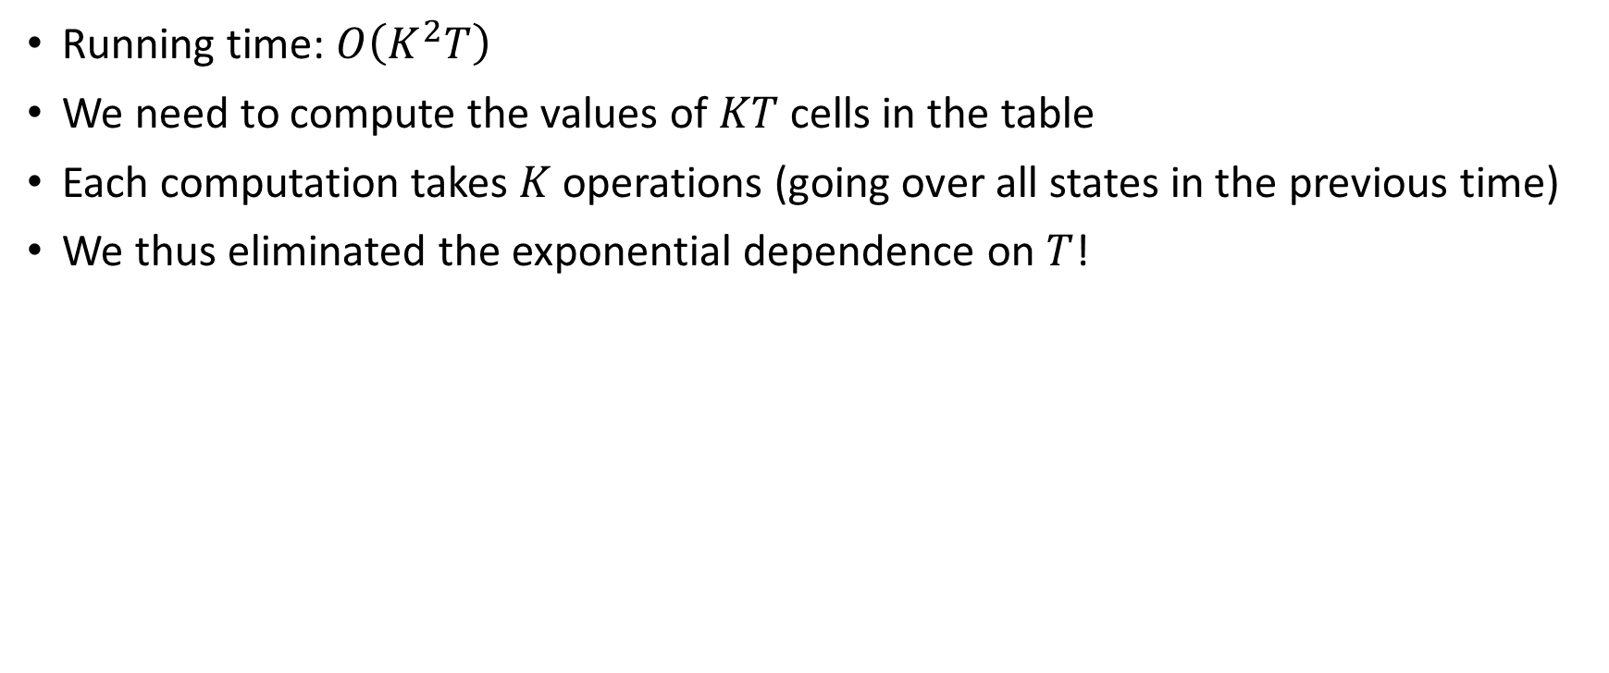
Remarks
Running time: $O\left(K^{2}T\right)$
We need to compute the values of $KT$ cells in the table
Each computation takes $K$ operations (going over all states in the previous time)
We thus eliminated the exponential dependence on $T$!

Slide 43
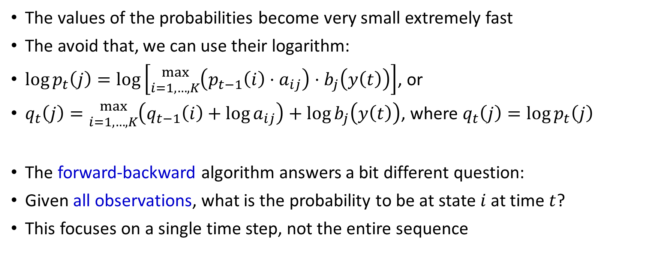
Remarks
The values of the probabilities become very small extremely fast
The avoid that, we can use their logarithm:
$\log{p_{t}\left(j\right)}=\log\left[{max \atop i=1,…,K}\left(p_{t−1}\left(i\right)⋅a_{ij}\right)⋅b_{j}\left(y\left(t\right)\right)\right]$, or
$q_{t}\left(j\right)={max \atop i=1,…,K}\left(q_{t−1}\left(i\right)+\log{a_{ij}}\right)+\log{b_{j}\left(y\left(t\right)\right)}$, where $q_{t}\left(j\right)=\log{p_{t}\left(j\right)}$
The forward-backward algorithm answers a bit different question:
Given all observations, what is the probability to be at state $i$ at time $t$?
This focuses on a single time step, not the entire sequence

Slide 44
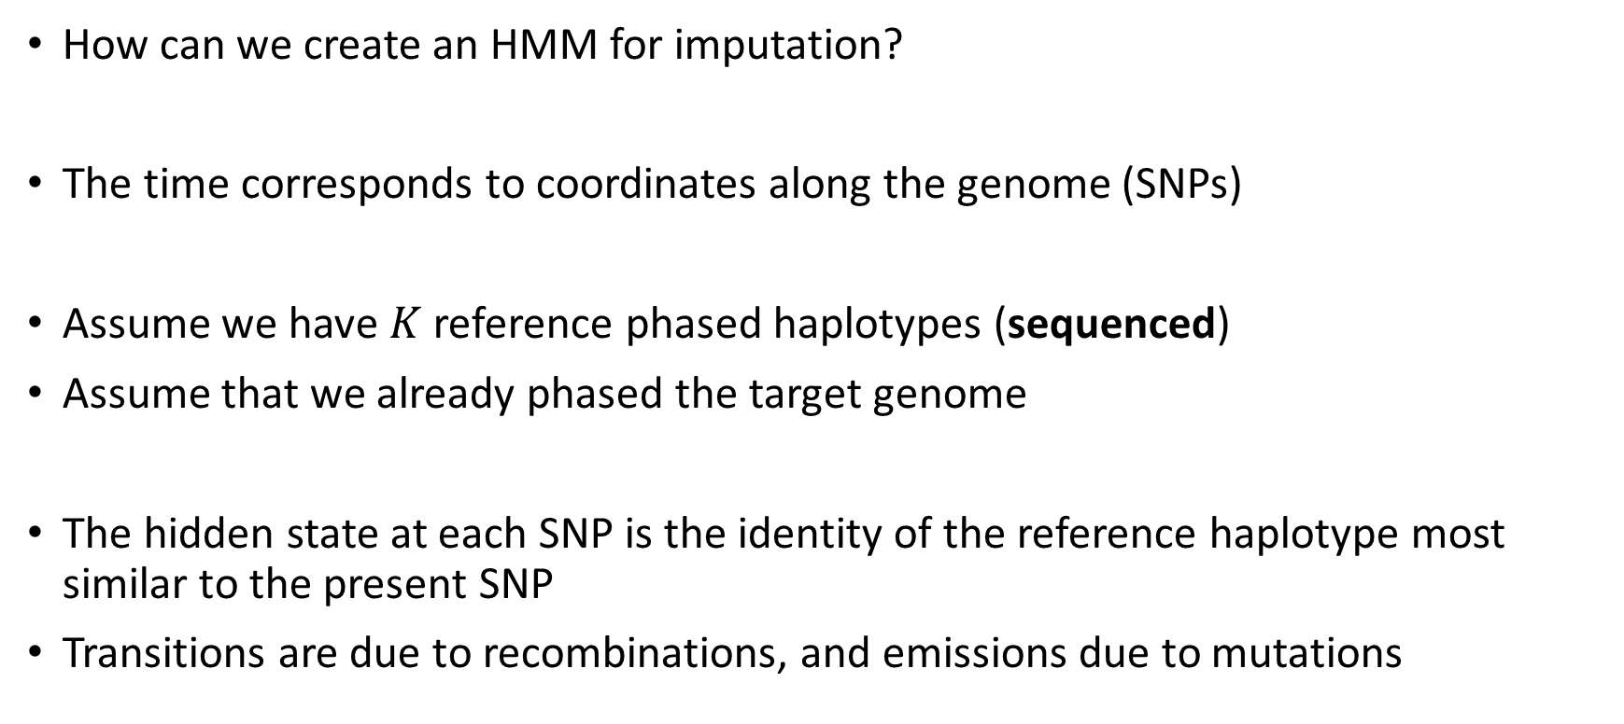
How is it related to imputation?
How can we create an HMM for imputation?
The time corresponds to coordinates along the genome (SNPs)
Assume we have $K$ reference phased haplotypes (sequenced)
Assume that we already phased the target genome
The hidden state at each SNP is the identity of the reference haplotype most similar to the present SNP
Transitions are due to recombinations, and emissions due to mutations

Slide 45
HMM for imputation
 | SNP 1 | SNP 2 | SNP 3 | SNP 4 | SNP 5 | SNP 6 | SNP 7 | SNP 8 | SNP 9 | SNP 10
Ref 1 | A | C | A | T | T | A | A | C | G | C
Ref 2 | G | C | C | C | G | G | A | G | A | A
Ref 3 | A | T | A | C | T | G | A | G | G | A
Ref 4 | A | T | C | T | G | G | G | C | A | C
Target | G | T | C | C | G | A | A | G | G | C
Hidden state | 2 | 2 | 2 | 2 | 2 | 1 | 1 | 1 | 1 | 1
For the HMM, we use only array SNPs
The sequence of hidden states is estimated using Viterbi
The gaps between each SNPs are filled with variants found on the fully sequenced reference haplotype

Slide 46
HMM for imputation
 | SNP 1 |  |  |  | SNP 2 |  |  |  |  | SNP 3
Ref 2 (sequencing) | G | C | G | T | C | C | A | G | A | C
Target (array) | G | ? | ? | ? | T | ? | ? | ? | ? | C
Target (imputed) | G | C | G | T | C | C | A | G | A | C
For each target genome, the two haplotypes are imputed using the HMM
The complete target genotype is obtained by combining the two imputed haplotypes

Slide 47
Genealogical interpretation
The matching reference haplotype is the one with the lowest time to the most recent common ancestor (TMRCA) with the target
When recombination happens, the path to the MRCA breaks
Time (generations)
TMRCA
0
Target
Ref 1
Ref 2
Ref 3
Ref 4
Ref 5

Slide 48

Genealogical interpretation
Recombinations change the path taken along the tree
The most recent common ancestor will likely change
$T_{1}$ generations ago
Target
Ref 1

Slide 49
Genealogical interpretation
After recombination, the reference haplotype with the closest TMRCA may change: a change in the hidden state
Time (generations)
TMRCA
0
Target
Ref 1
Ref 2
Ref 3
Ref 4
Ref 5

Slide 50
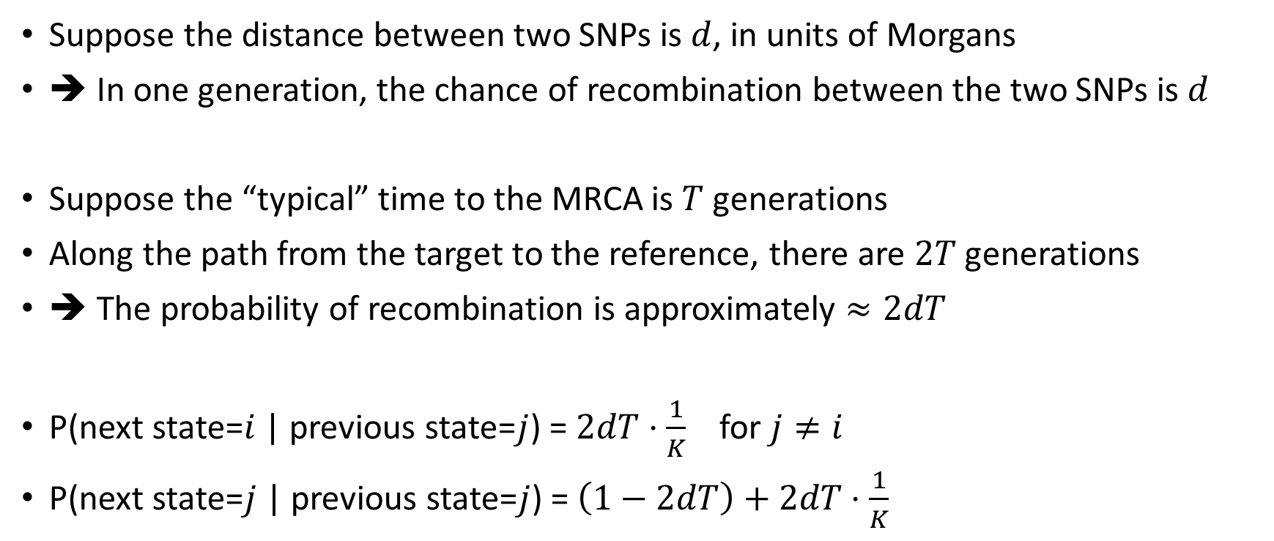
Modeling transitions
Suppose the distance between two SNPs is $d$, in units of Morgans
➔ In one generation, the chance of recombination between the two SNPs is $d$
Suppose the “typical” time to the MRCA is $T$ generations
Along the path from the target to the reference, there are $2T$ generations
➔ The probability of recombination is approximately $≈2dT$
P(next state=$i$ | previous state=$j$) = $2dT⋅\frac{1}{K}$ for $j≠i$
P(next state=$j$ | previous state=$j$) = $\left(1−2dT\right)+2dT⋅\frac{1}{K}$

Slide 51
Modeling emissions
 | SNP 1 | SNP 2 | SNP 3 | SNP 4 | SNP 5 | SNP 6 | SNP 7 | SNP 8 | SNP 9 | SNP 10
Ref 1 |  |  |  |  |  | A | A | C | G | C
Ref 2 | G | C | C | C | G
Target | G | T | C | C | G | A | A | G | G | C
Hidden state | 2 | 2 | 2 | 2 | 2 | 1 | 1 | 1 | 1 | 1
Where do the differences come from?
  The hidden state is not accurate – the reference haplotype is not similar enough to the target, at least along part of the window
  Mutations since the MRCA
  Genotyping errors

Slide 52
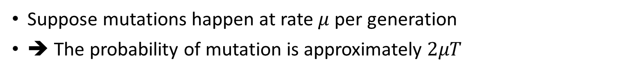
Modeling emissions
Suppose mutations happen at rate $μ$ per generation
➔ The probability of mutation is approximately $2μT$
Genotyping errors and haplotype misidentification are usually just incorporated into the mutation rate
Time (generations)
TMRCA
0
Target
Ref 1
Ref 2
Ref 3
Ref 4
Ref 5

Slide 53
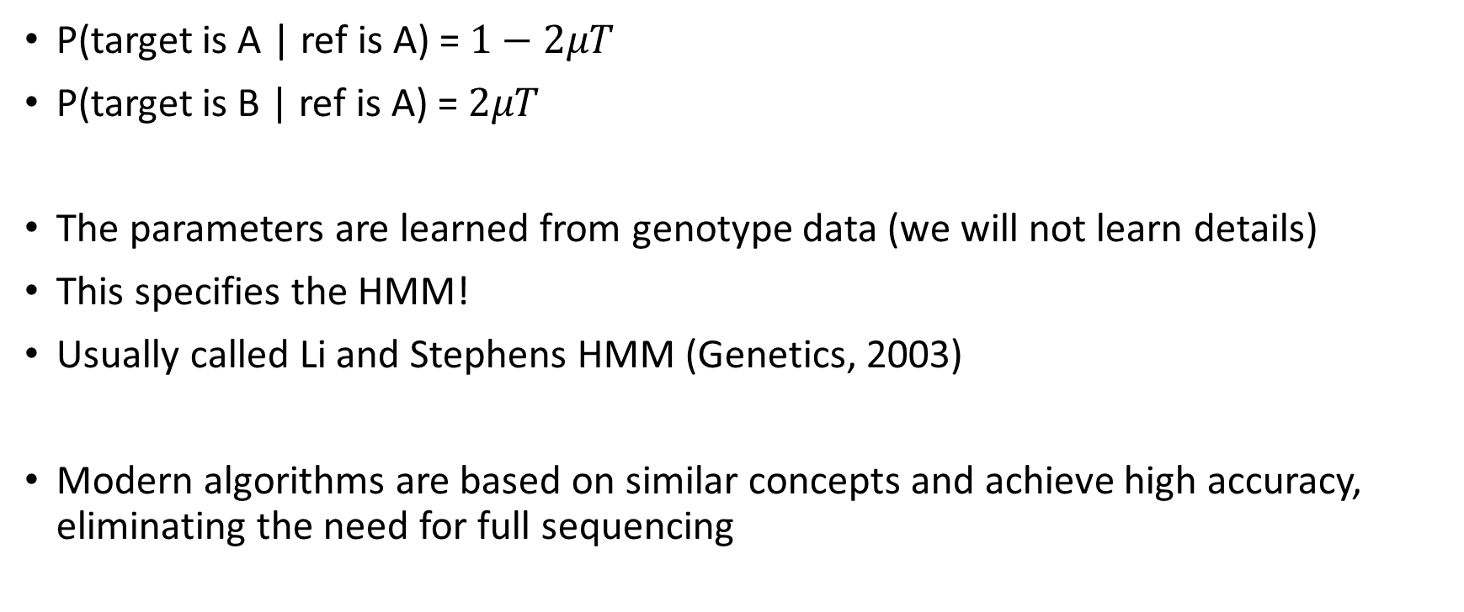
Modeling emissions
P(target is A | ref is A) = $1−2μT$
P(target is B | ref is A) = $2μT$
The parameters are learned from genotype data (we will not learn details)
This specifies the HMM!
Usually called Li and Stephens HMM (Genetics, 2003)
Modern algorithms are based on similar concepts and achieve high accuracy, eliminating the need for full sequencing

