Slide 1
Advanced Topics in Data Analysis
Shai Carmi

Slide 2
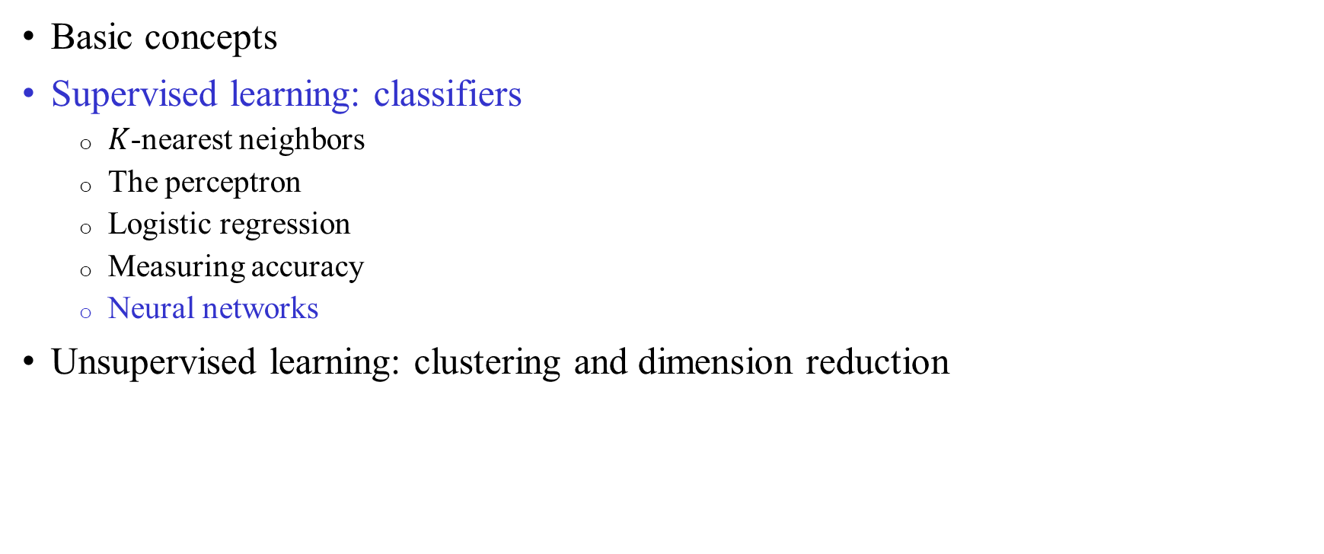
Introduction to machine learning
Basic concepts
Supervised learning: classifiers
  $K$-nearest neighbors
  The perceptron
  Logistic regression
  Measuring accuracy
  Neural networks
Unsupervised learning: clustering and dimension reduction

Slide 3
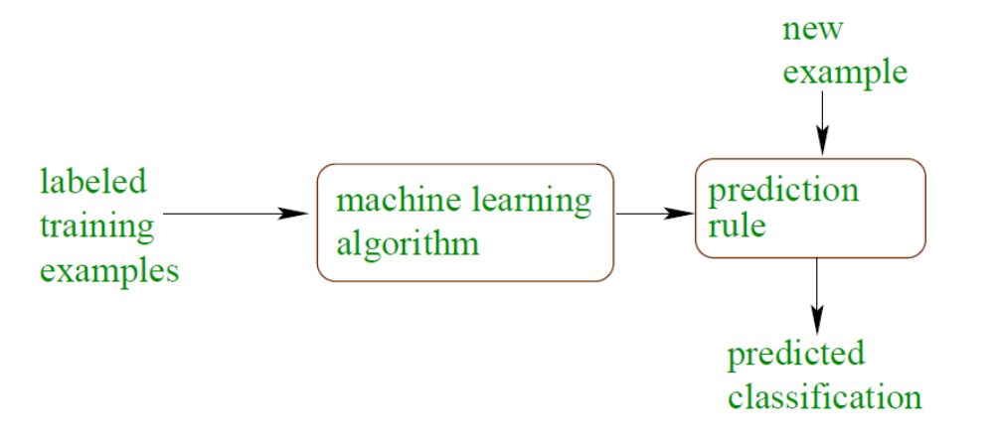
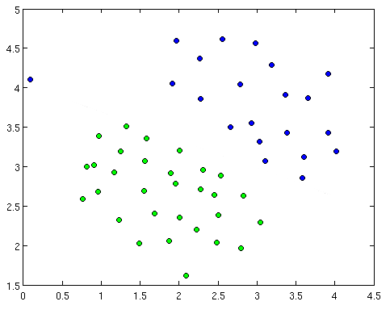
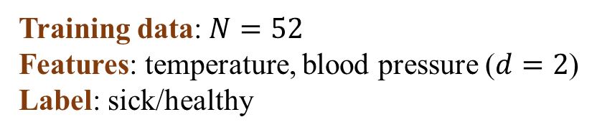
Supervised learning: classification
Training data: $N=52$
Features: temperature, blood pressure ($d=2$)
Label: sick/healthy
learning
Sick
?
Healthy
?
?
Temperature
Class separation line
?
?
Blood pressure

Slide 4

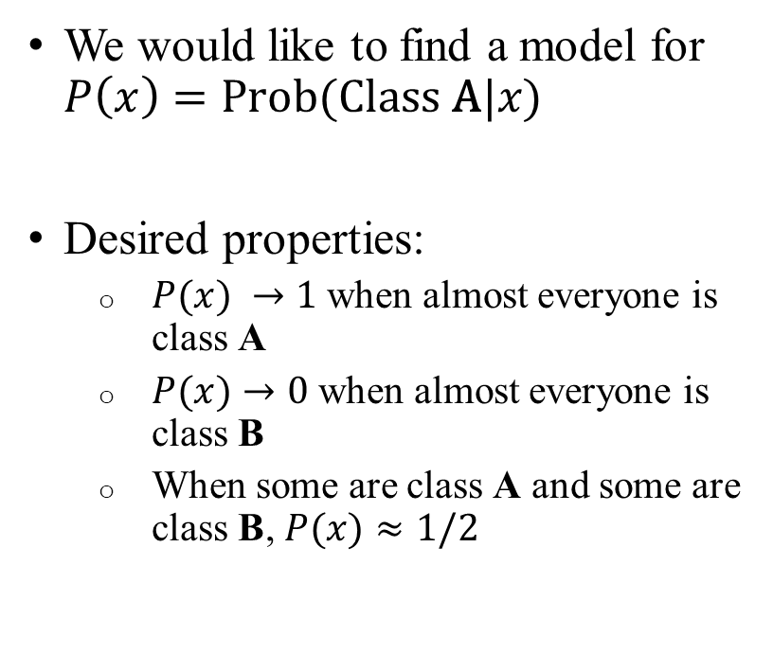


Modeling class probabilities
We would like to find a model for $P\left(x\right)=\text{Prob}(\text{Class} \text{A}|x)$
Desired properties:
  $P(x) →1$ when almost everyone is class A
  $P(x)→0$ when almost everyone is class B
  When some are class A and some are class B, $P(x)≈1/2$
$$\text{Prob}(\text{class} \text{A}|x)$$
Class A
1
x x x x xxx x xxx
$$P(x)$$
0
xxx x x xxx x x x
$$x$$
Class B

Slide 5
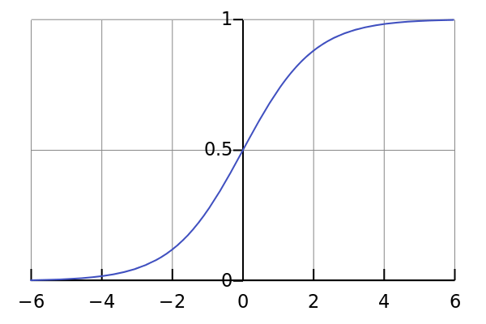
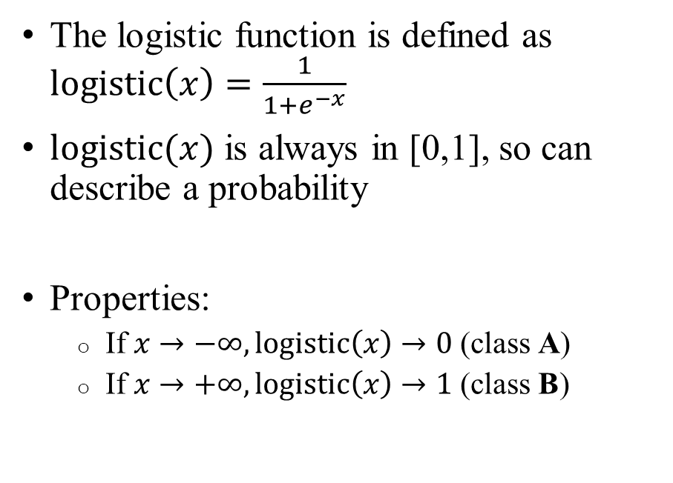


The logistic function
$$logistic⁡(x)$$
The logistic function is defined as $logi\text{stic}\left(x\right)=\frac{1}{1+e^{−x}}$
$logistic⁡(x)$ is always in [0,1], so can describe a probability
Properties:
  If $x→−∞, \text{logistic}\left(x\right)→0$ (class A)
  If $x→+∞, \text{logistic}\left(x\right)→1$ (class B)
$$x$$

Slide 6
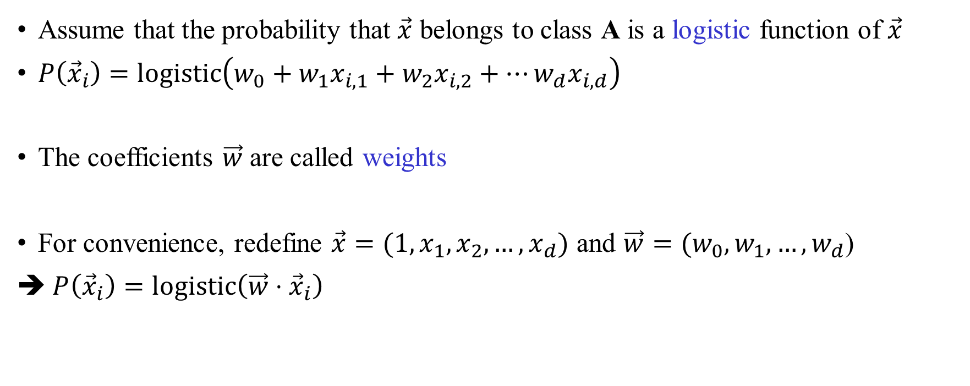
Logistic regression
Assume that the probability that $\vec{x}$ belongs to class A is a logistic function of $\vec{x}$
$P\left({\vec{x}}_{i}\right)=\text{logistic}\left(w_{0}+w_{1}x_{i,1}+w_{2}x_{i,2}+…w_{d}x_{i,d}\right)$
The coefficients $\vec{w}$ are called weights
For convenience, redefine $\vec{x}=(1,x_{1},x_{2},…,x_{d})$ and $\vec{w}=(w_{0},w_{1},…,w_{d}$)
➔ $P\left({\vec{x}}_{i}\right)=\text{logistic}\left(\vec{w}⋅{\vec{x}}_{i}\right)$

Slide 7
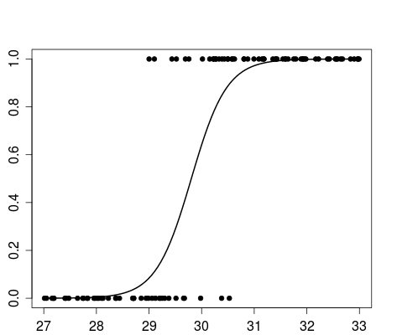
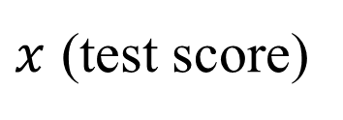
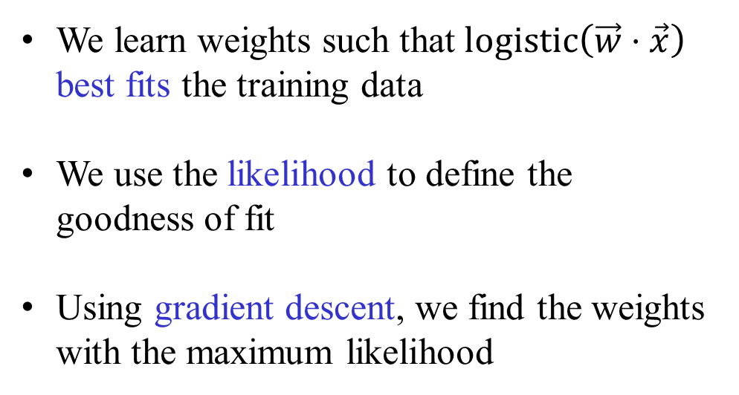

Logistic regression
$$P\left(x\right)=logistic⁡(wx)$$
We learn weights such that $\text{logistic}\left(\vec{w}⋅\vec{x}\right)$ best fits the training data
We use the likelihood to define the goodness of fit
Using gradient descent, we find the weights with the maximum likelihood
Sick
Healthy
$x$ (test score)

Slide 8
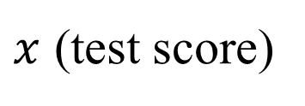

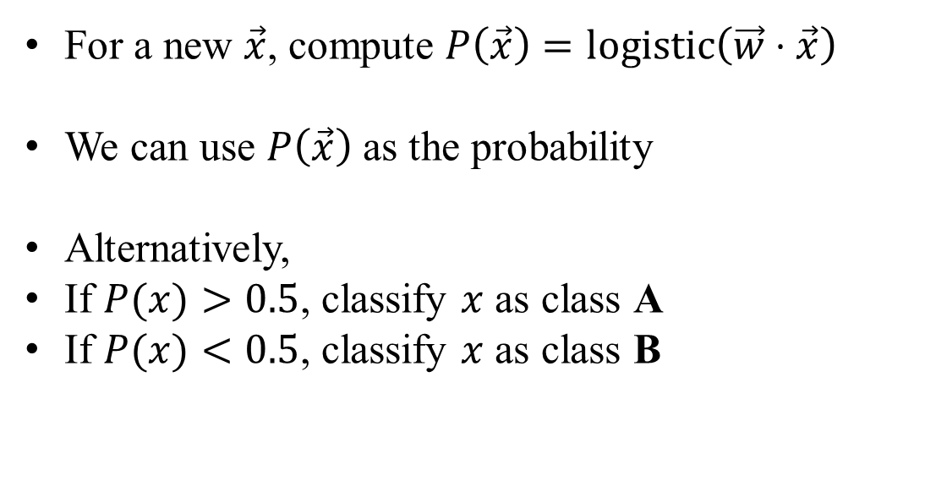
Prediction
$$P\left(x\right)=logistic⁡(wx)$$
For a new $\vec{x}$, compute $P\left(\vec{x}\right)=\text{logi}\text{s}\text{t}\text{ic}\left(\vec{w}⋅\vec{x}\right)$
We can use $P\left(\vec{x}\right)$ as the probability
Alternatively,
If $P(x)>0.5$, classify $x$ as class A
If $P(x)<0.5$, classify $x$ as class B
Sick
Actual data points
sick/healthy?
P(sick)=0.2
Healthy
$x$ (test score)

Slide 9
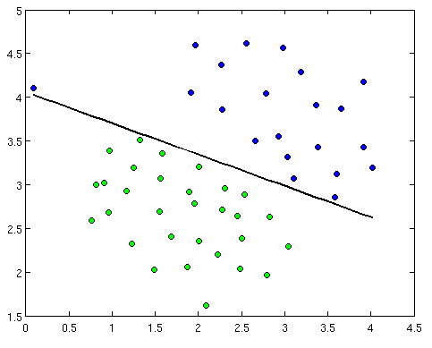
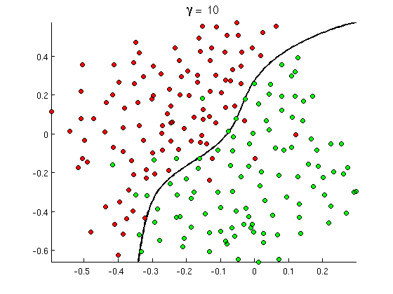
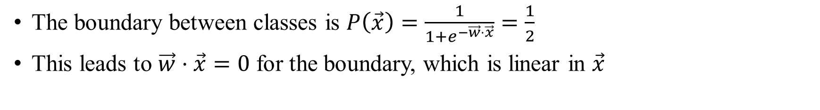

Logistic regression is a linear classifier
The boundary between classes is $P\left(\vec{x}\right)=\frac{1}{1+e^{−\vec{w}⋅\vec{x}}}=\frac{1}{2}$
This leads to $\vec{w}⋅\vec{x}=0$ for the boundary, which is linear in $\vec{x}$
What to do about a non-linear boundary?
Sick
Healthy
Temperature
$\vec{w}⋅\vec{x}=0$
Blood pressure

Slide 10
Taxonomy of methods
Parametric?
Yes
No
Linear?
K-nearest-neighbors
Decision Trees
(Random Forests, Boosting)
Gaussian Processes
Yes
No
Perceptron
Logistic Regression
Linear Discriminant Analysis
Naïve Bayes Classifier
Support Vector Classifier
Neural Networks
Support Vector Machines (some)

Slide 11

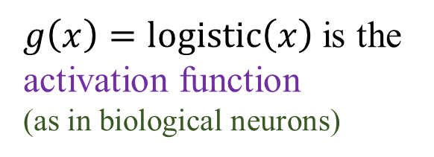
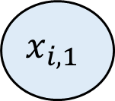

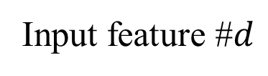


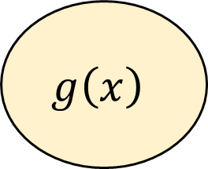
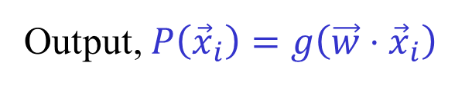
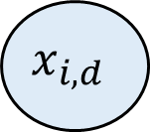




A graphical representation of logistic regression
Neuron
$g\left(x\right)=\text{logi}\text{s}\text{t}\text{ic}\left(x\right)$ is the activation function
(as in biological neurons)
$$x_{i,0}$$
Input feature #0
$$w_{0}$$
$$x_{i,1}$$
$$w_{1}$$
+
Input feature #1
$$g\left(x\right)$$
Output, $P\left({\vec{x}}_{i}\right)=g\left(\vec{w}⋅{\vec{x}}_{i}\right)$
$$x_{i,2}$$
Input feature #2
$$w_{2}$$
$$g\left(x\right)=\text{logistic}(x)$$
…
$$w_{d}$$
$$x_{i,d}$$
Input feature #$d$
$$x$$

Slide 12
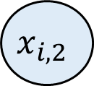
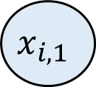

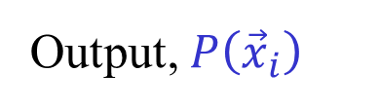
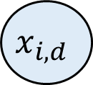
The neural network
Neuron 1
+
logistic
$$x_{i,1}$$
We add a layer of “neurons”
Called the hidden layer
+
$$x_{i,2}$$
logistic
+
Output, $P\left({\vec{x}}_{i}\right)$
logistic
Neuron 2
…
Output neuron
…
$$x_{i,d}$$
+
logistic
Neuron $m$

Slide 13


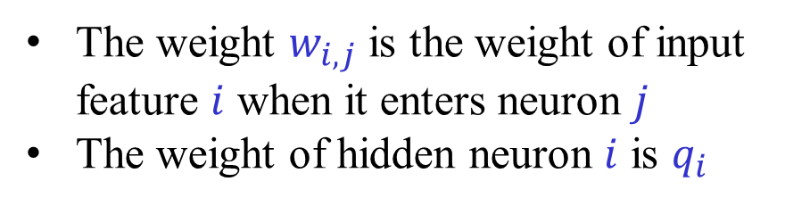
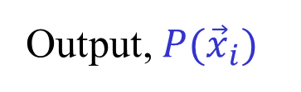










The neural network
Neuron 1
+
$$w_{1,1}$$
logistic
$$x_{i,1}$$
$$q_{1}$$
$$w_{2,1}$$
$$w_{d,1}$$
+
Output, $P({\vec{x}}_{i})$
logistic
$$w_{1,2}$$
+
$$x_{i,2}$$
logistic
$$w_{2,2}$$
$$q_{2}$$
Output neuron
Neuron 2
$$w_{d,2}$$
…
…
$$w_{1,m}$$
$$q_{m}$$
The weight $w_{i,j}$ is the weight of input feature $i$ when it enters neuron $j$
The weight of hidden neuron $i$ is $q_{i}$
$$w_{2,m}$$
$$x_{i,d}$$
+
$$w_{d,m}$$
logistic
Neuron $m$

Slide 14






Neural networks: intuition
Non-linear decision boundary
But can be represented using two linear classifiers
$$x_{2}$$
x
Are we above the red line?
x
x
x
o
o
o
$$x_{0}$$
Neuron 1
o
+
o
o
x
logistic
x
x
+
Output, $P(\vec{x})$
$$x_{1}$$
logistic
$$x_{1}$$
+
logistic
Output neuron
$$x_{2}$$
Neuron 2
X: Class A
O: Class B
Are we above the pink line?

Slide 15

Neural networks: intuition
x₂
x
x
X: Class A
O: Class B
x
x
o
Are we above the red line?
o
o
o
o
o
x
x
x
x₀
Neuron 1
+
logistic
x₁
+
Output, $f(\vec{x})$
x₁
logistic
Neuron 2
Class A
+
Output neuron
Output neuron
logistic
1
x
x
x₂
Neuron 2
o
o
o
x
x
o
o
o
Are we above the pink line?
Class B
x
x
x
0
1
Neuron 1

Slide 16



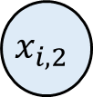











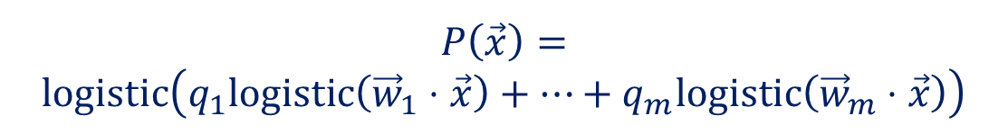
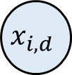


The neural network
Neuron 1
+
$$w_{1,1}$$
logistic
$$x_{i,1}$$
$$q_{1}$$
$$w_{2,1}$$
$$w_{d,1}$$
+
Output, $P({\vec{x}}_{i})$
$$w_{1,2}$$
logistic
+
$$x_{i,2}$$
logistic
Output neuron
$$q_{2}$$
$$w_{2,2}$$
Neuron 2
$$w_{d,2}$$
…
…
$$P\left(\vec{x}\right)=$$
$$\text{logi}\text{s}\text{t}\text{ic}\left(q_{1}\text{logi}\text{s}\text{t}\text{ic}\left({\vec{w}}_{1}⋅\vec{x}\right)+…+q_{m}\text{logi}\text{s}\text{t}\text{ic}\left({\vec{w}}_{m}⋅\vec{x}\right)\right)$$
$$w_{2,m}$$
$$w_{1,m}$$
$$q_{m}$$
$$x_{i,d}$$
+
$${\vec{w}}_{1}=\left(w_{1,1},w_{2,1},…,w_{d,1}\right)$$
$$w_{d,m}$$
logistic
Neuron $m$

Slide 17
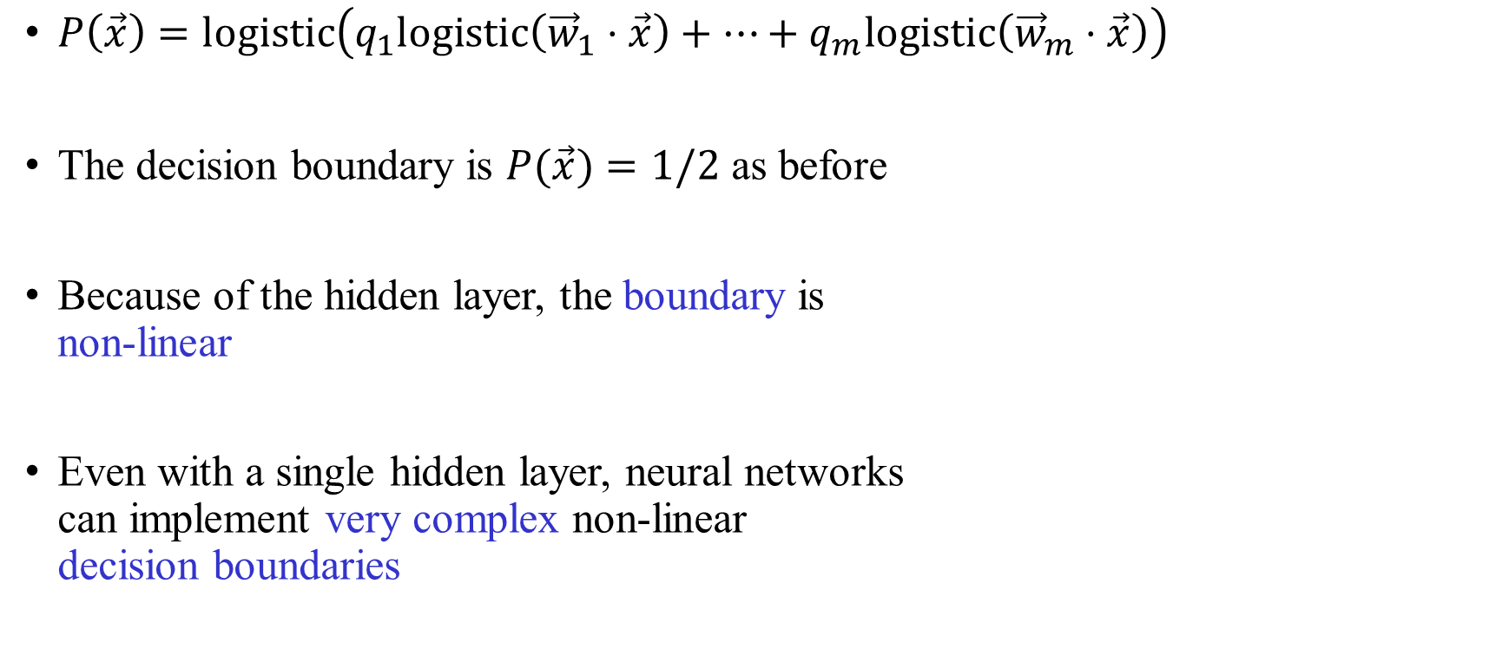
Neural network is a non-linear classifier
$P\left(\vec{x}\right)=\text{logistic}\left(q_{1}\text{l}\text{ogi}\text{s}\text{t}\text{ic}\left({\vec{w}}_{1}⋅\vec{x}\right)+…+q_{m}\text{logi}\text{s}\text{t}\text{ic}\left({\vec{w}}_{m}⋅\vec{x}\right)\right)$
The decision boundary is $P(\vec{x})=1/2$ as before
Because of the hidden layer, the boundary is
non-linear
Even with a single hidden layer, neural networks
can implement very complex non-linear
decision boundaries

Slide 18





Intuition
Each input is sent to all neurons in the hidden layer, with different weights
Neuron 1
+
logistic
Each hidden neuron computes a different (linear) “function” of all inputs, representing “higher-level” features
The output neuron computes the final output as a function of those high-level features
$$x_{1}$$
+
$$x_{2}$$
logistic
+
Output, $P(\vec{x})$
logistic
Neuron 2
Output neuron
…
…
$$x_{d}$$
+
logistic
Neuron $m$

Slide 19
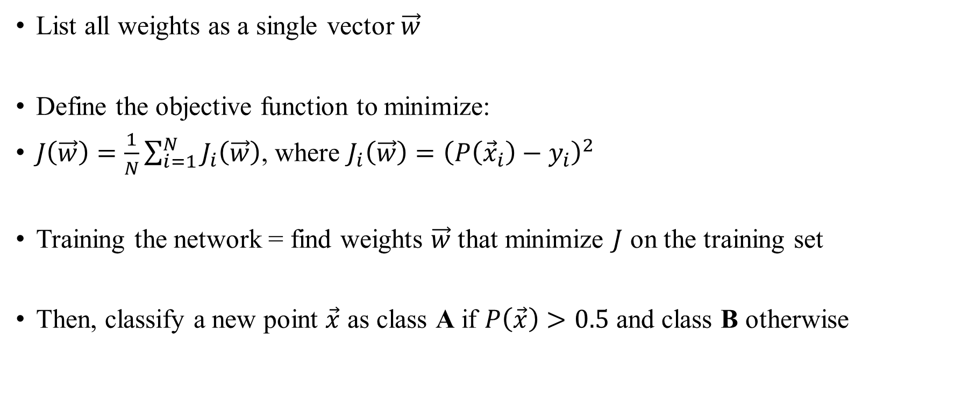
How to train a neural network?
List all weights as a single vector $\vec{w}$
Define the objective function to minimize:
$J\left(\vec{w}\right)=\frac{1}{N}\sum_{i=1}^{N}{J_{i}\left(\vec{w}\right)}$, where $J_{i}\left(\vec{w}\right)={\left(P\left({\vec{x}}_{i}\right)−y_{i}\right)}^{2}$
Training the network = find weights $\vec{w}$ that minimize $J$ on the training set
Then, classify a new point $\vec{x}$ as class A if $P\left(\vec{x}\right)>0.5$ and class B otherwise

Slide 20
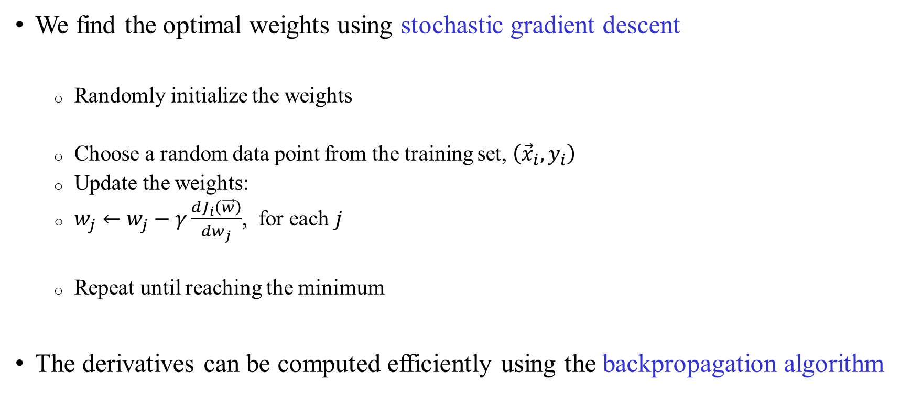
How to learn the weights?
We find the optimal weights using stochastic gradient descent
  Randomly initialize the weights
  Choose a random data point from the training set, $\left({\vec{x}}_{i},y_{i}\right)$
  Update the weights:
  $w_{j}←w_{j}−γ\frac{dJ_{i}\left(\vec{w}\right)}{dw_{j}}$, for each $j$
  Repeat until reaching the minimum
The derivatives can be computed efficiently using the backpropagation algorithm

Slide 21
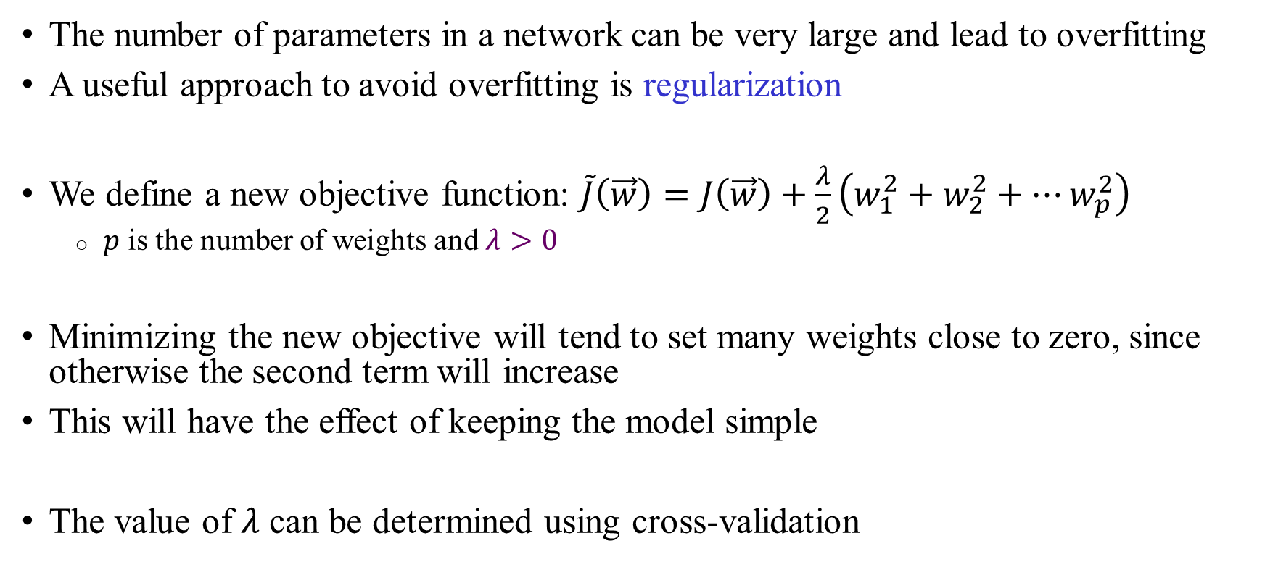
Regularization
The number of parameters in a network can be very large and lead to overfitting
A useful approach to avoid overfitting is regularization
We define a new objective function: $\tilde{J}\left(\vec{w}\right)=J\left(\vec{w}\right)+\frac{λ}{2}\left(w_{1}^{2}+w_{2}^{2}+…w_{p}^{2}\right)$
  $p$ is the number of weights and $λ>0$
Minimizing the new objective will tend to set many weights close to zero, since otherwise the second term will increase
This will have the effect of keeping the model simple
The value of $λ$ can be determined using cross-validation

Slide 22
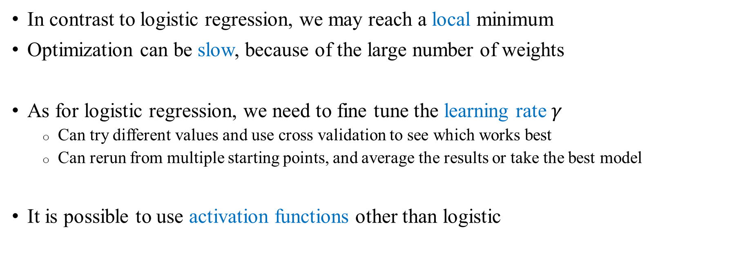
Remarks
In contrast to logistic regression, we may reach a local minimum
Optimization can be slow, because of the large number of weights
As for logistic regression, we need to fine tune the learning rate $γ$
  Can try different values and use cross validation to see which works best
  Can rerun from multiple starting points, and average the results or take the best model
It is possible to use activation functions other than logistic

Slide 23
Neural networks: brief history
Neural networks were popular in the 80’s, but went out of fashion in the 90’s
Revived in the late 2000’s due to:
  The availability of large amounts of labeled and unlabeled data
  The increase in computing power and particularly, the affordability of GPUs
  Theoretical developments that increased speed and accuracy
Currently the strongest solution for prediction based on images, speech, and language, i.e., complex natural signals with high levels of non-linearity
Milestone goals recently achieved (human-like performance)
Recent developments fall under “deep learning”

Slide 24
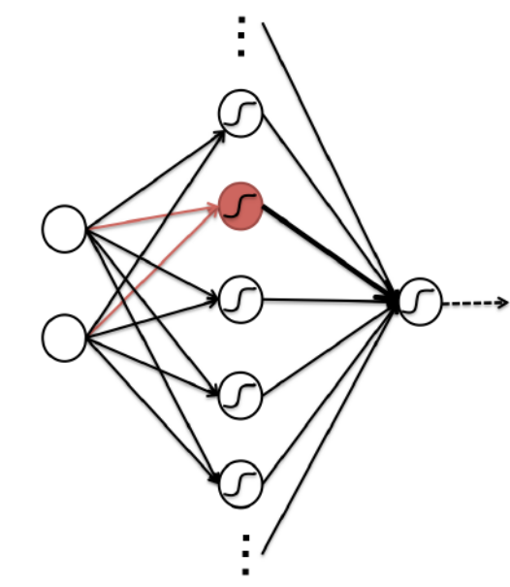
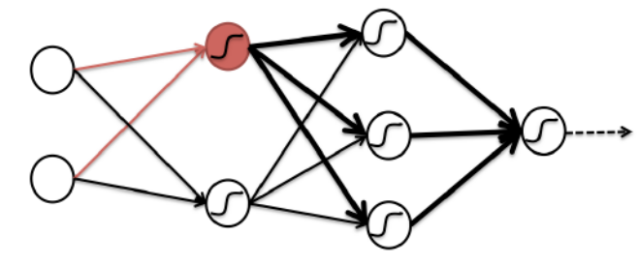
What is “deep”?
Having multiple hidden layers can improve accuracy
The same feature (red)
can be used multiple times
Useful for images, speech, etc.,
where features can appear
repeatedly anywhere
Shallow network
Deep network

Slide 25


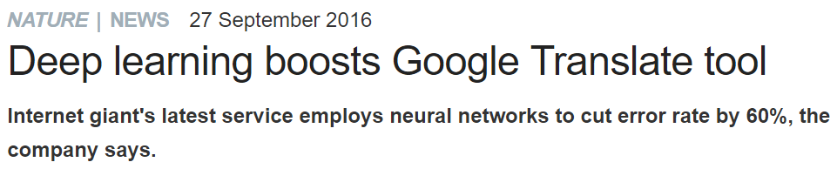

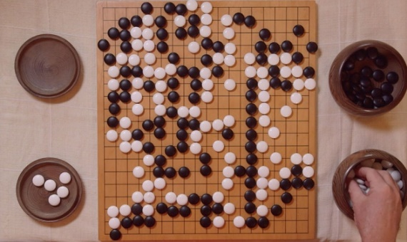

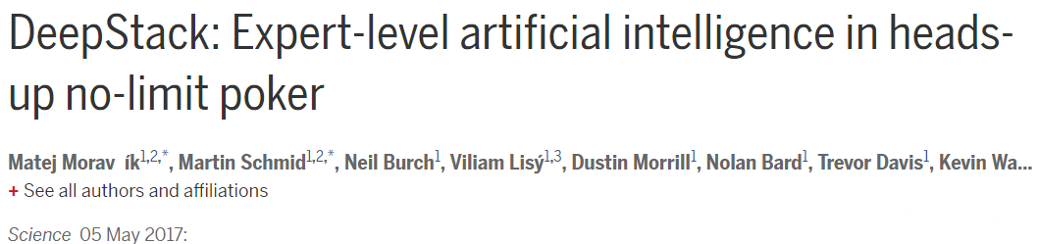

Deep learning: the new frontier

Slide 26



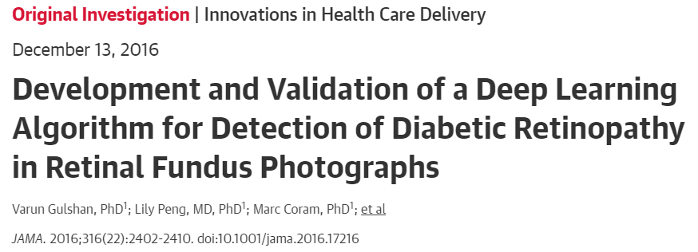
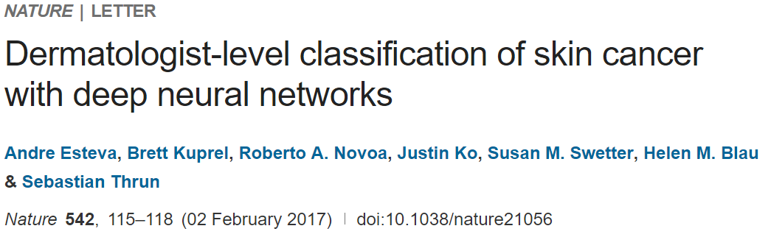

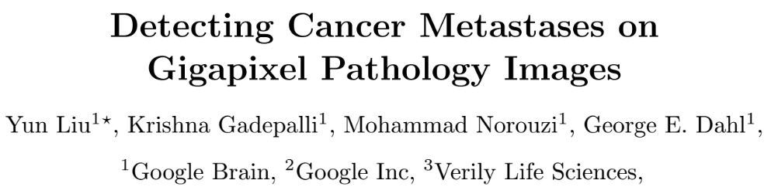

Deep learning in medicine

Slide 27
Neural networks: advantages
A neural network can represent any complex function (at the cost of more units)
Unparalleled performance, success in problems thought to be impossible
Neural networks learn the features automatically: the middle layers can be thought of as representing the features
“Feature engineering” not needed!
Specialized architectures guarantee that prediction is robust to small shifts or rotations of the features (e.g., in images)

Slide 28
Neural networks: disadvantages
Usually impossible to interpret the inferred model: each input is used multiple times and non-linearly
Can be a problem in medicine
Can be very slow to train and requires large training sets
Requires tailoring the architecture to the specific problem at hand, possibly with extensive cross-validation
Many architectures possible, and expertise is required for network design

