Slide 1
Advanced Topics in Data Analysis
Shai Carmi

Slide 2
Introduction to machine learning
Machine learning
  Basic concepts
  Supervised learning: classifiers
  Unsupervised learning: clustering and dimension reduction
    Time permitting

Slide 3
Introduction to machine learning
Basic concepts
Supervised learning: classifiers
  K-nearest neighbors
  Linear classifiers: regression, logistic, perceptron
  Measuring accuracy
  Neural networks
Unsupervised learning: clustering and dimension reduction

Slide 4
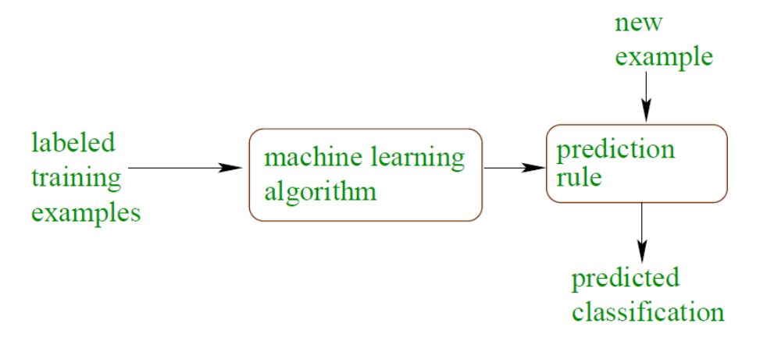
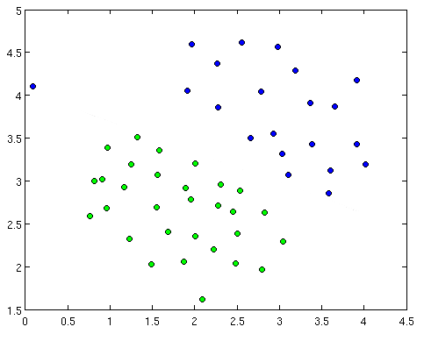
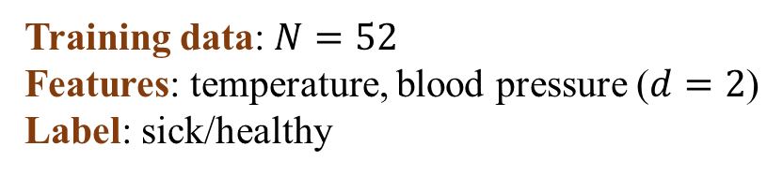
Supervised learning: classification
Training data: $N=52$
Features: temperature, blood pressure ($d=2$)
Label: sick/healthy
learning
Sick
?
Healthy
?
?
Temperature
A machine learning classifier divides the
space into the different classes
We can then assign a label to each new point
Class separation line
?
?
Blood pressure

Slide 5
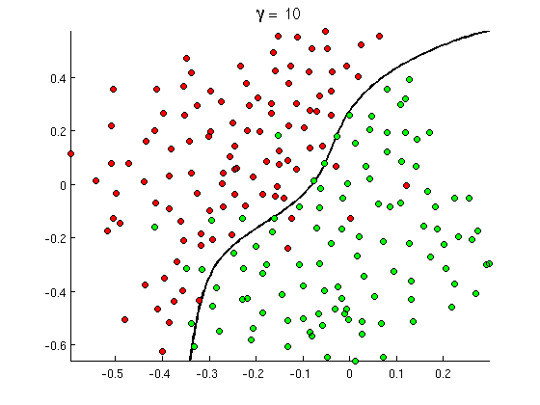
Classification using complex models
learning
More complex models are often needed
Need to be careful about overfitting

Slide 6
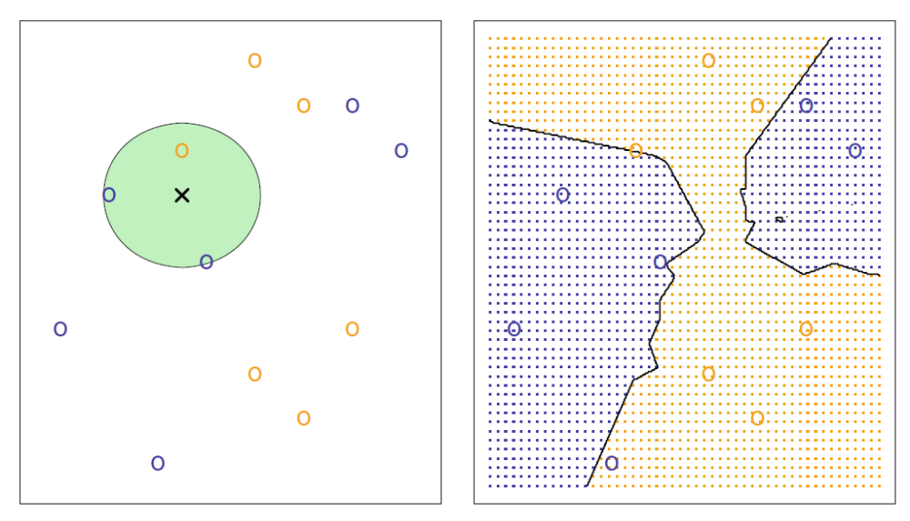
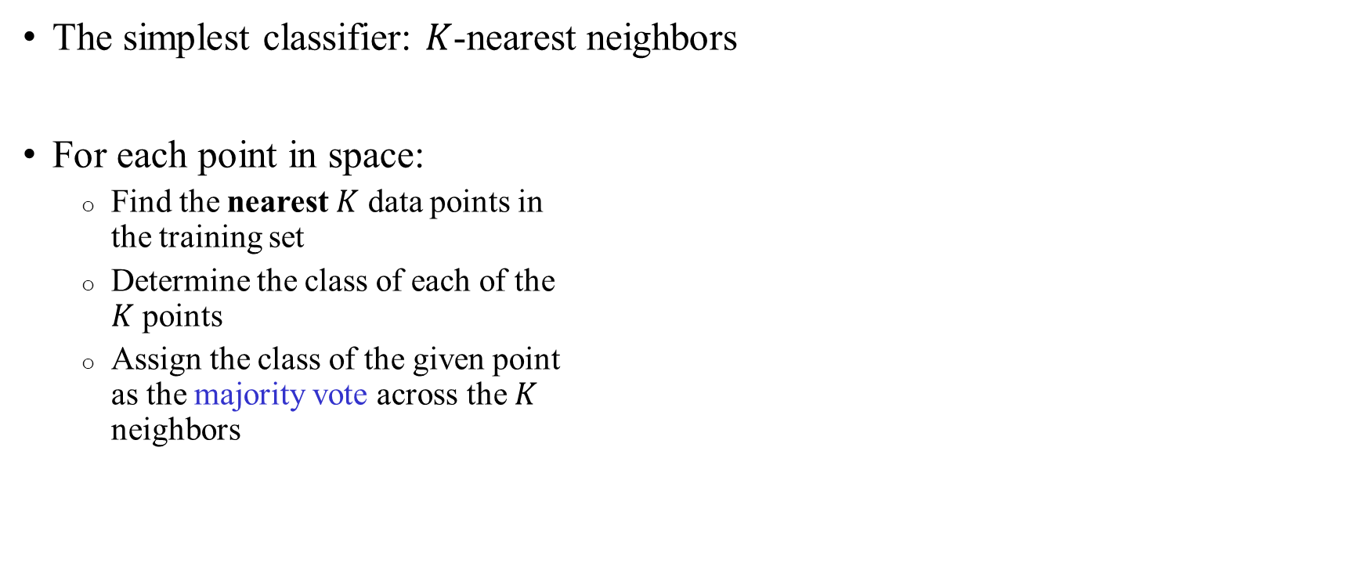

A simple classifier
The simplest classifier: $K$-nearest neighbors
For each point in space:
  Find the nearest $K$ data points in
  the training set
  Determine the class of each of the
  $K$ points
  Assign the class of the given point
  as the majority vote across the $K$
  neighbors
$K$=3

Slide 7
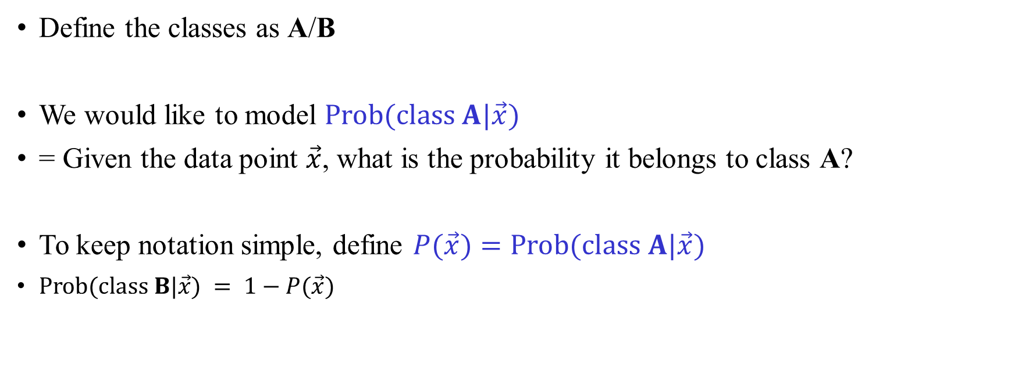
Modeling class probabilities
Define the classes as A/B
We would like to model $\text{Prob}(\text{class} A|\vec{x})$
= Given the data point $\vec{x}$, what is the probability it belongs to class A?
To keep notation simple, define $P(\vec{x})=\text{Prob}(\text{class} A|\vec{x})$
$\text{Prob}(\text{class} B|\vec{x}) = 1−P(\vec{x})$

Slide 8

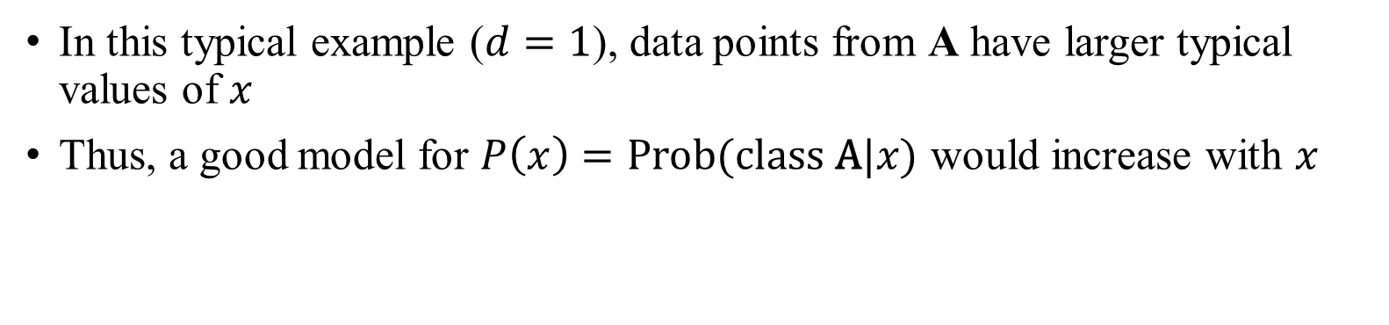
Modeling class probabilities
In this typical example ($d=1$), data points from A have larger typical values of $x$
Thus, a good model for $P\left(x\right)=\text{Prob}(\text{class} \text{A}|x)$ would increase with $x$
Class A data points
x x x x xxx x xxx
Class B data points
xxx x x xxx x x x
$$x$$

Slide 9


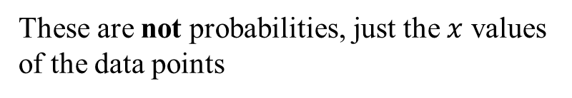
Modeling class probabilities
$$P\left(x\right)=P(\text{class} \text{A}|x)$$
What would be a good model?
Class A data points
1
x x x x xxx x xxx
0
xxx x x xxx x x x
$$x$$
Class B data points
These are not probabilities, just the $x$ values of the data points

Slide 10
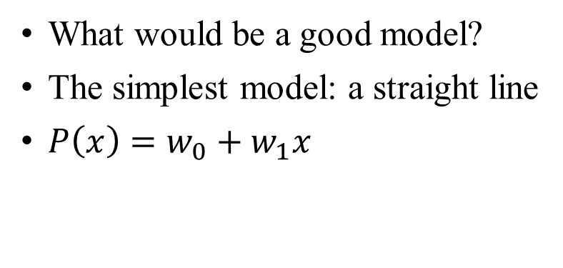

Modeling class probabilities
What would be a good model?
The simplest model: a straight line
$P\left(x\right)=w_{0}+w_{1}x$
Class A
1
x x x x xxx x xxx
$$P(x)$$
0
xxx x x xxx x x x
$$x$$
Class B

Slide 11
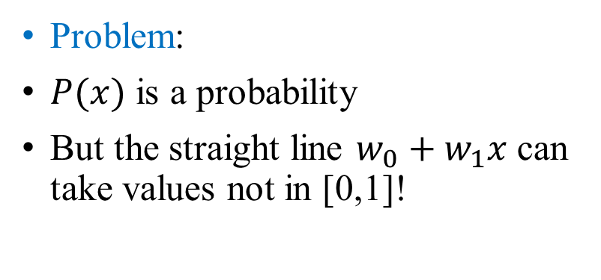
Modeling class probabilities
Problem:
$P(x)$ is a probability
But the straight line $w_{0}+w_{1}x$ can take values not in [0,1]!
Class A
1
x x x x xxx x xxx
$$P(x)$$
0
xxx x x xxx x x x
$$x$$
Class B

Slide 12
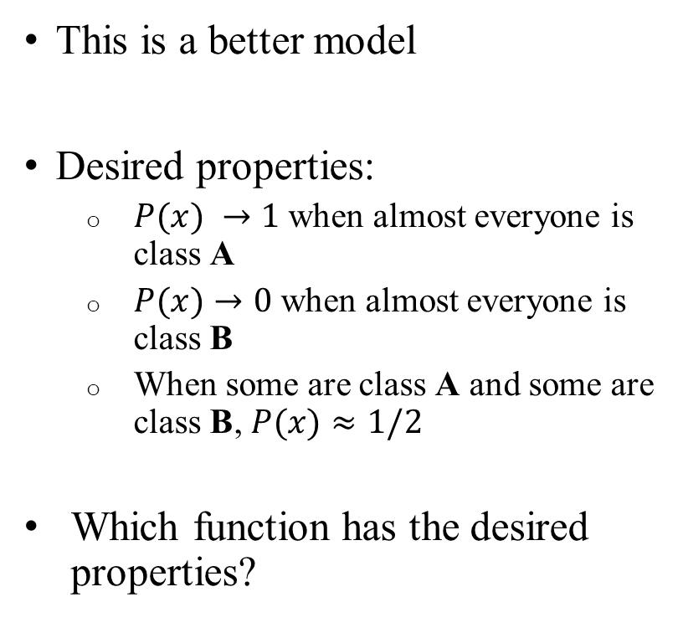

Modeling class probabilities
This is a better model
Desired properties:
  $P(x) →1$ when almost everyone is class A
  $P(x)→0$ when almost everyone is class B
  When some are class A and some are class B, $P(x)≈1/2$
Which function has the desired properties?
$$P\left(x\right)=P(\text{class} \text{A}|x)$$
Class A
1
x x x x xxx x xxx
$$P(x)$$
0
xxx x x xxx x x x
$$x$$
Class B

Slide 13
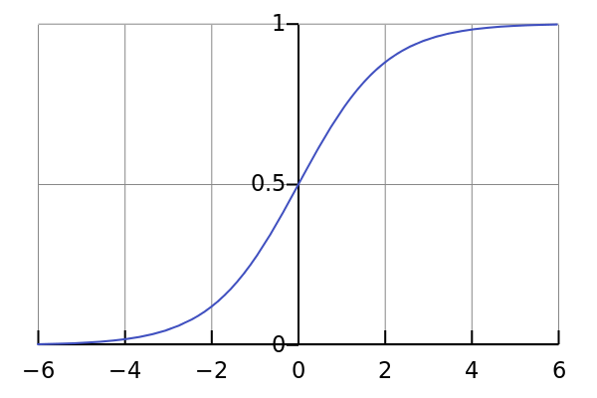
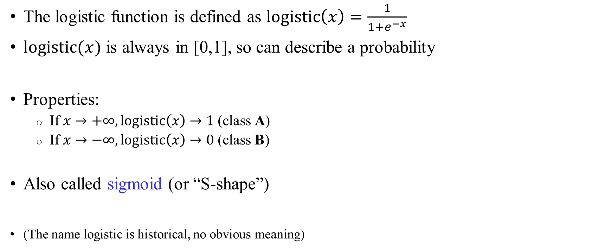


The logistic function
The logistic function is defined as $logi\text{stic}\left(x\right)=\frac{1}{1+e^{−x}}$
$logistic⁡(x)$ is always in [0,1], so can describe a probability
Properties:
  If $x→+∞, \text{logi}\text{s}\text{t}\text{ic}\left(x\right)→1$ (class A)
  If $x→−∞, \text{logistic}\left(x\right)→0$ (class B)
Also called sigmoid (or “S-shape”)
(The name logistic is historical, no obvious meaning)
$$logistic⁡(x)$$
$$x$$

Slide 14
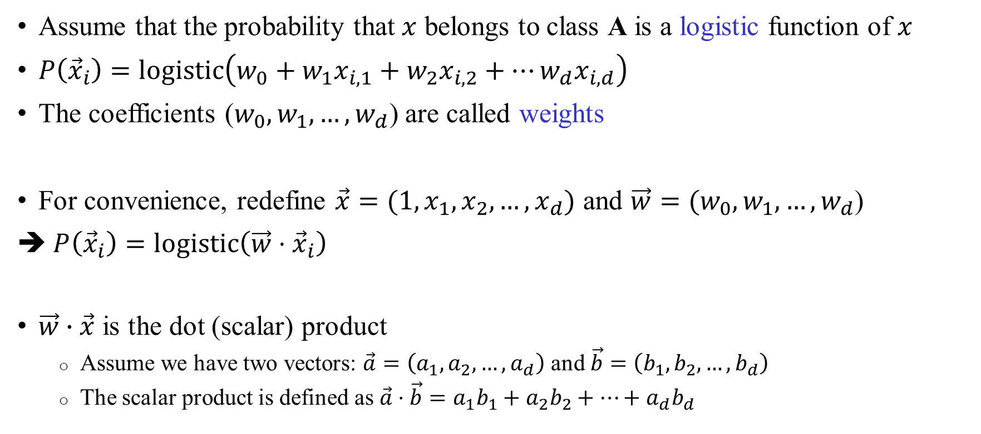
An idea
Assume that the probability that $x$ belongs to class A is a logistic function of $x$
$P\left({\vec{x}}_{i}\right)=\text{logistic}\left(w_{0}+w_{1}x_{i,1}+w_{2}x_{i,2}+…w_{d}x_{i,d}\right)$
The coefficients ($w_{0},w_{1},…,w_{d}$) are called weights
For convenience, redefine $\vec{x}=(1,x_{1},x_{2},…,x_{d})$ and $\vec{w}=(w_{0},w_{1},…,w_{d}$)
➔ $P\left({\vec{x}}_{i}\right)=\text{logistic}\left(\vec{w}⋅{\vec{x}}_{i}\right)$
$\vec{w}∙\vec{x}$ is the dot (scalar) product
  Assume we have two vectors: $\vec{a}=\left(a_{1},a_{2},…,a_{d}\right)$ and $\vec{b}=\left(b_{1},b_{2},…,b_{d}\right)$
  The scalar product is defined as $\vec{a}⋅\vec{b}=a_{1}b_{1}+a_{2}b_{2}+…+a_{d}b_{d}$

Slide 15

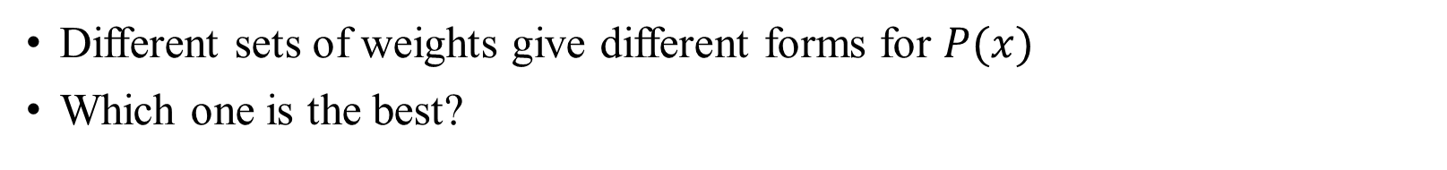



Which weights should we choose?
Different sets of weights give different forms for $P(x)$
Which one is the best?
$$P\left(x\right)=\text{logistic}(w_{0}+w_{1}x)$$
1
x x x x xxx x xxx
0.5
Change in $w_{0}$: shift in location
Change in $w_{1}$: shaper transitions
0
xxx x x xxx x x x
$$x$$

Slide 16

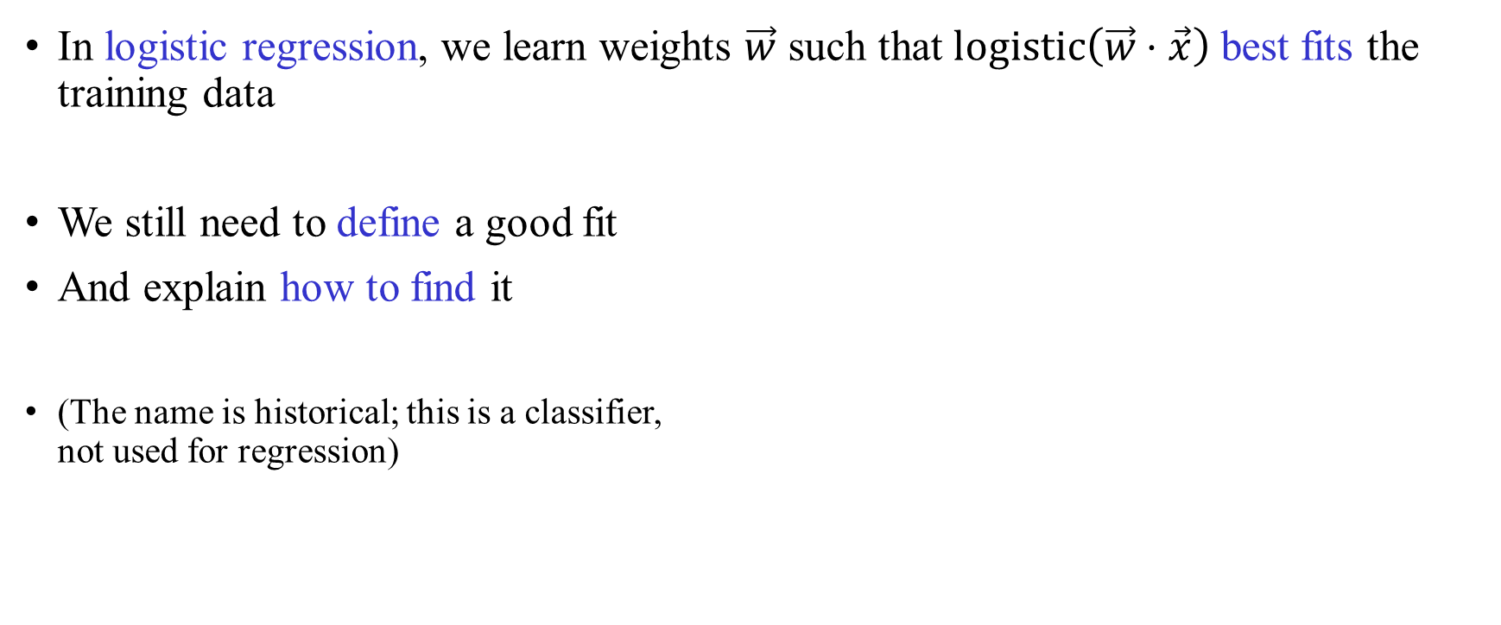


Logistic regression
In logistic regression, we learn weights $\vec{w}$ such that $\text{logistic}\left(\vec{w}⋅\vec{x}\right)$ best fits the training data
We still need to define a good fit
And explain how to find it
(The name is historical; this is a classifier,
not used for regression)
Training data points
$$P(x)$$
1
x x x x xxx x xxx
$$\text{logistic}\left(w⋅x\right)$$
$$x$$
0
xxx x x xxx x x x

Slide 17
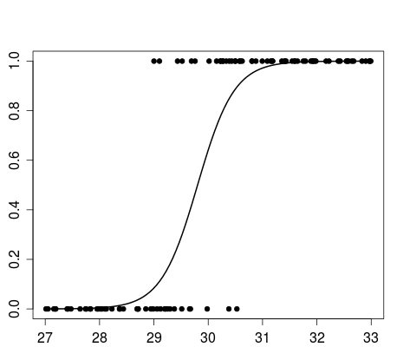
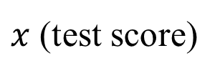
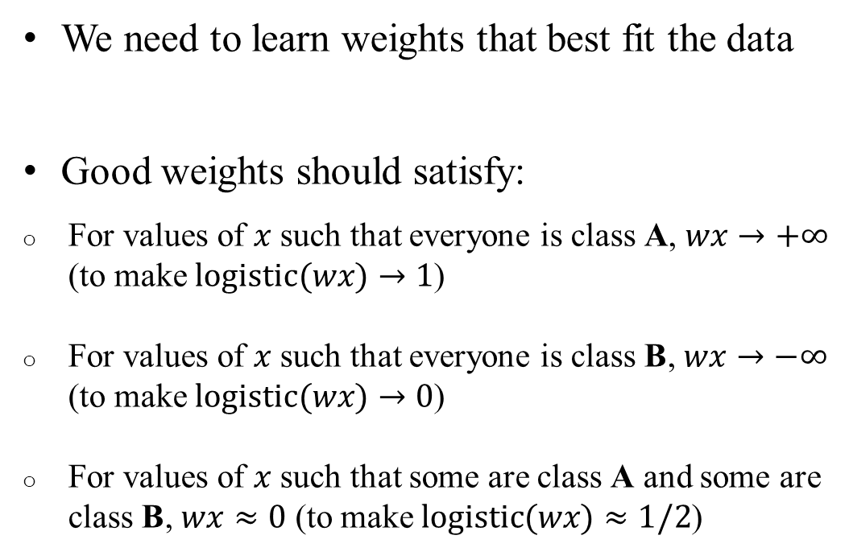

Properties
We need to learn weights that best fit the data
Good weights should satisfy:
For values of $x$ such that everyone is class A, $wx→+∞$ (to make $\text{logistic}(wx)→1$)
For values of $x$ such that everyone is class B, $wx→−∞$ (to make $\text{logistic}(wx)→0$)
For values of $x$ such that some are class A and some are class B, $wx≈0$ (to make $\text{logistic}(wx)≈1/2$)
Sick
$$P\left(x\right)$$
Healthy
$x$ (test score)

Slide 18
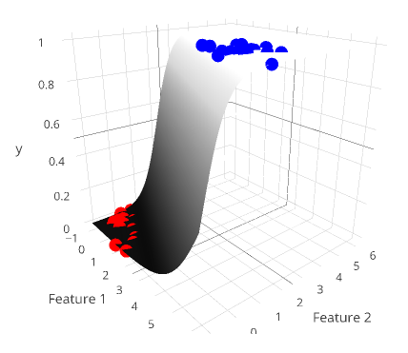
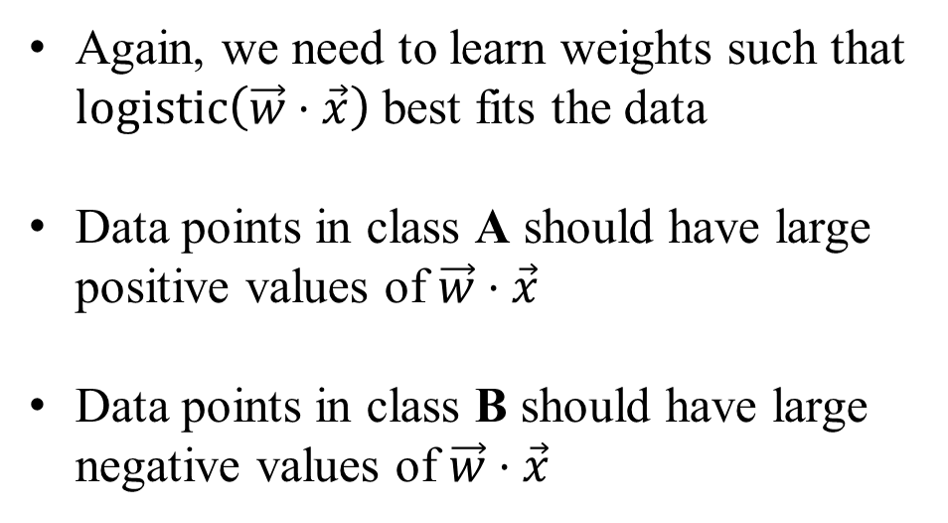



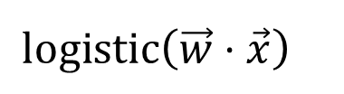
An example in two dimensions
Again, we need to learn weights such that $\text{logistic}\left(\vec{w}⋅\vec{x}\right)$ best fits the data
Data points in class A should have large positive values of $\vec{w}⋅\vec{x}$
Data points in class B should have large negative values of $\vec{w}⋅\vec{x}$
$$y$$
$$\text{logi}\text{s}\text{t}\text{ic}\left(\vec{w}⋅\vec{x}\right)$$
$$x_{1}$$
$$x_{1}$$
$$x_{2}$$

Slide 19
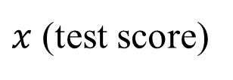

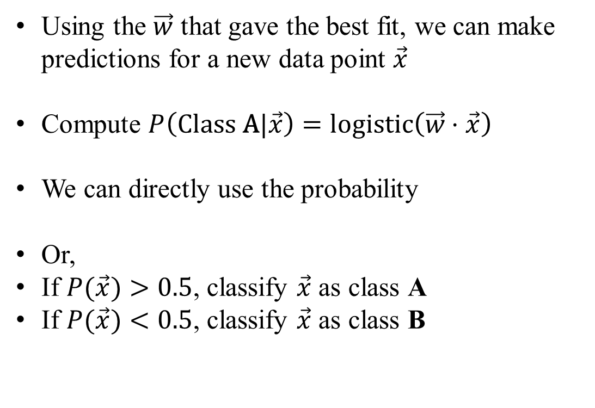
Prediction
Using the $\vec{w}$ that gave the best fit, we can make predictions for a new data point $\vec{x}$
Compute $P\left(\text{Class} \text{A}|\vec{x}\right)=\text{logi}\text{s}\text{t}\text{ic}\left(\vec{w}⋅\vec{x}\right)$
We can directly use the probability
Or,
If $P(\vec{x})>0.5$, classify $\vec{x}$ as class A
If $P(\vec{x})<0.5$, classify $\vec{x}$ as class B
Sick
sick/healthy?
$$P\left(x\right)=logistic(wx)$$
P(sick)=0.2
Healthy
$x$ (test score)

Slide 20


The class boundary
$$P(x)=\text{logistic}\left(\vec{w}⋅\vec{x}\right)$$
1
x x x x xxx x xxx
The class boundary
P(A)=0.5
0.5
Class B
Class A
0
xxx x x xxx x x x
$$x$$

Slide 21
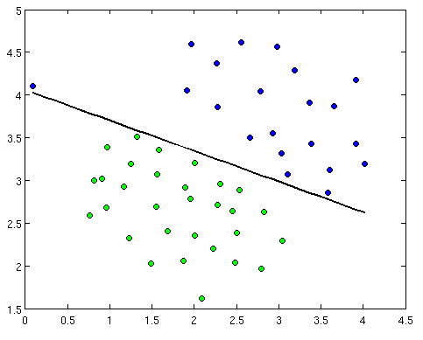
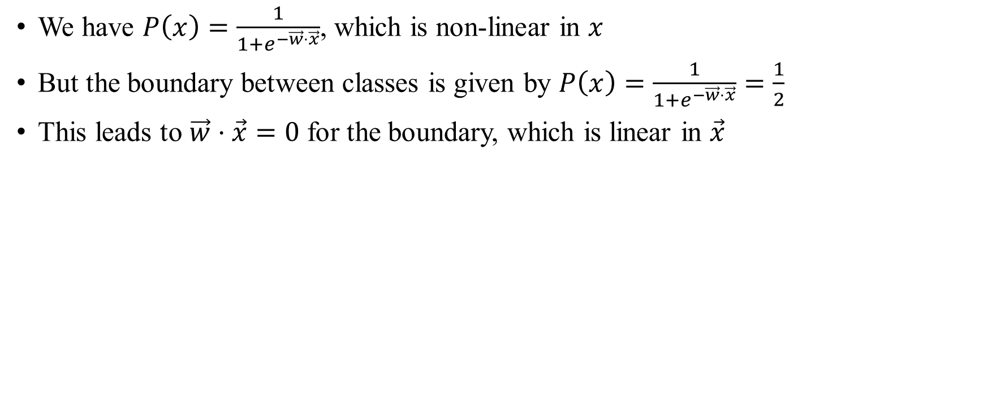
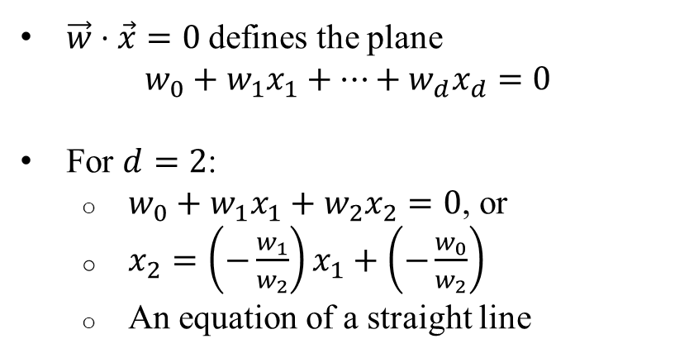

Logistic regression is a linear classifier
We have $P\left(x\right)=\frac{1}{1+e^{−\vec{w}⋅\vec{x}}}$, which is non-linear in $x$
But the boundary between classes is given by $P\left(x\right)=\frac{1}{1+e^{−\vec{w}⋅\vec{x}}}=\frac{1}{2}$
This leads to $\vec{w}⋅\vec{x}=0$ for the boundary, which is linear in $\vec{x}$
Sick
$\vec{w}⋅\vec{x}=0$ defines the plane
$w_{0}+w_{1}x_{1}+…+w_{d}x_{d}=0$
For $d=2$:
  $w_{0}+w_{1}x_{1}+w_{2}x_{2}=0$, or
  $x_{2}=\left(−\frac{w_{1}}{w_{2}}\right)x_{1}+\left(−\frac{w_{0}}{w_{2}}\right)$
  An equation of a straight line
Healthy
Temperature
$\vec{w}⋅\vec{x}=0$
Blood pressure

Slide 22
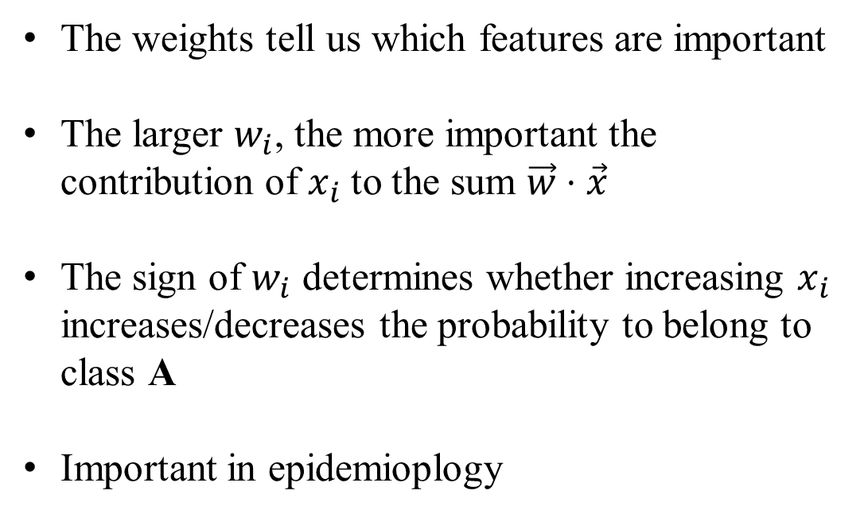

The weights
The weights tell us which features are important
The larger $w_{i}$, the more important the contribution of $x_{i}$ to the sum $\vec{w}⋅\vec{x}$
The sign of $w_{i}$ determines whether increasing $x_{i}$ increases/decreases the probability to belong to class A
Important in epidemioplogy
Sick
$$P\left(x\right)$$
Healthy
$x$ (test score)

Slide 23
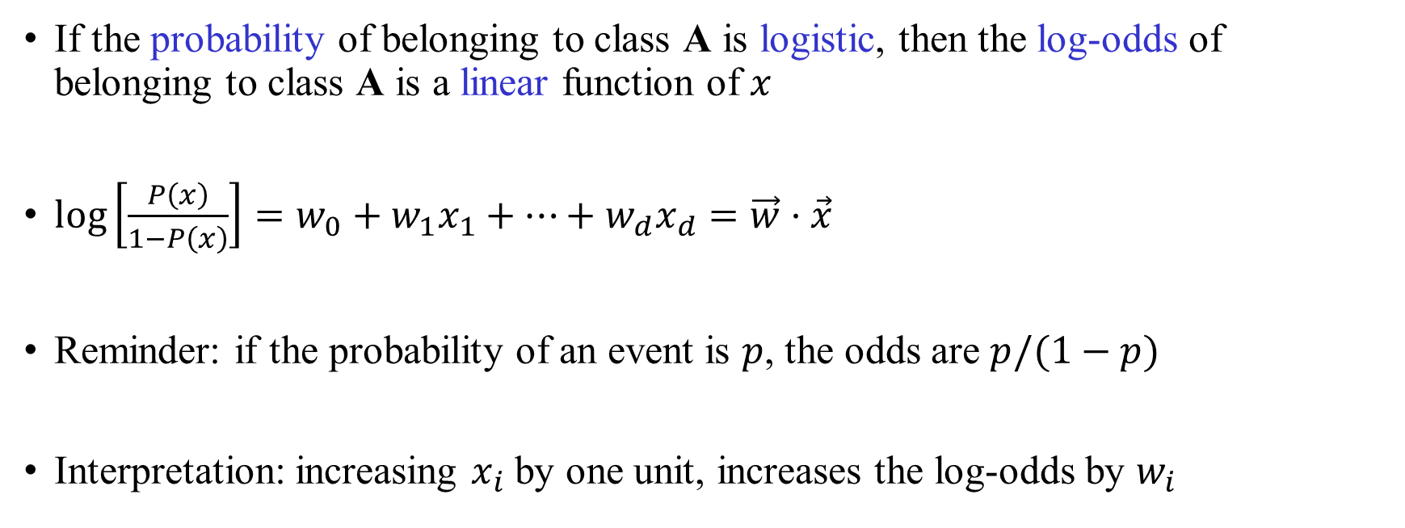
An equivalent representation
If the probability of belonging to class A is logistic, then the log-odds of belonging to class A is a linear function of $x$
$\log\left[\frac{P\left(x\right)}{1−P\left(x\right)}\right]=w_{0}+w_{1}x_{1}+…+w_{d}x_{d}=\vec{w}⋅\vec{x}$
Reminder: if the probability of an event is $p$, the odds are $p/(1−p)$
Interpretation: increasing $x_{i}$ by one unit, increases the log-odds by $w_{i}$
The log is in base e

Slide 24
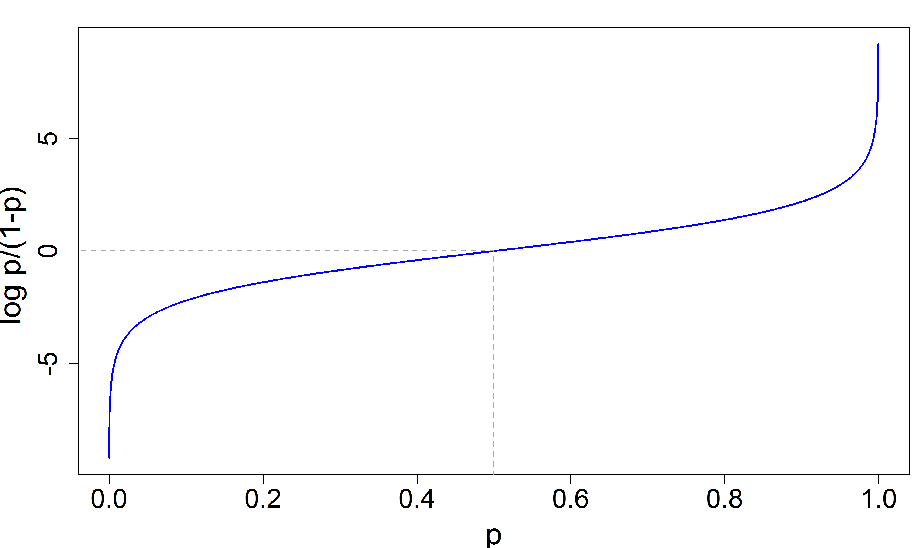
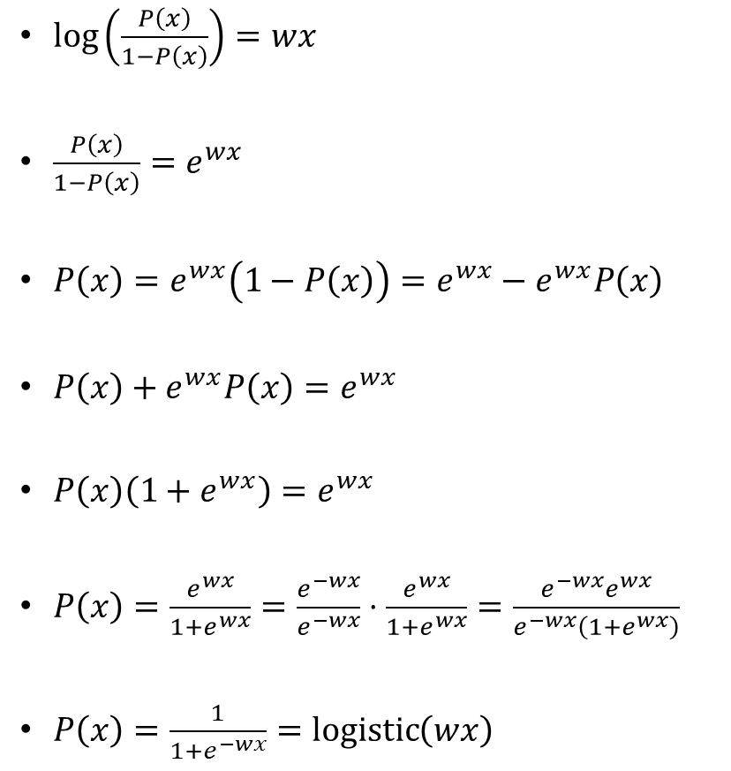
Proof
$\log\left(\frac{P\left(x\right)}{1−P\left(x\right)}\right)=wx$
$\frac{P\left(x\right)}{1−P\left(x\right)}=e^{wx}$
$P\left(x\right)=e^{wx}\left(1−P\left(x\right)\right)=e^{wx}−e^{wx}P\left(x\right)$
$P\left(x\right)+e^{wx}P\left(x\right)=e^{wx}$
$P\left(x\right)\left(1+e^{wx}\right)=e^{wx}$
$P\left(x\right)=\frac{e^{wx}}{1+e^{wx}}=\frac{e^{−wx}}{e^{−wx}}⋅\frac{e^{wx}}{1+e^{wx}}=\frac{e^{−wx}e^{wx}}{e^{−wx}\left(1+e^{wx}\right)}$
$P\left(x\right)=\frac{1}{1+e^{−wx}}=\operatorname{logistic}\left(wx\right)$
The odds can be any positive value
The log-odds can take any real value
The log-odds

Slide 25
How to learn the weights?
We need to define a good fit
We need a method to find the best fit weights

Slide 26
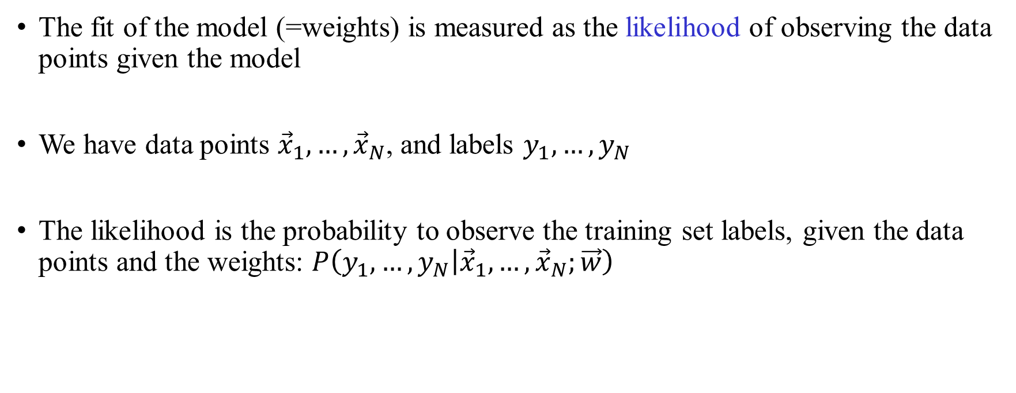
Define the fit of the model
The fit of the model (=weights) is measured as the likelihood of observing the data points given the model
We have data points ${\vec{x}}_{1},…,{\vec{x}}_{N}$, and labels $y_{1},…,y_{N}$
The likelihood is the probability to observe the training set labels, given the data points and the weights: $P\left(y_{1},…,y_{N} | {\vec{x}}_{1},…,{\vec{x}}_{N};\vec{w}\right)$

Slide 27
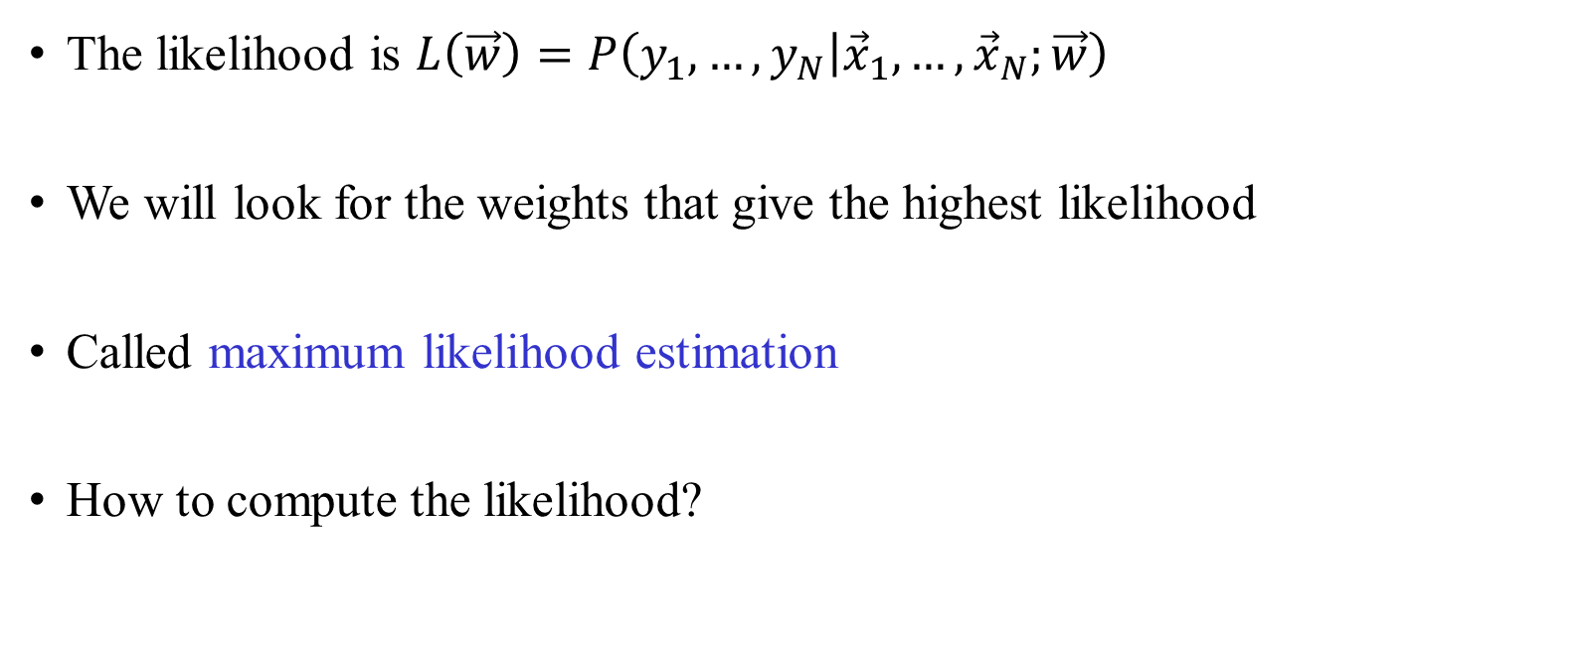
How to learn the weights?
The likelihood is $L\left(\vec{w}\right)=P\left(y_{1},…,y_{N} | {\vec{x}}_{1},…,{\vec{x}}_{N};\vec{w}\right)$
We will look for the weights that give the highest likelihood
Called maximum likelihood estimation
How to compute the likelihood?

Slide 28
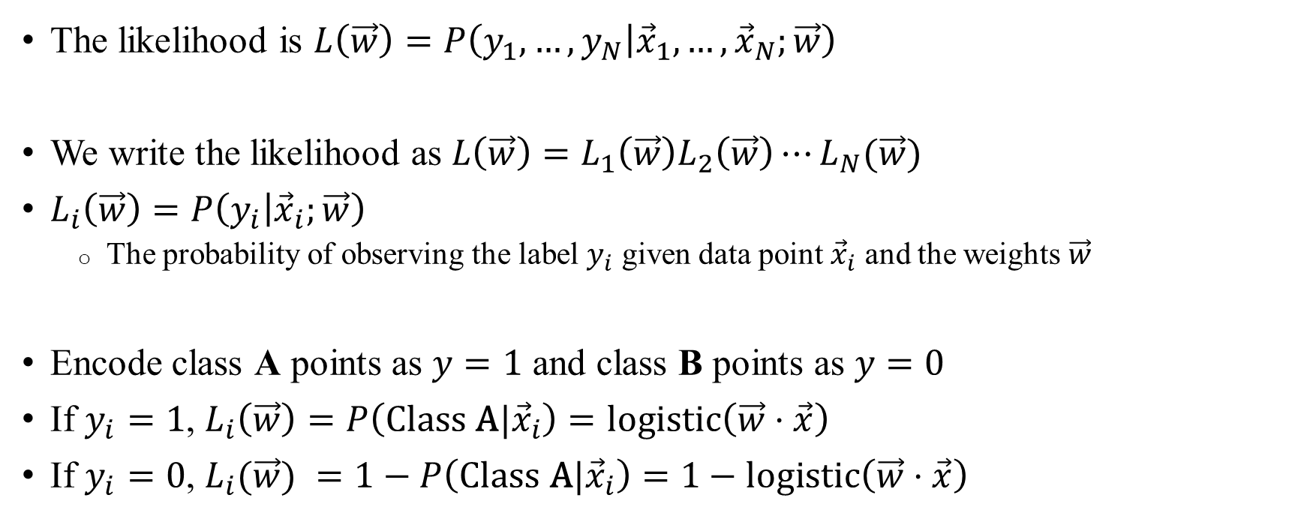
How to compute the likelihood
The likelihood is $L\left(\vec{w}\right)=P\left(y_{1},…,y_{N} | {\vec{x}}_{1},…,{\vec{x}}_{N};\vec{w}\right)$
We write the likelihood as $L\left(\vec{w}\right)=L_{1}\left(\vec{w}\right)L_{2}\left(\vec{w}\right)⋯L_{N}(\vec{w})$
$L_{i}\left(\vec{w}\right)=P\left(y_{i} | {\vec{x}}_{i};\vec{w}\right)$
  The probability of observing the label $y_{i}$ given data point ${\vec{x}}_{i}$ and the weights $\vec{w}$
Encode class A points as $y=1$ and class B points as $y=0$
If $y_{i}=1$, $L_{i}\left(\vec{w}\right)=P\left(\text{Class} \text{A}|{\vec{x}}_{i}\right)=\text{logistic}\left(\vec{w}⋅\vec{x}\right)$
If $y_{i}=0$, $L_{i}(\vec{w}) =1−P\left({\text{Class} \text{A}|\vec{x}}_{i}\right)=1−\text{logi}\text{s}\text{t}\text{ic}\left(\vec{w}⋅\vec{x}\right)$

Slide 29
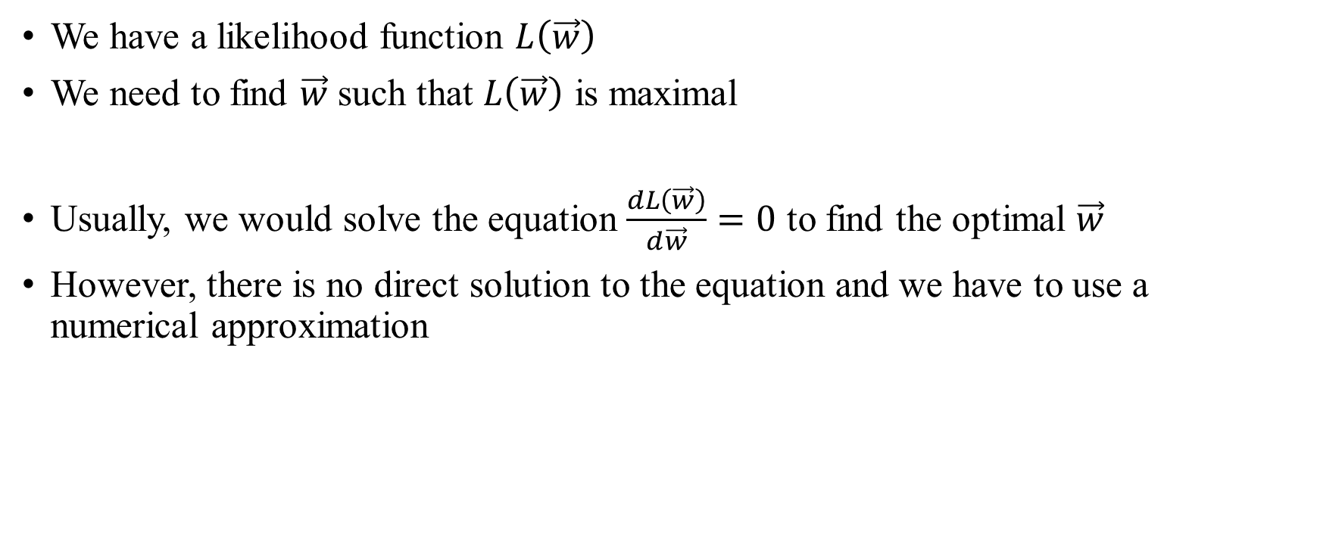
How to find the maximum likelihood solution
We have a likelihood function $L\left(\vec{w}\right)$
We need to find $\vec{w}$ such that $L\left(\vec{w}\right)$ is maximal
Usually, we would solve the equation $\frac{dL\left(\vec{w}\right)}{d\vec{w}}=0$ to find the optimal $\vec{w}$
However, there is no direct solution to the equation and we have to use a numerical approximation

Slide 30

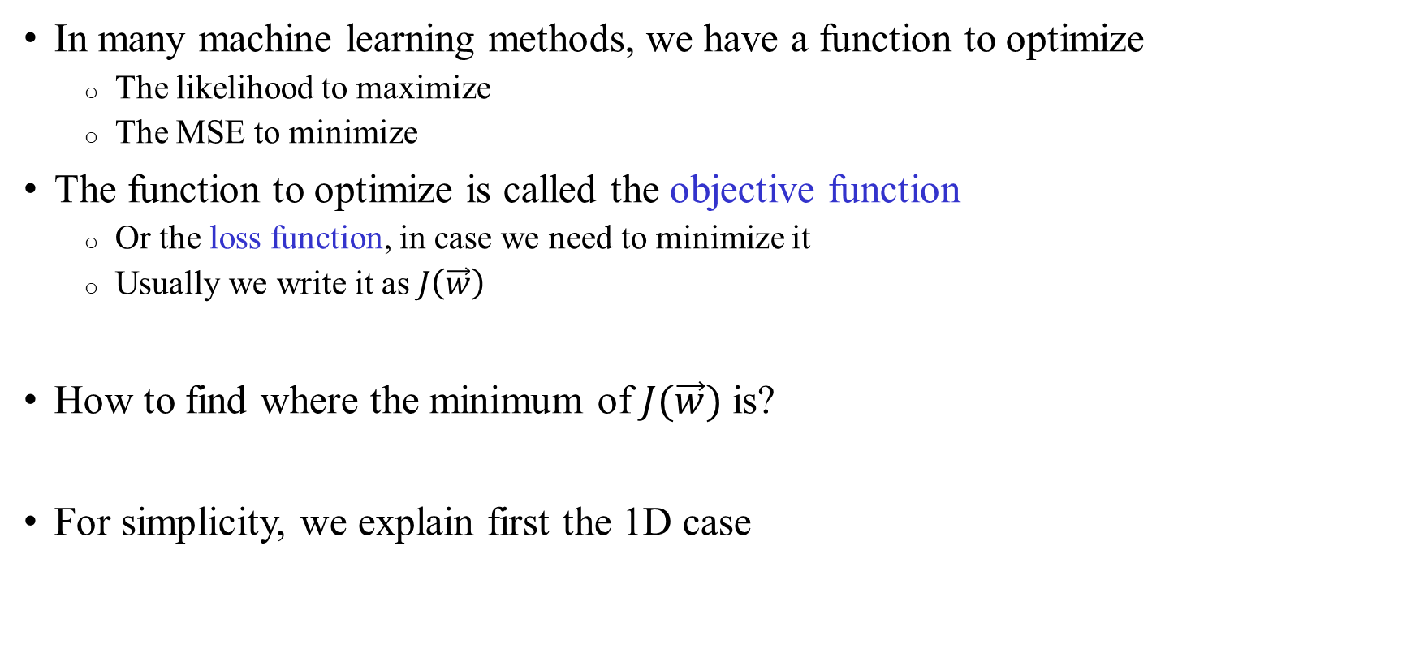

Optimization
In many machine learning methods, we have a function to optimize
  The likelihood to maximize
  The MSE to minimize
The function to optimize is called the objective function
  Or the loss function, in case we need to minimize it
  Usually we write it as $J\left(\vec{w}\right)$
How to find where the minimum of $J(\vec{w})$ is?
For simplicity, we explain first the 1D case
$$J(w)$$
$$w$$
The minimum

Slide 31

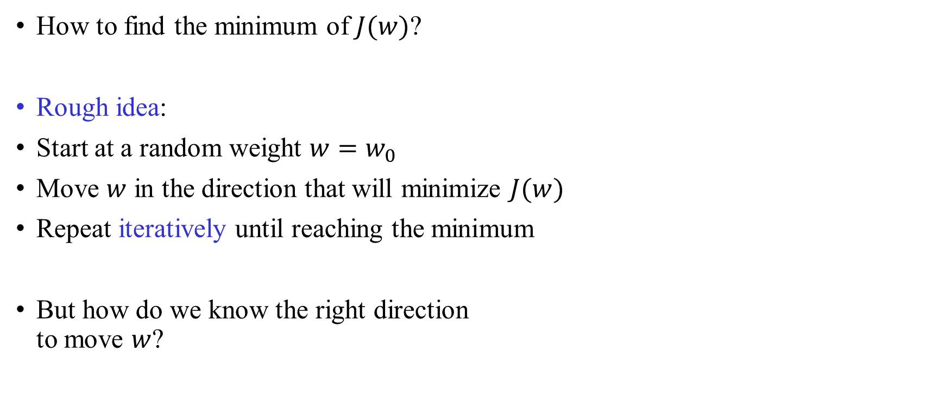


Basic idea
How to find the minimum of $J(w)$?
Rough idea:
Start at a random weight $w=w_{0}$
Move $w$ in the direction that will minimize $J(w)$
Repeat iteratively until reaching the minimum
But how do we know the right direction
to move $w$?
$$J(w)$$
$$w$$
$$w_{0}$$
The minimum

Slide 32
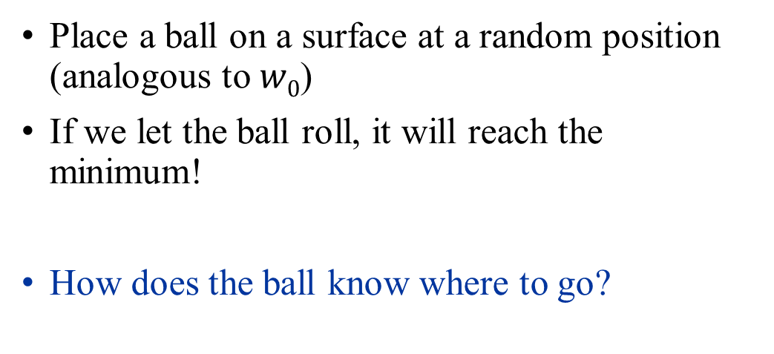


Choosing the right direction: an analogy
Place a ball on a surface at a random position (analogous to $w0$)
If we let the ball roll, it will reach the minimum!
How does the ball know where to go?
$$J(w)$$
$$w$$
$$w_{0}$$
The minimum

Slide 33
Choosing the right direction: an analogy
Laws of nature:
If the derivative is positive, the ball goes left
  Smaller coordinate (negative step)
If the derivative is negative, the ball goes right
  Larger coordinate (positive step)
If the derivative is zero, we’re at the minimum
  No movement
Function is increasing
Derivative positive
Move left
$$J(w)$$
$$w$$
$$w_{0}$$
The minimum

Slide 34
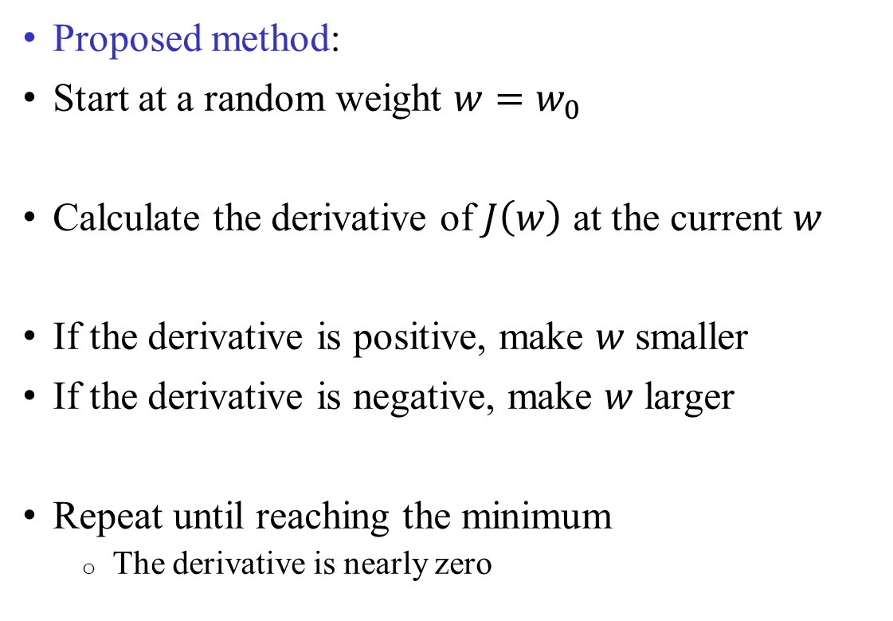
Choosing the right direction
Proposed method:
Start at a random weight $w=w_{0}$
Calculate the derivative of $J\left(w\right)$ at the current $w$
If the derivative is positive, make $w$ smaller
If the derivative is negative, make $w$ larger
Repeat until reaching the minimum
  The derivative is nearly zero
$$J(w)$$
$$w$$
$$w_{0}$$
The minimum

Slide 35
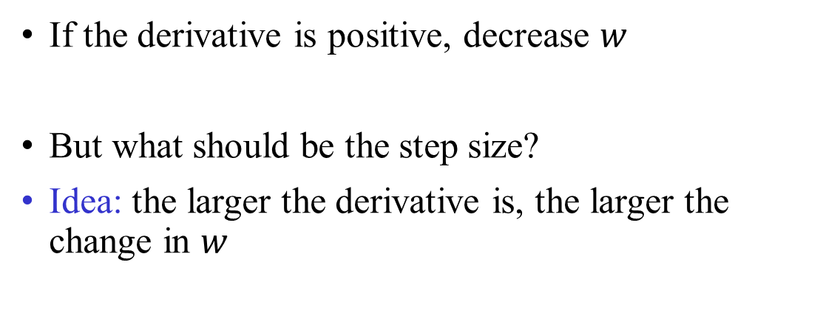
Choosing the right direction
If the derivative is positive, decrease $w$
But what should be the step size?
Idea: the larger the derivative is, the larger the change in $w$
$$J(w)$$
$$w$$
$$w_{0}$$
Large derivative
➔ large change
Small derivative
➔ Small change

Slide 36
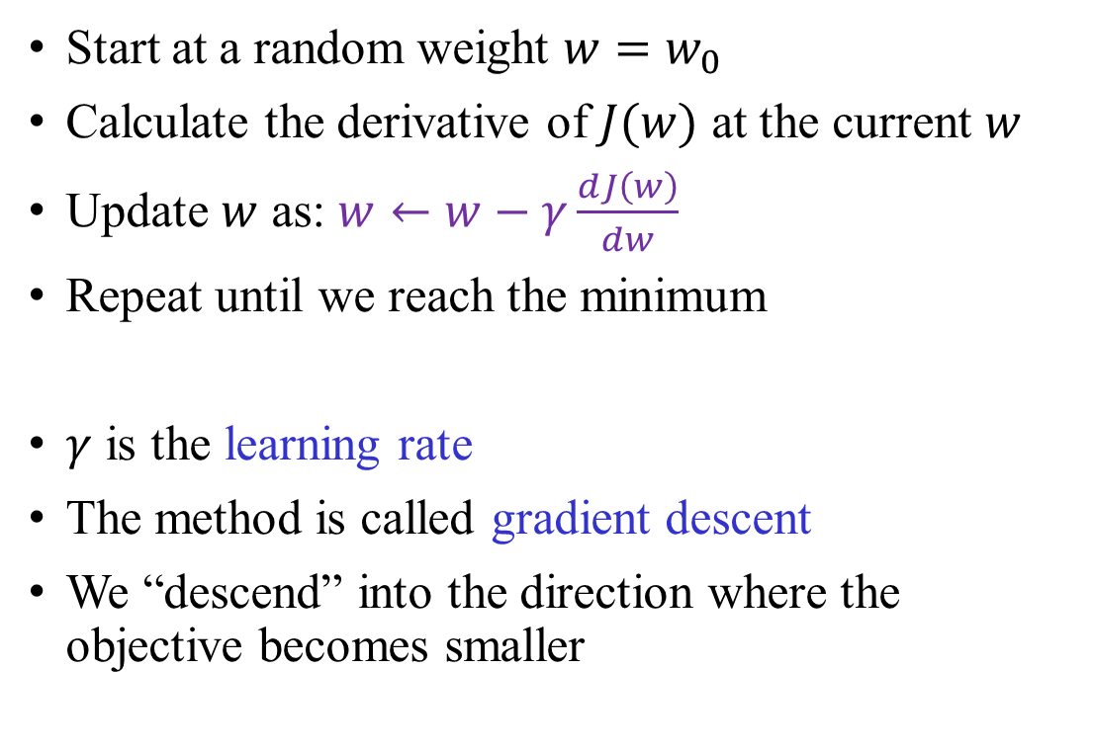
Final method
Start at a random weight $w=w_{0}$
Calculate the derivative of $J(w)$ at the current $w$
Update $w$ as: $w←w−γ\frac{dJ\left(w\right)}{dw}$
Repeat until we reach the minimum
$γ$ is the learning rate
The method is called gradient descent
We “descend” into the direction where the
objective becomes smaller
$$J(w)$$
$$w$$
$$w_{0}$$
The minimum

Slide 37
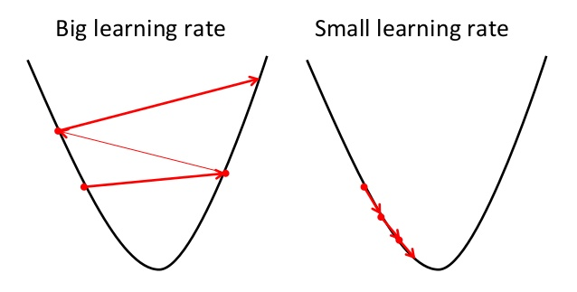
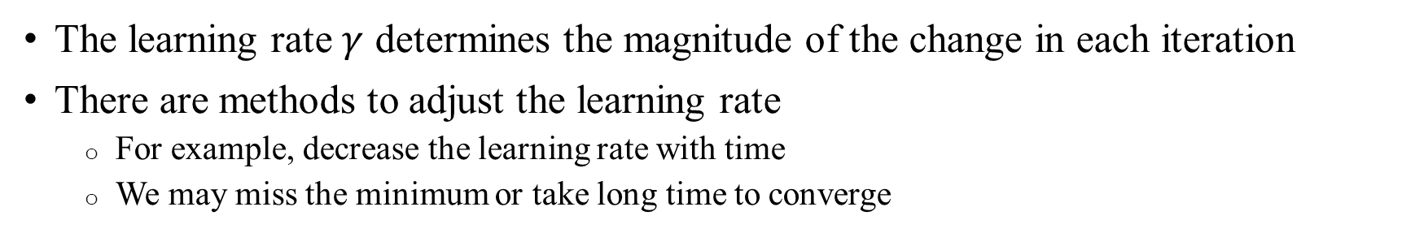
The learning rate
The learning rate $γ$ determines the magnitude of the change in each iteration
There are methods to adjust the learning rate
  For example, decrease the learning rate with time
  We may miss the minimum or take long time to converge
Overshooting, oscillations
Too slow

Slide 38
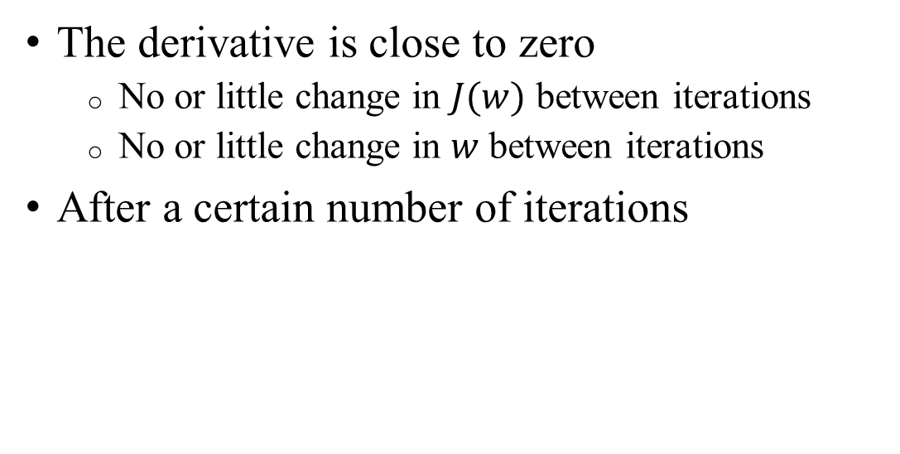
When to stop the method?
The derivative is close to zero
  No or little change in $J(w)$ between iterations
  No or little change in $w$ between iterations
After a certain number of iterations
$$J(w)$$
$$w$$
$$w_{0}$$
The minimum

Slide 39
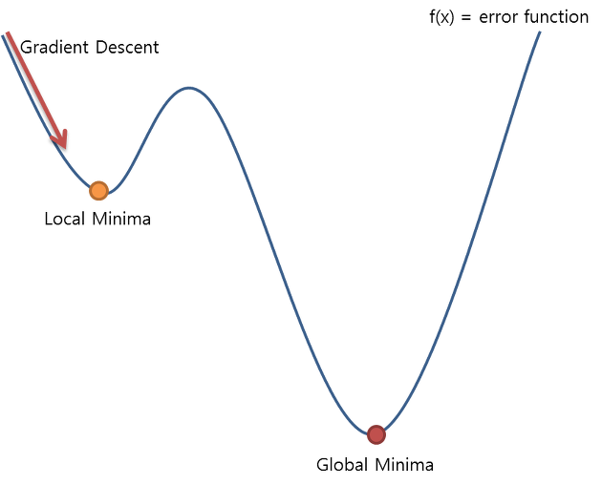

Global vs local minimum
For some objective functions, there is only one (global) minimum
  Gradient descent will usually bring us to that minimum
For other objective functions gradient descent may end up in a local minimum
It is recommended to try multiple random starting points
$$J(w)$$
Local minimum
Global minimum

Slide 40

Gradient descent in 2D and higher dimensions
In 2D and higher dimensions, the derivative is called the gradient
It is a vector pointing in the direction where the objective function increases the fastest
Black: high values. Gray: low values.

Slide 41
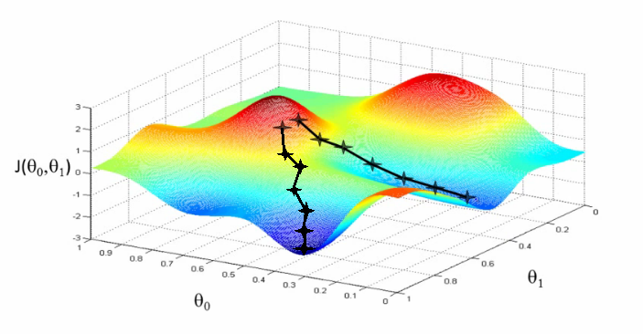
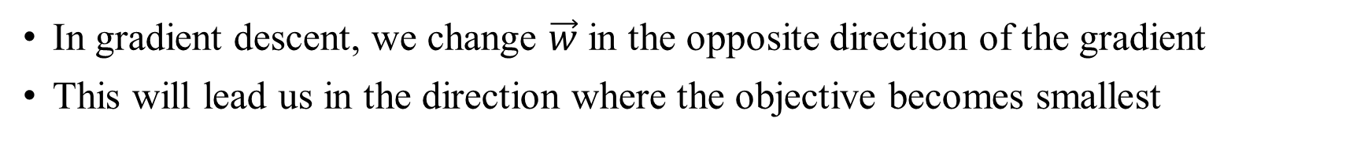



Gradient descent in 2D and higher dimensions
In gradient descent, we change $\vec{w}$ in the opposite direction of the gradient
This will lead us in the direction where the objective becomes smallest
Gradient descent paths
$${J(w_{1},w}_{2})$$
$$w_{1}$$
$$w_{2}$$

Slide 42

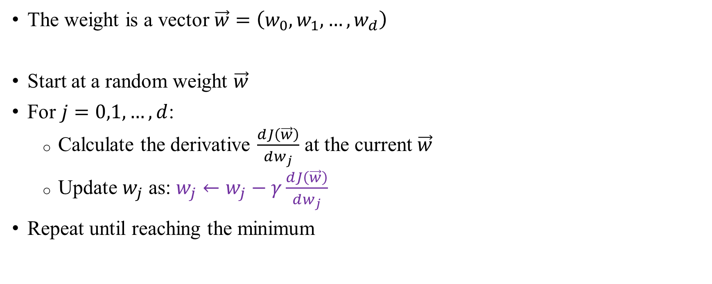


Gradient descent in 2D and higher dimensions
The weight is a vector $\vec{w}=\left(w_{0},w_{1},…,w_{d}\right)$
Start at a random weight $\vec{w}$
For $j=0,1,…,d$:
  Calculate the derivative $\frac{dJ\left(\vec{w}\right)}{dw_{j}}$ at the current $\vec{w}$
  Update $w_{j}$ as: $w_{j}←w_{j}−γ\frac{dJ\left(\vec{w}\right)}{dw_{j}}$
Repeat until reaching the minimum
$${J(w_{1},w}_{2})$$
$$w_{1}$$
$$w_{2}$$

Slide 43

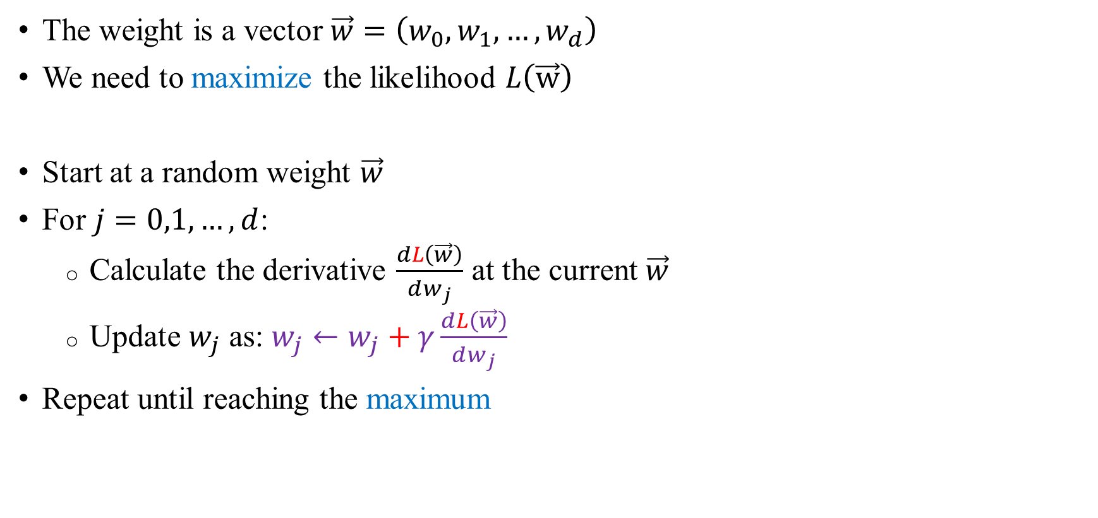


Gradient descent for logistic regression
The weight is a vector $\vec{w}=\left(w_{0},w_{1},…,w_{d}\right)$
We need to maximize the likelihood $L\left(\vec{w}\right)$
Start at a random weight $\vec{w}$
For $j=0,1,…,d$:
  Calculate the derivative $\frac{dL\left(\vec{w}\right)}{dw_{j}}$ at the current $\vec{w}$
  Update $w_{j}$ as: $w_{j}←w_{j}+γ\frac{dL\left(\vec{w}\right)}{dw_{j}}$
Repeat until reaching the maximum
Function is decreasing
Derivative negative
Move left
$$L(w)$$
The maximum
$$w$$
$$w0$$

Slide 44
Problem
For large training sets, computing the derivative of the likelihood becomes very time consuming
Learning becomes very slow

Slide 45

Stochastic gradient descent
Start at a random weight $\vec{w}$
Choose a random data point $({\vec{x}}_{i},y_{i})$
For $j=0,1,…,d$:
  Calculate the derivative of the likelihood of the current data point: $\frac{dL_{i}\left(\vec{w}\right)}{dw_{j}}$
  Update $w_{j}$ as: $w_{j}←w_{j}+γ\frac{dL_{i}\left(\vec{w}\right)}{dw_{j}}$
Repeat until reaching the maximum
Empirically, this brings us faster to the optimum

Slide 46





What are the derivatives?
The learning algorithm is not fully specified until we have the derivatives
It can be shown:
$\frac{dL_{i}\left(\vec{w}\right)}{dw_{j}}=x_{i,j}\left(y_{i}−\text{logi}\text{s}\text{t}\text{ic}\left(\vec{w}⋅{\vec{x}}_{i}\right)\right)$
The farther $y_{i}$ is from $P\left(x_{i}\right)=\operatorname{logistic}\left(\vec{w}⋅{\vec{x}}_{i}\right)$, the larger is the derivative
➔ Bigger step to correct $\vec{w}$
The difference between the predicted probability of ${\vec{x}}_{i}$ to belong to class 1 and the actual indicator of whether ${\vec{x}}_{i}$ is in class 1
The predicted $P\left({\vec{x}}_{i}\right)$, the probability of ${\vec{x}}_{i}$ to belong to class 1
The $j$^{th} coordinate of ${\vec{x}}_{i}$
The label of ${\vec{x}}_{i}$

Slide 47

Stochastic gradient descent for logistic regression
Start at a random weight $\vec{w}$
Choose a random data point $({\vec{x}}_{i},y_{i})$
For $j=0,1,…,d$:
  Update $w_{j}$ as: $w_{j}←w_{j}+γx_{i,j}\left(y_{i}−\text{logi}\text{s}\text{t}\text{ic}\left(\vec{w}⋅{\vec{x}}_{i}\right)\right)$
Repeat until reaching the maximum

Slide 48
Logistic regression: discussion
A very popular method, in particular as a first analysis
Numerous implementations available (including in R), fast
We are guaranteed there is only one (global) optimum
Provides information on the contribution of each feature
Relatively robust to overfitting (because a simple model is assumed)
There are extensions available for multi-class classification
But performance is worse when the true boundary between classes is highly non-linear

Slide 49
Taxonomy of methods
Parametric?
Yes
No
Linear?
K-nearest-neighbors
Decision Trees
(Random Forests, Boosting)
Gaussian Processes
Yes
No
Logistic Regression
Perceptron
Linear Discriminant Analysis
Naïve Bayes Classifier
Support Vector Classifier
Neural Networks
Support Vector Machines (some)

Slide 50


Taxonomy of methods
Parametric: we classify each data point $x$ according to a “decision function” $f(x)$
  The number of parameters of $f(x)$ is independent of the sample size
  In linear methods, $f(x)$ is linear
Non-parametric: the decision function is not fixed but its complexity depends on the sample size
Parametric, linear
Parametric, non-linear
Non-parametric

Slide 51

Measuring performance
What would be a good measure of the performance of a classifier?
Assume Class 0: healthy, Class 1: sick; total number of data points: $N$
A simple measure of accuracy is the classification error: $(FP+FN)/N$
 |  | Predicted state
 |  | Class Sick | Class Healthy
True state | Class Sick | True Positive (TP) | False Negative (FN)
 | Class Healthy | False Positive (FP) | True Negative (TN)

Slide 52

Example
P(sick)
Sick
Class boundary
False negatives
False positives
Threshold: P(sick)=0.5
Healthy
Predicted healthy
Predicted sick
$x$ (test score)

Slide 53

The confusion matrix
There are many ways to measure accuracy!
The PPV is particularly important: given a positive diagnosis, how likely this is true?

Slide 54
Not all errors are created equal
The cost of a false positive (unnecessary intervention) may be large or small
  Mastectomy or chemotherapy vs taking antibiotics or avoiding a food item
The cost of a false negative (misdetection) may be large or small
  Meningitis or early cancer vs throat culture or pregnancy test
The relative costs are not always known a priori and may change
Can classifiers change their false positive/false-negative tradeoff?
  Classify all individuals as sick: no false negatives, many false positives
  Classify all individuals as healthy: no false positives, many false negatives
If they do, how to measure their accuracy?

Slide 55

A classifier can change its FN/FP rates
In logistic regression, $P\left(\vec{x}\right)=1/\left(1+e^{−\vec{w}⋅\vec{x}}\right)$
Previously:
  If $P(\vec{x})>0.5$, classify $\vec{x}$ as Class 1 (sick)
  If $P(\vec{x})<0.5$, classify $\vec{x}$ as Class 0 (healthy)
But we can use the actual value of $P(\vec{x})$ (the probability of Class 1)

Slide 56

A classifier can change its FN/FP rates
Define a threshold $t$
If $P(\vec{x})>t$, classify $\vec{x}$ as sick, otherwise as healthy
If $P(\vec{x})>0.2$, classify $\vec{x}$ as sick, otherwise as healthy
  ➔ Many false positives
  ➔ Few false negatives
If $P(\vec{x})>0.8$, classify $\vec{x}$ as sick, otherwise as healthy
  ➔ Many false negatives
  ➔ few false positives
Using the threshold $t$ we can control the trade-off between false positives and false negatives

Slide 57



A classifier can change its FN/FP rates
False negatives
P(sick)
Define a threshold $t$
If $P(\vec{x})>t$, classify $\vec{x}$ as sick, otherwise as healthy
Sick
Class boundary
False positives
Threshold
$$t=0.2$$
Healthy
$x$ (test score)

Slide 58

A classifier can change its FN/FP rates
False negatives
P(sick)
Define a threshold $t$
If $P(\vec{x})>t$, classify $\vec{x}$ as sick, otherwise as healthy
Sick
Class boundary
False positives
Threshold
$$t=0.5$$
Healthy
$x$ (test score)

Slide 59


A classifier can change its FN/FP rates
False negatives
P(sick)
Define a threshold $t$
If $P(\vec{x})>t$, classify $\vec{x}$ as sick, otherwise as healthy
How to measure the overall performance over different choices of the boundaries?
Sick
Class boundary
False positives
Threshold
$$t=0.8$$
Healthy
$x$ (test score)

Slide 60












ROC curves
ROC: Receiver Operating Characteristic (historical name)
True positive rate, sensitivity, TP/(condition P)
100%
*
$$t=0$$
If $P(\vec{x})>t$, classify $\vec{x}$ as sick, otherwise as healthy
$$t=0.3$$
*
*
*
$$t=0.2$$
$$t=0.1$$
$$t=0.4$$
*
Classify everyone as sick
$$t=0.5$$
*
*
$$t=0.6$$
*
$$t=0.7$$
*
$$t=0.8$$
Classify everyone as healthy
*
$$t=0.9$$
*
$$t=1$$
0%
100%
False positive rate, 1-specifcity, FP/(condition N)

Slide 61

Comparison of ROC curves
A random classifier will randomly assign each individual as sick with some probability $p$
The true positive rate will be $p$
The false positive rate will also be $p$
This is because we identify positives with probability $p$, regardless of their true condition
Thus, a random classifier will have a ROC curve of $y=x$
True positive rate, sensitivity, TP/(condition P)
100%
Perfect
We would like to be here
Random
0%
100%
False positive rate, 1-specifcity, FP/(condition N)

Slide 62
Comparison of ROC curves
True positive rate, sensitivity, TP/(condition P)
Better than random model
Better model
Good model
Great model
100%
We would like to be here:
High sensitivity at a low cost of false positives
(the curve’s knee)
0%
100%
False positive rate, 1-specifcity, FP/(condition N)

Slide 63
Comparing methods
How to summarize the ROC curve into a single number that will allow comparison across methods?
True positive rate
100%
0%
100%
False positive rate

Slide 64

The area under the curve
The Area Under the ROC Curve (AUC) is a useful measure of the performance of a classifier, in the range [0.5,1]
True positive rate
True positive rate
True positive rate
1
1
Good
AUC=0.79
Random
AUC=0.5
Perfect
AUC=1
0
0
False positive rate
1
False positive rate
False positive rate
1

Slide 65
Other metrics
Precision-recall
F1 scores
Matthews correlation

