Slide 1
Personal Genomics
Recombination and linkage disequilibrium
Shai Carmi
School of Public Health

Slide 2
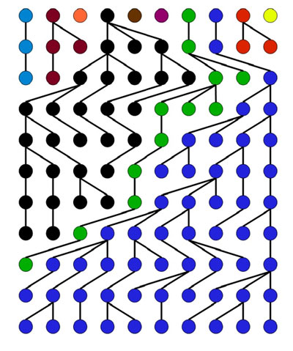
Definitions
Coalescence: the two lineages finding their most recent common ancestor (MRCA)
Coalescence time: the time of the most recent common ancestor (TMRCA)
Coalescent tree: the graph that connects specific present-day individuals to their MRCA
  Can be more than two individuals
Also called the gene genealogy
MRCA
TMRCA=4

Slide 3
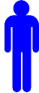

The coalescent
It is convenient to assume that the population size is relatively large
Thus, the probability to coalesce in any single generation is very small
  ➔ Not much happens in each generation
We assume time is continuous, and ignore the discrete nature of generations
What is the distribution of coalescence times?
Time
$$t$$
0 (=present)

Slide 4


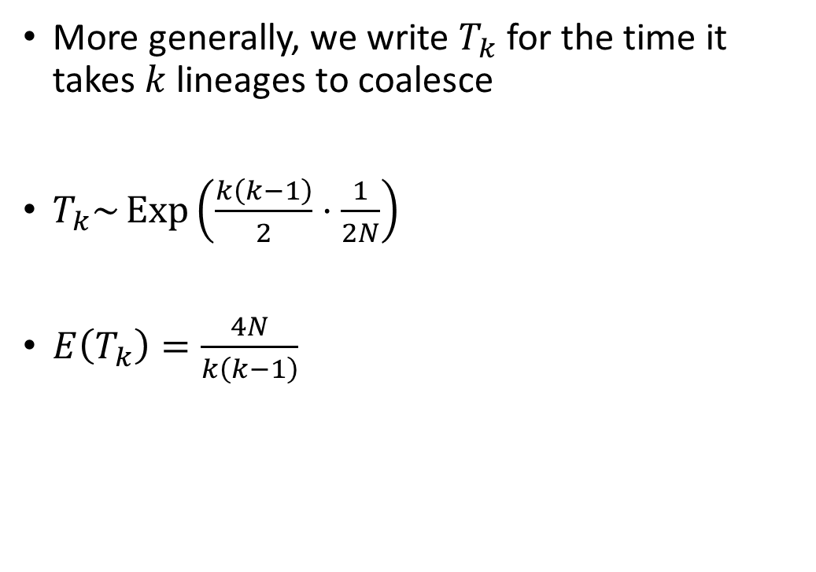



Larger samples
More generally, we write $T_{k}$ for the time it takes $k$ lineages to coalesce
$T_{k}\sim \operatorname{Exp}\left(\frac{k\left(k−1\right)}{2}⋅\frac{1}{2N}\right)$
$E\left(T_{k}\right)=\frac{4N}{k\left(k−1\right)}$
Time
MRCA
$$T_{2}$$
$$T_{3}$$
$$T_{4}$$
$$T_{5}$$
$$T_{6}$$
0

Slide 5
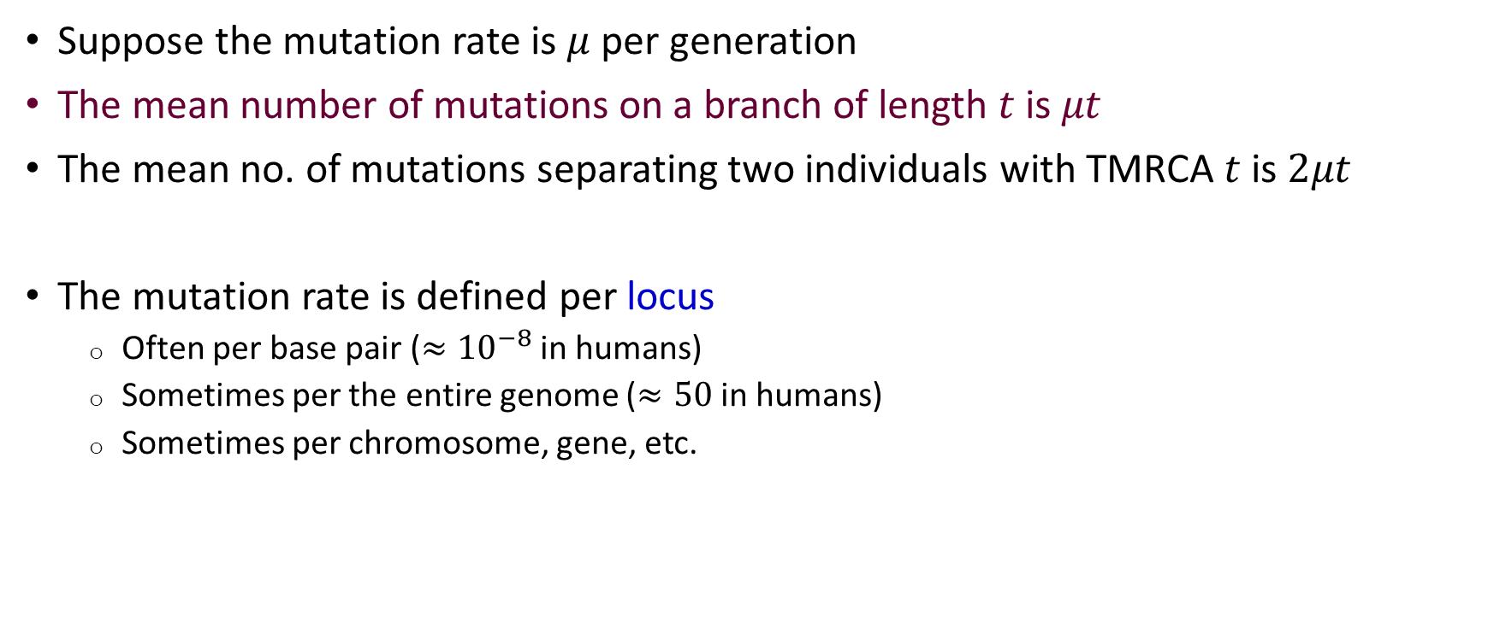
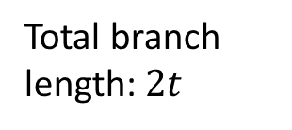

How to model mutation?
Suppose the mutation rate is $μ$ per generation
The mean number of mutations on a branch of length $t$ is $μt$
The mean no. of mutations separating two individuals with TMRCA $t$ is $2μt$
The mutation rate is defined per locus
  Often per base pair ($≈{10}^{−8}$ in humans)
  Sometimes per the entire genome ($≈50$ in humans)
  Sometimes per chromosome, gene, etc.
Time
$$t$$
Total branch length: $2t$
0 (=present)

Slide 6
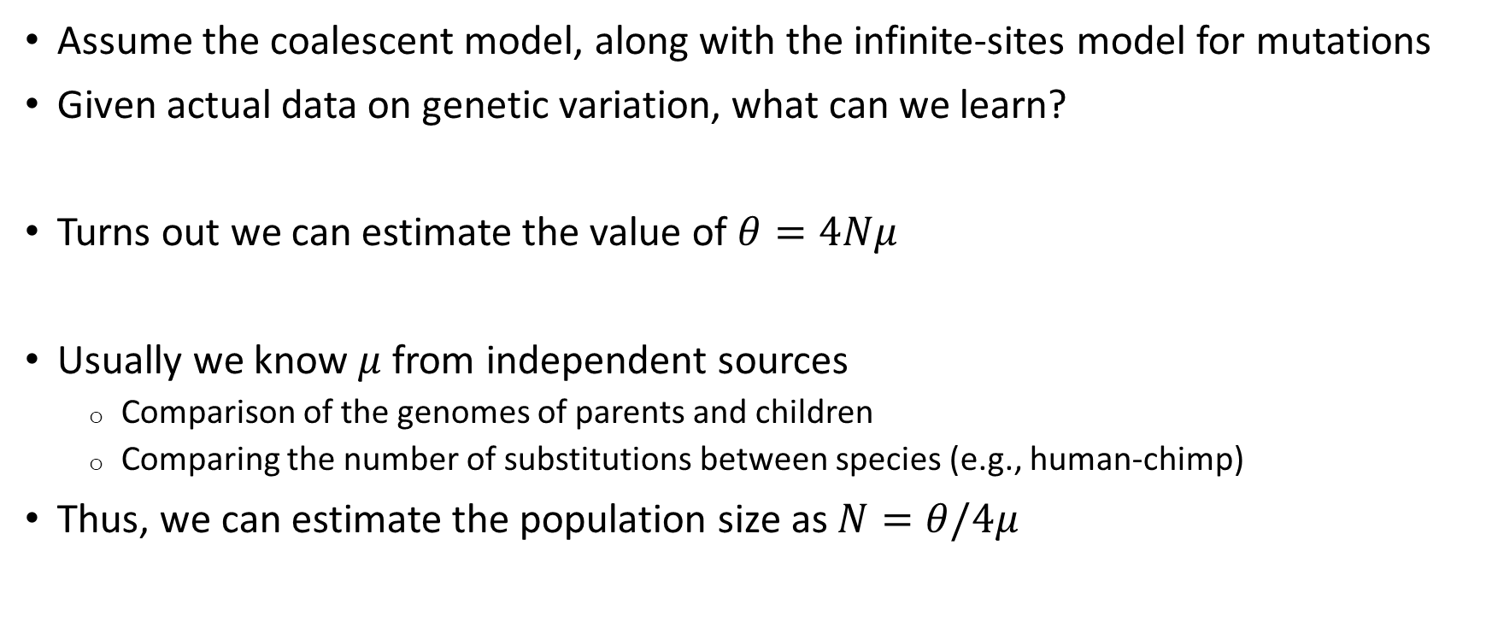
Demographic inference
Assume the coalescent model, along with the infinite-sites model for mutations
Given actual data on genetic variation, what can we learn?
Turns out we can estimate the value of $θ=4Nμ$
Usually we know $μ$ from independent sources
  Comparison of the genomes of parents and children
  Comparing the number of substitutions between species (e.g., human-chimp)
Thus, we can estimate the population size as $N=θ/4μ$

Slide 7
What does the data look like?
To develop the estimator, let us understand the data better
Typically, we have the entire sequence of a short region in a number of chromosomes
  We assume that we can obtain the sequences of single (phased) chromosomes
  The chromosomes can belong to the same of different individuals
Chromosome 1
Chromosome 2
Chromosome 3
Chromosome 4
ACAAGATCCTACGTTCAGCTTCCCG
ACAGGCTCCCACATTCCGCTTGACG
ACTGGCTCCCACATTCAGCTTGACA
ACAGGATCGCACATTCAGTTTGACG

Slide 8
Note: the sample genealogy
Time
sites 6/9
When the sequence is not very long, we can assume no recombination in the region
Thus, there is a single genealogy that connects all chromosomes in the sample
The sequence must be consistent with a genealogy
sites 2/5/10
site 3
sites 4/8
site 7
sites 1/11
1
2
3
4
site1 site2 site3 site4 site5 site6 site7 site8 site9 site10 site11
Chr 1
Chr 2
Chr 3
Chr 4
0 1 0 0 1 0 0 0 0 1 0
0 0 1 0 0 1 1 0 1 0 0
1 0 1 0 0 1 0 0 1 0 1
0 0 0 1 0 1 0 1 1 0 0

Slide 9
The sample genealogy
If the sequences are inconsistent with any genealogy, it means that our assumptions are wrong
  There was a repeat mutation (i.e., the infinite-sites model is wrong)
  Most likely, there was recombination
Site 2
Site 1
site1 site2
Chr 1
Chr 2
Chr 3
0 1
1 0
1 1
1
2
3
1
3
2
2
3
1

Slide 10
Recombination?
We have so far discussed a single “locus”, i.e., a single region of DNA in which we know the entire sequence
We assumed no recombination within the locus
This means that all samples have the same genealogy
No recombination is reasonable for short regions
As the regions grow in length, recombination necessarily occurs
Meaning the genealogy is not the same everywhere
1
2
3
4
5

Slide 11

Why would the genealogy change?
A recombination event would change the genealogy (coalescent tree)
The times and identities of MRCAs will change
Recombination
1
2

Slide 12
Why would the genealogy change?
Recombination leads to rewiring the genealogy and to changes in the MRCAs
Each recombination “splits” one lineage only, but over long distances, many recombination events happen, changing the tree completely
New MRCAs
The lineage in the left locus
The lineage “splits”
A new lineage
1
2
3
4
5
1
2
3
4
5

Slide 13
Multiple loci
Long regions are difficult to work with, because the effect of recombination on the estimators is complicated
On the other extreme is the case when we consider multiple independent regions (“loci”)
For example, two loci can be on different chromosomes
In that case, the genealogy of each region is independent
1
2
3
4
5

Slide 14
Multiple loci
Locus 1
Locus 2
bp1 bp2 bp3 bp4 bp5
bp1 bp2 bp3 bp4 bp5
Chr 1
Chr 2
Chr 3
Chr 4
0 0 0 0 1
1 0 0 0 1
0 0 0 0 0
0 0 0 1 0
0 1 0 0 0
0 0 0 1 0
0 0 0 1 0
1 0 0 0 0
1
2
3
4
1
2
3
4

Slide 15
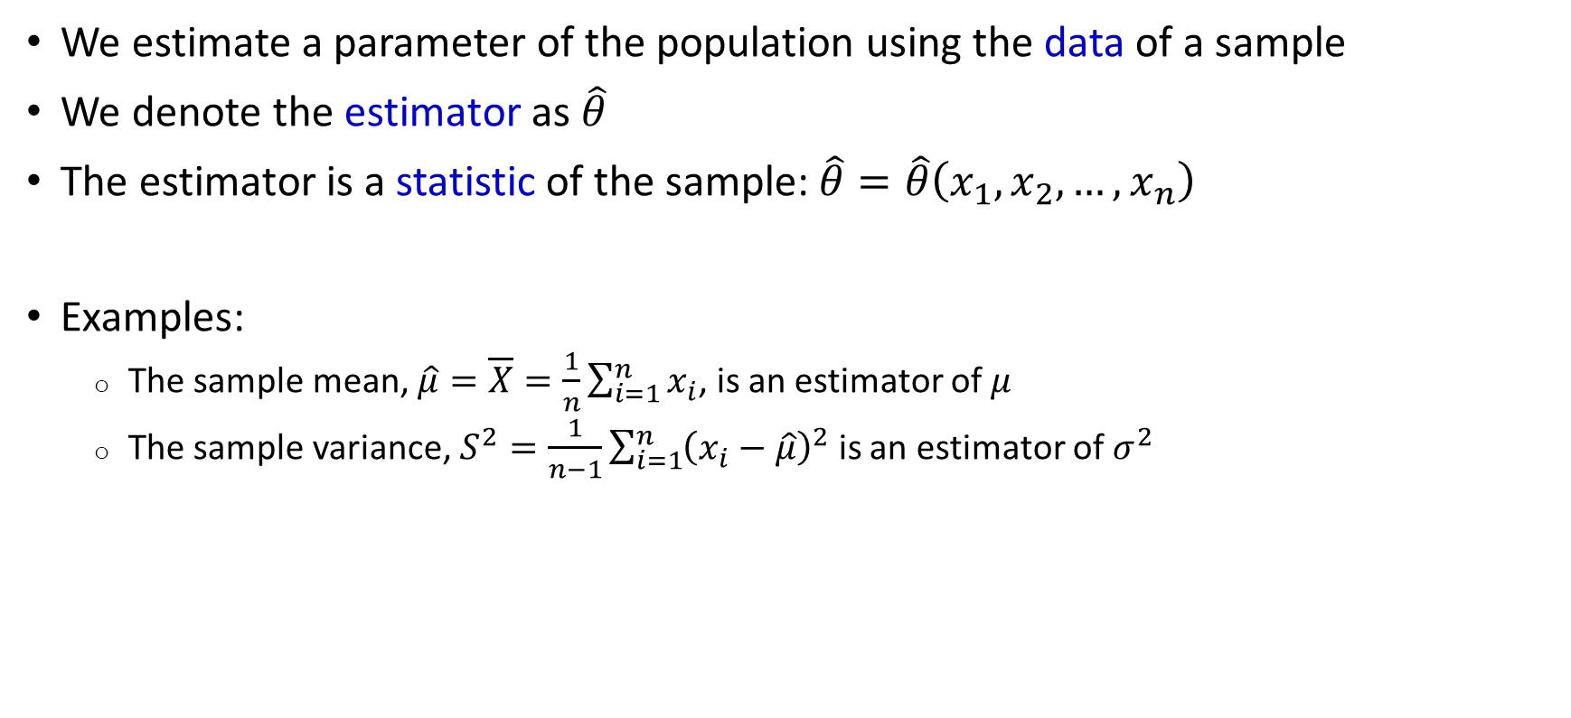
Reminder: estimation
We estimate a parameter of the population using the data of a sample
We denote the estimator as $\hat{θ}$
The estimator is a statistic of the sample: $\hat{θ}=\hat{θ}\left(x_{1},x_{2},…,x_{n}\right)$
Examples:
  The sample mean, $\hat{μ}=\overline{X}=\frac{1}{n}\sum_{i=1}^{n}{x_{i}}$, is an estimator of $μ$
  The sample variance, $S^{2}=\frac{1}{n−1}\sum_{i=1}^{n}{{\left(x_{i}−\hat{μ}\right)}^{2}}$ is an estimator of $σ^{2}$

Slide 16
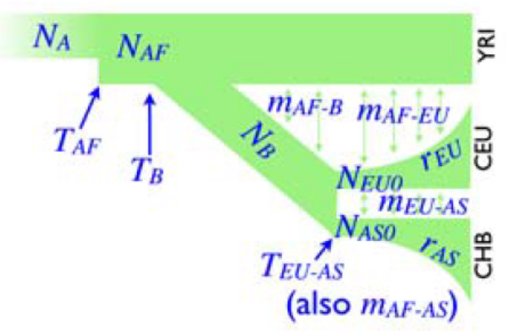
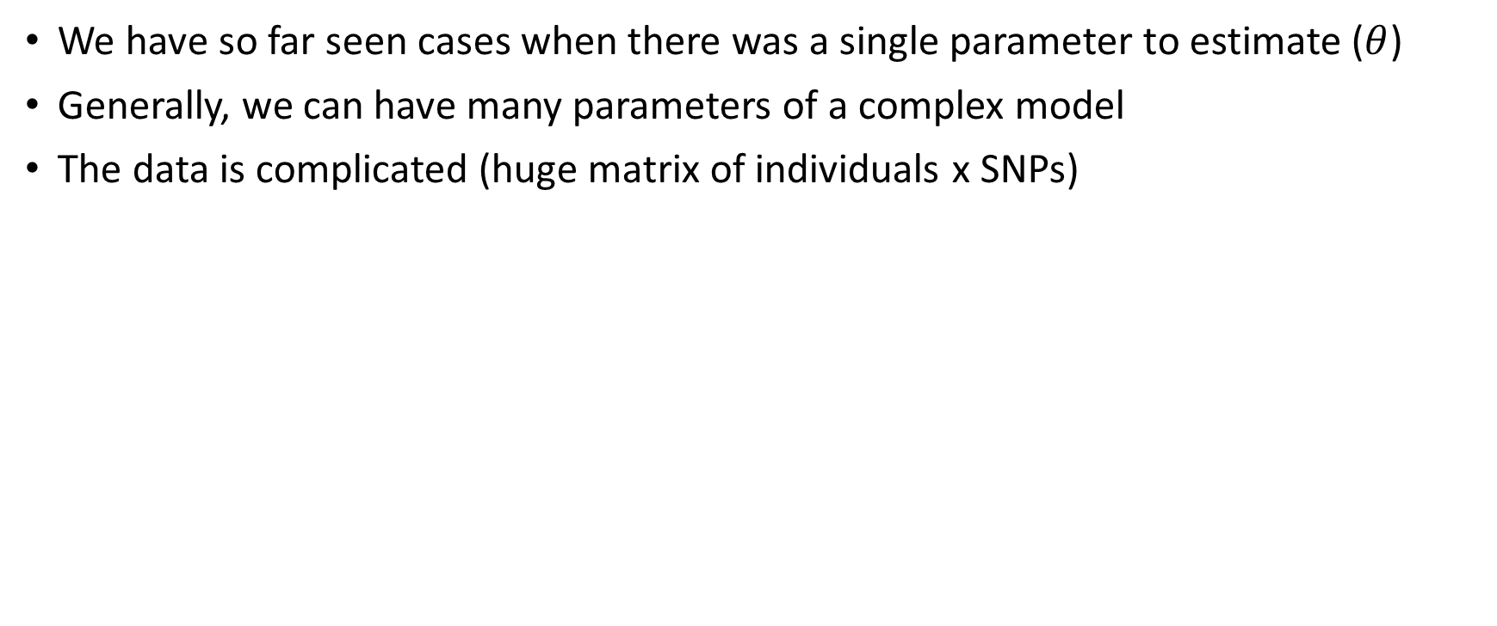
General demographic inference
We have so far seen cases when there was a single parameter to estimate ($θ$)
Generally, we can have many parameters of a complex model
The data is complicated (huge matrix of individuals x SNPs)

Slide 17
General demographic inference
Key general idea: use summary statistics of the genetic data
Find the demographic model that best fits those summary statistics
Examples of summary statistics:
  The number of segregating sites
  The number of pairwise differences
  The allele frequency spectrum
For each inferred model, we can compute its bias and variance
  Usually numerically by simulations

Slide 18
What other summary statistics are available?
The main class of other statistics long regions that are identical between individuals
Called “shared haplotypes” or “shared segments”
Or “Identical-by-descent” (IBD) segments
For example, we can use the number and lengths of such regions

Slide 19

Sharing between relatives
Siblings
First cousins
Probability of sharing: 12.5%
Mean segment length: 25cM
Shared segment
Probability of sharing: 50%
Mean segment length: 50cM
Shared segment

Slide 20


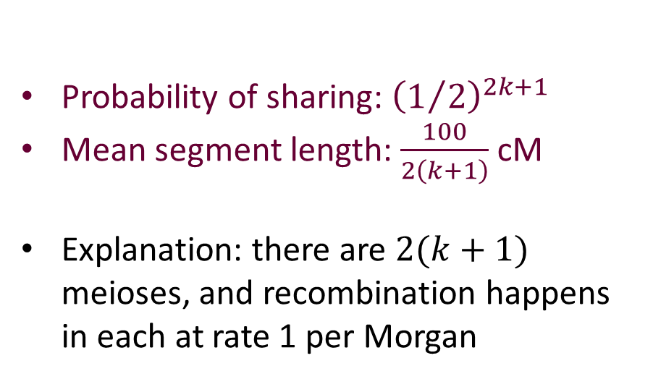
Sharing between remote relatives
$k$^{th}-generation cousins
Probability of sharing: ${\left(1/2\right)}^{2k+1}$
Mean segment length: $\frac{100}{2\left(k+1\right)}$ cM
Explanation: there are $2(k+1)$ meioses, and recombination happens in each at rate 1 per Morgan
$$k$$
Shared segments

Slide 21






Mean segment length
The length of the segment shared with the ancestor is the distance to the closest recombination across all meioses
$$t=5$$
Ancestral chromosome
$$t=4$$
$$t=3$$
Meioses along one branch
From the MRCA to the present-day sample
$$t=2$$
$$t=1$$
$$t=0$$
Segment shared with ancestor

Slide 22
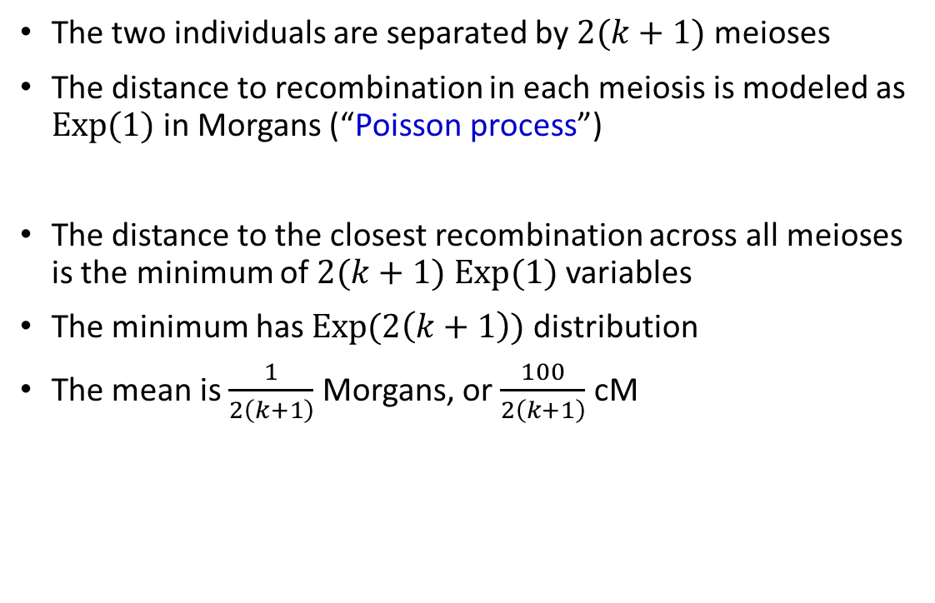
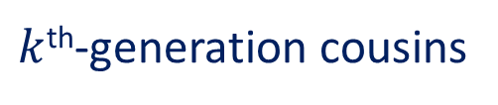

Mean segment length
$k$^{th}-generation cousins
The two individuals are separated by $2(k+1)$ meioses
The distance to recombination in each meiosis is modeled as $Exp⁡(1)$ in Morgans (“Poisson process”)
The distance to the closest recombination across all meioses is the minimum of $2(k+1)$ $Exp⁡(1)$ variables
The minimum has $Exp⁡(2\left(k+1\right))$ distribution
The mean is $\frac{1}{2\left(k+1\right)}$ Morgans, or $\frac{100}{2\left(k+1\right)}$ cM
$$k$$
Distance to recombination
Shared segment

Slide 23
Sharing between unrelated individuals
Even unrelated individuals have a common ancestor at some point
They share the ancestral chromosome until recombination happens
New MRCAs
A new lineage
1
2
3
4
1
2
3
4

Slide 24
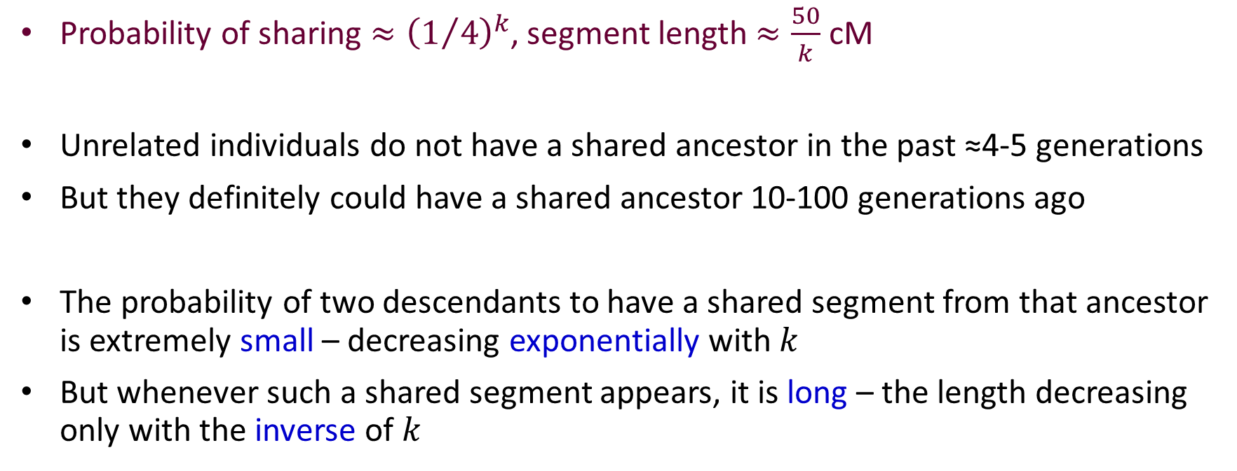
Sharing between unrelated individuals
Probability of sharing ${≈\left(1/4\right)}^{k}$, segment length $≈\frac{50}{k}$ cM
Unrelated individuals do not have a shared ancestor in the past ≈4-5 generations
But they definitely could have a shared ancestor 10-100 generations ago
The probability of two descendants to have a shared segment from that ancestor is extremely small – decreasing exponentially with $k$
But whenever such a shared segment appears, it is long – the length decreasing only with the inverse of $k$

Slide 25
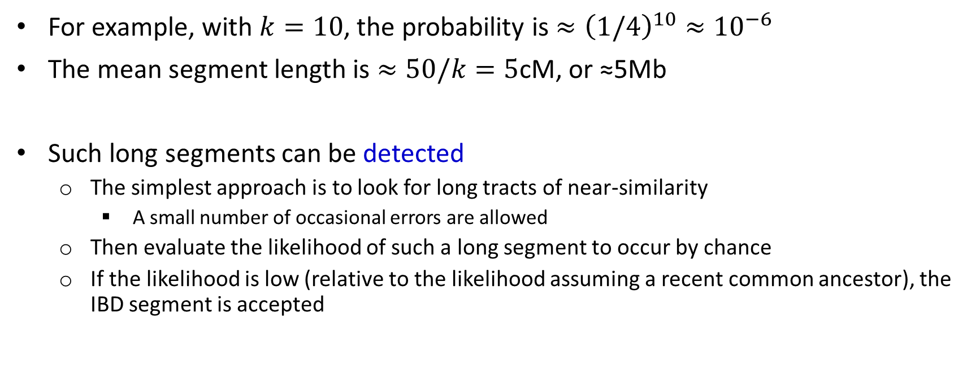
Sharing between unrelated individuals
For example, with $k=10$, the probability is $≈{\left(1/4\right)}^{10}≈{10}^{−6}$
The mean segment length is $≈50/k=5$cM, or ≈5Mb
Such long segments can be detected
  The simplest approach is to look for long tracts of near-similarity
    A small number of occasional errors are allowed
  Then evaluate the likelihood of such a long segment to occur by chance
  If the likelihood is low (relative to the likelihood assuming a recent common ancestor), the IBD segment is accepted

Slide 26
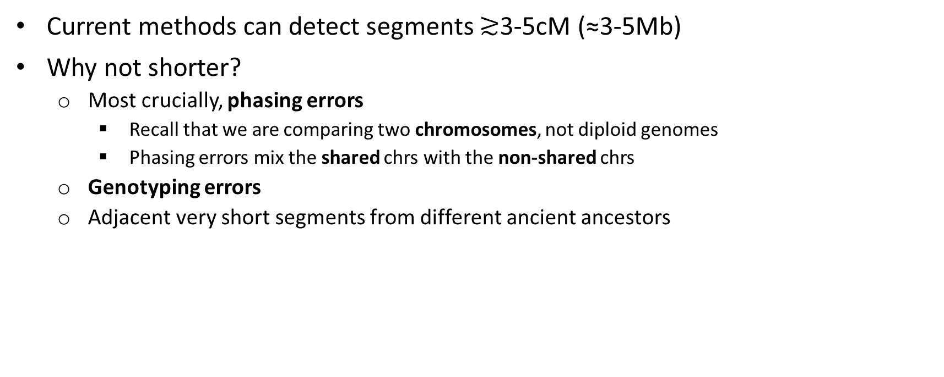


Sharing between unrelated individuals
$k$^{th}-generation cousins
Current methods can detect segments $≳$3-5cM (≈3-5Mb)
Why not shorter?
  Most crucially, phasing errors
    Recall that we are comparing two chromosomes, not diploid genomes
    Phasing errors mix the shared chrs with the non-shared chrs
  Genotyping errors
  Adjacent very short segments from different ancient ancestors
$$k$$
Accurate phasing
Poor phasing
Shared segment

Slide 27
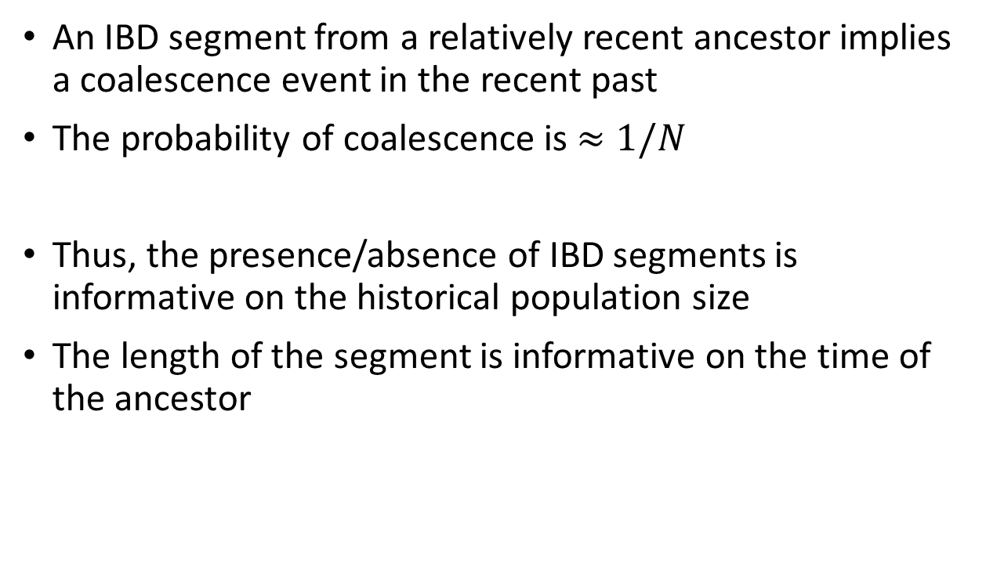
Why are IBD segments informative?
$k$^{th}-generation cousins
An IBD segment from a relatively recent ancestor implies a coalescence event in the recent past
The probability of coalescence is $≈1/N$
Thus, the presence/absence of IBD segments is informative on the historical population size
The length of the segment is informative on the time of the ancestor
$$k$$
Shared segment

Slide 28
What does it imply on founder events?
Segment length $ℓ≈50/k$ ➔ bottleneck time $k≈50/ℓ$
Number of segments (out of all pairs)
Number of segments (out of all pairs)
1/10
There were ≈10 founders
1/20
There were ≈20 founders
10cM
Segment length
2cM
Segment length
Bottleneck was ≈5 generations ago
Bottleneck was ≈25 generations ago

Slide 29

More complex histories
Note: segment lengths must be specified in cM
Population size $N(t)$
Time (generations)
Number of segments (out of all pairs)
0.05
25
20
0.02
5
50
2cM
10cM
Segment length
Present

Slide 30
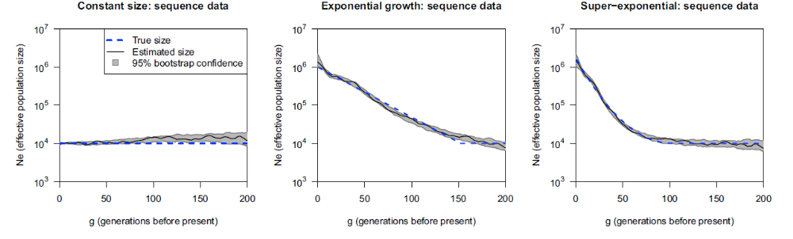
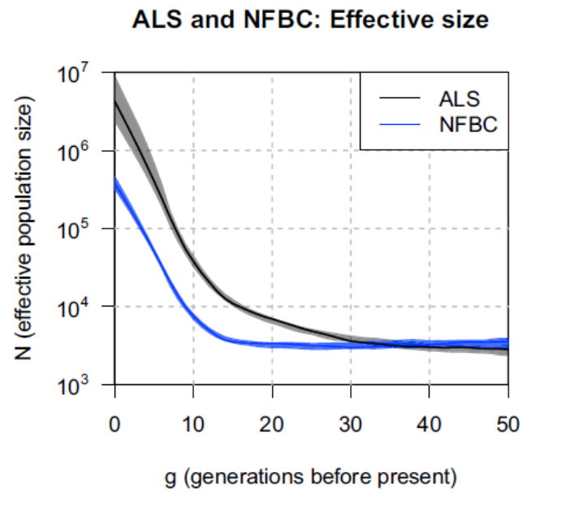
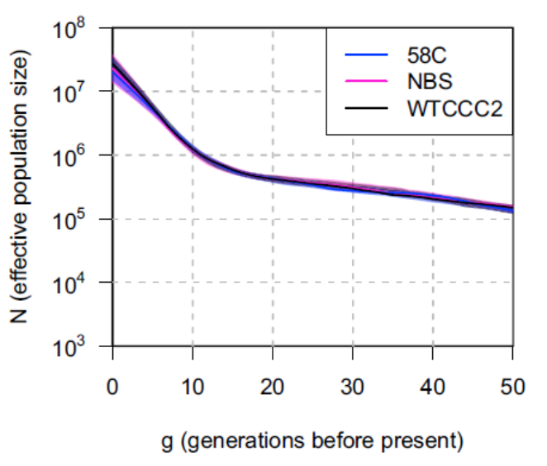
Examples
Finland
UK
Browning and Browning, AJHG, 2015

Slide 31
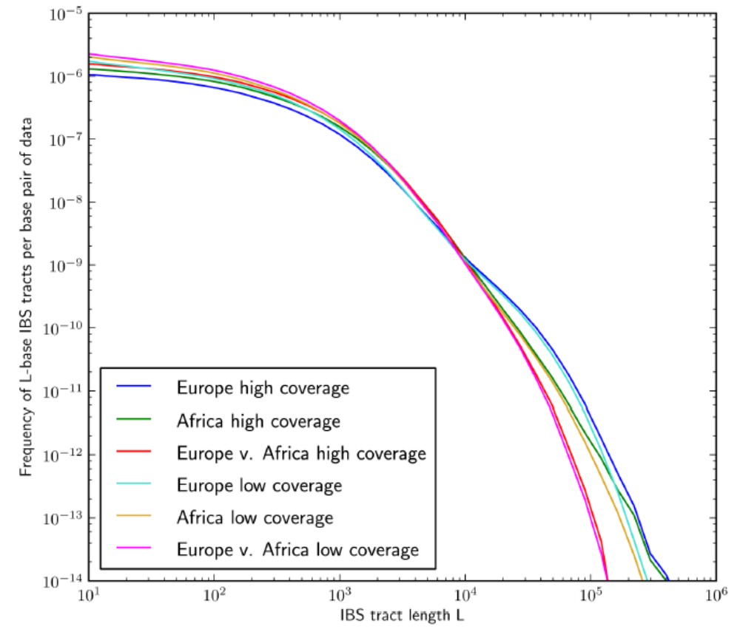
A related method
Harris and Nielsen, PLOS Genetics, 2013
Used whole-genome sequencing
Searched for the maximal tracts that are completely identical between pairs of chromosomes
  Used trios to guarantee phasing is accurate
  This also includes very rare mutations, each of which will terminate the segment
They consider both short and long segments
  Ancient vs recent common ancestors
Then fit a parametric demographic model

Slide 32
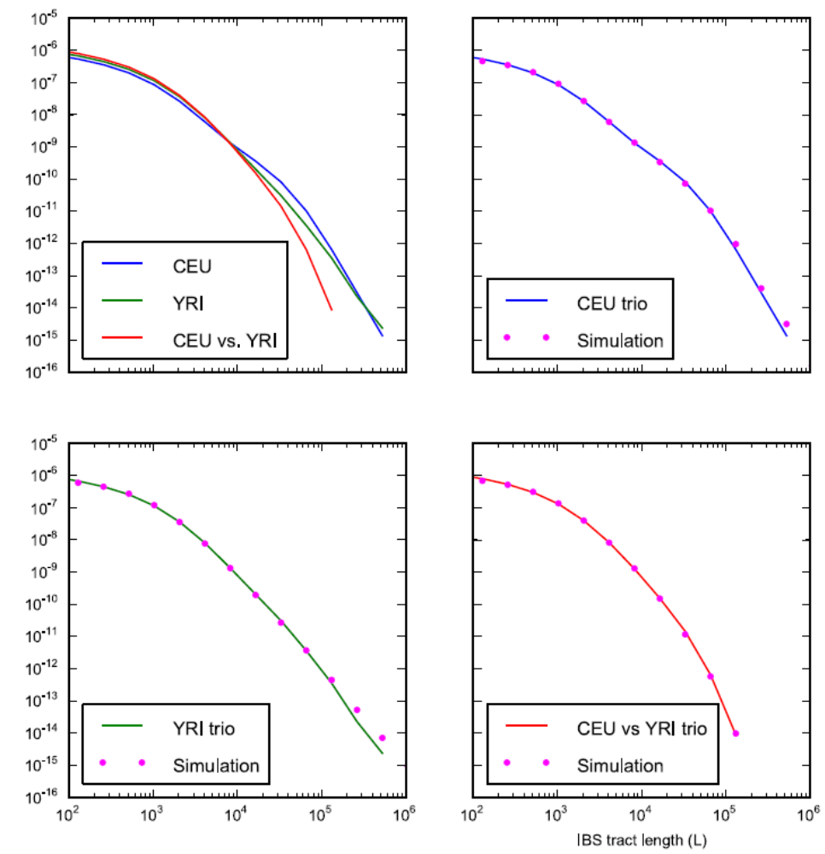
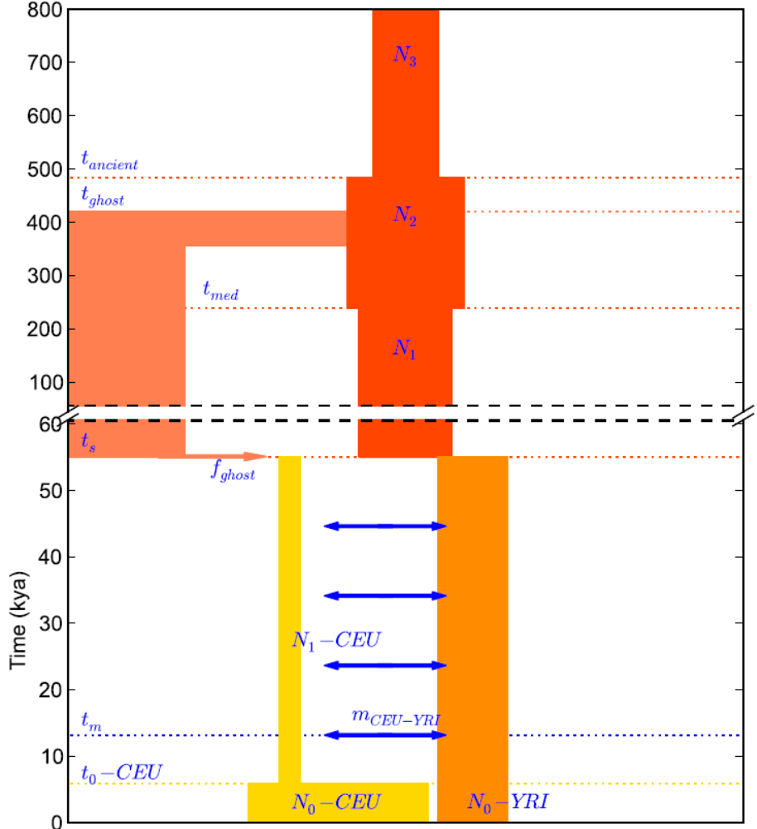
Results

Slide 33
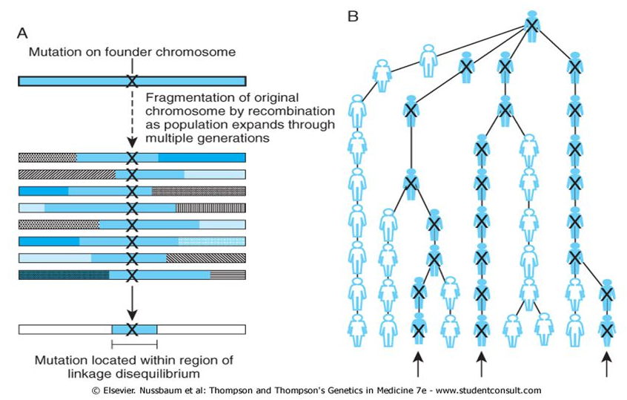
Linkage disequilibrium
Mutations that remain on the same haplotype throughout the generations are in LD
LD is usually incomplete: two alleles appear together more than random, but not always
LD is lost with time and distance between SNPs

Slide 34
Perfect linkage disequilibrium
Time
Not polymorphic
SNP
A G
A G
A C
A C
A G
A G
C G
A C
A C
A G
A G
C G
A C
A C
A G
A G
C G
A C
A C
A G
In the present, we have only three types of haplotypes: AG, CG, AC
Thus, C on site 1 always goes together with G in site 2
These sites are perfectly correlated or in perfect linkage disequilibrium

Slide 35
Linkage equilibrium
Time
Chr 1
Chr 2
Chr 1
Chr 2
Chr 1
Chr 2
A
C
A
G
A
G
Individual
A
C
A
G
A
G
T
C
A
C
A
G
A
G
A
G
A
G
T
C
T
G
A
G
A
G
A
C
A
C
The two homologous chromosomes of each individual are transmitted independently of one another, due to Mendel’s law of random segregation
Thus, no correlation can appear between alleles on different chromosomes

Slide 36
Linkage disequilibrium: distant sites
A G
A G
A C
A C
A C
A G
C G
A C
A C
A C
A G
C G
C G
C G
A C
A C
Recombination
A G
C C
C G
C G
A C
If recombination happens, we now see all four haplotypes: AG, CG, AC, CC
After many generations, the sites will be completely uncorrelated (“equilibrium”)
But in intermediate time, there will be some correlation
  E.g., most of the times C goes with G, but not always

Slide 37
Linkage disequilibrium
The name is a bit misleading
Linkage disequilibrium (LD) simply means correlation between alleles
  The correlation can be perfect: some combinations of alleles never appears
  Or imperfect: some combinations are preferred, but we see all possibilities
Equilibrium means two alleles are completely uncorrelated
  All combinations are equally likely
  (Almost) always the case when the two sites are on different chromosomes
    (Except, say, when the combination the minor allele in both is lethal)
  When the sites are far apart along the chromosome
    Distance of > ≈1MB for common mutations
    Or more if the mutation is very recent

Slide 38
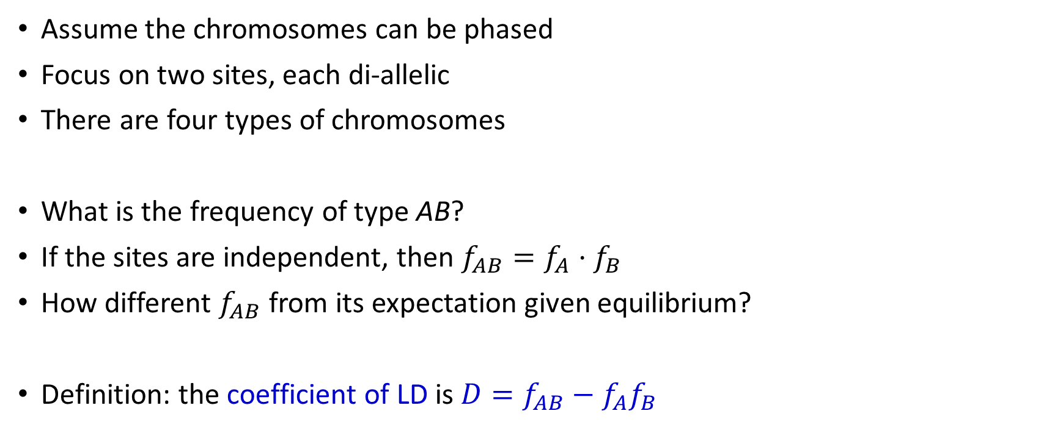
Measuring LD
Assume the chromosomes can be phased
Focus on two sites, each di-allelic
There are four types of chromosomes
What is the frequency of type AB?
If the sites are independent, then $f_{AB}=f_{A}⋅f_{B}$
How different $f_{AB}$ from its expectation given equilibrium?
Definition: the coefficient of LD is $D=f_{AB}−f_{A}f_{B}$
A B
A b
a B
a b

Slide 39
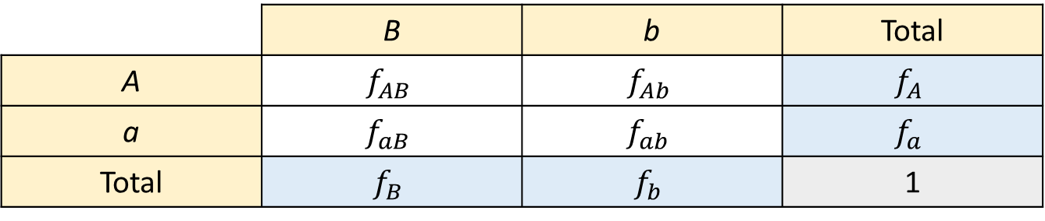
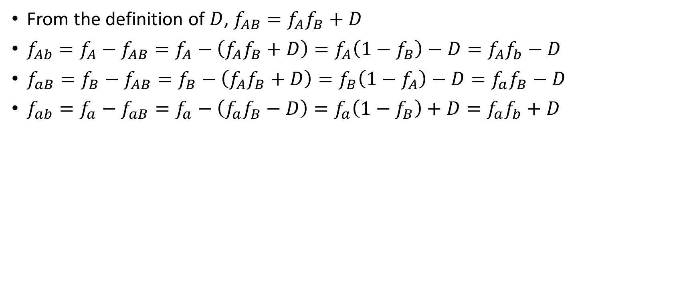
Measuring LD
From the definition of $D$, $f_{AB}=f_{A}f_{B}+D$
$f_{Ab}=f_{A}−f_{AB}=f_{A}−\left(f_{A}f_{B}+D\right)=f_{A}\left(1−f_{B}\right)−D=f_{A}f_{b}−D$
$f_{aB}=f_{B}−f_{AB}=f_{B}−\left(f_{A}f_{B}+D\right)=f_{B}\left(1−f_{A}\right)−D=f_{a}f_{B}−D$
$f_{ab}=f_{a}−f_{aB}=f_{a}−\left(f_{a}f_{B}−D\right)=f_{a}\left(1−f_{B}\right)+D=f_{a}f_{b}+D$
First row
First column
second row
A B
 | B | b | Total
A | $$f_{AB}$$ | $$f_{Ab}$$ | $$f_{A}$$
a | $$f_{aB}$$ | $$f_{ab}$$ | $$f_{a}$$
Total | $$f_{B}$$ | $$f_{b}$$ | 1
A b
a B
a b

Slide 40

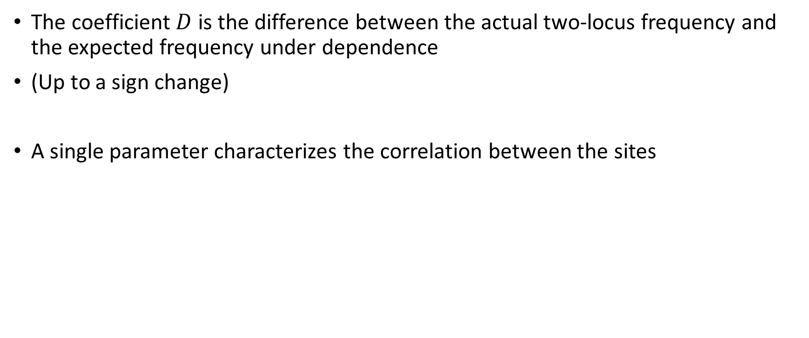
What does it mean?
The coefficient $D$ is the difference between the actual two-locus frequency and the expected frequency under dependence
(Up to a sign change)
A single parameter characterizes the correlation between the sites
 | B | b | Total
A | $$f_{AB}=f_{A}f_{B}+D$$ | $$f_{Ab}=f_{A}f_{b}−D$$ | $$f_{A}$$
a | $$f_{aB}=f_{a}f_{B}−D$$ | $$f_{ab}=f_{a}f_{b}+D$$ | $$f_{a}$$
Total | $$f_{B}$$ | $$f_{b}$$ | 1

Slide 41

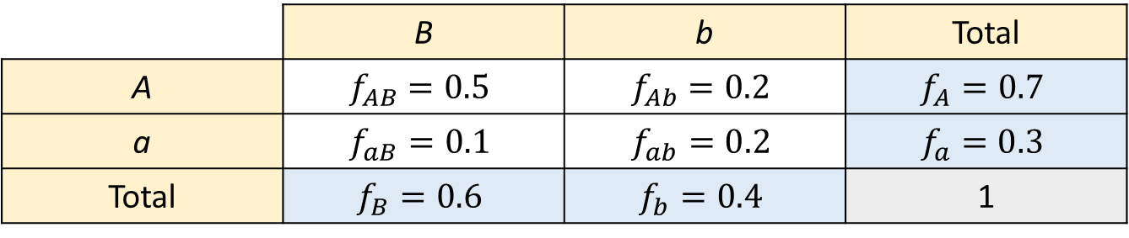
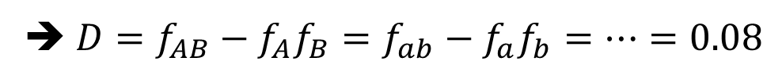
Example
Observed
 | B | b | Total
A | $$f_{AB}=0.5$$ | $$f_{Ab}=0.2$$ | $$f_{A}=0.7$$
a | $$f_{aB}=0.1$$ | $$f_{ab}=0.2$$ | $$f_{a}=0.3$$
Total | $$f_{B}=0.6$$ | $$f_{b}=0.4$$ | 1
Expected under independence
 | B | b | Total
A | $$f_{A}f_{B}=0.42$$ | $$f_{A}f_{b}=0.28$$ | $$f_{A}$$
a | $$f_{a}f_{B}=0.18$$ | $$f_{a}f_{b}=0.12$$ | $$f_{a}$$
Total | $$f_{B}$$ | $$f_{b}$$ | 1
➔ $D=f_{AB}−f_{A}f_{B}=f_{ab}−f_{a}f_{b}=…=0.08$

Slide 42
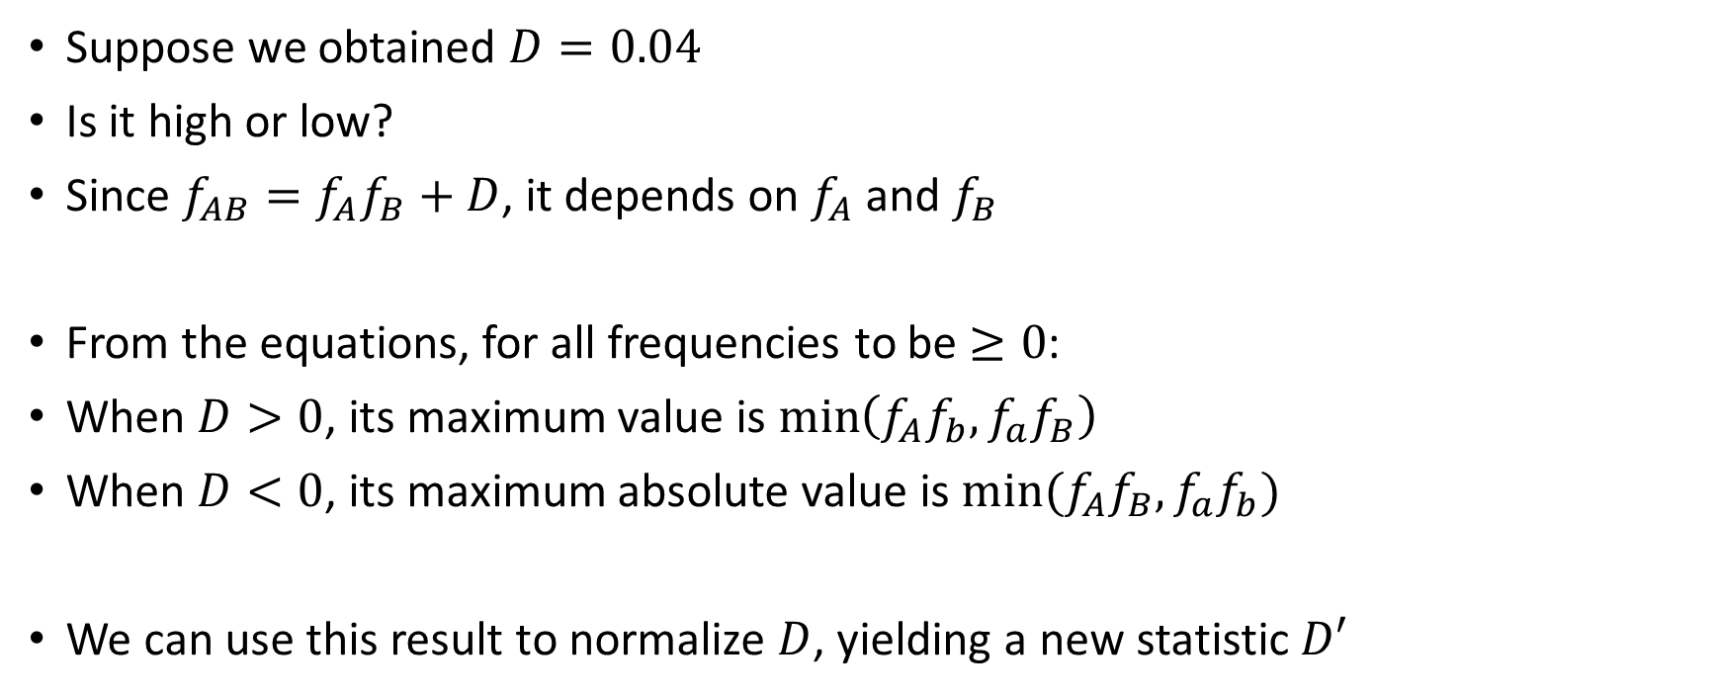
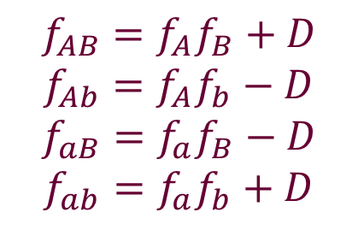
What is a large value of $D$?
Suppose we obtained $D=0.04$
Is it high or low?
Since $f_{AB}=f_{A}f_{B}+D$, it depends on $f_{A}$ and $f_{B}$
From the equations, for all frequencies to be $≥0$:
When $D>0$, its maximum value is $\min\left(f_{A}f_{b},f_{a}f_{B}\right)$
When $D<0$, its maximum absolute value is $min⁡(f_{A}f_{B},f_{a}f_{b})$
We can use this result to normalize $D$, yielding a new statistic $D′$
$$f_{AB}=f_{A}f_{B}+D$$
$$f_{Ab}=f_{A}f_{b}−D$$
$$f_{aB}=f_{a}f_{B}−D$$
$$f_{ab}=f_{a}f_{b}+D$$

Slide 43
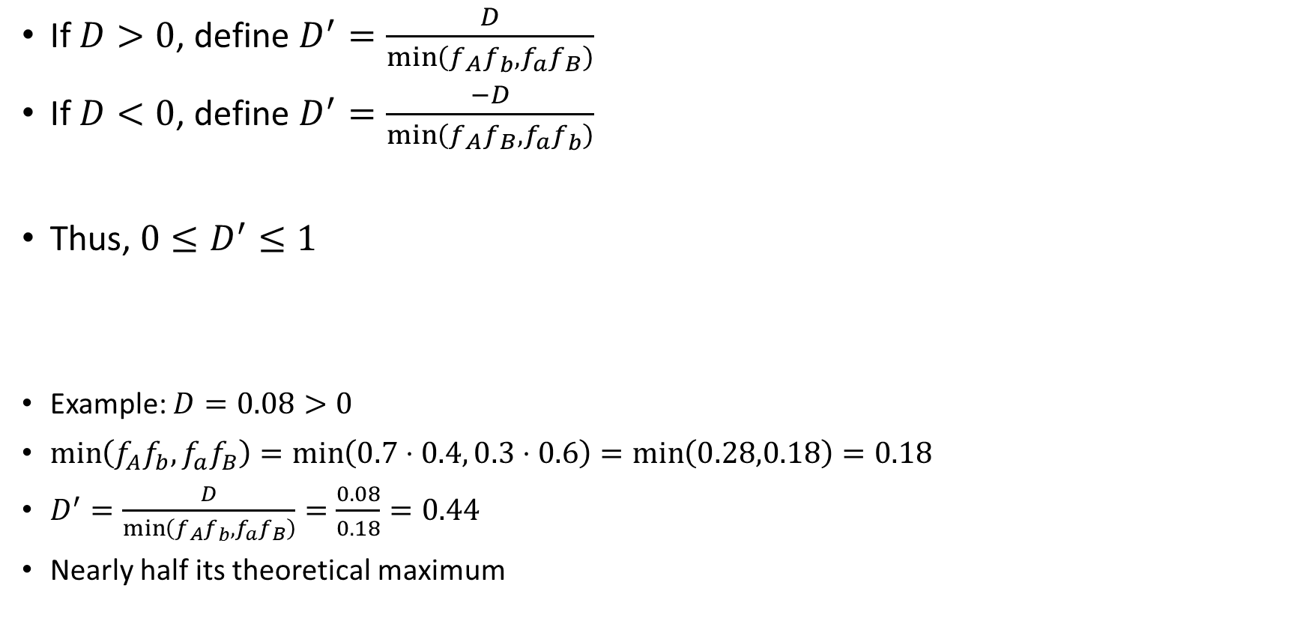
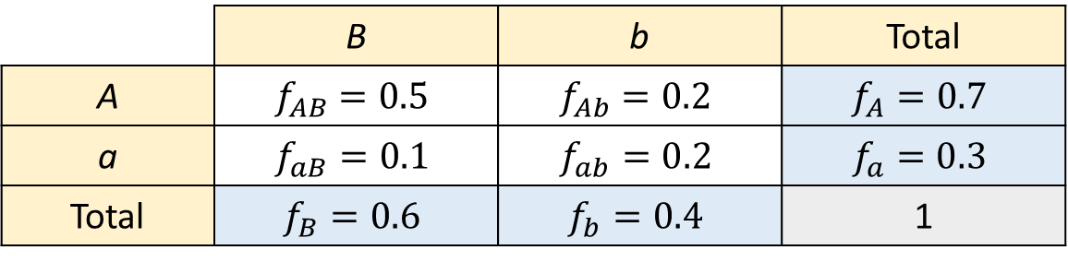
Lewontin’s $D^{′}$
If $D>0$, define $D^{′}=\frac{D}{\min\left(f_{A}f_{b},f_{a}f_{B}\right)}$
If $D<0$, define $D^{′}=\frac{−D}{\min\left(f_{A}f_{B},f_{a}f_{b}\right)}$
Thus, $0≤D^{′}≤1$
Example: $D=0.08>0$
$\min\left(f_{A}f_{b},f_{a}f_{B}\right)=\min\left(0.7⋅0.4, 0.3⋅0.6\right)=\min\left(0.28,0.18\right)=0.18$
$D^{′}=\frac{D}{\min\left(f_{A}f_{b},f_{a}f_{B}\right)}=\frac{0.08}{0.18}=0.44$
Nearly half its theoretical maximum
 | B | b | Total
A | $$f_{AB}=0.5$$ | $$f_{Ab}=0.2$$ | $$f_{A}=0.7$$
a | $$f_{aB}=0.1$$ | $$f_{ab}=0.2$$ | $$f_{a}=0.3$$
Total | $$f_{B}=0.6$$ | $$f_{b}=0.4$$ | 1

Slide 44
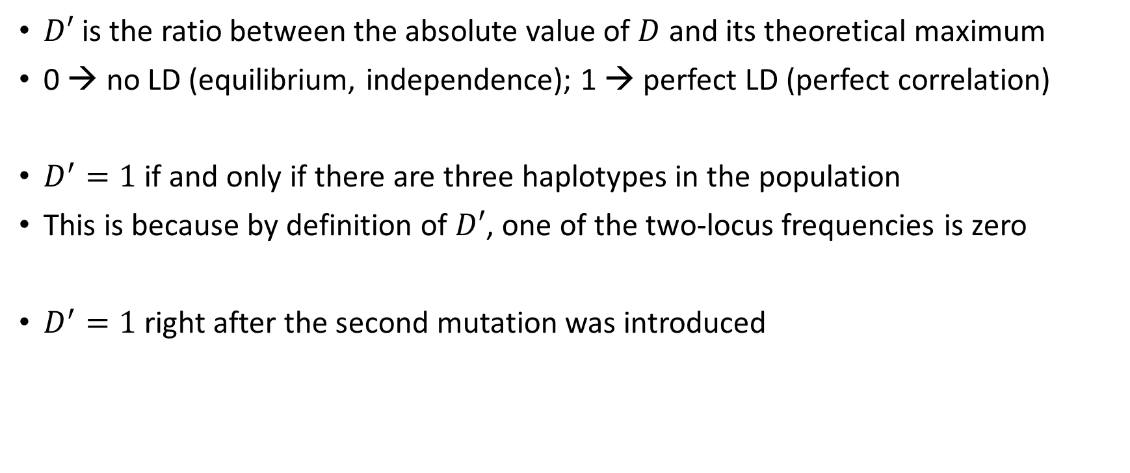
Properties of $D^{′}$
$D′$ is the ratio between the absolute value of $D$ and its theoretical maximum
0 → no LD (equilibrium, independence); 1 → perfect LD (perfect correlation)
$D^{′}=1$ if and only if there are three haplotypes in the population
This is because by definition of $D′$, one of the two-locus frequencies is zero
$D^{′}=1$ right after the second mutation was introduced
A B
A B
A b
A b
A B
a B
A b
A b

Slide 45
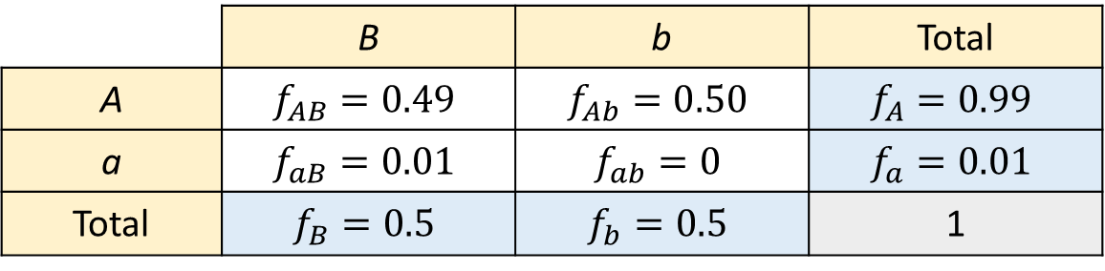
$D^{′}$ after a new mutation
Assume the new mutation affected one out of 100 chromosomes and that the other allele has frequency 50%
 | B | b | Total
A | $$f_{AB}=0.49$$ | $$f_{Ab}=0.50$$ | $$f_{A}=0.99$$
a | $$f_{aB}=0.01$$ | $$f_{ab}=0$$ | $$f_{a}=0.01$$
Total | $$f_{B}=0.5$$ | $$f_{b}=0.5$$ | 1
A B
A B
A b
A b
A B
a B
A b
A b

Slide 46
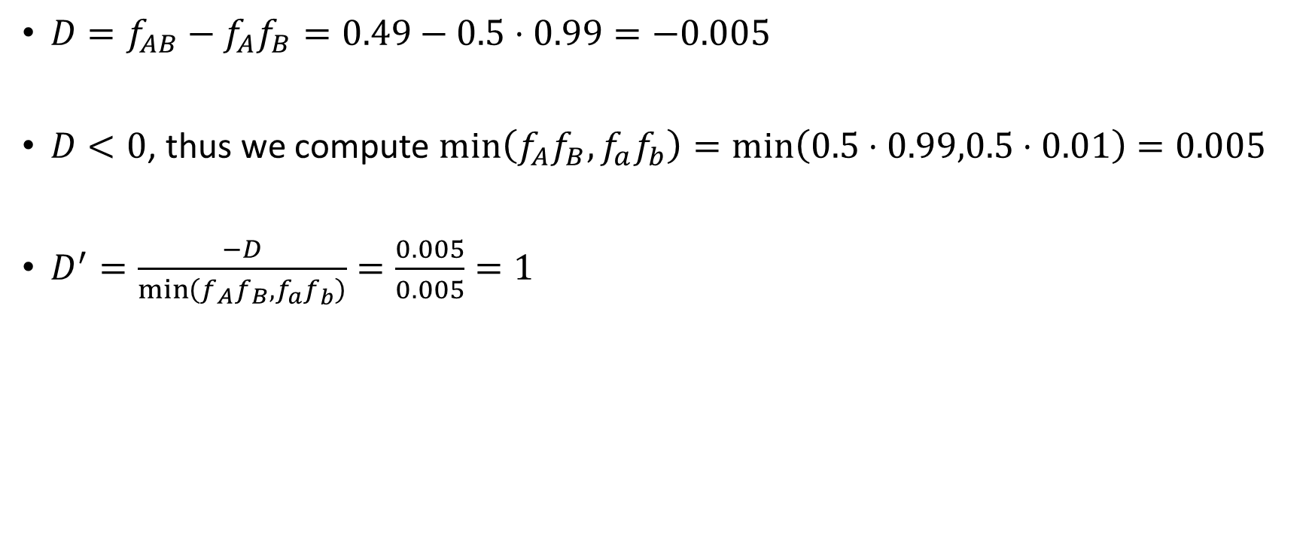

$D^{′}$ after a new mutation
$D=f_{AB}−f_{A}f_{B}=0.49−0.5⋅0.99=−0.005$
$D<0$, thus we compute $\min\left(f_{A}f_{B},f_{a}f_{b}\right)=\min\left(0.5⋅0.99,0.5⋅0.01\right)=0.005$
$D^{′}=\frac{−D}{\min\left(f_{A}f_{B},f_{a}f_{b}\right)}=\frac{0.005}{0.005}=1$
 | B | b | Total
A | $$f_{AB}=0.49$$ | $$f_{Ab}=0.50$$ | $$f_{A}=0.99$$
a | $$f_{aB}=0.01$$ | $$f_{ab}=0$$ | $$f_{a}=0.01$$
Total | $$f_{B}=0.5$$ | $$f_{b}=0.5$$ | 1

Slide 47
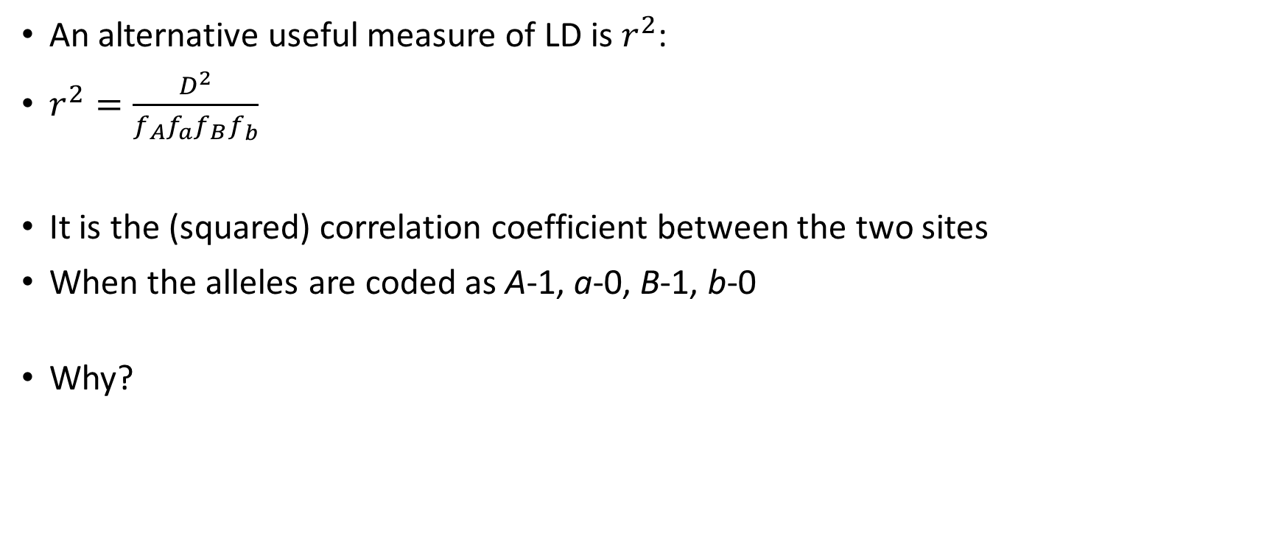
The correlation coefficient
An alternative useful measure of LD is $r^{2}$:
$r^{2}=\frac{D^{2}}{f_{A}f_{a}f_{B}f_{b}}$
It is the (squared) correlation coefficient between the two sites
When the alleles are coded as A-1, a-0, B-1, b-0
Why?

Slide 48
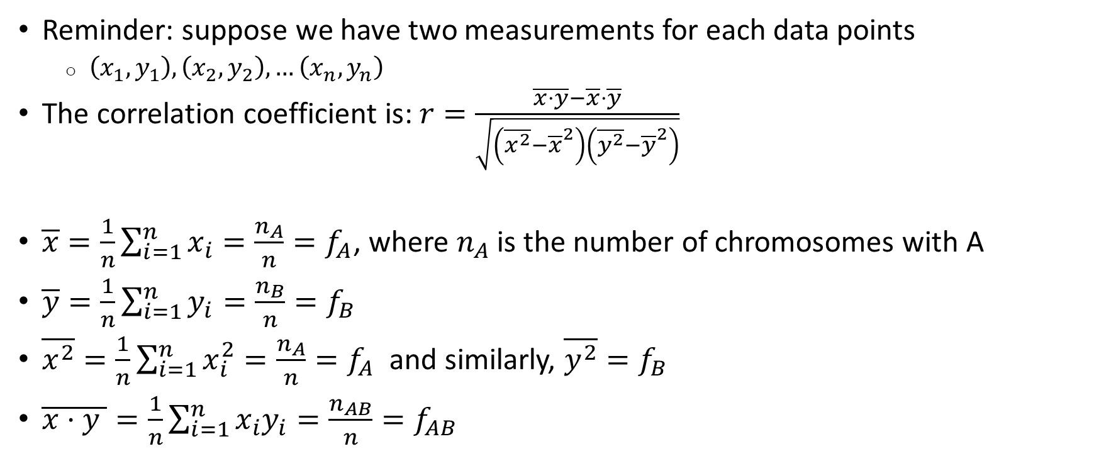
The correlation coefficient
Reminder: suppose we have two measurements for each data points
  $\left(x_{1},y_{1}\right),\left(x_{2},y_{2}\right),…\left(x_{n},y_{n}\right)$
The correlation coefficient is: $r=\frac{\overline{x⋅y}−\overline{x}⋅\overline{y}}{\sqrt{\left(\overline{x^{2}}−{\overline{x}}^{2}\right)\left(\overline{y^{2}}−{\overline{y}}^{2}\right)}}$
$\overline{x}=\frac{1}{n}\sum_{i=1}^{n}{x_{i}}=\frac{n_{A}}{n}=f_{A}$, where $n_{A}$ is the number of chromosomes with A
$\overline{y}=\frac{1}{n}\sum_{i=1}^{n}{y_{i}}=\frac{n_{B}}{n}=f_{B}$
$\overline{x^{2}}=\frac{1}{n}\sum_{i=1}^{n}{x_{i}^{2}}=\frac{n_{A}}{n}=f_{A}$ and similarly, $\overline{y^{2}}=f_{B}$
$\overline{x⋅y }=\frac{1}{n}\sum_{i=1}^{n}{x_{i}y_{i}}=\frac{n_{AB}}{n}=f_{AB}$

Slide 49
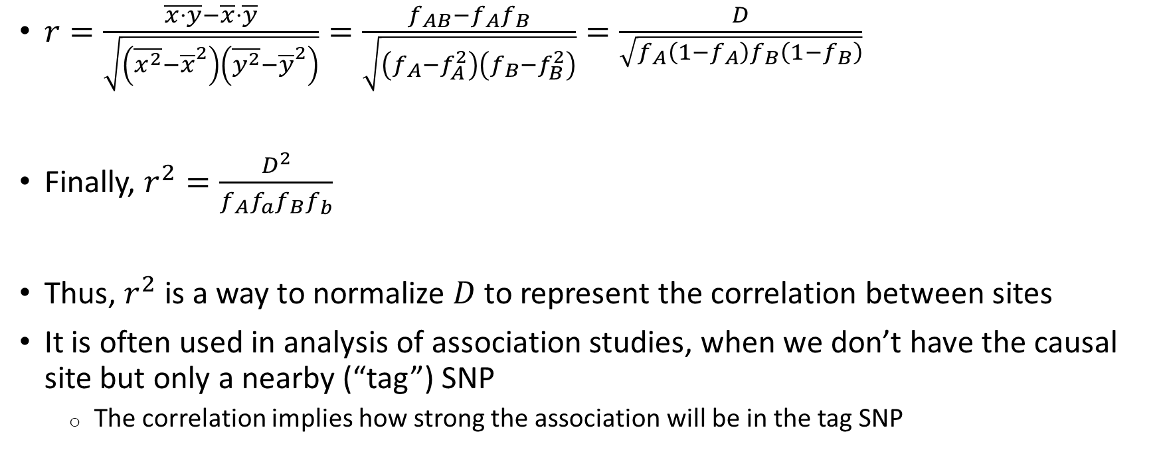
The correlation coefficient
$r=\frac{\overline{x⋅y}−\overline{x}⋅\overline{y}}{\sqrt{\left(\overline{x^{2}}−{\overline{x}}^{2}\right)\left(\overline{y^{2}}−{\overline{y}}^{2}\right)}}=\frac{f_{AB}−f_{A}f_{B}}{\sqrt{\left(f_{A}−f_{A}^{2}\right)\left(f_{B}−f_{B}^{2}\right)}}=\frac{D}{\sqrt{f_{A}\left(1−f_{A}\right)f_{B}\left(1−f_{B}\right)}}$
Finally, $r^{2}=\frac{D^{2}}{f_{A}f_{a}f_{B}f_{b}}$
Thus, $r^{2}$ is a way to normalize $D$ to represent the correlation between sites
It is often used in analysis of association studies, when we don’t have the causal site but only a nearby (“tag”) SNP
  The correlation implies how strong the association will be in the tag SNP

Slide 50
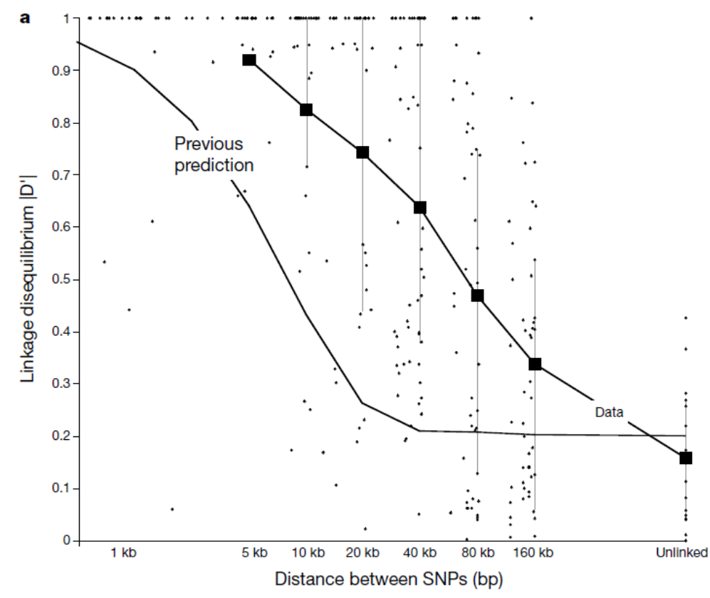
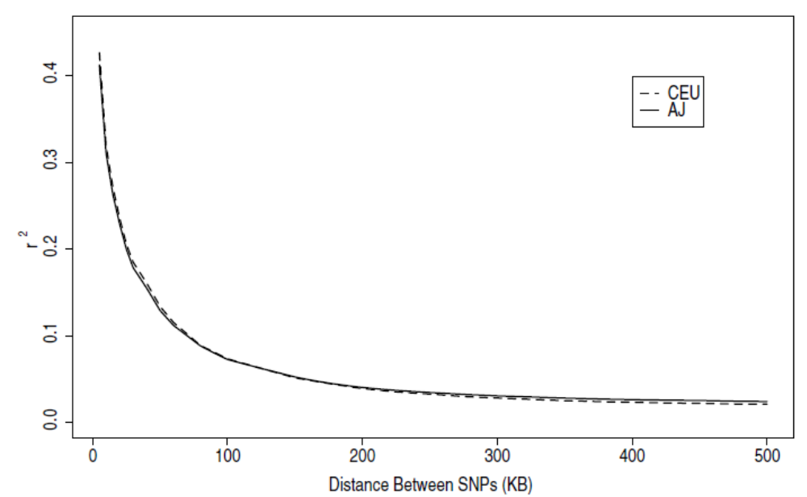
In humans
Europeans
Ashkenazi Jews
Olshen et al., BMC Genet, 2008
Reich et al., Nature, 2001
First genome-wide data

Slide 51
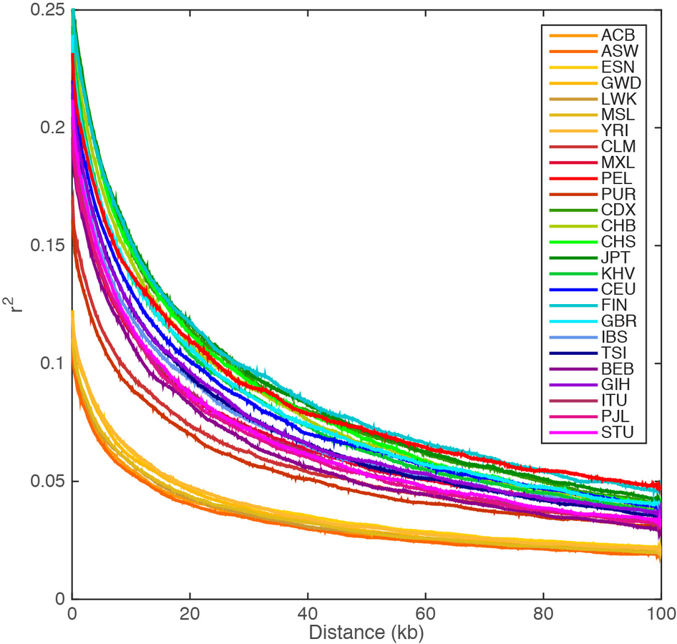
Across populations
Small population size ➔
More recent common ancestors ➔
Less opportunities for recombination ➔
Higher LD
African populations did not suffer from the out-of-Africa bottleneck, and thus have lower levels of LD
Eurasian populations
African populations

Slide 52
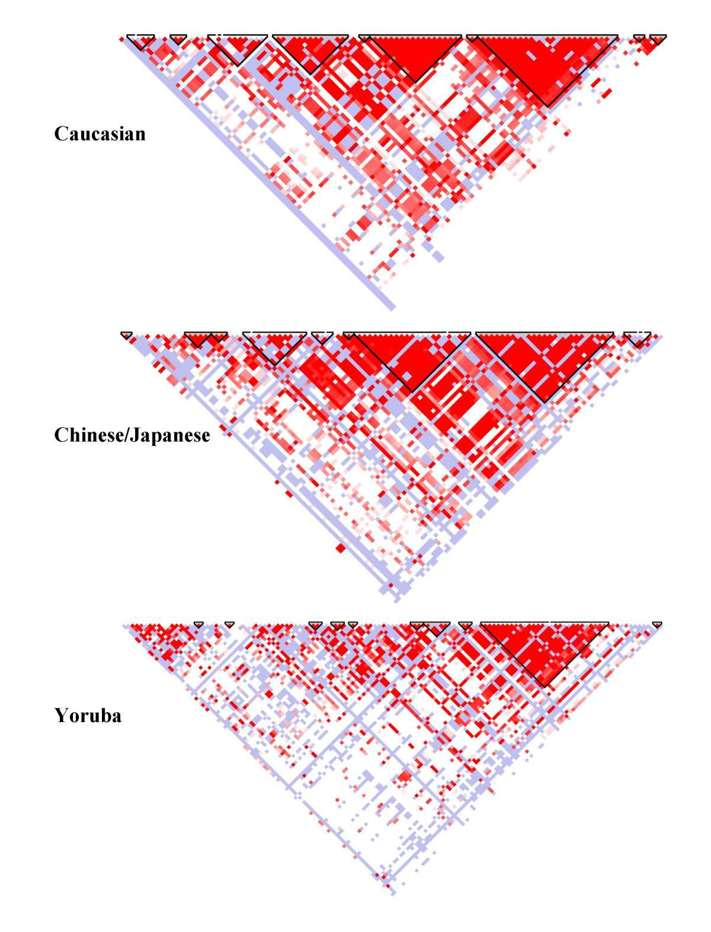
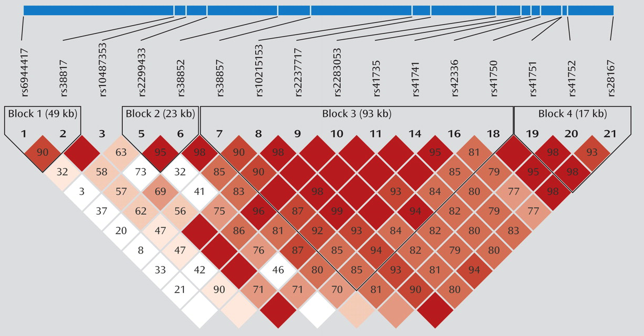
Haploview graphs

Slide 53
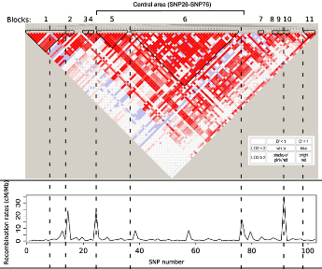
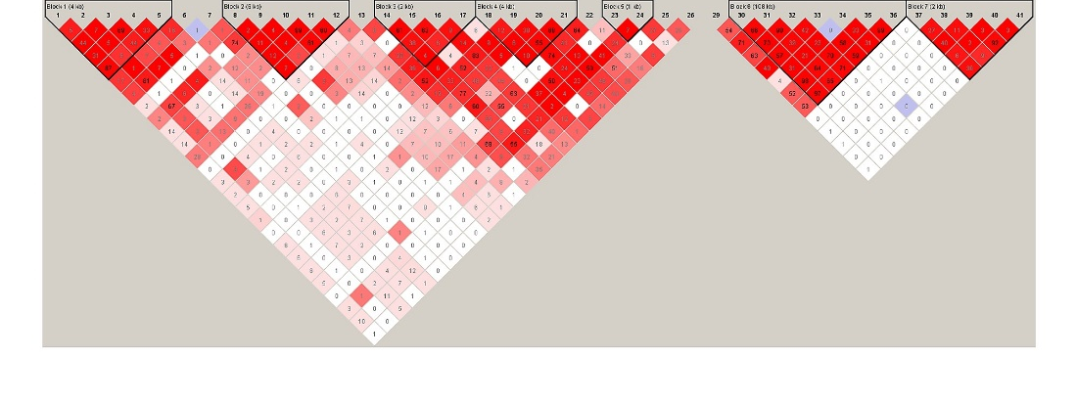
LD “blocks”
Recombination is mostly concentrated in “hotspots”
Thus, SNPs are highly correlated between hotspots
Forming a pattern of LD blocks
Block sizes are in tens of kb

Slide 54
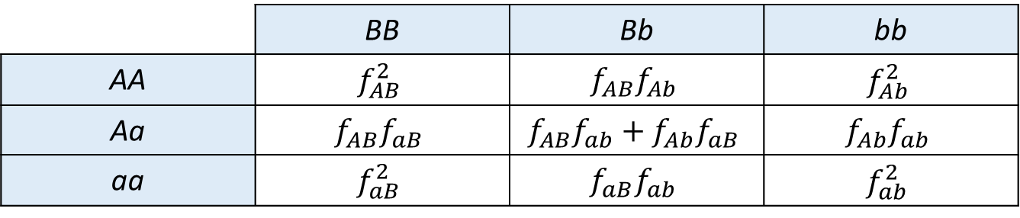
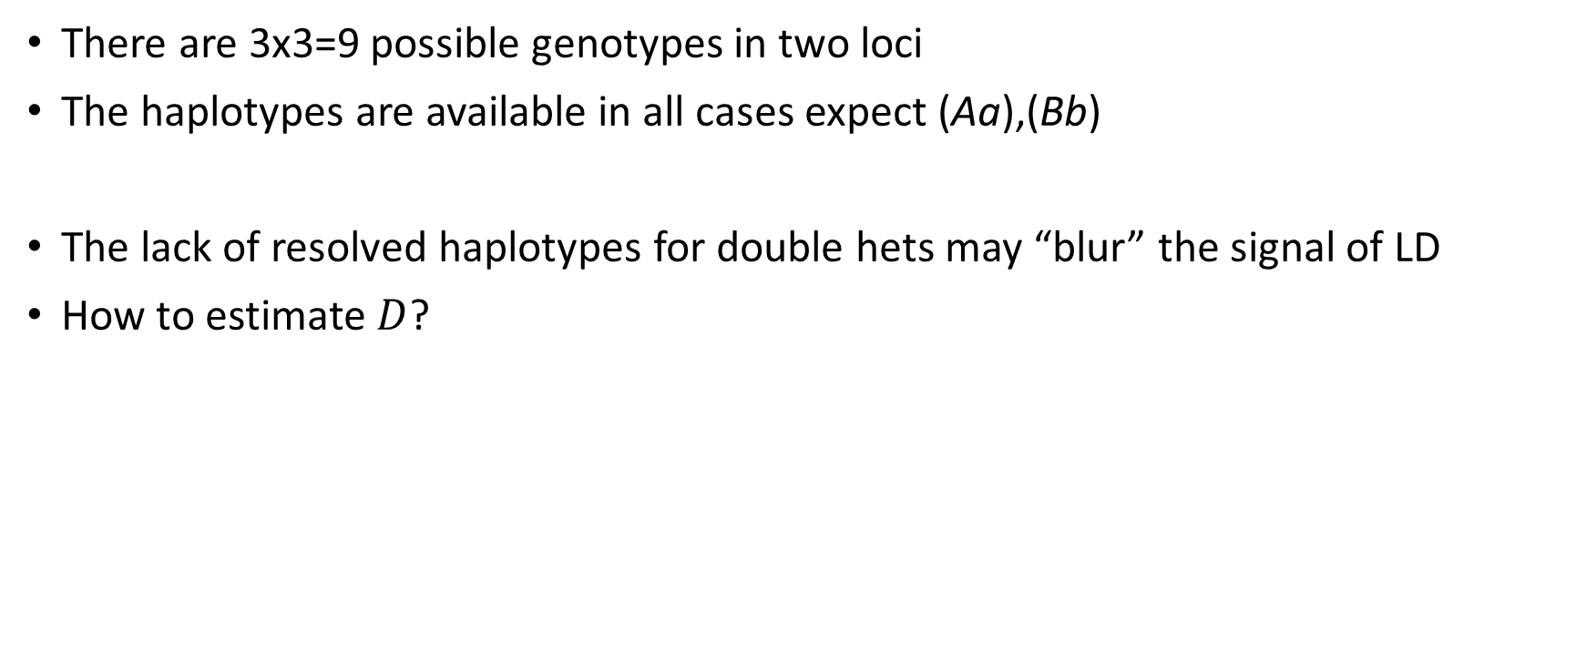
Diploid individuals
There are 3x3=9 possible genotypes in two loci
The haplotypes are available in all cases expect (Aa),(Bb)
The lack of resolved haplotypes for double hets may “blur” the signal of LD
How to estimate $D$?
 | BB | Bb | bb
AA | $$f_{AB}^{2}$$ | $$f_{AB}f_{Ab}$$ | $$f_{Ab}^{2}$$
Aa | $$f_{AB}f_{aB}$$ | $$f_{AB}f_{ab}+f_{Ab}f_{aB}$$ | $$f_{Ab}f_{ab}$$
aa | $$f_{aB}^{2}$$ | $$f_{aB}f_{ab}$$ | $$f_{ab}^{2}$$

Slide 55
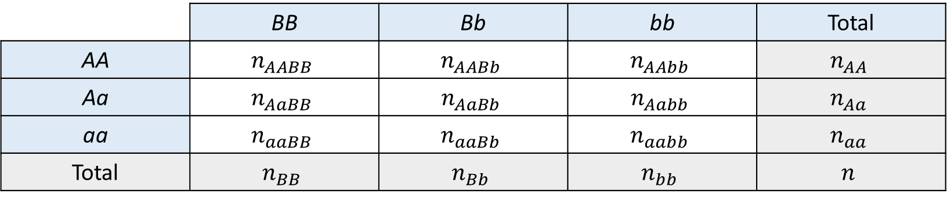
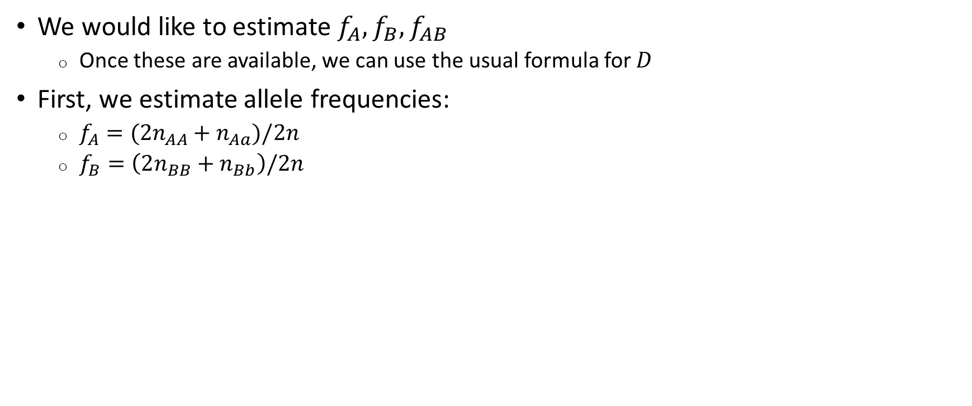
Diploid individuals
We would like to estimate $f_{A}, f_{B}, f_{AB}$
  Once these are available, we can use the usual formula for $D$
First, we estimate allele frequencies:
  $f_{A}=({2n}_{AA}+n_{Aa})/2n$
  $f_{B}=\left(2n_{BB}+n_{Bb}\right)/2n$
 | BB | Bb | bb | Total
AA | $$n_{AABB}$$ | $$n_{AABb}$$ | $$n_{AAbb}$$ | $$n_{AA}$$
Aa | $$n_{AaBB}$$ | $$n_{AaBb}$$ | $$n_{Aabb}$$ | $$n_{Aa}$$
aa | $$n_{aaBB}$$ | $$n_{aaBb}$$ | $$n_{aabb}$$ | $$n_{aa}$$
Total | $$n_{BB}$$ | $$n_{Bb}$$ | $$n_{bb}$$ | $$n$$

Slide 56


Diploid individuals
Next, $f_{AB}=\left(2n_{AABB}+n_{AABb}+n_{AaBB}+?\right)/2n$
What is the proportion of AB haplotypes in the central cell?
  The central cell has either AB/ab (probability $f_{AB}f_{ab}$) or Ab/aB (probability $f_{Ab}f_{aB}$)
  There will be a count of one AB haplotype with probability $f_{AB}f_{ab}/\left(f_{AB}f_{ab}+f_{Ab}f_{aB}\right)$
Thus, $f_{AB}=\frac{\left(2n_{AABB}+n_{AABb}+n_{AaBB}+n_{AaBb}\frac{f_{AB}f_{ab}}{f_{AB}f_{ab}+f_{Ab}f_{aB}}\right)}{2n}$
 | BB | Bb | bb | Total
AA | $$n_{AABB}$$ | $$n_{AABb}$$ | $$n_{AAbb}$$ | $$n_{AA}$$
Aa | $$n_{AaBB}$$ | $$n_{AaBb}$$ | $$n_{Aabb}$$ | $$n_{Aa}$$
aa | $$n_{aaBB}$$ | $$n_{aaBb}$$ | $$n_{aabb}$$ | $$n_{aa}$$
Total | $$n_{BB}$$ | $$n_{Bb}$$ | $$n_{bb}$$ | $$n$$

Slide 57

Diploid individuals
$f_{AB}=\frac{2n_{AABB}+n_{AABb}+n_{AaBB}+n_{AaBb}\frac{f_{AB}f_{ab}}{f_{AB}f_{ab}+f_{Ab}f_{aB}}}{2n}$
We still have $f_{ab},f_{Ab},f_{aB}$ in the equation!
But we can substitute:
  $f_{Ab}=f_{A}−f_{AB}$ (because $f_{AB}+f_{Ab}=f_{A}$)
  $f_{aB}=f_{B}−f_{AB}$ (because $f_{AB}+f_{aB}=f_{B}$)
  $f_{ab}+f_{aB}=f_{a}=1−f_{A}$ ➔ $f_{ab}=1−f_{A}−f_{aB}=1−f_{A}−f_{B}+f_{AB}$
$f_{AB}=\frac{2n_{AABB}+n_{AABb}+n_{AaBB}+n_{AaBb}\frac{f_{AB}\left(1−f_{A}−f_{B}+f_{AB}\right)}{f_{AB}\left(1−f_{A}−f_{B}+f_{AB}\right)+\left(f_{A}−f_{AB}\right)\left(f_{B}−f_{AB}\right)}}{2n}$
This is a cubic equation for $f_{AB}$, given the two-locus genotype counts

Slide 58
Multinomial distribution
Assume 10 athletes are competing, and everyone is guaranteed a medal
Chance of gold: 0.1, chances of silver: 0.3, chances of bronze: 0.6
What is the probability of (3,5,2) gold/silver/bronze medals?
Medal | Gold | Silver | Bronze | Total
Probability | 0.1 | 0.3 | 0.6 | 1
Observed | 3 | 5 | 2 | 10

Slide 59

Multinomial distribution
Suppose we sort athletes by last name
The probability of this series of wins GGGSSSSSBB is ${0.1}^{3}{0.3}^{5}{0.2}^{2}$
But we can have the same medals also by SGSSGBSBGS, etc.
How many arrangements are there for exactly (3,5,2) medals?
Medal | Gold | Silver | Bronze | Total
Probability | 0.1 | 0.3 | 0.6 | 1
Observed | 3 | 5 | 2 | 10

Slide 60

Multinomial distribution
Why $\frac{10!}{3!5!2!}$?
  Assume the first three are gold, next five are silver, last two are bronze, and ask how many ways we have to order the athletes
  10! is the number of ways to order all 10 athletes in a row
  But the internal order of gold medalists doesn’t matter, so we in fact counted multiple times the same winners
  Specifically, we counted each set of 3 gold winners 3! times, the number of ways to order the three gold medalists
  Same for silver (5!) and bronze (2!)
Thus, the probability of (3,5,2) wins is $P\left(3,5,2\right)=\frac{10!}{3!5!2!}{0.1}^{3}{0.3}^{5}{0.5}^{2}$

Slide 61


Multinomial distribution
In general, suppose we have three outcomes with probabilities $p_{1},p_{2},p_{3}$
The probability to observed $n_{1}$ type 1 outcomes, $n_{2}$ type 2, $n_{3}$ type 3 is:
$P\left(n_{1},n_{2},n_{3}\right)=\frac{n!}{n_{1}!n_{2}!n_{3}!}p_{1}^{n_{1}}p_{2}^{n_{2}}p_{3}^{n_{3}}$ (the multinomial distribution)
Extends similarly to more than three outcome
Note that for two outcomes, this is just the binomial distribution
  $P\left(n_{1},n_{2}\right)=\frac{n!}{n_{1}!n_{2}!}p_{1}^{n_{1}}p_{2}^{n_{2}}=\left({n \atop n_{1}}\right)p_{1}^{n_{1}}{\left(1−p_{1}\right)}^{n−n_{1}}$, since $n_{2}=n−n_{1}$ and $p_{2}=1−p_{1}$
Outcome | 1 | 2 | 3 | Total
Probability | $$p_{1}$$ | $$p_{2}$$ | $$p_{3}$$ | 1
Observed | $$n_{1}$$ | $$n_{2}$$ | $$n_{3}$$ | $$n$$

Slide 62


Another approach for diploids
We can use a maximum likelihood approach
Assume the $2n$ haplotypes are distributed multinomially
$L=\frac{n!}{n_{AABB}!n_{AABb}!⋯n_{aabb}!}{\left(f_{AB}^{2}\right)}^{n_{AABB}}{\left(f_{AB}f_{Ab}\right)}^{n_{AABb}}⋯{\left(f_{ab}^{2}\right)}^{n_{aabb}}$
 | BB | Bb | bb
AA | $$f_{AB}^{2}$$ | $$f_{AB}f_{Ab}$$ | $$f_{Ab}^{2}$$
Aa | $$f_{AB}f_{aB}$$ | $$f_{AB}f_{ab}+f_{Ab}f_{aB}$$ | $$f_{Ab}f_{ab}$$
aa | $$f_{aB}^{2}$$ | $$f_{aB}f_{ab}$$ | $$f_{ab}^{2}$$

Slide 63


MLE approach
$L=\frac{n!}{n_{AABB}!n_{AABb}!⋯n_{aabb}!}{\left(f_{AB}^{2}\right)}^{n_{AABB}}{\left(f_{AB}f_{Ab}\right)}^{n_{AABb}}⋯{\left(f_{ab}^{2}\right)}^{n_{aabb}}$
Let us take the log of the likelihood, and ignore all terms independent of $f_{AB}$
$\log{L}=\left(2n_{AABB}+n_{AABb}+n_{AaBB}\right)\log{f_{AB}}+n_{AaBb}\log\left(f_{AB}f_{ab}+f_{Ab}f_{aB}\right)+const⁡$
The MLE of $f_{AB}$ satisfies $\frac{d{\log{L}}}{d{f_{AB}}}=0$
Same as the previous (“counting”) solution
Hill, Heredity, 1974
Implemented in Plink
 | BB | Bb | bb
AA | $$f_{AB}^{2}$$ | $$f_{AB}f_{Ab}$$ | $$f_{Ab}^{2}$$
Aa | $$f_{AB}f_{aB}$$ | $$f_{AB}f_{ab}+f_{Ab}f_{aB}$$ | $$f_{Ab}f_{ab}$$
aa | $$f_{aB}^{2}$$ | $$f_{aB}f_{ab}$$ | $$f_{ab}^{2}$$

Slide 64

The evolution of LD
Assume an infinitely large population with random mating
Suppose at a certain generation ($t$), the LD is $D(t)$
At the next generation, $D\left(t+1\right)=\left(1−c\right)D(t)$
  $c$ is the probability of a recombinant haplotype
  The proof is based on writing down all possible haplotypes after one generation
Thus, $D\left(t\right)={\left(1−c\right)}^{t}D\left(0\right)$

Slide 65



The probability of a recombinant haplotype
A B
a b
Original haplotypes
Probability $1−c$
A B
A b
Recombinant haplotypes
Probability $c$
a b
a B
Assume the genetic distance between the two sites is $d$ Morgans
What is $c$?
The haplotype will be recombinant, if and only if the number of crossovers is odd

Slide 66

The probability of a recombinant haplotype
Assume the rate of recombination is 1 per Morgan, independently at each small genomic region
According to the theory of Poisson processes, given distance $d$ between sites, the number of crossovers between them (in one generation) is Poisson with mean $d$
$P\left(n\right)=e^{−d}\frac{d^{n}}{n!}$
$P\left(n odd\right)=\sum_{k=0}^{∞}{P(2k+1)}=\sum_{k=0}^{∞}{e^{−d}\frac{d^{2k+1}}{\left(2k+1\right)!}}$
Distance to recombination

Slide 67


The probability of a recombinant haplotype
$c=P\left(n odd\right)=\sum_{k=0}^{∞}{e^{−d}\frac{d^{2k+1}}{\left(2k+1\right)!}}=e^{−d}\frac{\left(e^{d}−e^{−d}\right)}{2}=\frac{1−e^{−2d}}{2}$
For $d≪1$, $c\left(d\right)≈d$
  At most one event is seen, and if an event has happened, the haplotype will be recombinant
For $d≫1$, $c\left(d\right)=1/2$
  Many recombinations have happened, and the total number could equally be even or odd
  Unlinked sites have $c=1/2$: equal probability for each haplotype
$$\sum_{k=0}^{∞}{\frac{d^{2k+1}}{\left(2k+1\right)!}}=\frac{e^{d}−e^{−d}}{2}$$

Slide 68


Map functions
$c(d)$ is called a map function
$c\left(d\right)=\left(1−e^{−2d}\right)/2$ is called Haldane’s map function
Haldane’s map assumes that recombination is a Poisson process
But this is just an approximation
In practice, crossover interference means that crossover cannot come too close to one another
Almost always, each chromosome must have at least one crossover, even the shorter ones
This would lead to other map functions
J. B. S. Haldane
1892-1964
United Kingdom

Slide 69


Crossover interference
Campbell et al., Nat Commun, 2015
Distance between crossovers
No interference=
Poisson process

Slide 70



Models of crossover interference
If the Poisson process is wrong, then what is a good model for the distance between crossovers?
First, we model the distance between chiasmata
We assume follows a Gamma distribution:
$P\left(x\right)=\frac{λ^{k}}{Γ\left(k\right)}x^{k−1}e^{−λx}$
Chiasma
Gamma function
Roughly, $Γ\left(k\right)=\left(k−1\right)!$

Slide 71




The Gamma distribution
$$P\left(x\right)=\frac{λ^{k}}{Γ\left(k\right)}x^{k−1}e^{−λx}$$
Gamma distribution is parametrized by $λ$ and $k$
It can be thought of as a sum of $k$ exponential variables, each with rate $λ$
  It is also meaningful for fractional $k$, but this is more complicated
For $k=1$, the Gamma distribution is exponential with rate $λ$
For $k>1$, the distribution is peaked: very short distances are not allowed
The mean is $k/λ$
Here, $θ=1/λ$

Slide 72

Why Gamma distribution?
The Gamma distribution a sum of $k$ exponential variables, each with rate $k$
Biological idea:
  Chiasmata form at locations of double-strand breaks (DSBs) in the chromosome
  DSBs are distributed randomly according to a Poisson process, and thus the distance between DSBs is exponential with rate $λ$
  But not all DSB become chiasmata: only one in $k$
  Thus, the distance between chiasmata is Gamma with parameters $k$ and $λ$
In our case, $λ=2k$
This is because the mean distance, $k/λ$, must be 0.5
Why?

Slide 73
From chiasmata to inter-crossover distances
Each chiasma affects only two of the four chromosomes in the tetrad
Thus, only half the gametes will have an observed recombination!
Chiasma

Slide 74

From chiasmata to inter-crossover distances
We assume that each chiasma affects two chromosomes randomly: No chromatid interference
Thus, each chiasma ends the inter-co segment with probability 1/2
The number of chiasma per inter-co segment is geometric:
$P\left(m\right)={\left(\frac{1}{2}\right)}^{m−1}⋅\left(\frac{1}{2}\right)={\left(\frac{1}{2}\right)}^{m}$
If a segment runs through $m$ chiasmata, its length is a sum of $m$ Gamma distributions
The sum of $m$ Gamma variables with parameters $k,λ$ is also Gamma with parameters $mk,λ$

Slide 75

From chiasmata to inter-crossover distances
Denote $P_{G}(x;k,λ)$ the distribution of a Gamma variable with parameters $k,λ$
The final distribution of the inter-co distances is:
$P\left(x\right)=\sum_{m=1}^{∞}{{\left(\frac{1}{2}\right)}^{m}}P_{G}\left(x;mk,2k\right)$
Since $m$ is geometric is probability 1/2 of success, its mean is 2
➔ On average, there are two chiasmata between crossovers
The mean distance between chiasmata is 0.5 (Morgans)
Thus, the mean distance between crossovers is 2*0.5=1, as expected

Slide 76

Is that a good fit?
It was found that the Gamma model is not a good fit
Some distances are still short, which is unexpected under Gamma
A better model: a small proportion $p$ of the crossovers are “free”
Namely they are not subject to (“escape”) the regulation of interference
The distance between them is exponential
Called the Housworth-Sthal model (2003)

Slide 77


The crossover interference with escape model
The typical values of $k$ in humans are around 5-10
The escape parameter is 0.05-0.1, and increasing with maternal age
  ➔ Regulation of inter-co distances loosens with time!
Distance between crossovers
The solid line
Campbell et al., Nat Commun, 2015

Slide 78

Comment
Fledel-Alon, PLOS Genet, 2009
Even the Gamma model with escape is not perfect
It is strongly suggested that each chromosome must undergo at least one crossover (affecting 2/4 gametes)
Beyond that, the number of crossovers increases linearly with the chromosome length

Slide 79

Comment
The presence of at least one crossover is thought to be required for proper segregation of the chromosomes during meiosis
➔ Without crossovers, some gametes may get 0 or 2 copies
➔ Leading to aneuploidies
But exceptions are seen too
Risk factor for Down syndrome!
Probability of no crossover
Fledel-Alon et al., PLOS Genet, 2009

Slide 80


The evolution of LD
$D\left(t\right)={\left(1−c\right)}^{t}D\left(0\right)$
The reduction in LD in one generation is proportional to $1−c$
  If the sites are near ($c$ is small), the reduction is small
  If the sites are far apart, $1−c=0.5$, and LD is reduced by half each generation
  Or sites on different chromosomes
Approximately, $D\left(t\right)≈e^{−ct}D(0)$
  For short times, $ct≪1$, $D\left(t\right)=\left(1−ct\right)D(0)$

Slide 81

An example
Consider two sites on the same gene, say 100kb apart
  This is approximately a distance of $d=0.1$ cM
  $d≪1$, thus $c≈d=0.001$
$\frac{D\left(t\right)}{D\left(0\right)}=e^{−ct}=e^{−t/1000}$
After 100 generations (≈2,500 years), $D$ declined to $e^{−0.1}=0.90$ its initial value
After 1000 generations (≈25,000 years), $D$ declined to $e^{−1}=0.37$ its initial value
After 5,000 generations (≈125,000 years), $D$ declined to $e^{−5}=0.006$ its initial value

Slide 82


Inference of human demographic history
The decay of LD with physical/genetic distance can be fit to demographic models
Schaffner et al., Genome Res, 2005
West Africans
East Asians
Europeans

Slide 83

Do methods agree?
Results are often not compatible across methods!
Major elements do agree:
  Out-of-Africa migration and bottleneck ≈50-100kya
  2-3% Admixture with Neanderthals in non-Africans
  Very rapid recent expansion of Eurasians
  Recent colonization of the Americas from Asia (≈15kya)
  Recent European/African/Native-Am admixture in the Americas
Lecture notes, Ryan Gutenkunst, University of Arizona

Slide 84

How to choose a method?
The more weight our summary statistics give to long identical regions and/or rare mutations, the more relevant the method for recent history
Statistics based on similarity across short regions and common mutations are informative on the ancient history
If the method makes use of haplotypes, phasing quality is important
If rare/de-novo mutations are used, sequencing quality is important
Methods based on mutations depend on knowing the mutation rate
  The order of magnitude is known with confidence ($≈{10}^{−8}$ per generation per bp)
  But there is a debate on the precise value and the rate’s evolution
  The recombination rate is less controversial, but also not perfectly estimated
Whole-genomes are very informative even at small samples
Ancient genomes are extremely useful when they exist

Slide 85
Genealogical ancestors vs genetic ancestors
The genealogy is (or may be) different at each locus
The genealogical ancestors are fixed throughout the genome, but not the genetic ancestors
New MRCAs
Note that for haploid species, no recombination happens and there is a single genealogical and genetic tree
A new lineage
1
2
3
4
1
2
3
4

Slide 86





Genealogical ancestors vs genetic ancestors
Each individual has a pedigree, namely a set of ancestors in each past generation
There are $2^{k}$ ancestors after $k$ generations, those they may be overlapping
$k=4$,
14 ancestors
$k=3$, 8 ancestors
Siblings
$k=2$, 4 ancestors
$k=1$, 2 ancestors
Relationship between ancestors leads to less than $2^{k}$ overall ancestors

Slide 87
Genealogical ancestors vs genetic ancestors
At each locus, the genetic material is inherited from exactly one ancestor
This corresponds to a path along the genealogy
Locus 1
Locus 3
Locus 2
Comment:
Y chr is inherited only through fathers (right-only)
mtDNA only through mothers (left-only)

Slide 88

Genealogical ancestors vs genetic ancestors
Only one genealogic ancestor is the genetic ancestor at each locus
Some genealogical ancestors may not be genetic ancestors at all
Consider $k=10$, and assume $2^{k}=1024$ ancestors (no relationship between ancestors)
The probability of a locus to be inherited from a specific ancestor is $1/2^{k}=0.001$
The mean segment length is $100/k=10$ cM
The entire genome is 3500cM, so there are, on average, 350 loci
The mean number of inherited loci is $350⋅0.001=0.34$
The probability of inheriting nothing is roughly ${\left(1−0.001\right)}^{350}=0.71$
More likely to inherit nothing!

Slide 89

Genealogical ancestors vs genetic ancestors
We are not really genetically related to ancestors 10-15 generations ago!
Even if they are famous!

Slide 90

Reconstructing the genealogy at all loci
A number of techniques allow the reconstruction of the genealogy at each genomic position, including the position of recombinations
ARGWeaver; Rasmussen et al., 2014
New MRCAs
A new lineage
1
2
3
4
1
2
3
4

Slide 91
Coalescence and recombination
Consider a chromosomal region containing two sites (A,B)
Consider two chromosomes
Will both sites have the same genealogy and TMRCA?
Different genealogies
A B
MRCA of A
A B
MRCA of B
Same genealogy
MRCA of A and B
A B
A B
A B
Recombination
A B
A B
A B
A B

Slide 92
Coalescence and recombination
Different genealogies
Backwards in time, recombination splits the chromosome
A B
MRCA of A
Forward in time
Each of these chrs have a different genealogy
A B
A B
MRCA of B
Parents
A B
Backward in time
A B
A B
Recombination
Child
A B
A B
A B

Slide 93
Coalescence and recombination
What is the probability of the two sites to have the same genealogy/MRCA?
This will happen if the two chromosomes coalesce before any one of them recombines
This is because recombination splits the lineages across sites
Leading to a different genealogy for each
Coalescence before recombination
Same genealogy
MRCA of A and B
A B
A B
A B

Slide 94

Coalescence and recombination
Looking backwards in time, coalescence happens each generation at rate $1/2N$
Assume $c≈d≪1$
Recombination does not happens each generation at rate ${\left(1−d\right)}^{2}≈1−2d$
  Both lineages need to have no recombination
Recombination happens each generation at rate $2d$
Same genealogy
MRCA of A and B
A B
A B
A B

Slide 95

Coalescence and recombination
Coalescence happens at rate $1/2N$
Recombination happens at rate $2d$
Time to coalescence is $\operatorname{Exp}\left(1/2N\right)$, time to recombination is $\operatorname{Exp}\left(2d\right)$
Which event will happen first
Coalescence will happen first with probability:
$\frac{1/2N}{1/2N+2d}=\frac{1}{1+4Nd}$
Coalescence or recombination?
A B
A B

Slide 96

Coalescence and recombination
The probability of both sites to have the same genealogy (coalescence first) is:
$\frac{1}{1+4Nd}=\frac{1}{1+ρ}$
$ρ=4Nd$ is the scaled recombination rate
Compares the relative strength of recombination in comparison to coalescence
Analogous to $θ=4Nμ$, the scaled mutation rate
Remark: it can also be shown that $E\left[r^{2}\right]≈\frac{1}{1+ρ}$

Slide 97

Coalescence and recombination
The probability of coalescence first: $\frac{1}{1+4Nd}=\frac{1}{1+ρ}$
Small $ρ$ ($ρ≪1$) → low recombination rate (nearby sites) or small population → $\frac{1}{1+ρ}→1$ → coalescence first → same genealogy
Large $ρ$ ($ρ≫1$) → high recombination rate (distant sites) or large population → $\frac{1}{1+ρ}→0$ → recombination first → different genealogies

Slide 98
Remark
Different genealogies, same MRCA
The previous calculation has ignored the possibility of “back-coalescence”
A model that allows back-coalescence is called the Ancestral Recombination Graph (ARG)
The ARG is significantly more complicated than a model that ignores back-coalescence, and the gain in accuracy is small
MRCA of A and B
A B
Back-coalescence
A B
A B
A B
Recombination
A B
A B

