Slide 1
Advanced Topics in Data Analysis
Shai Carmi

Slide 2
Introduction to machine learning
Basic concepts
  Definitions and examples
  Regression
  Overfitting
  Bias-variance tradeoff
  Classifiers
  Cross validation
  Discussion

Slide 3
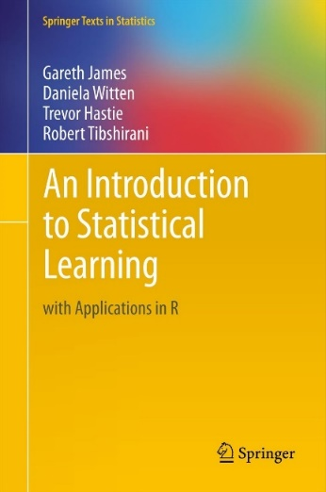
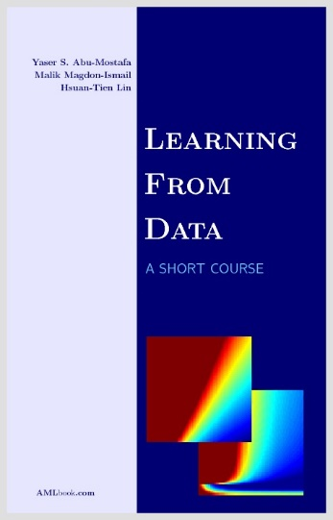
Bibliography
An Introduction to Statistical Learning: with Applications in R
  Gareth James, Daniela Witten, Trevor Hastie, and Robert Tibshirani
  Springer, 2013
  PDF available online (http://www-bcf.usc.edu/~gareth/ISL/)
Learning From Data
  Yaser S. Abu-Mostafa, Malik Magdon-Ismail, and Hsuan-Tien Lin
  AMLBook, 2012

Slide 4
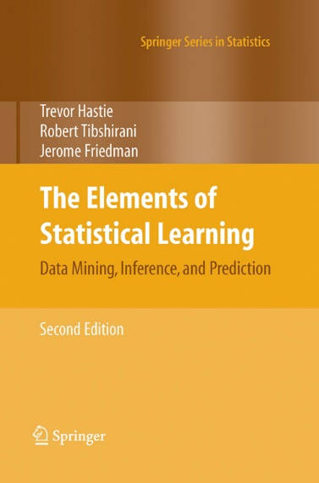
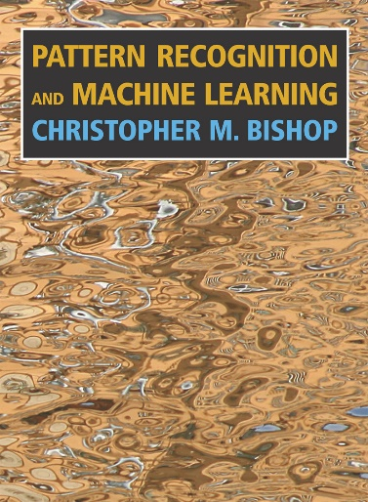
Advanced reading
The Elements of Statistical Learning: Data Mining, Inference, and Prediction
  Trevor Hastie, Robert Tibshirani, and Jerome Friedman
  Springer, 2009
  Available online
  (http://statweb.stanford.edu/~tibs/ElemStatLearn/download.html)
Pattern Recognition and Machine Learning
  Christopher M. Bishop
  Springer, 2007

Slide 5
Motivation
A person arrives at the emergency room with a set of symptoms that could possibly be attributed to one of two medical conditions
  Myocardial infarction vs heartburn
  Bacterial vs viral infection
  Overdose from one of two possible drugs
The person undergoes multiple tests
  E.g., blood pressure, temperature, physical examination, X-ray, urine test, biopsy
We also have clinical and demographic information:
  E.g., medical background, sex, age, occupation, address, family history
How to diagnose?

Slide 6
Motivation
Current method of diagnosis could be:
  Call an expert physician to interpret the results
  Perform a decisive but expensive or lengthy additional test
  Look in papers and books to understand the underlying biology
But we would like to save time, money, and personnel and improve accuracy
We have data: information on thousands of previous patients
  We have their test results + clinical and demographic information
  We also saved their previous ground truth diagnosis
Can we use the data to diagnose a new incoming patient?

Slide 7


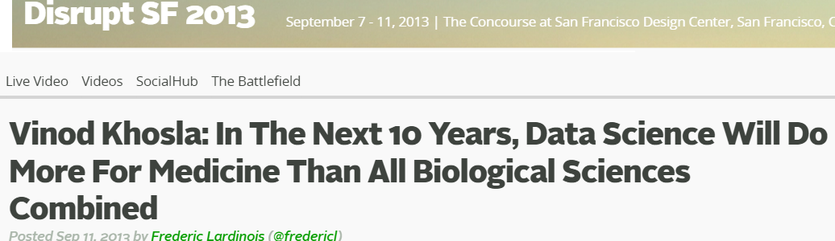
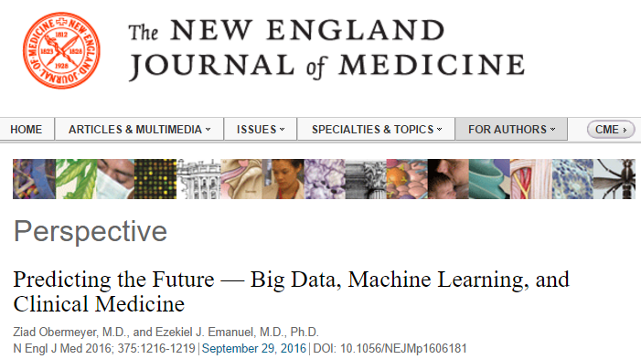
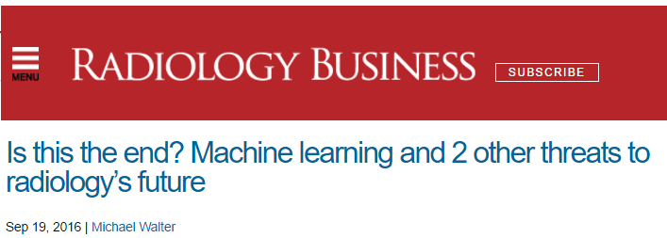
A revolution in medicine

Slide 8
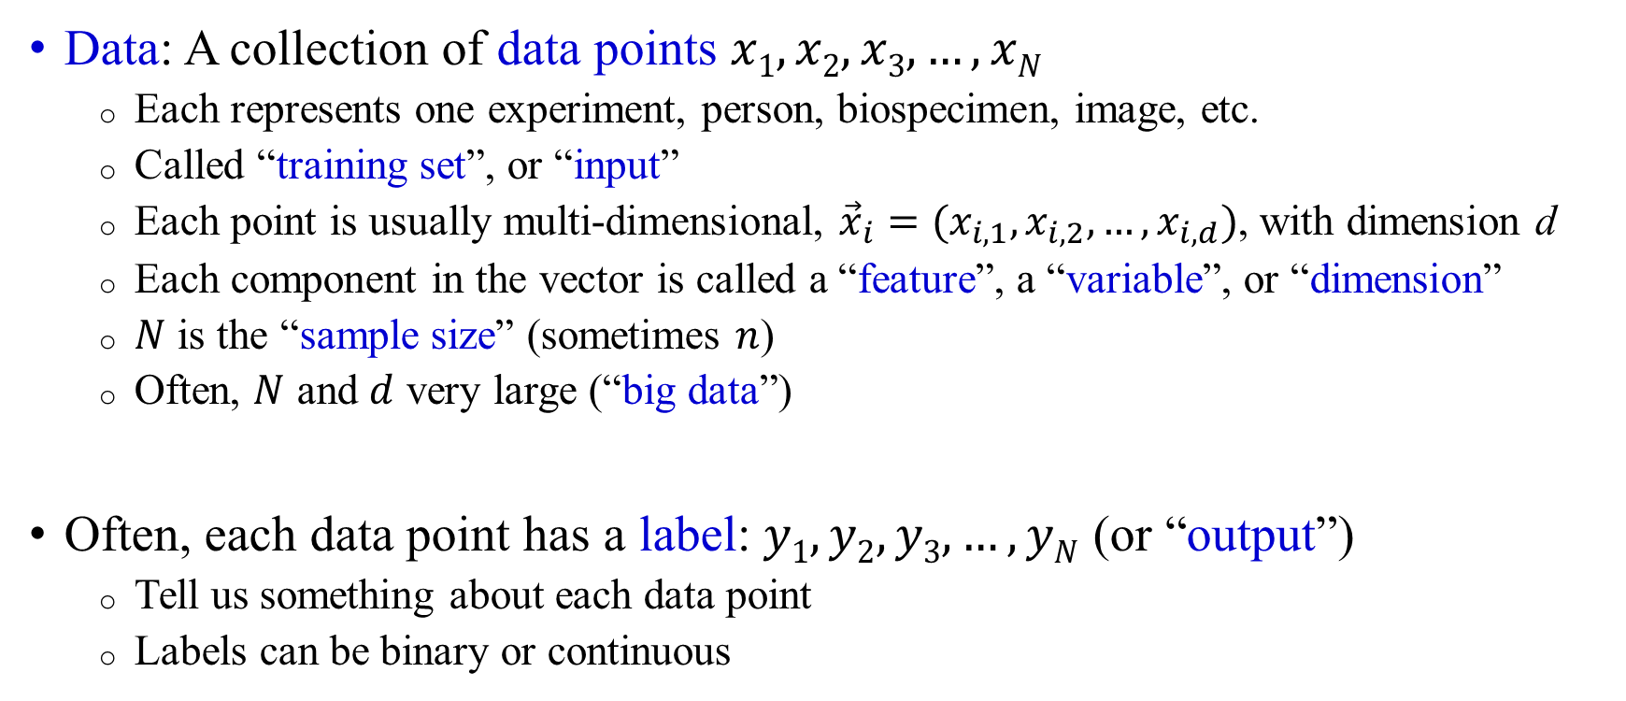
Basic definitions
Data: A collection of data points $x1, x2, x3,…,xN$
  Each represents one experiment, person, biospecimen, image, etc.
  Called “training set”, or “input”
  Each point is usually multi-dimensional, ${\vec{x}}_{i}=(x_{i,1},x_{i,2},…,x_{i,d})$, with dimension d
  Each component in the vector is called a “feature”, a “variable”, or “dimension”
  $N$ is the “sample size” (sometimes $n$)
  Often, $N$ and $d$ very large (“big data”)
Often, each data point has a label: $y1, y2, y3,…,yN$ (or “output”)
  Tell us something about each data point
  Labels can be binary or continuous

Slide 9
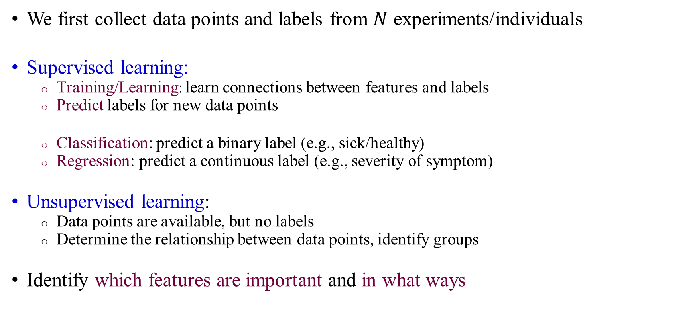
What does machine learning do?
We first collect data points and labels from $N$ experiments/individuals
Supervised learning:
  Training/Learning: learn connections between features and labels
  Predict labels for new data points
  Classification: predict a binary label (e.g., sick/healthy)
  Regression: predict a continuous label (e.g., severity of symptom)
Unsupervised learning:
  Data points are available, but no labels
  Determine the relationship between data points, identify groups
Identify which features are important and in what ways

Slide 10
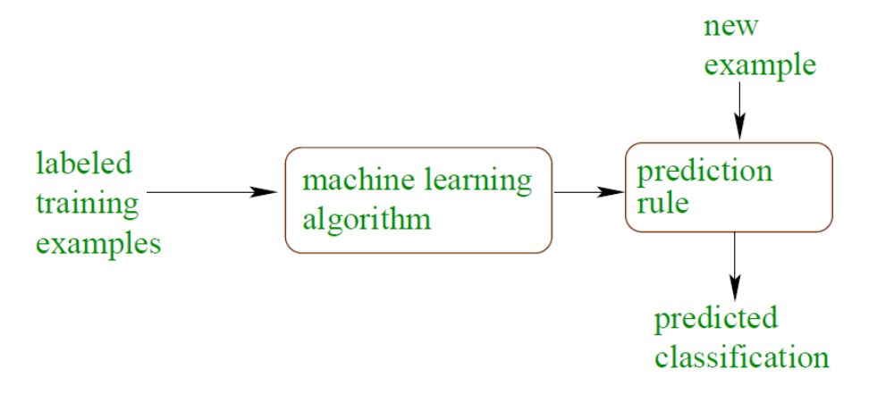
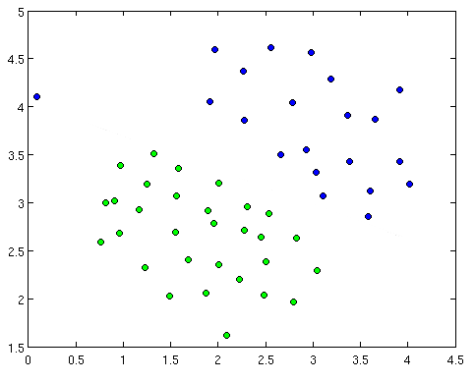
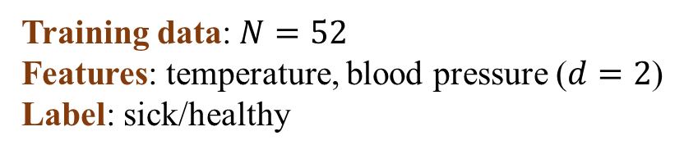
Supervised learning: Classification
Training data: $N=52$
Features: temperature, blood pressure ($d=2$)
Label: sick/healthy
learning
Sick
?
Healthy
?
?
Temperature
A machine learning classifier divides the
space into the different classes
We can then assign a label to each new point
The classifier we learned is called our “model”
Class separation line
?
?
Blood pressure

Slide 11
Classification examples
What are the features of each data point?
What is the dimension?
What is the typical sample size?
Data points:
  Blood counts
  Genome sequence
  Monitor recordings
  MRI photos
  Heart rate and blood pressure recordings
  Electronic medical records, lifestyle or demographic parameters
Labels:
  Typically, risk to develop a disease over a given period (“clinical outcome”)
  Precise (=expert) diagnosis (e.g., radiologists, pathologists)
  Success of treatment/complications
  Side effects of drugs or procedures
  Health-related behavior

Slide 12
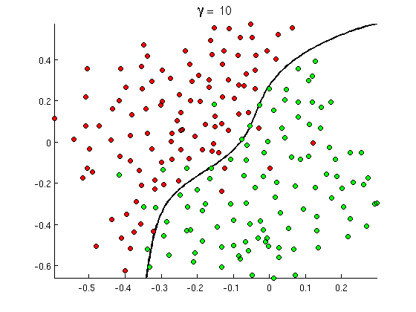
Complex models
learning
More “complex” (“flexible”) models than a straight line are often needed
Complex models can improve accuracy, but …
  Are more difficult to interpret
  May end up leading to lower accuracy

Slide 13
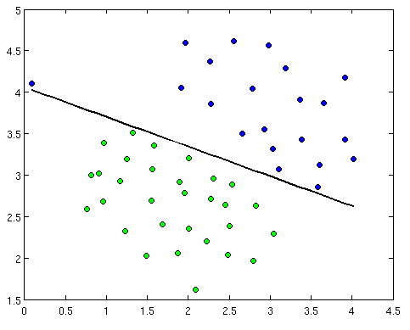
Learning a classifier
learning
What does learning mean?
  We select the method (or algorithm, or type) of classifier (e.g., divide the space using a straight line)
  Find the parameters of the classifier (e.g., slope and intercept for a line) that classify the training set with the highest accuracy

Slide 14
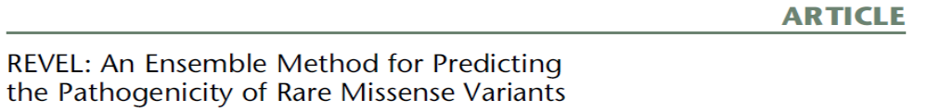
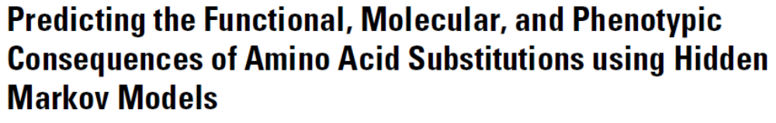
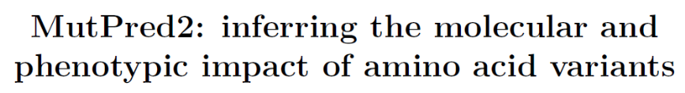
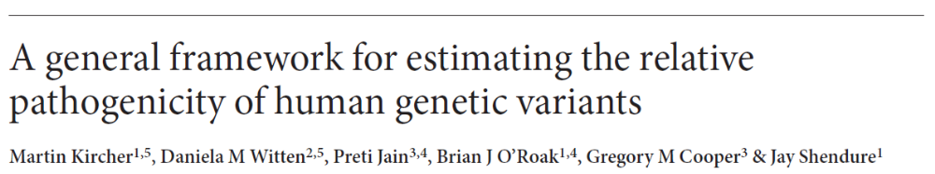
How to determine whether a mutation is pathogenic?
Many mutations are discovered in the genomes of patients
Which of them is pathogenic? Which is benign?
Each mutation is characterized by many features:
  Substitution or deletion, intergenic or genic, distance to coding sequence or splice site, impact on protein, gene expression in each tissue, epigenetics (methylation, chromatic modification, transcription factor binding, etc.), evolutionary conservation, polymorphism in the population
For a small training set, mutations were heavily investigated and labeled as pathogenic/benign
A classification algorithm learns the connections between features and pathogenicity
We can now predict which of the new mutations is pathogenic

Slide 15
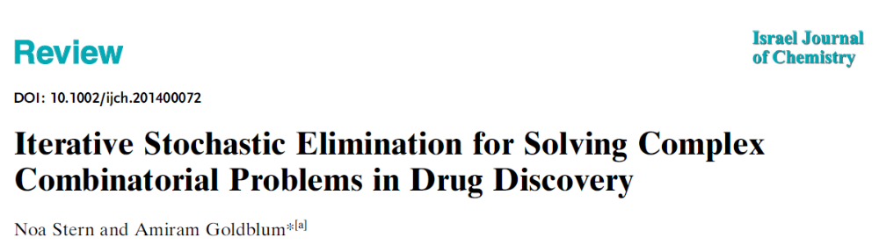
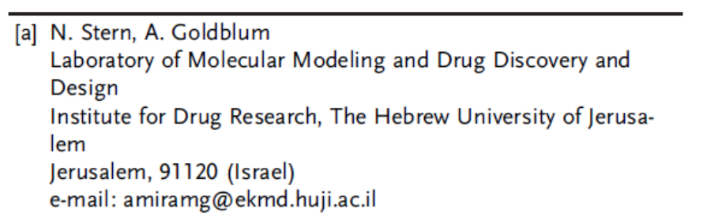
Drug discovery
Which one of millions of small molecules binds
to a target (e.g., a protein)?
Each molecule in the database is encoded by a large
number of chemical and physical properties (features)
For a small training set, actual (expensive) experiments were performed to label them as binders/non-binders
A classification algorithm learns the connections between features and binding ability
We can now predict which of the other molecules in the database can bind
Other papers have attempted to predict side effects, etc.
Can we distinguish sweet and bitter molecules?
https://www.biorxiv.org/content/early/2018/09/27/426692

Slide 16
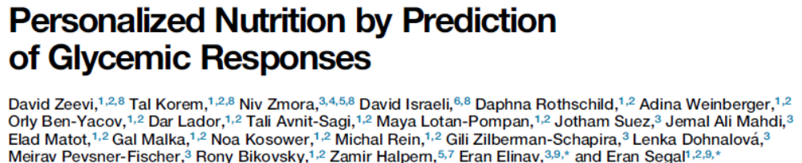
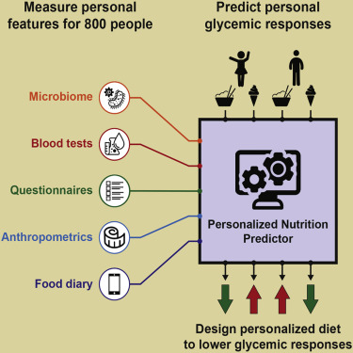
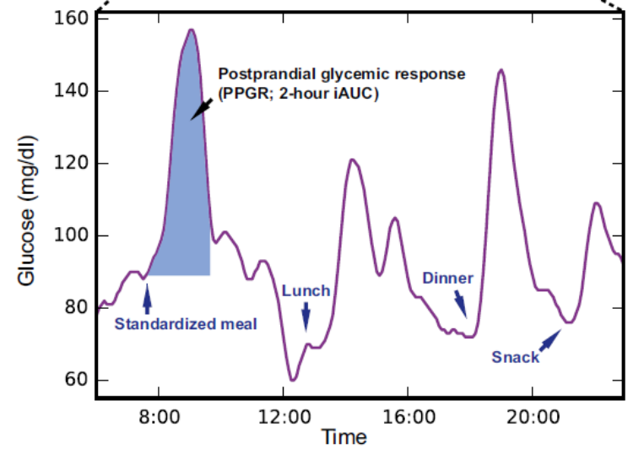
Predicting the glycemic response
The “damage” of a meal is approximated by the total rise in glucose levels
How to personalize food recommendations that will minimize the glycemic response?
Each individual is characterized by several features
For a small training set, the glycemic response (output) was measured
A regression algorithm was applied to learn the connections between the features and the response, and predict the response for new meals

Slide 17
Introduction to machine learning
Basic concepts
  Definitions and examples
  Regression
  Overfitting
  Bias-variance tradeoff
  Classifiers
  Cross validation
  Discussion

Slide 18
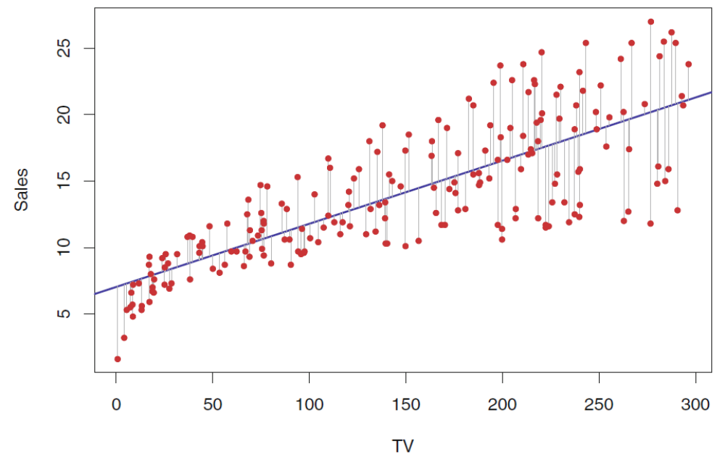
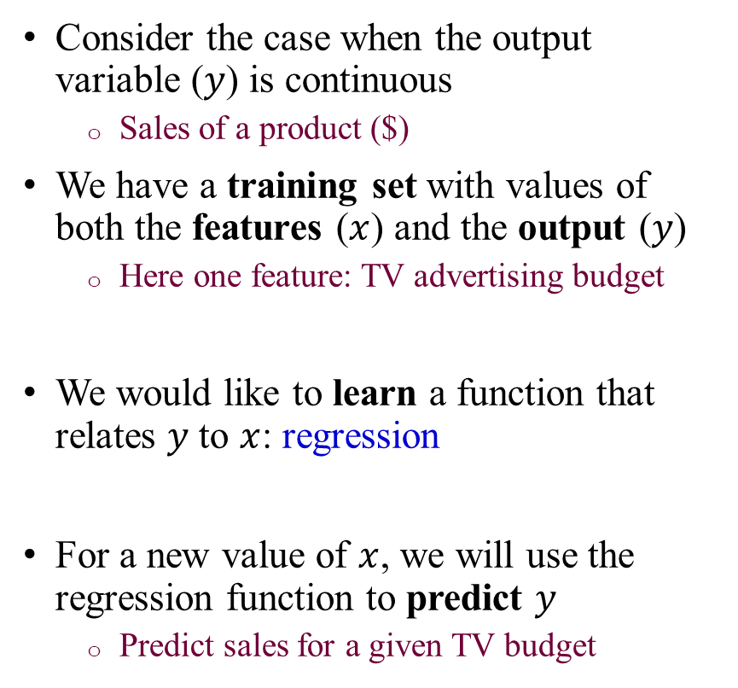
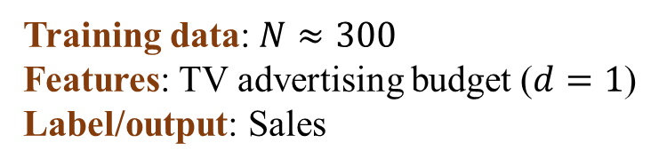
Supervised learning: regression
Training data: $N≈300$
Features: TV advertising budget ($d=1$)
Label/output: Sales
Consider the case when the output variable ($y$) is continuous
  Sales of a product ($)
We have a training set with values of both the features ($x$) and the output ($y$)
  Here one feature: TV advertising budget
We would like to learn a function that relates $y$ to $x$: regression
For a new value of $x$, we will use the regression function to predict $y$
  Predict sales for a given TV budget
Sales?

Slide 19
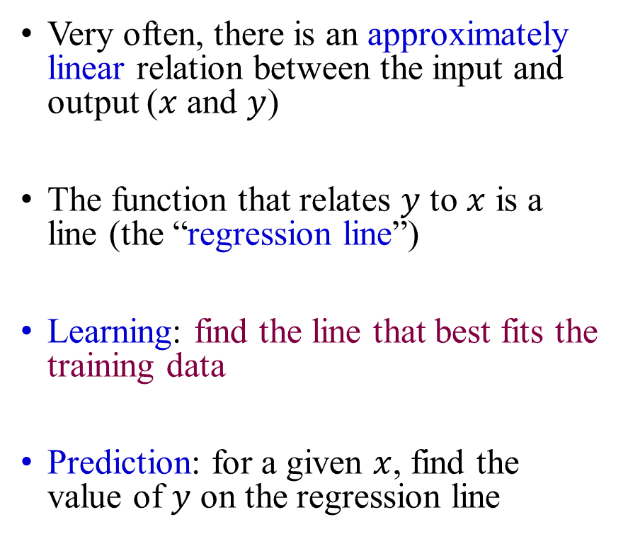
Simple linear regression
Training data: $N≈300$
Features: TV advertising budget ($d=1$)
Label/output: Sales
Very often, there is an approximately linear relation between the input and output ($x$ and $y$)
The function that relates $y$ to $x$ is a line (the “regression line”)
Learning: find the line that best fits the training data
Prediction: for a given $x$, find the value of $y$ on the regression line
Predicted sales
Sales?

Slide 20
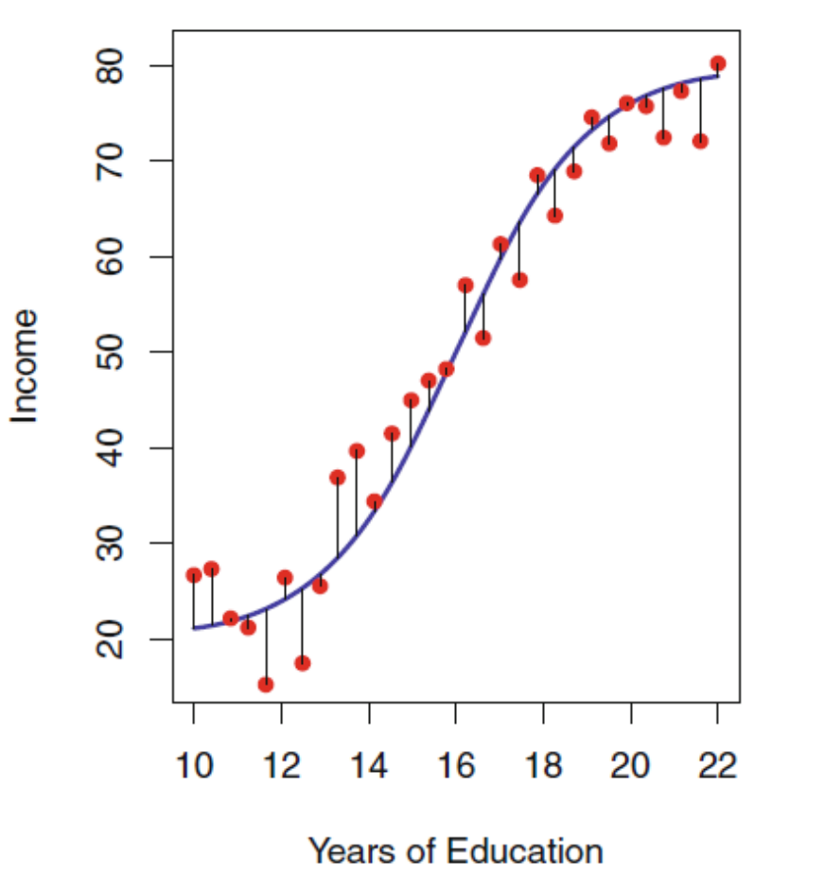
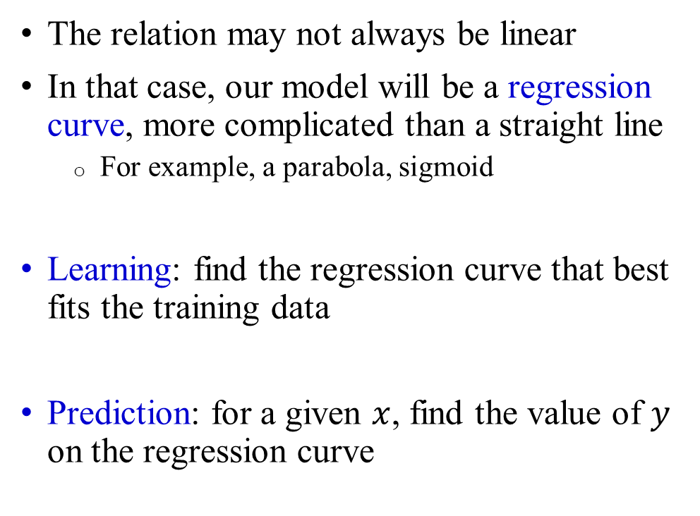
Non-linear regression
The relation may not always be linear
In that case, our model will be a regression curve, more complicated than a straight line
  For example, a parabola, sigmoid
Learning: find the regression curve that best fits the training data
Prediction: for a given $x$, find the value of $y$ on the regression curve
Predicted income
Income?

Slide 21
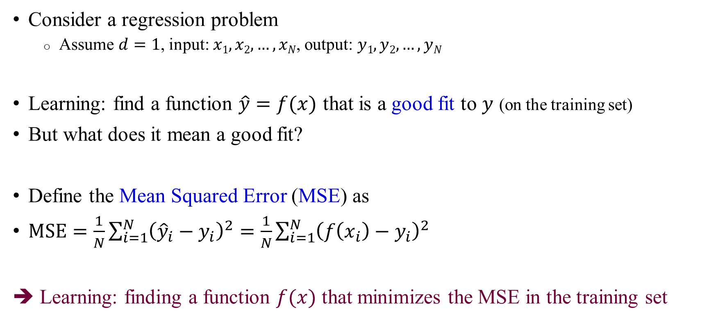
How do we learn?
Consider a regression problem
  Assume $d=1$, input: $x1, x2, …, xN$, output: $y1, y2, …, yN$
Learning: find a function $\hat{y}=f(x)$ that is a good fit to $y$ (on the training set)
But what does it mean a good fit?
Define the Mean Squared Error (MSE) as
$\text{MSE}=\frac{1}{N}\sum_{i=1}^{N}{{\left({\hat{y}}_{i}−y_{i}\right)}^{2}}=\frac{1}{N}\sum_{i=1}^{N}{{\left(f\left(x_{i}\right)−y_{i}\right)}^{2}}$
➔ Learning: finding a function $f(x)$ that minimizes the MSE in the training set

Slide 22



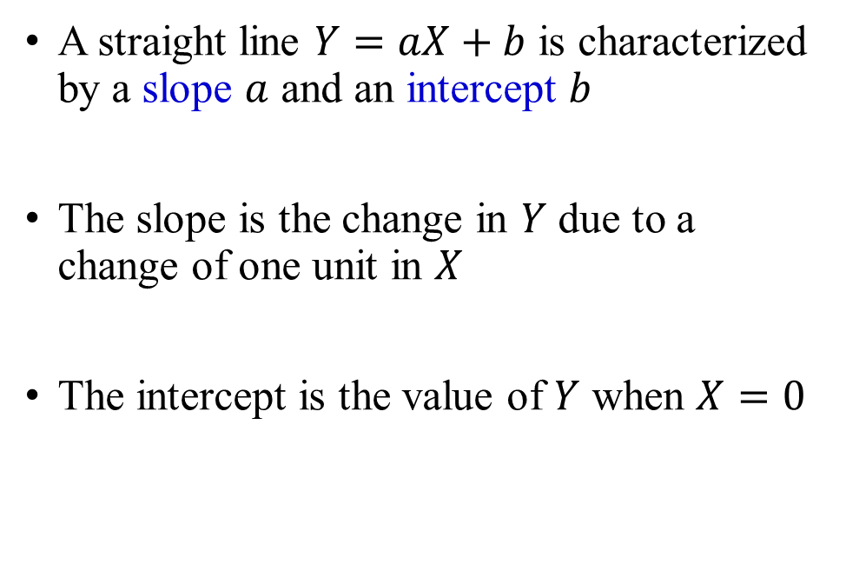




Reminder: straight lines
A straight line $Y=aX+b$ is characterized by a slope $a$ and an intercept $b$
The slope is the change in $Y$ due to a change of one unit in $X$
The intercept is the value of $Y$ when $X=0$
$$Y=aX+b$$
$$a<0$$
$$Y$$
$$a>0$$
$$b$$
$$b$$
$$X$$

Slide 23
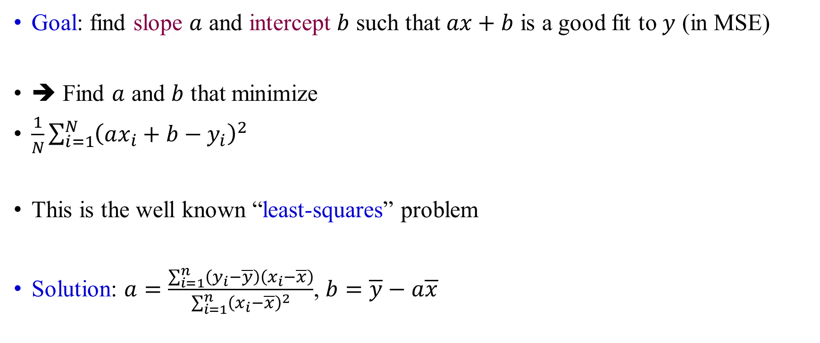
Learning simple linear regression
Goal: find slope $a$ and intercept $b$ such that $ax+b$ is a good fit to $y$ (in MSE)
➔ Find $a$ and $b$ that minimize
$\frac{1}{N}\sum_{i=1}^{N}{{\left(ax_{i}+b−y_{i}\right)}^{2}}$
This is the well known “least-squares” problem
Solution: $a=\frac{\sum_{i=1}^{n}{\left(y_{i}−\overline{y}\right)\left(x_{i}−\overline{x}\right)}}{\sum_{i=1}^{n}{{\left(x_{i}−\overline{x}\right)}^{2}}}$, $b=\overline{y}−a\overline{x}$
Errors

Slide 24
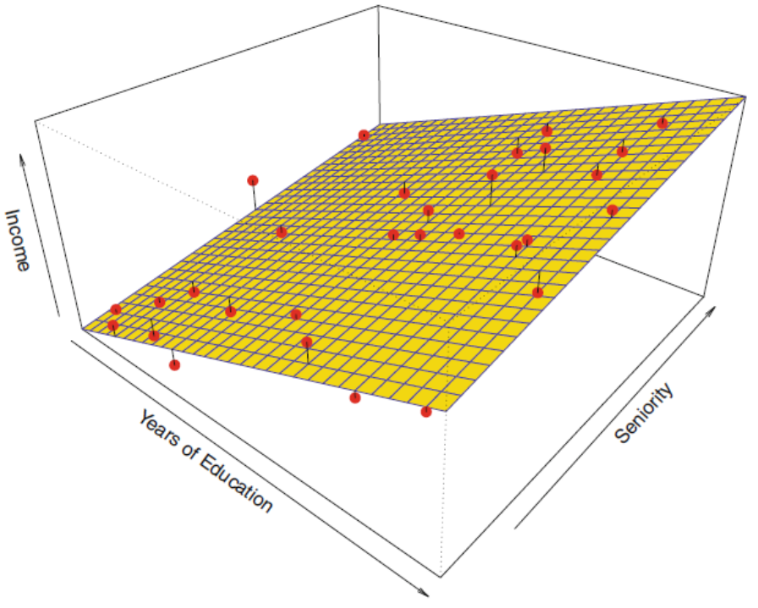
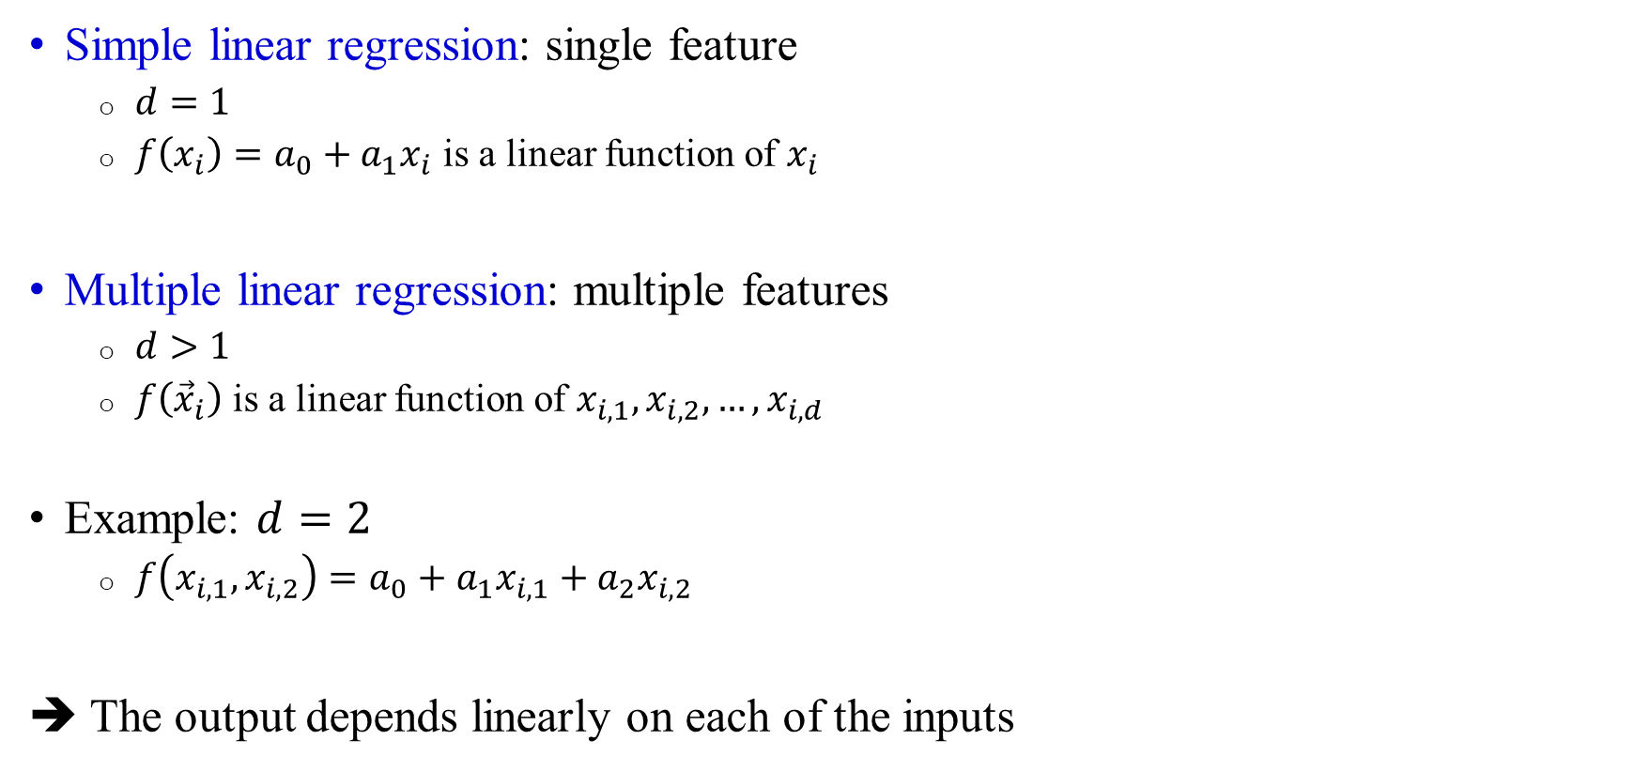

Multiple linear regression
Simple linear regression: single feature
  $d=1$
  $f\left(x_{i}\right)=a_{0}+a_{1}x_{i}$ is a linear function of $x_{i}$
Multiple linear regression: multiple features
  $d>1$
  $f\left({\vec{x}}_{i}\right)$ is a linear function of $x_{i,1},x_{i,2},…,x_{i,d}$
Example: $d=2$
  $f\left(x_{i,1},x_{i,2}\right)=a_{0}+a_{1}x_{i,1}+a_{2}x_{i,2}$
➔ The output depends linearly on each of the inputs
$$d=2$$
Income
Seniority
Years of education

Slide 25
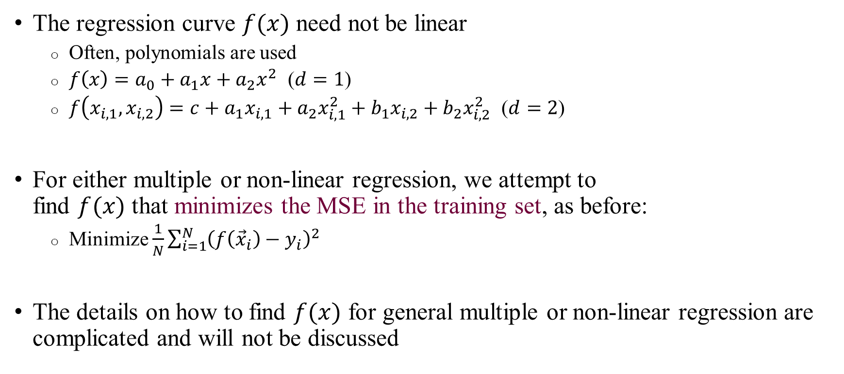
Non-linear regression
The regression curve $f(x)$ need not be linear
  Often, polynomials are used
  $f\left(x\right)=a_{0}+a_{1}x+a_{2}x^{2}$ ($d=1$)
  $f\left(x_{i,1},x_{i,2}\right)=c+a_{1}x_{i,1}+a_{2}x_{i,1}^{2}+b_{1}x_{i,2}+b_{2}x_{i,2}^{2}$ ($d=2$)
For either multiple or non-linear regression, we attempt to
find $f(x)$ that minimizes the MSE in the training set, as before:
  Minimize $\frac{1}{N}\sum_{i=1}^{N}{{\left(f\left({\vec{x}}_{i}\right)−y_{i}\right)}^{2}}$
The details on how to find $f(x)$ for general multiple or non-linear regression are complicated and will not be discussed

Slide 26
Introduction to machine learning
Basic concepts
  Definitions and examples
  Regression
  Overfitting
  Bias-variance tradeoff
  Classifiers
  Cross validation
  Discussion

Slide 27

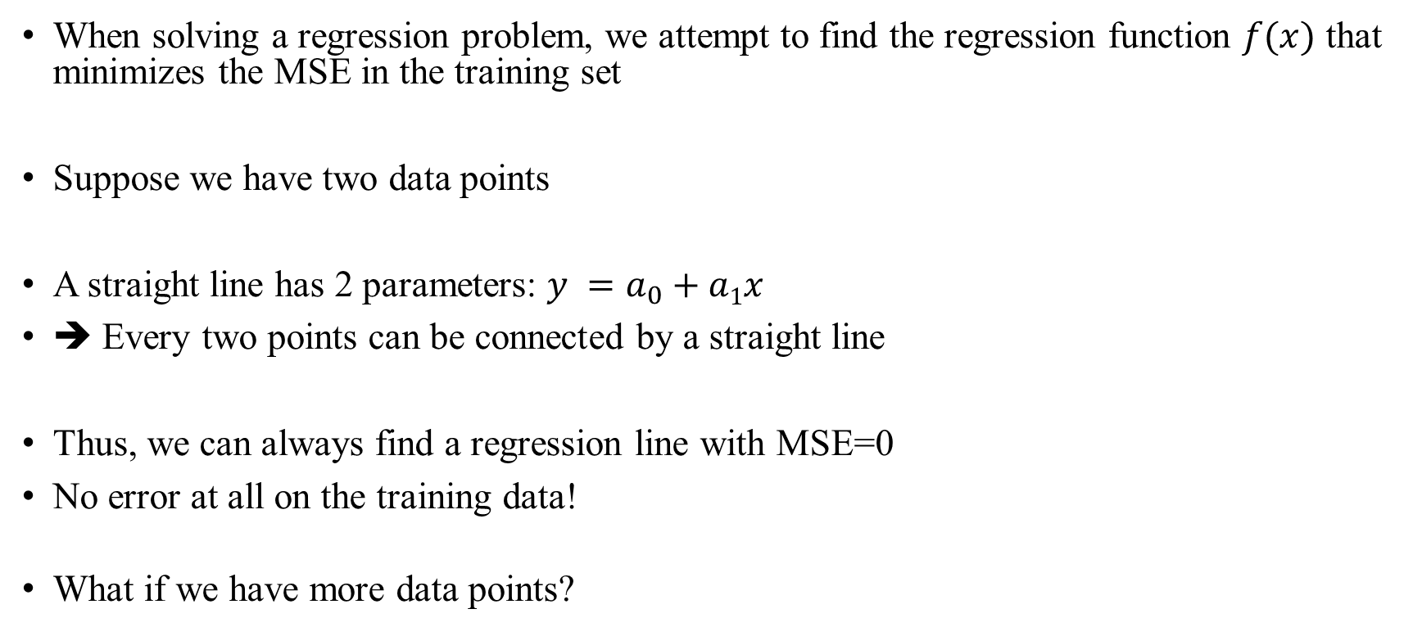

“Cheating”
When solving a regression problem, we attempt to find the regression function $f(x)$ that minimizes the MSE in the training set
Suppose we have two data points
A straight line has 2 parameters: $y =a_{0}+a1x$
➔ Every two points can be connected by a straight line
Thus, we can always find a regression line with MSE=0
No error at all on the training data!
What if we have more data points?
$$Y$$
$$X$$

Slide 28

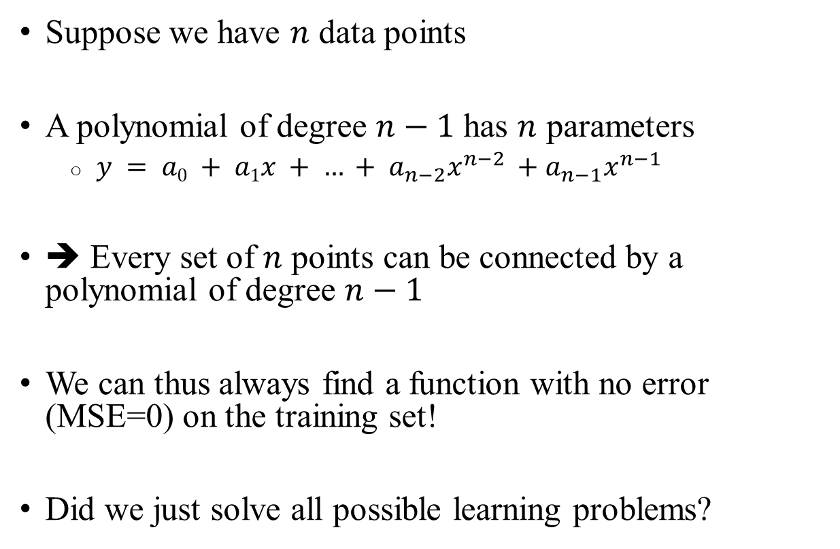


“Cheating”
Suppose we have $n$ data points
A polynomial of degree $n−1$ has $n$ parameters
  $y = a0 + a1x + … + a_{n−2}x^{n−2} +a_{n−1}x^{n−1}$
➔ Every set of $n$ points can be connected by a polynomial of degree $n−1$
We can thus always find a function with no error (MSE=0) on the training set!
Did we just solve all possible learning problems?
$$Y$$
$$n=4$$
$$X$$

Slide 29
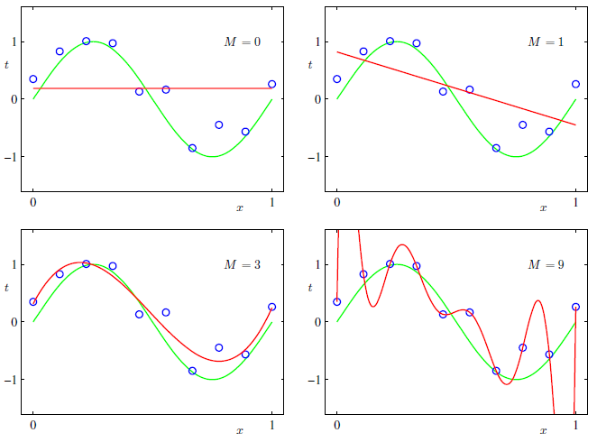
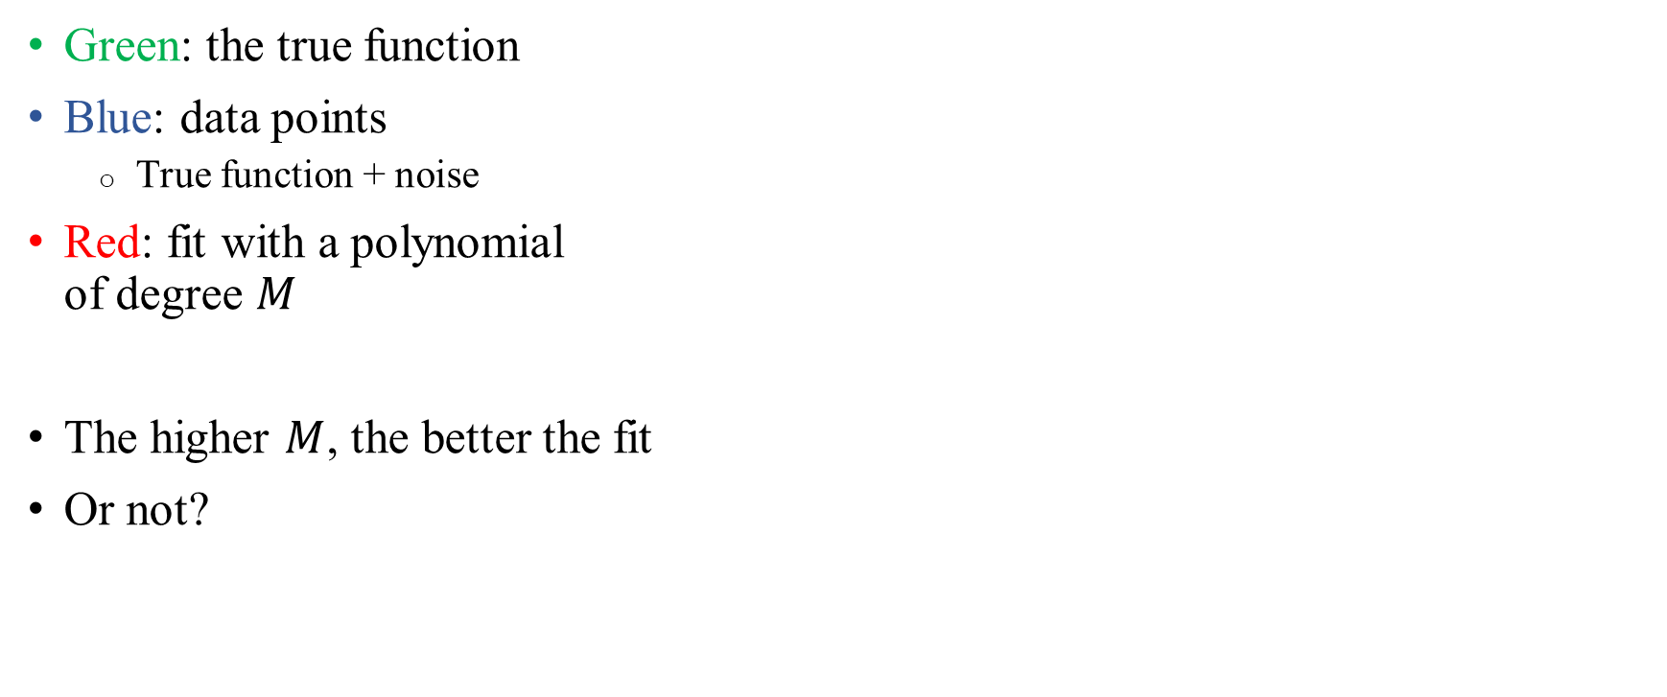
“Cheating”
Green: the true function
Blue: data points
  True function + noise
Red: fit with a polynomial
of degree $M$
The higher $M$, the better the fit
Or not?
Very large MSE
MSE=0!

Slide 30
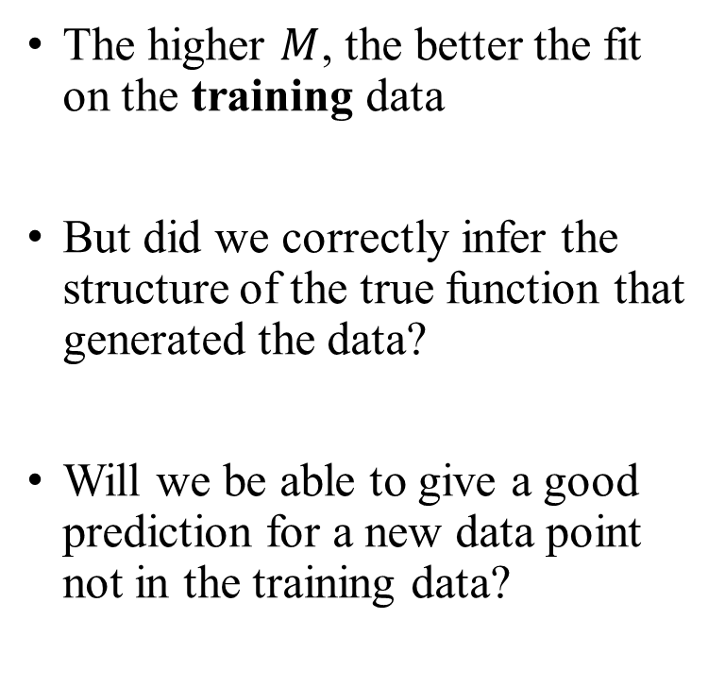
Did we correctly inferred the true function?
The higher $M$, the better the fit on the training data
But did we correctly infer the structure of the true function that generated the data?
Will we be able to give a good prediction for a new data point not in the training data?
Very large MSE
MSE=0!

Slide 31
Overfitting
A machine learning algorithm learns to minimize the error in the training set
But we really care about the error in a test set, an independent set of data points, for which the label is unknown to the learning algorithm
The test set represents the realistic performance
A method that works very well on the training set but poorly on the test set is overfitting

Slide 32
Overfitting
When using models that are too complex, we are effectively fitting the “noise” in the data
Therefore, the resulting models do not generalize well to future data sets
Good fit
Overfitting

Slide 33
Underfitting
Is it better to have very simple models?
Models too simple do not capture the structure of the true function, and do not perform well even on the training data
Called underfitting

Slide 34
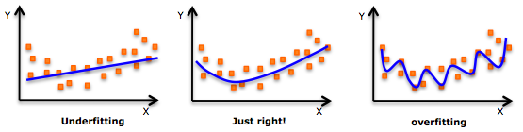
Overfitting and underfitting
Underfitting
Is it better to have very simple models?
Very simple models do not capture the structure of the true function, and perform poorly even on the training data
Called underfitting
Good fit
Overfitting

Slide 35
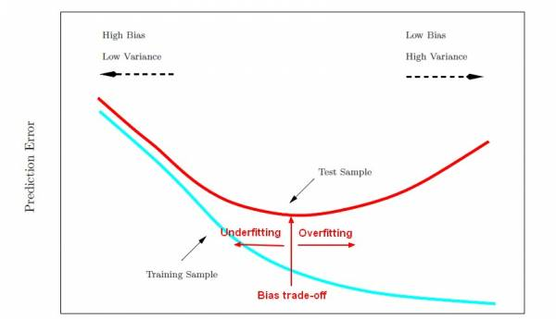
Overfitting
We
Prediction error (e.g., MSE)
Test error
We want to be here
Training error
Good fit
Low
Model complexity/flexibility
High

Slide 36
Introduction to machine learning
Basic concepts
  Definitions and examples
  Regression
  Overfitting
  Bias-variance tradeoff
  Classifiers
  Cross validation
  Discussion

Slide 37
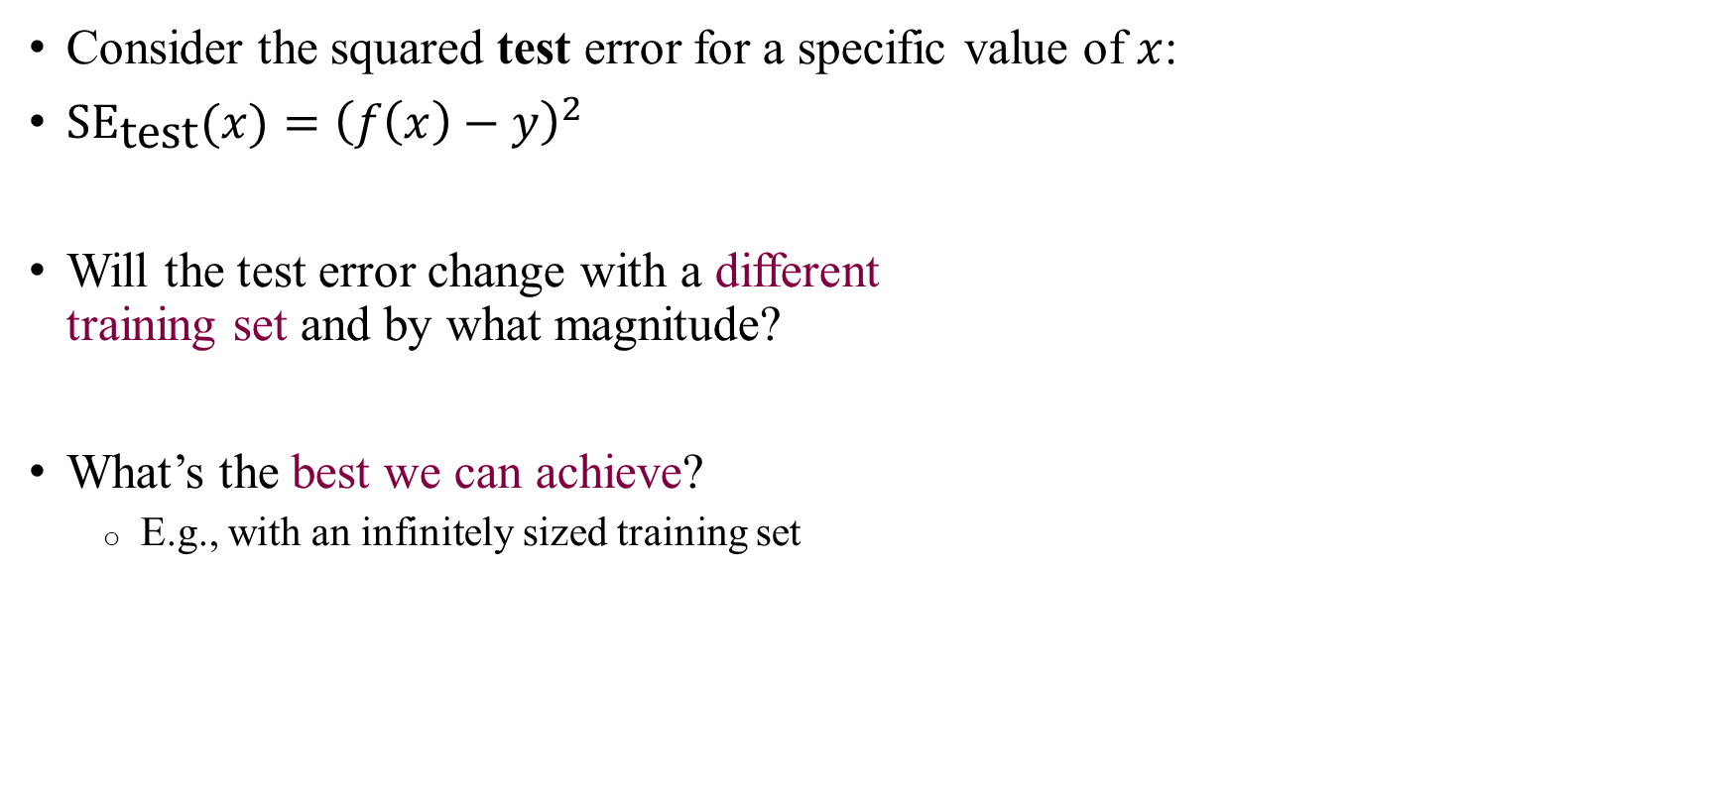


What are the sources of error?
Consider the squared test error for a specific value of $x$:
$\text{S}{\text{E}}_{\text{test}}(x)={\left(f\left(x\right)−y\right)}^{2}$
Will the test error change with a different
training set and by what magnitude?
What’s the best we can achieve?
  E.g., with an infinitely sized training set
$$y$$
$$f(x)$$
test error

Slide 38
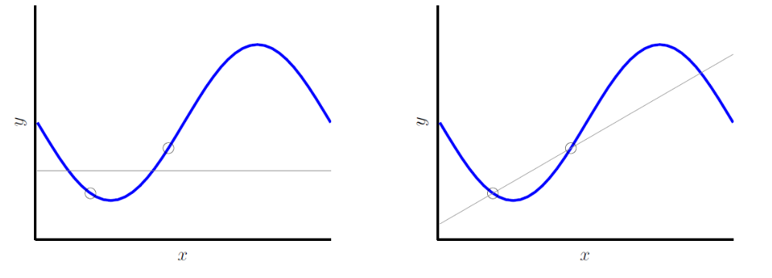


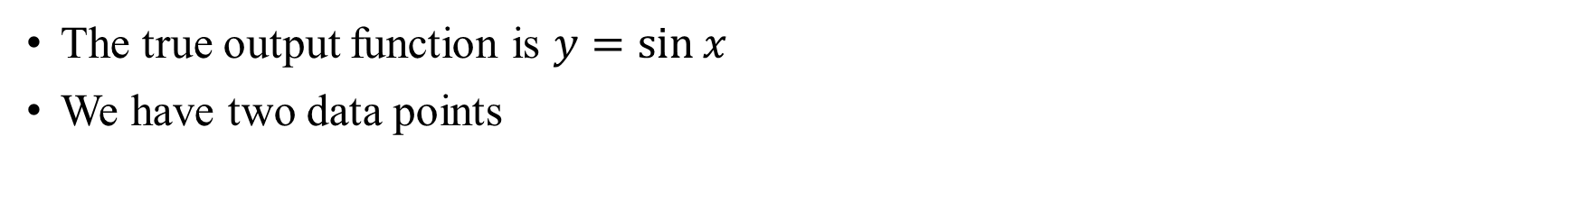




A simple experiment
The true output function is $y=\sin{x}$
We have two data points
Learning the best horizontal line
Learning the best straight line
$$y$$
Test error
$$y$$
$$y$$
$$f(x)$$
$$x$$
$$x$$

Slide 39
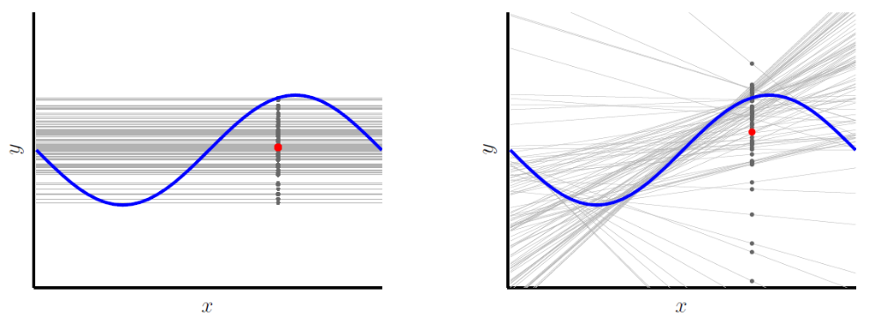

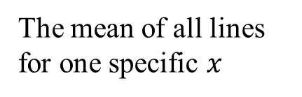





What happens if we use a different training set?
We assume that training sets are drawn randomly
Each different training set will lead to a different regression line
The models differ on their test errors
The mean of all lines for one specific $x$
$$y$$
Test error
$$y$$
$$y$$
$$f(x)$$
$$x$$
$$x$$

Slide 40
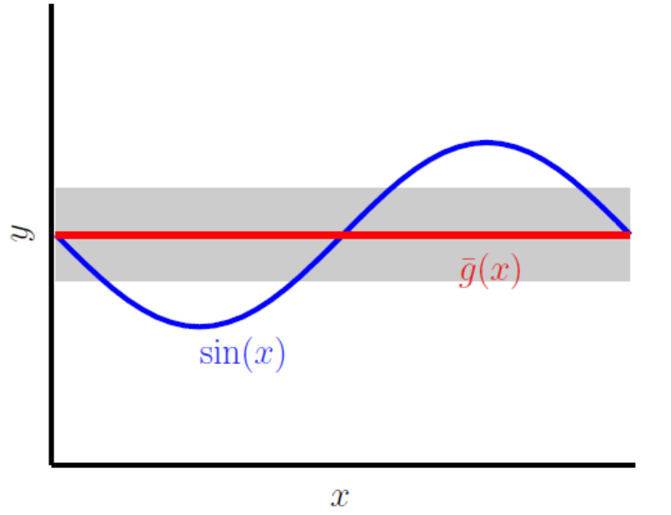
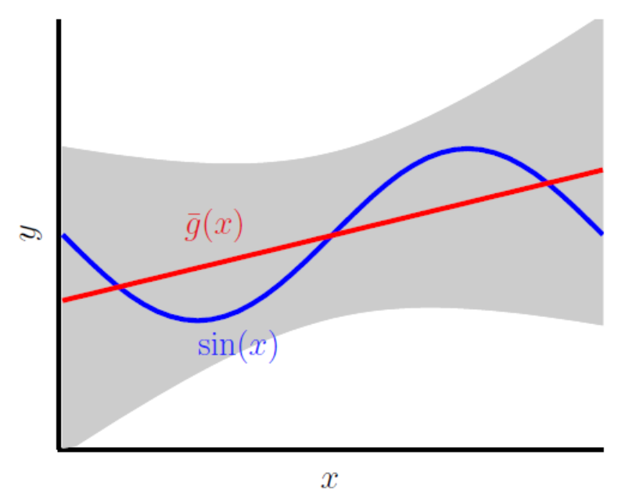



All possible training sets
The models differ on how far they are on average from the truth
They also differ on how much the difference (from the truth) varies across training sets
Grey area:
The variance of the prediction across training sets
Red line:
The mean of all possible training sets
The average prediction is far from the truth
The average prediction is close to the truth
$$y$$
$$y$$
Not much variation across training sets
Highly variable across training sets
$$x$$
$$x$$

Slide 41
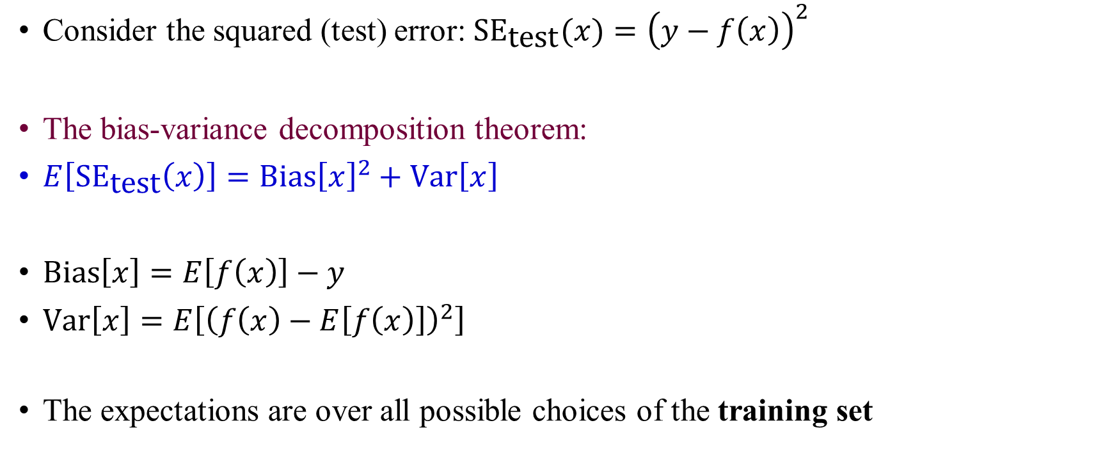
The bias-variance decomposition
Consider the squared (test) error: $\text{S}{\text{E}}_{\text{test}}(x)={\left(y−f\left(x\right)\right)}^{2}$
The bias-variance decomposition theorem:
$E\left[\text{S}{\text{E}}_{\text{test}}\left(x\right)\right]=\text{Bias}{\left[x\right]}^{2}+\text{Var}\left[x\right]$
$\text{Bias}\left[x\right]=E\left[f\left(x\right)\right]−y$
$\text{Var}\left[x\right]=E\left[{\left(f\left(x\right)−E\left[f\left(x\right)\right]\right)}^{2}\right]$
The expectations are over all possible choices of the training set

Slide 42
Bias and variance in linear regression
Bias: distance from the average of the prediction over all training sets
Variance: the extent to which the prediction varies across training sets

Slide 43

Bias and variance
Large bias, small variance
Small bias, large variance
Large bias, large variance
Small bias, small variance

Slide 44

The bias-variance decomposition: explanation
$E\left[\text{S}{\text{E}}_{\text{test}}\left(x\right)\right]=\text{Bias}{\left[x\right]}^{2}+\text{Var}\left[x\right]$
The bias is due to simplifying assumptions of our model
  For example, using a straight line to approximate a parabola
  The bias is squared in the formula of the MSE, so its contribution is always positive
The variance is how much $f(x)$ will vary across different training sets
  The more the model depends on the specific details of the data, the higher the variance
  We thus expect more complex models to have higher variance

Slide 45
The bias-variance tradeoff
Simple models: high bias,
low variance
Complex models: low bias,
high variance
High bias
Low variance
Low bias
High variance

Slide 46
The bias-variance tradeoff
Bias: distance from the average of the prediction over all training sets
Variance: the extent to which the prediction varies across training sets
Simple model
High bias
Low variance
Complex model
Low bias
High variance

Slide 47



The bias-variance tradeoff
Both bias and variance contribute to the error
We need to find the complexity that has the minimal sum of bias and variance
$$\text{S}{\text{E}}_{\text{test}}={\text{Bias}}^{2}+\text{Var}$$
Comment: usually, the squared error is averaged over all possible values of $x$ in the test set

Slide 48
The bias-variance tradeoff
High bias
Low variance
Low bias
High variance
Test error
Prediction error
We want to be here
Training error
Good fit
Low
Model complexity/flexibility
High

Slide 49




How to reduce error
Increasing the sample size will always reduce the test error
The training error is lower (better) for small $N$, because we can perfectly fit a small number of data points
Simple model
Complex model
Test error
Error
Error
Training error
Variance
Test error
Bias
Training error
Sample size $N$
Sample size $N$

Slide 50

Increasing the sample size
Adding data reduced the variance of the more complex model
The complex model has a lower bias and thus the total test error is overall lower
Bias = 0.5
Var = 0.25
Test error = 0.75
Bias = 0.21
Var = 1.69
Test error = 1.90
Bias = 0.5
Var = 0.1
Test error = 0.6
Bias = 0.21
Var = 0.21
Test error = 0.42

Slide 51
Introduction to machine learning
Basic concepts
  Definitions and examples
  Regression
  Overfitting
  Bias-variance tradeoff
  Classifiers
  Cross validation
  Discussion

Slide 52

The $K$-nearest neighbors classifier
The simplest possible classifier
For each point in space:
  Find the nearest $K$ data points in the training set
  Determine the class of each of the $K$ points
  Assign the class of the given point as the majority vote across the $K$ neighbors
Requires the user to specify the value of $K$

Slide 53


$K$-nearest neighbors (KNN)
$$K=3$$

Slide 54


Performance
The performance can be quite good in practice
But the choice of $K$ is crucial…
Best theoretically possible classifier
KNN

Slide 55

Underfitting and overfitting
100-NN
Simple model:
Underfitting
Best theoretically possible classifier
1-NN
Complex model:
Overfitting
Low bias
High variance
High bias
Low variance

Slide 56

KNN training and test error
We want to be here
High bias
Low variance
Low bias
High variance
100-NN
1-NN
Model complexity/flexibility

Slide 57
Introduction to machine learning
Basic concepts
  Definitions and examples
  Regression
  Overfitting
  Bias-variance tradeoff
  Classifiers
  Cross validation
  Discussion

Slide 58

How to find the optimum?
Setting $K$ too high leads to underfitting (high bias)
Setting $K$ too low leads to overfitting (high variance)
How to find the optimal $K$?
Solution:
For each $K$ in 1,2,…,100:
  Learn the classifier using the training set
  Calculate the error on the test set
Finally, use the value of $K$ that gave the lowest test error

Slide 59
Problem
Typically, we don’t have separate training and test sets
We usually have just training data

Slide 60

Solution
Divide the training data into two parts:
  Training
  Testing
Use the training set to learn the model for each K
Use the value of $K$ that gave the lowest test set error

Slide 61
Problem
If we split the training data, we reduce the sample size available for training
The accuracy of classification/regression is lower for smaller samples
Simple model
Complex model
Test error
Training error
Test error
Training error

Slide 62


Solution: cross validation
We can use the entire training set for both training and testing!
Divide the training set into 5 parts (”folds”)
For $i=1,2,3,4,5$:
  Use all parts except $i$ as a training set
  (four parts, 80% of the data)
  Learn the model using the training set
  Use part $i$ as a test set (20% of the data)
  Calculate the error using the test set
Average the five error terms for the final test error
Does that remind you of the bootstrap?

Slide 63

Typical workflow
In typical machine learning tasks (regression/classification), there will be a parameter controlling the complexity of the model
  Regression: degree of polynomial
  KNN Classification: the number of nearest neighbors
Call this parameter $K$

Slide 64

Typical workflow
Go over a range of complexity parameters, e.g., $K=1,2,…,20$
For each $K$, run 5-fold cross validation to obtain the test error for that $K$
  Divide the training data into 5 folds
  For each fold:
    Learn the model on the data without fold i
    Compute the test error on fold i
  Average over all 5 folds
  Optional: repeat for different partitions and average the cross validation error over the partitions
Find the value of $K$ that gives the minimal cross validation error
Re-train the model on the entire training set using the optimal $K$
Use the final model to make predictions

Slide 65

Cross validation error vs training error
The cross validation error is a good approximation to the true test error
Optimum
Overfitting
Underfitting

Slide 66

Variants
$K$-fold cross validation (CV): divide the training data into $K$ parts
  Typical choices of $K$: 5,10
Leave-one-out cross validation
For $i=1,2,…,N$:
  The training set is all data points except $i$ ($N−1$ points)
  The test set is point $i$ (a single point)
Average the $N$ estimates of the test error

Slide 67

Example: leave-one-out CV

Slide 68
Advantages of cross-validation
Largely removes the risk of overfitting
  Assuming that the training data points are independent and representative
Does not eliminate parts of the training set
The test error estimate is stable
Applies very generally
Easy to compute
Fast (for 5-fold or 10-fold validation)
Allows comparison between methods
Standard practice in machine learning

Slide 69
Model choice
It is usually a good practice to use simpler models, unless the more complex models provide a substantial increase in accuracy (in CV)
“Occam’s razor”
If not using cross validation, use prior knowledge to limit the model complexity

Slide 70
Introduction to machine learning
Basic concepts
  Definitions and examples
  Regression
  Overfitting
  Bias-variance tradeoff
  Classifiers
  Cross validation
  Discussion

Slide 71
Alternatives to machine learning
We started with an example
  A patient enters the ER, we have information from clinical and lab tests
  How to use data from previous patients to diagnose the new patient?
Tailored estimation methods, based on problem-specific probabilistic models
  Maximum likelihood estimation
  Bayesian models
“Expert systems”, which encode a set of pre-determined rules to be applied
  Essentially standard medical practice
  Used sometimes for games (e.g., chess)

Slide 72
The machine learning approach
Learning from the data, not from rules
  Rules may be unknown or inaccurate!
A set of standardized tools that can be applied to any problem in any domain
Easily applicable implementations available for numerous methods
Users only need to define features and collect a training set
Informative on the important features
Very powerful in practice
Methods are often “black-box”, no intuitive interpretation
Domain-specific knowledge can often help
Cannot fix poor-quality data

Slide 73
Why review different methods?
Many methods exist for learning
There is no single method that’s “best”
Important to understand how methods work and what are their advantages and disadvantages in different settings

Slide 74

The curse of dimensionality
With more features (=data in higher dimension), we have more information on each data point, and hence should be able to better classify it
But in practice, only up to a point
Too many features can be “confusing”,
leading to overfitting and worse
performance

Slide 75

Why?
The higher the dimension, the more spread apart the data points are in space
All distances become very large
The concept of “nearest neighbors” becomes meaningless
What to do?
  Do not add features that are probably not informative or redundant
  Reduce the dimension of the data (PCA)
  Use simpler models (as they require less parameters as the dimension grows)

