Slide 1
Personal Genomics
Genotyping
Shai Carmi
School of Public Health

Slide 2
How to read genomes?
Traditional method: Sanger sequencing
Next generation sequencing
Microarrays

Slide 3
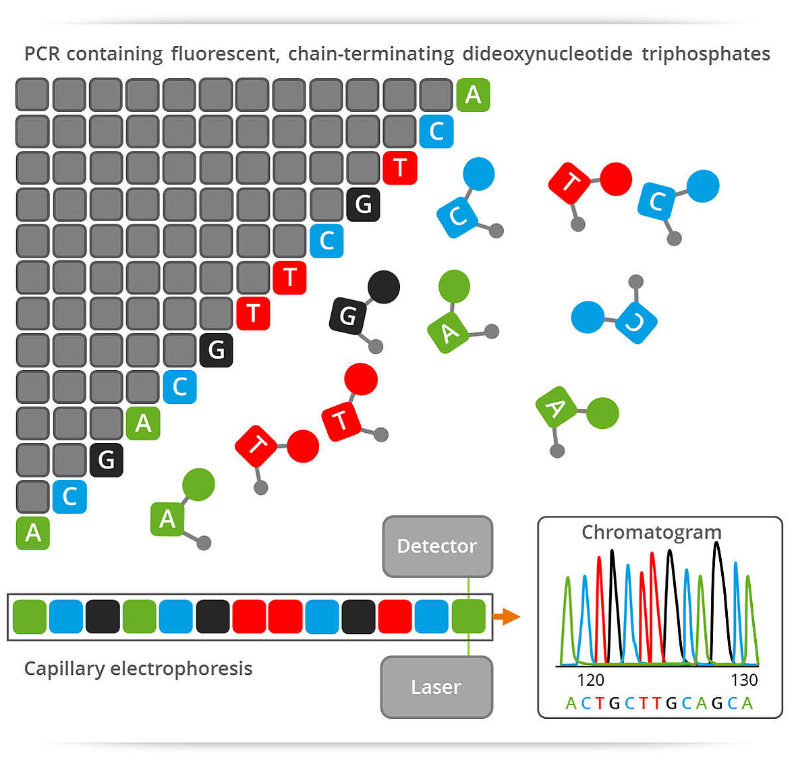
Sanger sequencing
Frederick Sanger: two Nobel prizes!
  Protein sequencing, DNA sequencing
Key point: use fluorescently labeled dideoxynucleotides, which are chain terminating
Read sequence based on fluorescence
Considered the gold standard!
Costs ≈$0.01 per base pair
Still useful for specific genes, small number of individuals

Slide 4
How to Sanger sequence entire genomes?
Sanger sequencing can only be applied to short fragments
How to sequence entire genomes?
  Even bacterial or yeast, etc.
Idea: shotgun sequencing
Fragment (randomly) multiple copies of the genome into short segments (tens/hundreds of bp)
Sequence each fragment
Assemble the sequences into the entire genome

Slide 5
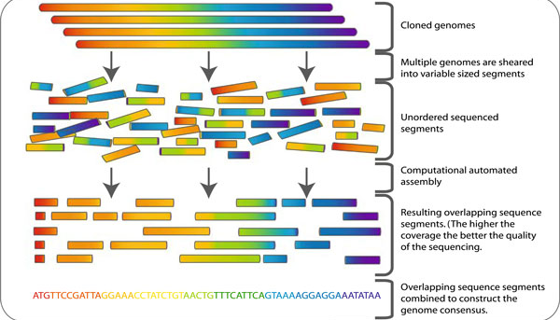
Shotgun sequencing

Slide 6
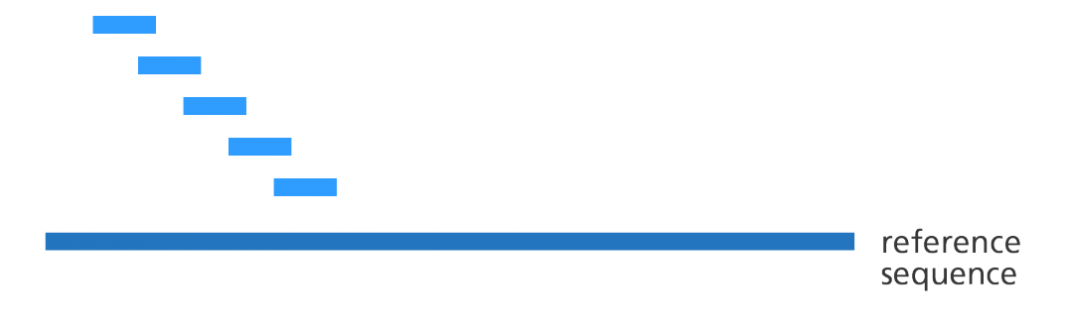
Sequence assembly
De-novo assembly: using short reads to create a full-length chromosome
Mapping: using a known reference sequence
  The genome sequenced is similar (but not identical) to the reference
  Requires alignment of the reads to the reference genome
  Much easier, but requires an additional step of variant calling

Slide 7
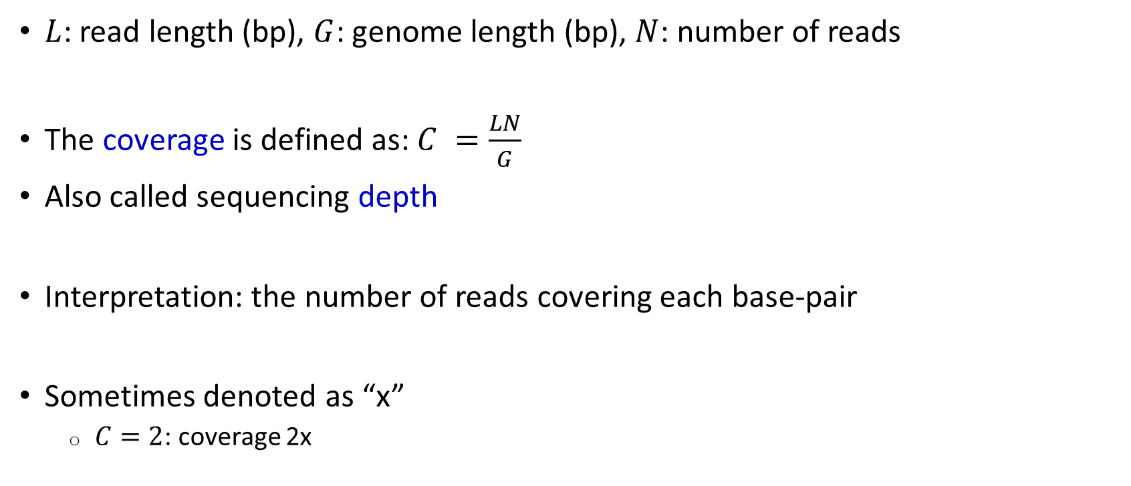
Coverage
$L$: read length (bp), $G$: genome length (bp), $N$: number of reads
The coverage is defined as: $C =\frac{LN}{G}$
Also called sequencing depth
Interpretation: the number of reads covering each base-pair
Sometimes denoted as “x”
  $C=2$: coverage 2x

Slide 8
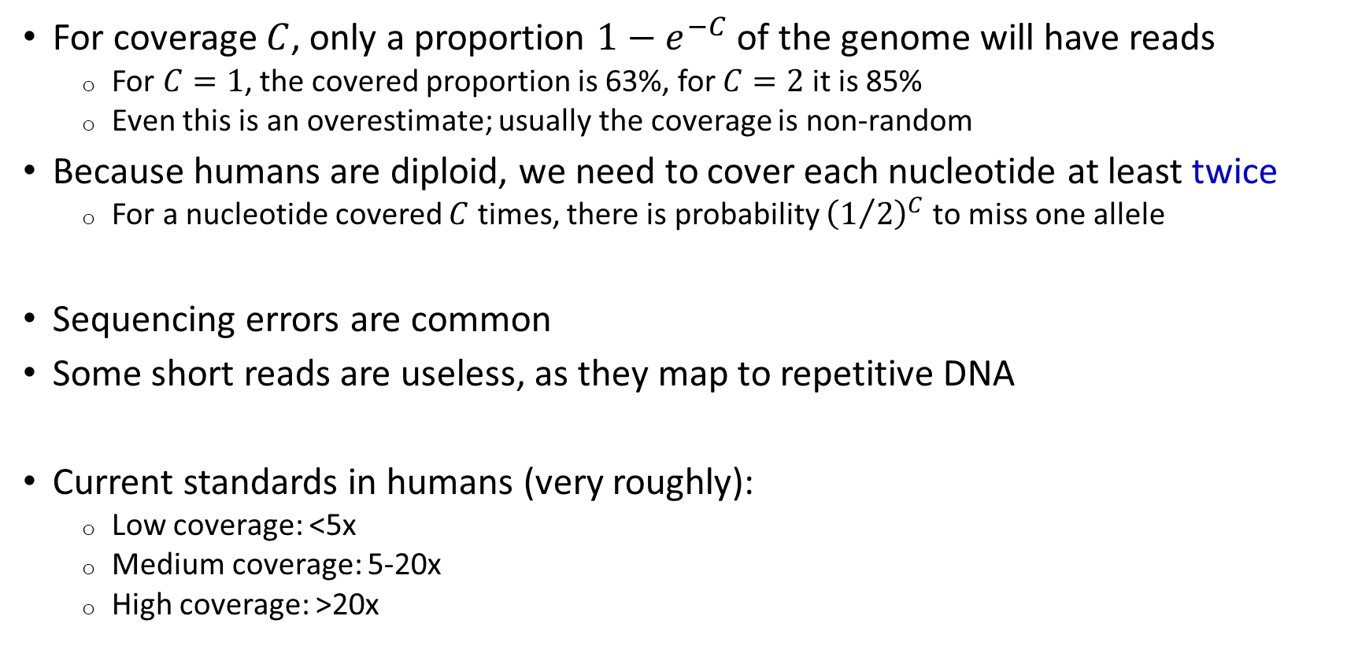
Why do we need high coverage?
For coverage $C$, only a proportion $1−e^{−C}$ of the genome will have reads
  For $C=1$, the covered proportion is 63%, for $C=2$ it is 85%
  Even this is an overestimate; usually the coverage is non-random
Because humans are diploid, we need to cover each nucleotide at least twice
  For a nucleotide covered $C$ times, there is probability ${\left(1/2\right)}^{C}$ to miss one allele
Sequencing errors are common
Some short reads are useless, as they map to repetitive DNA
Current standards in humans (very roughly):
  Low coverage: <5x
  Medium coverage: 5-20x
  High coverage: >20x

Slide 9
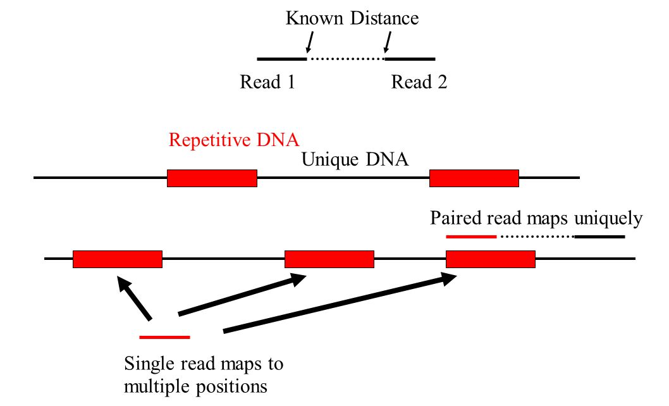
Paired-end sequencing
A major problem with shotgun sequencing is that the genome is highly repetitive
So it is difficult to assign a read to the correct place
Solution: paired-end reads
Sanger sequencing is still expensive
for an entire genome
  Millions of dollars, even today
  Can take months

Slide 10
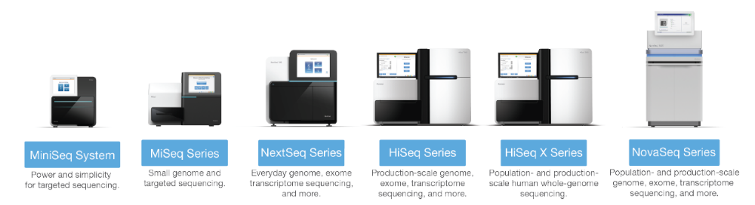
Illumina technology
Key point: parallelization
Up to billions of sequencing reactions happening in parallel on a surface
A human genome (30x) can be sequenced in ≈1 day and ≈$1000
  First human genome took ≈15 years and ≈$3,000,000,000
Read length is ≈50-150bp, usually with paired ends
Reads can also be “barcoded” according to origin and jointly sequenced

Slide 11
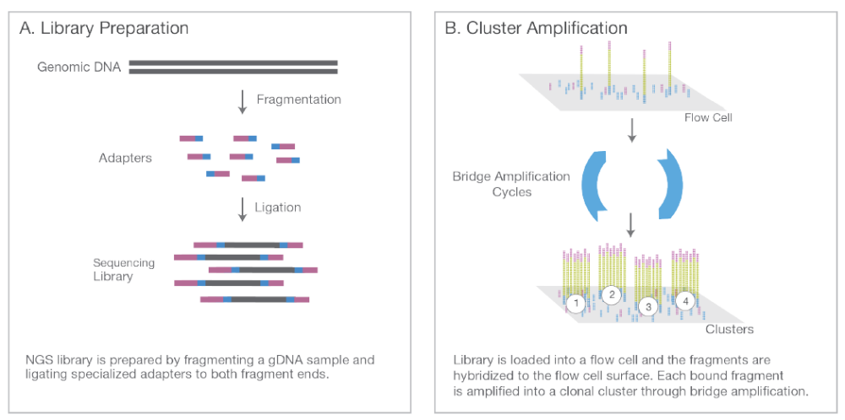
Illumina technology summary

Slide 12
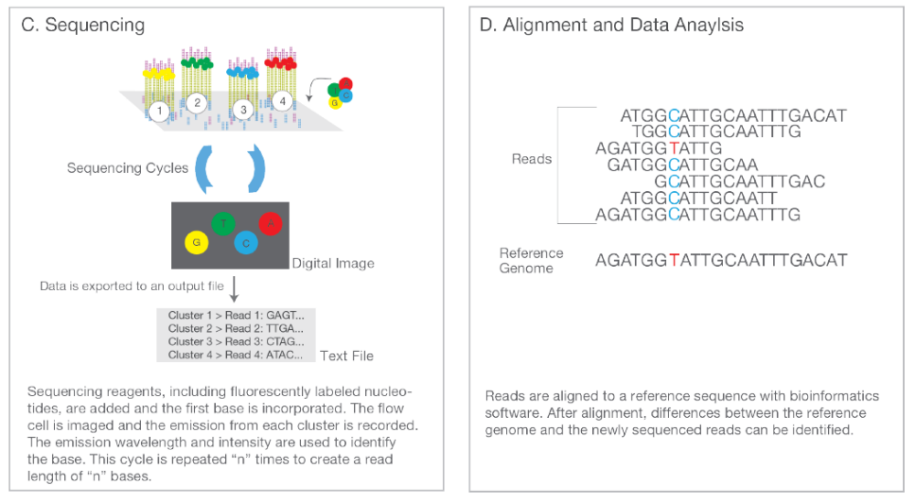
Illumina technology summary

Slide 13
Exome sequencing
For many applications, we care mostly about coding regions (exons)
Instead of sequencing the entire genome, we can sequence just ≈1-2% of it
  ≈30-60Mbp
  Due to the smaller target, the coverage is typically higher (≈100x or more)
  Current cost around ≈$400
Very useful for severe disorders, where the disease is likely monogenic and the causal mutation is likely coding
Currently very popular, but may go out of fashion due to the decrease in price of whole-genome sequencing (WGS)
It was shown that WGS is often more accurate even for coding regions
  In particular for copy-number variants

Slide 14
Sequencing bioinformatics outline
Mapping reads to the reference genome (“alignment”)
Calling variants (differences from reference)
Quality control

Slide 15


Alignment: where in the genome does each read originate?
Reference genome: ≈3×10⁹ bp
?
Reads: ≈100bp
A simple (naïve) search would be too slow!
Solution: Index genome in a quickly searchable data structure
CTTCTGATGGGATGTG
Genome
Index
…TTAGCTGCTTCTGATGGGATGTGACTCTGA…
CTTCTGATGGGATGTG
chr1:32899292-32899,306
Most popular algorithm: Burrows Wheeler Transform (software: BWA, bowtie)

Slide 16
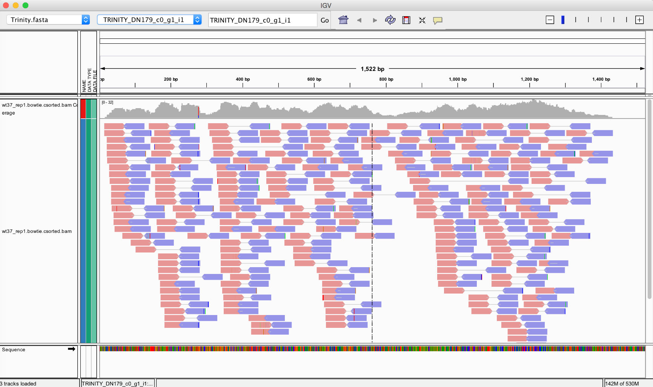
Alignment
IGV (Integrative Genome Viewer), “pileup” plots

Slide 17
Variant calling
What is the genotype at the middle G position?
Reference
GCACGTACGACGAGCATCGAATCAGC
ACGACGACCATCGAA
GTACGACGACCATCG
CGACGACCATCGAAT
CACGTACGACGACCA
ACGTACGACGACCAT
ACGACGACCATCGAA
ACGACCATCGAATCA
CGACGACCATCGAAT
GCACGTACGACGAGCATCGAATCAGC
ACGACGACCATCGAA
GTACGACGAGCATCG
CGACGAGCATCGAAT
CACGTACGACGACCA
ACGTACGACGAGCAT
ACGACGACCATCGAA
ACGACCATCGAATCA
CGACGAGCATCGAAT
Reads
Homozygous, CC
Heterozygous, GC

Slide 18
Variant calling
What is the genotype now? Is the C due to error?
In more advanced methods, the probability of an error is modeled
Popular tools: GATK, SamTools, FreeBayes
Reference
GCACGTACGACGAGCATCGAATCAGC
ACGACGAGCATCGAA
GTACGACGAGCATCG
CGACGACCATCGAAT
CACGTACGACGAGCA
ACGTACGACGAGCAT
ACGACGAGCATCGAA
ACGAGCATCGAATCA
CGACGAGCATCGAAT
Reads
???

Slide 19
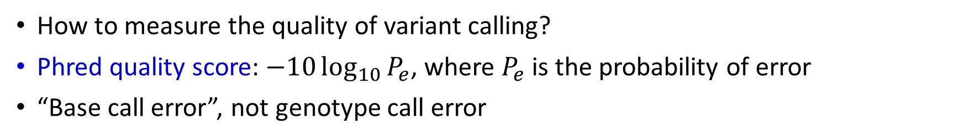
Sequencing errors
How to measure the quality of variant calling?
Phred quality score: $−10\log_{10}{P_{e}}$, where $P_{e}$ is the probability of error
“Base call error”, not genotype call error
How are genotyping errors measured?
Probability of incorrect call | Phred Score | Base call accuracy
1 in 10 | 10 | 90%
1 in 100 | 20 | 99%
1 in 1,000 | 30 | 99.9%
1 in 10,000 | 40 | 99.99%
1 in 100,000 | 50 | 99.999%
R: reference allele
A: alternate allele
Truth
 | RR | RA | AA
RR | 100 | 20 | 0
RA | 10 | 150 | 5
AA | 2 | 10 | 90
False negatives
Variant call
False positives

Slide 20


How to evaluate accuracy?
Mendelian consistency
Runs of homozygosity
Experimental validation in GT/near-GT technologies (Sanger, microarray)
Duplicates, at the level of sequencing technology or experimental repeat
Benchmarks: Genomes in a Bottle, Illumina Platinum Genomes, Global Alliance for Genomics and Health, SEQC-II Consortium
hets
AA
BB
AA
AA
BB?
AB?
roh

Slide 21
How easy is it to accurately call variants?
The 1000 Genomes Project divided the genome into three portions:
Strict (77%), easy to call variants
  Coverage remains nearly constant, very few low quality reads
Pilot (19%) and masked (4%) are difficult to call
  Extreme coverage (low/high), many low quality reads
Typically, a few thousands of false positives remain
A large proportion of the novel variants
Advanced methods exist to “clean” false positives

Slide 22
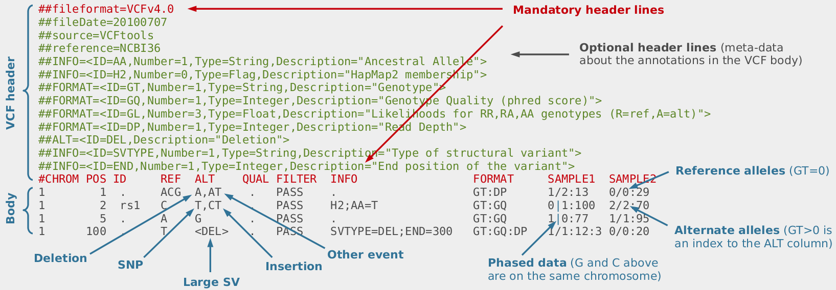
How does the data look like?
The most common format is VCF (Variant Call Format)

Slide 23
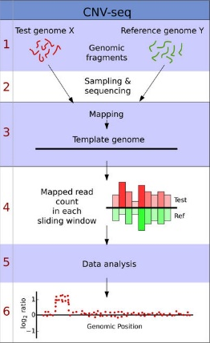
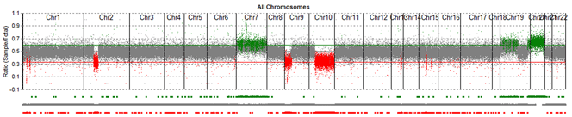
Calling copy-number variants
More sophisticated algorithms use Hidden Markov model to smooth the predicted boundaries of the CNVs
The difficult part is to account for changes in the coverage due to technical reasons

Slide 24
Genetic variation data (microarrays)
 | SNP 1 | SNP 2 | SNP 3 | SNP 4 | SNP 5 | SNP 7 | …
Individual 1 | AG | CC | AC | TT | AA | TT | GC
Individual 2 | AA | CT | AC | TT | AA | TT | CC
… | AA | TT | AC | GT | AA | TT | GG
Individual 1 | AG | CC | AA | GG | AA | TT | GG
Individual 2 | AG | TT | AA | GT | AA | CT | GG
… | AA | CC | CC | TT | AG | TT | GC
Population 1
Population 2
≈500k-10M SNPs
≈Hundreds/thousands/more individuals
SNP = Single Nucleotide Polymorphism

Slide 25
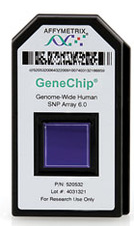
Microarray technology (SNP arrays, SNP chips)
Microarrays do not cover the entire genome, just selected SNPs
Selection of SNPs often reflects their order of discovery
  Usually meaning they are more frequent
  Sometimes the word “SNP” refers to those of frequency >1% or >5%
  A list of SNPs is maintained in dbSNP
  Variants not previously known are sometimes called “SNV” (single-nucleotide variants)
The number of SNPs ranges between 200k-5M
Some arrays are tailored to specific applications: Exome chip, Immunochip, Metabochip, OncoArray, human origins chip, Genographic project, etc.

Slide 26
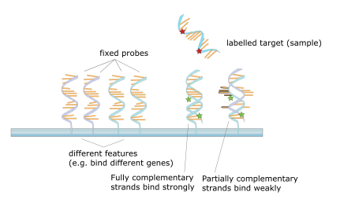
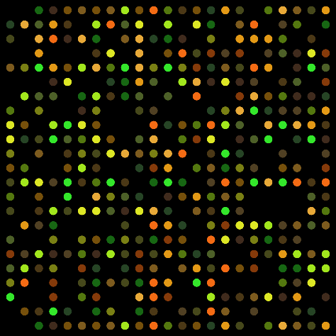
Microarray technology
Microarrays have surfaces densely covered with probes matching to the short DNA sequence around each SNP
Whenever a probe on a microarray hybridizes with target DNA having an A allele, it emits red light
If it hybridizes with a B allele, it emits green light
The array is then scanned and analyzed
Main array providers: Illumina, Affymetrix
Arrays are used for other applications, most notably gene expression profiling (but nearly obsolete)
Current cost: ≈$50-200

Slide 27
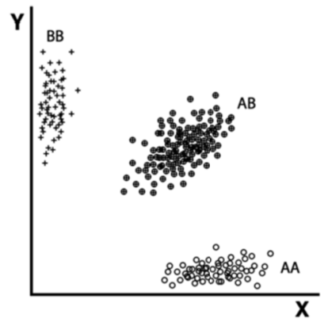
Genotype calling
The intensity of red and green light corresponds to the strength of binding of A and B alleles
Each data point in the red/green space corresponds to the genotype of one individual
How to call the genotypes?
Use unsupervised machine learning “clustering” methods for finding clusters
In our case, we have three clusters: AA, AB, BB
Intensity of green light
Intensity of red light

Slide 28
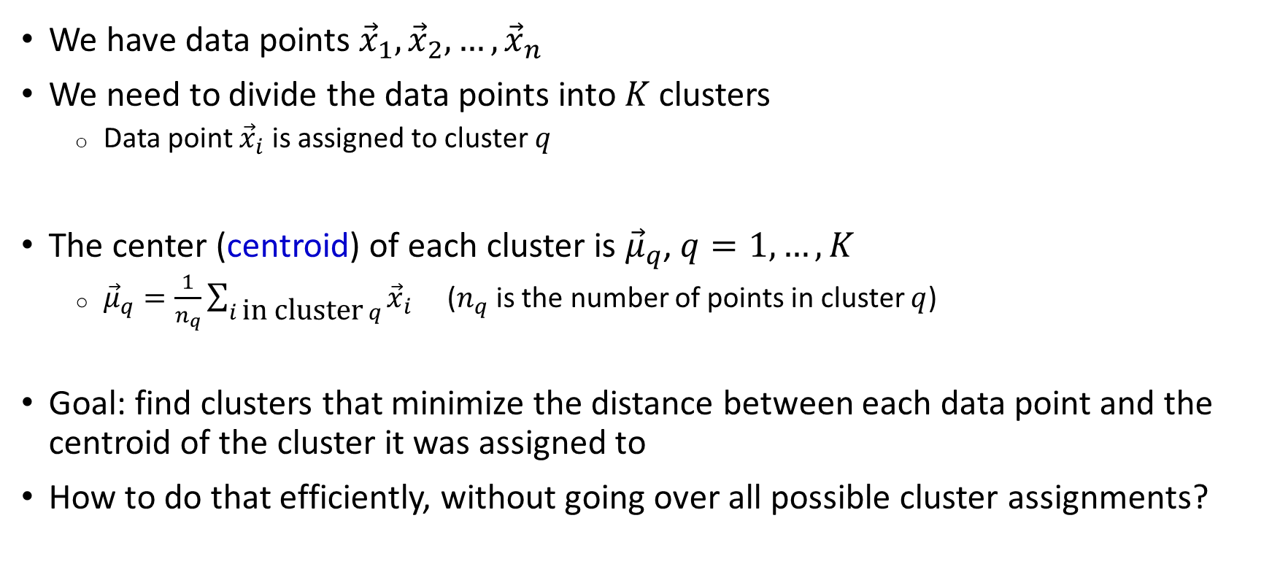
What is clustering?
We have data points ${\vec{x}}_{1},{\vec{x}}_{2},…,{\vec{x}}_{n}$
We need to divide the data points into $K$ clusters
  Data point ${\vec{x}}_{i}$ is assigned to cluster $q$
The center (centroid) of each cluster is ${\vec{μ}}_{q}$, $q=1,…,K$
  ${\vec{μ}}_{q}=\frac{1}{n_{q}}\sum_{i \text{in} \text{cluster} q}{{\vec{x}}_{i}}$ ($n_{q}$ is the number of points in cluster $q$)
Goal: find clusters that minimize the distance between each data point and the centroid of the cluster it was assigned to
How to do that efficiently, without going over all possible cluster assignments?
Red “centroid”
Green “centroid”
x
x
x
o
o
x
x
x

Slide 29
The K-means algorithm
Simplest algorithm
Fix the number of clusters K
Initialization: Assign each data point to a random cluster
Update step: Compute the center of each cluster
Assignment step: Assign each data point to the cluster with the nearest center
Repeat until convergence (=no change in cluster assignment)

Slide 30
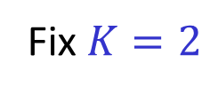
K-means: Example
Update: Compute the centroid of each cluster; Assignment: Assign each data point to the nearest centroid
Fix $K=2$
Red “centroid”
Green “centroid”
x
x
x
x
x
x
x
x
x
x
x
x
x
x
x
o
o
x
o
o
x
x
x
x
x
x
x
x
Original data
Random assignment
Update step
Assignment step (a)
Red “centroid”
Green “centroid”
No change in assignment: STOP
x
x
x
x
x
x
x
x
x
o
x
x
o
x
x
x
x
x
x
o
x
x
o
x
x
x
x
x
Assignment step (b)
Update step
Assignment step (a)
Assignment step (b)

Slide 31
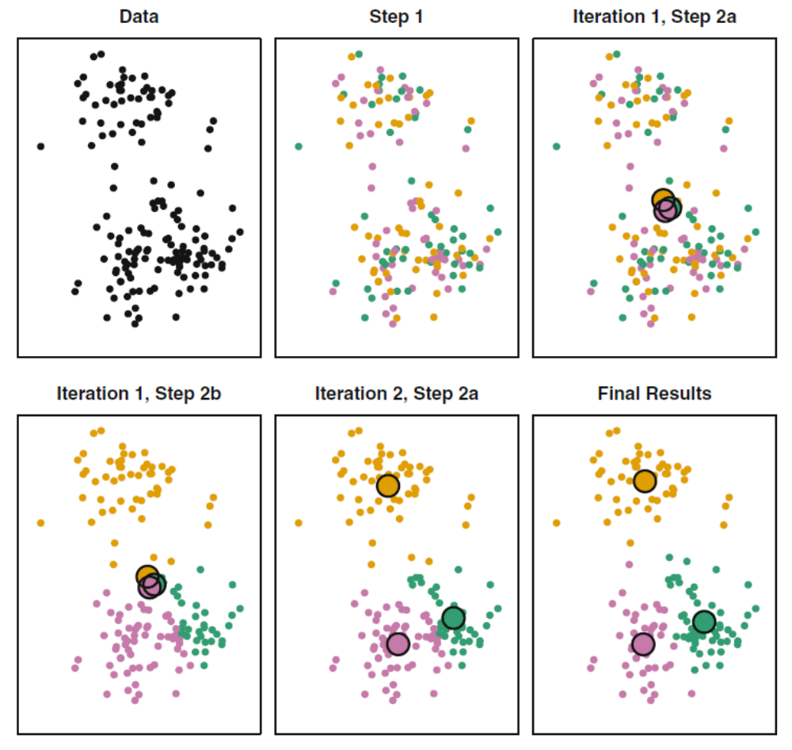
K-means: Example

Slide 32
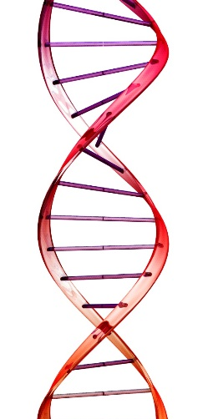
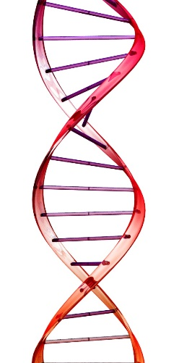
Quality control for microarrays
Remove A/T and C/G polymorphisms
  The strand of each probe is arbitrary
Remove SNPs where >5% of the individuals are missing
  The cutoff can be 1%, 2%, etc.
Remove individuals with >5% of SNPs missing
Remove SNPs with Mendelian inconsistency (if available)
Remove SNPs whose genotypes are associated with the genotyping batch/center
  “Batch effect”
Remove very rare SNPs
For some analyses, remove SNPs from complex regions (e.g., HLA on chr6)
T
A
A
T

Slide 33
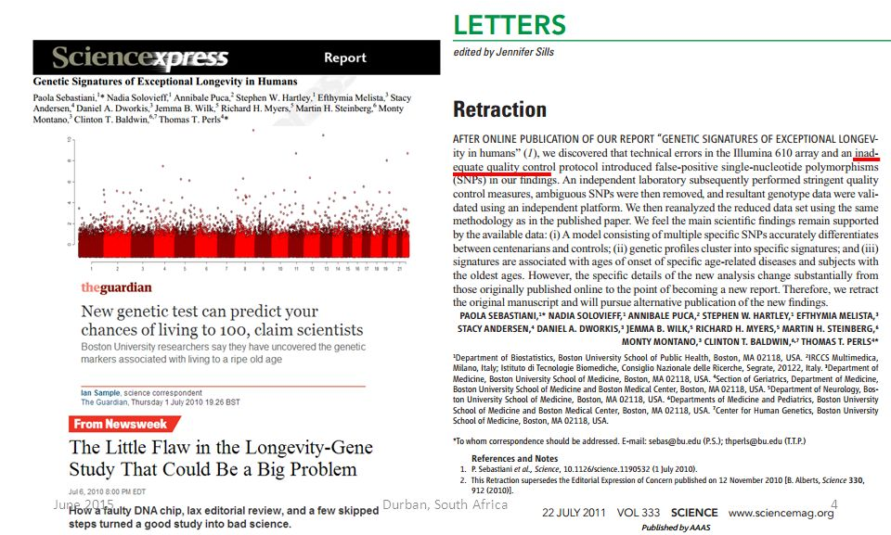
Why quality control?

Slide 34
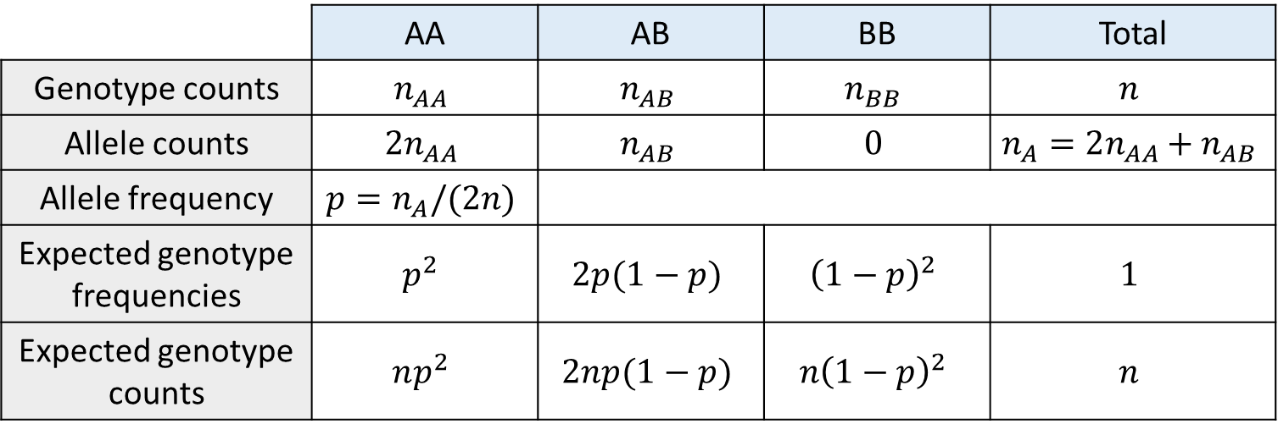
Are genotypes in Hardy-Weinberg equilibrium?
The allele frequency of A is the number of A’s divided by the total number of alleles
Do actual genotype counts agree with expectation?
 | AA | AB | BB | Total
Genotype counts | $$n_{AA}$$ | $$n_{AB}$$ | $$n_{BB}$$ | $$n$$
Allele counts | $$2n_{AA}$$ | $$n_{AB}$$ | $$0$$ | $$n_{A}=2n_{AA}+n_{AB}$$
Allele frequency | $$p=n_{A}/(2n)$$
Expected genotype frequencies | $$p^{2}$$ | $$2p(1−p)$$ | $${\left(1−p\right)}^{2}$$ | $$1$$
Expected genotype counts | $$np^{2}$$ | $$2np(1−p)$$ | $$n{\left(1−p\right)}^{2}$$ | $$n$$

Slide 35
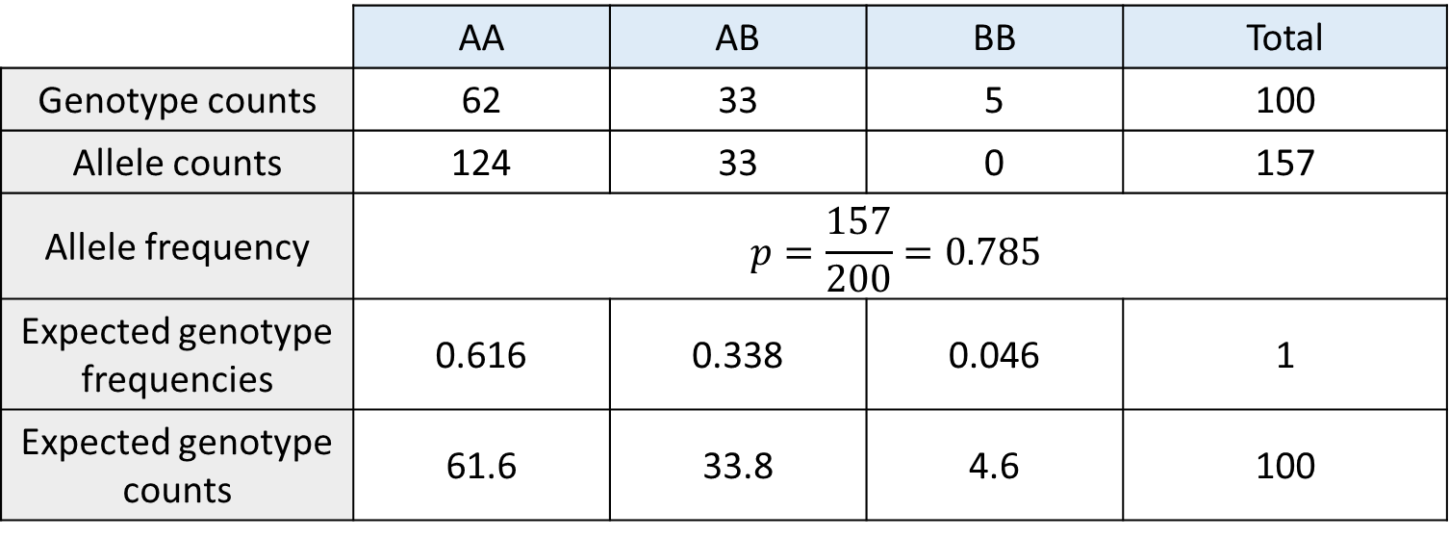
Example
We can compare observed and expected genotype counts to identify SNPs not in HW equilibrium
 | AA | AB | BB | Total
Genotype counts | 62 | 33 | 5 | 100
Allele counts | 124 | 33 | 0 | 157
Allele frequency | $$p=\frac{157}{200}=0.785$$
Expected genotype frequencies | 0.616 | 0.338 | 0.046 | 1
Expected genotype counts | 61.6 | 33.8 | 4.6 | 100

Slide 36
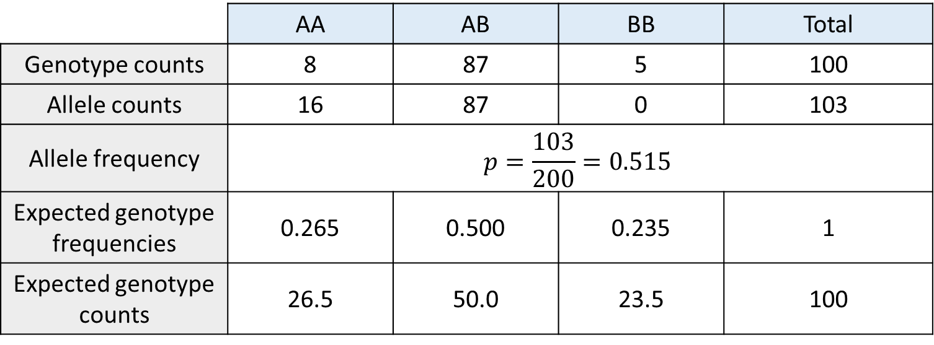
Example
Deviations are usually due to SNPs with a genotyping error
  E.g., when almost everyone is het, this could be a segmental duplication (not polymorphism)
 | AA | AB | BB | Total
Genotype counts | 8 | 87 | 5 | 100
Allele counts | 16 | 87 | 0 | 103
Allele frequency | $$p=\frac{103}{200}=0.515$$
Expected genotype frequencies | 0.265 | 0.500 | 0.235 | 1
Expected genotype counts | 26.5 | 50.0 | 23.5 | 100

Slide 37
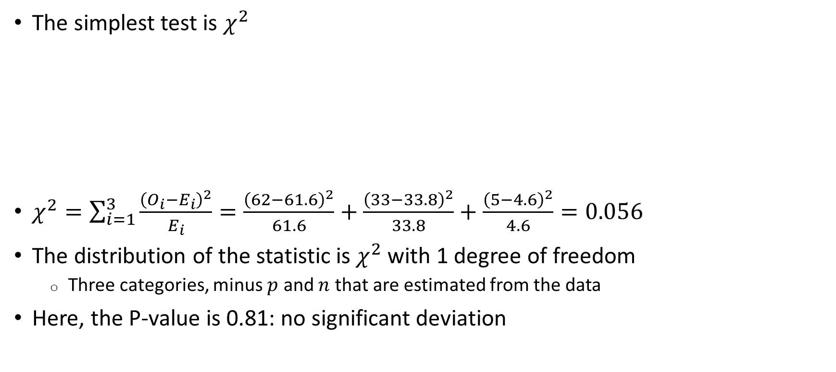
Testing for deviations from HWE
The simplest test is $χ^{2}$
$χ^{2}=\sum_{i=1}^{3}{\frac{{\left(O_{i}−E_{i}\right)}^{2}}{E_{i}}}=\frac{{\left(62−61.6\right)}^{2}}{61.6}+\frac{{\left(33−33.8\right)}^{2}}{33.8}+\frac{{\left(5−4.6\right)}^{2}}{4.6}=0.056$
The distribution of the statistic is $χ^{2}$ with 1 degree of freedom
  Three categories, minus $p$ and $n$ that are estimated from the data
Here, the P-value is 0.81: no significant deviation
 | AA | AB | BB | Total
Observed counts | 62 | 33 | 5 | 100
Expected counts | 61.6 | 33.8 | 4.6 | 100

Slide 38
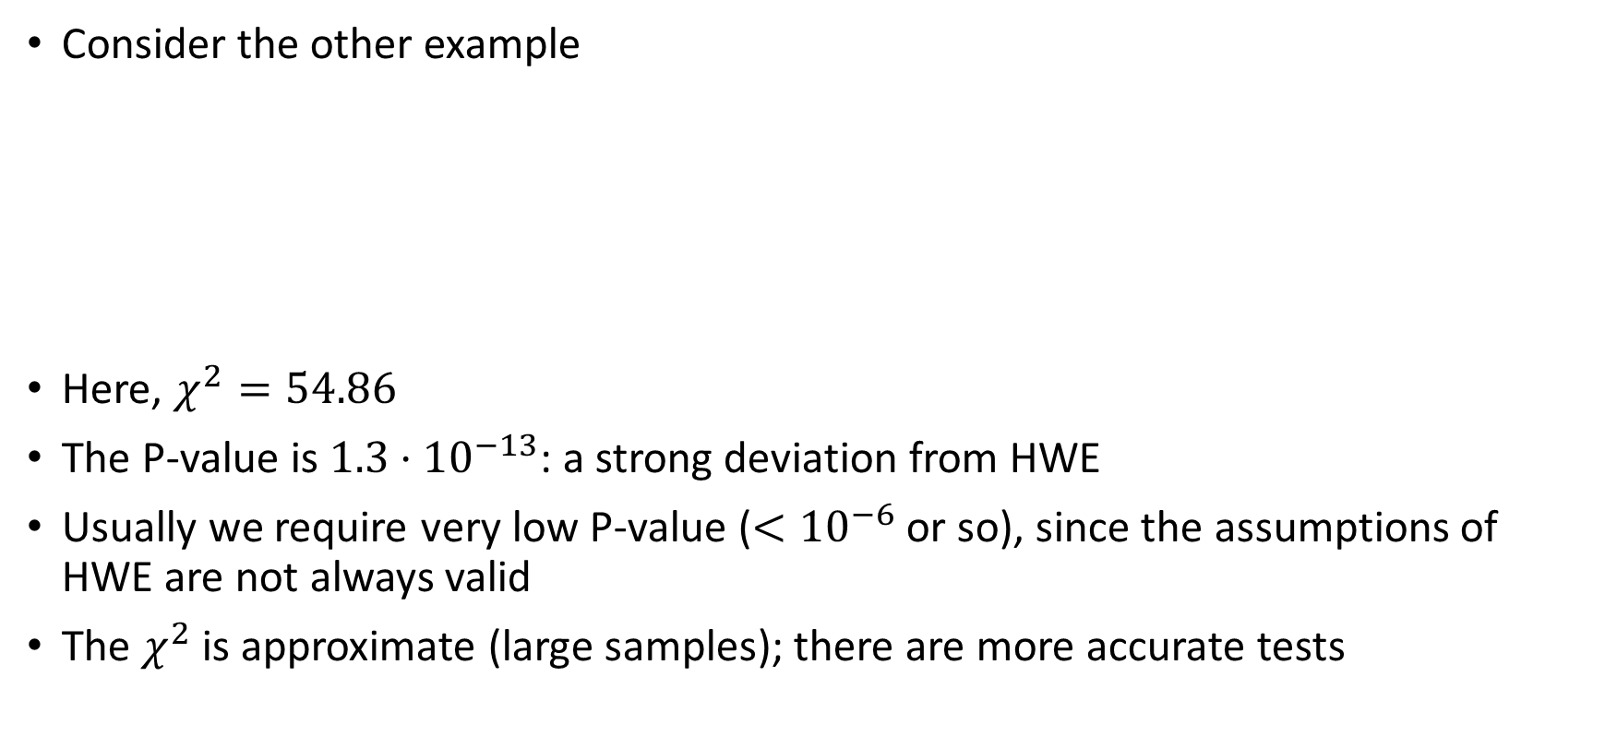
Testing for deviations from HWE
Consider the other example
Here, $χ^{2}=54.86$
The P-value is $1.3⋅{10}^{−13}$: a strong deviation from HWE
Usually we require very low P-value ($<{10}^{−6}$ or so), since the assumptions of HWE are not always valid
The $χ^{2}$ is approximate (large samples); there are more accurate tests
 | AA | AB | BB | Total
Observed counts | 8 | 87 | 5 | 100
Expected counts | 26.5 | 50.0 | 23.5 | 100

Slide 39
How does the data look like?
The most common format is Plink
There are also binary formats for faster processing and less memory requirement
Chr | SNP ID | Position (cM) | Position (bp) | Ind 1 | Ind 2 | Ind 3
1 | rs345 | 1.245 | 1764739 | AA | AG | AA
1 | rs564 | 2.342 | 3593958 | CT | CC | CC
1 | rs738 | 3.456 | 4869503 | AC | AC | AA
1 | rs937 | 4.764 | 6982049 | GG | AG | GG
TPED file
Family ID | Individual ID | Father ID | Mother ID | Sex | Phenotype
1 | 112 | 642 | 827 | 1 | 175
1 | 642 | 0 | 0 | 1 | 173
1 | 827 | 0 | 0 | 2 | 162
FAM file

