Slide 1
Personal Genomics
Introduction to Genomics
Shai Carmi
School of Public Health

Slide 2
Credits
Some slides/materials were borrowed from lecture notes of:
  Melissa Gymrek, The University of California, San Diego
  Erez Levanon, Bar-Ilan University
  Itamar Simon, The Hebrew University
  Or Zuk, The Hebrew University
  Liran Carmel, The Hebrew University
  Itsik Pe’er, Columbia University
  Priya Moorjani, The University of California, Berkeley

Slide 3
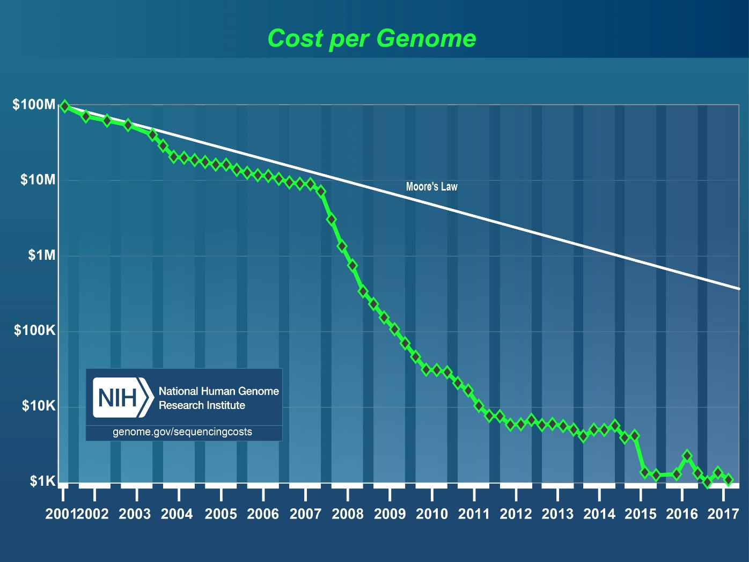
Whole-genome sequencing
We are in the era of a $1000 per genome!
≈1 million genomes have been sequenced

Slide 4
Microarray genotyping
Genotyping at 500k-1M markers is offered by a number of companies:
  23andMe, AncestryDNA, MyHeritage, FamilyTreeDNA, Genographic project …
Genetic studies of 100-500k individuals are now routine
Cost is ≈$50 per genome
>30 millions of individuals have been genotyped
What to do with the information?
How to interpret?

Slide 5
Medical applications
Personal genomics is a pillar of precision medicine
Established applications:
  Carrier screening, cancer predisposition, pharmacogenetics, Alzheimer’s, pediatric disorders
New applications:
  Nutrition, anthropometric traits, hair/eye color, fitness, fertility, late onset complex diseases
Related genomic data is accumulating:
  Reproduction-related testing (preimplantation, prenatal, post-natal)
  Microbiome, cell-free DNA, transcriptomics, other –omics, …
  Somatic mutations (cancer)

Slide 6
Ancestry applications
Learn about ancestry, from past century to hundreds of thousands of years ago
Maternal line (mtDNA) and paternal line (Y chr)
Detect (or confirm) relatives, forensics
Learn about historical demographic events of populations
  Changes in population sizes, population merges and splits, relation to ancient populations

Slide 7
Biological applications
Which genes/mutations were under selection and when/where?
What are the mutation and recombination rates? Do they evolve? Are they affected by genetics? How do they change along the genome? How are they affected by parental age?
What are the mechanisms causing complex structural genomic changes?

Slide 8
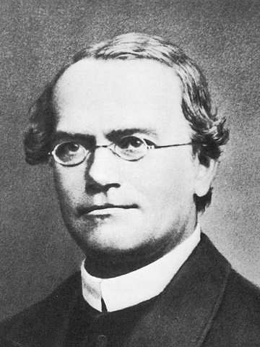
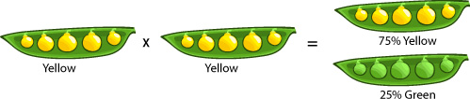
Mendel’s experiments (≈1865)
Green peas
Yellow peas
Genotype
GG
YY
F1 Generation
100% Yellow
YG
YG
YG
YG
F2 Generation
75% Yellow
25% Green
Heterozygous
YY
YG
GY
GG
Homozygous

Slide 9
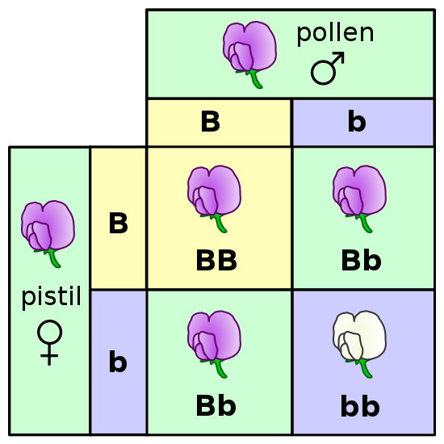
Mendel’s laws
Each organism has two copies of the hereditary “factors” (genes)
Each factor can have two forms (alleles)
Each gamete (sperm/egg) inherits exactly one allele for each gene, at random
Alleles can be dominant or recessive
Mendel’s work was ignored until the 20th century
Re-discovered in 1900
Fisher (1918) showed how Mendelian inheritance
can explain continuous traits
BB/bb: homozygous, Bb: heterozygous

Slide 10
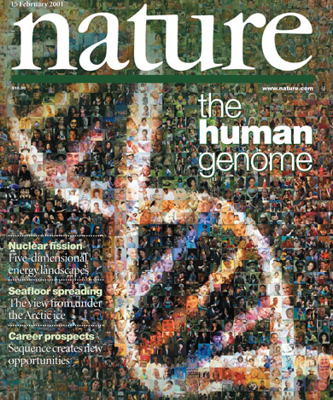
A century and more of genetics
First half of the 20th century: DNA is the hereditary material
1953: Watson and Crick decipher the DNA structure
1970’s to 1990’s: Genes mapped for Mendelian (single-gene) disorders
2001: The Human Genome Project
2000’s: A decline in sequencing costs
2010’s: Direct to Consumer Genetics
2010’s: Genome-wide association studies

Slide 11
The genetic material
The human body is made of ≈10¹³-10¹⁴ cells
All originate from a single cell (the zygote) through repeated cell divisions
Each cell contains the same copy of all of its DNA = its genome
The human genome is ≈3,000,000,000 letters long
Divided into 23 pairs of chromosomes
There are ≈20,000 genes

Slide 12
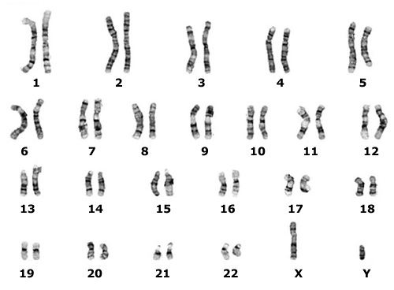
The chromosomes
Nucleus
Cell
Humans are diploid:
two copies per chromosomes
Chromosomes 1-22: autosomes
X,Y: sex chromosomes (males: XY, females: XX)
In the cytoplasm: mitochondria
The maternal and paternal copies of each chromosome are called homologous
Sex chromosomes

Slide 13
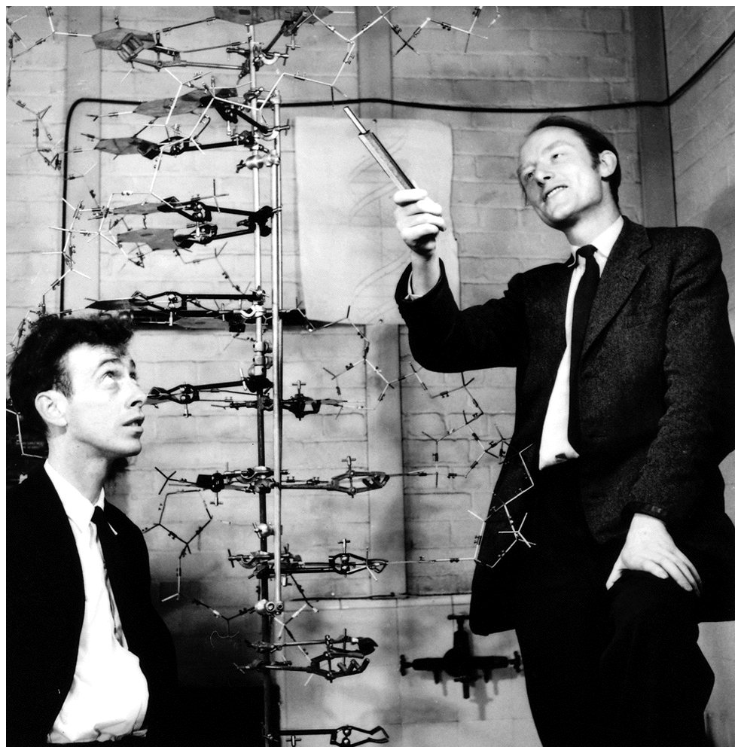
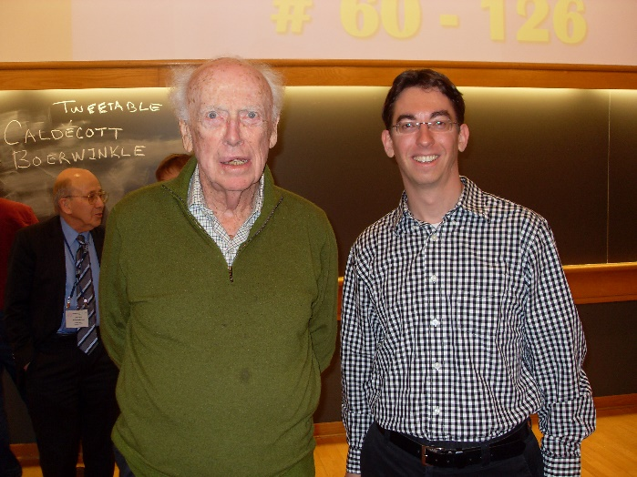
DNA (deoxyribonucleic acid) structure
Bases
Watson-Crick base pairing
Guanine
G
5’
3’
Purines
Adenine
A
C
G
Cytosine
C
Pyrimidines
A
T
Thymine
T
G
C
Phosphate
T
A
Deoxyribose
(sugar)
3’
5’
Nucleotide (nt)
Base pair (bp)

Slide 14
DNA strands
One strand is denoted “forward” (“positive”, +), and the other “reverse” (“negative”, -)
  Forward strand is starting at the shorter (p) arm
The sequence of each strand is read from 5’ to 3’
  Forward strand: 5’-CAGT-3’
  The reverse strand: 5’-ACTG-3’
  Also called the reverse complement
The sequence at the 5’-end is “upstream”, and in the 3’-end is “downstream”
In genes, the strand with the same sequence as the mRNA is called “sense”
  The other “antisense”
5’
3’
C
G
A
T
G
C
T
A
3’
5’
Strand
Strand

Slide 15
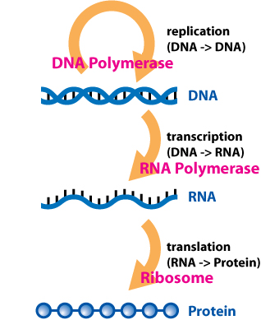
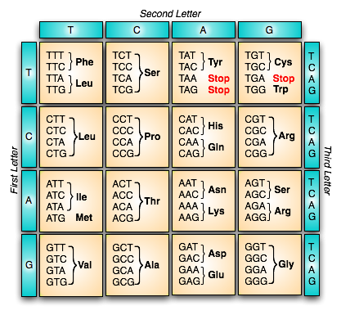
The Central Dogma

Slide 16
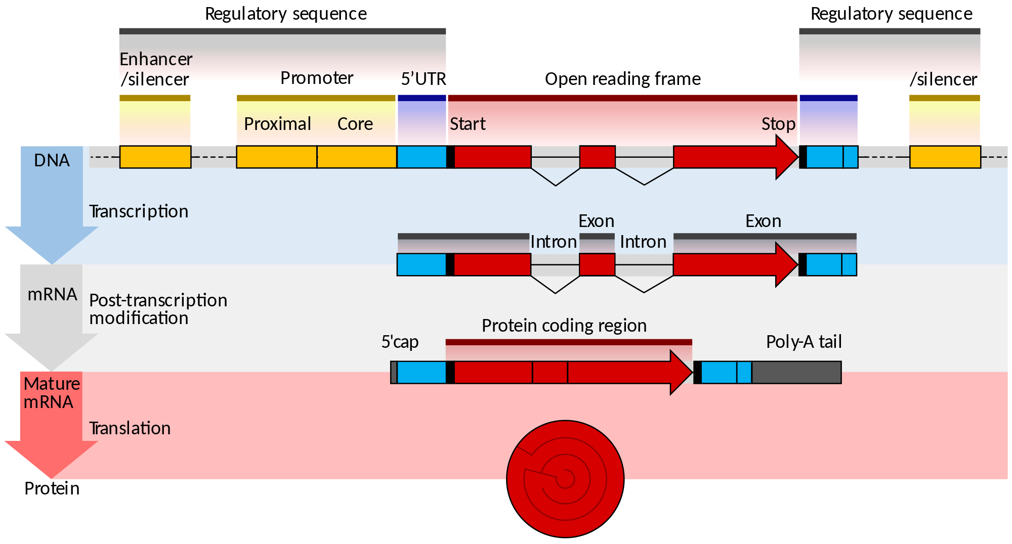
The structure of genes
3’UTR

Slide 17
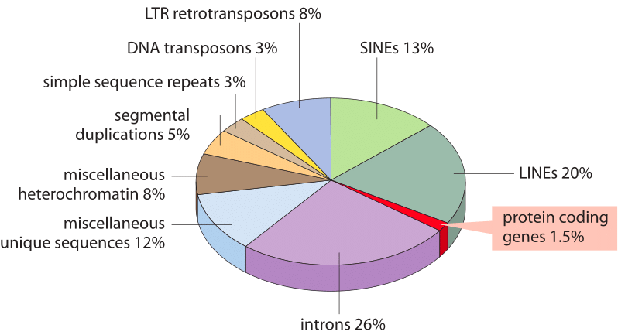
What’s in a genome?
Non-coding regions are no longer thought to be junk
Rather, they are important for the regulation of gene expression
Alu elements 10%

Slide 18
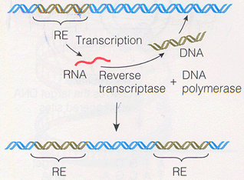
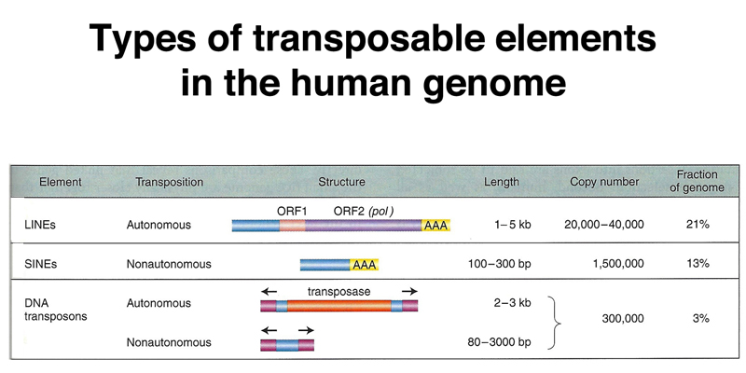
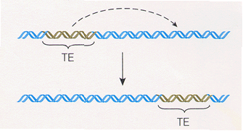
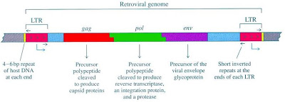
Mobile elements
Retrotransposons
DNA transposons
Breaking the Central Dogma!
Long Terminal Repeats

Slide 19
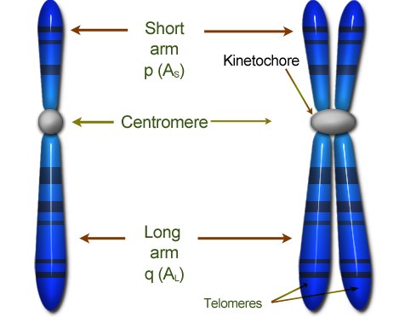
Heterochromatin
Telomeres are repetitive sequences at the ends of the chromosome
Their goal is to protect the chromosome ends and avoid loss of genetic material
Difficult to sequence
Centromeres are repetitive sequences usually
found at the center of the chromosome
Play a structural role in cell division
Also difficult to sequence

Slide 20
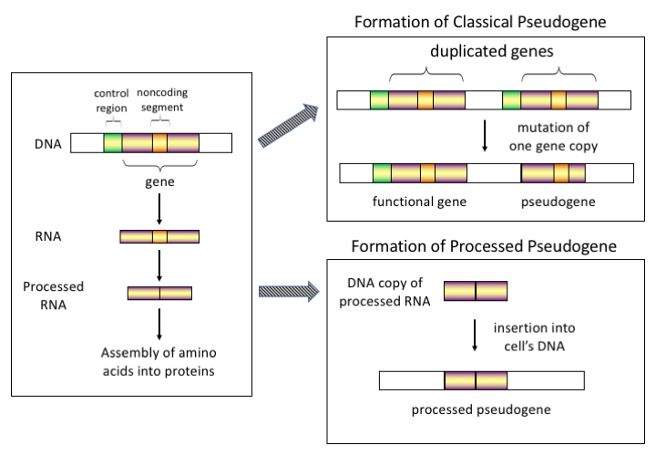
Pseudogenes

Slide 21
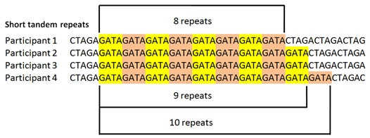
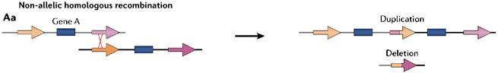
Short tandem repeats (STRs) and segmental duplications
STRs also called microsatellites or simple sequence repeats (SSRs)
Any number of repeats of sequences up to 6-10bp
Segmental duplications are longer (>1kb) duplications, tandem or interspersed, on the same chromosome or on different chromosomes

Slide 22
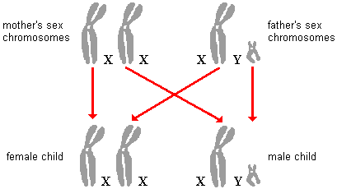
The X chromosome
The X chromosome is relatively large (156M), and has many important genes
All recessive deleterious mutations on X are harmful for males
In females, after a few days of embryonic development, each cell chooses randomly one of the X copies for inactivation
Gene expression is partly blocked from
the inactivated chromosome
Some genes “escape”

Slide 23
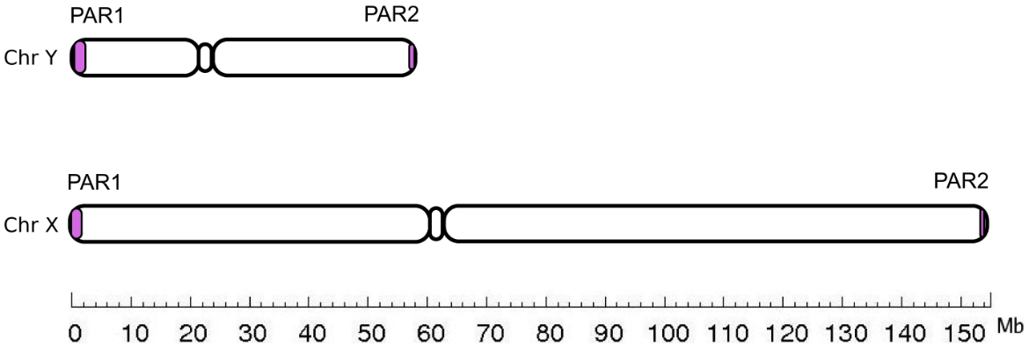
The Y chromosome
Total length 57Mb, but only ≈10Mb are not in repeats
Y chr evolves rapidly and has lost most of its genes since it has diverged from X
  Only ≈70 genes left
The crucial gene is SRY, responsible for male sex determination
The two “pseudo-autosomal” regions (PAR) on X/Y are “homologous” (similar), and can recombine like autosomal regions
2.6Mb
0.3Mb

Slide 24
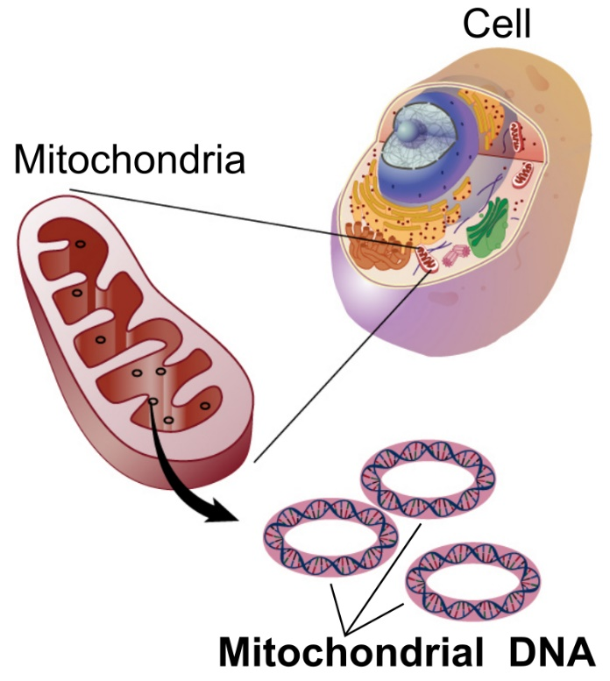
Mitochondrial DNA
Transmitted only from the mother
  The paternal mtDNA is degraded
Very short: only ≈16.5kb, 37 genes
There are hundreds of mitochondria per cell, and 2-10 mtDNA copies per mitochondrion
The mitochondria is thought have a prokaryotic origin
“The endosymbiotic theory”
Popular in population genetics due to the high copy
number and mutation rate (≈50x compared to the autosomes)

Slide 25
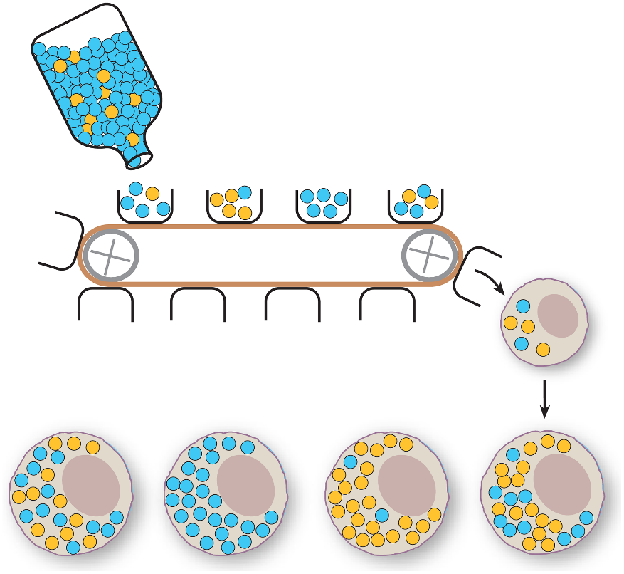
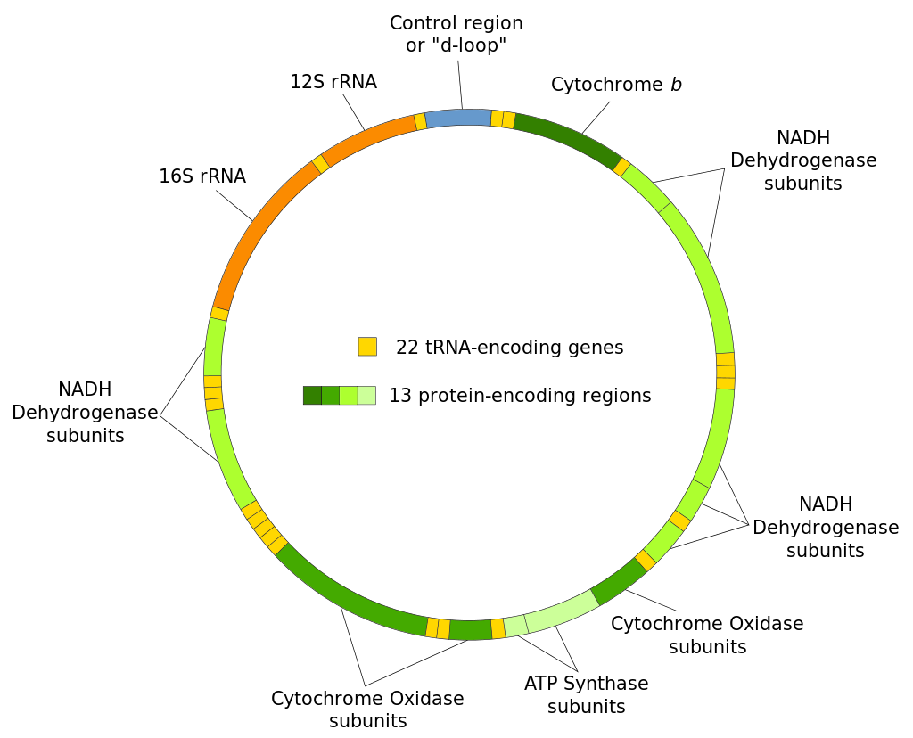
Mitochondrial DNA
The “hypervariable regions” have many mutations and are useful in population
genetics (HVR1: 16024-16383, HVR2: 57-372)
Usually, there is “heteroplasmy”, i.e., presence of multiple alleles in one cell/individual
The number of mtDNA
molecules transmitted
to the oocyte is only 7-10
(“bottleneck”), independently
in each child
Arslan et al., PNAS, 2019
Oocytes

Slide 26
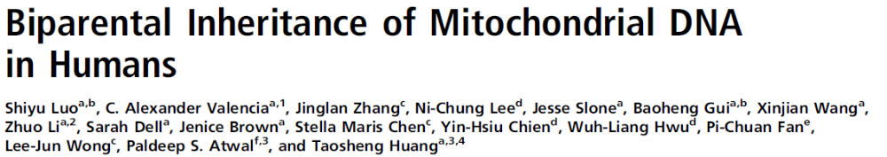
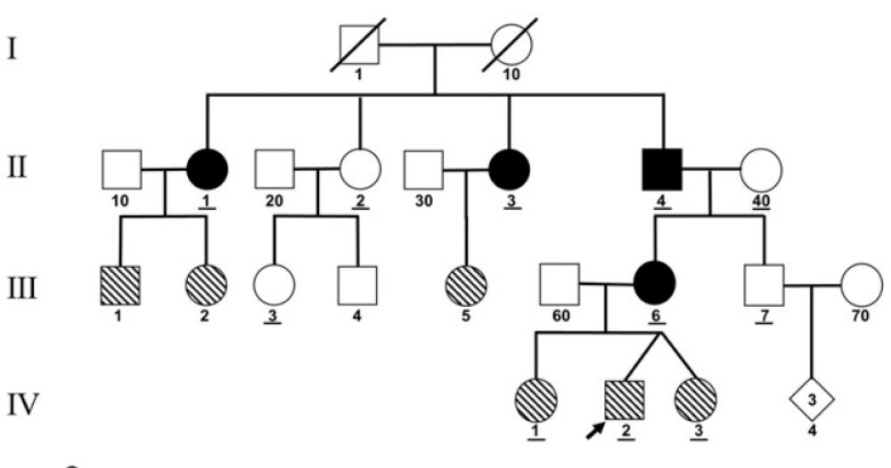
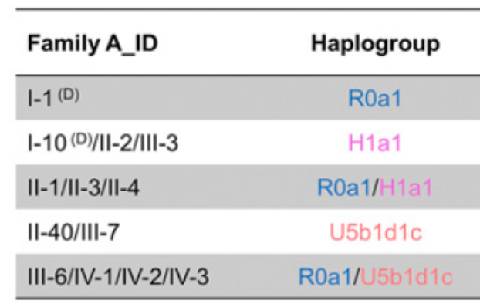
Though recently…
Three families found where mtDNA was transmitted from both parents
Biparental inheritance “runs in the family”
No other cases known so far

Slide 27
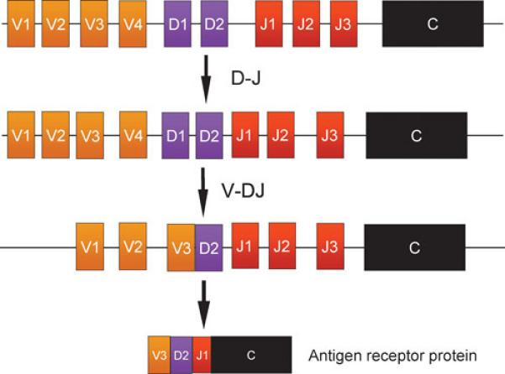
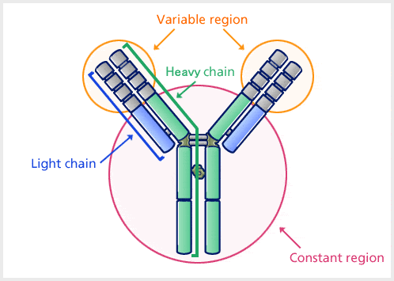
Immune system genes
How can the immune system recognize so many antigens?
Some regions of the genome encode for either antibodies (B cells, bone marrow) or T-cell receptors (thymus)
These regions undergo V(D)J recombination, to generate a huge diversity of antigen-binding regions
≈10¹¹ combinations!

Slide 28
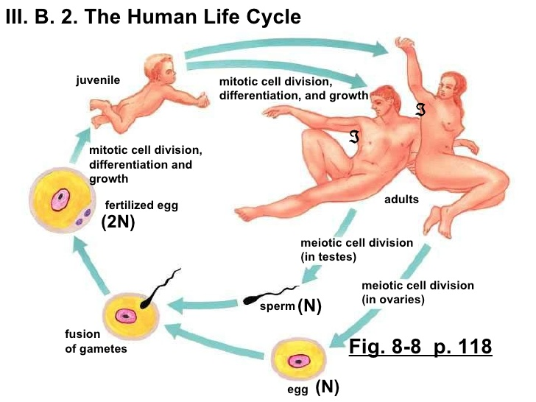
The human life cycle
Zygote
Gametes

Slide 29
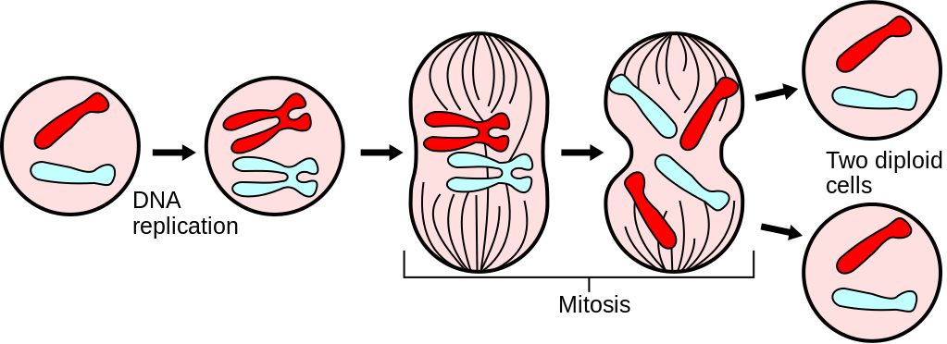
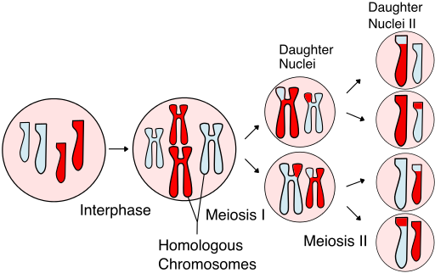
Mitosis and meiosis
Mitosis:
In somatic cells and dividing germ cells
2n➔4n➔2n
Meiosis:
In germline only
The final step in creating gametes
2n➔4n➔2n➔1n

Slide 30
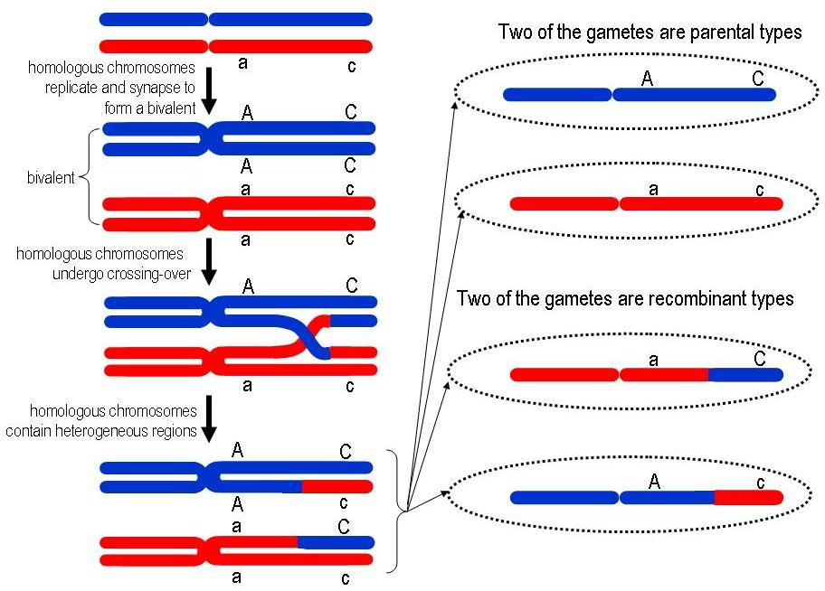
Recombination
Each is a double-strand helix
(Total: 8 strands)
(Tetrad)
At least one chiasma is obligatory, to guarantee proper segregation during meiosis
Chiasma
Sister chromatids

Slide 31
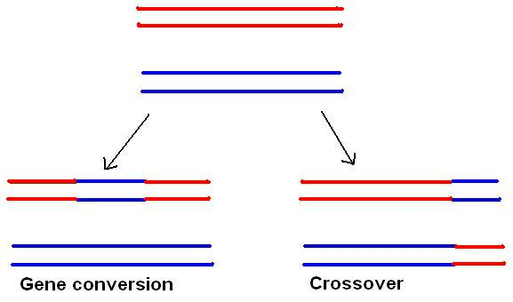
Non-crossover gene conversion
The tracts of gene conversion are short: 100-1000 bp
Happens at rate ≈5 times more than recombination
Has an observable effect only if at least one
heterozygous site exists within the tract
Has strong GC-bias: around ≈2/3 of the
times the G/C allele will be copied
Gene conversion occurs in all recombination events
But crossover occurs a small fraction of the times
Only two homologous chromatids are shown (four strands)

Slide 32
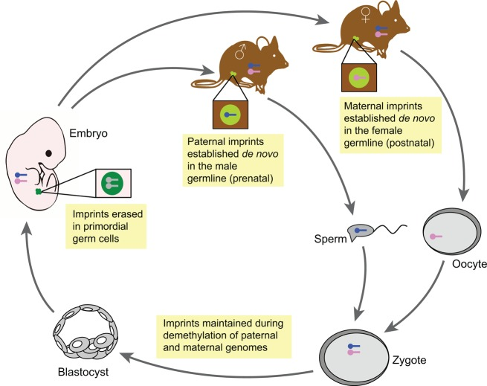
Genomic imprinting
Around 40 genes are methylated only on the chromosome that was transmitted from a specific parent
The methylated gene is usually silenced
  Sometimes in a tissue-specific manner
  Baran et al., Genome Res, 2015
Deletions in one chr15 region can cause:
Prader-Willi syndrome if paternal chr missing
  Due to maternally imprinted genes in the region
Angelman syndrome if maternal chr missing
  Due to a paternally imprinted gene in the same region
Plasschaert and Bartolomei, Development, 2014

Slide 33
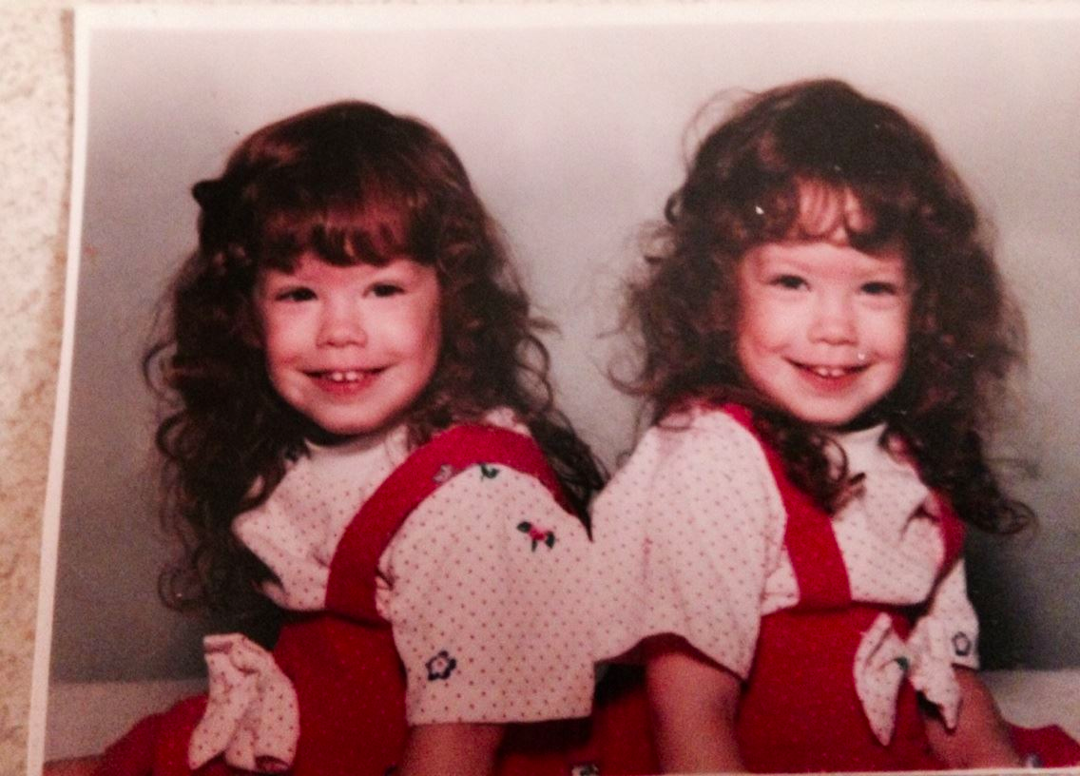

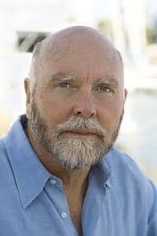
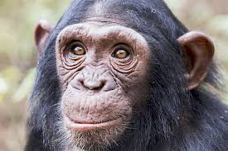
Genetic variation
Identical twins:
≈0 differences
We have so far seen the constituents of the human genome
But is there a single “human genome”?
The “reference” human genome is maintained by National Human Genome Research Institute (NHGRI)
70% from a single male from Buffalo, NY
There are several versions, current is GRCh38 (2013)
  But most commonly used is hg19/GRCh37 (2009)
Europeans differ from the reference in ≈4M sites
Unrelated humans
≈1/1,500 if same ancestry
≈1/1,000 otherwise
Human vs. chimp
≈1/100

Slide 34
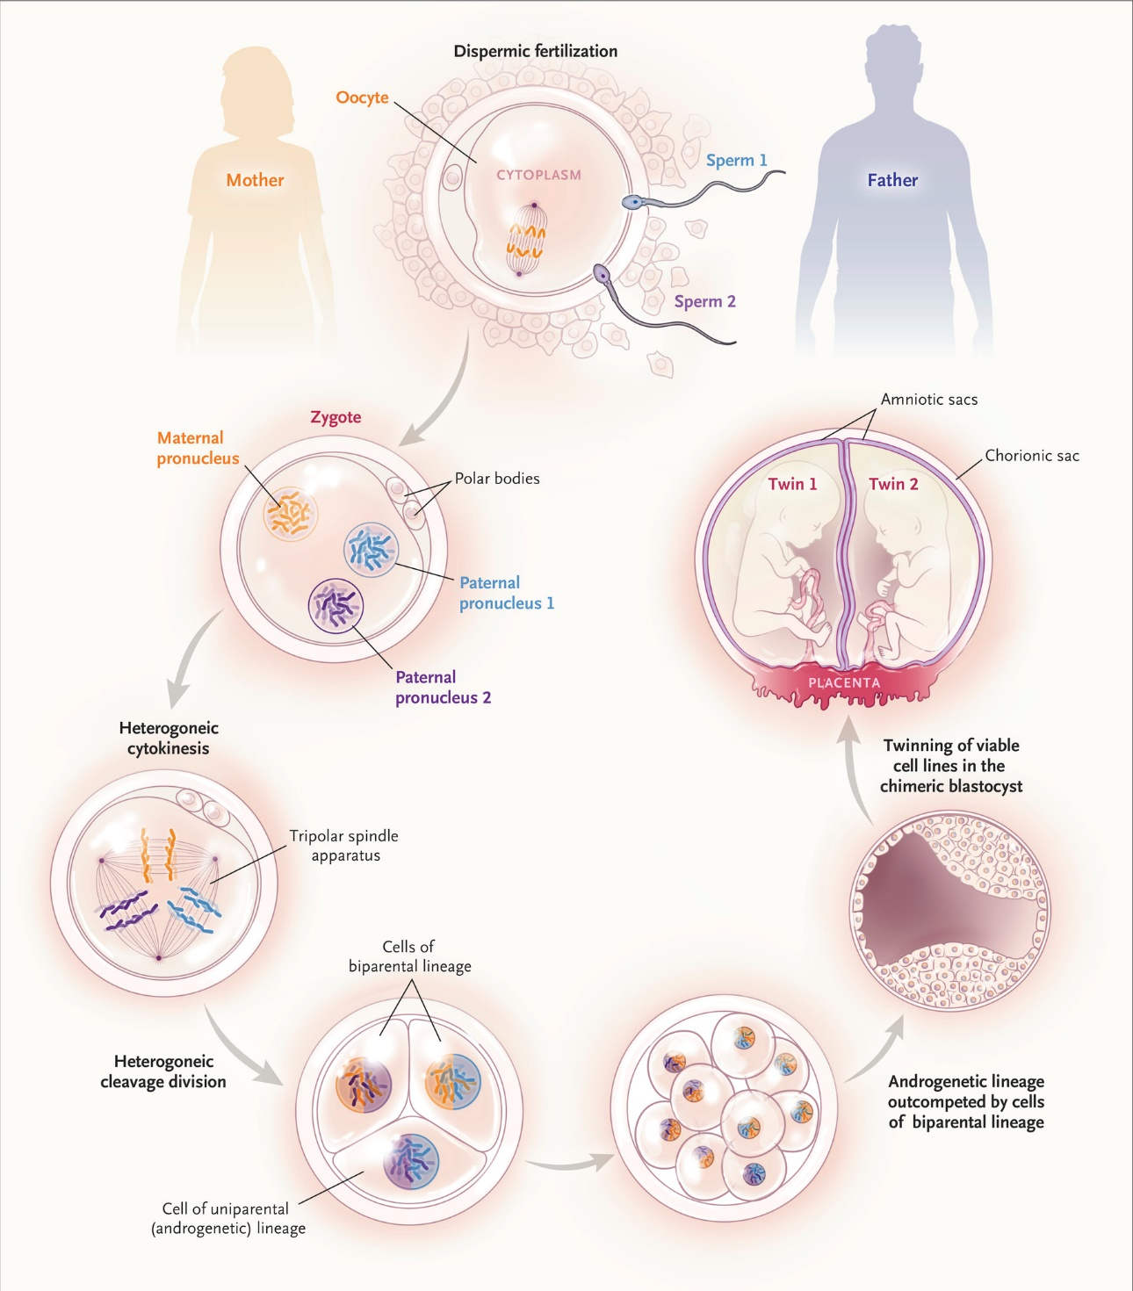
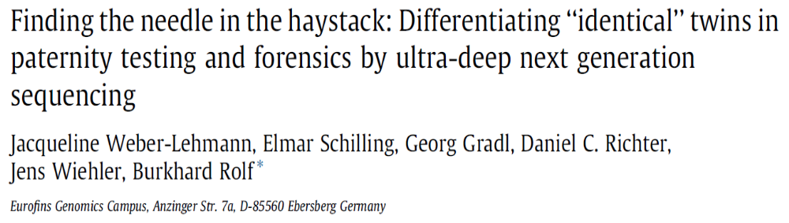
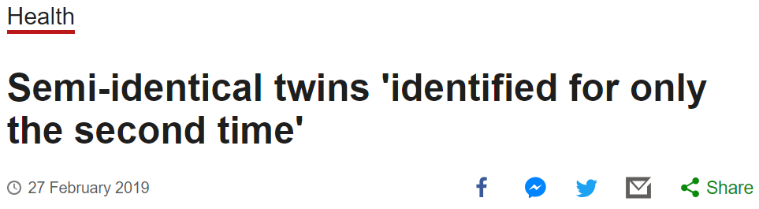
Twins not as simple
Identical twins not totally identical
Dizygotic twins can be “semi-identical”
BBC News
Gabbett et al., NEJM, 2019

Slide 35



What kind of differences can arise?
Single Nucleotide Variants/Substitutions (SNV)
Short insertions/deletions (indels; 1-20bp)
ACGACTCGAGCG
ACGACTCGAGCG
ACG-ACTTG
ACGACACGAGCG
ACGAC-CGAGCG
ACGTCACTTG
$$n_{SNV⁡}≈40−50$$
$$n_{indel⁡}≈3$$
Short Tandem Repeats (STR)
CAGCAG---CAGCAGCA
GATAGATAGATAGATA
Numbers are new variants per genome per generation:
“de novo” mutations
CAGCAGCAGCAGCAGCA
GATA----GATAGATA
$$n_{STR⁡}≈75$$

Slide 36



Types of genetic differences
Structural variants (SV), copy number variants (CNV) (20bp to mega-bases)
Duplication
$$n_{SV⁡}≈0.2$$
Deletion
Inversion
Mobile element insertions (MEI)
Aneuploidies
chr21
chr X
chr21
$$n_{ANE⁡}≈0.001$$
Alu
chr21
Down syndrome
Turner’s syndrome
XXY: Klinefelter syndrome, XXX: Triple X …
$$n_{MEI⁡}≈0.05$$

Slide 37
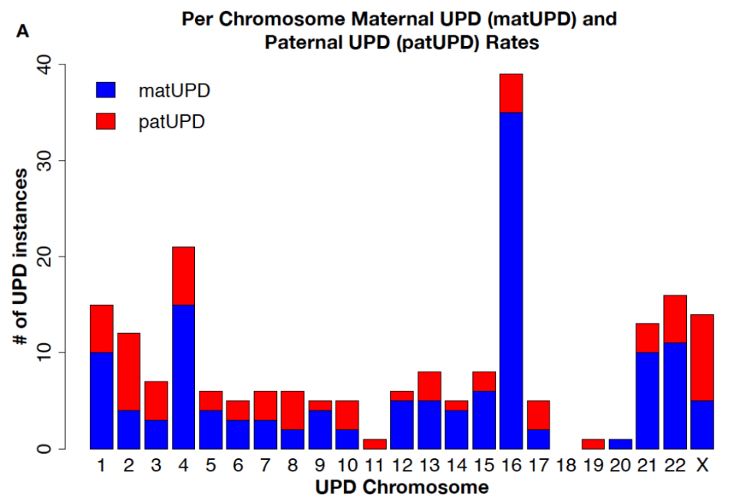
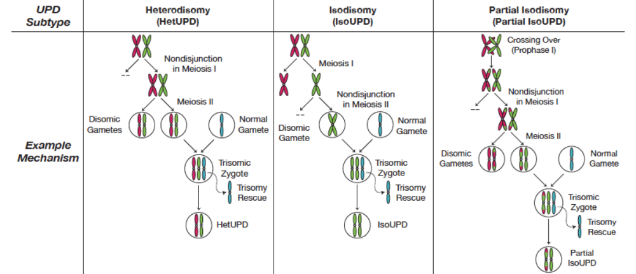
Uniparental disomy (UPD)
Prevalence in adults: 1/2000 (23andMe data)
Some chromosomes are sensitive due to genomic imprinting:
Alleles are expressed only from paternal/maternal chr
When one parent is missing ➔ no expression ➔ disease (e.g. Prader-Willi/Angelman)
Nakka et al., AJHG 2019

Slide 38



Genetic variation in related individuals
Siblings
First cousins
Identical DNA
50% identical
(For the co-inherited chromosome)
Identical DNA
12.5% identical

Slide 39

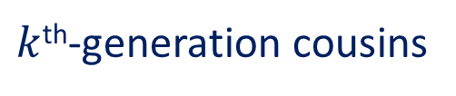
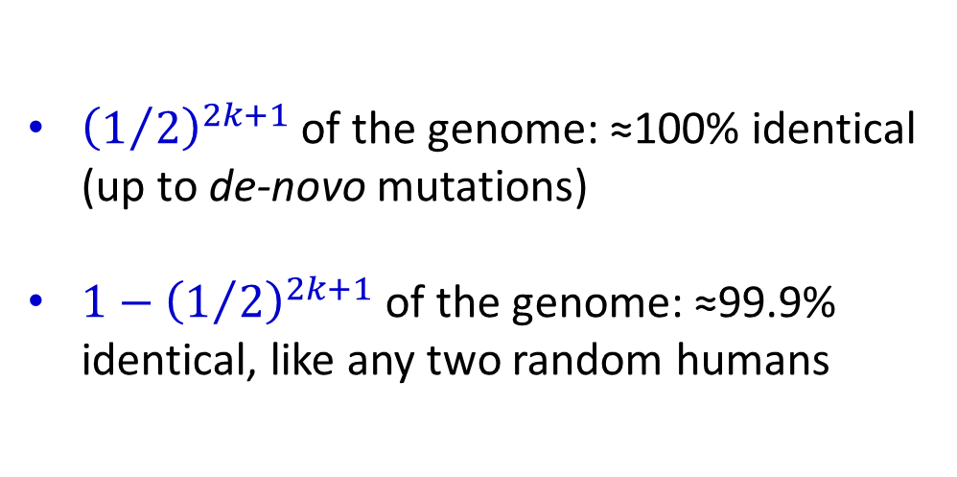
Genetic variation in related individuals
$k$^{th}-generation cousins
${\left(1/2\right)}^{2k+1}$ of the genome: ≈100% identical (up to de-novo mutations)
${1−\left(1/2\right)}^{2k+1}$ of the genome: ≈99.9% identical, like any two random humans
k
Identical DNA

Slide 40
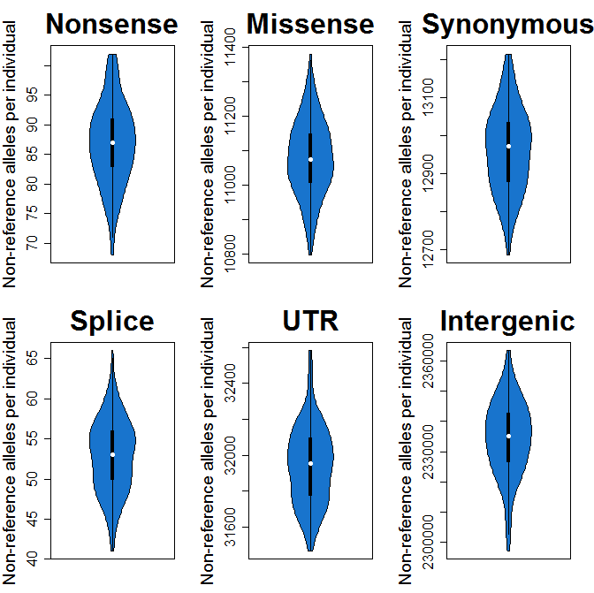
How many variants do we carry?
For European individuals, with respect to the reference:
3.4M single-nucleotide variants
  Among them, 1.2M homozygous
500k short insertions and deletions*
22k coding variants
  Among them, 10k non-synonymous
  200 loss of fucntion
A few hundreds of CNVs (total 5Mb)
1500 structural variations*
4000 mobile element insertions
Carmi et al., Nat Commun, 2014
128 Ashkenazi Jews
* Chaisson et al., Nat Commun, 2019:
800k indels, 2700 SV, 150 inversions

Slide 41
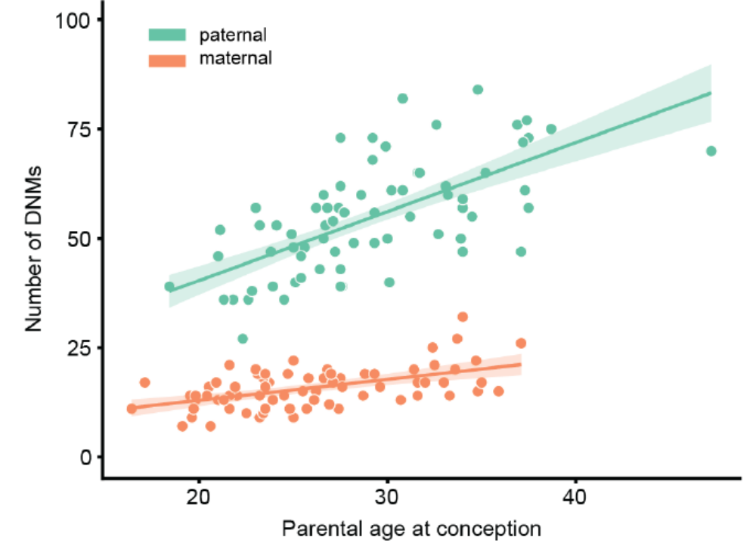
What affects the mutation rate?
Most mutations are paternal (≈80%)
Fathers accumulate ≈2 mutations each year
Rate varies across families
Sasani et al., 2019

Slide 42
The maternal age effect
The maternal age effect must be explained by damage-induced mutations, which accumulate with time
The paternal:maternal mutation rate in fact remains the same through all ages
Prenatal
Pre-puberty
Post-puberty
# of replication driven mutations
combined
male
female
Gao et al., PLOS Biol, 2016
Gao et al., PNAS, 2019
Wu et al., 2019
Conception
Birth
Puberty
Mean age of reproduction or
Generation time
Parental Age

Slide 43
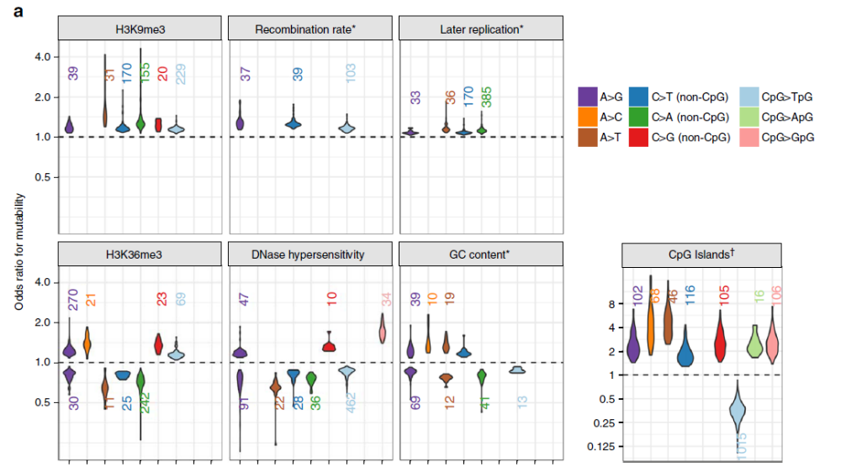
What affects the mutation rate?
Strong local signatures
Epigenetic modifications
Context preference differs across populations!
(Harris and Pritchard, eLife, 2017)
Carlson et al., Nat Commun, 2018

Slide 44

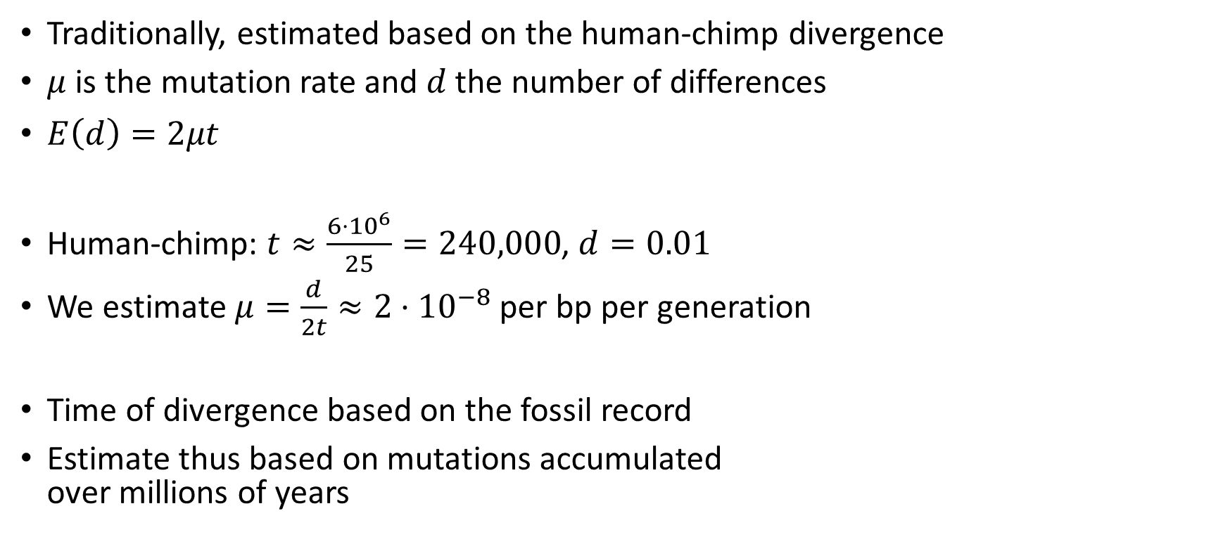
What is the mutation rate?
Traditionally, estimated based on the human-chimp divergence
$μ$ is the mutation rate and $d$ the number of differences
$E\left(d\right)=2μt$
Human-chimp: $t≈\frac{{6⋅10}^{6}}{25}=240,000$, $d=0.01$
We estimate $μ=\frac{d}{2t}≈2⋅{10}^{−8}$ per bp per generation
Time of divergence based on the fossil record
Estimate thus based on mutations accumulated
over millions of years
Ancestor
$$t$$
Species A
ACTGGACAAT
Species B
ACAGTACACT

Slide 45


What is the mutation rate?
Now that we sequence genomes, we can compare parents and children
The mutation rate: mutations per bp in the child but not in parents
All genome-wide studies are consistent with
$μ≈1⋅{10}^{−8}$ per bp per generation
Half the “phylogenetic” rate!
Reflects mutations from the past generation
How can this be?
AA
AA
AG
Segurel et al., Ann Rev Gen, 2014

Slide 46
How can this be?
The “phylogenetic” rate may rely on dubious assumptions on the time of human-chimp divergence, and on the demography during speciation
  Maybe divergence was much longer ago
The “pedigree” rate may rely on over-correcting for false positives, leading to missing actual mutations
Many proposed that the mutation rate has slowed down with evolution
  Supported directly by pedigree studies in primates (Besenbacher et al., Nat Eco Evo, 2019)
Could also be due to a change in the generation time

Slide 47


Another method
Study runs of homozygosity due to consanguinity
Segments should be perfectly homozygous except for new mutations
$μ≈1.5⋅{10}^{−8}$ per bp per generation
Narasimhan et al., Nat Commun, 2017

Slide 48


What is a de novo mutation?
We need to be very specific about what we mean by de novo
Interestingly, some de novo mutations can be shared by siblings (≈3%)
Somatic mutations cause “mosaicism”

Slide 49


More on mosaicism
In blood-extracted DNA, 1/20 British have mosaic chromosomal aberrations:
Deletions, duplications, or loss of heterozygosity, present only in some cells
Can lead to hematologic cancers
1/5 males have
mosaic loss of
Y chr
Loh et al., Nature, 2018
Thompson et al., 2019

Slide 50
Genetic variation data (microarrays)
 | SNP 1 | SNP 2 | SNP 3 | SNP 4 | SNP 5 | SNP 7 | …
Individual 1 | AG | CC | AC | TT | AA | TT | GC
Individual 2 | AA | CT | AC | TT | AA | TT | CC
… | AA | TT | AC | GT | AA | TT | GG
Individual 1 | AG | CC | AA | GG | AA | TT | GG
Individual 2 | AG | TT | AA | GT | AA | CT | GG
… | AA | CC | CC | TT | AG | TT | GC
Population 1
Population 2
≈500k-10M SNPs
≈Hundreds/thousands/more individuals
SNP = Single Nucleotide Polymorphism

Slide 51
Genetic variation terminology
Polymorphism: multiple alleles exist in the population
  Usually two alleles, in particular for SNVs
  If two alleles, called biallelic (or diallelic) site
Major allele: the more common allele
  SNP1: A, SNP2: C
Minor allele: the less common allele
  SNP1: G, SNP2: T
Minor allele frequency (MAF)
  SNP1: 3/12=25%, SNP2: 5/12=41.7%
  Can be at most 50%
Reference allele: the allele found in the reference genome
  Usually the major allele (not always, in case the reference has a rare allele)
Alternate allele: the other allele
 | SNP 1 | SNP 2
Ind 1 | AG | CC
Ind 2 | AA | CT
Ind 3 | AA | TT
Ind 4 | AG | CC
Ind 5 | AG | TT
Ind 6 | AA | CC

Slide 52
Genetic variation terminology
ID: usually based on dbSNP notation
Coordinate (bp): physical location according to the reference genome
Coordinate (cM): “genetic distance” in centiMorgans
 | ID | Chr | Coordinate (bp) | Coordinate (cM)
SNP 1 | rs1234 | 1 | 15423151 | 14.435
SNP 2 | rs2156 | 1 | 27672818 | 24.794
SNP 3 | rs3765 | 1 | 43284920 | 48.321
SNP 4 | rs6435 | 2 | 28395374 | 31.957
SNP 5 | rs1432 | 2 | 49596803 | 54.247
SNP 6 | rs2364 | 2 | 76264098 | 82.573

Slide 53


Genetic maps
The genetic distance (map distance) is a measure of the recombination rate:
If two SNPs are $d$ (cM) apart, the probability of recombination between them, in one generation, is $d/100$
1 Morgan = 100 cM
In humans, on average along the genome, 1Mb ≈ 1.25cM
$d$ cM
SNP1
SNP2

Slide 54
How to measure genetic distances?
Genetic maps, or recombination rates, are available in humans
Direct (pedigree) method: use parent-child genomes and count recombination events (deCODE or 23andMe)
Indirect (population) method: measure the correlation between alleles at the two SNPs (linkage)
  Higher correlation <==> less recombination
  Methods transform correlations to recombination rates
  Available maps: HapMap or 1000 Genomes Project
SNP1
SNP2
A
A
A
A
C
G
C
A
C
G

Slide 55



The recombination rate
The human recombination rate is $≈1⋅{10}^{−8}$ per bp per generation
  Numerically similar to the mutation rate
  About 50% higher rate in females
Weak increase with maternal age
Martin et al., Nat Commun, 2015:
“… because the factors that cause
aneuploidies increase with maternal
age, eggs with more crossovers are
more likely to be able to overcome
these and give rise to a live birth in
older mothers”
On X, recombination rate on the pseudo-autosomal region is extremely high, to guarantee at least one
Campbell et al., Nat Commun, 2015

Slide 56


Recombination hotspots
The recombination rate is only uniform in mega-base scale
Recombination is concentrated in hotspots, between which there is barely any recombination (coldspots)
There are ≈30k hotspots in genome (every ≈100kb), each 1-2kb wide
McVean et al., Science, 2004

Slide 57

What makes hotspots?
Segurel et al., PLOS Biol, 2011
Grey et al., PLOS Genet, 2018
Hotspot recognition is mediated nearly entirely by one gene: PRDM9
The motif is CCNCCNTNNCCNC, but explains only 40% of hotspots
PRDM9 catalyzes trimethylation of Histone 3
at lysine 4 and Histone 4 at lysine 36
This recruits recombination machinery
  Creating double-strand break, repair proteins, etc.
The only speciation gene known in vertebrates
Mice heretrozygous to PRDM9 alleles from two sub-species are sterile
Generate epigenetic mark to initiate recombination
DNA binding domain

Slide 58


PRDM9 evolution
Individuals with a different PRDM9 allele have very different binding motifs and hotspots (explains 80% of heritable variation in ‘‘hotspot usage’’)
PRDM9 is one of the fastest evolving genes. Why?
Crossovers “delete” their own binding motifs
PRDM9 must evolve to maintain recombination
  Important to avoid aneuploidy and increase diversity
Hotspots completely gone by <1Myr
  Lesecque et al., PLOS Genetics, 2014
“Red-queen” hypothesis

