Slide 1
Personal Genomics
Ancestry inference
Shai Carmi
School of Public Health

Slide 2
Problems
What is the genetic ancestry of an individual?
Can we assign individuals to populations/geographic regions?
Can we tell the proportion of ancestry for admixed individuals?
Can we visually identify clusters of similar individuals?
Can we infer the ancestry of each genomic region? And what does it imply on the population’s history?

Slide 3
Outline
PCA in population genetics
A model for ancestry proportions
Local ancestry inference
Inferring admixture time

Slide 4
Human genetics: very high dimensional data
Typical population genetic data
 | SNP 1 | SNP 2 | SNP 3 | SNP 4 | SNP 5 | SNP 7 | …
Individual 1 | 1 | 0 | 1 | 2 | 0 | 0 | 1
Individual 2 | 0 | 1 | 1 | 2 | 0 | 0 | 2
… | 0 | 2 | 1 | 1 | 0 | 0 | 0
Individual 1 | 1 | 0 | 0 | 0 | 0 | 0 | 0
Individual 2 | 1 | 2 | 0 | 1 | 0 | 1 | 0
… | 0 | 0 | 2 | 2 | 1 | 0 | 1
Population 1
Population 2
≈Hundreds/Thousands
of individuals
≈500k-1M SNPs
High dimension!

Slide 5
Dimension reduction
Data in very high dimension (thousands or more) is common
  Genotypes
  Imaging
  Clinical records
  Wearables
  Nutrition
Which features are important?
How to find sample similarity or clusters?
How to visualize?

Slide 6
Dimension reduction
Does this dataset really need to be represented in two dimensions?
At the cost of a little loss of information, we can use just the horizontal (rotated) axis
x
x
x
x
x
x
x
x
x
x
x
x
x
x
x
x
x
x
x
x
x
x
Most of the variation is along this axis
x
x
x
x
x
x
x
x
x
x
x
x
x
x
x
x
x
x
x
x
x
x
x
x
x
x
x
x
x
x
x
x
x
x
x
x
x
x
x
x
x
x
x
x
x
x
x
x
x
x
x
x
x
x
x
x
x
x
x
x
x
x
x
x
x
x
Little variation along this axis

Slide 7
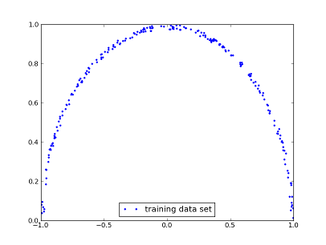
Dimension reduction
Does this dataset really need to be represented in two dimensions?
Clearly, the radius is almost the same for all points
So each data point can be represented only by its θ, with a minimal loss of information
θ

Slide 8
Dimension reduction
Calculate the variance along each possible axis
Axes with little variation are less interesting
Could be removed without a significant loss
The most important and popular method of dimension reduction is Principal Component Analysis (PCA)
Most of the variation is along this axis
x
x
x
x
x
x
x
x
x
x
x
x
x
x
x
x
x
x
x
x
x
x
Little variation along this axis

Slide 9
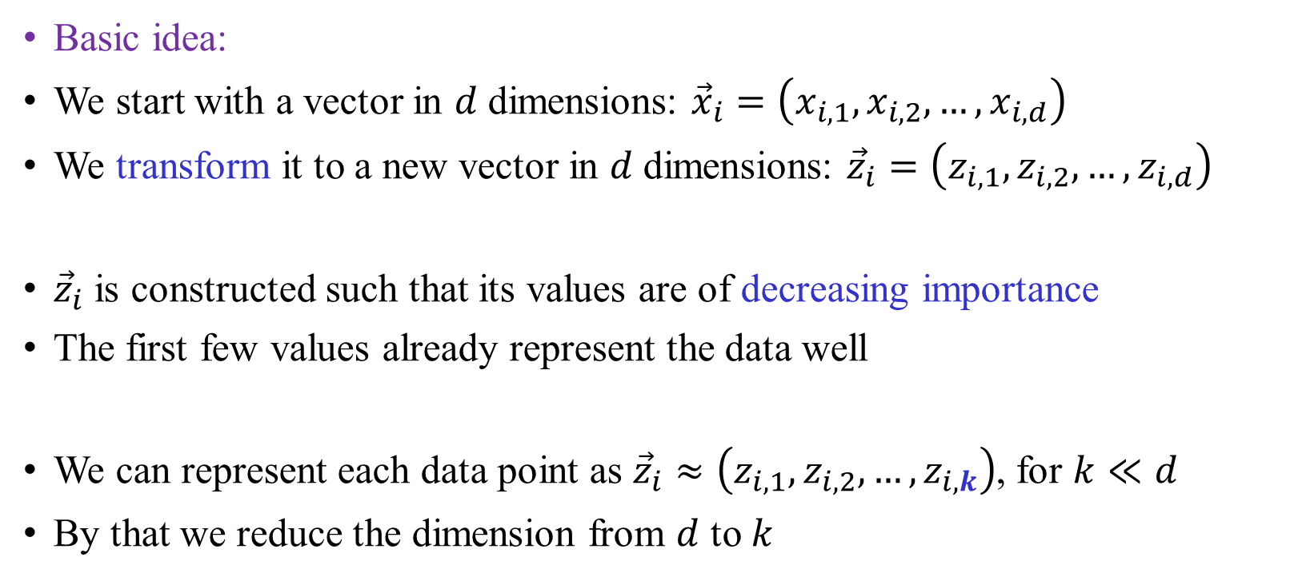
Principal Component Analysis (PCA)
Basic idea:
We start with a vector in $d$ dimensions: ${\vec{x}}_{i}=\left(x_{i,1},x_{i,2},…,x_{i,d}\right)$
We transform it to a new vector in $d$ dimensions: ${\vec{z}}_{i}=\left(z_{i,1},z_{i,2},…,z_{i,d}\right)$
${\vec{z}}_{i}$ is constructed such that its values are of decreasing importance
The first few values already represent the data well
We can represent each data point as ${\vec{z}}_{i}≈\left(z_{i,1},z_{i,2},…,z_{i,k}\right)$, for $k≪d$
By that we reduce the dimension from $d$ to $k$

Slide 10
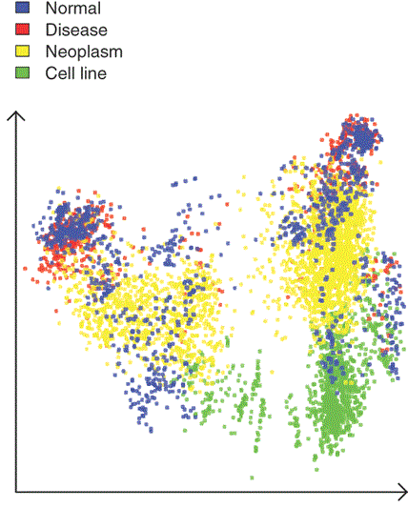
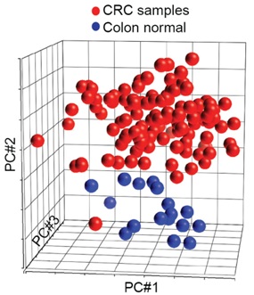
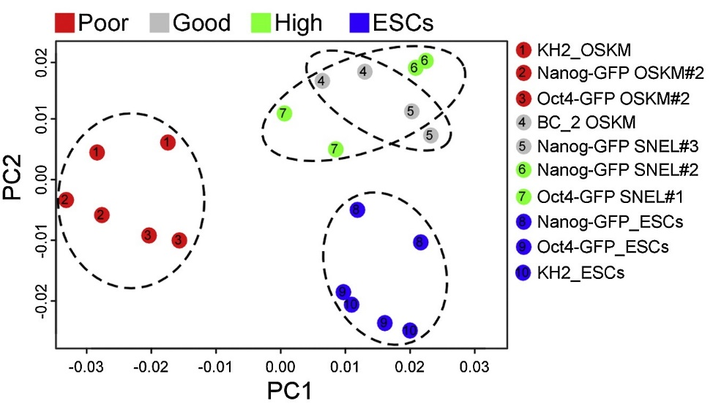
Examples: molecular biology and medicine
Gene expression in cancers
Gene expression in induced pluripotent vs embryonic stem cells (Buganim lab)

Slide 11
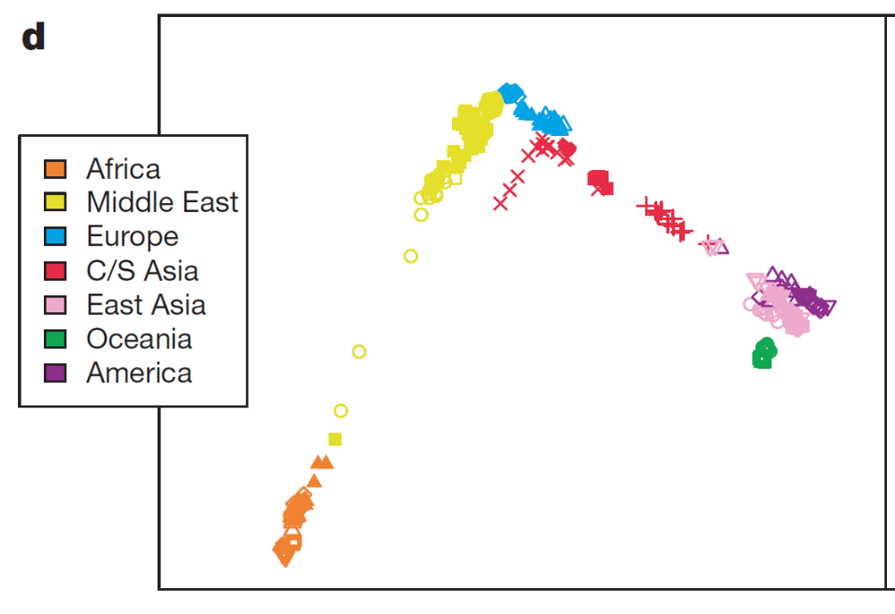
Human genetics: world populations
PCA shows that individuals cluster according to their geography
Jakobsson et al., Nature, 2008

Slide 12
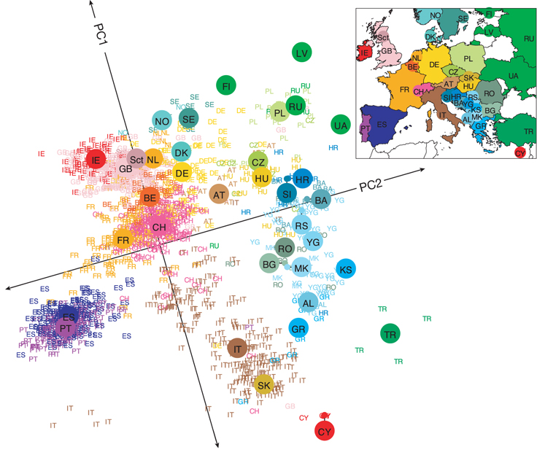
Human genetics: Europe
3,000 Europeans, 0.5M markers
AL, Albania; AT, Austria; BA, Bosnia-Herzegovina; BE, Belgium; BG, Bulgaria; CH, Switzerland; CY, Cyprus; CZ, Czech Republic; DE, Germany; DK, Denmark; ES, Spain; FI, Finland; FR, France; GB, United Kingdom; GR, Greece; HR, Croatia; HU, Hungary; IE, Ireland; IT, Italy; KS, Kosovo; LV, Latvia; MK, Macedonia; NO, Norway; NL, Netherlands; PL, Poland; PT, Portugal; RO, Romania; RS, Serbia and Montenegro; RU, Russia, Sct, Scotland; SE, Sweden; SI, Slovenia; SK, Slovakia; TR, Turkey; UA, Ukraine; YG, Yugoslavia
Novembre et al., Nature, 2008, Genes mirror geography within Europe

Slide 13
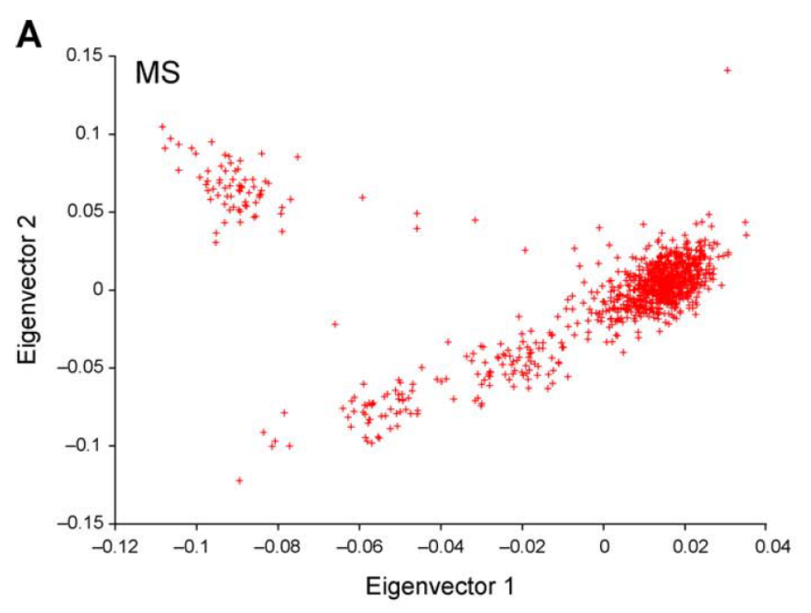
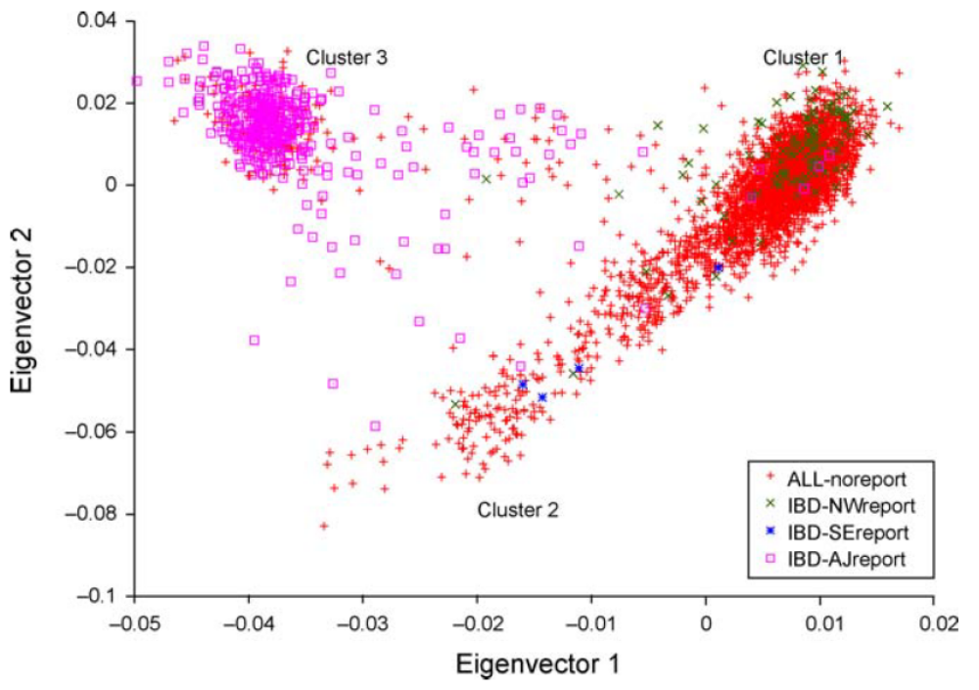
Outliers in Europe?
Ashkenazi Jews
Price et al., PLOS Genetics, 2008
?
Northern Europe
Southern Europe

Slide 14
Western Eurasia
Middle-East
Europe
Ashkenazi Jews (AJ)
Druze
Tuscans
French
Palestinians
Russians
Italians
Flemish
Bedouins
Sephardi Jews
(Italy, Turkey)
Basque
Sardinians
AJ have mixed European and Middle-Eastern ancestries
Close to Sephardi Jews
Carmi et al., Nat Commun, 2014; many previous studies

Slide 15
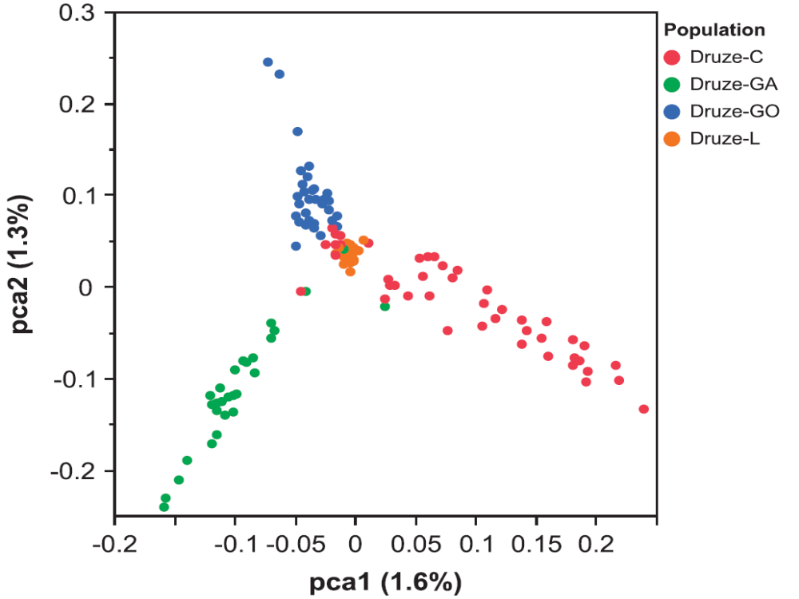
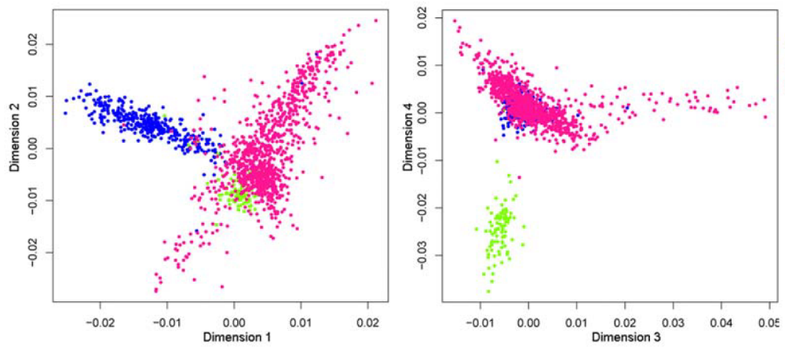
Lebanon and Druze
Zidan et al., EJHG, 2015
Haber et al., PLOS Genet, 2013
Carmel
Galil
Golan
Lebanon
Lebanese Christians
Lebanese Muslims
Lebanese Druze

Slide 16
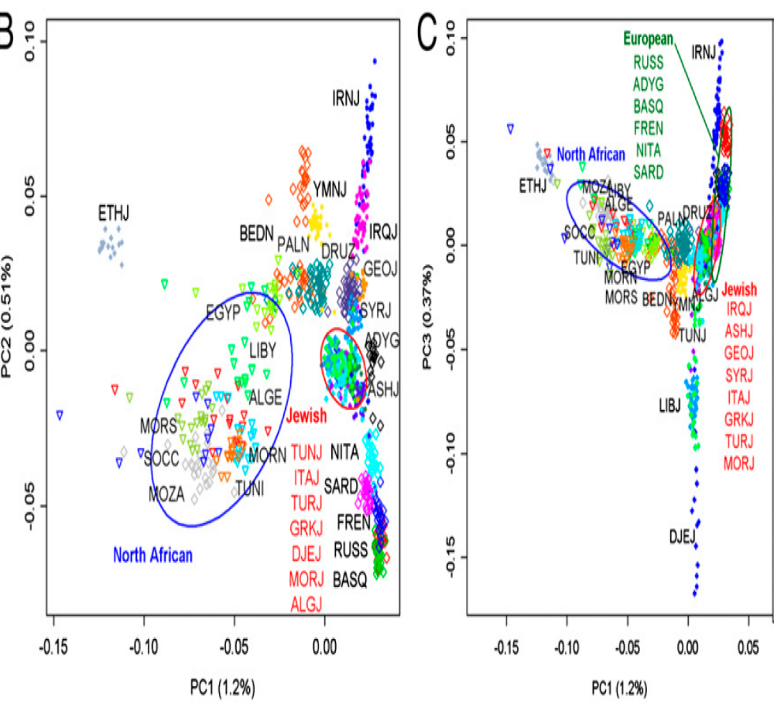
Middle-Eastern and North-African Jews
Middle-Eastern Jews
Genetic similarity between Ashkenazi, Sephardi, and North-African Jews
Also evident in high levels of genetic sharing
Middle-Eastern+Caucasian Jews form another cluster
Campbell et al., PNAS, 2012; Atzmon et al, AJHG 2010
Behar et al., Nature, 2010; Behar et al., Hum Biol, 2013

Slide 17
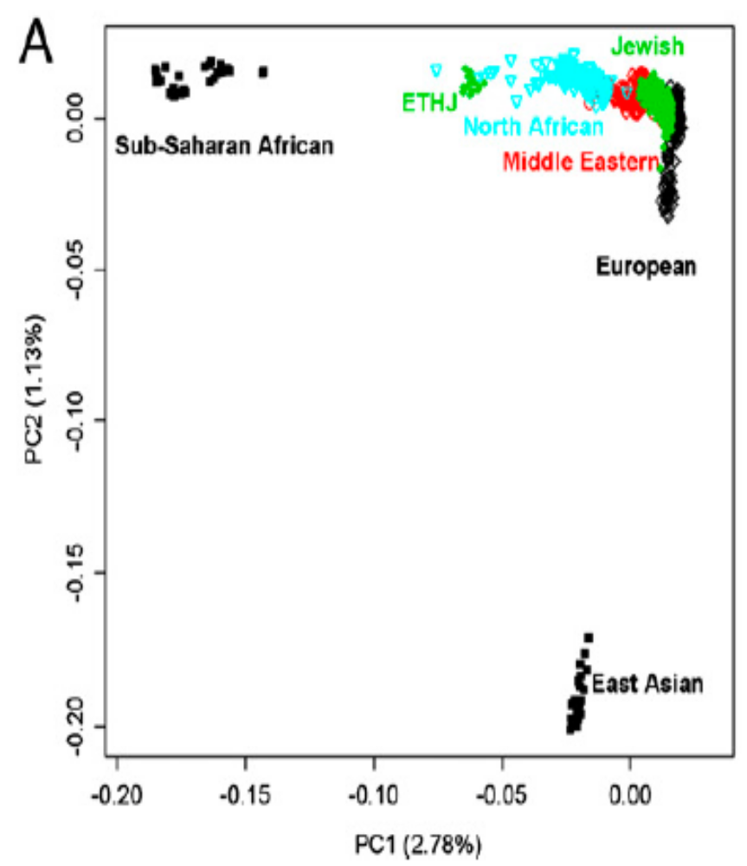
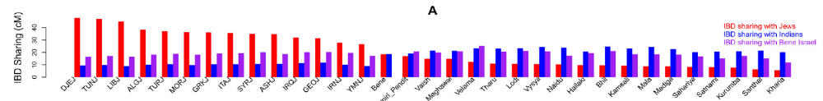
Other Jews
Yemenite Jews
  Distinct from other Jewish communities but also from Yemenites
  Weak signal of shared ancestry with other Jews
  Behar et al., Nature, 2010; Campbell et al., PNAS, 2012
Ethiopian, Indian, Chinese:
  Very close to their local populations
  Weak connections to the Middle-East in Indian Jews
  Waldman et al., Hum Genet, PLOS One, 2016, Tzur, Carmi, et al., unpublished
Campbell et al, PNAS, 2012
Waldman et al, PLOS One, 2016
Similarity to Jews
Similarity to Indians
Similarity to Indian Jews
Jewish populations

Slide 18
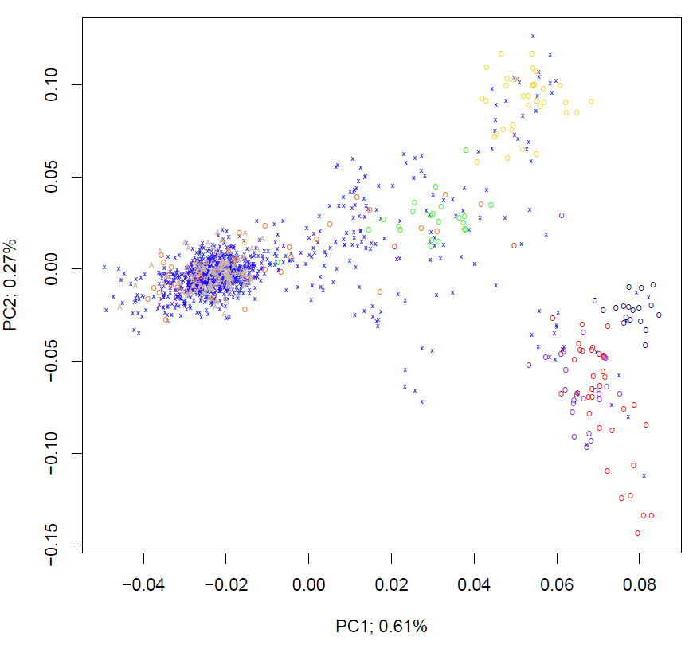
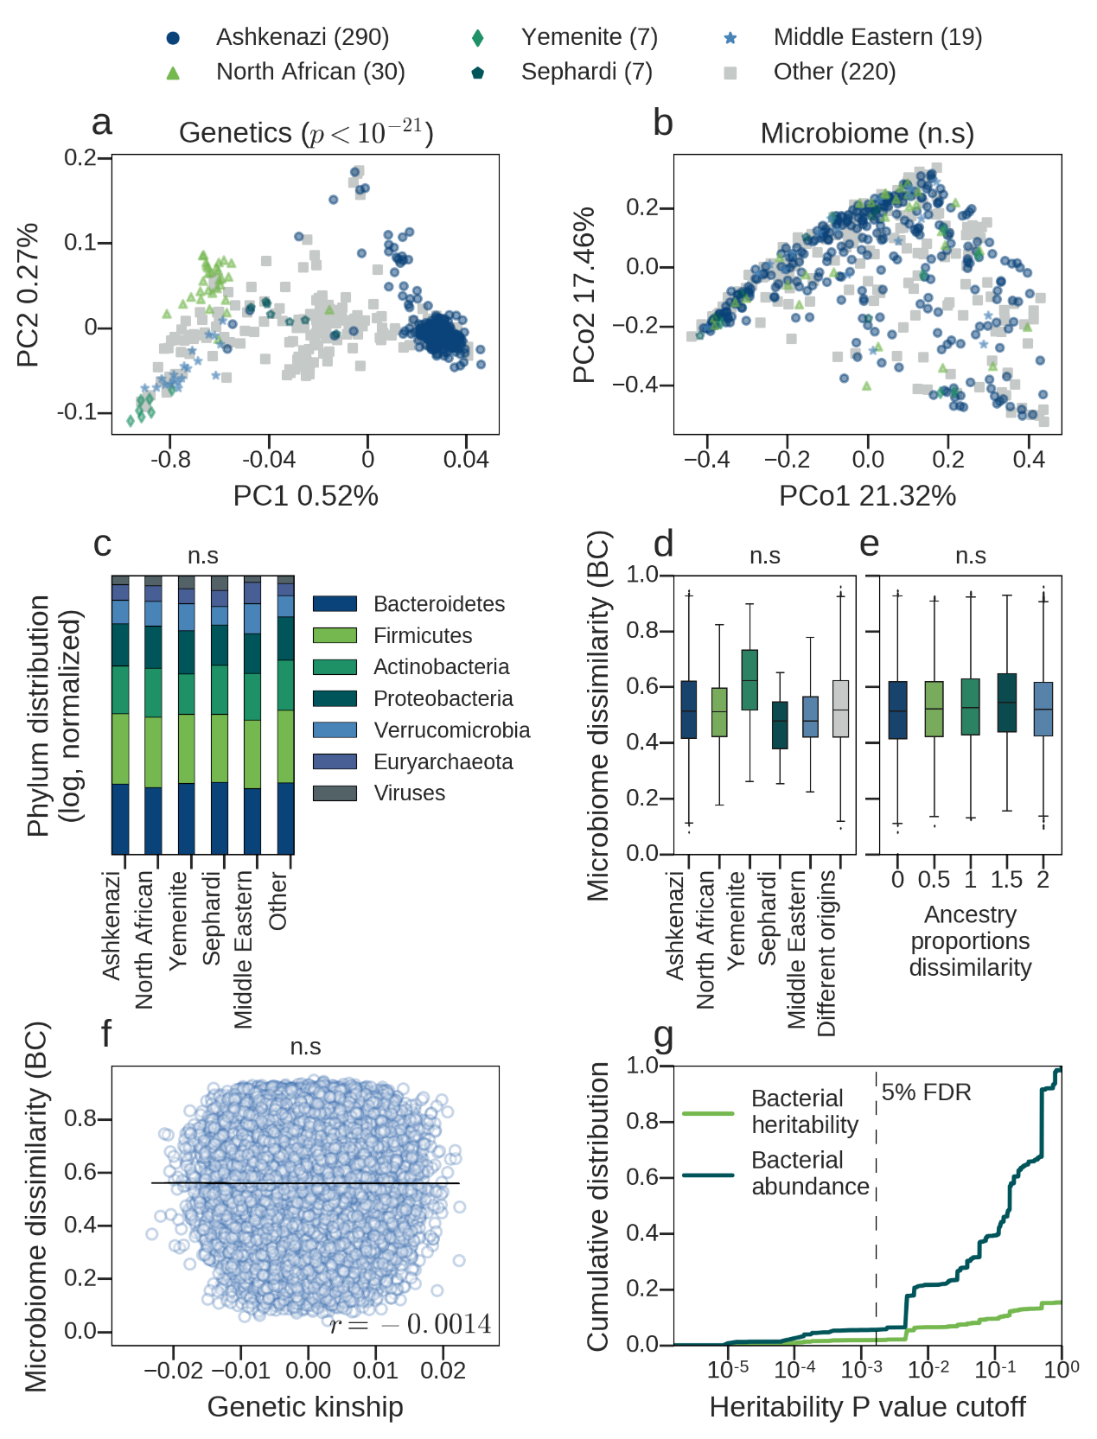
Recent studies from Israel
North-African
Sephardi
Yemenite
Ashkenazi
Caucasus
Kibbuzim in the North (n≈900)
Middle-East
A microbiome-host genetics study, Rehovot (n≈1000)
Granot-Hershkovitz, …, Carmi*, Hochner*, EJHG, 2018
Rothschild, …, Carmi, …, Segal, Nature, 2018

Slide 19
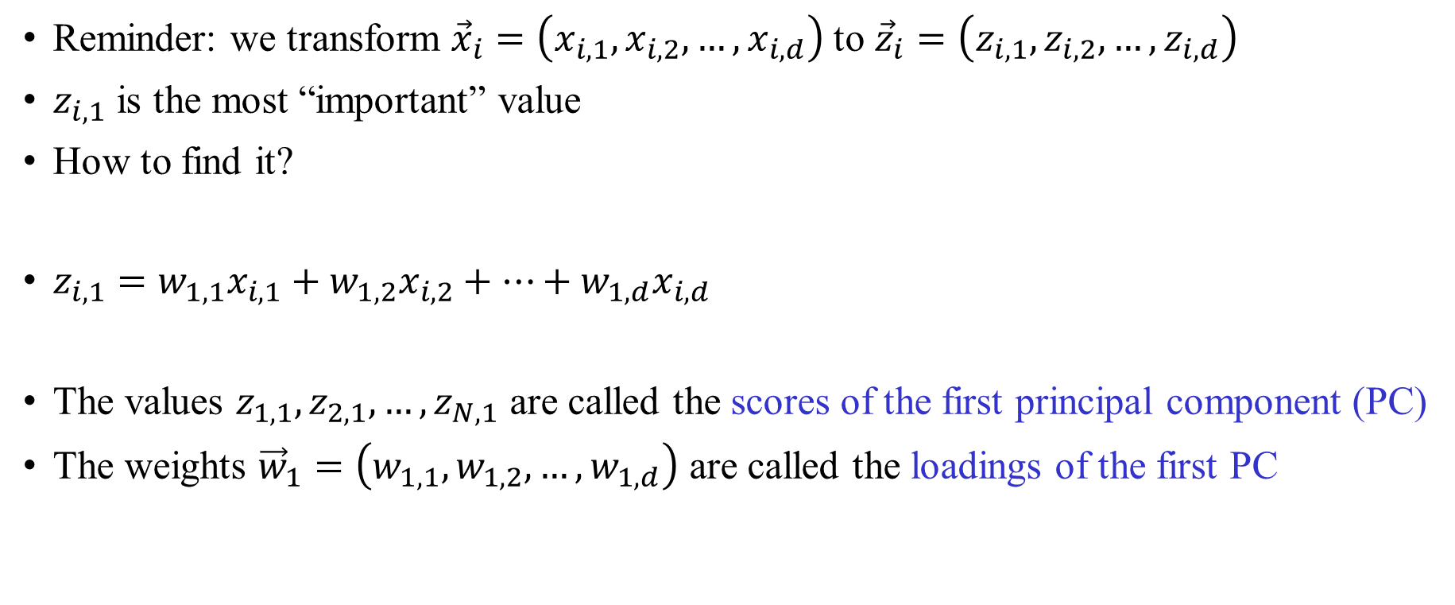
PCA: first step
Reminder: we transform ${\vec{x}}_{i}=\left(x_{i,1},x_{i,2},…,x_{i,d}\right)$ to ${\vec{z}}_{i}=\left(z_{i,1},z_{i,2},…,z_{i,d}\right)$
$z_{i,1}$ is the most “important” value
How to find it?
$z_{i,1}=w_{1,1}x_{i,1}+w_{1,2}x_{i,2}+…+w_{1,d}x_{i,d}$
The values $z_{1,1},z_{2,1},…,z_{N,1}$ are called the scores of the first principal component (PC)
The weights ${\vec{w}}_{1}=\left(w_{1,1},w_{1,2},…,w_{1,d}\right)$ are called the loadings of the first PC

Slide 20
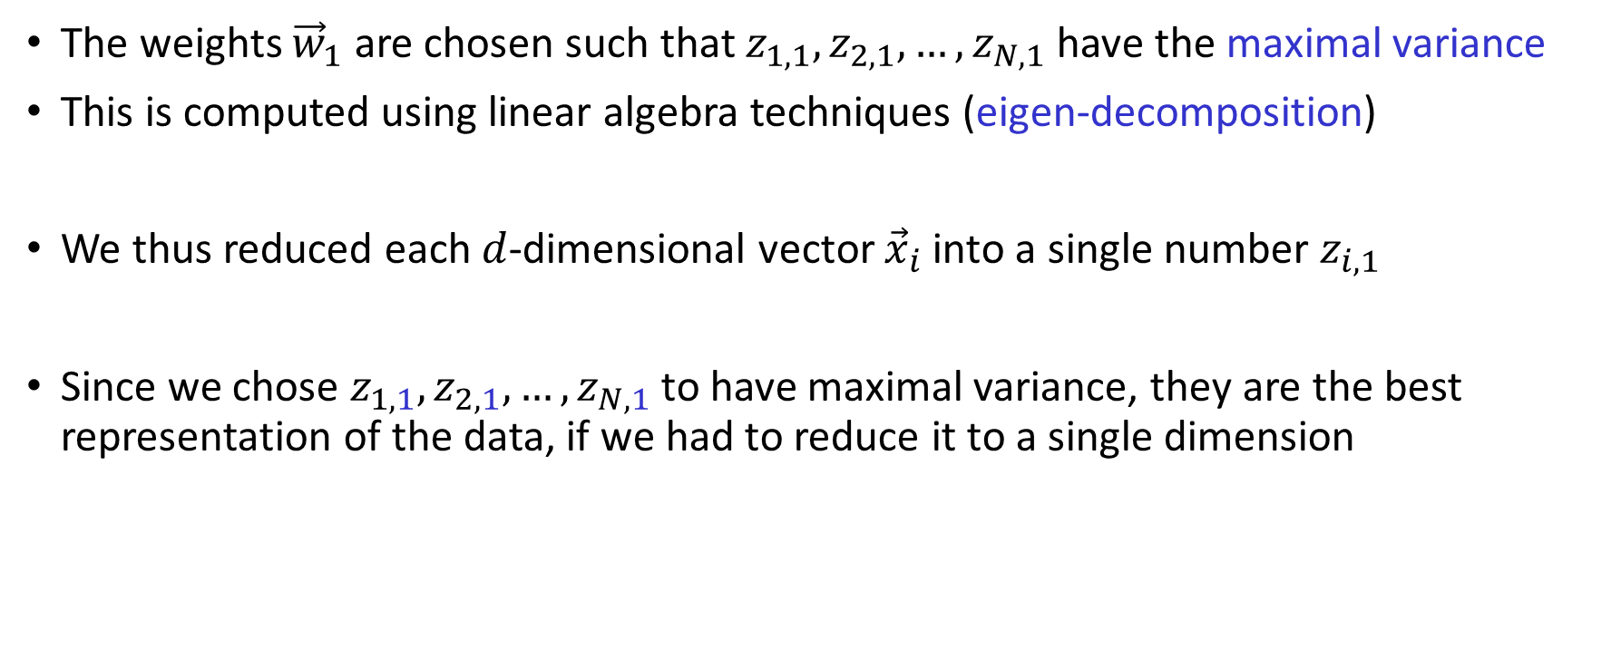
Computing the first PC
The weights ${\vec{w}}_{1}$ are chosen such that $z_{1,1},z_{2,1},…,z_{N,1}$ have the maximal variance
This is computed using linear algebra techniques (eigen-decomposition)
We thus reduced each $d$-dimensional vector ${\vec{x}}_{i}$ into a single number $z_{i,1}$
Since we chose $z_{1,1},z_{2,1},…,z_{N,1}$ to have maximal variance, they are the best representation of the data, if we had to reduce it to a single dimension

Slide 21
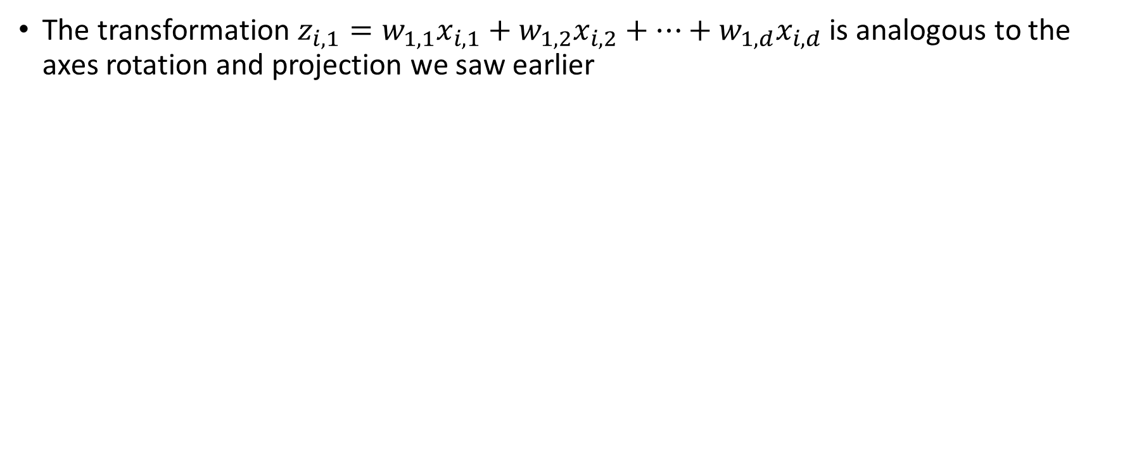
The first PC
The transformation $z_{i,1}=w_{1,1}x_{i,1}+w_{1,2}x_{i,2}+…+w_{1,d}x_{i,d}$ is analogous to the axes rotation and projection we saw earlier
x
The transformation
x
x
x
x
x
x
x
x
x
x
x
x
x
x
x
x
x
x
x
x
x
x
x
x
x
x
x
x
x
x
x
x
x
x
x
x
x
x
x
x
x
x
x
The coordinates along the new $x$-axis are the numbers $z_{i,1}$

Slide 22
The second principal component
We already found an axis (for PC1) that represents the maximal variance
What to do with the remaining variance?
We would like to find an axis along which
the remaining variance is maximal
x
x
x
x
x
x
x
x
x
x
x
x
x
x
x
x
x
x
x
x
x
x
Variability remains along the y-axis

Slide 23
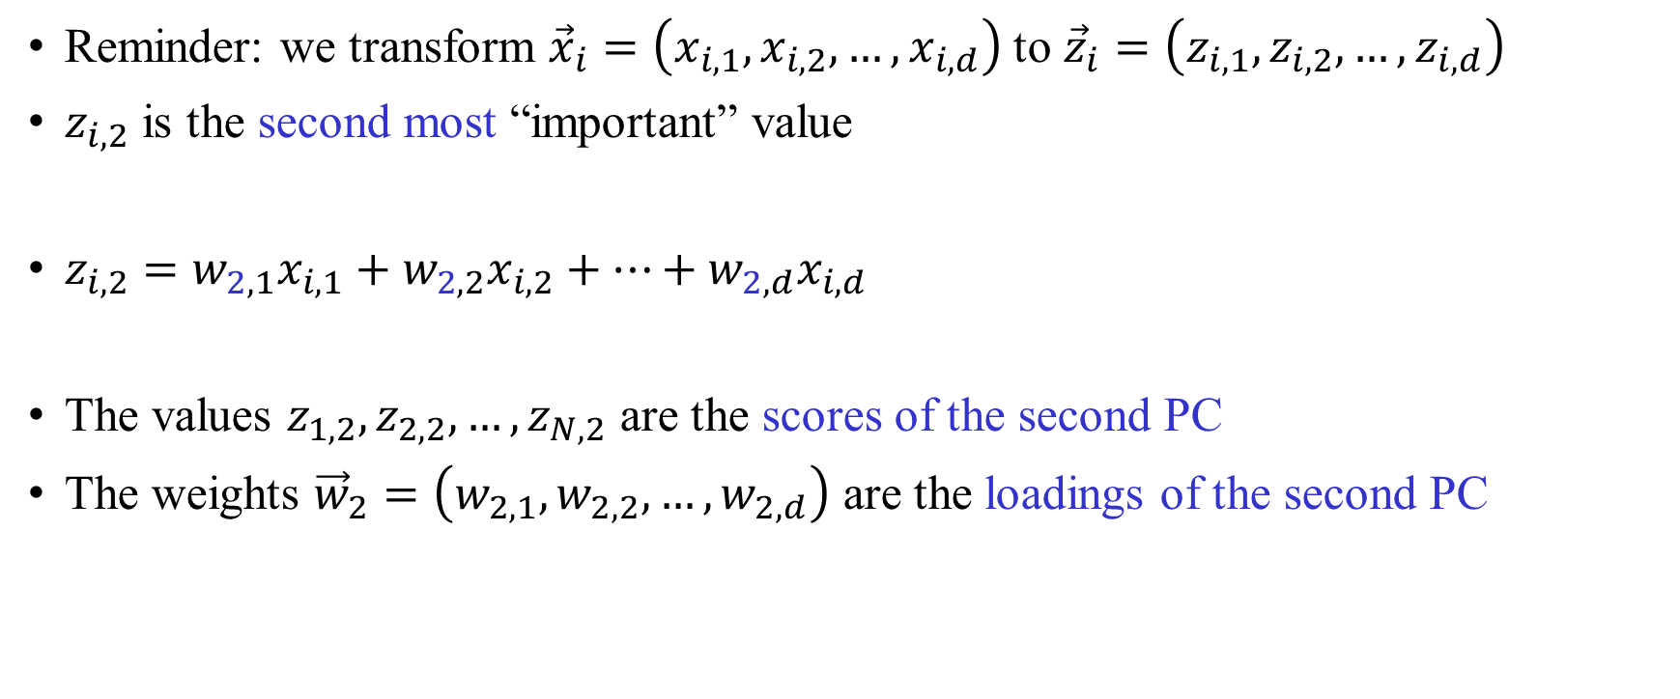
The second PC
Reminder: we transform ${\vec{x}}_{i}=\left(x_{i,1},x_{i,2},…,x_{i,d}\right)$ to ${\vec{z}}_{i}=\left(z_{i,1},z_{i,2},…,z_{i,d}\right)$
$z_{i,2}$ is the second most “important” value
$z_{i,2}=w_{2,1}x_{i,1}+w_{2,2}x_{i,2}+…+w_{2,d}x_{i,d}$
The values $z_{1,2},z_{2,2},…,z_{N,2}$ are the scores of the second PC
The weights ${\vec{w}}_{2}=\left(w_{2,1},w_{2,2},…,w_{2,d}\right)$ are the loadings of the second PC

Slide 24
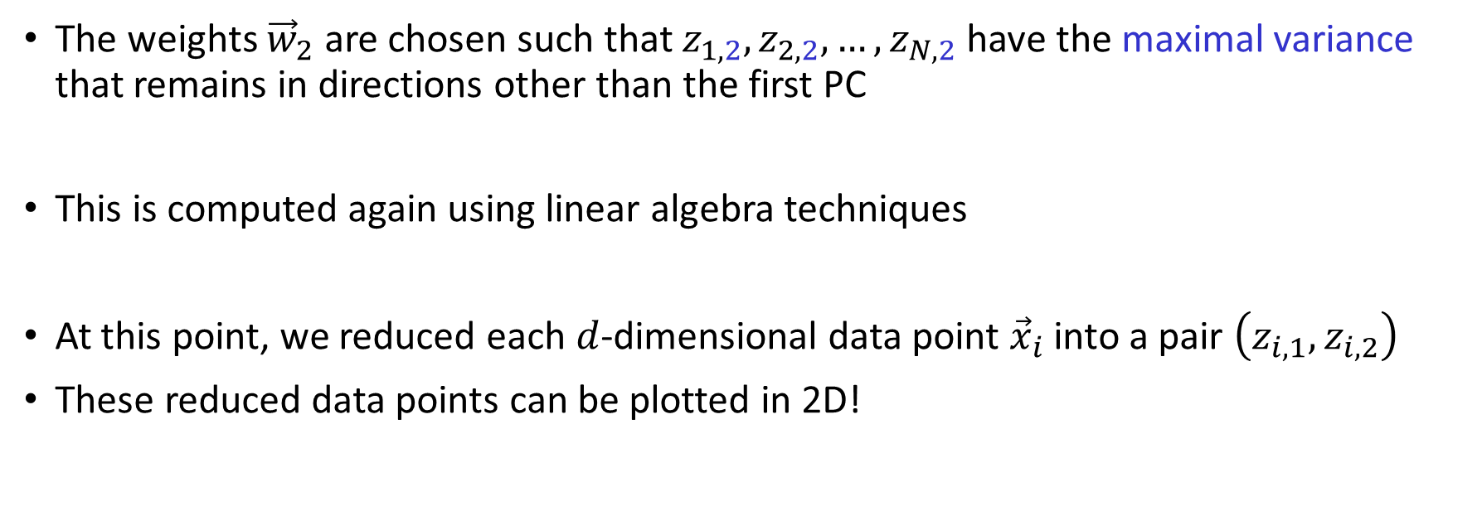
The second PC
The weights ${\vec{w}}_{2}$ are chosen such that $z_{1,2},z_{2,2},…,z_{N,2}$ have the maximal variance that remains in directions other than the first PC
This is computed again using linear algebra techniques
At this point, we reduced each $d$-dimensional data point ${\vec{x}}_{i}$ into a pair $\left(z_{i,1},z_{i,2}\right)$
These reduced data points can be plotted in 2D!

Slide 25
An interactive visualization
http://setosa.io/ev/principal-component-analysis/

Slide 26
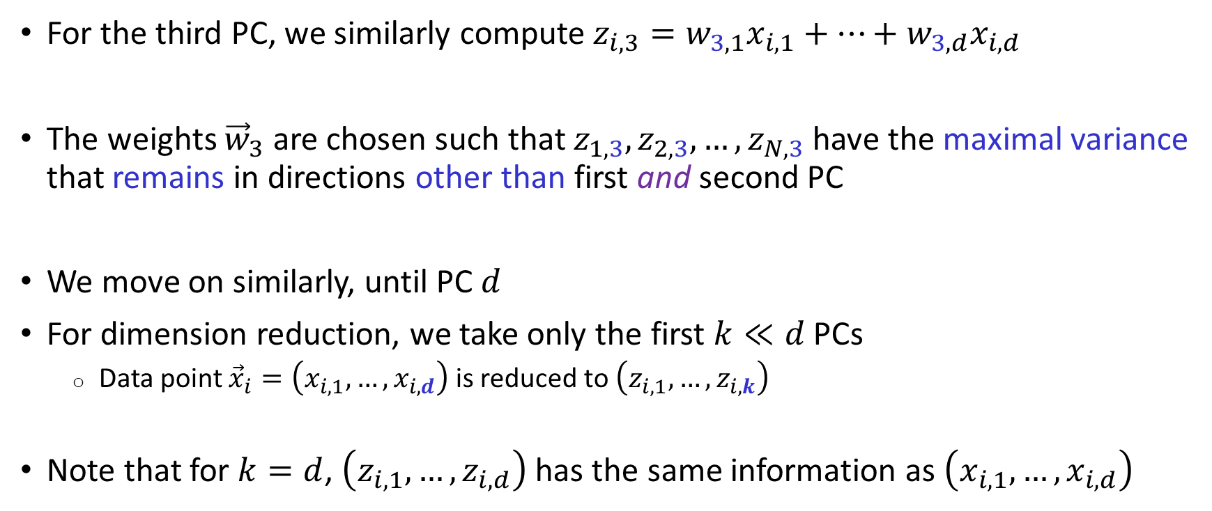
Higher PCs
For the third PC, we similarly compute $z_{i,3}=w_{3,1}x_{i,1}+…+w_{3,d}x_{i,d}$
The weights ${\vec{w}}_{3}$ are chosen such that $z_{1,3},z_{2,3},…,z_{N,3}$ have the maximal variance that remains in directions other than first and second PC
We move on similarly, until PC $d$
For dimension reduction, we take only the first $k≪d$ PCs
  Data point ${\vec{x}}_{i}=\left(x_{i,1},…,x_{i,d}\right)$ is reduced to $\left(z_{i,1},…,z_{i,k}\right)$
Note that for $k=d$, $\left(z_{i,1},…,z_{i,d}\right)$ has the same information as $\left(x_{i,1},…,x_{i,d}\right)$

Slide 27
What’s missing?
PCA can unambiguously assign individuals to populations only if the populations are highly diverged
For admixed individuals, PCA is not quantitative
  It has little information on the proportion of the genome coming from each source
  It has little information on the source populations

Slide 28
Outline
PCA in population genetics
A model for ancestry proportions
Local ancestry inference
Inferring admixture time

Slide 29
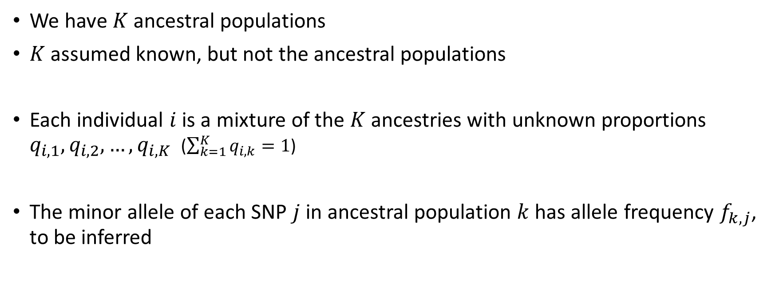
ADMIXTURE: ancestry mixture model
We have $K$ ancestral populations
$K$ assumed known, but not the ancestral populations
Each individual $i$ is a mixture of the $K$ ancestries with unknown proportions $q_{i,1},q_{i,2},…,q_{i,K}$ ($\sum_{k=1}^{K}{q_{i,k}}=1$)
The minor allele of each SNP $j$ in ancestral population $k$ has allele frequency $f_{k,j}$, to be inferred
Pritchard, Stephens, and Donnelly, Genetics, 2000
Alexander, Novembre, and Lange, Genome Res, 2009

Slide 30





















Graphically
Ancestry proportions
Example: three ancestral populations: blue, red, green
1
2
3
4
Allele frequencies
$$q_{1,b}$$
$$q_{3,b}$$
$$q_{4,b}$$
$$q_{2,b}$$
SNP 1
SNP 2
SNP 3
$$q_{4,r}$$
100%
$$q_{1,r}$$
$$q_{2,r}$$
100%
$$q_{3,r}$$
$$q_{4,g}$$
$$q_{1,g}$$
$$q_{2,g}$$
blue
red
green
blue
red
green
blue
red
green
$$q_{3,g}$$
$$f_{b,1}$$
$$f_{r,1}$$
$$f_{g,1}$$
$$f_{b,2}$$
$$f_{r,2}$$
$$f_{g,2}$$
$$f_{b,3}$$
$$f_{r,3}$$
$$f_{g,3}$$
Individuals
SNPs

Slide 31





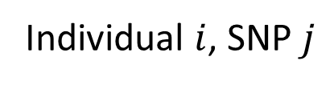






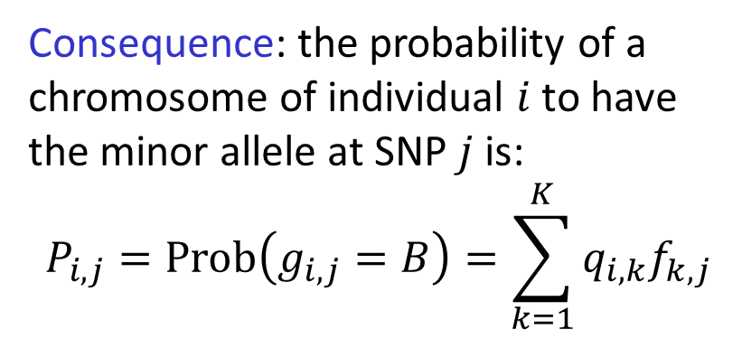
The probability to have the minor allele
A: major allele
B: minor allele
Consequence: the probability of a chromosome of individual $i$ to have the minor allele at SNP $j$ is:
$$P_{i,j}=\text{Prob}\left(g_{i,j}=B\right)=\sum_{k=1}^{K}{q_{i,k}f_{k,j}}$$
Individual $i$, SNP $j$
$$q_{i,b}$$
$$q_{i,g}$$
$$q_{i,r}$$
blue
red
green
$$f_{b,j}$$
$${1−f}_{b,j}$$
$$f_{r,j}$$
$${1−f}_{r,j}$$
$$f_{g,j}$$
$${1−f}_{g,j}$$
$g_{i,j}$: allele of SNP $j$ at individual $i$
$$g_{i,j}$$
B
A
B
A
B
A

Slide 32
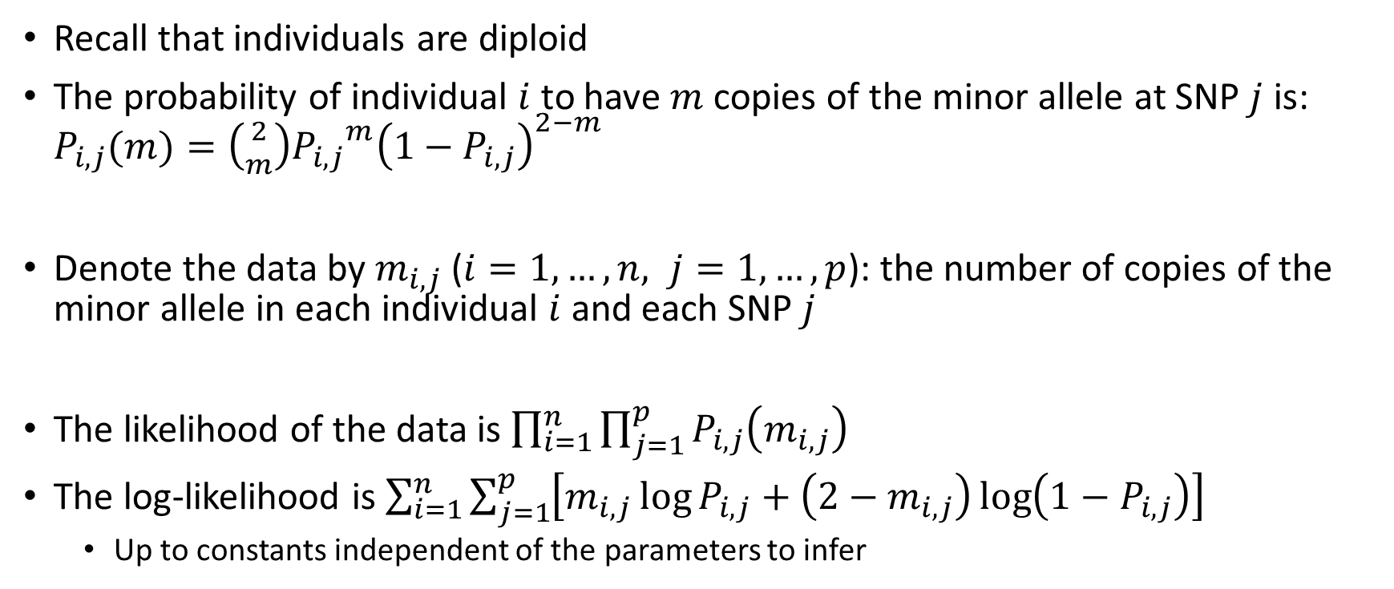
Ancestry mixture model
Recall that individuals are diploid
The probability of individual $i$ to have $m$ copies of the minor allele at SNP $j$ is: $P_{i,j}(m)=\left({2 \atop m}\right){P_{i,j}}^{m}{\left(1−P_{i,j}\right)}^{2−m}$
Denote the data by $m_{i,j}$ ($i=1,…,n, j=1,…,p$): the number of copies of the minor allele in each individual $i$ and each SNP $j$
The likelihood of the data is $\prod_{i=1}^{n}{\prod_{j=1}^{p}{P_{i,j}\left(m_{i,j}\right)}}$
The log-likelihood is $\sum_{i=1}^{n}{\sum_{j=1}^{p}{\left[m_{i,j}\log{P_{i,j}}+\left(2−m_{i,j}\right)\log\left(1−P_{i,j}\right)\right]}}$
  Up to constants independent of the parameters to infer

Slide 33
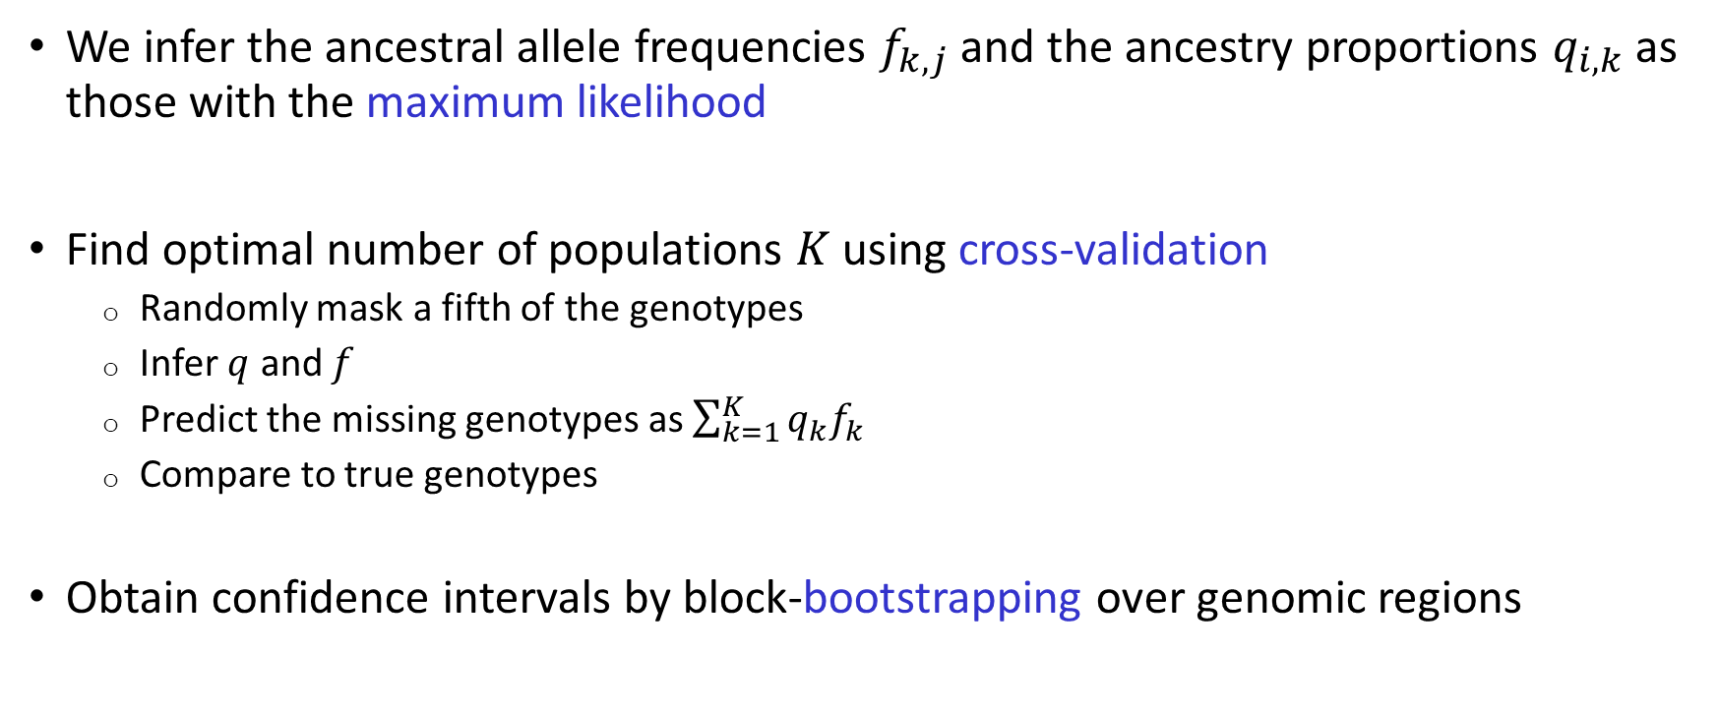
Inference
We infer the ancestral allele frequencies $f_{k,j}$ and the ancestry proportions $q_{i,k}$ as those with the maximum likelihood
Find optimal number of populations $K$ using cross-validation
  Randomly mask a fifth of the genotypes
  Infer $q$ and $f$
  Predict the missing genotypes as $\sum_{k=1}^{K}{q_{k}f_{k}}$
  Compare to true genotypes
Obtain confidence intervals by block-bootstrapping over genomic regions

Slide 34
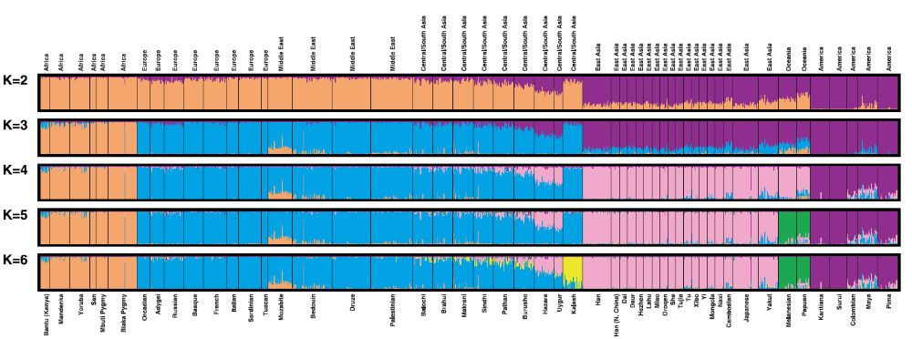
First application in humans
Rosenberg et al., Science, 2002 (STRs)
Central/South Asia
Middle-East
Africa
Europe
East Asia
Oceania

Slide 35
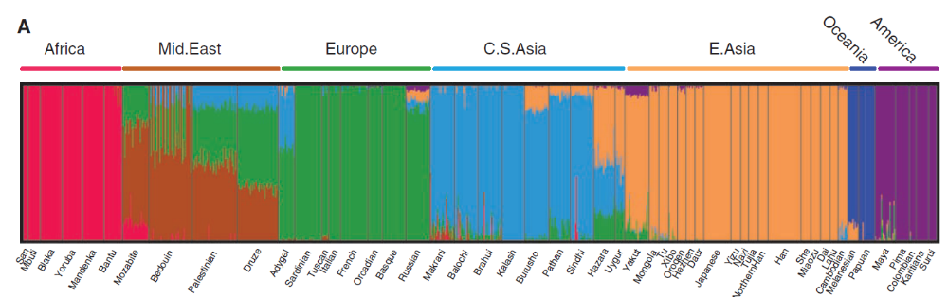
More world-wide applications
Li et al., Science, 2008
Auton et al., Genome Res, 2009

Slide 36
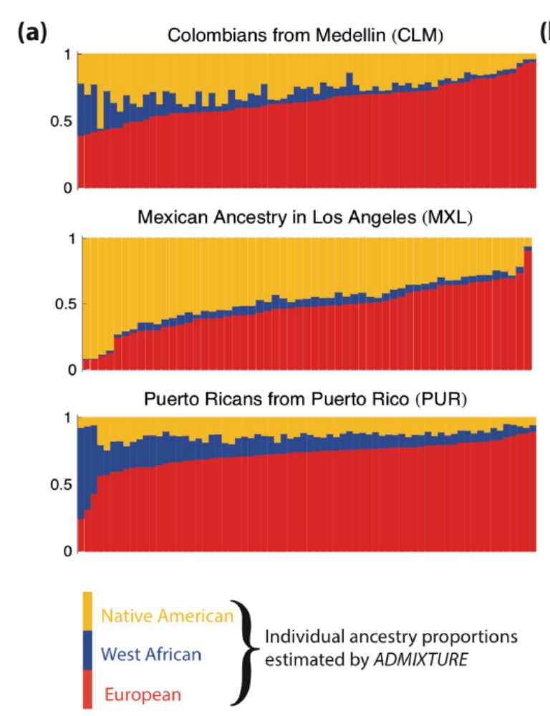
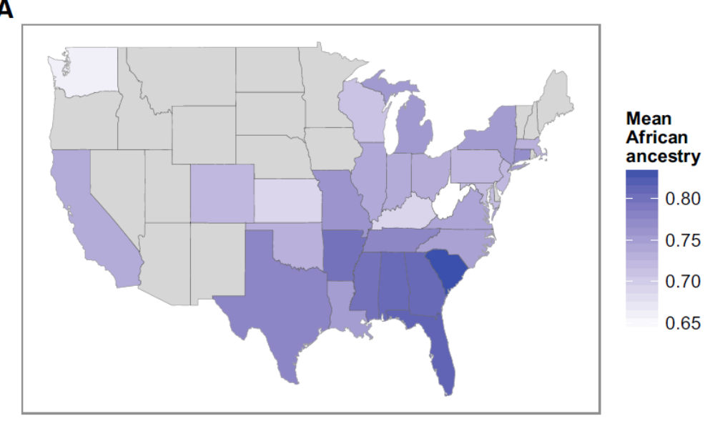
The Americas
Gravel et al., PLOS Genet, 2013
Bryc et al., AJHG, 2015

Slide 37
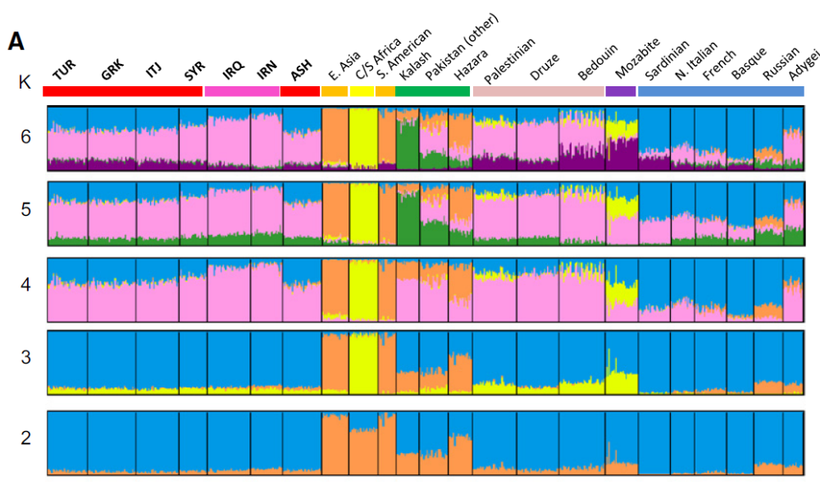
Jews and the Middle-East
Atzmon et al., AJHG 2010

Slide 38
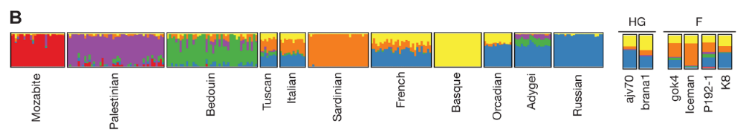
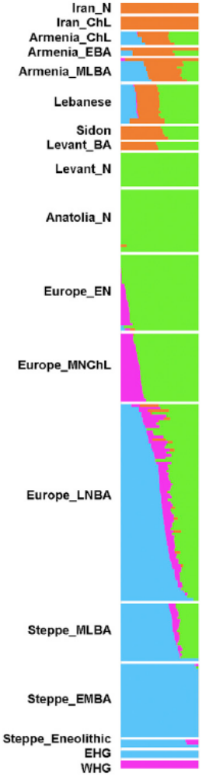
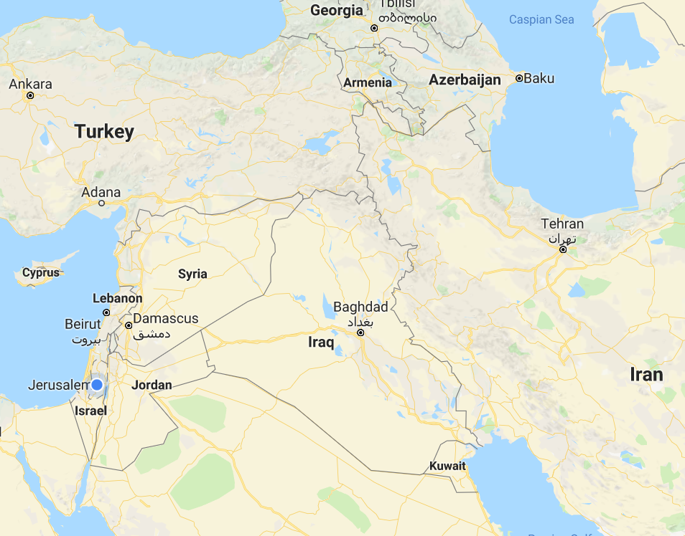
Ancient DNA
Sikora et al., PLOS Genet, 2014
3000-8000 years ago
Haber et al., AJHG, 2017

Slide 39
Outline
PCA in population genetics
A model for ancestry proportions
Local ancestry inference
Inferring admixture time

Slide 40
Local Ancestry Inference
ADMIXTURE estimate the global ancestry proportions (genome-wide)
Can we infer the ancestry at each SNP?
Motivation:
  An additional way to estimate global ancestry proportions
  Deviations in local ancestry from the genome-wide average at a SNP can indicate selection or an association with a disease
  Highly informative on historical demographic processes, e.g., admixture time

Slide 41
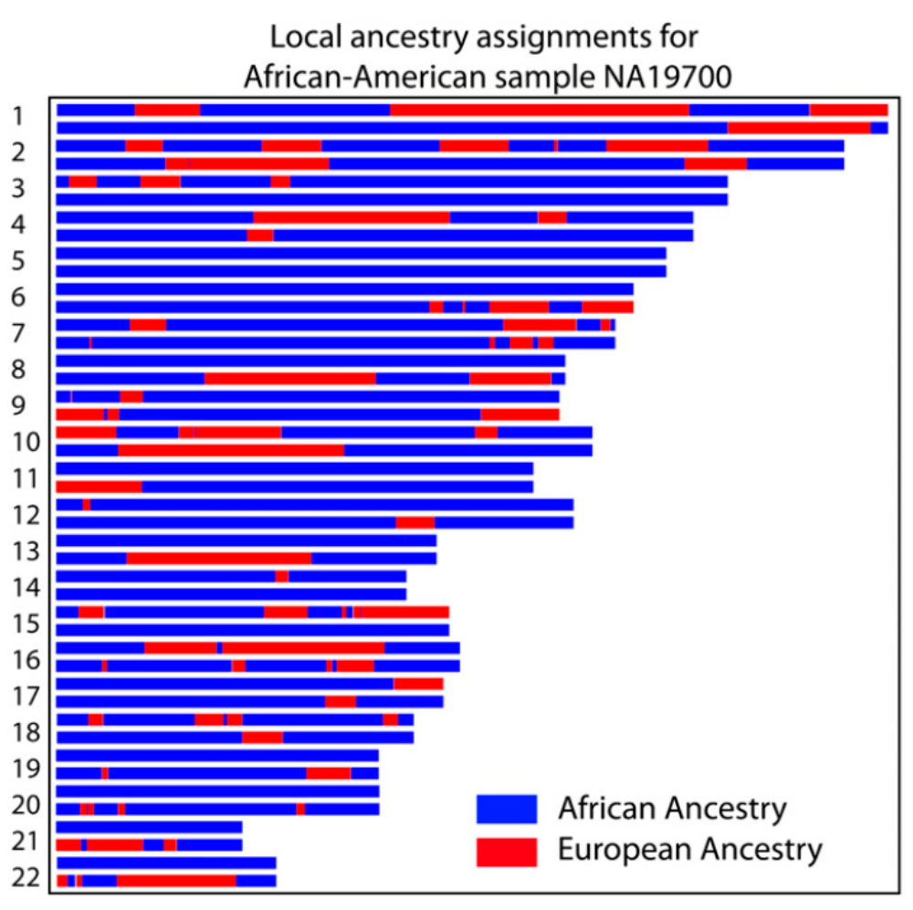
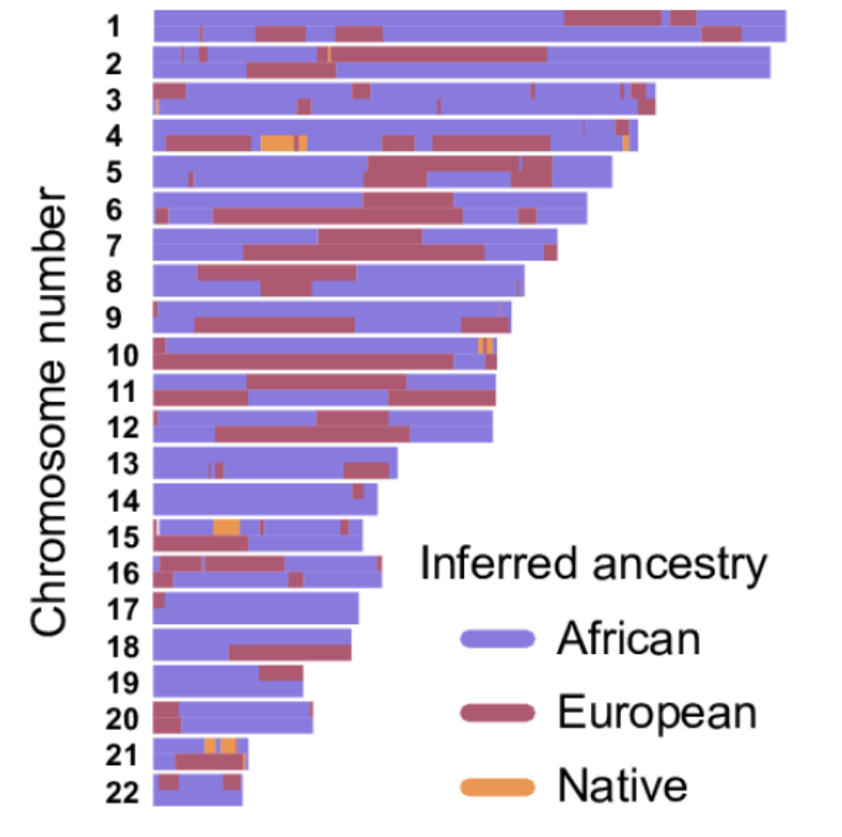
African-Americans
Gravel, Genetics, 2012
Baharian, PLOS Genet, 2016

Slide 42
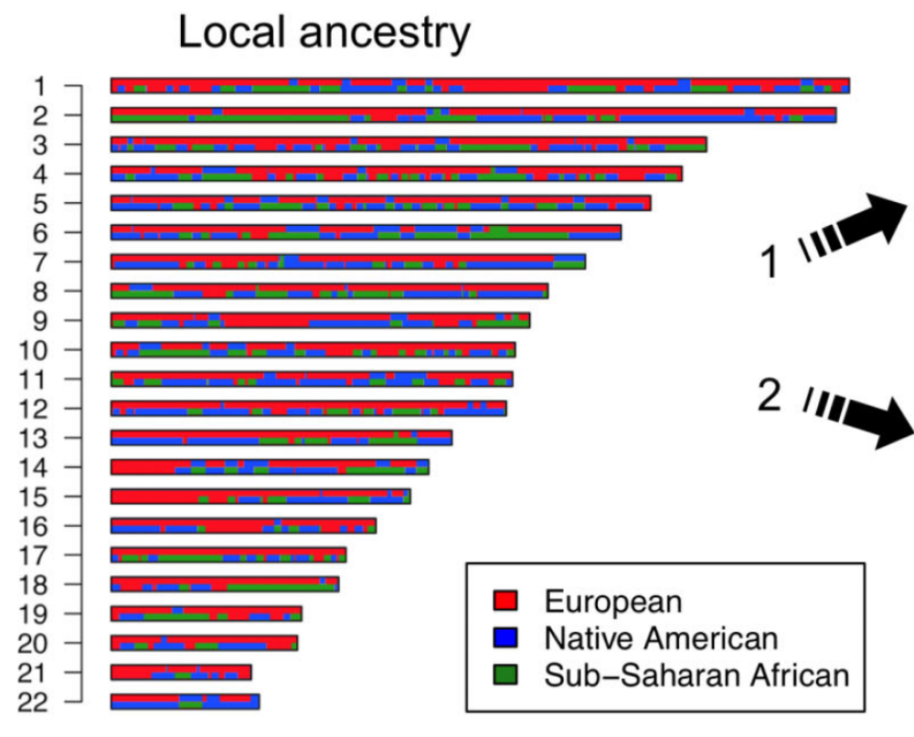
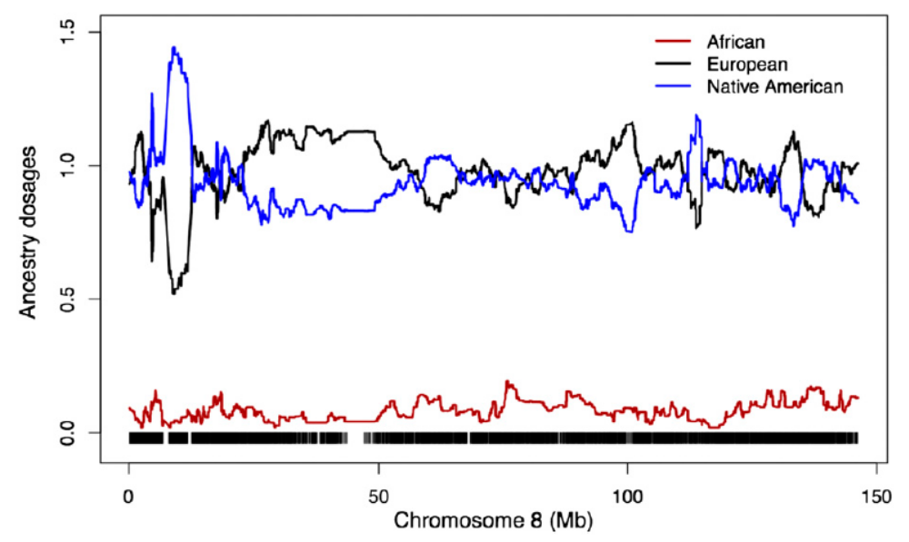
Caribbeans, Mexicans
Moreno-Estrada, PLOS Genet, 2013
Guan, Genetics, 2014
Average over 58 Mexicans
Caribbeans

Slide 43
How to Infer Local Ancestry?
Classes of methods:
Using reference allele frequencies
  Window-based
  HMM-based
Using reference haplotype sequences
  HMM-based
  Window-based + smoothing

Slide 44
Window-Based Methods
Window 1
Window 2
Frequency of Q allele Population A
80% 90% 70% 85% 75% 80% 75% 85% 65% 80% 70% 85%
Admixed chromosome
Q Q q Q Q Q q q q Q q q
Frequency of Q allele
Population B
30% 25% 40% 35% 15% 20% 25% 30% 15% 20% 20% 35%
Likelihood of ancestry A in window 1?
Likelihood of ancestry B in window 1?
Likelihood of ancestry A in window 2?
Likelihood of ancestry B in window 2?

Slide 45
Window-Based Methods
Assumes SNPs are independent!
Window 1:
Likelihood of ancestry A: $0.8×0.9×0.3×0.85×0.75×0.8=0.11$
Likelihood of ancestry B: $0.3×0.25×0.6×0.35×0.15×0.2=0.0005$
➔ Window 1 classified as A
Window 1
Window 2
Frequency of Q allele Population A
80% 90% 70% 85% 75% 80% 75% 85% 65% 80% 70% 85%
Admixed chr
Q Q q Q Q Q q q q Q q q
Frequency of Q allele
Population B
30% 25% 40% 35% 15% 20% 25% 30% 15% 20% 20% 35%

Slide 46
Window-Based Methods
Window 2:
Likelihood of ancestry A: $0.25×0.15×0.35×0.8×0.3×0.15=0.0005$
Likelihood of ancestry B: $0.75×0.7×0.85×0.2×0.8×0.65=0.05$
➔ Window 2 classified as B
Window 1
Window 2
Frequency of Q allele Population A
80% 90% 70% 85% 75% 80% 75% 85% 65% 80% 70% 85%
Admixed chr
Q Q q Q Q Q q q q Q q q
Frequency of Q allele
Population B
30% 25% 40% 35% 15% 20% 25% 30% 15% 20% 20% 35%

Slide 47
Window-Based Methods
Admixed chr
Q Q q Q Q Q q q q Q q q
Ancestry
A A A A A A B B B B B B
Proportion of A ancestry/State
A
1
B
0
Coordinate
Frequency of Q allele Population A
80% 90% 70% 85% 75% 80% 75% 85% 65% 80% 70% 85%
Frequency of Q allele
Population B
30% 25% 40% 35% 15% 20% 25% 30% 15% 20% 20% 35%

Slide 48
Diploid Genomes
Window 1
Window 2
Window 3
Admixed genome
QQ QQ Qq QQ Qq QQ qq Qq qq Qq qq qq
Frequency of Q allele Population A
80% 90% 70% 85% 75% 80% 75% 85% 65% 80% 70% 85%
Frequency of Q allele
Population B
30% 25% 40% 35% 15% 20% 25% 30% 15% 20% 20% 35%

Slide 49
Diploid Genomes
Window 1
Window 2
Window 3
Admixed genome
QQ QQ Qq QQ Qq QQ qq Qq qq Qq qq qq
Window 1:
Likelihood of ancestry AA: ${0.8}^{2}×{0.9}^{2}×\left(2∙0.7∙0.3\right)×{0.85}^{2}=0.16$
Likelihood of ancestry AB: $\left(0.8⋅0.3\right)×\left(0.9⋅0.25\right)×\left(0.7⋅0.6+0.3⋅0.4\right)×\left(0.85⋅0.35\right)=0.009$
Likelihood of ancestry BB: ${0.3}^{2}×{0.25}^{2}×\left(2⋅0.4⋅0.6\right)×{0.35}^{2}=0.0003$
➔ Window 1 classified as AA
Frequency of Q allele Population A
80% 90% 70% 85% 75% 80% 75% 85% 65% 80% 70% 85%
Frequency of Q allele
Population B
30% 25% 40% 35% 15% 20% 25% 30% 15% 20% 20% 35%

Slide 50
Diploid Genomes
Window 1
Window 2
Window 3
Admixed genome
QQ QQ Qq QQ Qq QQ qq Qq qq Qq qq qq
Window 2:
Likelihood of ancestry AA: $\left(2⋅0.75⋅0.25\right)×{0.8}^{2}×{0.25}^{2}×\left(2⋅0.85⋅0.15\right)=0.002$
Likelihood of ancestry AB: $\left(0.75⋅0.85+0.25⋅0.15\right)×\left(0.8⋅0.2\right)×\left(0.25⋅0.75\right)×\left(0.85⋅0.7+0.15⋅0.3\right)=0.01$
Likelihood of ancestry BB: $\left(2⋅0.15⋅0.85\right)×{0.2}^{2}×{0.75}^{2}×\left(2⋅0.3⋅0.7\right)=0.002$
➔ Window 2 classified as AB
Frequency of Q allele Population A
80% 90% 70% 85% 75% 80% 75% 85% 65% 80% 70% 85%
Frequency of Q allele
Population B
30% 25% 40% 35% 15% 20% 25% 30% 15% 20% 20% 35%

Slide 51
Diploid Genomes
Window 1
Window 2
Window 3
Admixed genome
QQ QQ Qq QQ Qq QQ qq Qq qq Qq qq qq
Window 3:
Likelihood of ancestry AA: ${0.35}^{2}×\left(2⋅0.8⋅0.2\right)×{0.3}^{2}×{0.15}^{2}=0.0001$
Likelihood of ancestry AB: $\left(0.35⋅0.85\right)×\left(0.8⋅0.8+0.2⋅0.2\right)×\left(0.3⋅0.8\right)×\left(0.15⋅0.65\right)=0.004$
Likelihood of ancestry BB: ${0.85}^{2}×\left(2⋅0.2⋅0.8\right)×{0.8}^{2}×{0.65}^{2}=0.06$
➔ Window 3 classified as BB
Frequency of Q allele Population A
80% 90% 70% 85% 75% 80% 75% 85% 65% 80% 70% 85%
Frequency of Q allele
Population B
30% 25% 40% 35% 15% 20% 25% 30% 15% 20% 20% 35%

Slide 52
Diploid Genomes
Admixed genome
QQ QQ Qq QQ Qq QQ qq Qq qq Qq qq qq
Ancestry
AA AA AA AA AB AB AB AB BB BB BB BB
Proportion of A ancestry/State
AA
1
AB
0.5
BB
0
Coordinate
Frequency of Q allele Population A
80% 90% 70% 85% 75% 80% 75% 85% 65% 80% 70% 85%
Frequency of Q allele
Population B
30% 25% 40% 35% 15% 20% 25% 30% 15% 20% 20% 35%

Slide 53
HMM-Based Methods
Admixed chr
Q Q q Q Q Q q q q Q q q
Ancestry
A A A A A A B B B B B B
State
A
HMM parameters?
B
Coordinate
Frequency of Q allele Population A
80% 90% 70% 85% 75% 80% 75% 85% 65% 80% 70% 85%
Frequency of Q allele
Population B
30% 25% 40% 35% 15% 20% 25% 30% 15% 20% 20% 35%

Slide 54
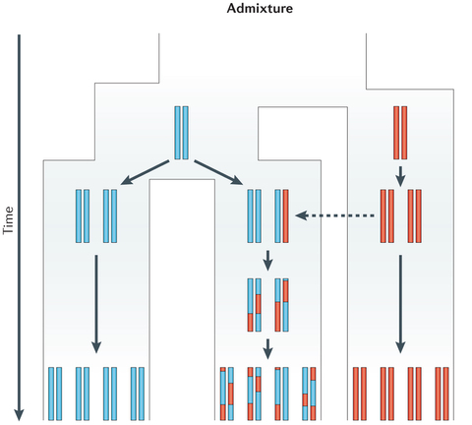
The Admixture Process
Racimo et al., Nat Rev Genet, 2015
Each generation since admixture, the ancestral blocks further break apart
The rate of recombination is 1 per Morgan per generation, or $T$ since admixture
For admixture $T$ generations ago, the blocks are of mean length $1/T$ Morgan (or $100/T$ cM)
A
B
$$T$$

Slide 55
The Admixture Process
Racimo et al., Nat Rev Genet, 2015
Starting at a fixed point, the probability of no recombination up to distance $d$ (Morgan) is $e^{−dT}$, since recombination is modeled as a Poisson process along the chromosome
Recombination may or may not change the ancestry
Assume ancestry proportions at admixture are $α_{A}$ and $α_{B}$ $(α_{A}+α_{B}=1)$
A
B
$$T$$

Slide 56
HMM-Based Methods
Admixed chr
Q Q q Q Q Q q q q Q q q
Ancestry state
A A A A A A B B B B B B
SNP 1
SNP 2
SNP 3
SNP p
Hidden state
A/B
A/B
A/B
A/B
…
Observation
Q/q
Q/q
Q/q
Q/q
Frequency of Q allele Population A ($f_{A}$)
80% 90% 70% 85% 75% 80% 75% 85% 65% 80% 70% 85%
Frequency of Q allele
Population B ($f_{B}$)
30% 25% 40% 35% 15% 20% 25% 30% 15% 20% 20% 35%

Slide 57
HMM-Based Methods
Admixed chr
Q Q q Q Q Q q q q Q q q
Ancestry state
A A A A A A B B B B B B
d
Transition probabilities:
$$P\left(A→A\right)=e^{−dT}+\left(1−e^{−dT}\right)α_{A}$$
$$P\left(A→B\right)=\left(1−e^{−dT}\right)α_{B}$$
$$P\left(B→A\right)=\left(1−e^{−dT}\right)α_{A}$$
$$P\left(B→B\right)=e^{−dT}+\left(1−e^{−dT}\right)α_{B}$$
Emission probabilities:
$$P\left(Q|A\right)=f_{A}$$
$$P\left(q|A\right)=\left(1−f_{A}\right)$$
$$P\left(Q|B\right)=f_{B}$$
$$P\left(q|B\right)=\left(1−f_{B}\right)$$
Initial probabilities:
$$P_{0}(A)=α_{A}$$
$$P_{0}(B)=α_{B}$$
Frequency of Q allele Population A ($f_{A}$)
80% 90% 70% 85% 75% 80% 75% 85% 65% 80% 70% 85%
Frequency of Q allele
Population B ($f_{B}$)
30% 25% 40% 35% 15% 20% 25% 30% 15% 20% 20% 35%

Slide 58
HMM-Based Methods
Admixed chr
Q Q q Q Q Q q q q Q q q
Ancestry state
A A A A A A B B B B B B
Inference:
Use Viterbi decoding or the posterior probabilities (forward-backward algorithm)
For diploid genomes, define an extended state space: (AA,AB,BA,BB)
Frequency of Q allele Population A ($f_{A}$)
80% 90% 70% 85% 75% 80% 75% 85% 65% 80% 70% 85%
Frequency of Q allele
Population B ($f_{B}$)
30% 25% 40% 35% 15% 20% 25% 30% 15% 20% 20% 35%

Slide 59
Using Reference Haplotypes
We have so far used allele frequencies, implicitly assuming that frequencies are independent across SNPs
However, linkage disequilibrium leads to correlation across SNPs in the ancestral populations
Can be modeled by using the actual reference haplotypes, not just the reference frequencies

Slide 60
HMM-Based Approaches
Q q Q Q Q q q Q Q q
Population A:
k haplotypes
q q Q q q Q q Q q q
q Q q Q Q Q q q q Q
Q Q Q q q q Q q Q Q
q q Q Q q q Q Q q q
Population B:
k haplotypes
q Q Q q Q q Q Q q q
Q Q q q q q Q Q q Q
Q q q q Q q q Q Q Q
SNP 1
SNP 2
SNP p
{A,B} x {1,…,k}
{A,B} x {1,…,k}
…
{A,B} x {1,…,k}
Hidden state
Observation
Q/q
Q/q
Q/q

Slide 61
Window-Based Approaches
Q q Q Q Q q q Q Q q
Population A:
k haplotypes
q q Q q q Q q Q q q
q Q q Q Q Q q q q Q
Q Q Q q q q Q q Q Q
q q Q Q q q Q Q q q
Population B:
k haplotypes
q Q Q q Q q Q Q q q
Q Q q q q q Q Q q Q
Q q q q Q q q Q Q Q
Admixed chr
q Q Q q Q Q q q q Q
Run Random Forest classifier…
Inferred state:
B
A

Slide 62
Some References
Classes of methods:
Using reference allele frequencies
  Window-based
    Sankararaman et al., AJHG, 2008; Pasaniuc et al., Bioinformatics, 2009
  HMM-based
    Patterson et al., AJHG, 2004
Using reference haplotype sequences
  HMM-based
    Sundquist, Genome Res, 2008, Price et al., PLOS Genet, 2009; Baran et al., Bioinformatics, 2012; Guan et al., Genetics, 2014
  Window-based + smoothing
    Brisbin et al., Human Biology, 2012; Churchhouse and Marchini, Genet Epidemiol, 2013; Maples et al., AJHG, 2013; Durand, Do, and Mountain, 2014 (23andMe)

Slide 63
Local Ancestry - Remarks
Accuracy can be determined by simulations or by testing Mendelian consistency
Accuracy is excellent for inter-continental admixture
  Could reach 95-99% for African-Americans, Latinos
  But accuracy is much lower within continents
Parameters such as the genome-wide ancestry proportions and the admixture time can be estimated using other methods/data sources
LAI is usually robust to misspecification of these parameters

Slide 64
Outline
PCA in population genetics
A model for ancestry proportions
Local ancestry inference
Inferring admixture time

Slide 65
Methods Overview
Distribution of ancestry proportions per chromosome
Distribution of the lengths of ancestry blocks
The decay of weighted linkage disequilibrium with genetic distance
The decay of co-ancestry with genetic distance

Slide 66
(1) Chromosome-Wide Ancestry Proportions
Baharian et al., PLOS Genet, 2016
European ancestry
African ancestry

Slide 67
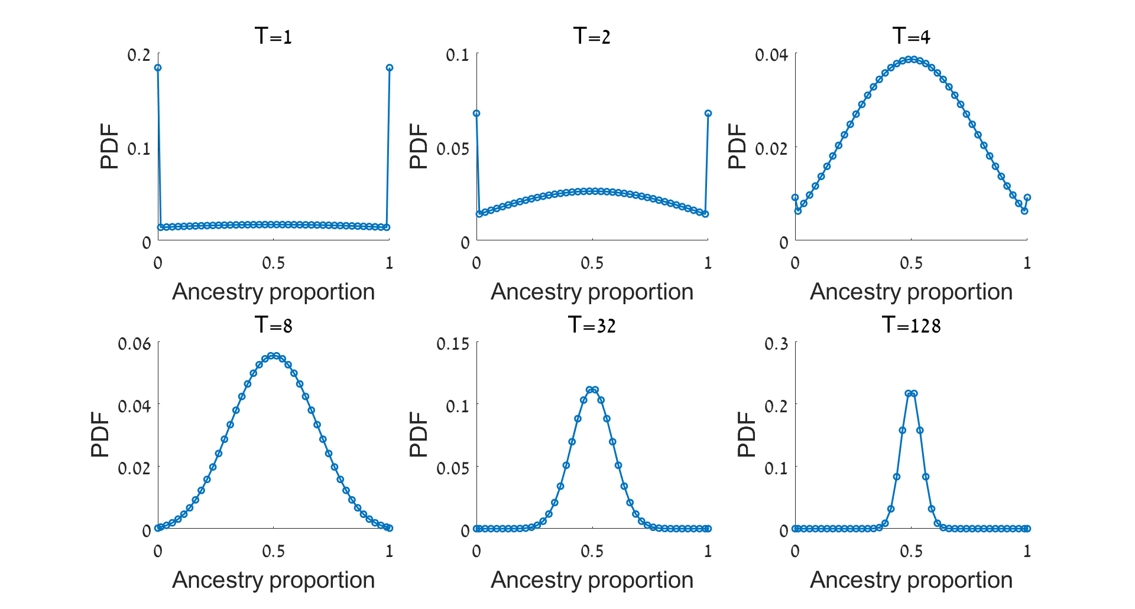
The Distribution of Ancestry Proportions
$$α_{A}=0.5$$

Slide 68
Chromosome-Wide Ancestry Proportions
There is variation across individuals in the proportion of ancestry deriving from each source in African-Americans and other populations
Consider admixture between A and B with proportions $α_{A}$ and $α_{B}$, respectively, that happened $T$ generations ago
Consider a chromosome of length $L$ Morgans
Denote by $x$ the proportion of A ancestry
$\text{E}\left(x\right)=α_{A}$
$\text{Var}\left(x\right)=\frac{2α_{A}\left(1−α_{A}\right)}{{\left(TL\right)}^{2}}\left(e^{−TL}+TL−1\right)$
Use method of moments to infer $α_{A}$ and $T$
Baharian et al., PLOS Genet, 2016

Slide 69
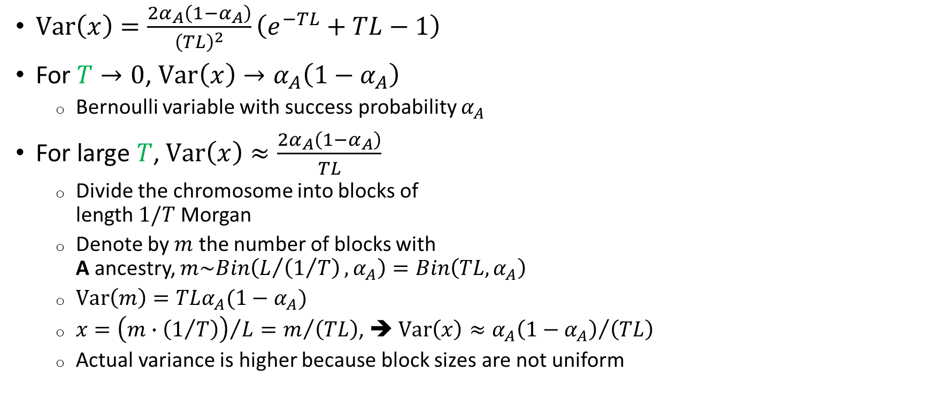
The Variance: Properties
$\text{Var}\left(x\right)=\frac{2α_{A}\left(1−α_{A}\right)}{{\left(TL\right)}^{2}}\left(e^{−TL}+TL−1\right)$
For $T→0$, $\text{Var}\left(x\right)→α_{A}\left(1−α_{A}\right)$
  Bernoulli variable with success probability $α_{A}$
For large $T$, $\text{Var}\left(x\right)≈\frac{2α_{A}\left(1−α_{A}\right)}{TL}$
  Divide the chromosome into blocks of
  length $1/T$ Morgan
  Denote by $m$ the number of blocks with
  A ancestry, $m\sim Bin\left(L/{\left(1/T\right)},α_{A}\right)=Bin\left(TL,α_{A}\right)$
  $Var⁡\left(m\right)=TLα_{A}(1−α_{A})$
  $x={\left(m∙\left(1/T\right)\right)}/L=m/{\left(TL\right)}$, ➔ $Var⁡\left(x\right)≈{α_{A}\left(1−α_{A}\right)}/{\left(TL\right)}$
  Actual variance is higher because block sizes are not uniform
$1/T$ Morgan
$L$ Morgan

Slide 70
Remarks
The chromosome-wide ancestry proportions can be inferred using ADMIXTURE/STRUCTURE, etc., or using local ancestry inference
Some references:
  Verdu and Rosenberg, Genetics, 2011; Gravel, Genetics, 2012; Botigue, PNAS, 2013; Liang and Nielsen, 2014
The distribution is also known, allowing MLE estimation
  Xue et al., PLOS Genetics, 2017
Difficult to extend beyond simple admixture
In practice, does not seem very robust

Slide 71
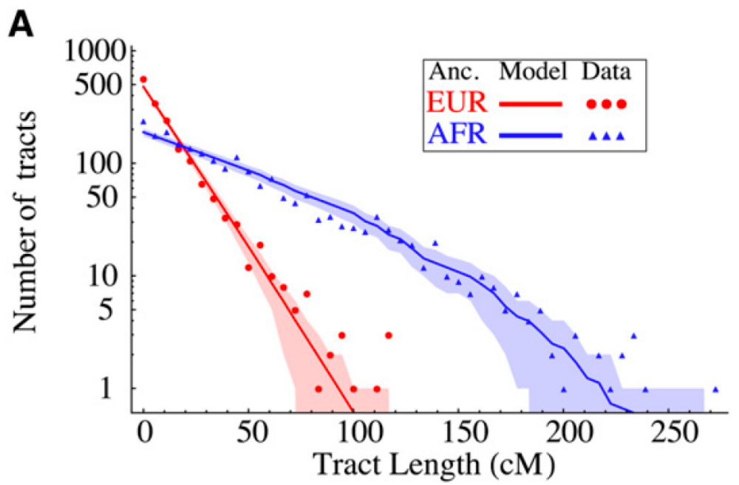
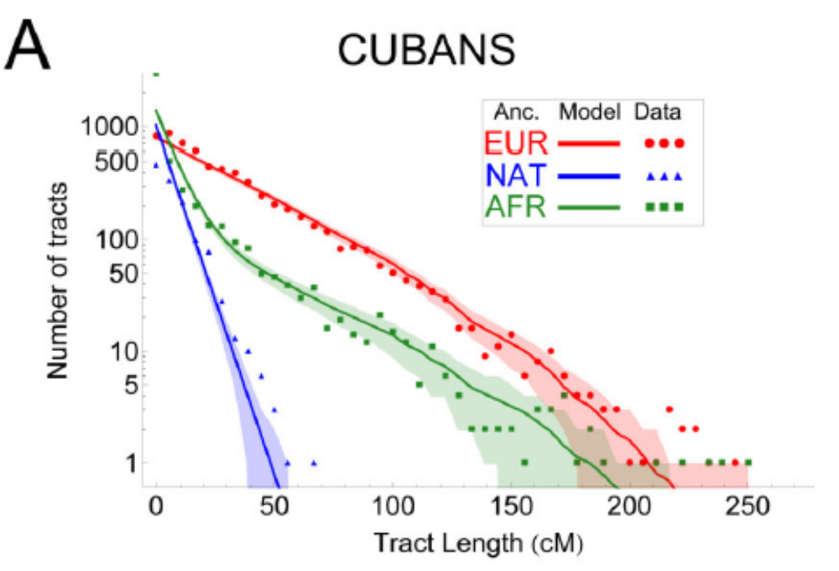
(2) Distribution of Segment Lengths
African-Americas; Gravel, Genetics, 2012
Moreno-Estrada, PLOS Genet, 2013

Slide 72
The Admixture Process
Racimo et al., Nat Rev Genet, 2015
Each generation since admixture, the ancestral blocks further break apart
The rate of recombination is 1 per Morgan per generation
For admixture $T$ generations ago, the blocks are of length $1/T$ Morgan
Recombination may or may not change the ancestry
Assume ancestry proportions at admixture are $α_{A}$ and $α_{B}$ $(α_{A}+α_{B}=1)$
A
B
$$T$$

Slide 73
Distribution of Segment Lengths
Recombinations along the chromosome are encountered at rate $T$ per Morgan
Starting from an A segment, the ancestry will change at a recombination site with probability $α_{B}=(1−α_{A})$
Thus, the rate at which A segments are terminated is $T(1−α_{A})$
The lengths of A segments are $ℓ_{A}\sim \text{Exp}\left[T(1−α_{A})\right]$
Use methods of moments again to infer $α_{A}$ and $T$

Slide 74
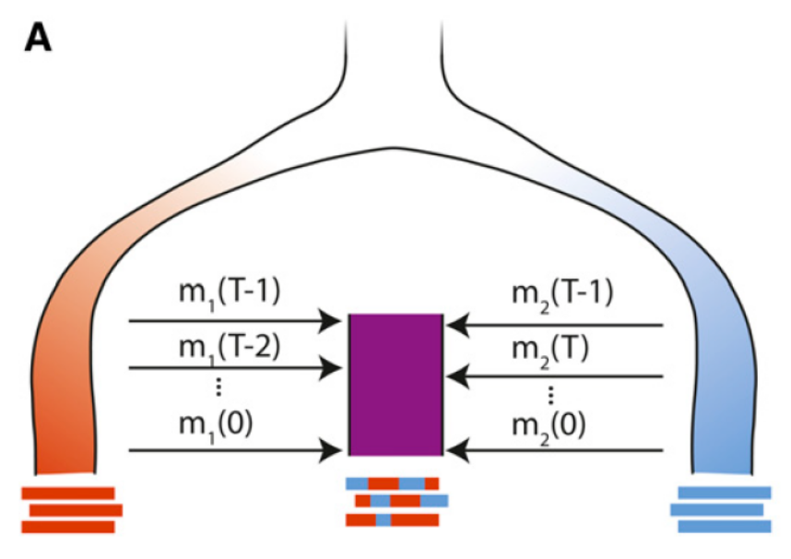
Remarks
Main results:
  European admixture in Caribbean populations: ≈15 generations ago
  Admixture in African-Americans: ≈5-10 generations ago
Key methodological papers:
  Pool and Nielsen, Genetics, 2009; Gravel, Genetics, 2012; Liang and Nielsen, Genetics, 2014; Ni et al., Sci Rep, 2016; Xue et al., PLOS Genetics, 2017; Median et al., Genetics, 2018
  The segment length distribution can be calculated numerically
  for very complex admixture histories (Gravel, Genetics, 2012)
A powerful inference tool for the past ≈20-30 generations
Cannot claim single-generation resolution:
  Assortative mating, post-admixture drift,
  dependence of ancestries across recombination events,
  crossover interference, LAI errors

Slide 75
(3) Long-Range Admixture LD
Consider SNP 1 and SNP 2, at distance $d$ (Morgan) apart
Denote the genotype vectors: ${\vec{g}}_{1},{\vec{g}}_{2}$
  ${\vec{g}}_{i}$ is a vector of the genotypes (#copies of one of the alleles; 0,1,2) of all individuals at SNP $i$
Denote allele frequencies at those SNPs: $f_{A,1},f_{A,2},f_{B,1},f_{B,2}$
Theorem: $\text{E}\left(\text{Cov}\left(g_{1},g_{2}\right)\right)∝α_{A}α_{B}{(f}_{A,1}−f_{B,1}){(f}_{A,2}−f_{B,2})e^{−Td}$
$${\vec{g}}_{1}$$
$${\vec{g}}_{2}$$
$$d$$

Slide 76
Long-Range Admixture LD
Denote by $y(d)$ the average of $\left[\text{Cov}\left(g_{1},g_{2}\right){(f}_{A,1}−f_{B,1}){(f}_{A,2}−f_{B,2})\right]$ over all pairs of SNPs in the genome at distance $d$ apart
Can show: $y(d)∝α_{A}α_{B}e^{−Td}$
The pre-factor does not depend on the admixture time
Since $y(d)∝α_{A}α_{B}e^{−Td}$, fit $y(d)$ vs $d$ to infer $T$

Slide 77
Inference of Admixture Time
Key papers:
  Moorjani et al., PLOS Genet, 2011; Patterson et al., Genetics, 2012; Loh et al., Genetics, 2013; Pickrell et al., PNAS, 2014; Zhou et al., Heredity, 2017
Can estimate confidence intervals using jackknifing over the chromosomes
Intuition: migrant chromosomes extend over long distances for recent admixture, thus creating linkage between remote alleles

Slide 78
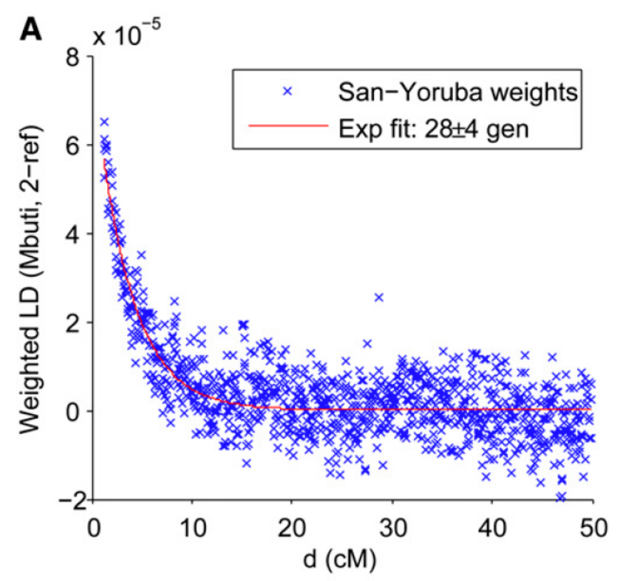
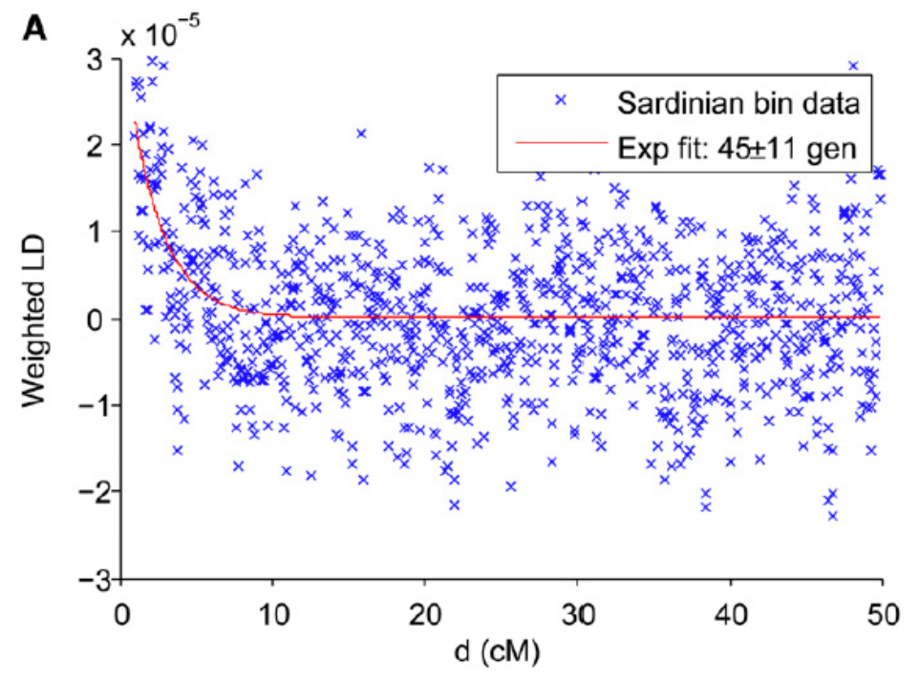
Examples
Mbuti (pygmies in Congo)
Sardinia
European/African sources
Patterson et al., Genetics, 2012

Slide 79
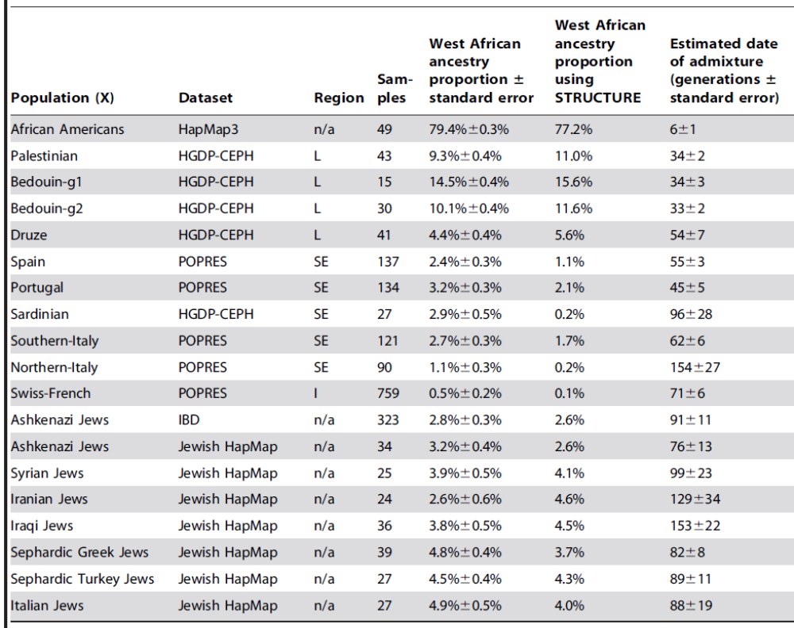
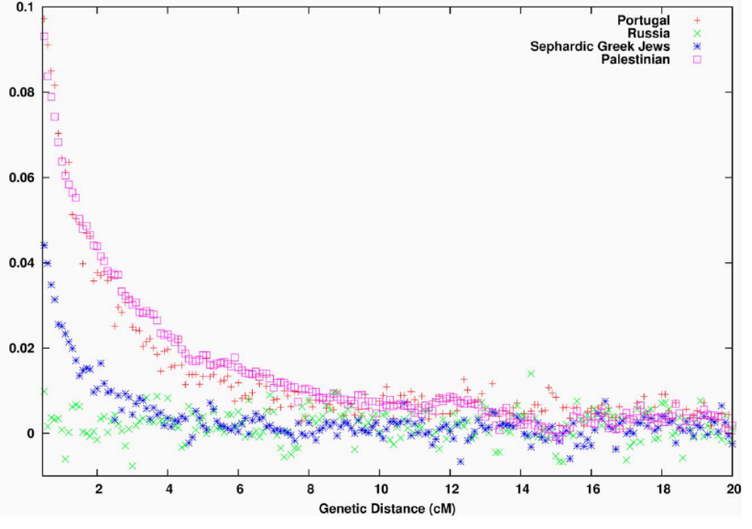
Examples
European/African sources
Moorjani et al., PLOS Genetics, 2011

Slide 80
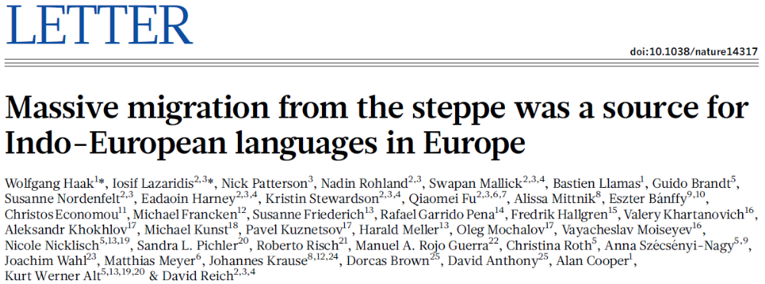


Examples
French: admixture between Sardinians and Native Americans (?!)
Patterson et al., Genetics, 2012

Slide 81
Pitfalls
Makes specific assumptions on the phylogeny of the populations
Sensitive to details of fitting procedure and noisy data
Very sensitive to long-range LD in the ancestral populations
Advantage over segment lengths:
  Uses all pairs of SNPs instead of using each SNP just once

Slide 82
(4) Co-ancestry vs Genetic Distance
Perform local ancestry inference using any method
Consider the ancestry at two SNPs at distance $d$ apart
The probability of both to have ancestry A:
  $p_{AA}\left(d\right)=α_{A}\left[e^{−Td}+\left(1−e^{−Td}\right)α_{A}\right]={α_{A}}^{2}+α_{A}(1−α_{A})e^{−Td}$
Average $p_{AA}\left(d\right)$ over all pairs of SNPs, and fit $α_{A}$ and $T$
A
A
A
B
B
A
A
A
B
B
A
A
$$d$$

Slide 83



Examples
Key papers:
  Hellenthal et al., Science, 2014; Leslie et al., Nature, 2015; Busby et al., Curr Biol, 2015
  Interactive website: http://admixturemap.paintmychromosomes.com/
Powerful in inferring admixture between closely related populations
  Care must be taken in interpretation since ancestral populations are difficult to identify, particularly using modern samples only

