Slide 1
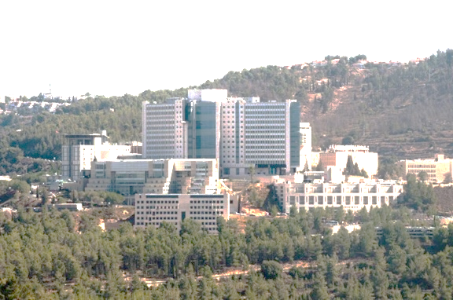



What is the utility of screening human embryos for polygenic traits?
Shai Carmi
Public Health
The Hebrew University of Jerusalem
scarmilab.org
@ShaiCarmi
HUJI
December 2019

Slide 2
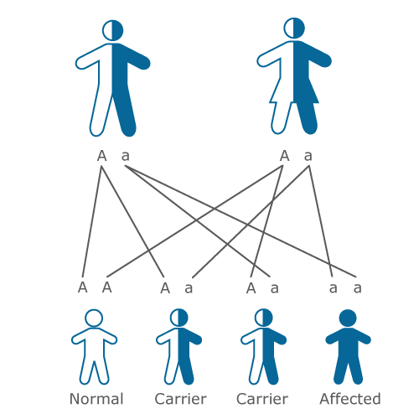
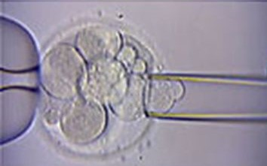
Genetic screening of embryos
Why?
  Mendelian disease mutations
  Recurrent pregnancy loss
How?
  Grow IVF embryos for 3-5 days
  Amplify DNA from a single cell
What?
  Traditionally: single mutations, aneuploidy
  Now: whole-genome haplotypes, CNVs
  Universal, fast, accurate, low cost

Slide 3



How could it be possible?
Parents (microarray)
Embryos are a mosaic of the parents
Only need to infer crossover locations
(Up to de-novo mutations)
Embryo 1
Embryo 2
Embryo 3
Array/low-coverage sequencing

Slide 4
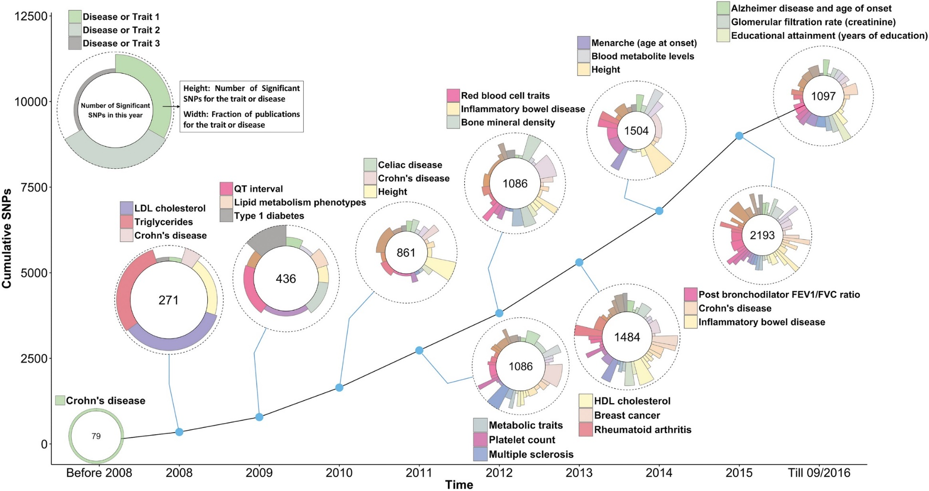
In parallel, progress in complex trait genetics
Visscher et al., 10 Years of GWAS Discovery: Biology, Function, and Translation, AJHG, 2017

Slide 5
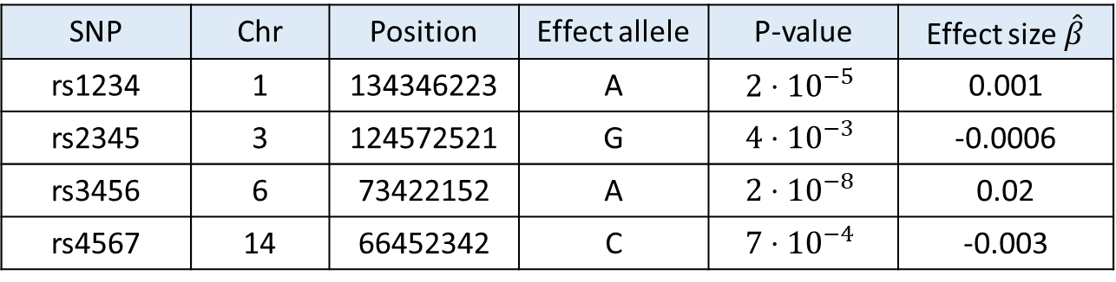

Discovery ➔ prediction
Trait
Summary statistics are publicly/freely available
Effect size:
Quantitative traits: increase in trait with each allele (regression slope)
Disease (binary) traits: log odds-ratio
$$β$$
Allele count
0
1
2
SNP | Chr | Position | Effect allele | P-value | Effect size $\hat{β}$
rs1234 | 1 | 134346223 | A | $$2⋅{10}^{−5}$$ | 0.001
rs2345 | 3 | 124572521 | G | $$4⋅{10}^{−3}$$ | -0.0006
rs3456 | 6 | 73422152 | A | $$2⋅{10}^{−8}$$ | 0.02
rs4567 | 14 | 66452342 | C | $$7⋅{10}^{−4}$$ | -0.003

Slide 6
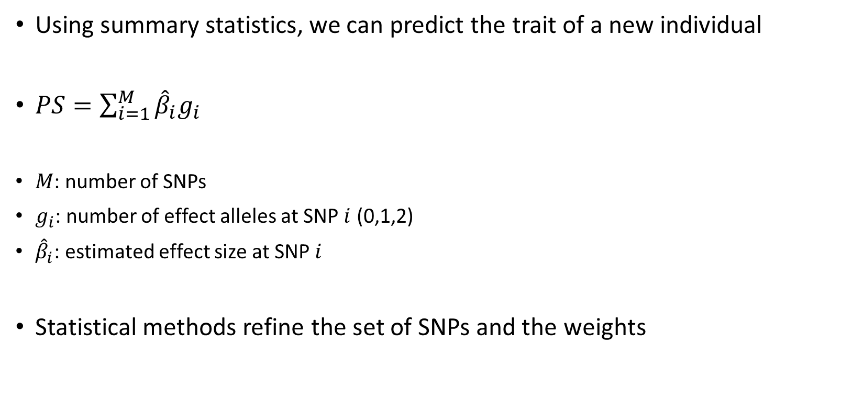
Polygenic scores (PS)
Using summary statistics, we can predict the trait of a new individual
$PS=\sum_{i=1}^{M}{{\hat{β}}_{i}g_{i}}$
$M$: number of SNPs
$g_{i}$: number of effect alleles at SNP $i$ (0,1,2)
${\hat{β}}_{i}$: estimated effect size at SNP $i$
Statistical methods refine the set of SNPs and the weights

Slide 7
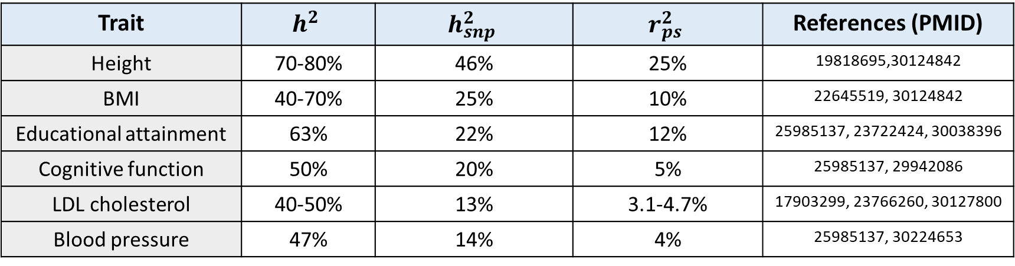
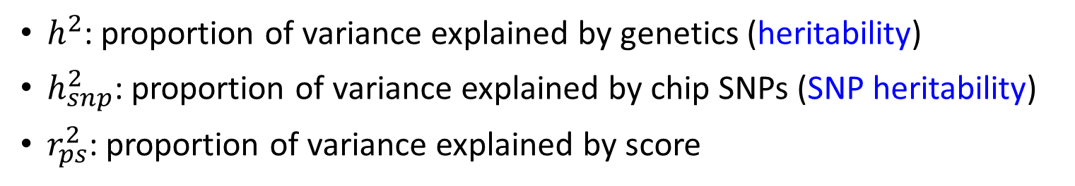

Performance of polygenic scores
$h^{2}$: proportion of variance explained by genetics (heritability)
$h_{snp}^{2}$: proportion of variance explained by chip SNPs (SNP heritability)
$r_{ps}^{2}$: proportion of variance explained by score
$${r_{ps}^{2}<h_{snp}^{2}<h}^{2}<1$$
Trait | $$h^{2}$$ | $$h_{snp}^{2}$$ | $$r_{ps}^{2}$$ | References (PMID)
Height | 70-80% | 46% | 25% | 19818695,30124842
BMI | 40-70% | 25% | 10% | 22645519, 30124842
Educational attainment | 63% | 22% | 12% | 25985137, 23722424, 30038396
Cognitive function | 50% | 20% | 5% | 25985137, 29942086
LDL cholesterol | 40-50% | 13% | 3.1-4.7% | 17903299, 23766260, 30127800
Blood pressure | 47% | 14% | 4% | 25985137, 30224653

Slide 8

Implications
Screening embryos for complex traits now feasible
At least one company is already offering the test

Slide 9

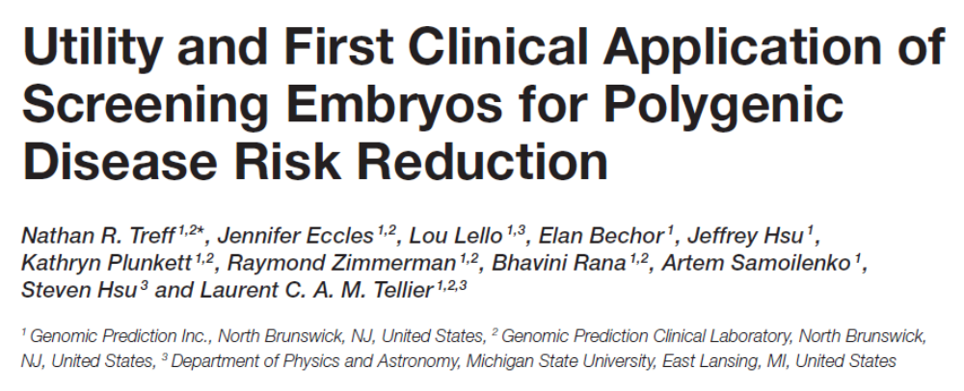
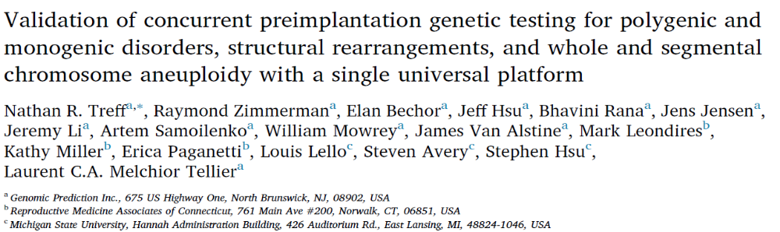
Screening embryos for complex traits now feasible
From GP website:
  Type 1 and Type 2 Diabetes
  Coronary Artery Disease, Heart Attack Risk, Hypercholesterolemia, Hypertension
  Breast Cancer, Testicular Cancer, Prostate Cancer, Malignant Melanoma, Basal Cell Carcinoma
  Intellectual Disability
  Idiopathic Short Stature
December 2019
April 2019

Slide 10
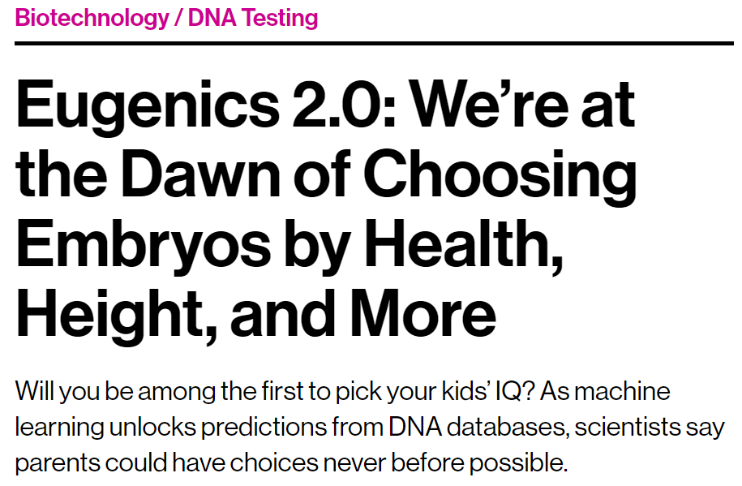
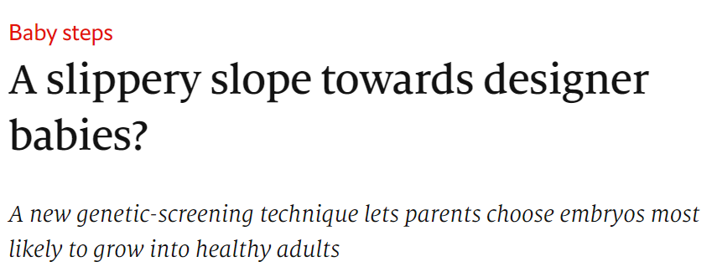
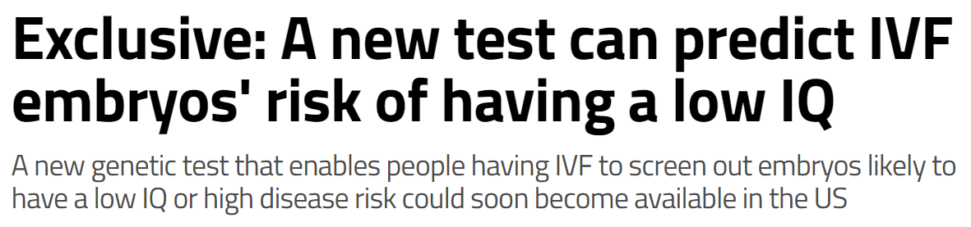
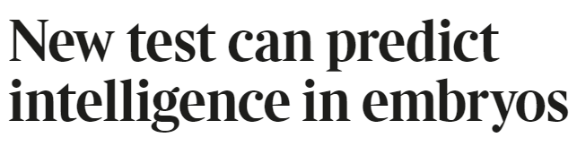
Obviously, ethical concerns
MIT Technology Review
November 2017
Antonio Regalado
The Economist, November 2018
New Scientist, November 2018
The Times, November 2018

Slide 11
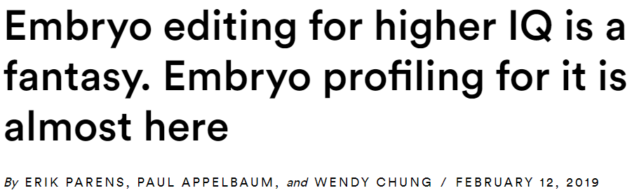

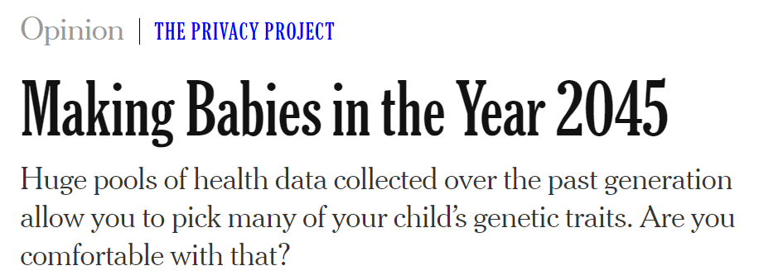
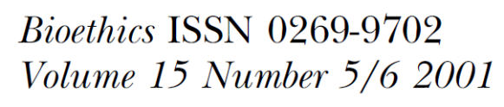
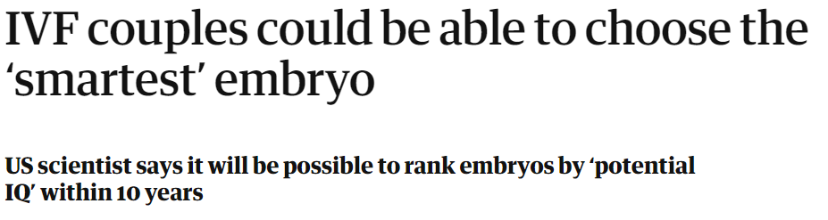
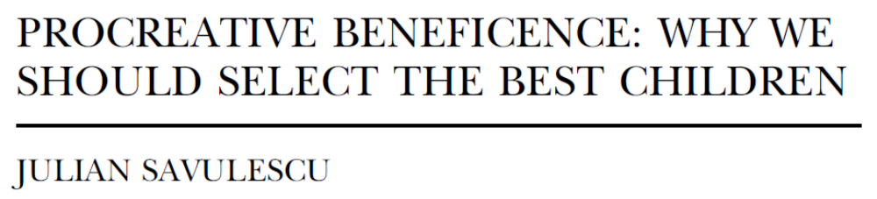
Obviously, ethical concerns
STAT, February 2019
NY Times, April 2019
BUT…
The Guardian, May 2019

Slide 12
No data!
Does it work? What are the expected outcomes?
So far: economic analysis, no empirical data (Shulman and Bostrom, 2014; gwern blog)
Our approach:
Simulations based on real data
Quantitative genetic model
Large nuclear families

Slide 13

Simulations overview
Predicted
trait
Start with real genomes
Pair individuals (randomly/real couples)
Gain
Simulate $n$ offspring
Avg
Compute PS and predict trait of offspring
Gain = (prediction of top-scoring embryo) $−$ (average prediction)

Slide 14
Traits/cohorts
Gil Atzmon, Nir Barzilai
Einstein College of Medicine
Height
102 couples, 700k SNPs
Ashkenazi Jews, a longevity study (Sathyan et al., 2018)
Cognitive ability (IQ)
919 young males, 480k SNPs
Greek schizophrenia study (Stefanis et al., 2004)
Nikos Stefanis, Alex Hatzimanolis, Nikolaos Smyrnis, Dimitrios Avramopoulos, University of Athens

Slide 15
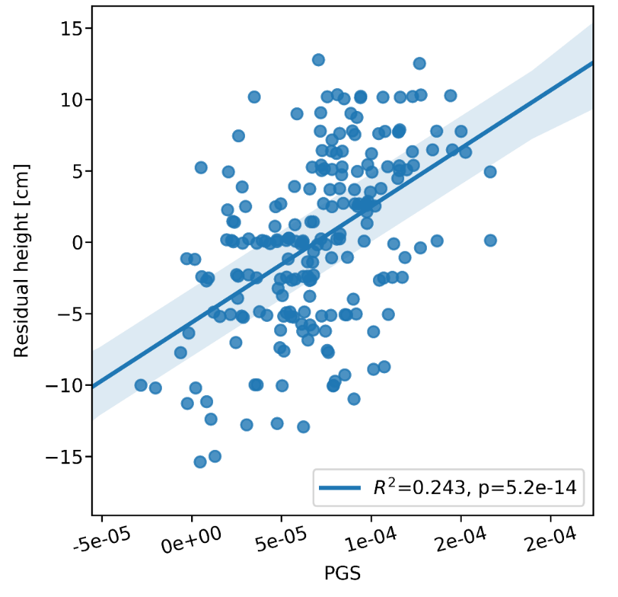

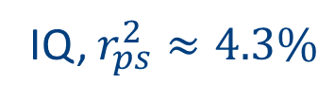
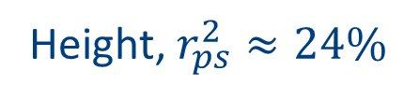
Polygenic scores
Height
Yengo et al., 2018
700k individuals
IQ
Savage et al., 2018
270k individuals
Cross-validation for tuning parameters
Height, $r_{ps}^{2}≈24\%$
IQ, $r_{ps}^{2}≈4.3\%$
IQ
Height residual (cm)
Polygenic score
Polygenic score

Slide 16
Simulating embryos
To simulate a gamete:
  Poisson number of crossovers, random placement
  Independent random segregation
Gametes paired to form diploids
Polygenic scores computed and phenotypes predicted
Parental chrs

Slide 17
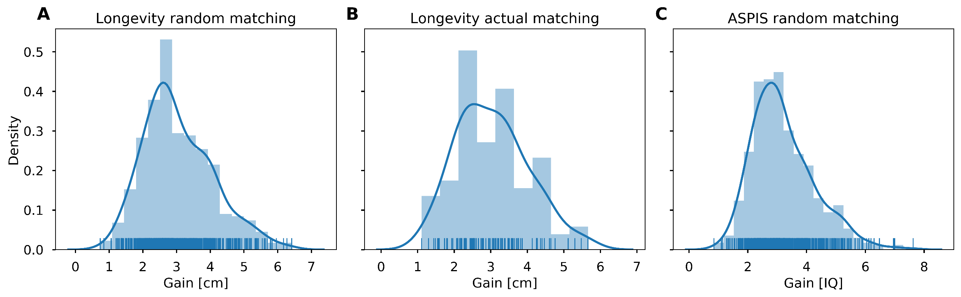
Experiments ($n=10$ embryos)
Gain in height: 2-4 cm
Real/random families behave similarly
Gain in IQ: 2-4 points
Height (random couples)
Height (real couples)
IQ
Density

Slide 18
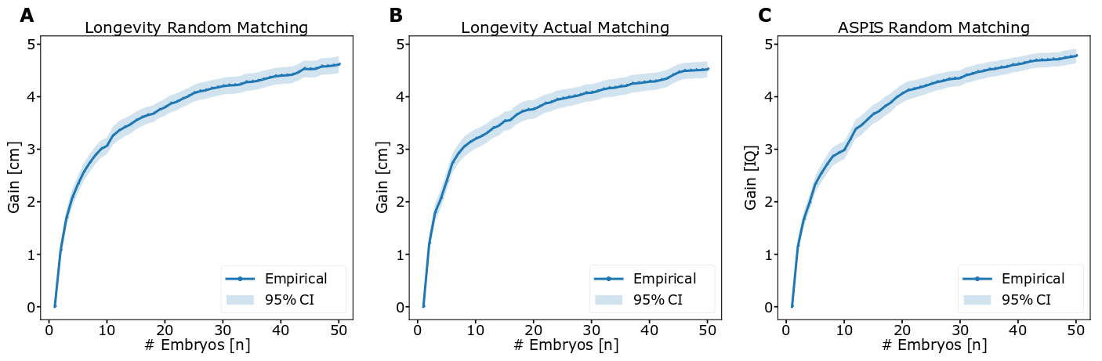
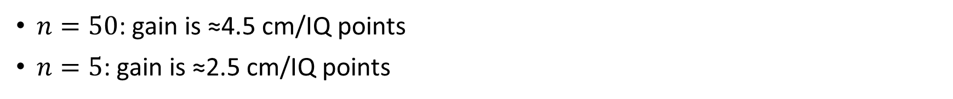
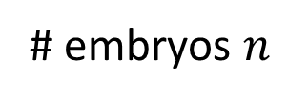


More/less embryos?
$n=50$: gain is ≈4.5 cm/IQ points
$n=5$: gain is ≈2.5 cm/IQ points
Height random
Height real
IQ
Gain (cm)
Gain (cm)
Gain (points)
# embryos $n$
# embryos $n$
# embryos $n$

Slide 19
Questions
Are these results expected?
What happens for even more embryos?
What happens if we have better predictors?
We need a quantitative genetic model

Slide 20
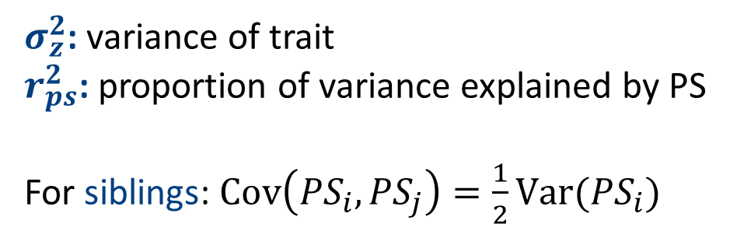
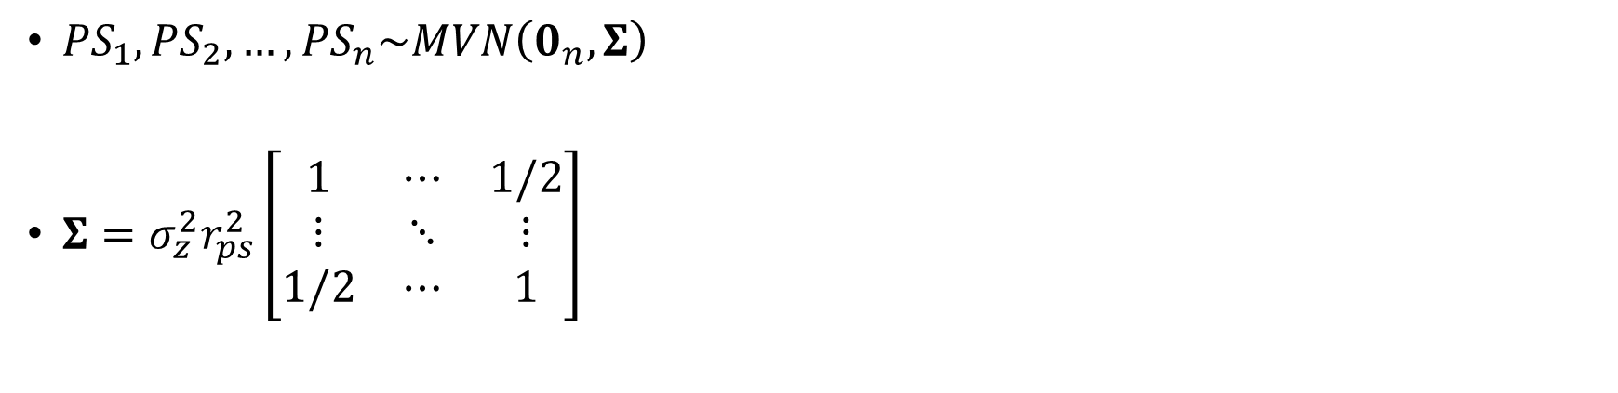
A model for the polygenic scores of sibs
${PS}_{1},{PS}_{2},…,{PS}_{n}\sim MVN\left(0_{n},Σ\right)$
$Σ=σ_{z}^{2}r_{ps}^{2}\left[\begin{matrix}1 & ⋯ & 1/2 \\ ⋮ & ⋱ & ⋮ \\ 1/2 & ⋯ & 1\end{matrix}\right]$
$σ_{z}^{2}$: variance of trait
$r_{ps}^{2}$: proportion of variance explained by PS
For siblings: $\text{Cov}\left({PS}_{i},{PS}_{j}\right)=\frac{1}{2}\text{Var}({PS}_{i})$

Slide 21
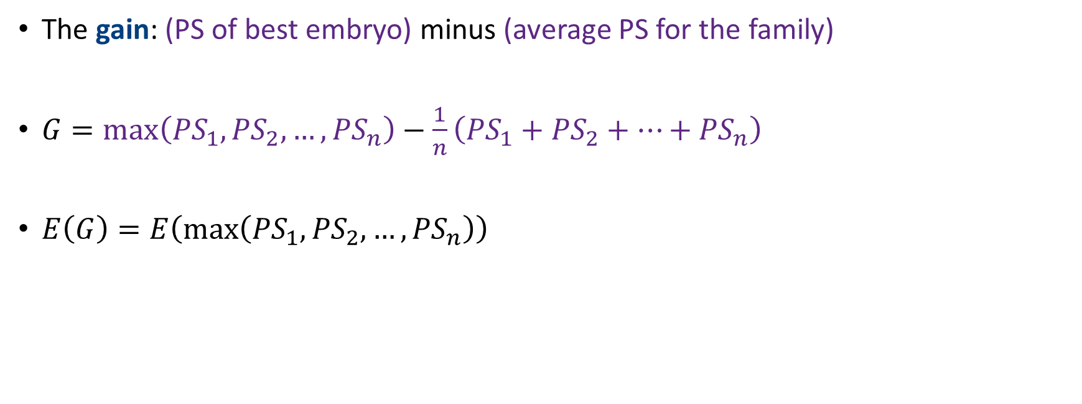
The gain under the model
The gain: (PS of best embryo) minus (average PS for the family)
$G=\max\left({PS}_{1},{PS}_{2},…,{PS}_{n}\right)−\frac{1}{n}\left({PS}_{1}+{PS}_{2}+…+{PS}_{n}\right)$
$E\left(G\right)=E\left(\max\left({PS}_{1},{PS}_{2},…,{PS}_{n}\right)\right)$

Slide 22

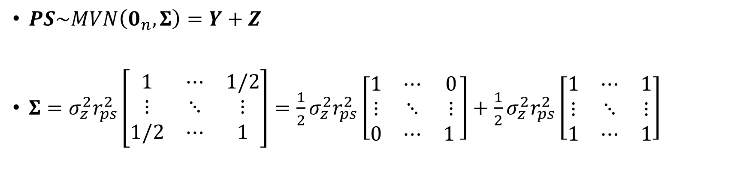

Decomposing the polygenic scores
$PS\sim MVN\left(0_{n},Σ\right)=Y+Z$
$Σ=σ_{z}^{2}r_{ps}^{2}\left[\begin{matrix}1 & ⋯ & 1/2 \\ ⋮ & ⋱ & ⋮ \\ 1/2 & ⋯ & 1\end{matrix}\right]=\frac{1}{2}σ_{z}^{2}r_{ps}^{2}\left[\begin{matrix}1 & ⋯ & 0 \\ ⋮ & ⋱ & ⋮ \\ 0 & ⋯ & 1 \end{matrix}\right]+\frac{1}{2}σ_{z}^{2}r_{ps}^{2}\left[\begin{matrix}1 & ⋯ & 1 \\ ⋮ & ⋱ & ⋮ \\ 1 & ⋯ & 1\end{matrix}\right]$
$$Y$$
$$Z$$
Independent normals
Identical normals
Do not affect the max

Slide 23
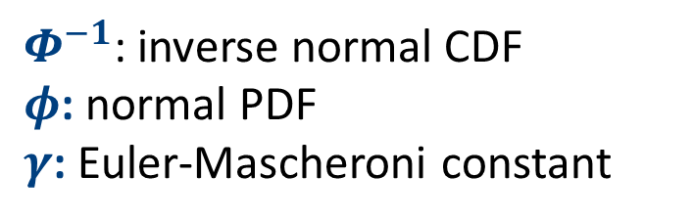
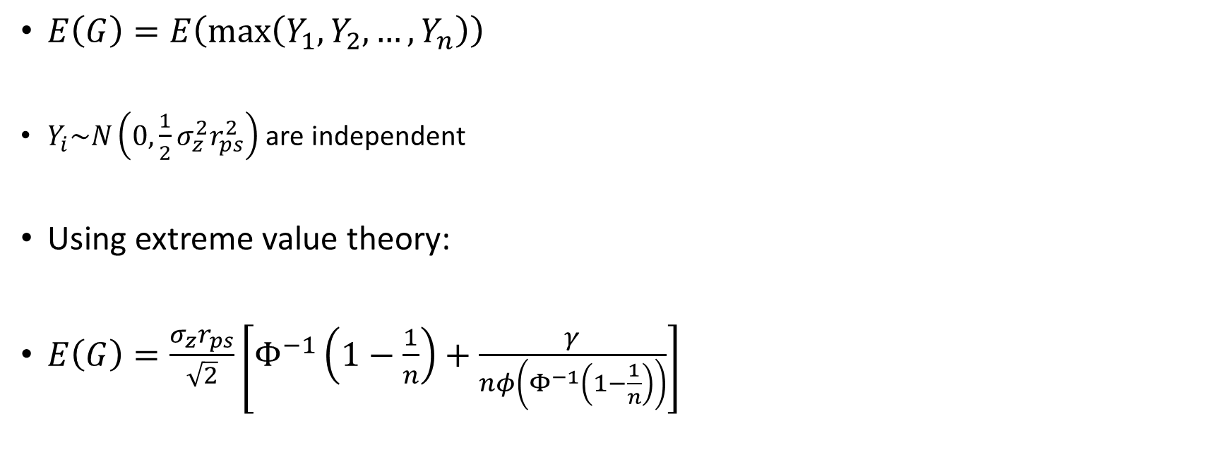
The mean gain
$E\left(G\right)=E\left(\max\left(Y_{1},Y_{2},…,Y_{n}\right)\right)$
$Y_{i}\sim N\left(0,\frac{1}{2}σ_{z}^{2}r_{ps}^{2}\right)$ are independent
Using extreme value theory:
$E\left(G\right)=\frac{σ_{z}r_{ps}}{\sqrt{2}}\left[Φ^{−1}\left(1−\frac{1}{n}\right)+\frac{γ}{nφ\left(Φ^{−1}\left(1−\frac{1}{n}\right)\right)}\right]$
$Φ^{−1}$: inverse normal CDF
$φ$: normal PDF
$γ$: Euler-Mascheroni constant

Slide 24
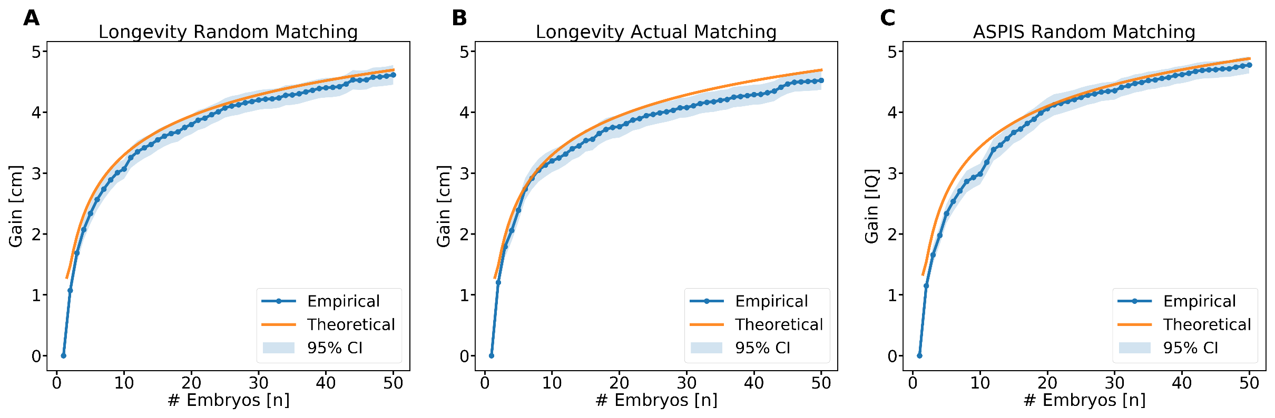
Confirming the theory

Slide 25
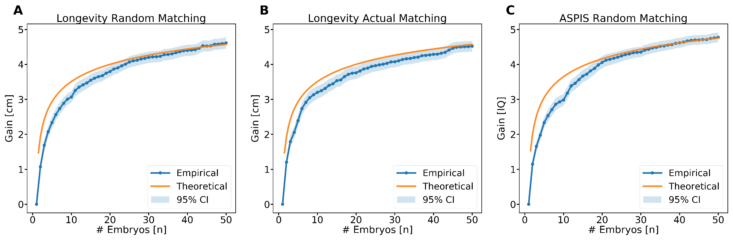

A useful approximation
$σ_{z}$: SD of the trait
$$E\left(Gain\right)≈σ_{z}r_{ps}⋅O\left(\sqrt{\log{n}}\right)$$
Accuracy of the score
Contribution of the number of embryos

Slide 26
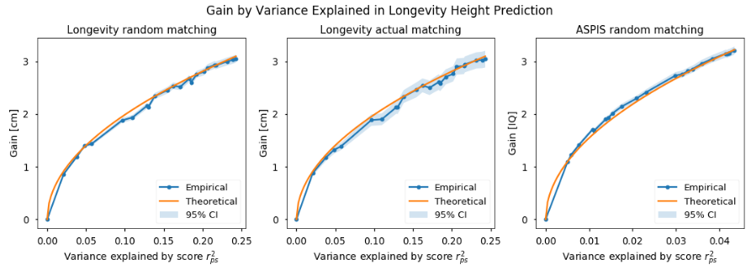
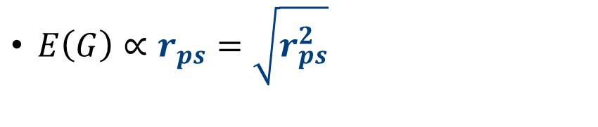
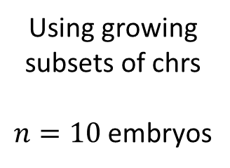
The effect of the predictor
$E\left(G\right)∝r_{ps}=\sqrt{r_{ps}^{2}}$
Can estimate the gain for future predictors!
Using growing subsets of chrs
$n=10$ embryos

Slide 27
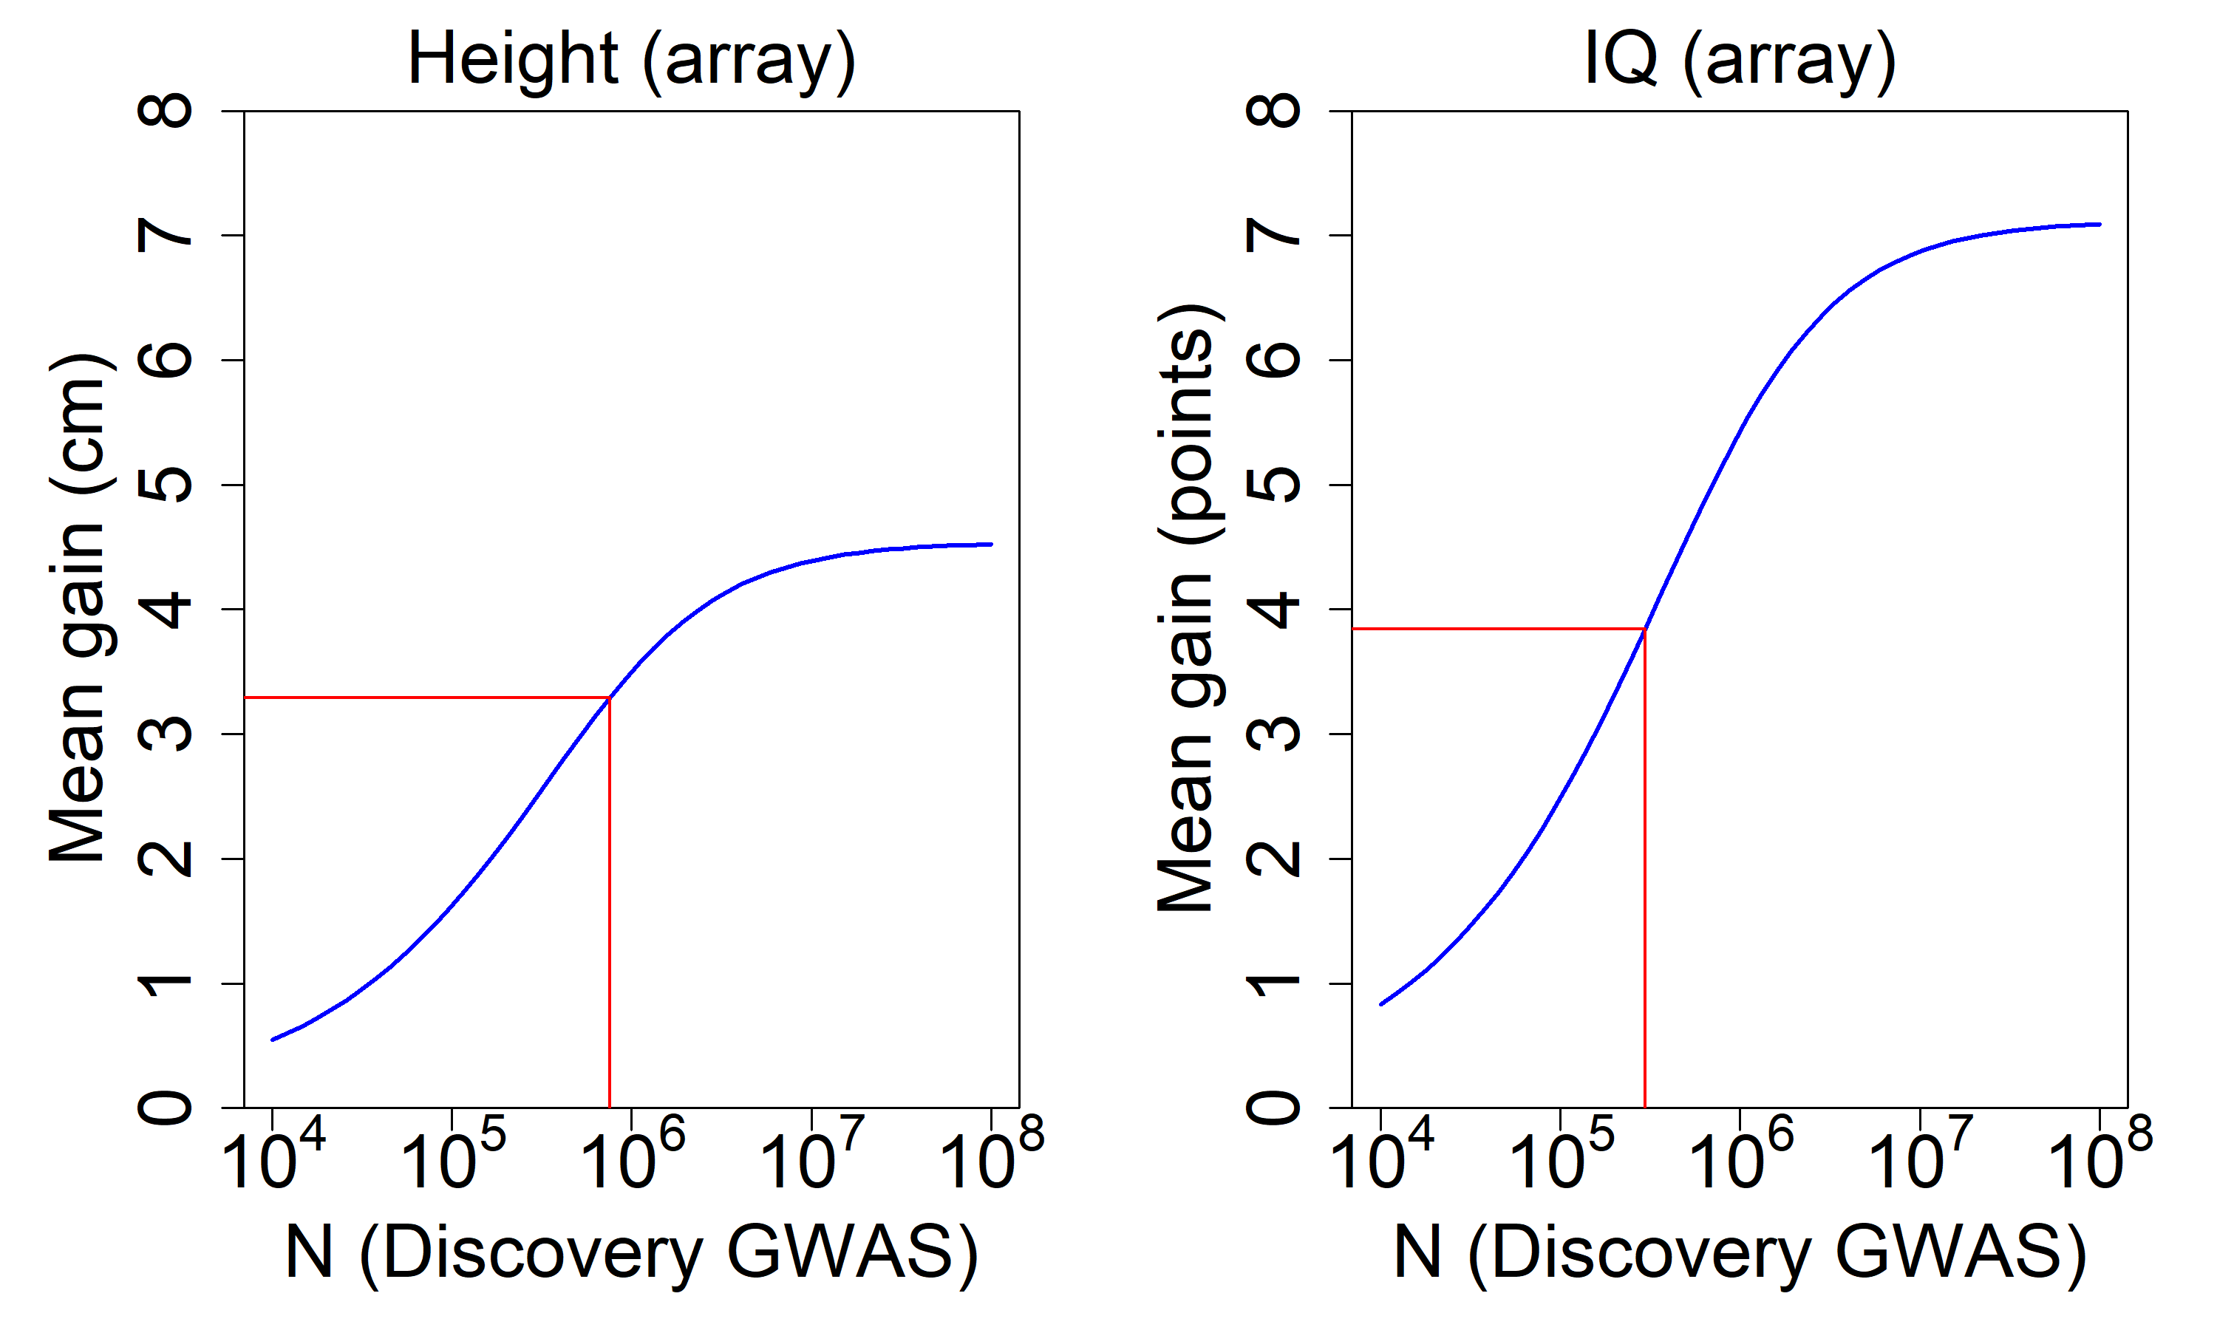
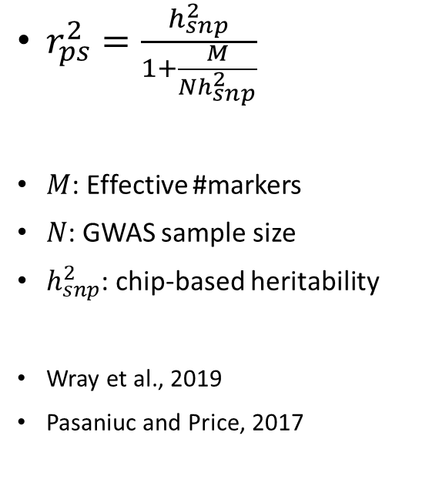
Larger GWASs?
$r_{ps}^{2}=\frac{h_{snp}^{2}}{1+\frac{M}{Nh_{snp}^{2}}}$
$M$: Effective #markers
$N$: GWAS sample size
$h_{snp}^{2}$: chip-based heritability
Wray et al., 2019
Pasaniuc and Price, 2017
10 embryos

Slide 28
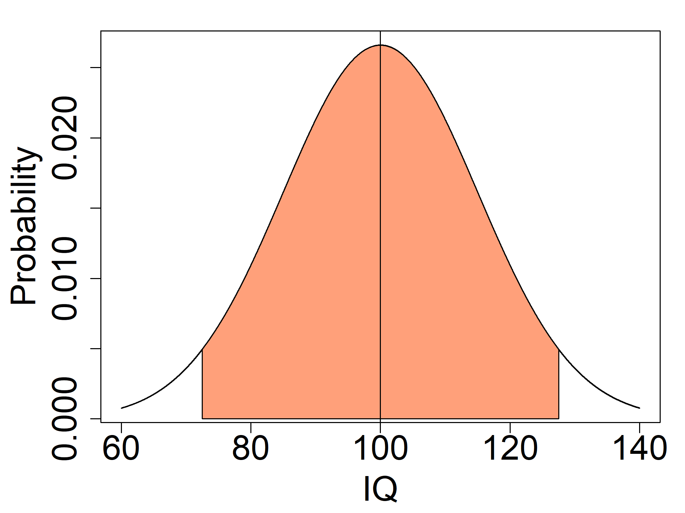
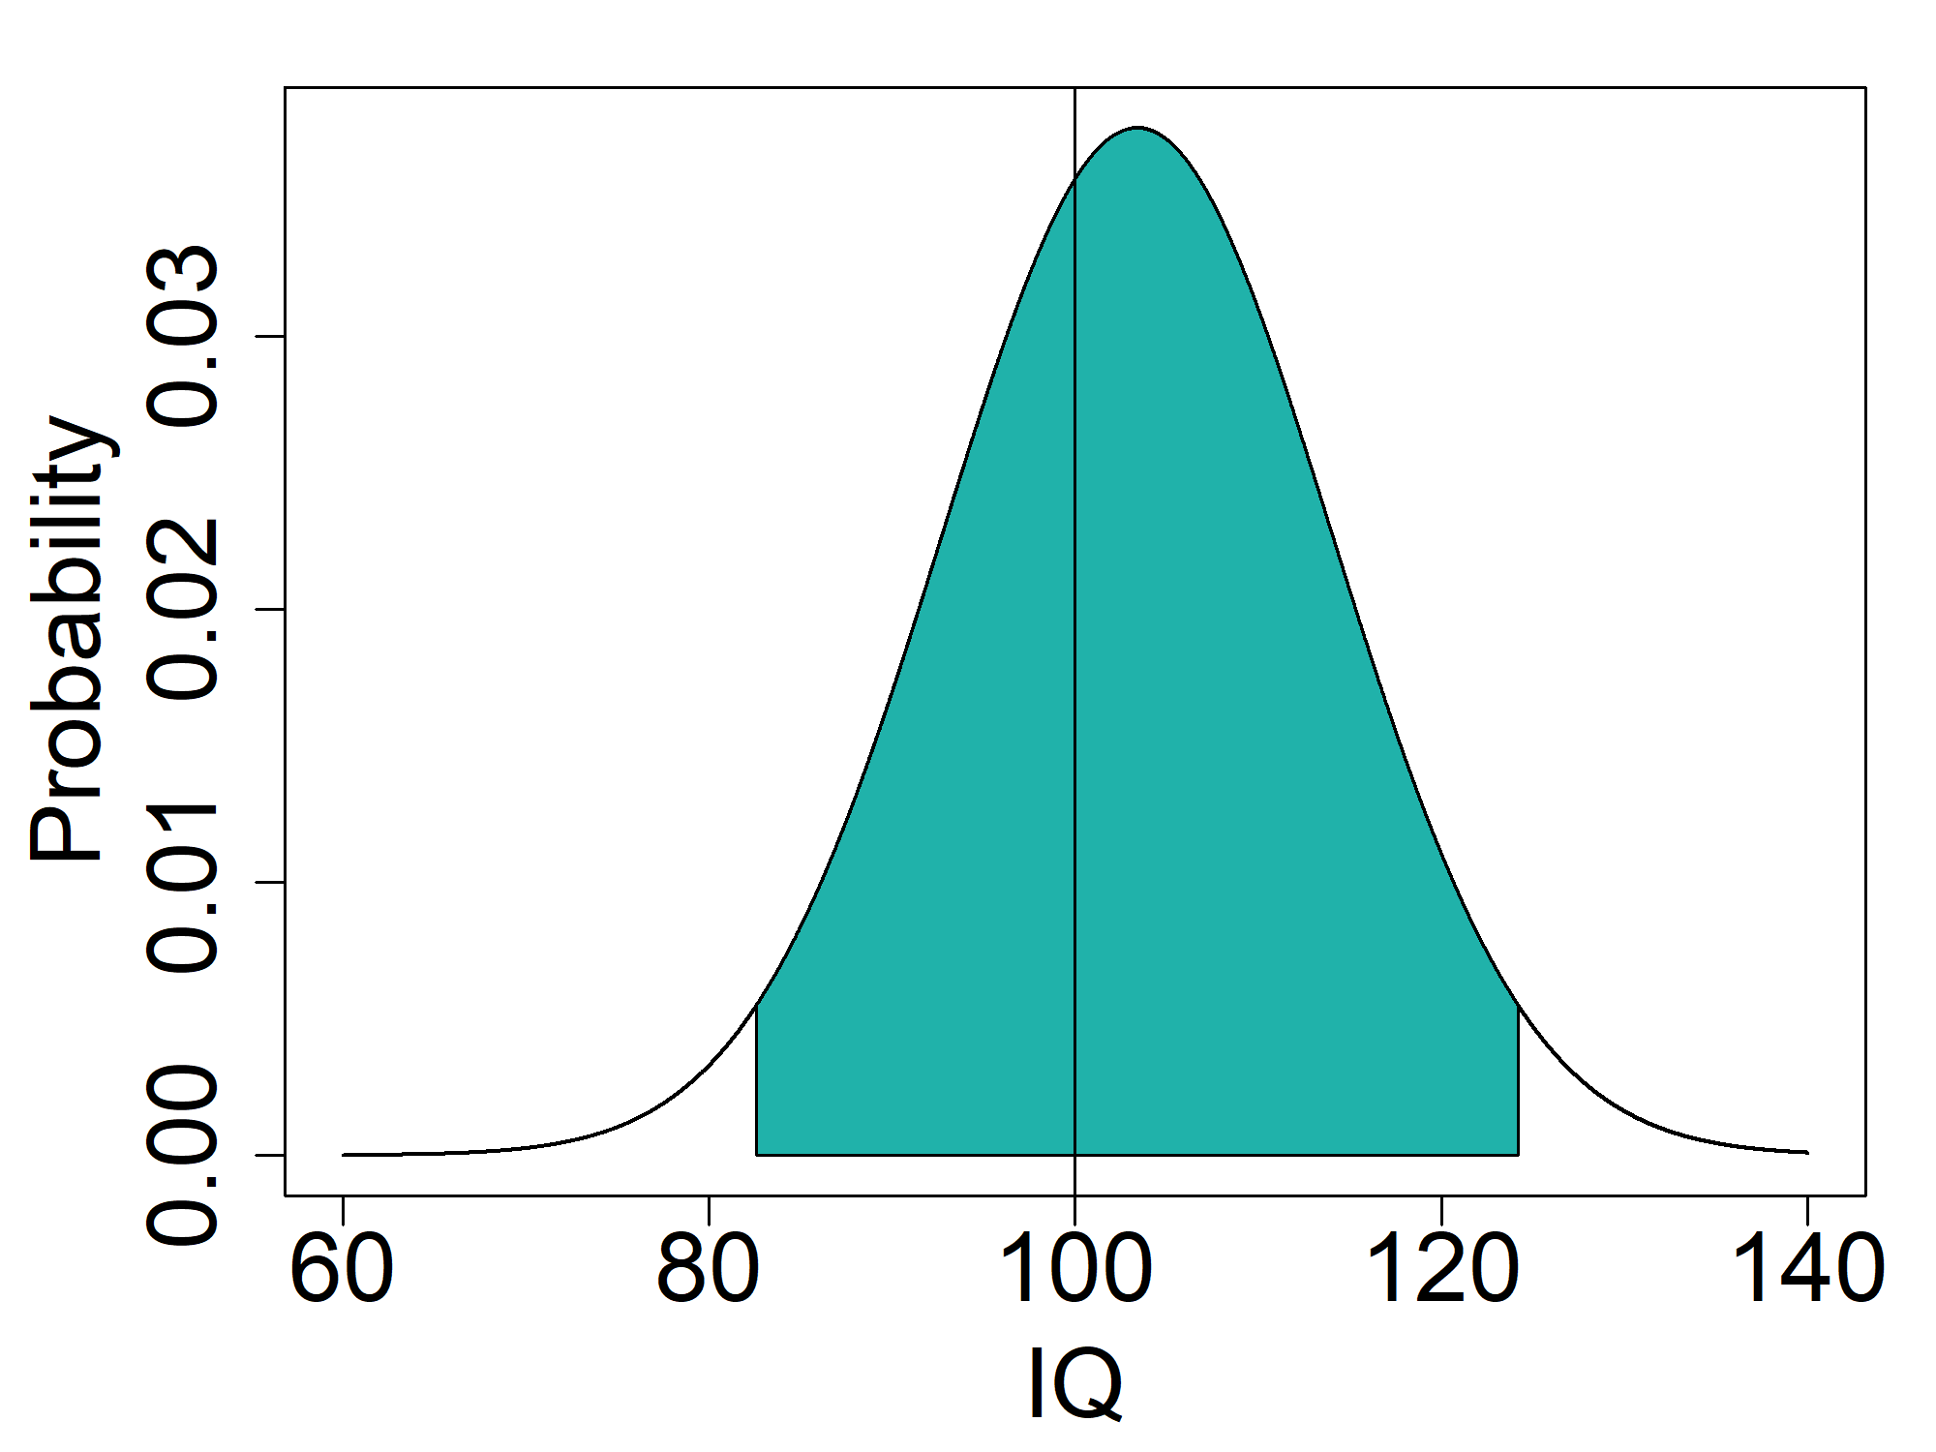

The actual gain is uncertain
IQ
Embryos are random
Non-score genetic factors
Non-genetic factors
No selection
[72,128]
Selection
[83,124]
$n=10$, $h^{2}=0.5$, $r_{ps}^{2}=4.3\%$

Slide 29
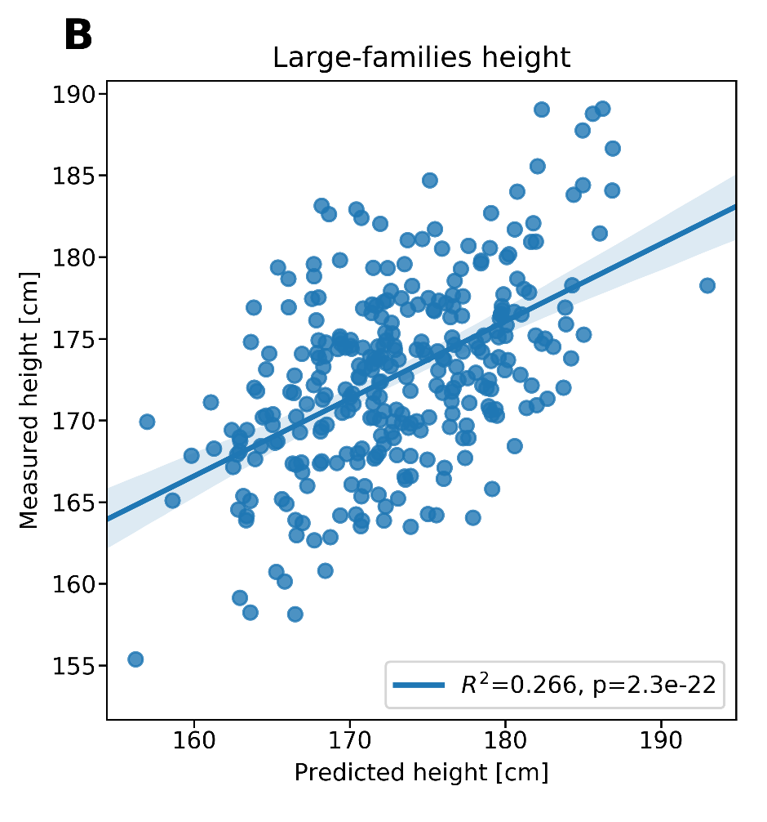
But what about an actual experiment?...
Ethical issues + too long
But we can consider large nuclear families
28 Ultra-orthodox Jewish families (Israel/US)
9.6 adult children per family (range: 3-20)
Genotype + height available!
Danny Zeevi, Leonid Kruglyak, UCLA

Slide 30
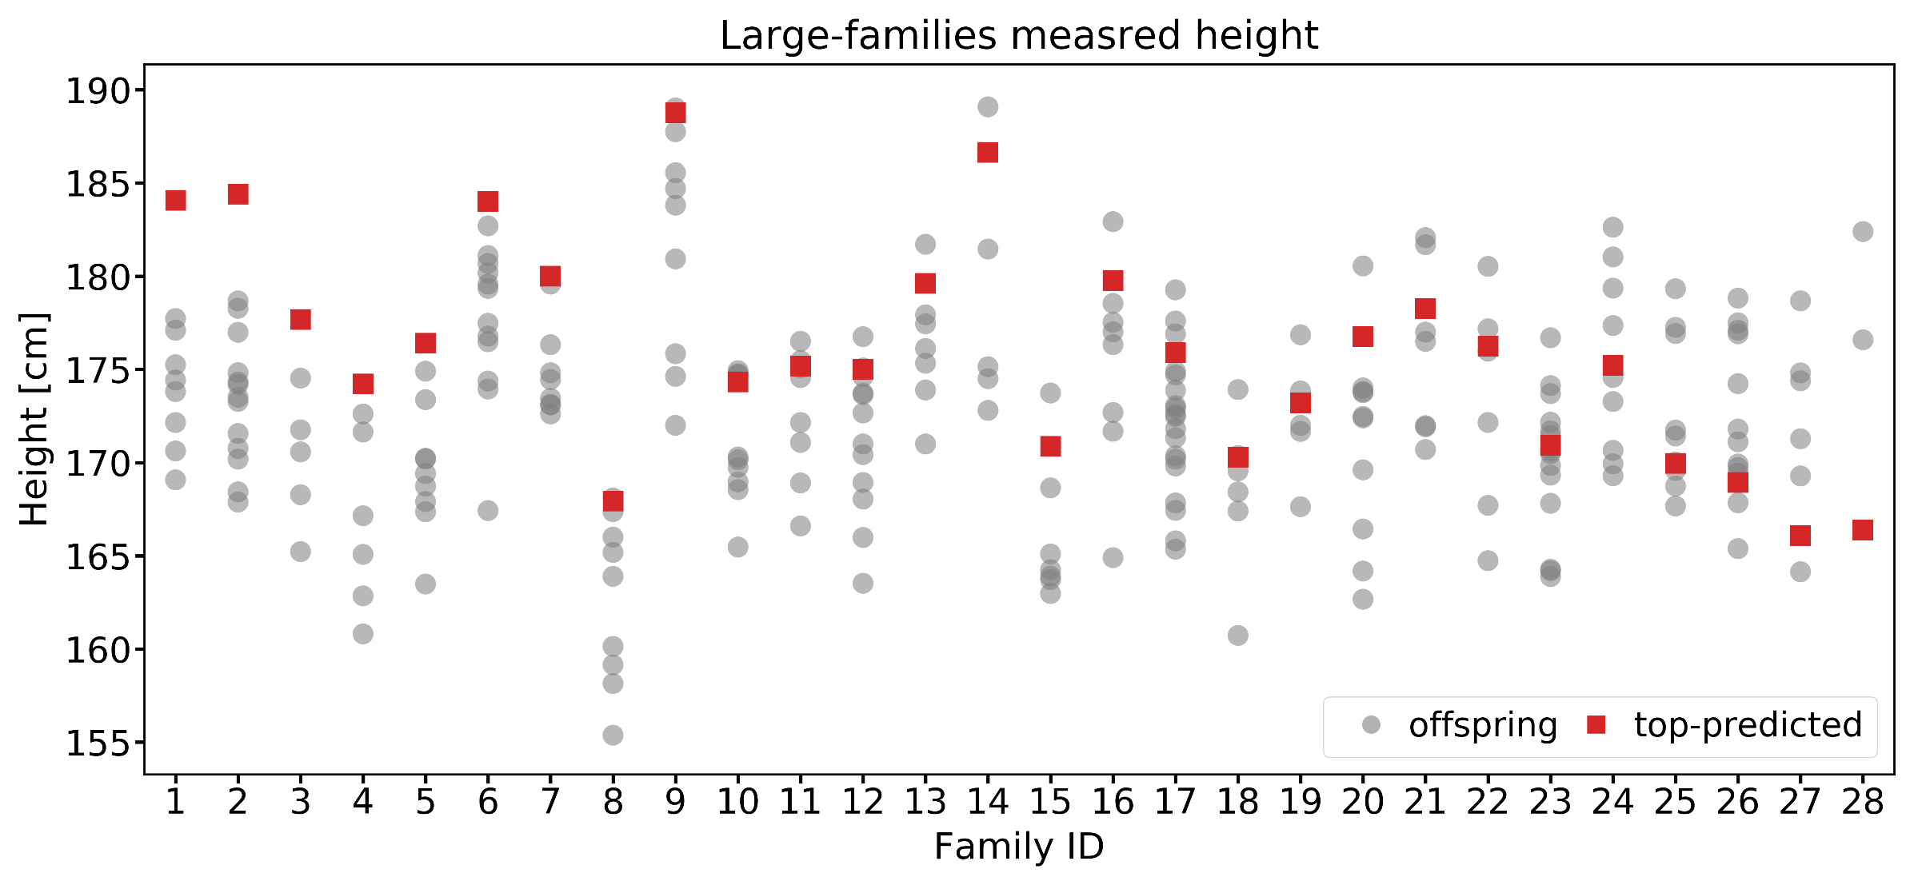
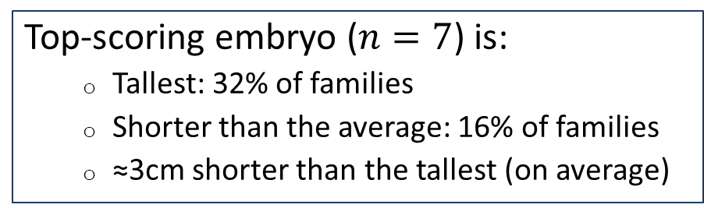
An “experiment”
Top-scoring embryo ($n=7$) is:
  Tallest: 32% of families
  Shorter than the average: 16% of families
  ≈3cm shorter than the tallest (on average)
Danny Zeevi, Leonid Kruglyak, UCLA

Slide 31
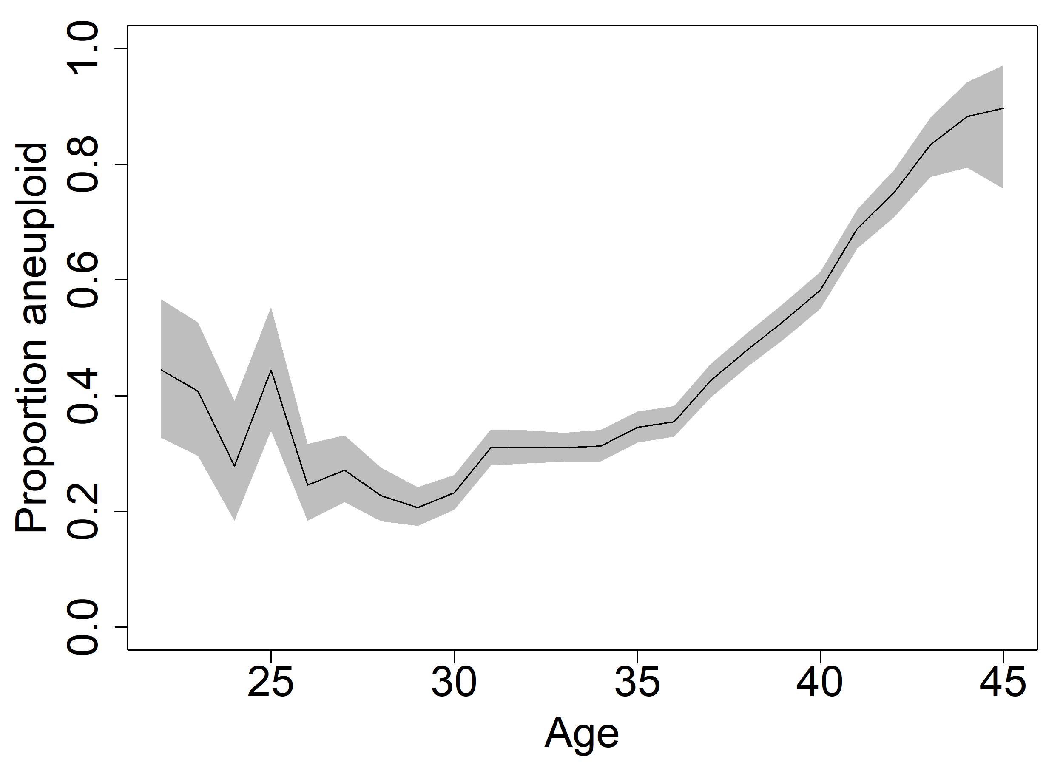
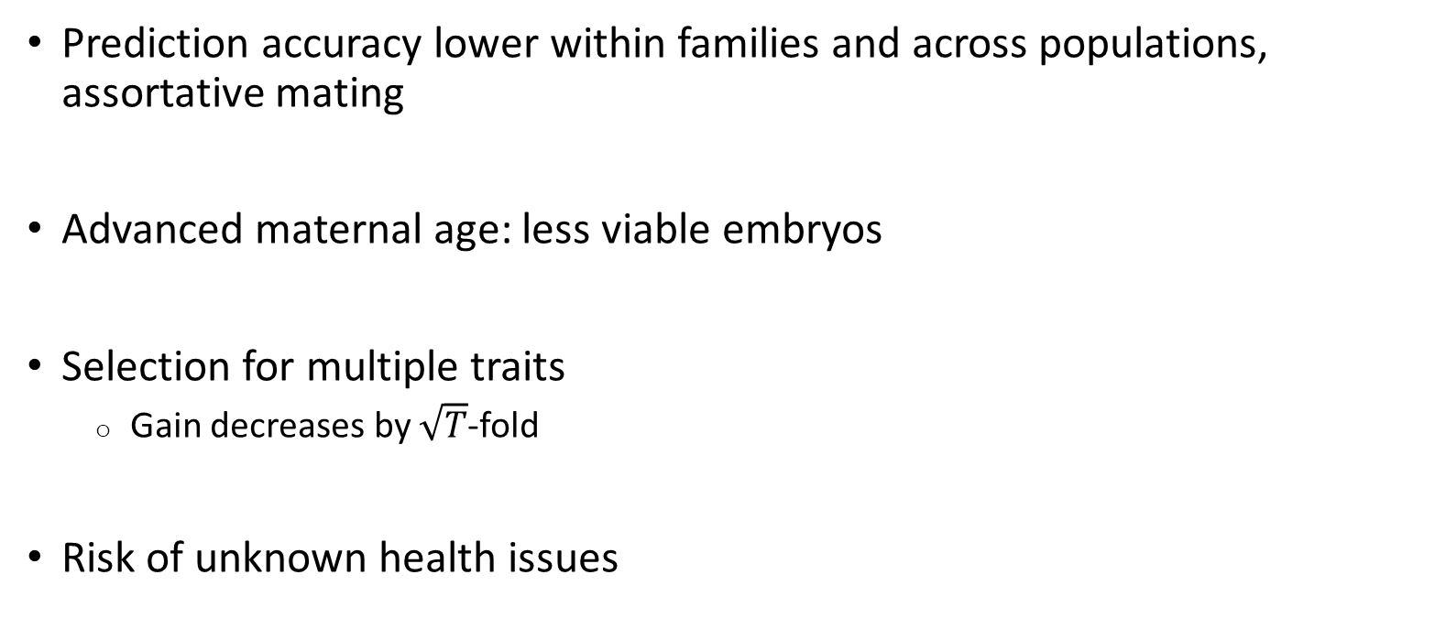
Many practical limitations
Prediction accuracy lower within families and across populations, assortative mating
Advanced maternal age: less viable embryos
Selection for multiple traits
  Gain decreases by $\sqrt{T}$-fold
Risk of unknown health issues
From Franasiak et al., 2014

Slide 32
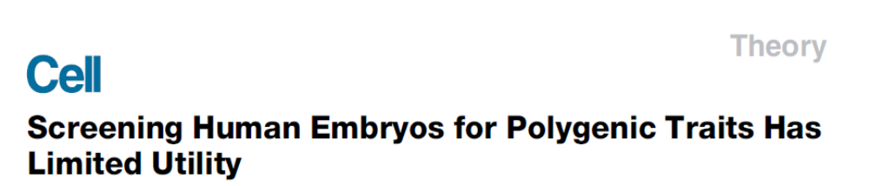
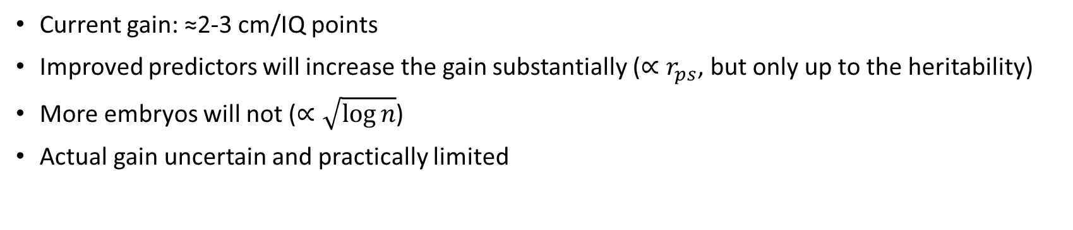
Summary
Current gain: ≈2-3 cm/IQ points
Improved predictors will increase the gain substantially ($∝r_{ps}$, but only up to the heritability)
More embryos will not ($∝\sqrt{\log{n}}$)
Actual gain uncertain and practically limited
Acknowledgements:
Ehud Karavani, HUJI
Or Zuk, HUJI
Danny Zeevi, UCLA
Todd Lencz, Northwell
Abisch-Frenkel Foundation

