Slide 1
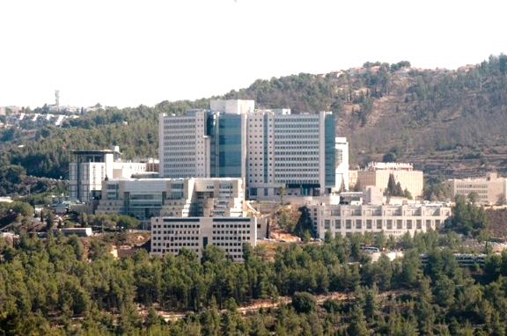



Inferring the past demography of founder populations using haplotype sharing
Shai Carmi
Braun School of Public Health and Community Medicine
The Hebrew University of Jerusalem
December 2018

Slide 2
Outline
Haplotype sharing and demographic history
Application 1: Ashkenazi population genetics
  The founder event
  Time of admixture
Application 2: Other populations
  Druze
  Irish Travellers
  The effect of consanguinity

Slide 3
Haplotype sharing and demographic history

Slide 4



Sharing between relatives
Siblings
First cousins
Probability: 12.5%
Mean length: 25cM
Probability: 50%
Mean length: 50cM
Shared haplotype
Identical-by-descent (IBD) segment
Shared haplotype

Slide 5


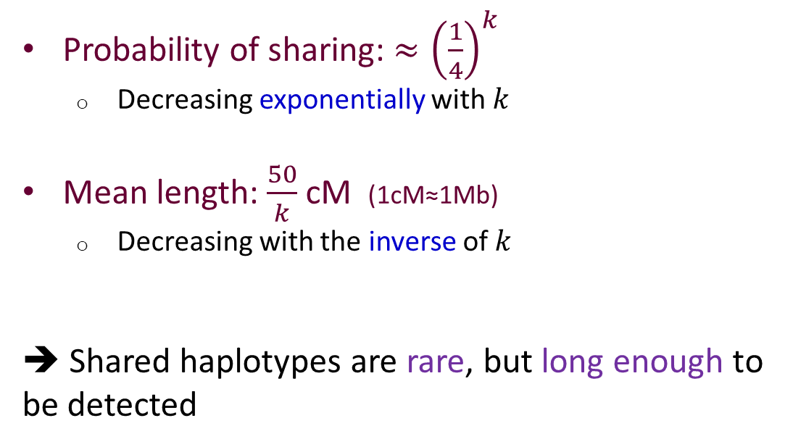

Sharing between remote relatives
$k$^{th}-generation cousins
Probability of sharing: ${≈\left(\frac{1}{4}\right)}^{k}$
  Decreasing exponentially with $k$
Mean length: $\frac{50}{k}$ cM (1cM≈1Mb)
  Decreasing with the inverse of $k$
➔ Shared haplotypes are rare, but long enough to be detected
$$k$$
Shared haplotype

Slide 6
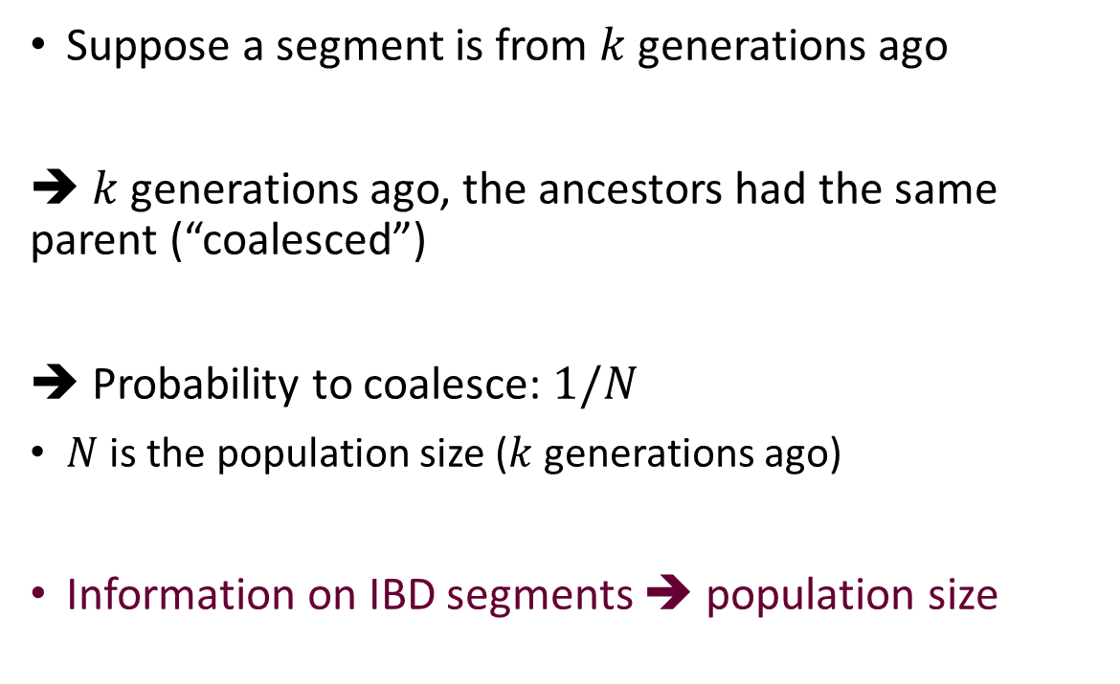
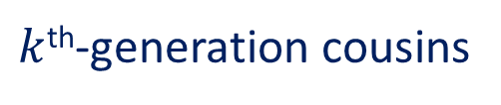

Inferring demographic events
$k$^{th}-generation cousins
Suppose a segment is from $k$ generations ago
➔ $k$ generations ago, the ancestors had the same parent (“coalesced”)
➔ Probability to coalesce: $1/N$
$N$ is the population size ($k$ generations ago)
Information on IBD segments ➔ population size
$$k$$
Shared haplotype

Slide 7
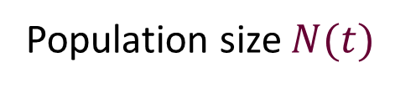
A founder event
Population size $N(t)$
Time
A bottleneck, or a founder event
Present

Slide 8
Detecting founder events
Segment length $ℓ≈\frac{50}{k}$ ➔ bottleneck time $k≈\frac{50}{ℓ}$
Probability of sharing
Probability of sharing
There were ≈20 founders
1/20
There were ≈40 founders
1/40
10cM
Segment length
2cM
Segment length
Founder event was ≈5 generations ago
Founder event was ≈25 generations ago

Slide 9

More complex histories
Population size $N(t)$
Time (generations)
Probability of sharing
1/40
25
40
1/100
2cM
10cM
Segment length
5
100
Palamara et al., AJHG, 2012; Carmi et al., Genetics, 2013; Carmi et al., Theor Popul Biol, 2014
Present

Slide 10


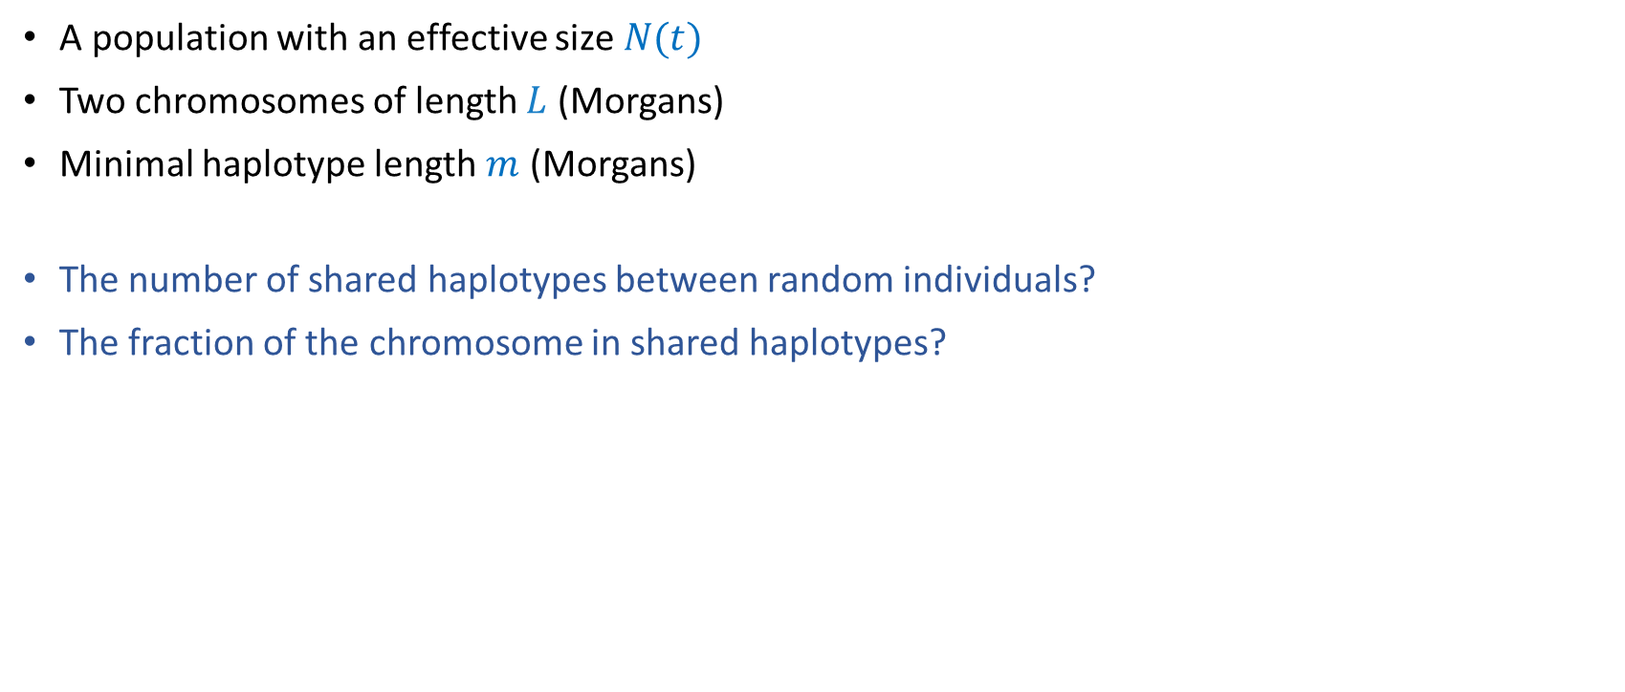



A population model
A population with an effective size $N(t)$
Two chromosomes of length $L$ (Morgans)
Minimal haplotype length $m$ (Morgans)
The number of shared haplotypes between random individuals?
The fraction of the chromosome in shared haplotypes?
$$ℓ1$$
$$ℓ2$$
$$ℓ3$$
$$m$$
$$L$$
Palamara et al., AJHG, 2012; Carmi et al., Genetics, 2013; Carmi et al., Theor Popul Biol, 2014

Slide 11
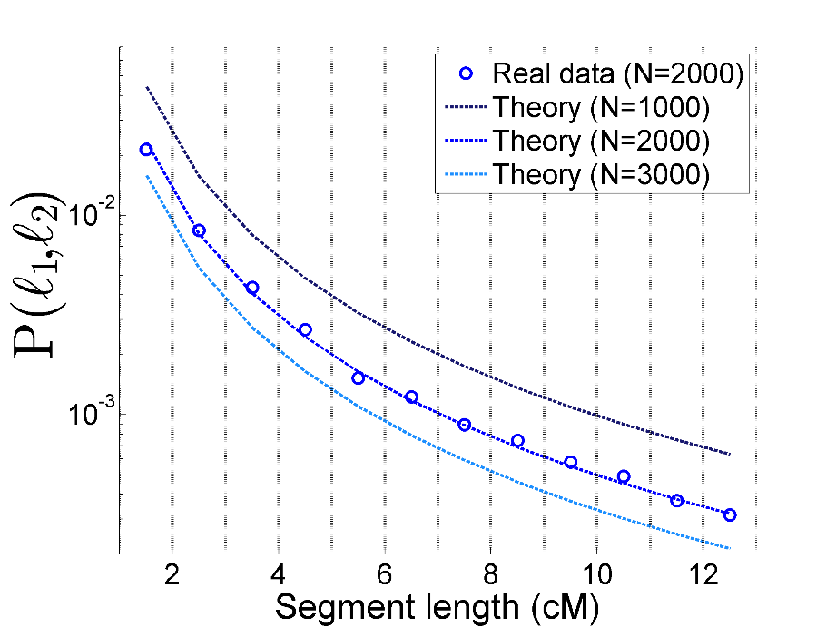

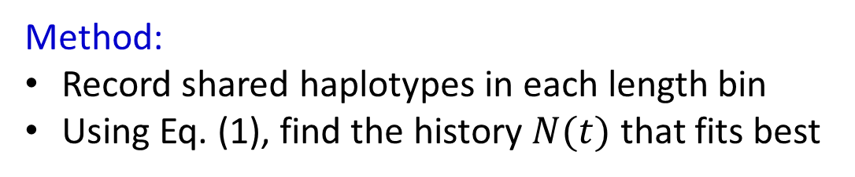
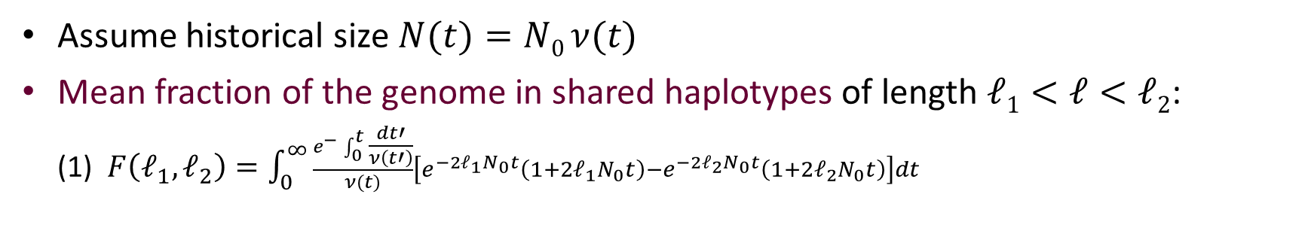
Population size inference
Assume historical size $N(t)=N0 ν(t)$
Mean fraction of the genome in shared haplotypes of length $ℓ1<ℓ<ℓ2$:
(1) $F\left(ℓ_{1},ℓ_{2}\right)=\int_{0}^{∞}{\frac{e^{−}\int_{0}^{t}{\frac{dt′}{ν\left(t′\right)}}}{ν(t)}\left[e^{−2ℓ_{1}N_{0}t}\left(1+2ℓ_{1}N_{0}t\right)−e^{−2ℓ_{2}N_{0}t}\left(1+2ℓ_{2}N_{0}t\right)\right]dt}$
Hypothetical example
Method:
Record shared haplotypes in each length bin
Using Eq. (1), find the history $N(t)$ that fits best
$$F\left(ℓ_{1},ℓ_{2}\right)$$
Palamara et al., AJHG, 2012

Slide 12
Application 1: Ashkenazi population genetics
The founder event
Time of admixture

Slide 13
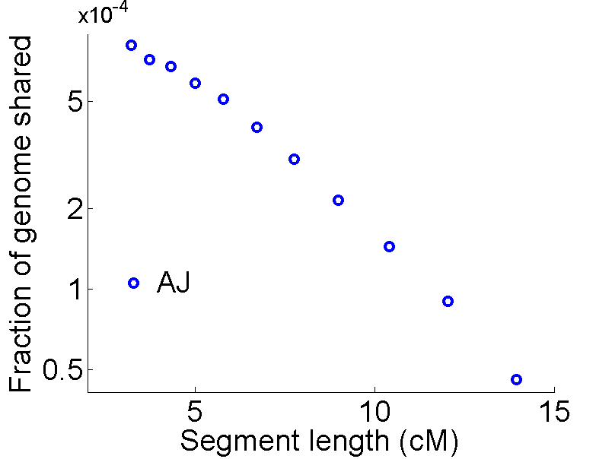
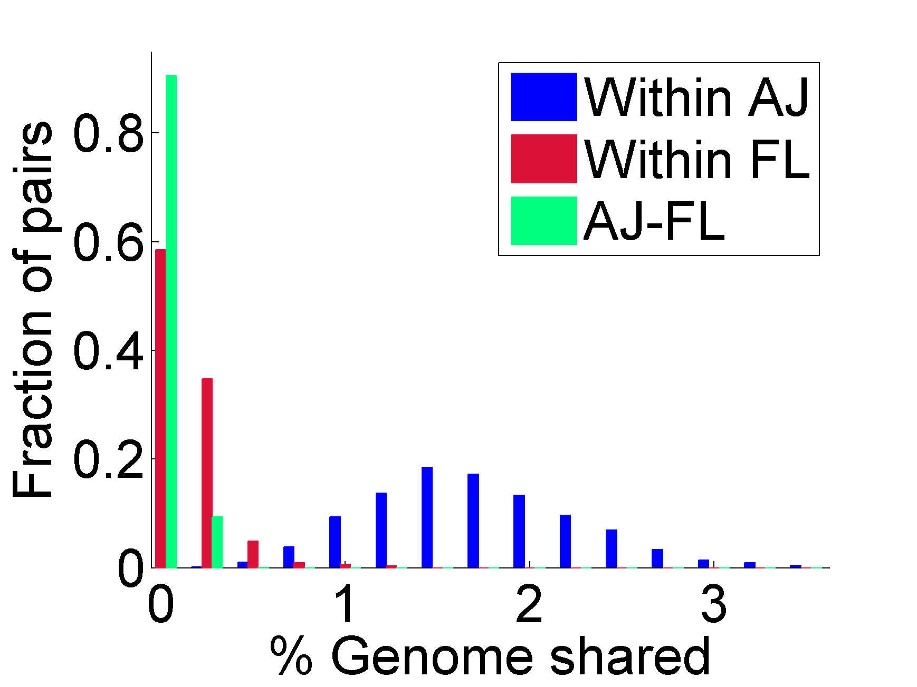
The Ashkenazi Jewish (AJ) bottleneck
128 whole-genomes
Within AJ
Within EU
AJ-EU
A pair of AJ individuals shares 1-2% of their genome (≈10-15 long haplotypes)
Carmi et al., Nat Commun, 2014. See also: Atzmon et al., AJHG, 2010, Palamara et al., AJHG, 2012, Granot-Hershkovitz et al., EJHG, 2018

Slide 14
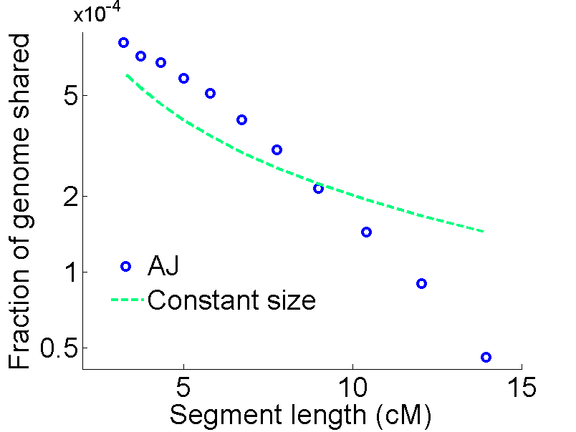
The AJ bottleneck
Within AJ
Within EU
AJ-EU

Slide 15
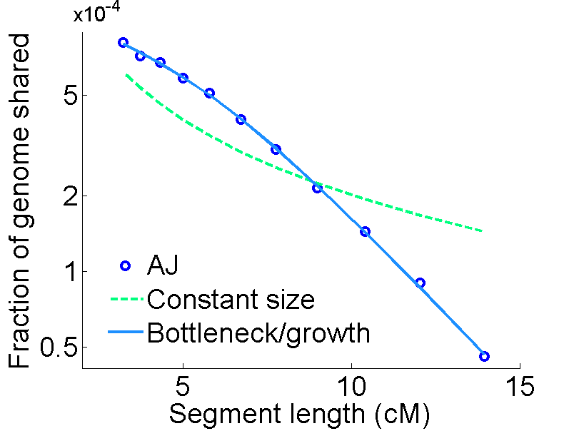
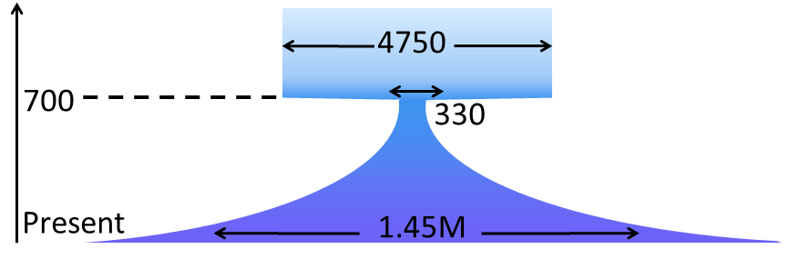
The AJ bottleneck
Assuming 1 generation=25 years
Time (years)

Slide 16
Historical interpretation
Key point: population sizes are effective, i.e., represent an “idealized” population behaving according to a model
  Roughly the number of reproducing individuals
  Census population size was probably higher
May represent the early Jewish settlement in Poland
Similar growth rates were observed elsewhere (French Canadians, Amish)

Slide 17
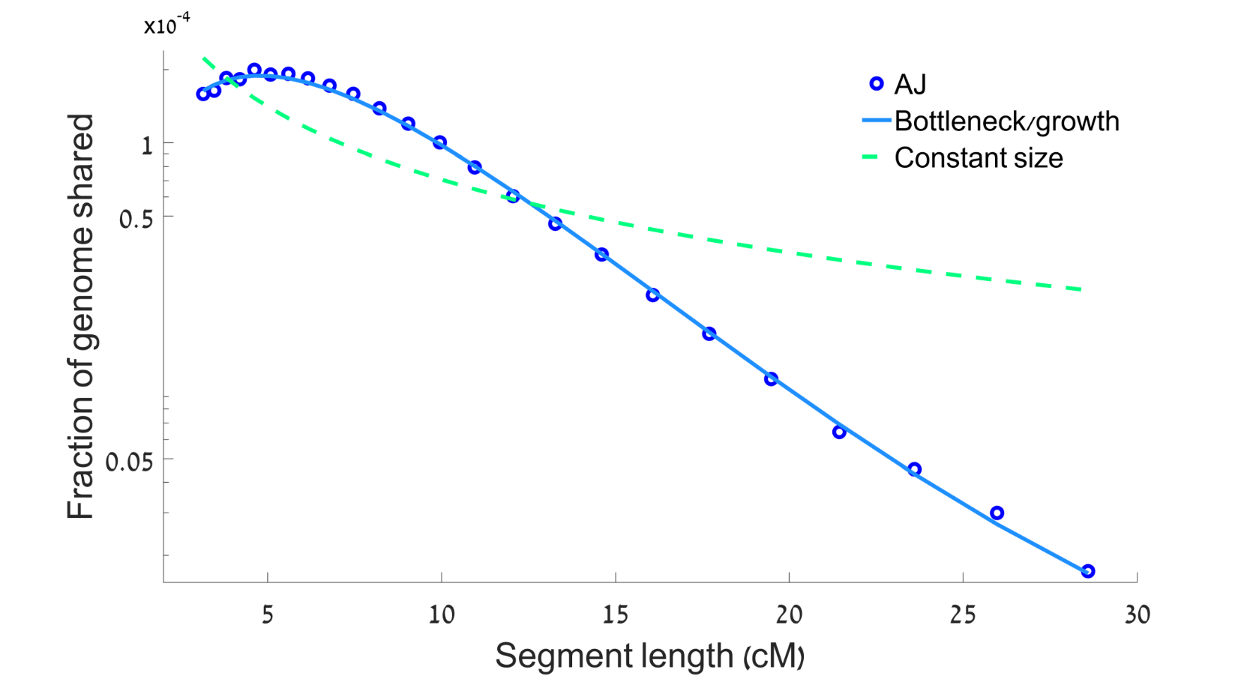
Replication (1)
≈900 Kibbutzim members (≈300 unrelated)
Bottleneck size: ≈450 individuals
Bottleneck time: ≈600 years
Granot-Hershkovitz, …, Carmi*, Hochner*, EJHG, 2018

Slide 18
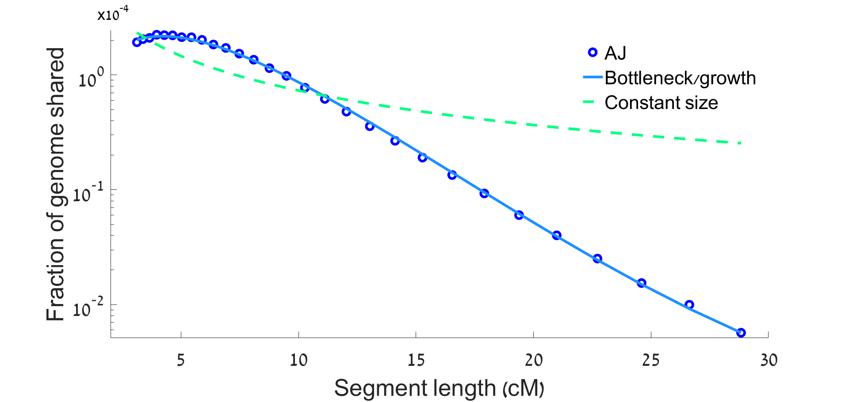
Replication (2)
≈2500 individuals from a schizophrenia case-control study
Bottleneck size: ≈300 individuals
Bottleneck time: ≈650 years
In work:
Other methods?
Sex-specific founder events?
Guha et al., Genome Biol, 2012

Slide 19
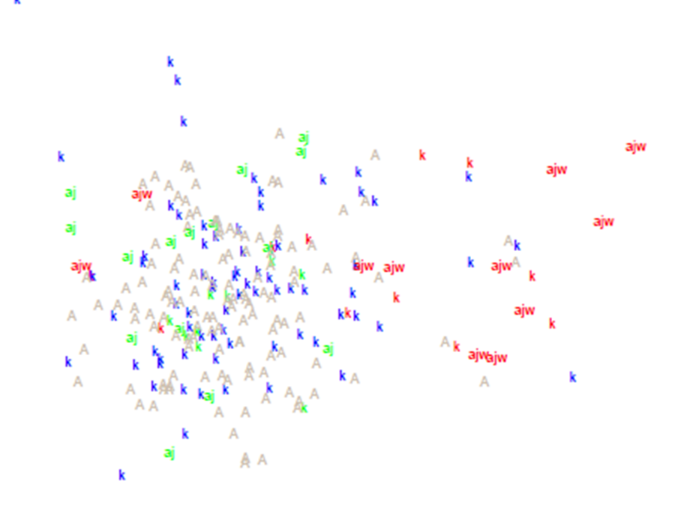
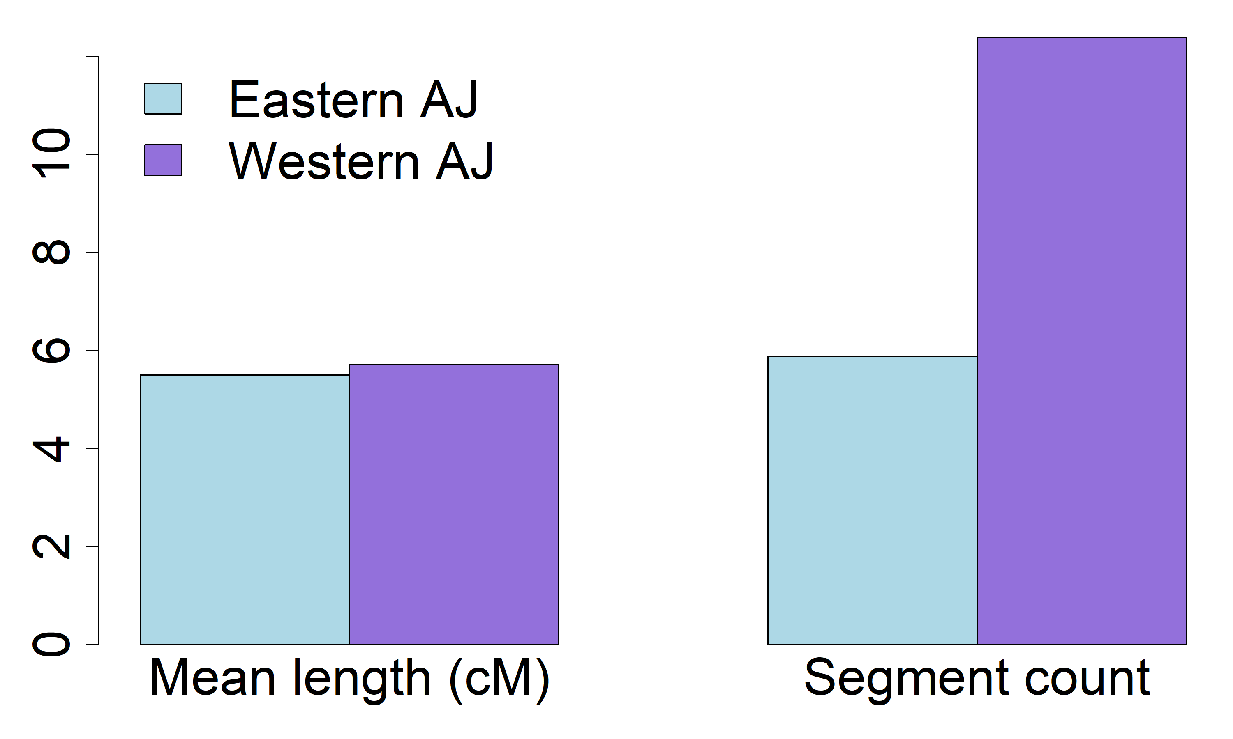
Are Eastern AJ distinct from Western AJ?
≈300 Kibbutzim members (Granot-Hershkovitz, …, Carmi*, Hochner*, EJHG, 2018)
Red: Western AJ
Green: Eastern AJ
PC2
IBD sharing within regions
PC1

Slide 20
Are all AJ third-cousins?
Not genealogically, but they do share a large amount of genetic material
The total amount of genetic material shared between AJ pairs is about the same as third cousins
But shared blocks are shorter and they have more differences compared to cousins
Nevertheless, most direct-to-consumer services are confounded

Slide 21










Are all AJ third-cousins?
Shared haplotype
*
Difference
Cousins
A
$$∗$$
B
$$∗$$
Unrelated AJ
A
$$∗ ∗$$
$$∗$$
$$∗$$
$$∗$$
B
$$∗ ∗$$
$$∗$$
$$∗$$
$$∗$$

Slide 22

Chromosomes of admixed individuals
Time (generations)
Population A
Population B
AJ have Middle-Eastern and European ancestries
Did the founder event happen before or also after admixture?
$$t$$
Present
Admixed population

Slide 23
Evidence for multiple admixture events
EU
EU
ME
ME
700 years
EU
Observed pattern
Time
IBD segments
42%
Genome
53%
Xue, …, Carmi, PLOS Genetics, 2017

Slide 24
Putting it all together
Time (generations ago)
Xue, …, Carmi, PLOS Genetics, 2017
Ancestral Middle-Eastern population
Southern EU admixture
Replacing ≈35-60%
600-1300 ya
≈25-50
Eastern EU admixture
Bottleneck
Replacing ≈15-25%
600-900 ya
≈25-35
250-500 ya
≈10-20
Population size

Slide 25
Application 2: other populations
Druze
Irish Travellers
The effect of consanguinity

Slide 26
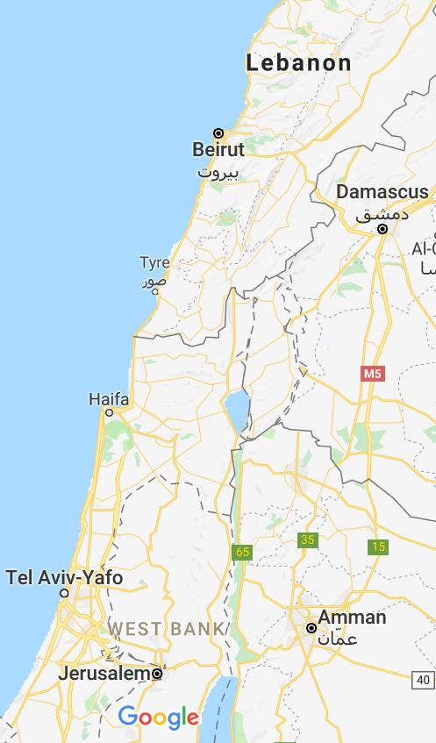
Druze genetics
Religion formed in 10th century Egypt
  Demographic upheavals
  Conversion (in and out) prohibited
Today: ≈1M, mostly in Syria and Lebanon
We genotyped 40 Israeli Druze trios
Haplotype sharing abundant
  0.3-3% of the genome, in segments >3cM
Zidan*, Ben-Avraham*, Carmi*, et al., EJHG, 2015

Slide 27
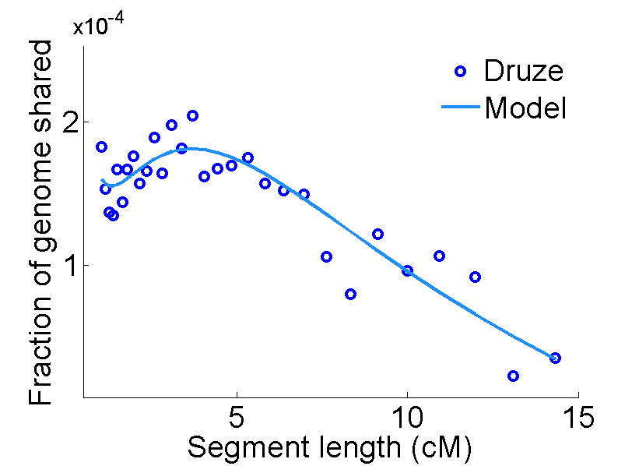
A recent bottleneck
Time
41,000
3000
900
(years)
6100
Present
Zidan*, Ben-Avraham*, Carmi*, et al., EJHG, 2015

Slide 28
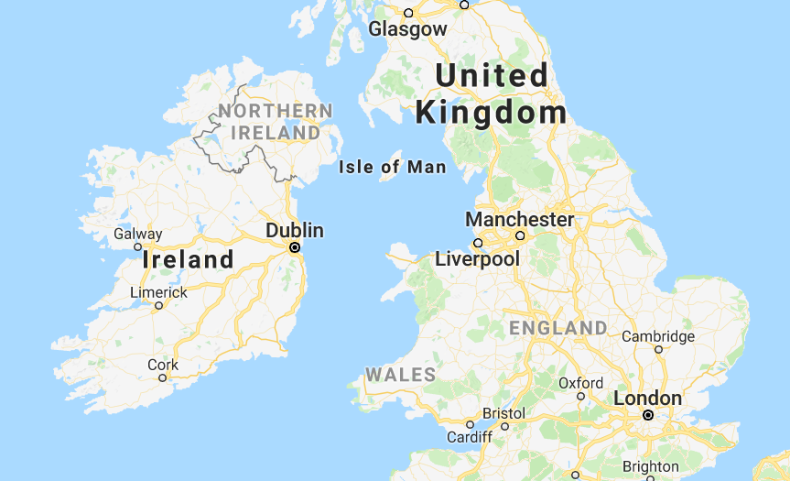
Irish Travellers
A nomad community of ≈30k, speaking their
own language and socially isolated
We genotyped 50 Irish Travellers
The population is similar to, yet distinct from,
Settled Irish; no Roma origins
Haplotype sharing is abundant, organized in two sub-groups
Gilbert, Carmi, et al., Sci. Rep., 2017

Slide 29
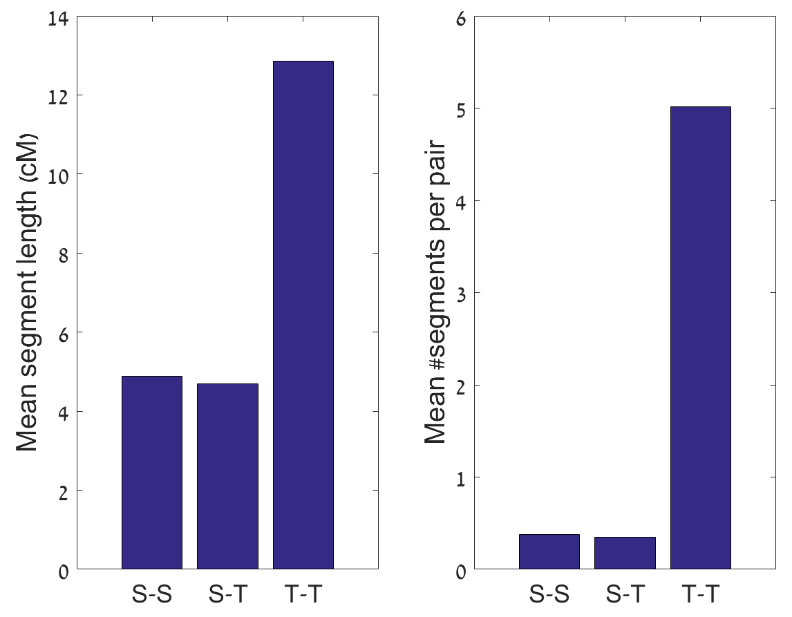
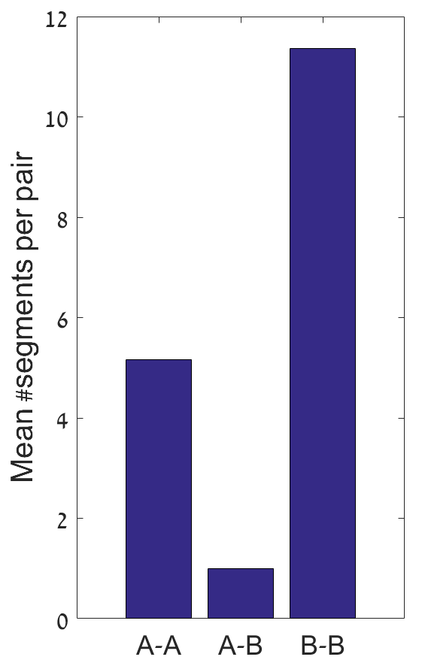
Irish Travellers: haplotype sharing
S: Settled, T: Travellers
Gilbert, Carmi, et al., Sci. Rep., 2017

Slide 30
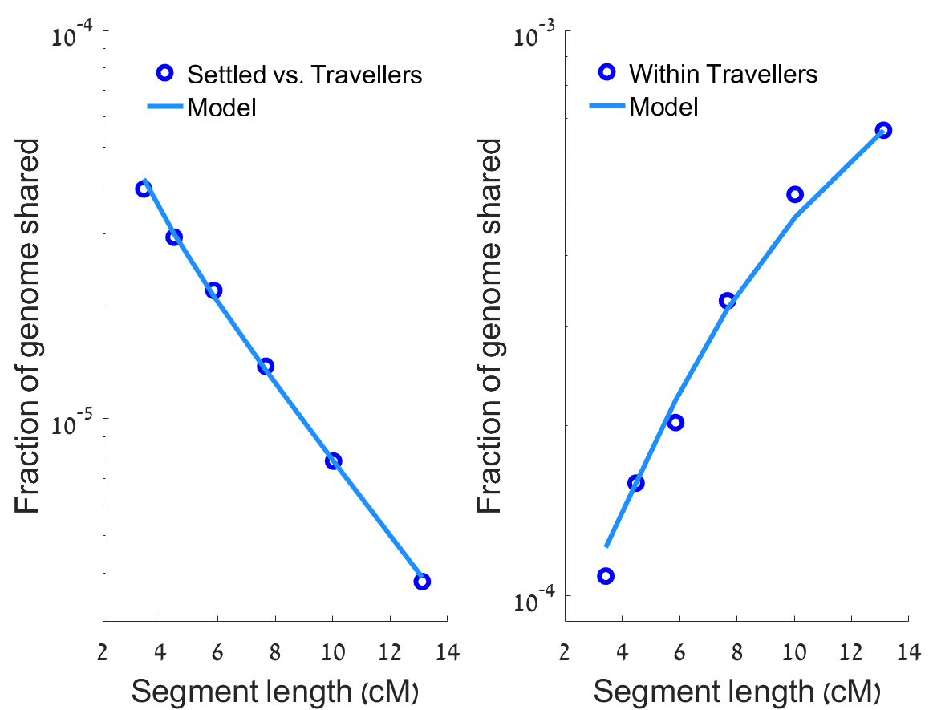
Irish Travellers: demographic reconstruction
Time
(years ago)
90k
400
300
50k
A/B
450/10
5M
Settled
Traveller
Present
Gilbert, Carmi, et al., Sci. Rep., 2017

Slide 31
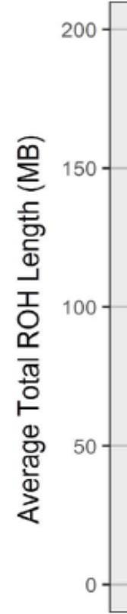
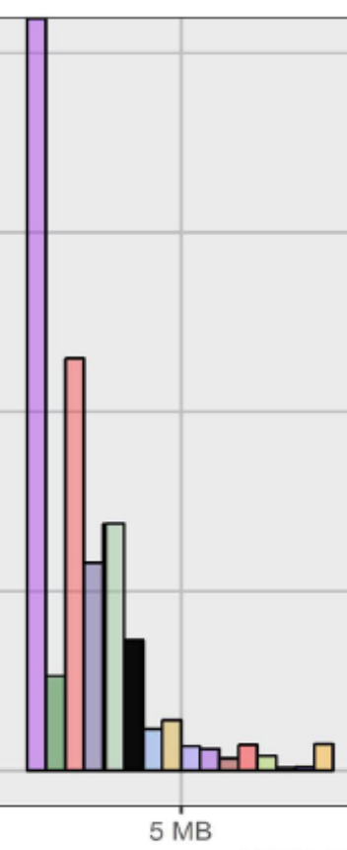
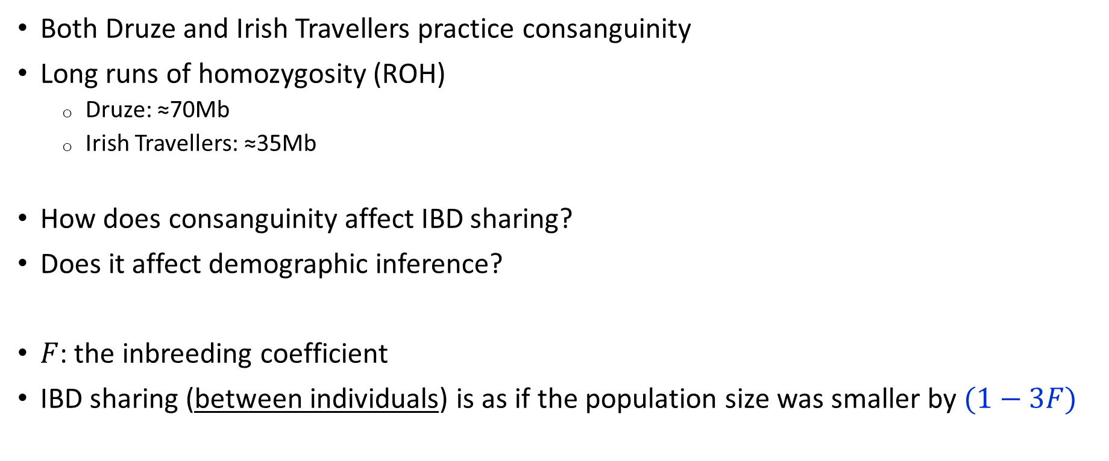
Confounding by consanguinity?
Both Druze and Irish Travellers practice consanguinity
Long runs of homozygosity (ROH)
  Druze: ≈70Mb
  Irish Travellers: ≈35Mb
How does consanguinity affect IBD sharing?
Does it affect demographic inference?
$F$: the inbreeding coefficient
IBD sharing (between individuals) is as if the population size was smaller by $(1−3F)$
Druze
Travellers
Severson, Carmi, Rosenberg, Genetics, 2019

Slide 32



Acknowledgements
The Ashkenazi Genome Consortium:
  Ariel Darvasi, Gil Atzmon, Inga Peter, Lorraine Clark, Harry Ostrer, Todd Lencz, Itsik Pe’er
Genetic sharing theory:
  Pier Palamara, Peter Wilton, Shuo Yang, John Wakeley, Itsik Pe’er
Ashkenazi ancestry:
  James Xue, Itsik Pe’er
Kibbutzim:
  Einat Granot-Hershkovitz, David Karasik, Inga Peter, Yechiel Friedlander, Hagit Hochner
Druze genetics:
  Jamal Zidan, Dan Ben-Avraham, Taiseer Maray, Eitan Friedman, Gil Atzmon
Irish Travellers genetics:
  Edmund Gilbert, James Wilson, Gianpiero Cavalleri
Consanguinity:
  Alissa Severson, Noah Rosenberg

