Slide 1

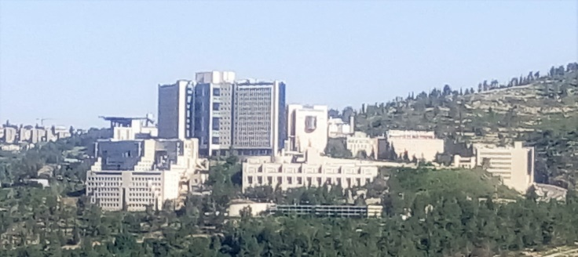


Coalescence Times at Two Loci under Markovian Coalescent Approximations and Pedigree Models
Shai Carmi
The Hebrew University of Jerusalem
Oxford, September 2016
Joint work with: Peter Wilton, Léndara King, John Wakeley (Harvard)
Asger Hobolth (Aarhus)

Slide 2
Outline
Background: Two-Locus Models, the ARG, SMC/SMC’
A Two-Locus Model for SMC’ and Model Comparison
The Effect of the Shared Pedigree On Estimators of θ

Slide 3
Outline
Background: Two-Locus Models, the ARG, SMC/SMC’
A Two-Locus Model for SMC’ and Model Comparison
The Effect of the Shared Pedigree On Estimators of θ

Slide 4
Model: Two Loci, Two Sequences
Locus 1
Locus 2
Sequence 1
Sequence 2
Genetic distance ρ=4N_{e}r
Time (generations
scaled by 2N_{e})
t₁
Time to Most Recent Common Ancestor (TMRCA)
=Coalescence Time
t₂
Present
Sequence 1
Sequence 2
Sequence 1
Sequence 2

Slide 5
Why Use the Two-Locus Model?
Simplest model for drift + recombination
Details can be complex
Non-trivial behavior
End goal: the joint PDF f(t₁,t₂|ρ)
  Conditional PDF f(t₂|t₁)
  Cov(t₁,t₂)
  Prob(t₁=t₂)
Useful for:
  r² measure of LD (McVean, 2002)
  Demographic inference (PSMC and variants, Harris & Nielsen, 2013, …)
  Mutation/recombination rate estimation

Slide 6
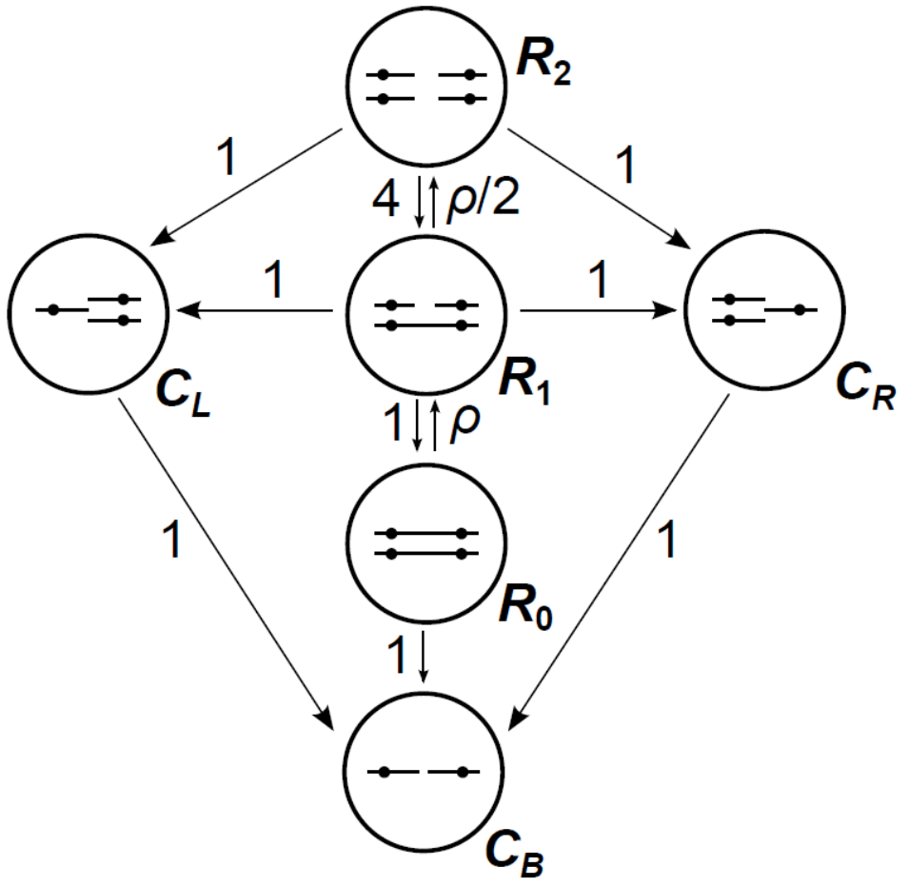

The Ancestral Recombination Graph (ARG)
Markov process backwards in time:
Griffiths, 1981
Hudson, 1983
Simonsen and Churchill, 1997
Wakeley, 2009
Hobolth and Jensen, 2014
ARG: $\text{Cov}\left(t_{1},t_{2}\right)=\frac{ρ+18}{ρ^{2}+13ρ+18}$
Start
here
Along the sequence of a continuous chr:
Wiuf and Hein, 1999
Each recombination event breaks the genealogy
The new genealogy depends on all previous ones
Complicated

Slide 7

The Sequentially Markov Coalescent (SMC)
McVean and Cardin, 2005 (also Li and Durbin, 2011, and others)
Naturally defined along the sequence:
$t_{1}\sim \text{Exp}(1)$; ${q_{SMC }(t_{n+1}|t}_{n})$, $t_{n+1}≠t_{n}$
Recombination event
TMRCA
t₃
t₆
t₅
t₁
t₇
t₂
t₈
t₄
0
Coordinate

Slide 8

The SMC’
Marjoram and Wall, 2006
Also in: Eriksson et al., 2009; Harris and Nielsen, 2013, Carmi et al., 2014, Zheng et al., 2014, Schiffels and Durbin, 2014, Palacios et al., 2015, and various simulators
$t_{1}\sim \text{Exp}(1)$; ${q_{SMC′ }(t_{n+1}|t}_{n})$
Recombination event
TMRCA
t₃
t₅=t₆=t₇
t₁=t₂
t₈
t₄
0
Coordinate

Slide 9
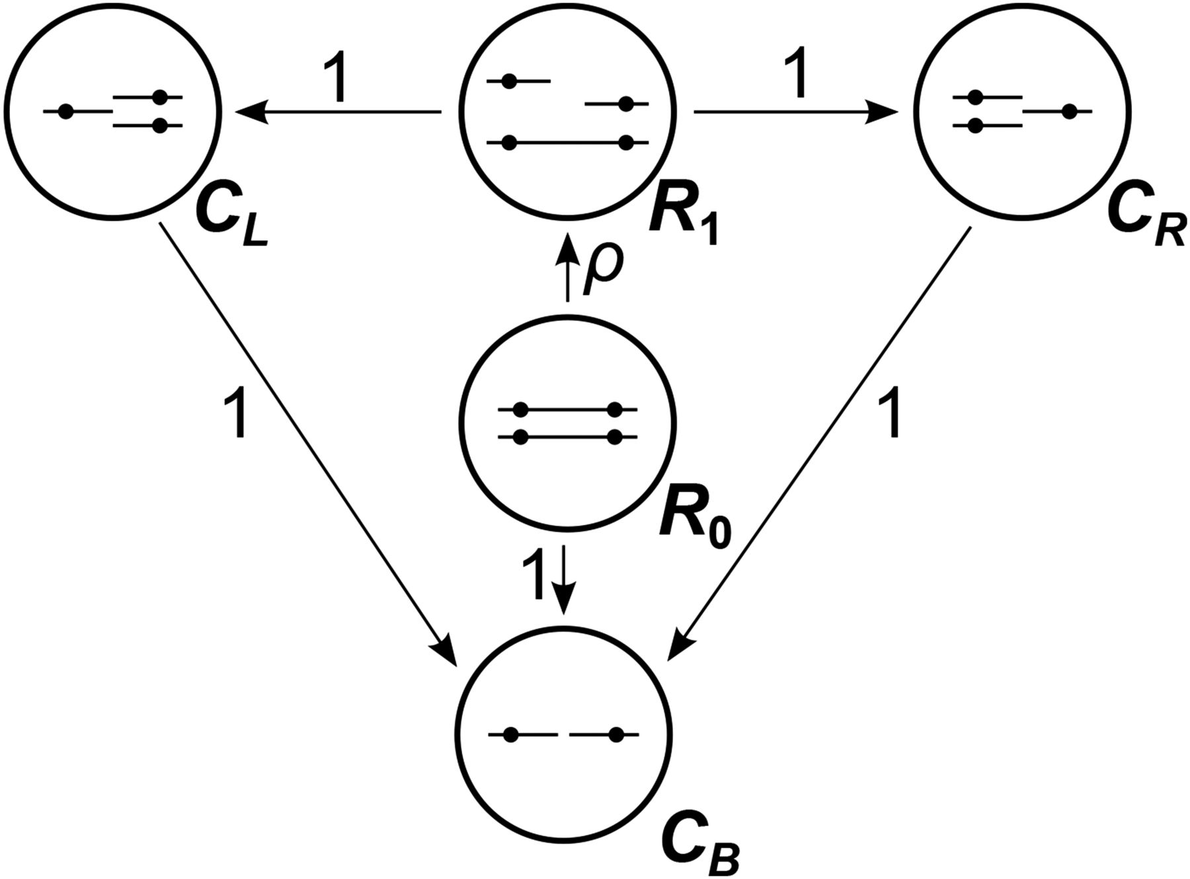
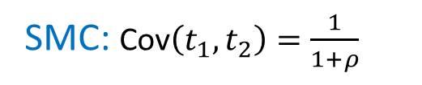
What About Two Fixed Loci?
SMC is easy
Start
here
A two-locus model for SMC’?
Joint PDF f(t₁,t₂)?
Comparison to ARG/SMC?
SMC: $\text{Cov}\left(t_{1},t_{2}\right)=\frac{1}{1+ρ}$

Slide 10
Outline
Background: Two-Locus Models, the ARG, SMC/SMC’
A Two-Locus Model for SMC’ and Model Comparison
The Effect of the Shared Pedigree On Estimators of θ

Slide 11


Model Rules Comparison
Ancestral material
Non-ancestral material
ARG
SMC’
SMC

Slide 12
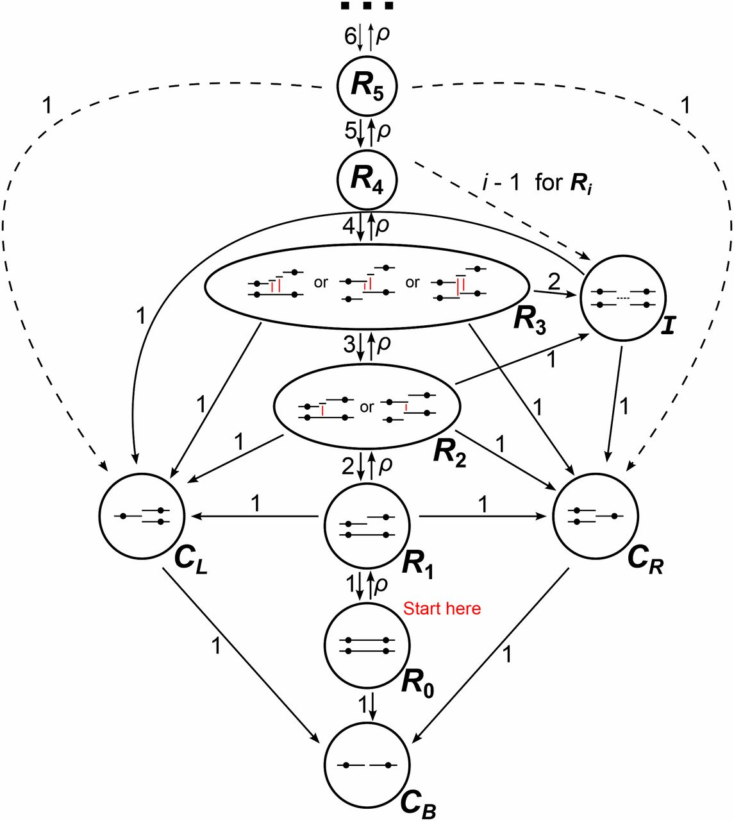
A Two-Locus Model for SMC’
State R_{j}:
j recombination events
State I:
Independent loci
States C_{L}, C_{R}:
Single-locus coalescence
State C_{B}:
Two-locus coalescence
Peter Wilton

Slide 13
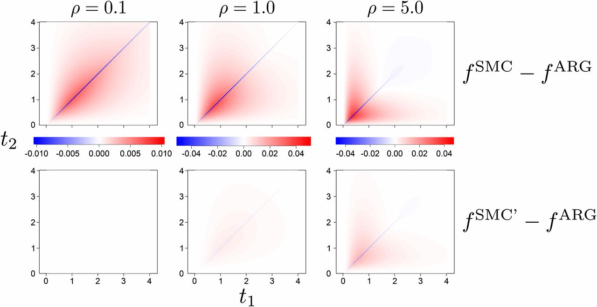
Joint Density of Coalescence Times
Used Kolmogorov equations to derive closed-form f(t₁,t₂)

Slide 14
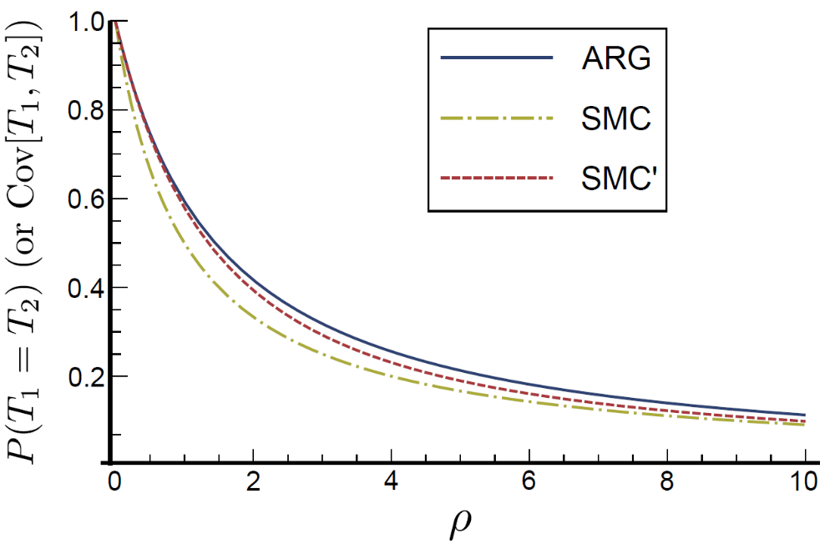
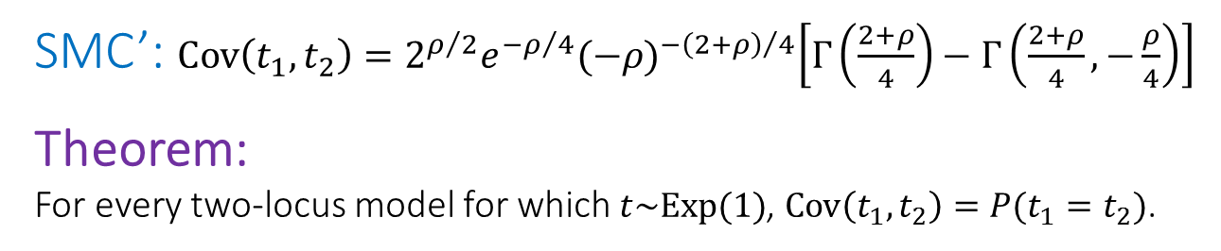
Covariance of Coalescence Times
SMC’: $\text{Cov}\left(t_{1},t_{2}\right)=2^{ρ/2}e^{−ρ/4}{(−ρ)}^{−{\left(2+ρ\right)}/4}\left[Γ\left(\frac{2+ρ}{4}\right)−Γ\left(\frac{2+ρ}{4},−\frac{ρ}{4}\right)\right]$
Theorem:
For every two-locus model for which $t\sim \text{Exp}(1)$, $\text{Cov}\left(t_{1},t_{2}\right)=P(t_{1}=t_{2})$.
See also Eriksson et al., 2009

Slide 15
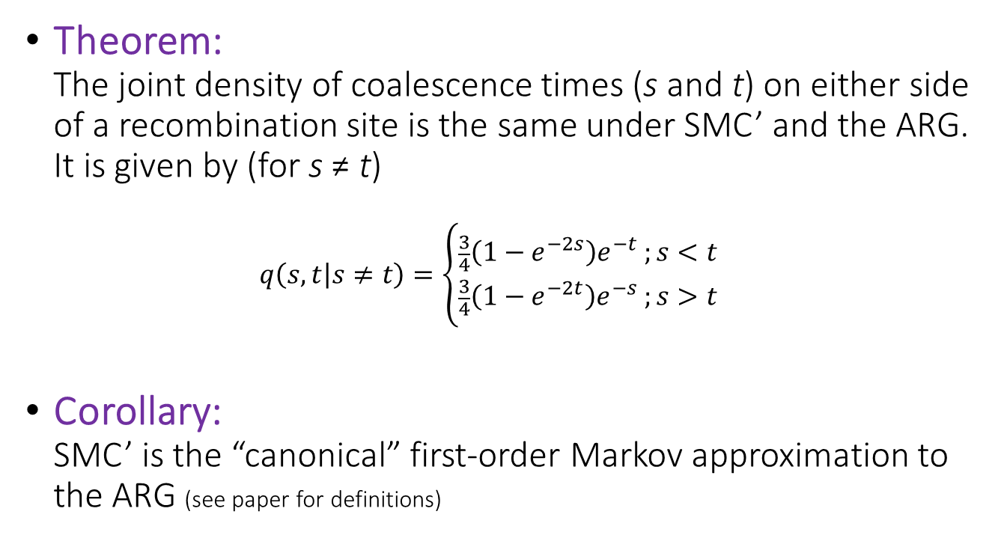
SMC’ and ARG: Deeper Connections
Theorem:
The joint density of coalescence times (s and t) on either side of a recombination site is the same under SMC’ and the ARG. It is given by (for s ≠ t)
$q\left(s,t | s≠t\right)=\left\{\begin{aligned}\frac{3}{4}\left(1−e^{−2s}\right)e^{−t} ;s<t \\ \frac{3}{4}\left(1−e^{−2t}\right)e^{−s} ;s>t\end{aligned}\right.$
Corollary:
SMC’ is the “canonical” first-order Markov approximation to the ARG (see paper for definitions)

Slide 16
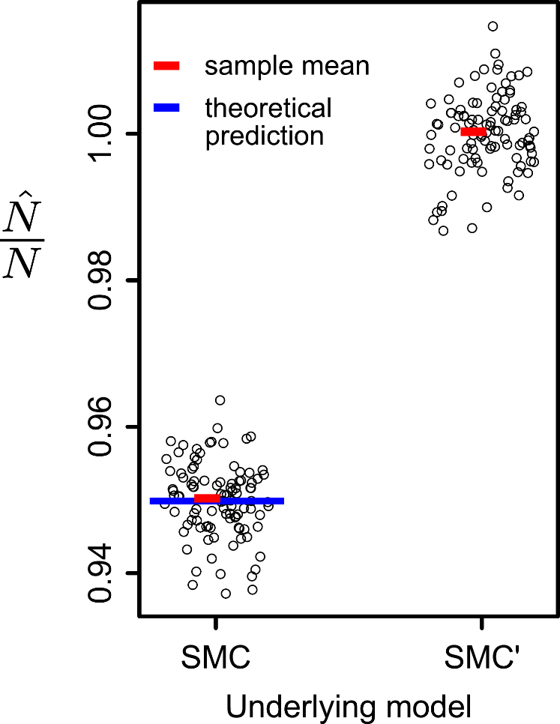
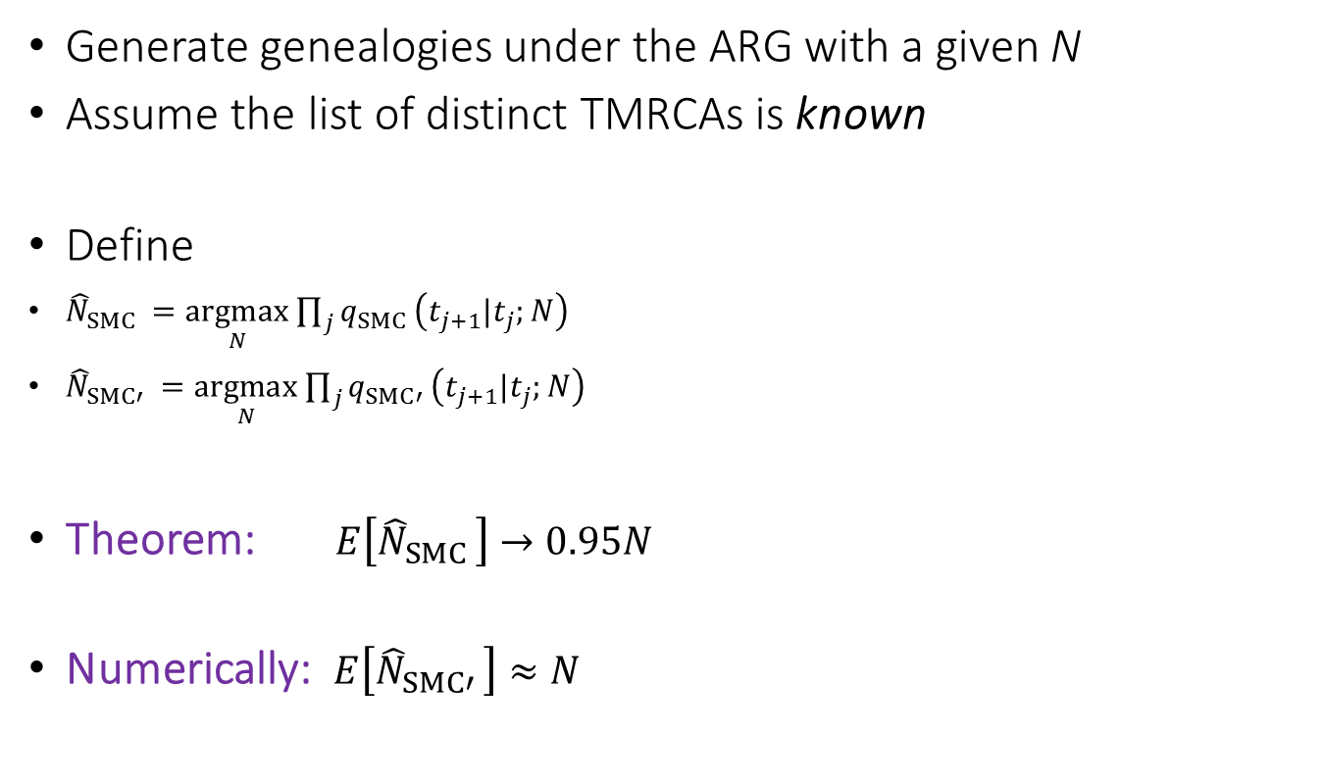
Implications to Demographic Inference
Generate genealogies under the ARG with a given N
Assume the list of distinct TMRCAs is known
Define
${\hat{N}}_{SMC }=\underset{N}{argmax}{\prod_{j}{q_{SMC }\left(t_{j+1}|t_{j};N\right)}}$
${\hat{N}}_{SMC′ }=\underset{N}{argmax}{\prod_{j}{q_{SMC′ }\left(t_{j+1}|t_{j};N\right)}}$
Theorem: $E\left[{\hat{N}}_{SMC }\right]→0.95N$
Numerically: $E\left[{\hat{N}}_{SMC′ }\right]≈N$

Slide 17
Outline
Background: Two-Locus Models, the ARG, SMC/SMC’
A Two-Locus Model for SMC’ and Model Comparison
The Effect of the Shared Pedigree On Estimators of θ

Slide 18
Is the ARG a Good Model?
In reality:
  Individuals are diploid; can be male or female
  Family tree is shared across all loci, even unlinked

Slide 19
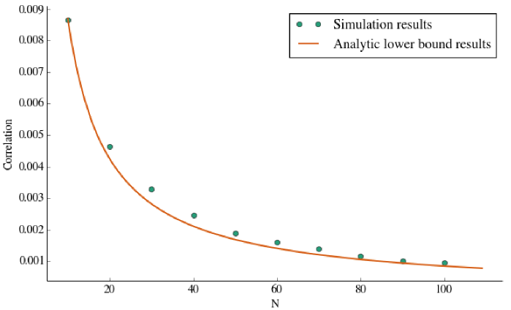
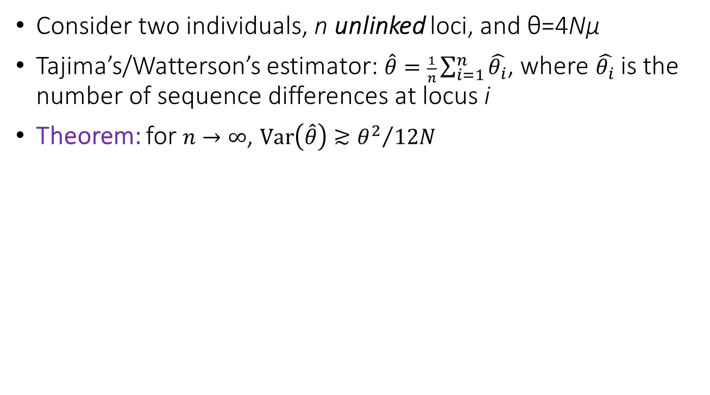

The Effect of the Shared Pedigree on Tajima’s Estimator
Consider two individuals, n unlinked loci, and θ=4Nμ
Tajima’s/Watterson’s estimator: $\hat{θ}=\frac{1}{n}\sum_{i=1}^{n}{\hat{θ_{i}}}$, where $\hat{θ_{i}}$ is the number of sequence differences at locus i
Theorem: for $n→∞$, $\text{Var}\left(\hat{θ}\right)≳{θ^{2}}/{12N}$
$$\text{Var}\left(\hat{θ}\right)/θ^{2}$$
The non-zero variance results from all gene genealogies sharing the same pedigree
N

Slide 20
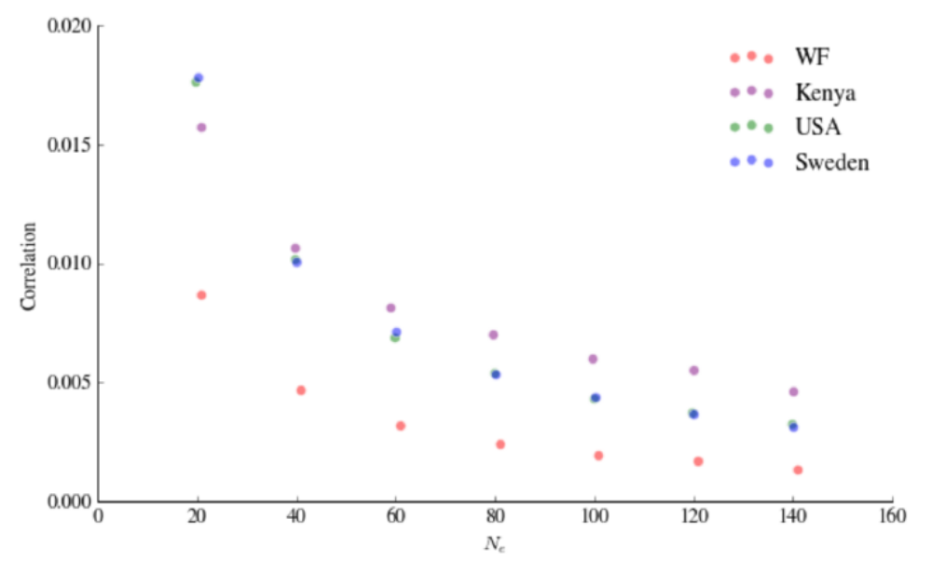
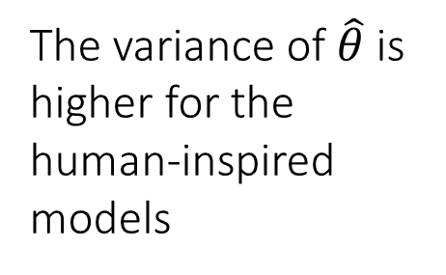

Two-Locus Models Inspired by Real Genealogies
We modified the Wright-Fisher model to imitate real human (single-generation) genealogical patterns
$$\text{Var}\left(\hat{θ}\right)/θ^{2}$$
The variance of $\hat{θ}$ is higher for the human-inspired models
2N
Léandra King

Slide 21


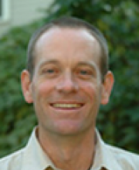
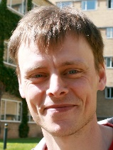
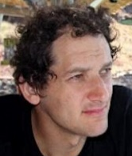
Acknowledgements
Harvard University:
Peter Wilton, Léandra King, John Wakeley
Aarhus University:
Asger Hobolth
Columbia University:
Itsik Pe’er
Publications:
P. R. Wilton, S. Carmi*, and A. Hobolth*. The SMC’ is a highly accurate approximation to the ancestral recombination graph. Genetics 200, 343 (2015).
L. King, J. Wakeley, and S. Carmi. A non-zero variance of Tajima's estimator for two sequences even for infinitely many unlinked loci. (bioRxiv 069989).
Thank you for your attention!

