Slide 1

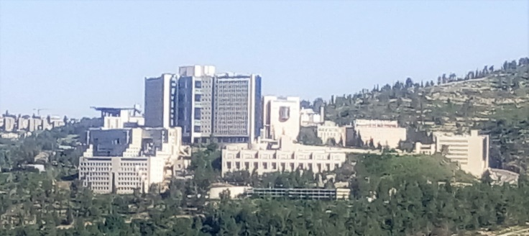


The Time and Place of European Gene Flow into Ashkenazi Jews
Shai Carmi
The Hebrew University of Jerusalem
2016
Joint work with Itsik Pe’er, James Xue (Columbia University)

Slide 2
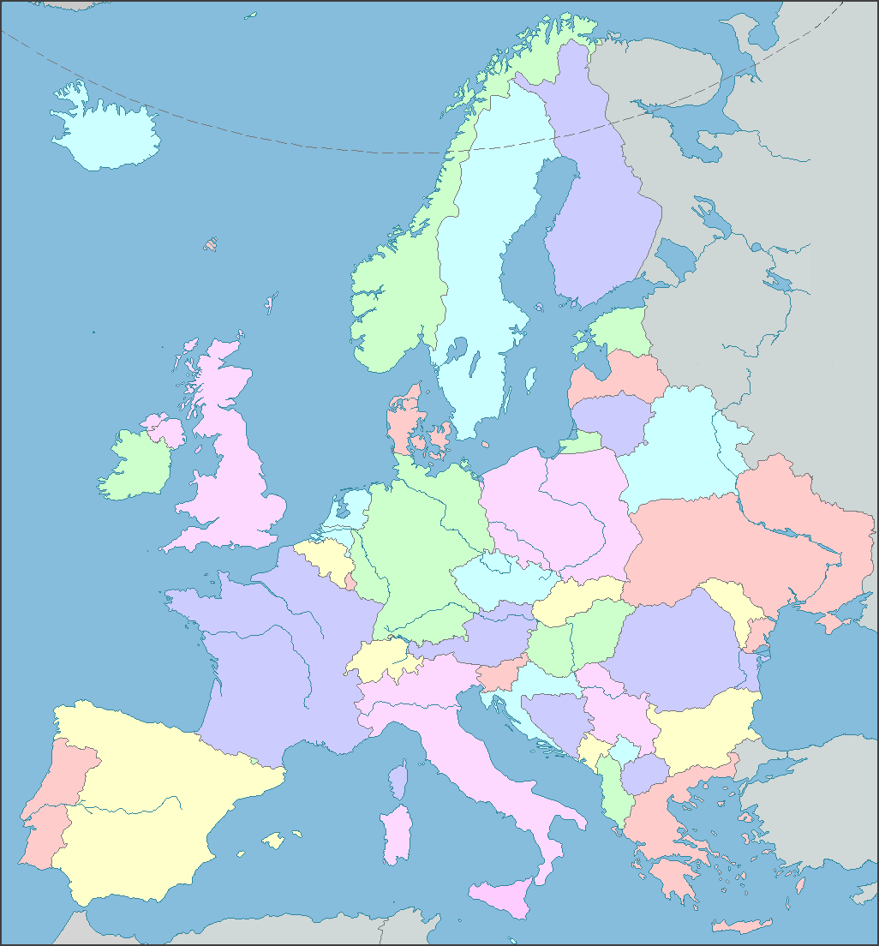
Ashkenazi History: Known
Ca. 1000:
Small communities in
Northern France, Rhineland
Migration east
Expansion
Migration to US and Israel

Slide 3
Ashkenazi History: Genetics
Origin?
  Middle-Eastern/European
Relation to other Jews?
  Close to Sephardi Jews
Founder event?
  Effective size: hundreds
  Time: ≈25-35 generations ago
European gene flow:
  How much?
    ≈50-60%
  When?
  Where?

Slide 4
The Geographic Origin of Polish Jews
“Most of these theories … are myths or speculation … based on some vague or misunderstood references. …
It will probably be impossible to say definitely where the ... Jews in Poland … came from.”
B. Weinryb, The Jews of Poland, 1972

Slide 5
The Geographic Origin of Polish Jews
“Most of these theories … are myths or speculation … based on some vague or misunderstood references. …
It will probably be impossible to say definitely where the ... Jews in Poland … came from.”
B. Weinryb, The Jews of Poland, 1972

Slide 6
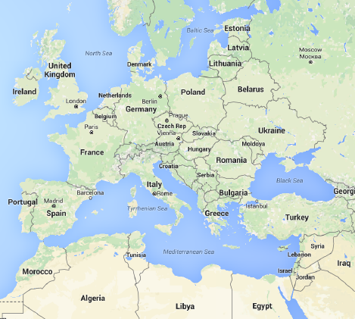
Simple Approach: Problem
ME
EU
An Ashkenazi genome
ME
x
x
x
x
x
x
x
EU
x
x
x
x
o
x
o
o
x
o
x
o
PC2
x
o
x
x
x
x
x
x
x
x
x
x
x
AJ
x
PC1
Kopelman et al., BMC Genet, 2009
Atzmon et al., AJHG, 2010
Behar et al., Nature, 2010
Bray et al., PNAS, 2010
Guha et al., Genome Biol, 2012
Behar et al., Hum Biol, 2014
Carmi et al., Nat Commun, 2014
O’connor et al., Mol Biol Evol, 2015
Turkic origin hypothesis

Slide 7
Our Approach: Local Ancestry Inference
ME
EU
An Ashkenazi genome
ME
x
x
x
x
x
x
x
EU
x
x
x
x
o
x
o
ME
EU
o
x
o
x
o
PC2
x
o
x
x
x
x
x
x
x
x
x
x
x
AJ
x
EU
PC1
x
x
x
x
x
x
x
x
ME
x
x
x
x
x
o
x
x
o
x
x
x
x
o
x
x
o
o
x
x
o
x
o
o
o
x
x
x
o
x
o
o
PC2
PC2
x
x
x
x
x
x
x
x
x
x
x
x
x
x
x
x
x
x
x
x
x
x
x
x
x
x
Use RFMix (Maples et al., AJHG, 2013)
Per-SNP accuracy ≈70-80%
PC1
PC1
Johnson et al., PLoS Genet, 2011
Moreno-Estrada et al., PLoS Genet, 2013

Slide 8
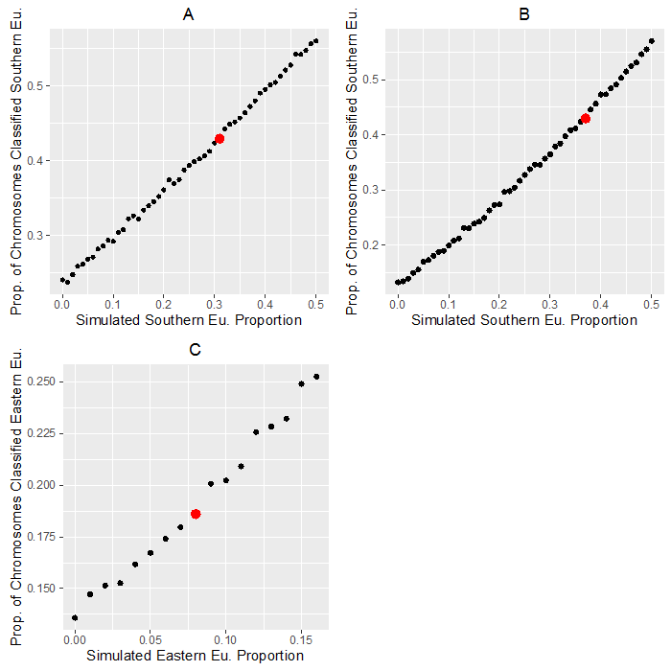
Localization of AJ admixture Sources
Used Naïve Bayes approach
  Likelihood of source X:
  Product of allele frequencies of all SNPs in EU/ME segments
Most likely source is Southern-EU (mostly Italy)
Simulations suggest that Southern-EU is ≈34% of AJ ancestry or ≈2/3 of EU ancestry
Minor sources?
Real data

Slide 9
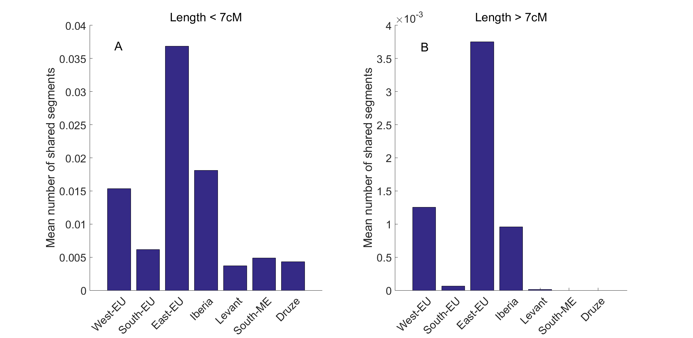
Localization of the Minor Source
IBD sharing between AJ and other populations
Sharing with Eastern-EU is highest

Slide 10
Comments on Localization
We ran other methods to find localization
  Alder, f₄ stats, TreeMix were not robust in simulations
  Globetrotter (Hellenthal et al., Science, 2014) worked better
  Also identified Southern-EU as the predominant source
Middle-Eastern most likely source was the Levant

Slide 11
Time of Admixture
Multiple methods:
  The mean EU segment lengths
  The distribution of total EU ancestry
  The decay of admixture LD (Alder, Globetrotter)
Inferred admixture time: ≈25-40 generations ago
What if there were multiple events?

Slide 12
Admixture vs Bottleneck
EU
EU
ME
ME
25-35 gen ago
EU
Time
Ancestry of IBD segments ≈ Ancestry at the bottleneck
IBD
Genome

Slide 13
Admixture vs Bottleneck
EU
ME
EU
Replacing ≈20%
Higher Eastern-EU ancestry
ME
EU
IBD
42%
Genome
53%

Slide 14
A Very Speculative Historical Model
Time (generations ago)
Ancestral Middle-Eastern population
Southern EU admixture
Replacing ≈35-60%
≈25-50
Eastern EU admixture
Bottleneck
Replacing ≈15-25%
≈25-35
≈10-20
Population size

Slide 15



Acknowledgements
Columbia University:
Itsik Pe’er
James Xue (now @ Harvard)
AJ genotypes:
Todd Lencz (LIJMC)
Ariel Darvasi (HUJI)
Discussion:
Ashkenazi Genome Consortium members
Manuscript available on
Thank you for your attention!

Slide 16
Local Ancestry Inference
LAMP-LD on simulate admixed individuals (Baran et al., 2012)
Admixture | F_{ST} | Accuracy (6 generations)
CEU:YRI | 7.2% | 99%
CHB:TSI | 5.4% | 94.7%
FIN:TSI | 0.6% | Same as random
CEU:TSI | 0.15% | Same as random
For EU/ME, F_{ST}≈1-2%
RFMix (Maples et al., 2013)
  Simulated EU/ME admixed genomes, 30 generations
  Accuracy was 70-80%

Slide 17
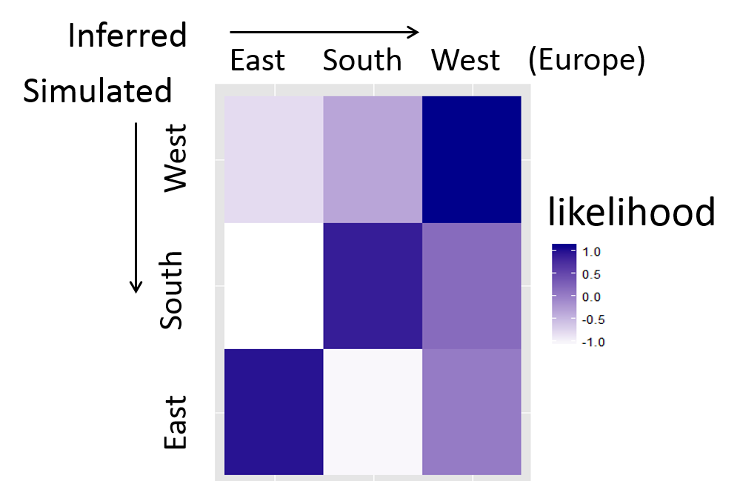
Geographic Inference
Advertised PCA method does not work
Used “Naïve Bayes” to classify the source of each chr
  Likelihood of source X: product of allele freq of all SNPs in EU/ME segments
Does it work even for low LAI accuracy?

