Slide 1


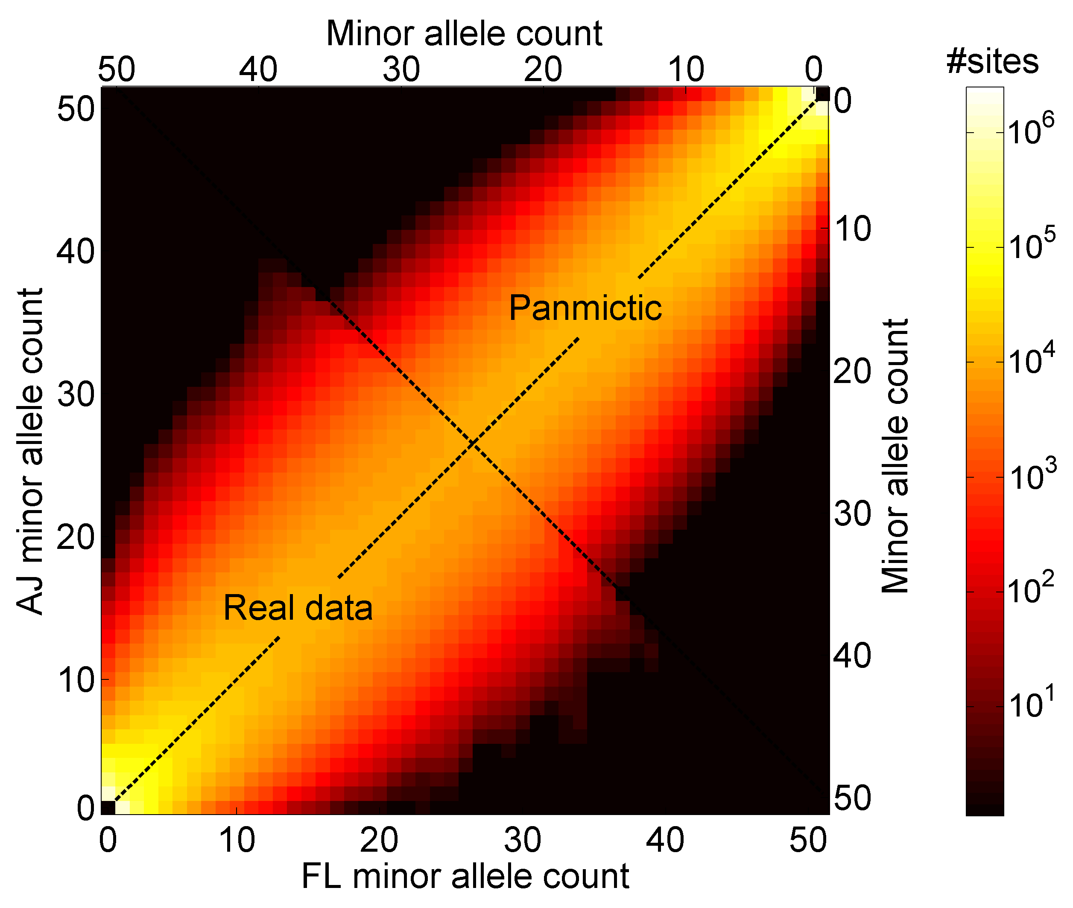
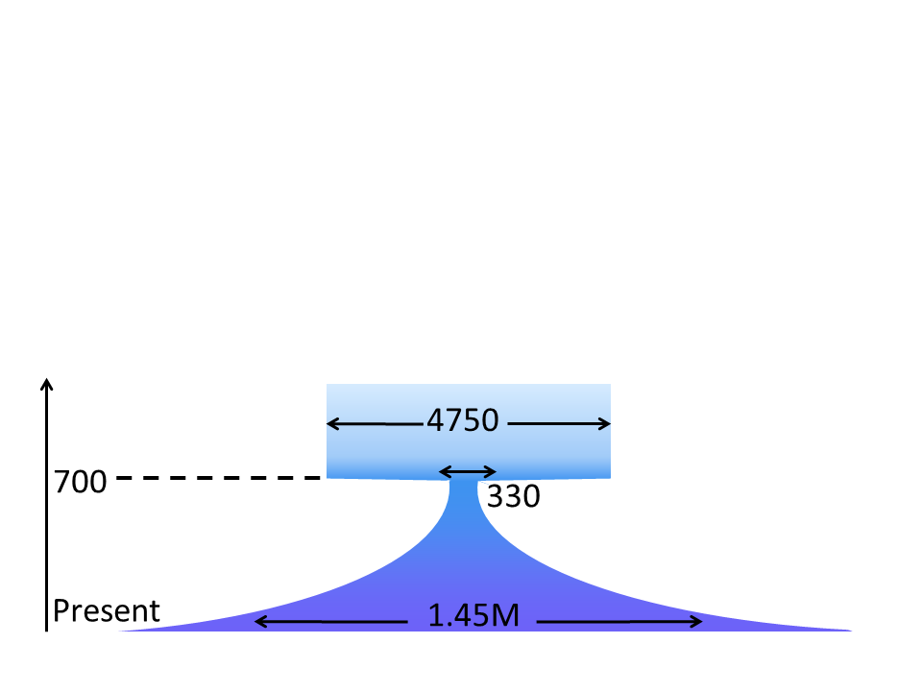
Genomic Segment Sharing:
Theory and Demographic Inference
Shai Carmi
Department of Computer Science
Columbia University
Itsik Pe’er’s lab
2015
k
Shared segment

Slide 2
Outline
Hidden Relatedness
Segment Sharing Theory
Ashkenazi Genetics and History
Druze Genetics
Genomic Coverage

Slide 3
Outline
Hidden Relatedness
Segment Sharing Theory
Ashkenazi Genetics and History
Druze Genetics
Genomic Coverage

Slide 4

Genetic Sharing between Siblings
Siblings share, on average,
50% of the chromosome
they co-inherit
Shared segment lengths are exponentially distributed
Mean segment length is
50 centi-Morgans (cM)
Shared segments

Slide 5
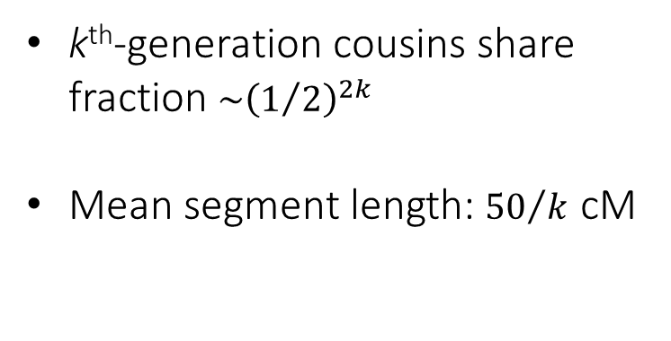
Sharing between Cousins
k^{th}-generation cousins share fraction $\sim {\left(1/2\right)}^{2k}$
Mean segment length: ${50}/k$ cM
k
Shared segment

Slide 6
Sharing between Unrelated Individuals
Differences
Usually for unrelated individuals:
Individual A
Individual B
Human genome: ≈3∙10⁹ “letters”; typically: ≈2∙10⁶ differences
Sometimes:
Individual A
Individual B
A shared segment

Slide 7
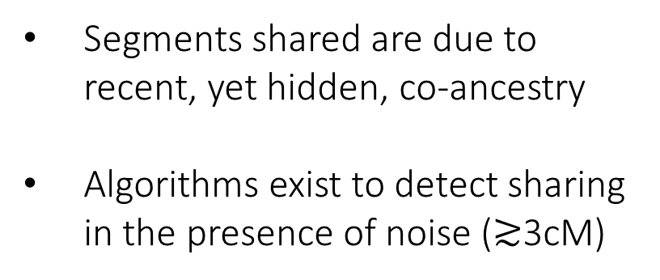
Hidden Relatedness
Segments shared are due to recent, yet hidden, co-ancestry
Algorithms exist to detect sharing in the presence of noise ($≳$3cM)
k
Shared segment

Slide 8
Importance
Segments are rare but long, hence observable
A segment indicates recent co-ancestry
Methods and theory
Shared segment detection
  Gusev et al., 2009
  Yang, Carmi, et al., 2015
Disease mapping
  Gusev et al., 2011, 2012
Pedigree reconstruction
  Henn et al., 2012
Demographic inference
  Palamara et al., 2012, 2013
  Carmi et al., 2013, 2014
Population histories
Ashkenazi Jews
  Gusev et al., 2012
  Carmi et al., 2014
Other Jews
  Atzmon et al., 2010
  Campbell et al., 2012
Druze
  Zidan, Ben-Avraham, Carmi, et al., 2014
Netherlands
  Francioly et al., 2014
Disease/trait mapping
Cholesterol, Micronesia
  Kenny et al., 2009, 2010
Parkinson’s, AJ
  Vacic et al., 2014
Schizophrenia, AJ
  Mukherjee et al., 2014

Slide 9
Outline
Hidden Relatedness
Segment Sharing Theory
Ashkenazi Genetics and History
Druze Genetics
Genomic Coverage

Slide 10
Segment Sharing Theory
Model:
  A population with constant size N
  Two chromosomes of length L (Morgans)
  A minimal segment length m (Morgans)
The distribution of segment lengths, ψ(ℓ)?
The number of shared segments, n_{m}?
The fraction of the chromosome in shared segments, f_{m}?
ℓ₁
ℓ₂
ℓ₃
m
L

Slide 11
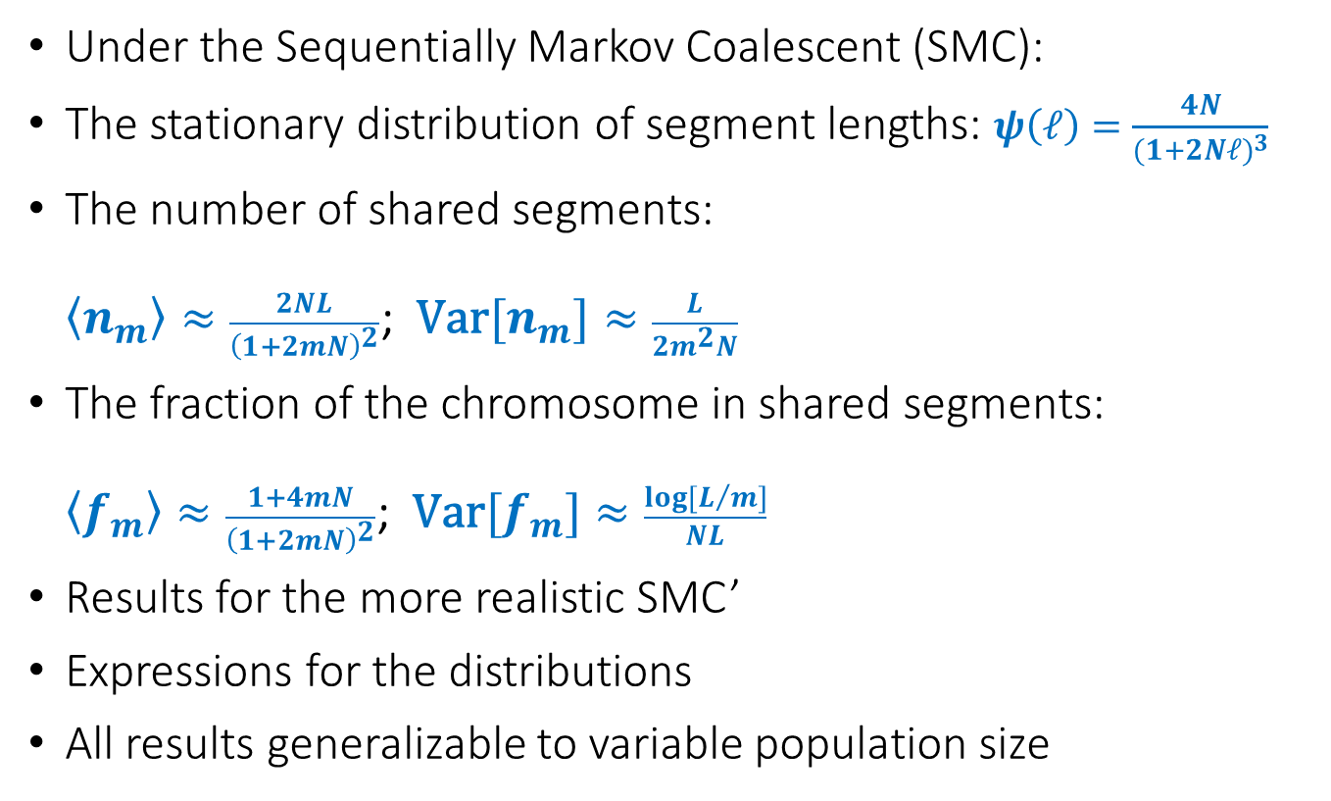
Results overview
Under the Sequentially Markov Coalescent (SMC):
The stationary distribution of segment lengths: $ψ\left(ℓ\right)=\frac{4N}{{(1+2Nℓ)}^{3}}$
The number of shared segments:
$\left\langle n_{m}\right\rangle ≈\frac{2NL}{{\left(1+2mN\right)}^{2}}$; $\text{Var}[n_{m}]≈\frac{L}{2m^{2}N}$
The fraction of the chromosome in shared segments:
$\left\langle f_{m}\right\rangle ≈\frac{1+4mN}{{\left(1+2mN\right)}^{2}}$; $\text{Var}[f_{m}]≈\frac{log⁡[L/m]}{NL}$
Results for the more realistic SMC’
Expressions for the distributions
All results generalizable to variable population size
Palamara et al., 2012; Carmi et al., 2013; Carmi et al., Theor Popul Biol, 2014

Slide 12
The Sequentially Markov Coalescent
t₁
t₁
a
b
t₂
Recombination
SMC
Next tree
McVean and Cardin, 2005
a
b
t₁
a
b
time
a
b
SMC’
Coordinate along the chromosome
Marjoram and Wall, 2006

Slide 13

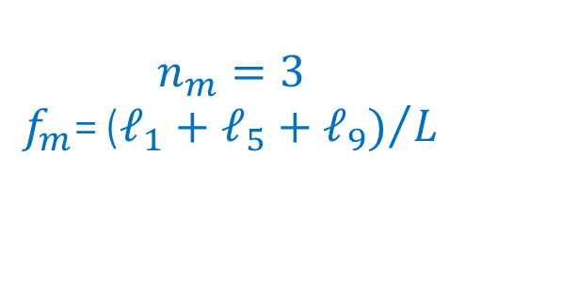

Shared Segments under SMC
Given $t$: $ℓ∼\operatorname{Exp}{(2Nt)}$
t₈
$t_{1}\sim \text{Exp}(1)$; ${q_{SMC}(t_{n+1}|t}_{n})$
t₇
t₃
$$n_{m}=3$$
$$f_{m}\text{=}{\text{(}ℓ_{1}+ℓ_{5}+ℓ_{9})}/L$$
t₂
cutoff m
t₄
t₁
t₆
t₁₀
t₉
t₅
ℓ₁
ℓ₂
ℓ₃
ℓ₄
ℓ₅
ℓ₆
ℓ₇
ℓ₈
ℓ₉
ℓ₁₀
0
Coordinate
L

Slide 14
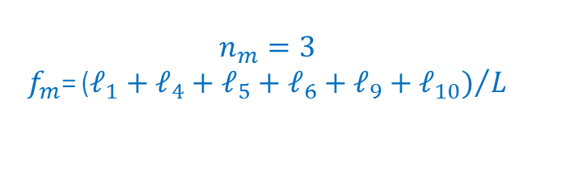

Shared Segments under SMC’
Given $t$: $ℓ∼\operatorname{Exp}{(2Nt)}$
t₈
$t_{1}\sim \text{Exp}\left(1\right)$; ${q_{SMC′}(t_{n+1}|t}_{n})$
t₇
t₃
$$n_{m}=3$$
$$f_{m}\text{=}{\text{(}ℓ_{1}+ℓ_{4}+ℓ_{5}+ℓ_{6}+ℓ_{9}+ℓ_{10})}/L$$
t₂
cutoff m
t₄
t₄
t₄
t₁
t₉
t₉
ℓ₁
ℓ₂
ℓ₃
ℓ₄
ℓ₅
ℓ₆
ℓ₇
ℓ₈
ℓ₉
ℓ₁₀
0
Coordinate
L

Slide 15
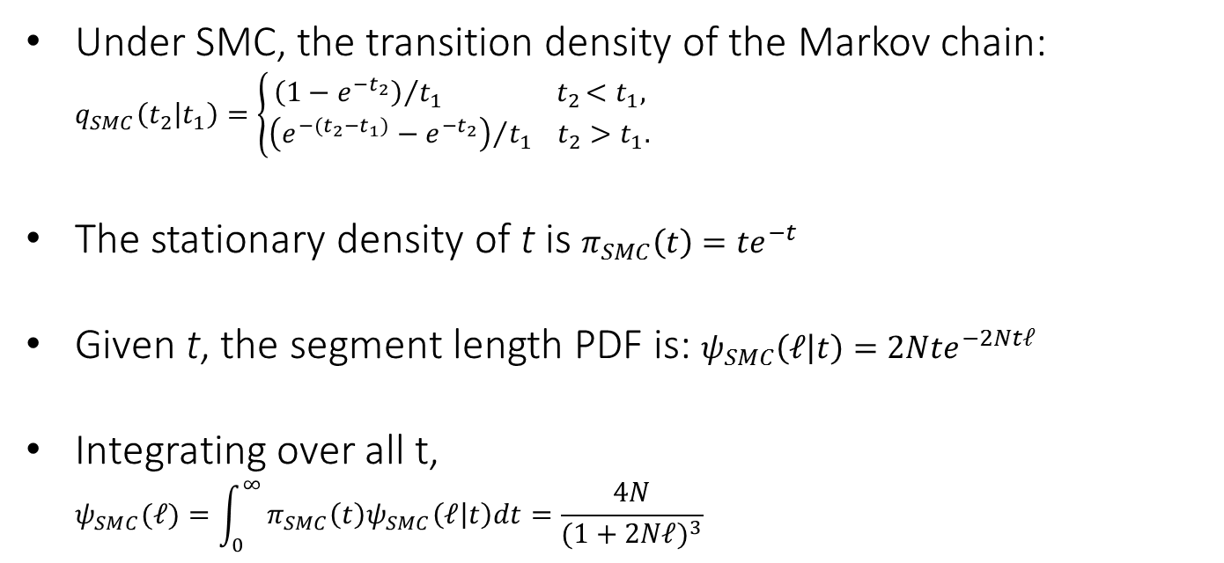
The Stationary Segment Length PDF (SMC)
Under SMC, the transition density of the Markov chain: $q_{SMC}\left(t_{2} | t_{1}\right)=\left\{\begin{aligned}{\left(1−e^{−t_{2}}\right)}/{t_{1}} { t}_{2}<t_{1}, \\ {\left(e^{−(t_{2}−t_{1})}−e^{−t_{2}}\right)}/{t_{1}} t_{2}>t_{1}.\end{aligned}\right.$
The stationary density of t is $π_{SMC}\left(t\right)=te^{−t}$
Given t, the segment length PDF is: $ψ_{SMC}\left(ℓ | t\right)=2Nte^{−2Ntℓ}$
Integrating over all t,
$ψ_{SMC}(ℓ)=\int_{0}^{∞}{π_{SMC}\left(t\right)ψ_{SMC}\left(ℓ | t\right)dt=\frac{4N}{{(1+2Nℓ)}^{3}}}$
Li and Durbin, 2011
Carmi et al., Theor Popul Biol, 2014

Slide 16
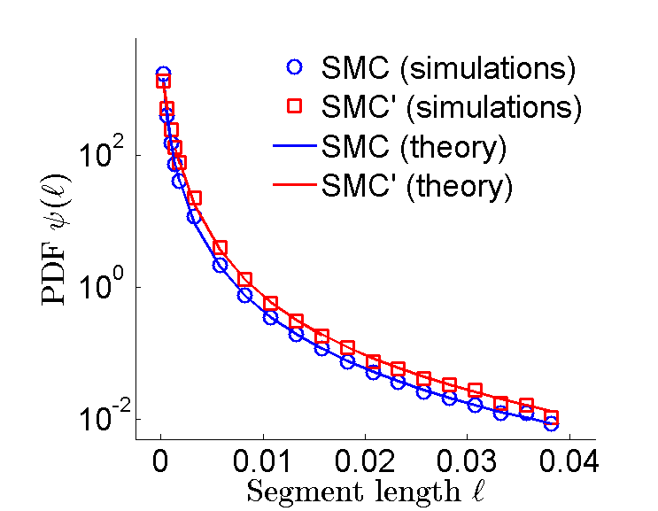
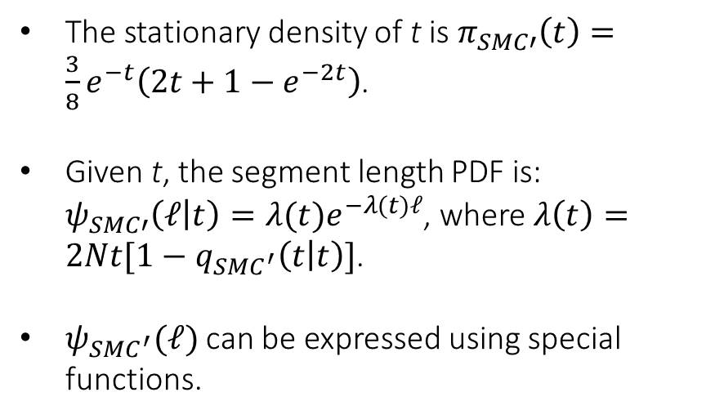
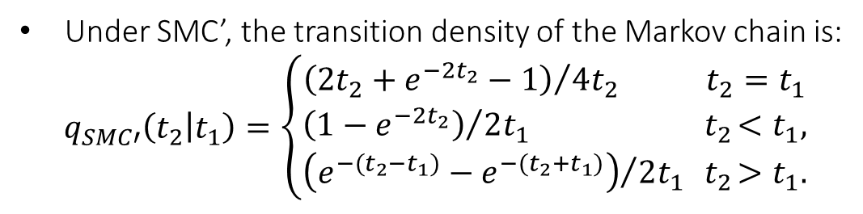
The Stationary Segment Length PDF (SMC’)
Under SMC’, the transition density of the Markov chain is:
$$q_{SMC′}\left(t_{2} | t_{1}\right)=\left\{\begin{aligned}\begin{aligned}{\left(2t_{2}+e^{−2t_{2}}−1\right)}/{4t_{2}} t_{2}=t_{1} \\ {\left(1−e^{−2t_{2}}\right)}/{2t_{1}} { t}_{2}<t_{1},\end{aligned} \\ {\left(e^{−(t_{2}−t_{1})}−e^{−(t_{2}+t_{1})}\right)}/{2t_{1}}{ t}_{2}>t_{1}.\end{aligned}\right.$$
The stationary density of t is $π_{SMC′}\left(t\right)=\frac{3}{8}e^{−t}\left(2t+1−e^{−2t}\right)$.
Given t, the segment length PDF is: $ψ_{SMC′}\left(ℓ | t\right)=λ(t)e^{−λ(t)ℓ}$, where $λ\left(t\right)=2Nt[1−q_{SMC^{′}}\left(t | t\right)]$.
$ψ_{SMC^{′}}(ℓ)$ can be expressed using special functions.
Carmi et al., Theor Popul Biol, 2014

Slide 17

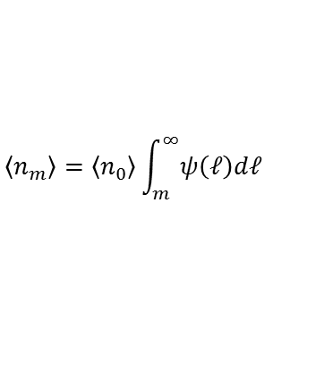

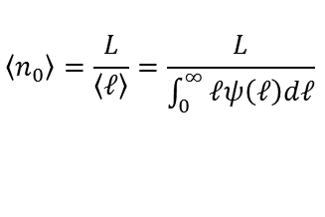



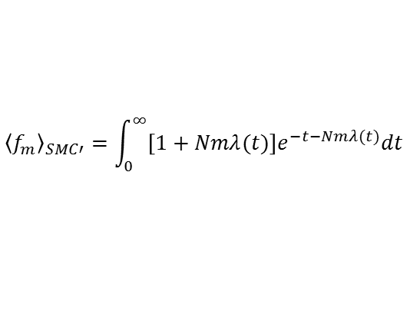
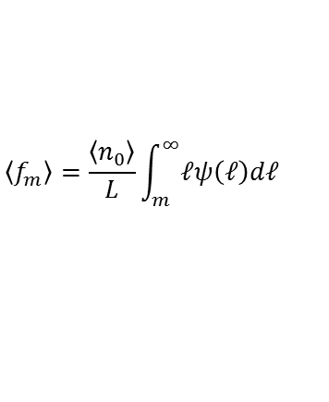
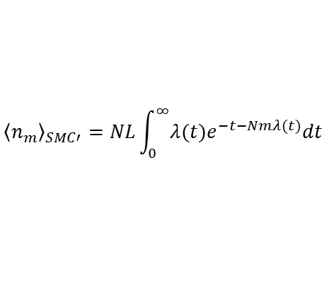
Means (Long-Chromosome Limit)
General
SMC
SMC’
$$\left\langle n_{0}\right\rangle =\frac{L}{\left\langle ℓ\right\rangle }=\frac{L}{\int_{0}^{∞}{ℓψ\left(ℓ\right)dℓ}}$$
$${\left\langle n_{0}\right\rangle }_{SMC}=2NL$$
$${\left\langle n_{0}\right\rangle }_{SMC′}=4NL/3$$
$$\left\langle n_{m}\right\rangle =\left\langle n_{0}\right\rangle \int_{m}^{∞}{ψ\left(ℓ\right)dℓ}$$
$${\left\langle n_{m}\right\rangle }_{SMC}=\frac{2NL}{{\left(1+2mN\right)}^{2}}$$
$${\left\langle n_{m}\right\rangle }_{SMC′}=NL\int_{0}^{∞}{λ(t)e^{−t−Nmλ(t)}dt}$$
$$\left\langle f_{m}\right\rangle =\frac{\left\langle n_{0}\right\rangle }{L}\int_{m}^{∞}{ℓψ\left(ℓ\right)dℓ}$$
$${\left\langle f_{m}\right\rangle }_{SMC}=\frac{1+4mN}{{\left(1+2mN\right)}^{2}}$$
$${\left\langle f_{m}\right\rangle }_{SMC′}=\int_{0}^{∞}{\left[1+Nmλ(t)\right]e^{−t−Nmλ(t)}dt}$$
$$λ\left(t\right)=N\left[2t+1−e^{−2t}\right]/2$$
Explicit expressions available
n₀: the total number of segments (of any length)
2/3 of recombination events change the TMRCA!

Slide 18
The Renewal Approximation
t₁
t₂
Recombination
time
Coordinate along the chromosome
The PDF of t₂ is independent of t₁
Successive segments have independent lengths ψ(ℓ)
Numerically indistinguishable from full model
Carmi et al., Theor Popul Biol, 2014

Slide 19
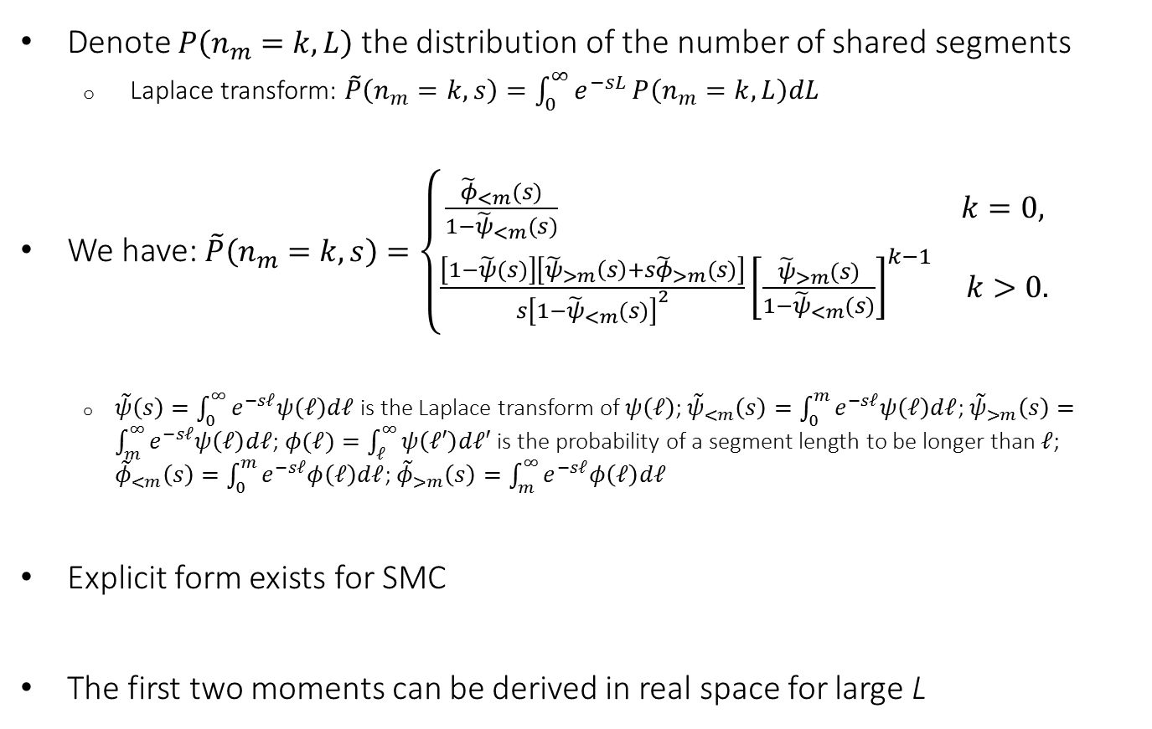
The Distribution of the Number of Segments
Denote $P\left(n_{m}=k,L\right)$ the distribution of the number of shared segments
  Laplace transform: $\tilde{P}\left(n_{m}=k,s\right)=\int_{0}^{∞}{e^{−sL}}P\left(n_{m}=k,L\right)dL$
We have: $\tilde{P}\left(n_{m}=k,s\right)=\left\{\begin{aligned}\frac{{\tilde{φ}}_{<m}(s)}{1−{\tilde{ψ}}_{<m}(s)} k=0, \\ \frac{\left[1−\tilde{ψ}(s)\right]\left[{\tilde{ψ}}_{>m}\left(s\right)+s{\tilde{φ}}_{>m}(s)\right]}{s{\left[1−{\tilde{ψ}}_{<m}(s)\right]}^{2}}{\left[\frac{{\tilde{ψ}}_{>m}(s)}{1−{\tilde{ψ}}_{<m}(s)}\right]}^{k−1} k>0.\end{aligned}\right.$
  $\tilde{ψ}\left(s\right)=\int_{0}^{∞}{e^{−sℓ}ψ\left(ℓ\right)dℓ}$ is the Laplace transform of $ψ\left(ℓ\right)$; ${\tilde{ψ}}_{<m}\left(s\right)=\int_{0}^{m}{e^{−sℓ}ψ\left(ℓ\right)dℓ}$; ${\tilde{ψ}}_{>m}\left(s\right)=\int_{m}^{∞}{e^{−sℓ}ψ\left(ℓ\right)dℓ}$;$φ(ℓ)=\int_{ℓ}^{∞}{ψ\left(ℓ′\right)dℓ′}$ is the probability of a segment length to be longer than $ℓ$; ${\tilde{φ}}_{<m}\left(s\right)=\int_{0}^{m}{e^{−sℓ}φ\left(ℓ\right)dℓ}$; ${\tilde{φ}}_{>m}\left(s\right)=\int_{m}^{∞}{e^{−sℓ}φ\left(ℓ\right)dℓ}$
Explicit form exists for SMC
The first two moments can be derived in real space for large L

Slide 20
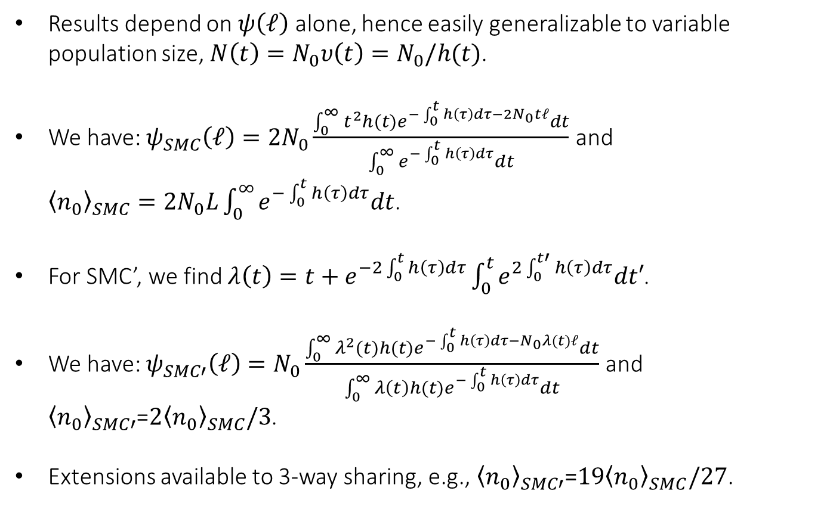
Variable Population Size
Results depend on $ψ\left(ℓ\right)$ alone, hence easily generalizable to variable population size, $N\left(t\right)=N_{0}υ\left(t\right)=N_{0}/h(t)$.
We have: $ψ_{SMC}\left(ℓ\right)=2N_{0}\frac{\int_{0}^{∞}{t^{2}h(t)e^{−\int_{0}^{t}{h\left(τ\right)dτ}−2N_{0}tℓ}dt}}{\int_{0}^{∞}{e^{−\int_{0}^{t}{h\left(τ\right)dτ}}dt}}$ and
${\left\langle n_{0}\right\rangle }_{SMC}=2N_{0}L\int_{0}^{∞}{e^{−\int_{0}^{t}{h\left(τ\right)dτ}}dt}$.
For SMC’, we find $λ\left(t\right)=t+e^{−2\int_{0}^{t}{h\left(τ\right)dτ}}\int_{0}^{t}{e^{2\int_{0}^{t′}{h\left(τ\right)dτ}}dt′}$.
We have: $ψ_{SMC′}\left(ℓ\right)=N_{0}\frac{\int_{0}^{∞}{λ^{2}(t)h(t)e^{−\int_{0}^{t}{h\left(τ\right)dτ}−N_{0}λ(t)ℓ}dt}}{\int_{0}^{∞}{{λ\left(t\right)h(t)e}^{−\int_{0}^{t}{h\left(τ\right)dτ}}dt}}$ and ${\left\langle n_{0}\right\rangle }_{SMC′}$=${2\left\langle n_{0}\right\rangle }_{SMC}/3$.
Extensions available to 3-way sharing, e.g., ${\left\langle n_{0}\right\rangle }_{SMC′}$=${19\left\langle n_{0}\right\rangle }_{SMC}/27$.

Slide 21
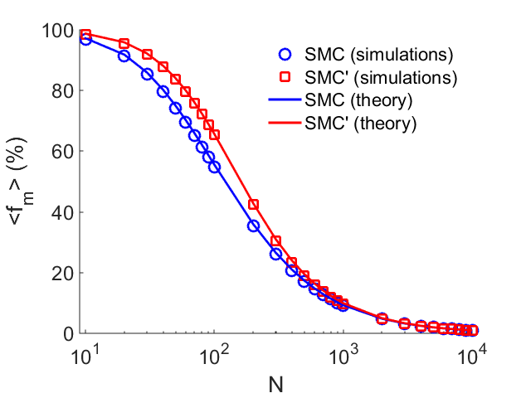
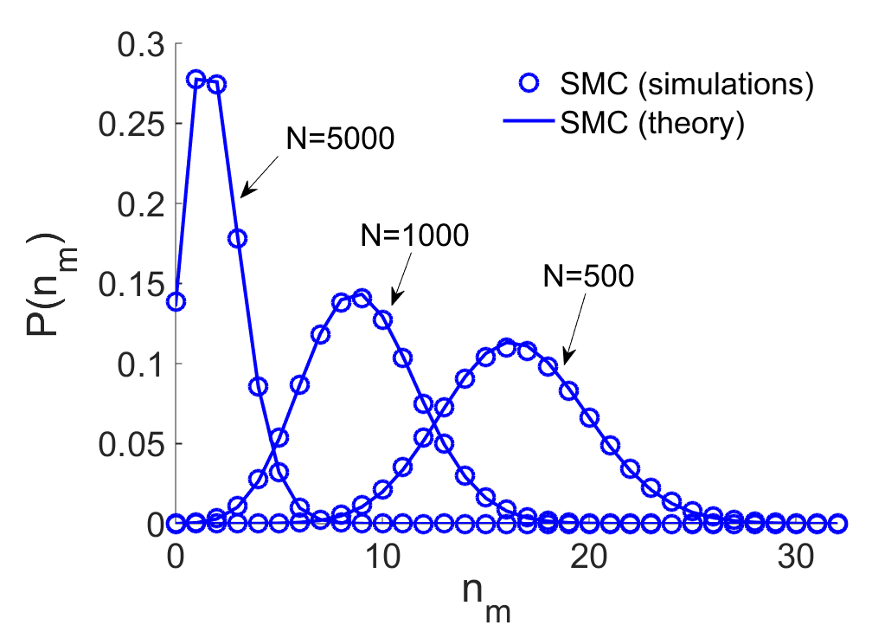
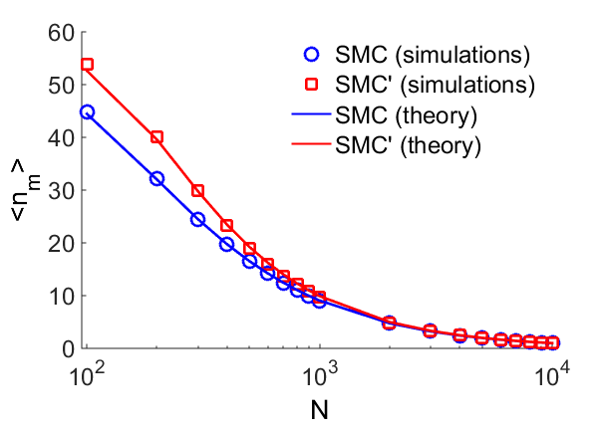
Simulations

Slide 22
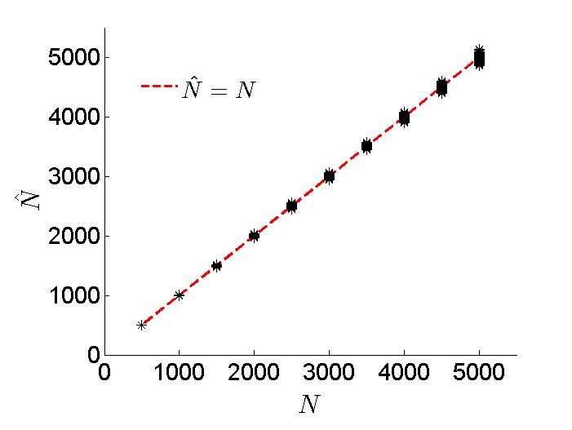
Historical Demographic Inference: MLE
Use the number of shared segments to infer the population size N
Stars: Inferred N according to the number of segments shared between 5000 chromosome pairs under SMC; L=200cM, m=1cM
Carmi et al., Theor Popul Biol, 2014

Slide 23
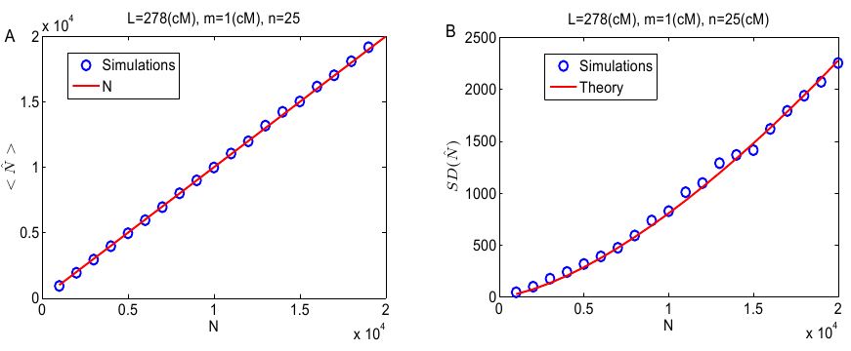
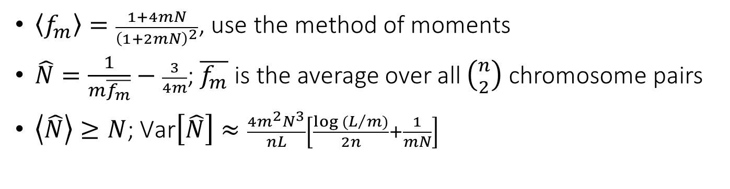


Demographic Inference: Method of Moments
$\left\langle f_{m}\right\rangle =\frac{1+4mN}{{\left(1+2mN\right)}^{2}}$, use the method of moments
$\hat{N}=\frac{1}{m\overline{f_{m}}}−\frac{3}{4m}$; $\overline{f_{m}}$ is the average over all $\left({n \atop 2}\right)$ chromosome pairs
$\left\langle \hat{N}\right\rangle ≥N$; $\text{Var}\left[\hat{N}\right]≈\frac{{4m}^{2}N^{3}}{nL}\left[\frac{log (L/m)}{2n}+\frac{1}{mN}\right]$
$$\left\langle \hat{N}\right\rangle$$
SD($\hat{N}$)
N
N
Palamara et al., 2012; Carmi et. al., 2013

Slide 24
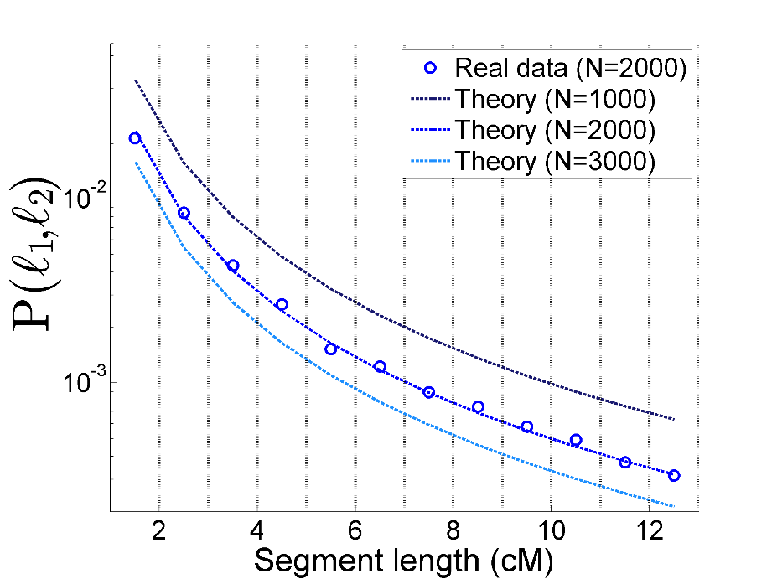

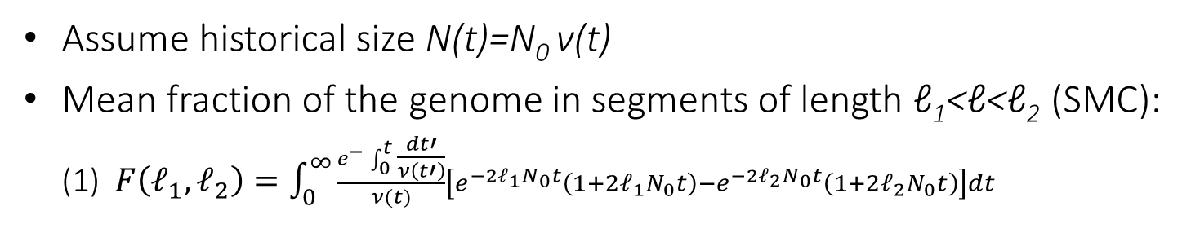
Demographic Inference: Complex History
Assume historical size N(t)=N₀ ν(t)
Mean fraction of the genome in segments of length ℓ₁<ℓ<ℓ₂ (SMC):
(1) $F\left(ℓ_{1},ℓ_{2}\right)=\int_{0}^{∞}{\frac{e^{−}\int_{0}^{t}{\frac{dt′}{ν\left(t′\right)}}}{ν(t)}\left[e^{−2ℓ_{1}N_{0}t}\left(1+2ℓ_{1}N_{0}t\right)−e^{−2ℓ_{2}N_{0}t}\left(1+2ℓ_{2}N_{0}t\right)\right]dt}$
Hypothetical example
Method:
Record shared segments in each length bin
Using Eq. (1), find the history N(t) that fits best
$$F\left(ℓ_{1},ℓ_{2}\right)$$
Palamara et al., 2012

Slide 25
Outline
Hidden Relatedness
Segment Sharing Theory
Ashkenazi Genetics and History
Druze Genetics
Genomic Coverage

Slide 26



Ashkenazi Jewish (AJ) Genetics: Significance
Medical genetics
  Large founder population
  Mendelian (single-gene) disorders
  Complex diseases
    Breast cancer, Parkinson’s, Crohn’s
Population genetics
  Debated origins
  Segment sharing
Why do we need to sequence genomes?
mtDNA: Behar et al., 2004; Behar et al., 2006
Y chr: Behar et al., 2003; Behar et al., 2004
Disease genes: Risch et al., 2003; Slatkin, 2004
SNP arrays: Gusev et al., 2012; Palamara et al., 2012
Review: Ostrer and Skorecki, 2013

Slide 27
Founder Populations: Opportunities
Time
Non-founder population
Founder population
Recent successes
Crete
  Tachmazidou et al., 2013; HDL
Finland
  Kurki et al. 2014; aneurysm
Iceland
  Many papers; most recently Steinthorsdottir et al., 2014; T2D
Ashkenazi Jews
  Hui et al., in preparation; Crohn’s
Bottleneck
See also:
Hatzikotoulas et al., 2014
Zuk et al., 2014
Present
Population size
Disease alleles (mutations)

Slide 28
Opportunities: Reduced Diversity
Chromosomes in the sample
Observed data
Inferred sequence
Imputation
Full sequence
Partial sequence (SNP array, low-coverage)
Inferred sequence
Problem: The Ashkenazi population is missing a reference panel of complete sequences

Slide 29
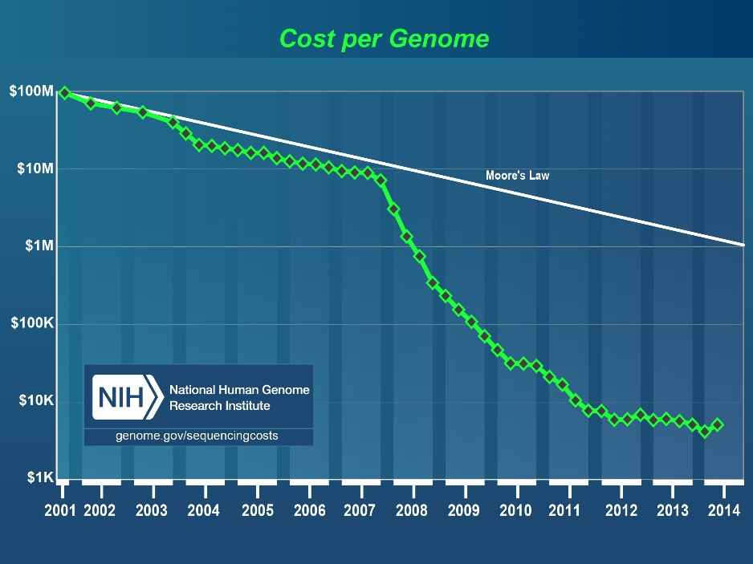

Opportunities: Personal Genomics in AJ
Personal clinical genomics is here
  But genomes are hard to interpret
Problem: The Ashkenazi population is missing a reference panel of complete sequences

Slide 30
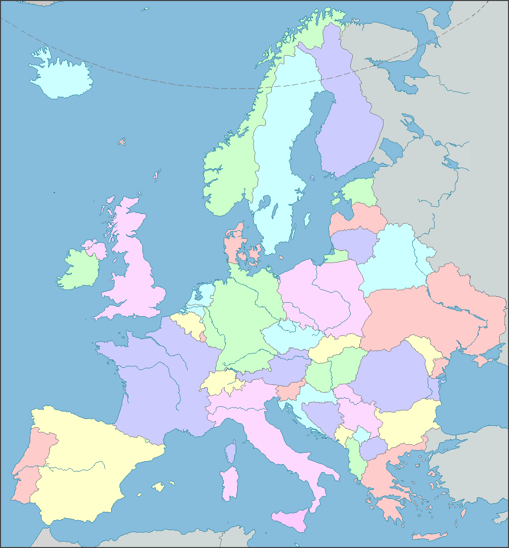
The Documented Ashkenazi History
Ca. 1000:
Small communities in
Northern France, Rhineland
Migration east
Expansion
Migration to US and Israel

Slide 31
Ashkenazi History: Questions
Origin?
Founder event?
European gene flow:
  Where?
  When?
  How much?
Relation to other Jews?

Slide 32







The Ashkenazi Genome Consortium
NY area labs interested in specific diseases
Impute
Large cohorts of AJ cases
Phase I: 128 whole genomes (completed*)
Phase II: ≈500 whole genomes (under way)
* Carmi et al., Nat Commun, 2014
Quantify utility in medical genetics
Learn about population history

Slide 33
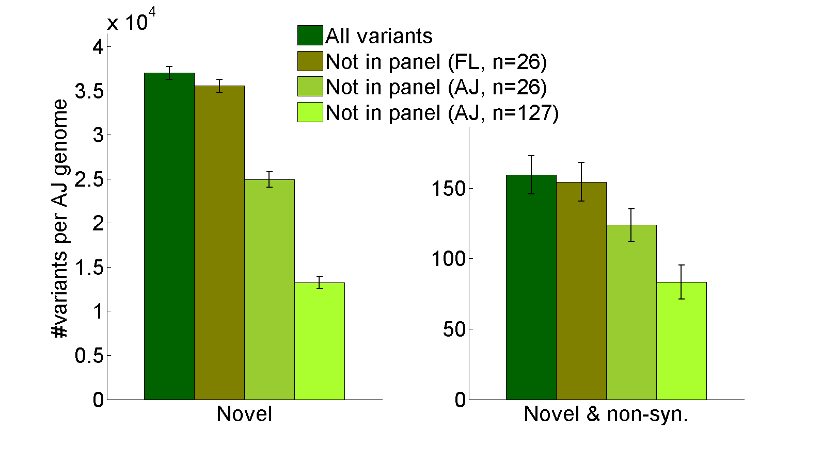
AJ Clinical Genomics
An Ashkenazi reference panel filters more benign variants from an AJ genome than a European panel
Carmi et al., Nat Commun, 2014

Slide 34
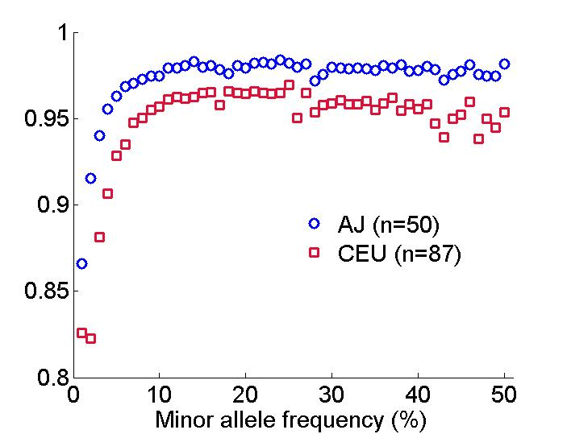
Imputation of AJ Genomes
An Ashkenazi reference panel improves imputation accuracy of AJ SNP arrays compared to the standard European panel
Correlation between imputed and real data
Rare variants (≤1%) accuracy:
87% vs 65%
Carmi et al., Nat Commun, 2014

Slide 35
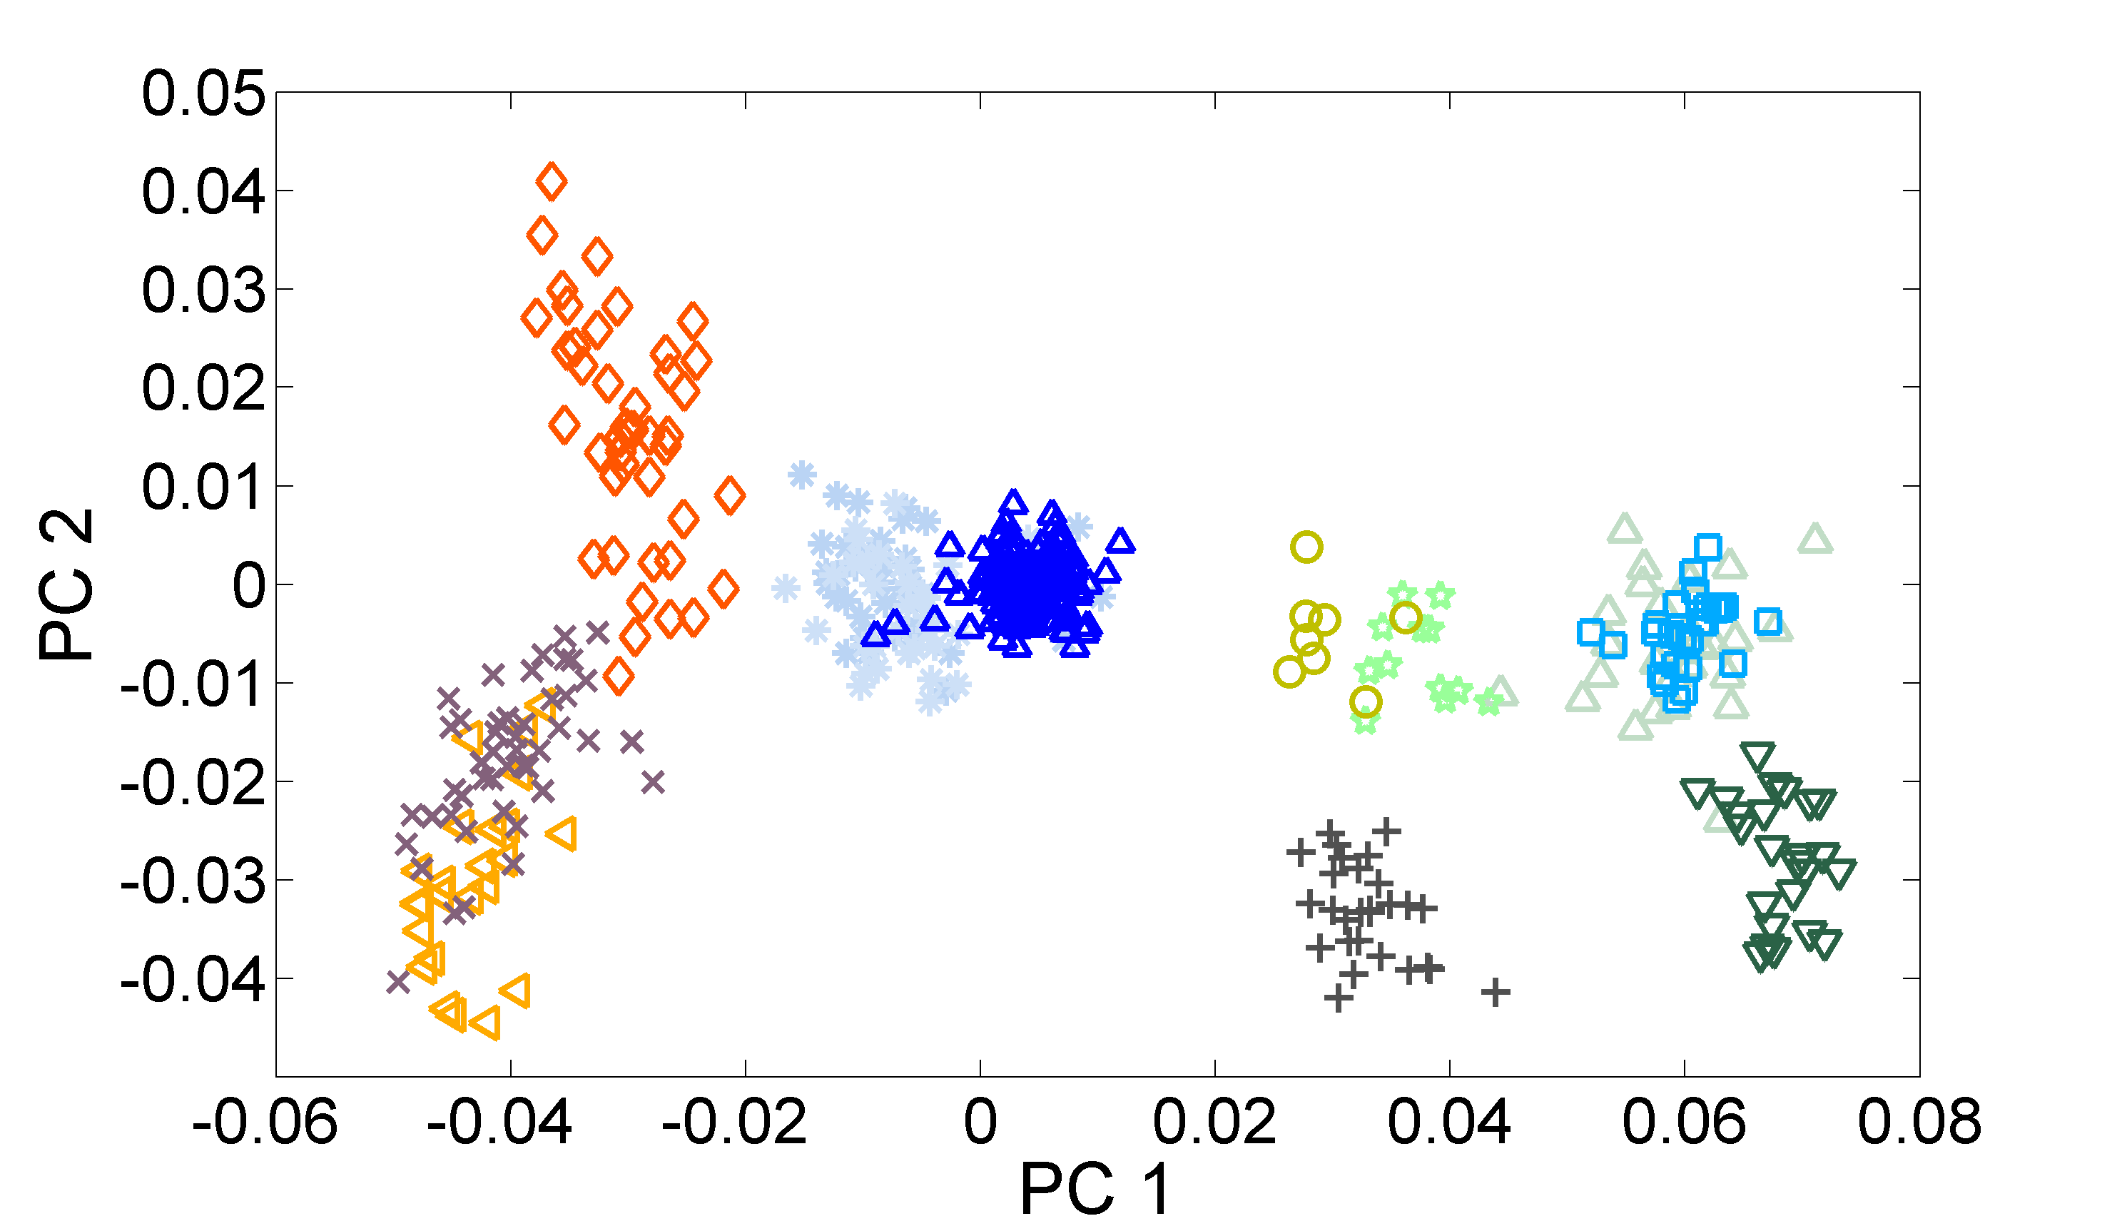
Principal Component Analysis (PCA)
Middle-East
Ashkenazi Jews (TAGC)
Europe
Druze
French
Tuscans
Palestinians
Flemish
Italians
Sephardi Jews
(Italy, Turkey)
Bedouins
Sardinians
Basque
Price et al., 2008; Olshen et al., 2008; Need et al., 2009; Kopelman et al., 2009; Atzmon et al., 2010; Behar et al., 2010; Bray et al., 2010; Guha et al., 2012; Behar et al., 2014

Slide 36

The Documented Ashkenazi History
Origin?
Founder event?
European gene flow:
  Where?
  When?
  How much?
Relation to other Jews?

Slide 37
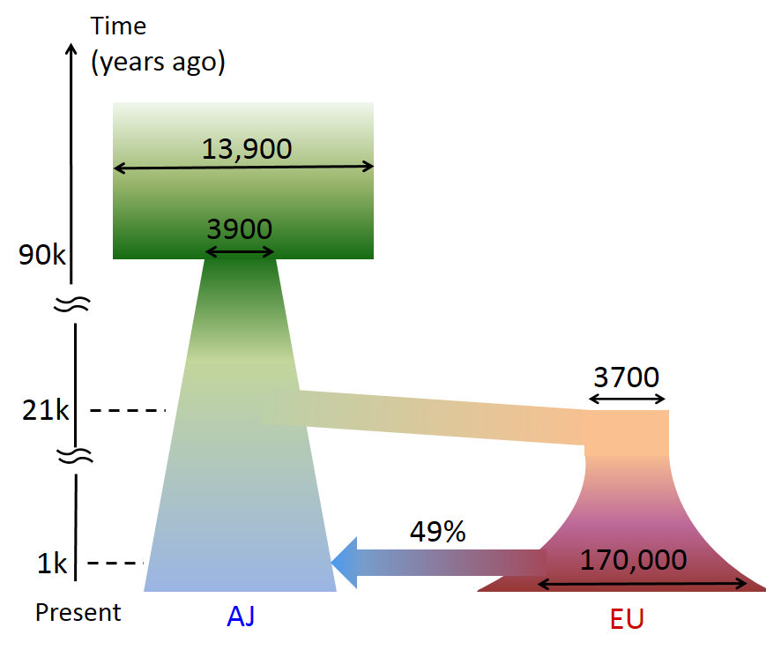
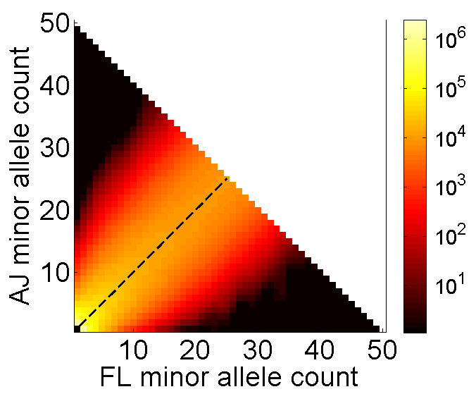
A Model for Ancient History
Comparison panel: 26 Flemish from Belgium (platform-matched)
#sites
Out-of-Africa
Middle-East
25x25 genomes
European gene flow
into AJ
Carmi et al., Nat Commun, 2014

Slide 38
The Documented Ashkenazi History
Origin?
Founder event?
European gene flow:
  Where?
  When?
  How much?
Relation to other Jews?

Slide 39
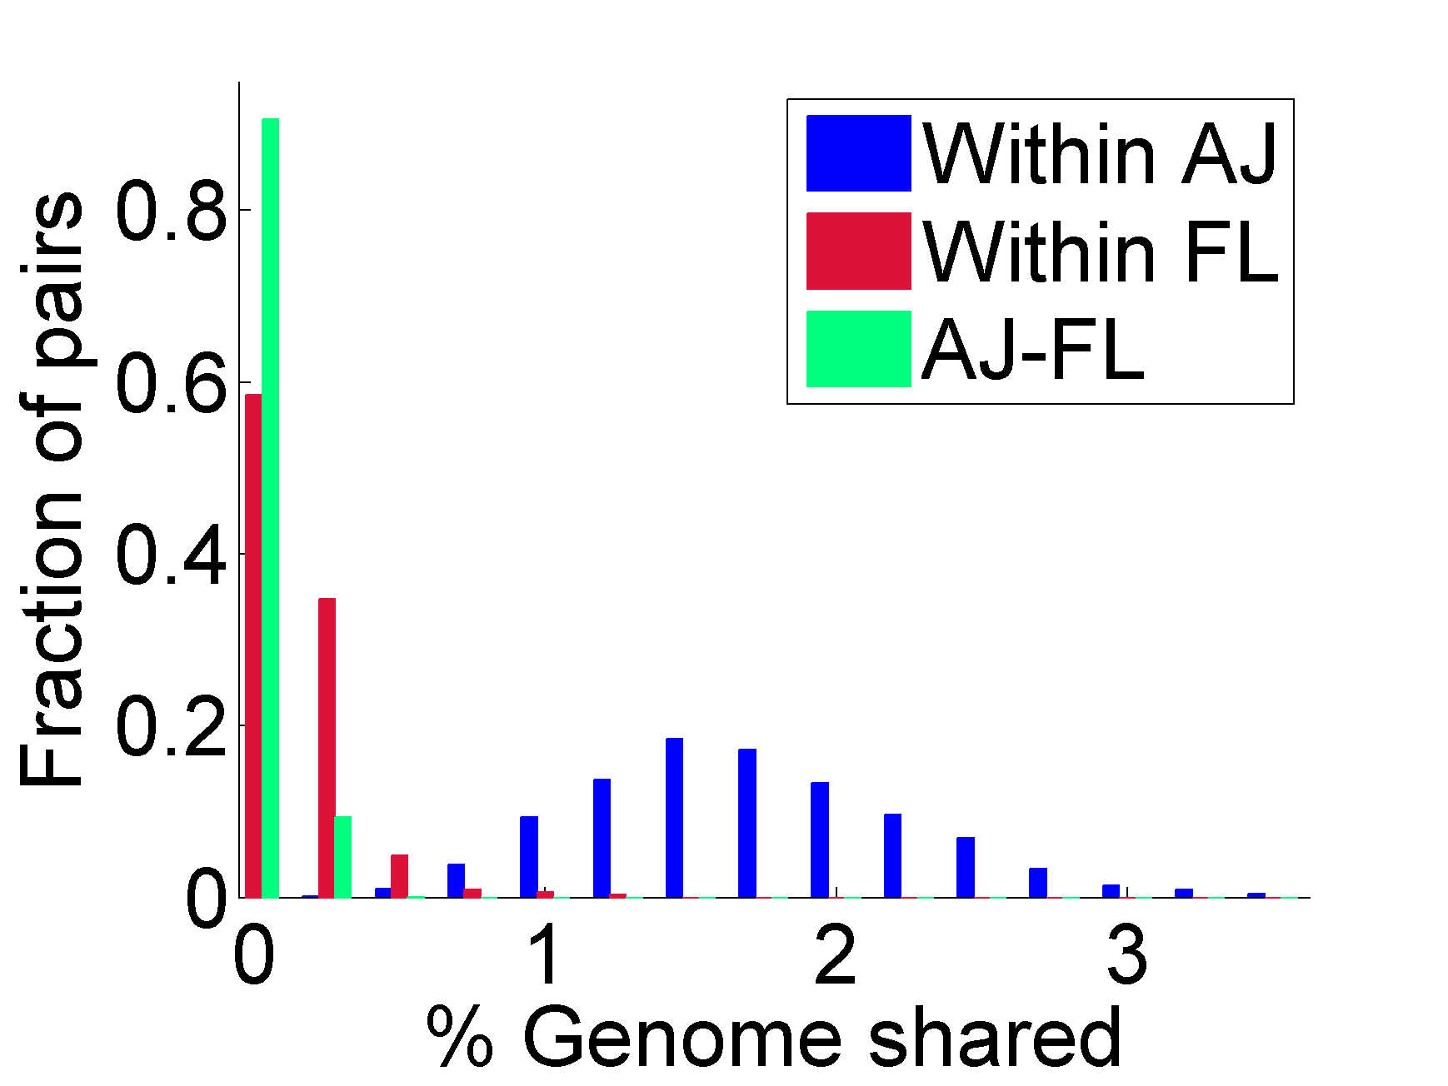
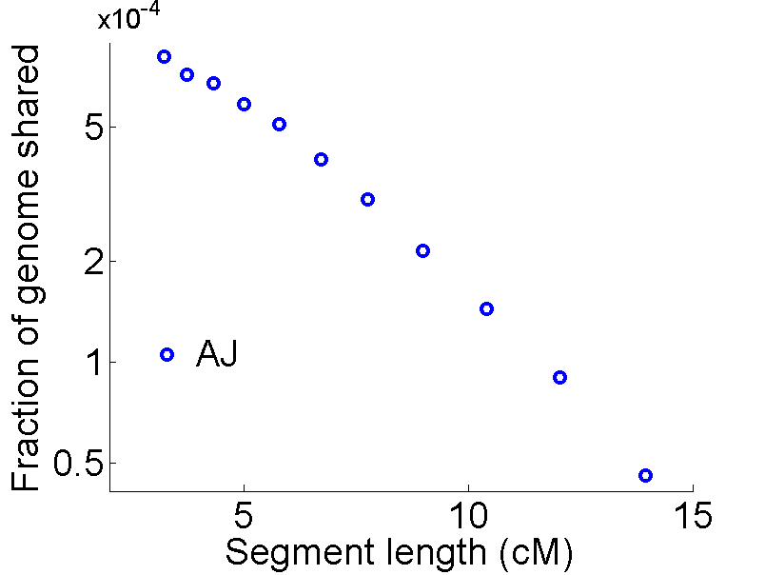
Segment Sharing in Ashkenazi Jews
A pair of AJ individuals shares 1-2% of their genome (≈50cM) in ≈10-15 long segments (>3cM)
Carmi et al., Nat. Commun., 2014
Palamara et al., 2012

Slide 40
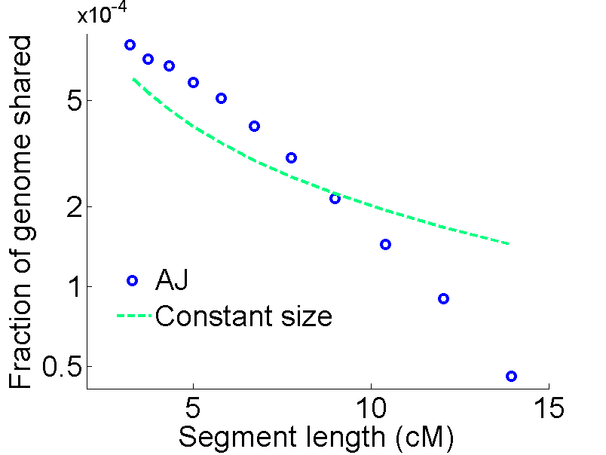
Inferring the Bottleneck Size and Time
Carmi et al., Nat. Commun., 2014
Palamara et al., 2012

Slide 41
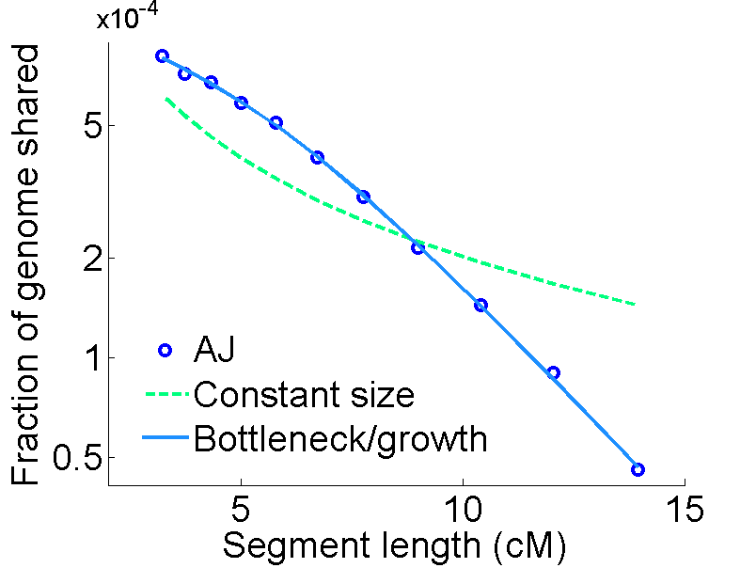
Inferring the Bottleneck Size and Time
Time (years)
Carmi et al., Nat. Commun., 2014
Palamara et al., 2012

Slide 42
Robustness
Potential confounders:
  Phasing, sequencing, and segment detection errors
  Model specification and assumptions
  Good resolution only for ≈10-50 generations ago
Parameter | 95% confidence interval
Bottleneck size | 249-419
Bottleneck time (years) | 625-800
Results consistent with previous studies
Time confirmed using lengths of haplotypes around doubletons
  Mathieson and McVean, 2014

Slide 43

Ashkenazi History
Origin?
Founder event?
European gene flow:
  Where?
  When?
  How much?
Relation to other Jews?

Slide 44
Outline
Hidden Relatedness
Segment Sharing Theory
Ashkenazi Genetics and History
Druze Genetics
Genomic Coverage

Slide 45
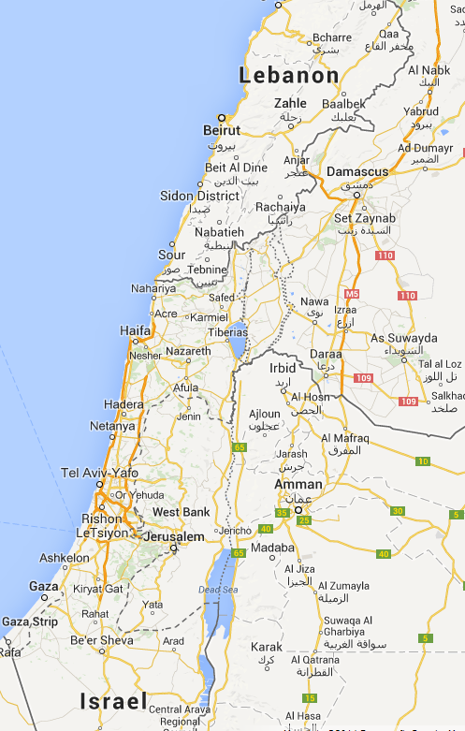
Druze Genetics
Religion formed in 10th century Egypt
  Demographic upheavals and geographic expansion
  Conversion (in and out) prohibited since an early stage
Today: Syria (40-50%), Lebanon (30-40%), Israel (10%)
We genotyped 40 Israeli Druze trios
Segment sharing abundant
  ≈100cM per pair in segments >0.5cM
Zidan*, Ben-Avraham*, Carmi* et al., EJHG (in press, 2014)

Slide 46
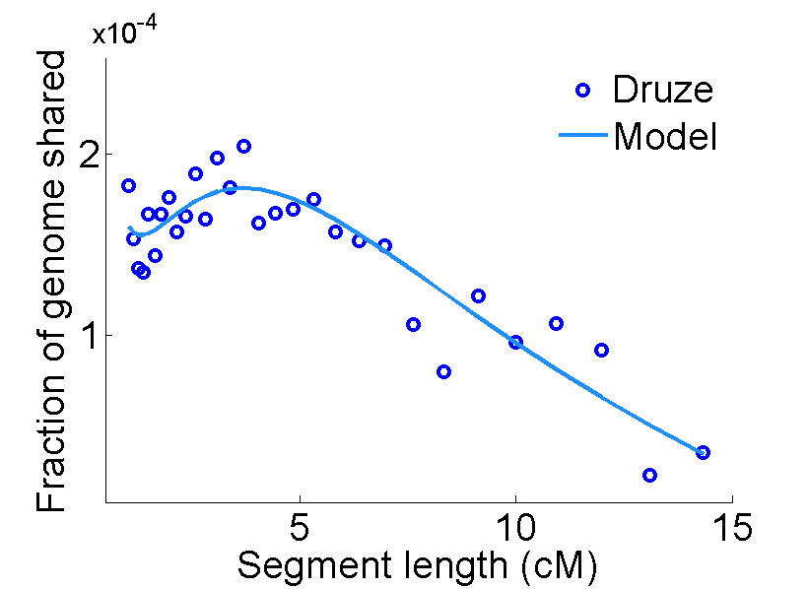
Druze Genetics: A Recent Bottleneck
Time
41,000
3000
900
(years)
6100
Present

Slide 47
Outline
Hidden Relatedness
Segment Sharing Theory
Ashkenazi Genetics and History
Druze Genetics
Genomic Coverage

Slide 48
Coverage by Shared Segments
A sequenced reference panel
What fraction of the genome can we cover with segments shared with the panel?
Partly sequenced genome
Impute
Full sequence
Partial sequence
Inferred sequence

Slide 49
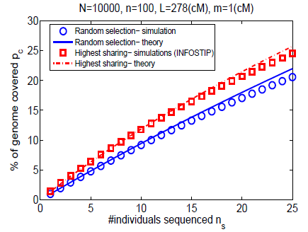
Coverage by Shared Segments: Theory
Idea: select top-sharing individuals to be fully sequenced
  Gusev et al., 2012
Expressions for the coverage under selection schemes
  Carmi et al., Genetics, 2013
Minor effect on power
Select

Slide 50
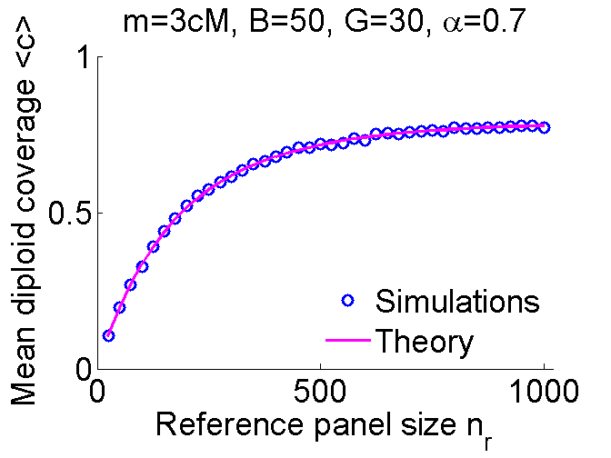


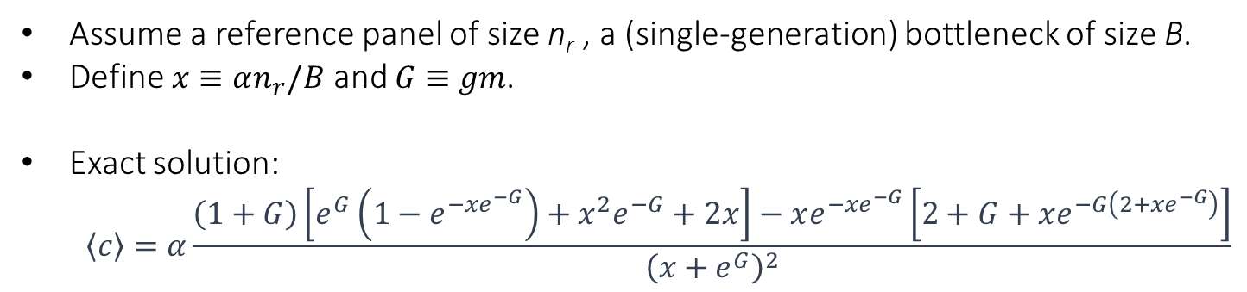

Coverage by Shared Segments: Theory
Assume a reference panel of size n_{r} , a (single-generation) bottleneck of size B.
Define $x≡αn_{r}/B$ and $G≡gm$.
Exact solution:
  $$\left\langle c\right\rangle =α\frac{\left(1+G\right)\left[e^{G}\left(1−e^{−xe^{−G}}\right)+x^{2}e^{−G}+2x\right]−xe^{−xe^{−G}}\left[2+G+xe^{−G\left(2+xe^{−G}\right)}\right]}{{\left(x+e^{G}\right)}^{2}}$$
Time
(gen)
$$N→∞$$
$$N→∞$$
g+1
g
B
1-α
$$N→∞$$
Present
See also Carmi et al., 2013

Slide 51
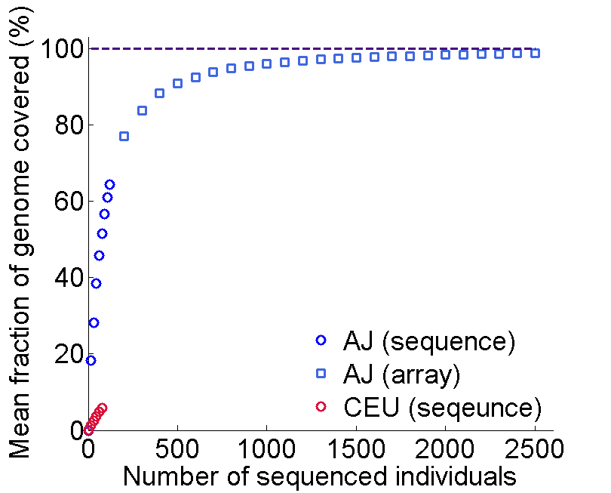
Coverage in Ashkenazi Jews
Segments >3cM
Mine public data?
Other studies?
Phase II
Now

Slide 52
The Era of Near-Complete Coverage
Segments >3cM
Mine public data?
Other studies?
Phase II
Now
Every locus in a new genome has a fully sequenced “relative”
Opportunities:
  Interpretation of personal genomes
  Cost-effectively implementing large-scale association studies
  Historical inference
Methods to be developed!

Slide 53
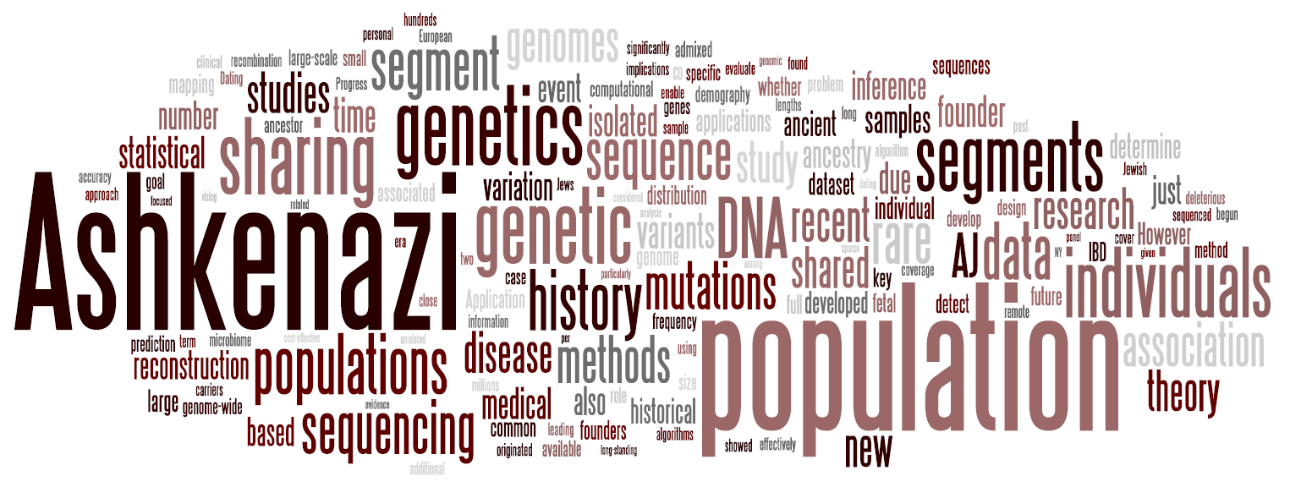
Summary
We developed theory for segment sharing
We sequenced 128 Ashkenazi whole-genomes; useful for medical genetics
Segment sharing reveals an Ashkenazi and Druze founder events
Coverage by shared segments important for imputation
My research statement

Slide 54
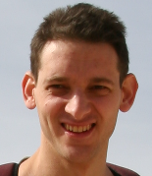







Acknowledgements
Itsik Pe’er’s lab:
James Xue, Ethan Kochav, Shuo Yang, Pier Palamara, Vladimir Vacic
TAGC consortium members:
Todd Lencz, Semanti Mukherjee (LIJMC)
Lorraine Clark, Xinmin Liu (CUMC)
Gil Atzmon, Harry Ostrer,
Danny Ben-Avraham (AECOM)
Inga Peter, Judy Cho (ISMMS)
Ariel Darvasi (HUJI)
Joseph Vijai (MSKCC)
Ken Hui (Yale)
VIB Ghent, Belgium
Harvard University:
Peter Wilton, John Wakeley
Sheba Medical Center:
Eitan Friedman
Funding:
Human Frontier Science program
Thank you for your attention!

