Slide 1

Navigation with local information
Shai Carmi
Bar-Ilan University
Israel
2009

Slide 2
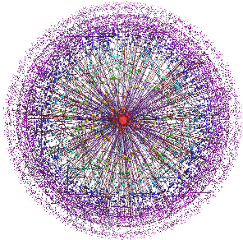
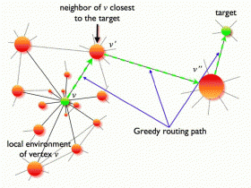
Why local information?
The Internet is huge.
So are social networks and
transportation networks.
Navigating with information of the
entire topology is not scalable.
To find target with local information,
we must use heuristics.
* Greedy routing: minimize distance to target.
* Route through nodes of high degree.
Boguna & Krioukov, PRL 102, 058701 (2009)

Slide 3
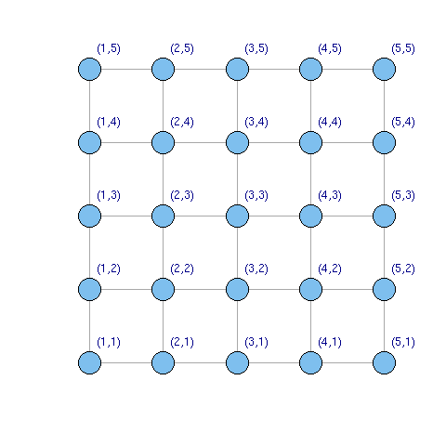
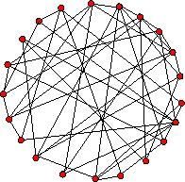

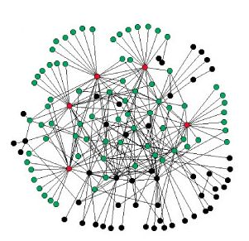

Network models- Introduction
In a network, links (edges) connect computers/individuals which are represented by nodes. There are few network models:
Simplest model: a regular lattice.
* Good for purely spatial, local, interactions.
Erdos-Renyi (ER) network model: fully random.
* Fixed number of nodes N, each link exists
with probability p.
* Narrow degree distribution:
where k is node degree.
Scale-free (SF) networks: emergence of hubs.
* Broad degree distribution:
* Nodes with extremely high degree exist (hubs).
* Other ingredients possible, e.g., growth, correlations.
* Found to describe most real-world systems.

Slide 4
Navigation models: Outline
Searching for the hub.
Kleinberg’s lattice model.

Slide 5
Navigation models
Searching for the hub.
Kleinberg’s lattice model.

Slide 6
How to find the most connected node in the network: An algorithm
Start from a given node.
Go to the neighbor with
highest degree
(break ties arbitrarily).
Keep going, until
reaching a peak-
a node whose degree is
greater than all of its
neighbors.
Basins of attraction are
formed around each hub.
3
1
2
2
2
1
2
2
2
4
3
2
3
1
1
1
Only knowledge of the neighbors’ degree is required!

Slide 7
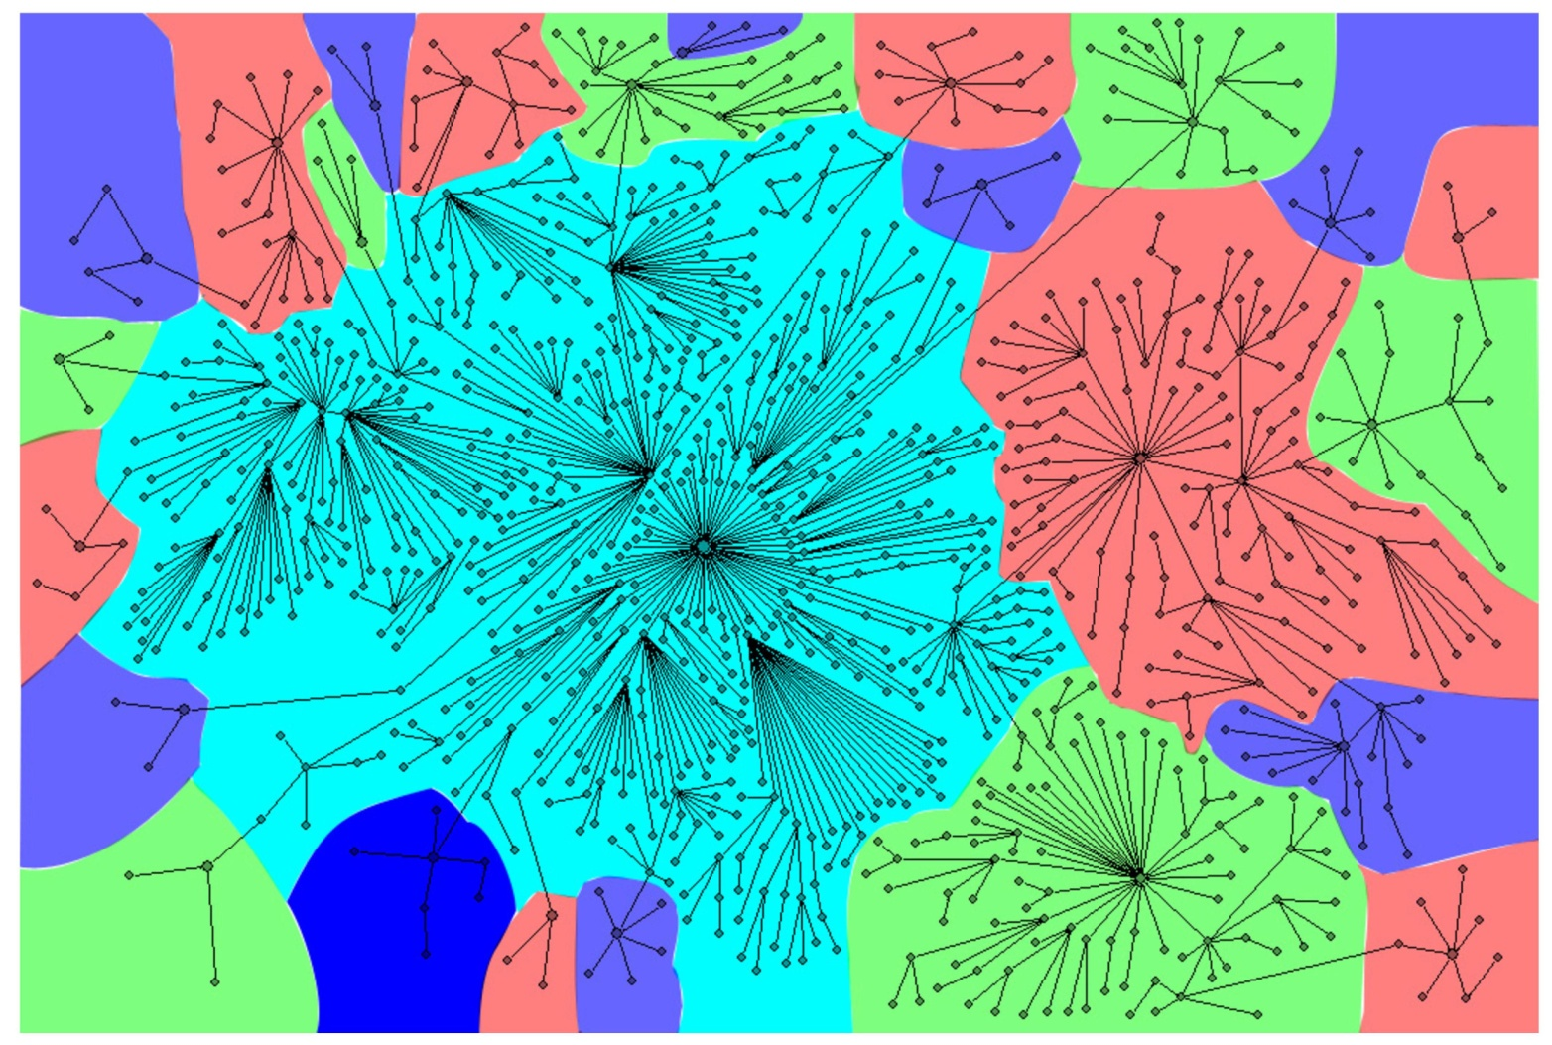
Large-scale example

Slide 8
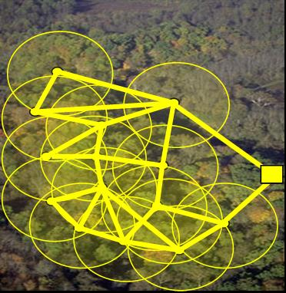
What is it good for?
A new way of decomposing the network based on the association to a hub.
In an energy landscape network, can tell us where will the system end up.
In wireless sensor networks, it is
desirable to deliver a message to
the hub with minimal energy
consumption. If the sensor network
has just one basin, our algorithm
will be useful.

Slide 9
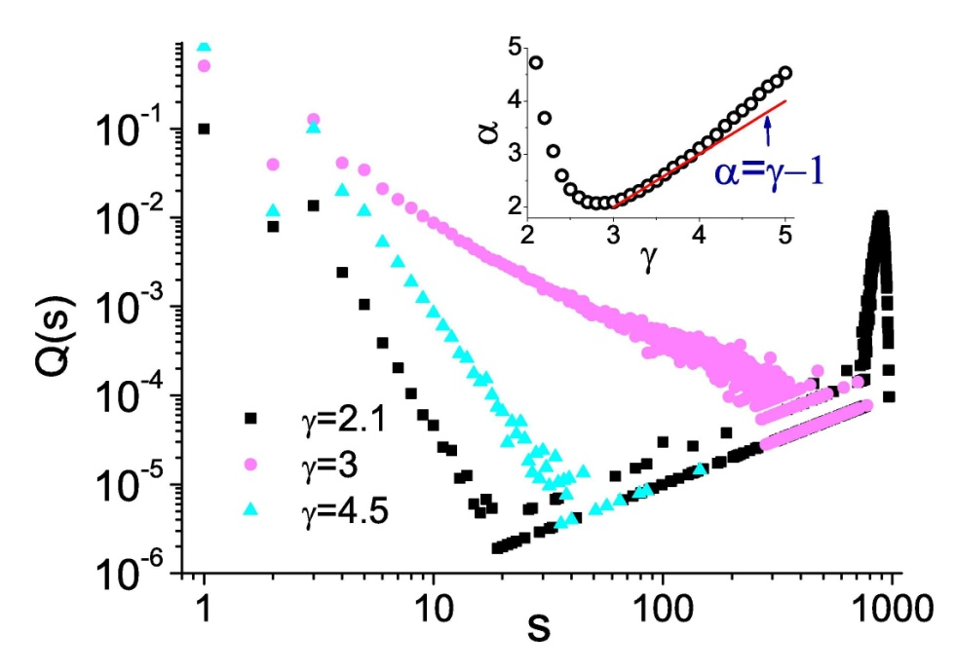
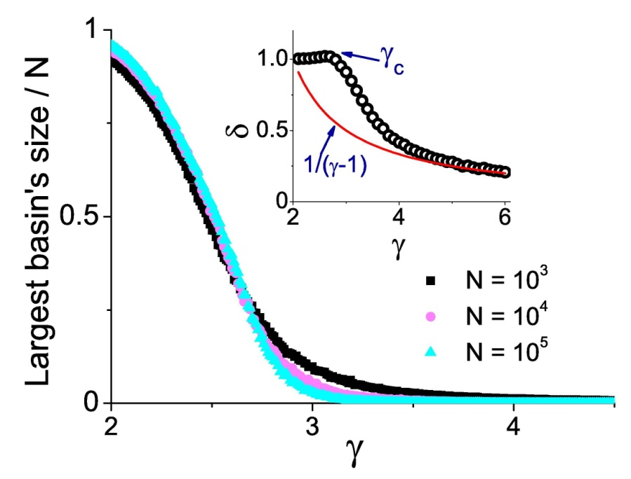
Basins distribution in scale-free networks
How does the basins topology depend on the degree exponent γ (P(k)~k^{-γ})?
The giant basin
Q(s)- the probability of a node to belong
to a basin of size s.
We empirically find that Q(s)~s^{-α}
for small s.
The size of the largest basin scales
as S~N^{δ}, where δ=1 for γ≤ γ_{c} and
δ≈1/(γ-1) for large γ.
Interpretation: for γ≤ γ_{c} ≈3 a giant basin exists that attracts most nodes.
For large γ where the network is more homogeneous it is fragmented to
numerous basins whose size distribution decays as a power-law.

Slide 10
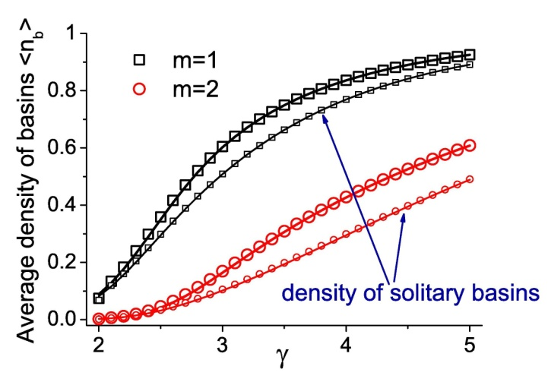
Theory- a transition at γ=3
The probability of a node with degree k to be a peak is approximately exp[-Ak^{3-γ}], where A is a k-independent constant.
For γ<3, the probability approaches zero-
only the true hub is a peak.
For γ>3, every node with large degree is almost surely a peak.
For large γ, the size of the giant basin scales as the size of the largest degree in the network S~N^{1/(γ-1)}.
The first two moments of the
number of basins can be
approximated analytically.

Slide 11
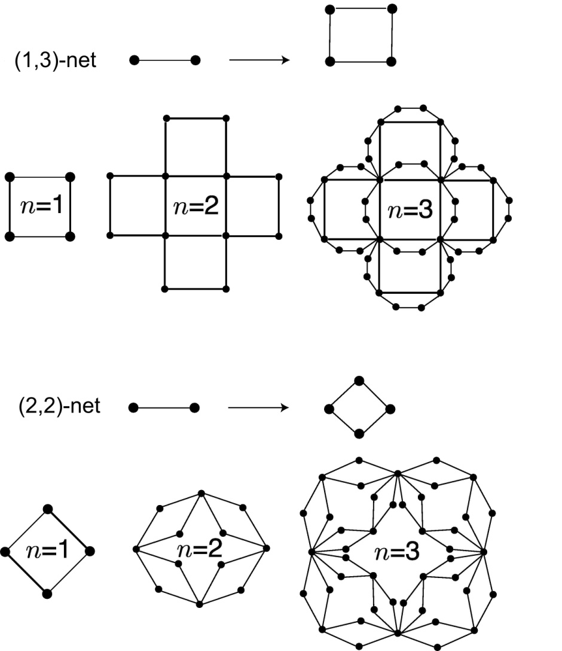
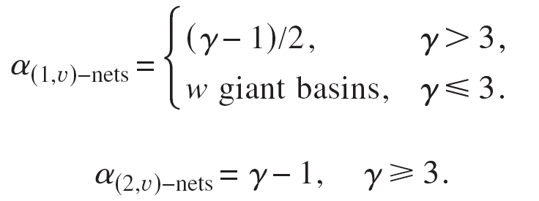
Deterministic fractal (u,v)-nets
The behavior Q(s)~s^{-α} can
be explained using a fractal
scale-free network model.
Each link in generation n
splits into u+v=w links in
generation n+1.

Slide 12
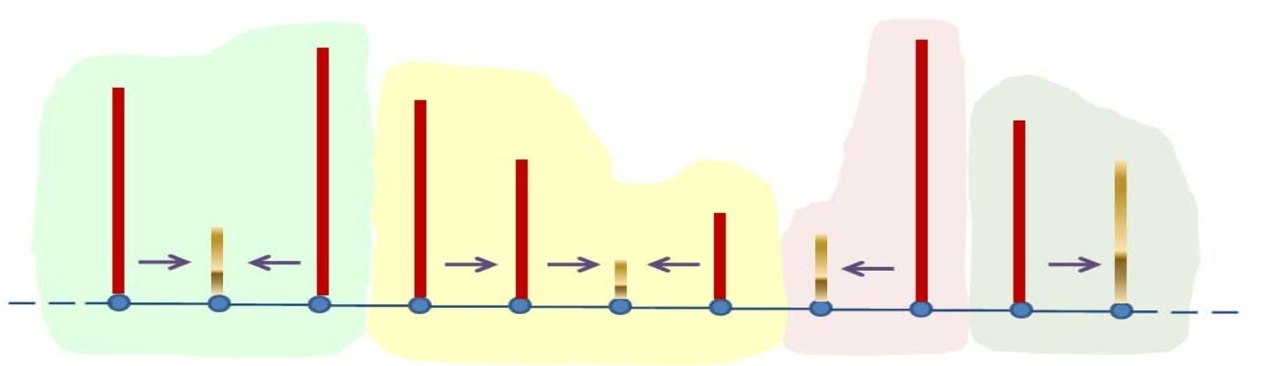
Generalization to lattices
Instead of degree, node’s importance is determined by a different attribute such as height or energy.
Assume each node is attracted to its shortest neighbor.
A physical interpretation of the size of the basins of attraction:
place one particle at each node and let the particles follow a path of steepest descent. The final number of particles in each node is the size of its basin of attractions.
peak
valley
peak
saddle
saddle
valley
peak
valley
peak
saddle
valley

Slide 13
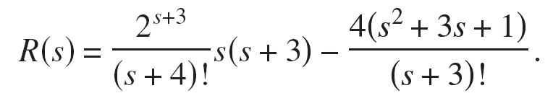
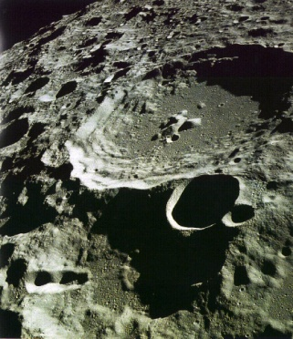
Results on lattices
Easy to calculate that the number of valleys is N/3± 2N/45.
Define R(s) as the probability of a node to be a valley of a basin of size s.
In 1D, R(1)=1/30, and
R(s) decays as 1/s!, much faster than the power-law for networks.
In 2D, the density of peaks and valleys is 1/5, of saddles 1/15.
We find R(1)=109/4290. Other values of R are
hard to obtain.
Other features appear such as craters and ridges.
For example, the density of craters is 3/715.

Slide 14
Navigation models
Searching for the hub.
Kleinberg’s lattice model.

Slide 15
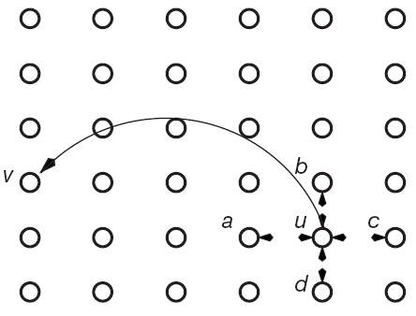
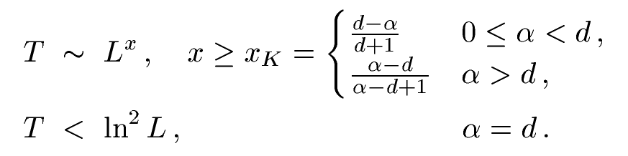
The navigation problem and Kleinberg’s model
Social networks are small-worlds, meaning that short paths exist.
But how do people find them?
Kleinberg’s model (2000)
* Underlying lattice.
* Nearest neighbors connections.
* One long-range link for each node.
* Probability for a long-range link over
distance r decays as r^{--α}.
* Greedy routing: message is always sent
to the neighbor geographically nearest to the destination.
Kleinberg proved (T- delivery time; d- dimension; L- lattice size)
In the special case α=d, local
information is enough to find
short paths!

Slide 16
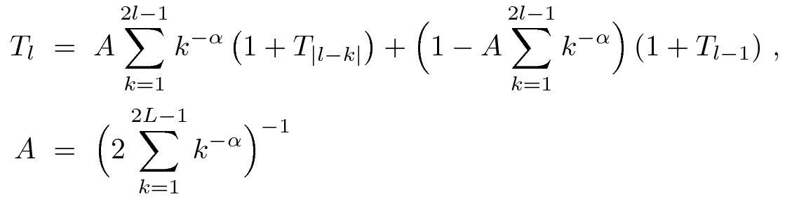
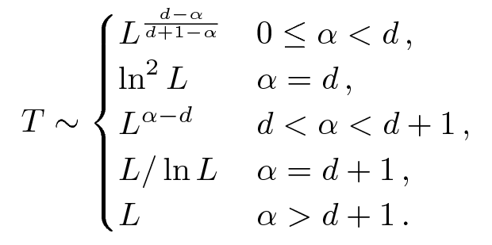
A theory of Kleinberg navigation
Kleinberg only provided lower bounds for α≠d and an upper bound for α=d but did not find the exact asymptotic behavior.
We write a master equation for T (using p_{i,i+k}=Ak^{-α}):
We find the
asymptotic solution:
Agrees with
Kleinberg’s bounds.

Slide 17
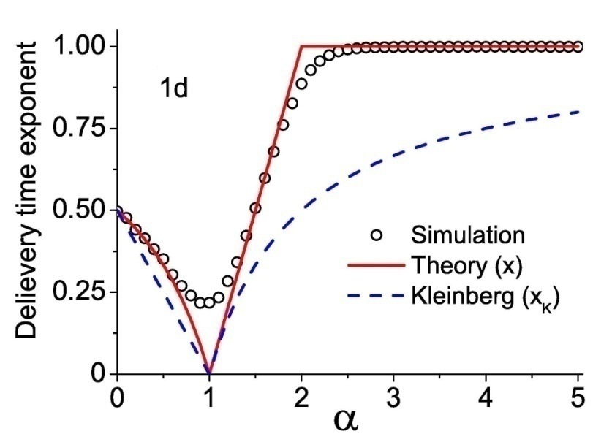
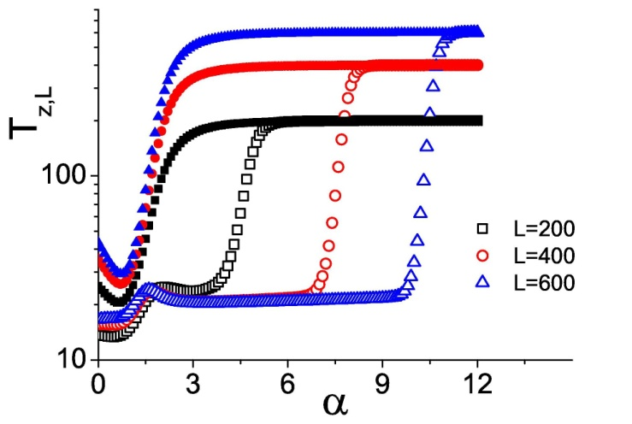
Simulations
Our solution agrees with
numerical results
(both simulations and
iteration of the master equation).
What happens if messages can be lost?
Define the probability of successful
completion of a single step as z.
By modifying the master equation,
we can calculate T_{z}(L) analytically.
No message loss
With message loss
The system is small-world for a much wider range of α!
Explains why the system need not be fine-tuned to become navigable.

Slide 18
Summary
Navigation with local information is a problem with interesting practical and theoretical aspects.
We study, analytically and numerically, the behavior of two models.
Searching for the hub
It is sometimes desirable to find the most connected node with minimal effort.
Each node is associated with a hub by walking up the degree gradient.
The network is decomposed into basins of attractions based on hub association.
A transition in scale-free networks: a giant basin emerges for γ<3. For γ>>3 each high degree node forms a basin.
We derived the basin size distribution for fractal models and 1D chain.
Kleinberg’s lattice model
Assume individuals are placed on a lattice with nn links plus one long-range link.
Messages are delivered using knowledge of neighbors location only.
Only bounds were known for the delivery time (for 9 years!).
We found exact asymptotic expression for the delivery time, in agreement with Kleinberg’s bounds.
Introduction of a fugacity parameter makes the model more realistic.

Slide 19

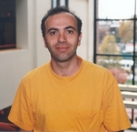


Acknowledgements and references
Prof. Daniel ben-Avraham (Clarkson University, NY)
and students Stephen Carter and Jie Sun.
Prof. Paul Krapivsky (Boston University, MA).
My advisor Prof. Shlomo Havlin.
My host in BU Prof. H. Eugene Stanley.
Shai Carmi, P.L. Krapivsky, and Daniel ben-Avraham. "Partition of networks into basins of attraction". Phys. Rev. E 78, 066111 (2008).
Shai Carmi, Stephen Carter, Jie Sun, and Daniel ben-Avraham. "Asymptotic behavior of the Kleinberg model". Phys. Rev. Lett. 102, 238702 (2009).

Slide 20
Thank you for your attention!

Slide 21
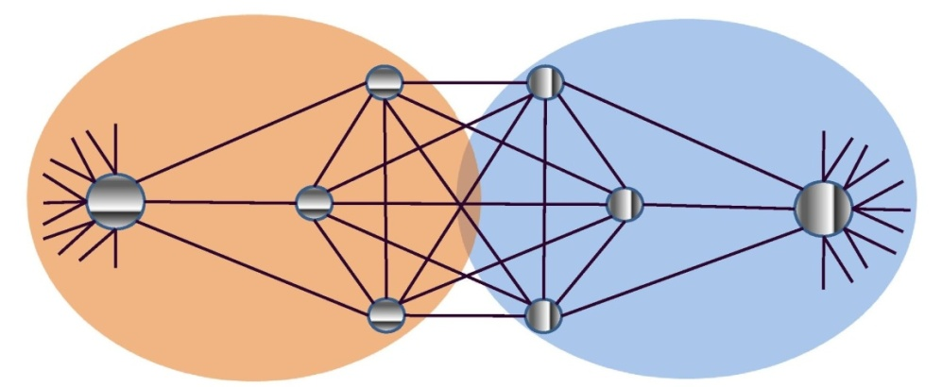
Basins of attraction vs. community detection
The calculation of the basins of attraction provides a decomposition of the network.
How does it compare with state of the art community detectors?
Most community detectors use global information.
More importantly, community detection and separation to basins have different goals. Consider this example:
Community detectors:
Maximize links
within communities;
minimize links
between communities.
Basins of attraction:
Separate nodes by
the hub they
associate with.
Not really two communities!

Slide 22
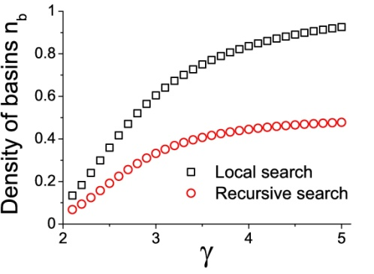
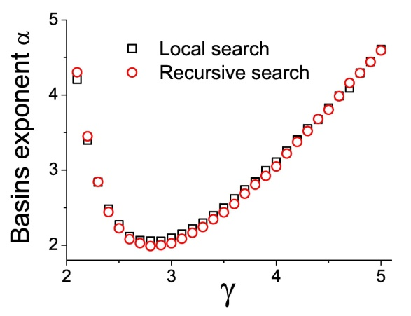
Tie breaking
What happens when the neighbor of highest degree of a node has the same degree as the node itself?
In our local search, a node can be a peak
even if it has neighbors of equal degree.
In a recursive search, we surf over
“ridges” of connected nodes of equal
degree to reach the true hub.
Less basins exist,
but other results
remain qualitatively
the same.
1
2
2
2
2
3
1
1
1
1
2
2
2
2
3
1

