Slide 1
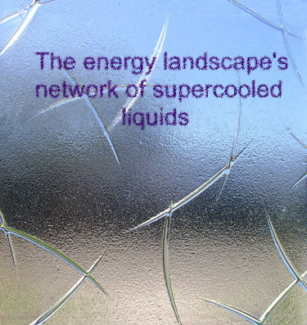
Shai Carmi
Bar-Ilan, BU
Together with: Shlomo Havlin, Chaoming Song, Kun Wang, and Hernan Makse

Slide 2
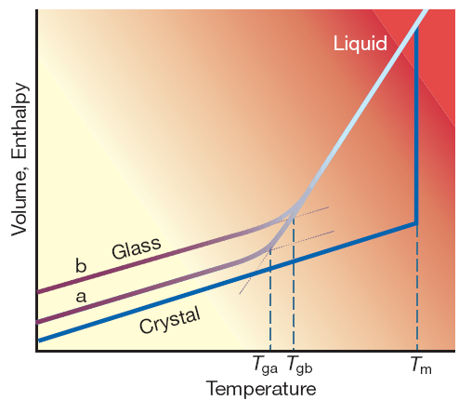
Supercooled liquids
A liquid can be cooled fast
enough to avoid
crystallization, even
below the freezing point.
At the glass transition
temperature T_{g}, the liquid
deviates from equilibrium,
freezes in a meta-stable state,
and becomes a glass.
The glassy state is disordered.
T_{g} depends on the cooling rate.

Slide 3
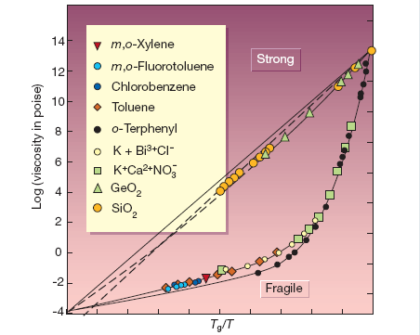
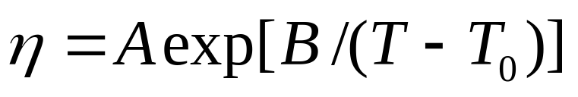
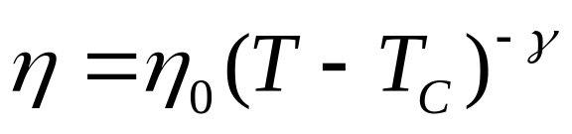
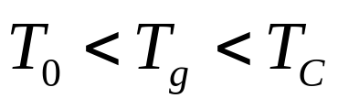
Glass concepts
T_{g} arbitrarily defined when the viscosity reaches 10¹³ P.
Glass=relaxation time
is longer than the time
of the experiment.
Strong and fragile glasses.
VTF equation:
Mode coupling theory equation:

Slide 4
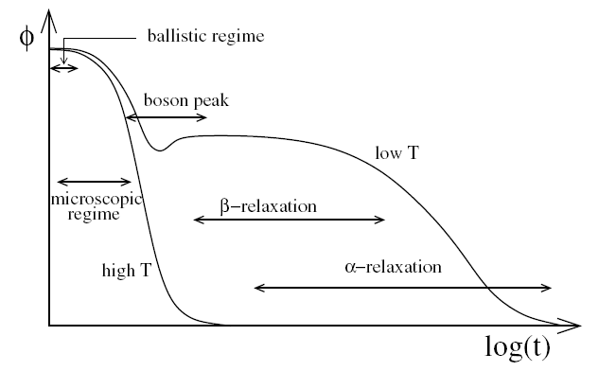
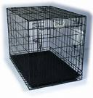

Relaxation
Cage effect
Stretched exponential

Slide 5
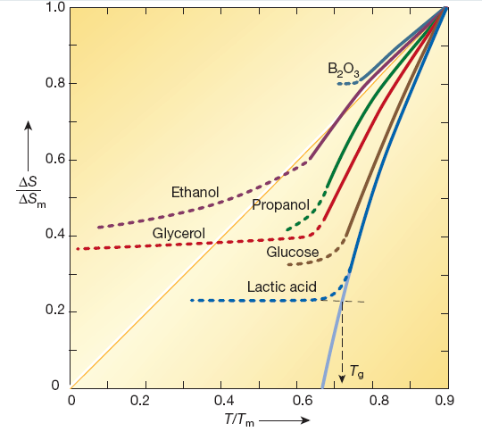
Entropy crisis
The crystal has zero entropy.
If the entropy of the supercooled liquid will be less than the crystal, the third law would be violated.
Glass transition intervenes to avoid crisis,
the system is frozen in
the ideal glass state.
Kauzmann temperature T_{K} <T_{g}

Slide 6
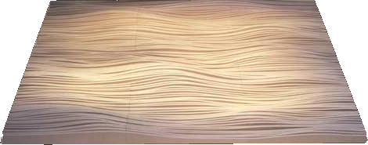
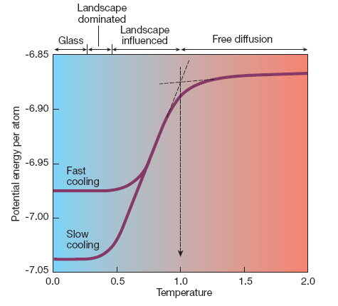
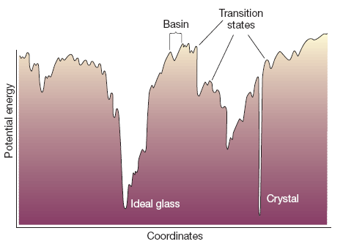
Energy landscape
A 3N-dimensional hyper surface of potential energy in which the system’s state is moving.

Slide 7
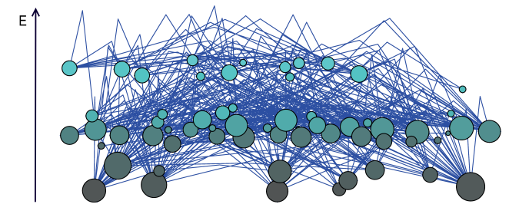

Energy landscape’s network
Molecular dynamics of Lennard-Jones clusters with one (MLJ) or two (BLJ) species to calculate basins and transition states.
Each basin is a node.
Basins separated by a first order saddle point are connected by a link.
Node size $∝$ degree

Slide 8
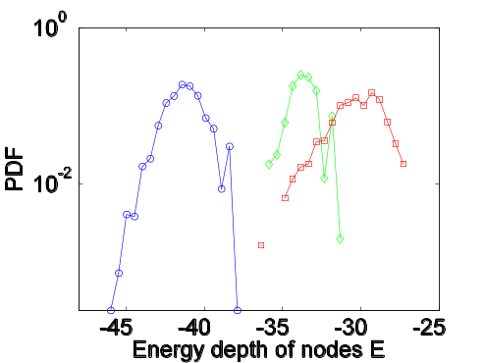
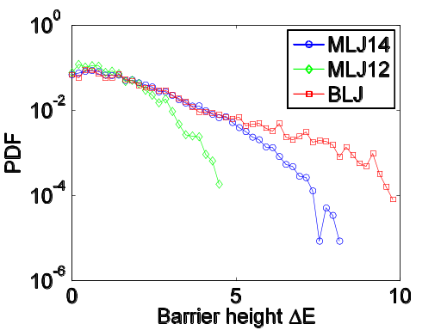
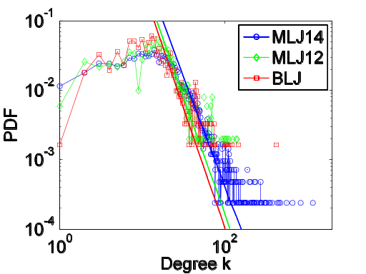
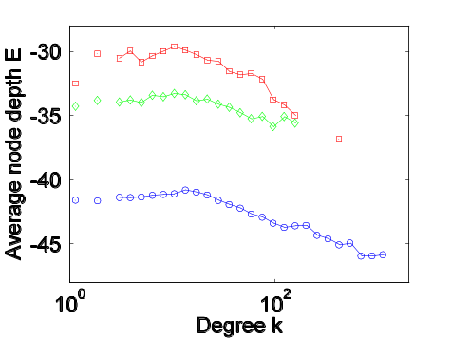
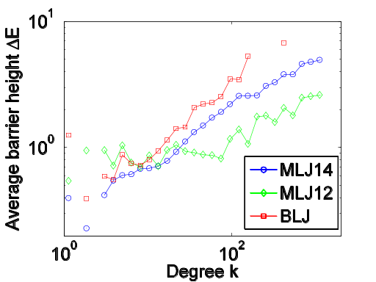
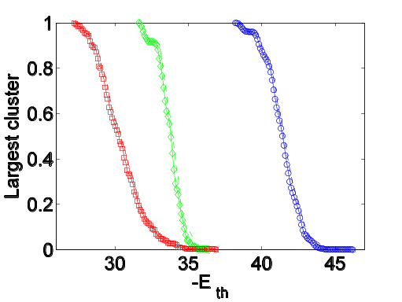
The network’s properties
Normal distribution of basins’ potential energies
Exponential distribution of energy barriers
The network is scale-free
The network is highly heterogeneous.
The degree is correlated with potential energy of the basins and the barrier heights.
Potential energy decreases with degree
Energy barriers grow with degree
Network remains connected in low energies

Slide 9
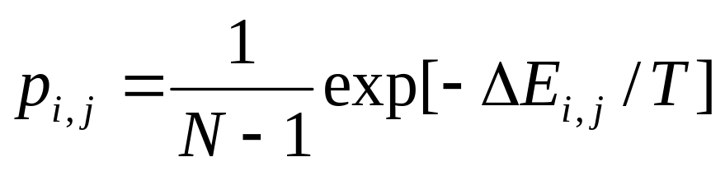
Model for the dynamics
Why do we need a model?
Near the transition, typical time diverges so MD simulations are too slow.
Energy landscape is 3N-dimensional- too detailed.
Neglect vibrational relaxations within the basins.
In low temperature, dynamics is dominated by activated hopping between basins.
What is the model?
ΔE_{j,i}
Arrhenius law:
ΔE_{i,j}
j
i
Number of nodes

Slide 10
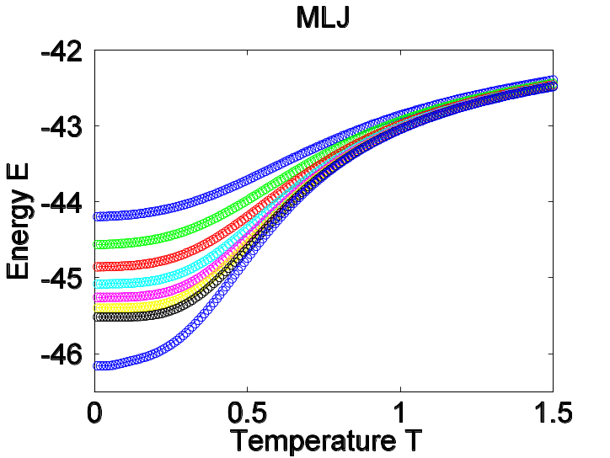
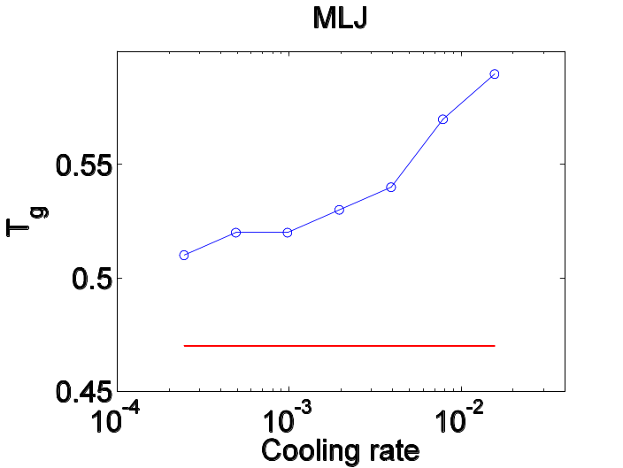
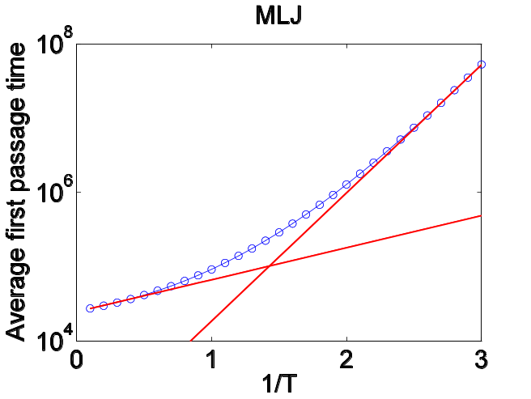
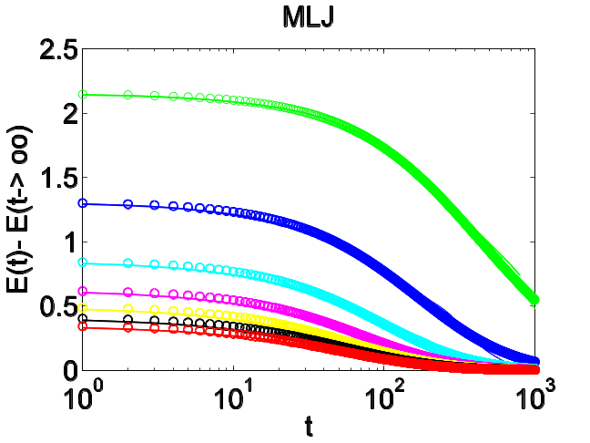
Applications of the model
Glass transition temperature
Different cooling rates
Infinitely slow cooling
Similar results for BLJ!
Correlation
Stretched
exponential
Relaxation time
Super-Arrhenius behavior-
fragile glass

Slide 11
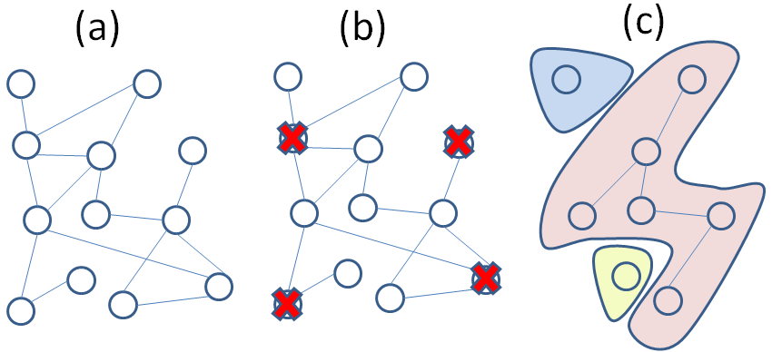
Percolation theory of networks
Remove a random fraction of the links/nodes.
When does the network breaks down?
At criticality, largest cluster vanishes and second largest diverges.

Slide 12
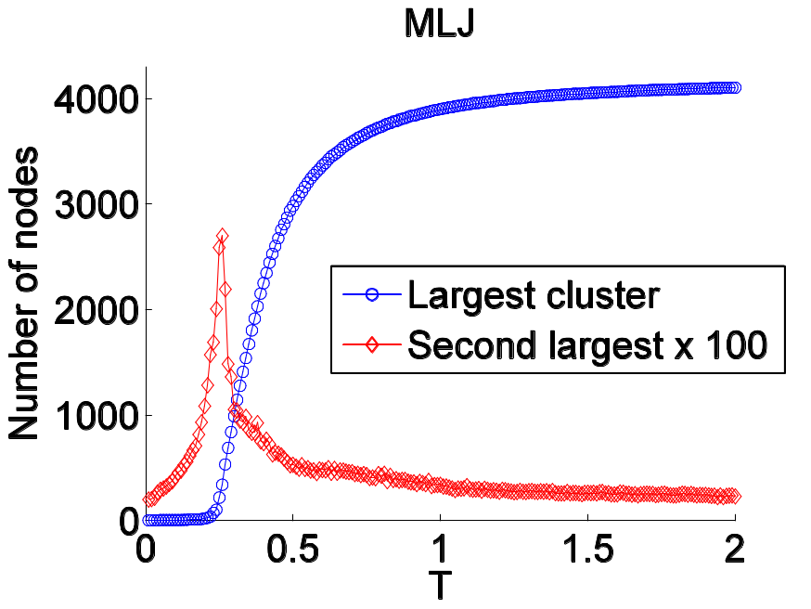

Application to the energy landscape
The probability of a link
to be effective is
Remove ineffective links.
At T_{K}, the connected part
of the network vanishes.
The network is at the ideal glass state!
Numerical identification of T_{K} for MLJ (0.26) and BLJ (0.47).
T_{K}

Slide 13
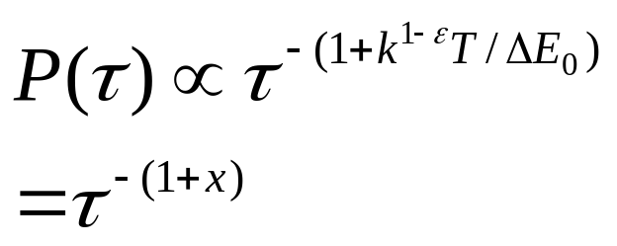
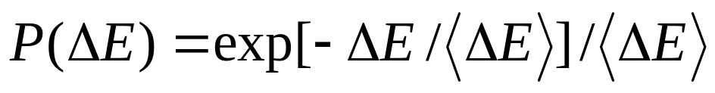
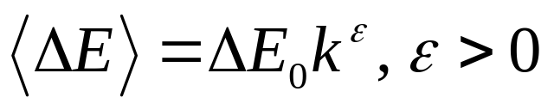
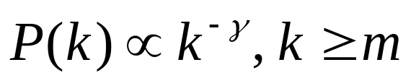
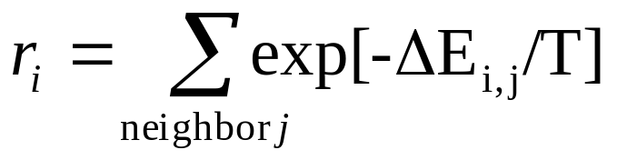
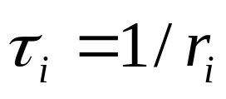
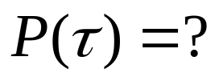
Toy model
Assumptions:
Solution:
If x<1: <τ>=∞
If x>1: <τ><∞
Network is scale-free
If ε<1: x increases with k—
<τ>=∞ for small degree nodes
rate to leave / time to stay
at node i
If ε>1: x decreases with k—
<τ>=∞ for hubs

Slide 14
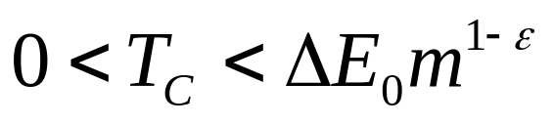
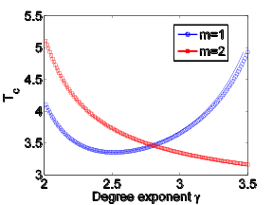
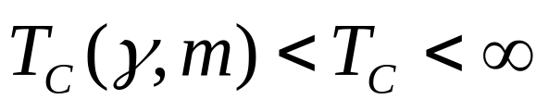
Percolation in the model
Nodes with <τ>=∞ are traps and are removed from the network.
As temperature is lowered, more nodes are removed until the percolation threshold is reached → glass transition.
ε<1
ε>1
random failure
targeted attack
Use percolation theory:
T_{C}
γ

Slide 15
Summary
Glasses are abundant in nature and technology, but out of equilibrium so hard to understand.
Molecular dynamics and energy landscape representation simplify the problem.
Network theory suggests a model that captures the essential properties of the glass transition.
Enables access to low temperatures.
Percolation picture describes landscape near the transition.
Can be generalized and extended to make predictions.

