Slide 1
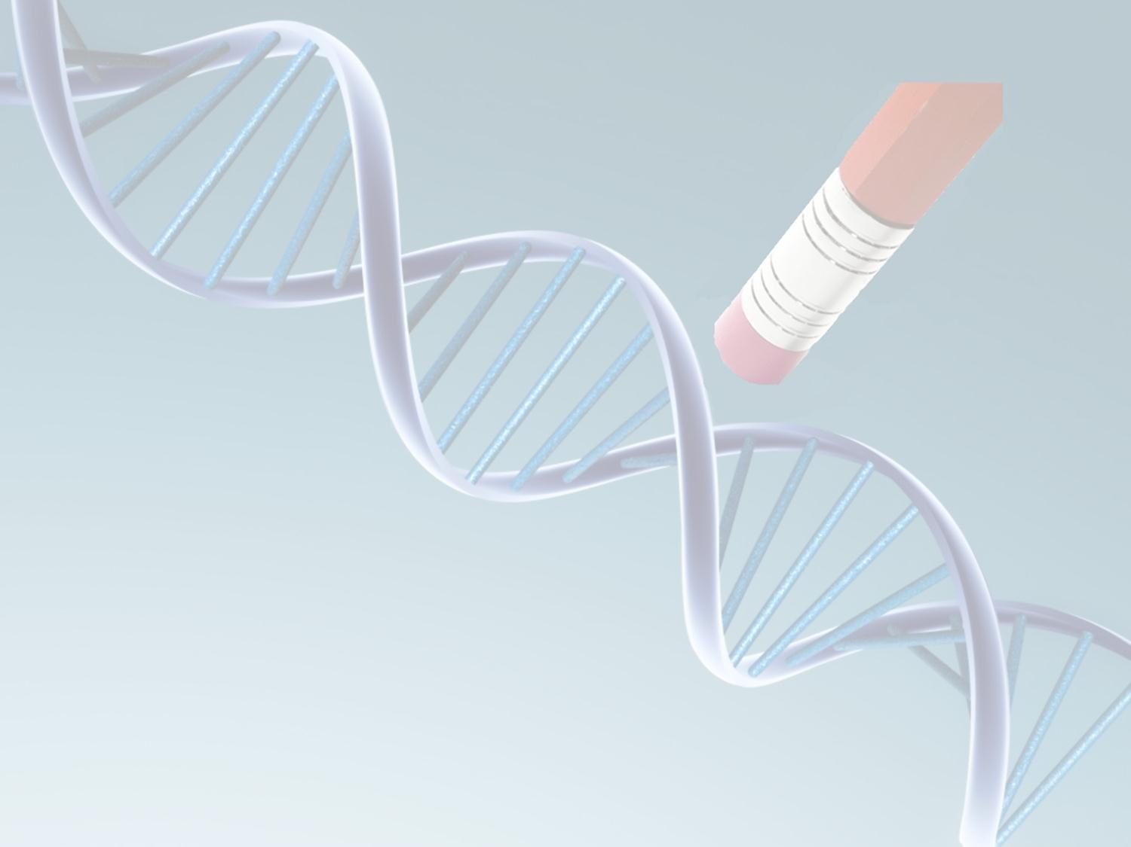
Large scale DNA editing of retrotransposons accelerates mammalian genome evolution
Shai Carmi, Erez Levanon
Bar-Ilan University
2010

Slide 2
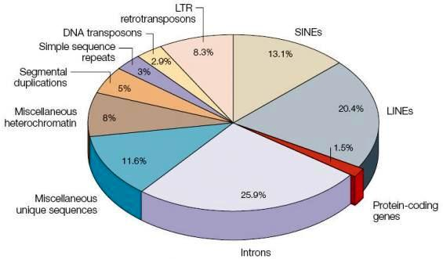
What’s in the genome?
Protein coding sequences are only 2% of the human genome.
Lots of other stuff: introns, promoters, enhancers, telomeres, rRNA, tRNA, miRNA, snRNA,…
Complexity is determined by non-coding DNA (all animals have few tens of thousands of genes).

Slide 3

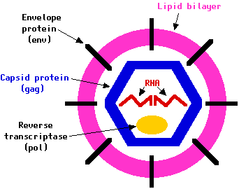
Mobile elements
Mobile elements comprise half of the human genome.
Pieces of 100-10k base pairs moving around the genome in a cut&paste or copy&paste mechanism.
Retrotransposons (RTs): ancient retroviruses.
Retroviral replication:
Viral RNA reverse transcribed
DNA integrated into the genome
RNA transcribed
Proteins translated
A new virus assembled!

Slide 4
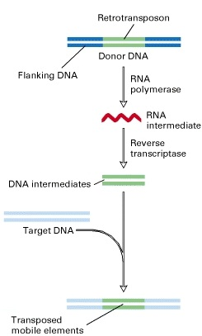
Retrotransposons
Transcription:
genomic DNA→RNA.
Translation:
viral RNA → proteins
(optional).
Reverse transcription:
viral RNA → DNA.
Insertion into new genomic
locations.

Slide 5
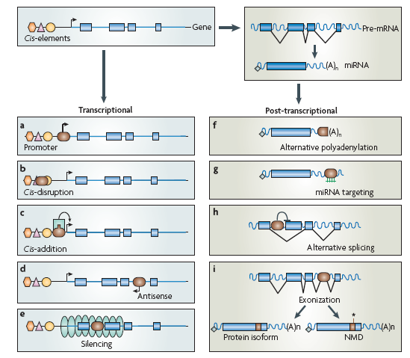
The effect of retrotransposons
Mutations, genetic disorders.
BUT,
A reservoir of
sequences for
genetic innovation.
Rewiring of gene
regulation networks.
Accumulation of
mutations and other
mechanisms inhibit
most RTs.

Slide 6
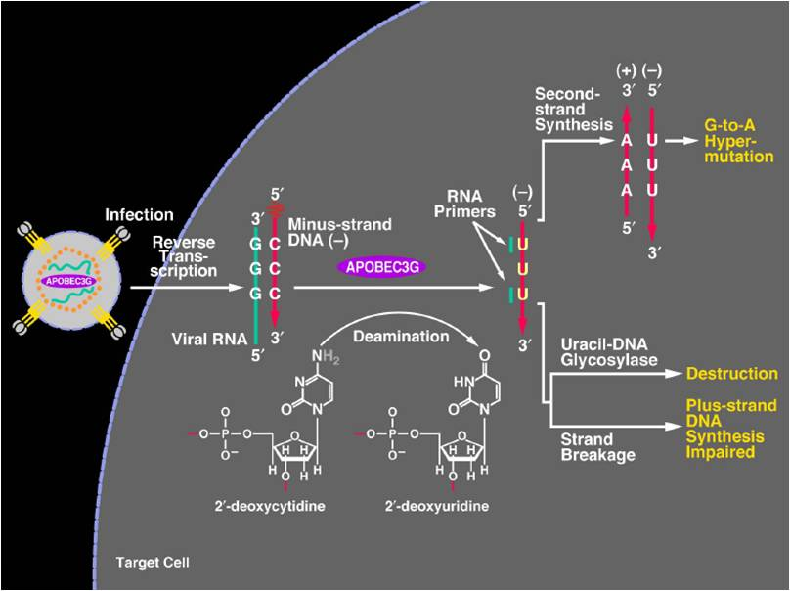
DNA Editing of retroviruses

Slide 7
DNA Editing of the genome
Genome (DNA)
5’
G
G
G
3’
5’
A
A
A
3’
RT
RT
3’
C
C
C
5’
3’
T
T
T
5’
RT
RT
Transcription
RNA
5’
G
G
G
3’
RT
Reverse transcription
Integration into a different locus,
with G→A mutations.
RNA
5’
G
G
G
3’
RT
DNA
3’
C
C
C
5’
RT
Digestion of RNA strand
DNA
3’
C
C
C
5’
RT
Editing
How often has
this happened?
DNA
3’
U
U
U
5’
RT
Synthesis of second DNA strand
DNA
5’
A
A
A
3’
RT
DNA
3’
U
U
U
5’
RT

Slide 8
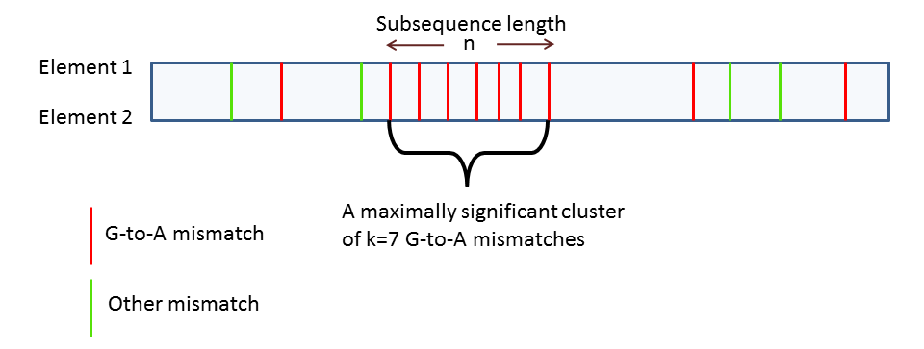
An algorithm
Extract all retrotransposons (of a given family).
Align pairwise using BLAST.
Search for high quality alignments with G→A clusters.

Slide 9
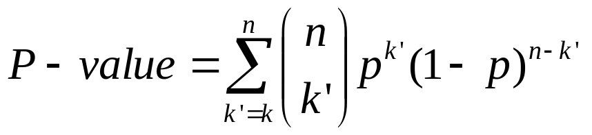
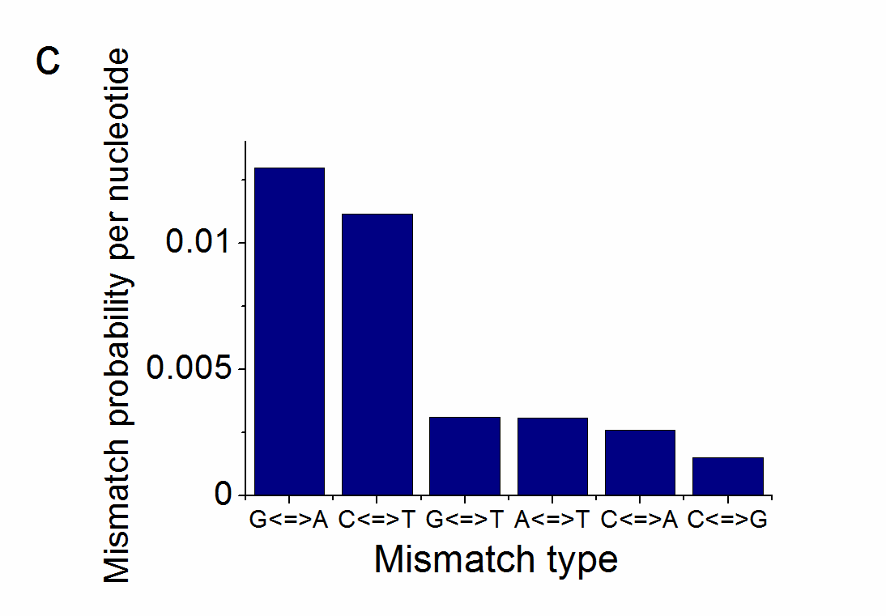
An algorithm
Define the transition probability:
p=[#(C-to-T)+#(T-to-C)] / (2*alignment_length).
k- cluster length, n- sequence length.

Slide 10
An algorithm
Define the transition probability:
p=[#(C-to-T)+#(T-to-C)] / (2*alignment_length).
k- cluster length, n- sequence length.
How many clusters do we expect by chance?
Use p=[#(G→A)+#(A→G)] / (2*alignment_length), and search for clusters of C→T!
Editing is strand-specific, and we align only positive strands.
True DNA editing will show no C→T clusters.

Slide 11
The results
Retrotransposon family | Total no. of elements in family | No. of edited elements- high confidence | No. of edited nucleotides- high confidence | No. of edited elements- low confidence | No. of edited nucleotides- low confidence
Mouse IAP | 26504 | 195 | 3539 | 446 | 7144
Mouse MusD | 12147 | 22 | 563 | 125 | 1418
Mouse LINE1 | 884320 | 1602 | 28876 | 6542 | 92248
Human HERV | 18593 | 21 | 528 | 284 | 2938
Human LINE1 | 927393 | 30 | 492 | 1319 | 13460
Human SVA | 3425 | 690 | 8940 | 2248 | 41391
Chimpanzee HERV | 19772 | 38 | 614 | 98 | 1029

Slide 12
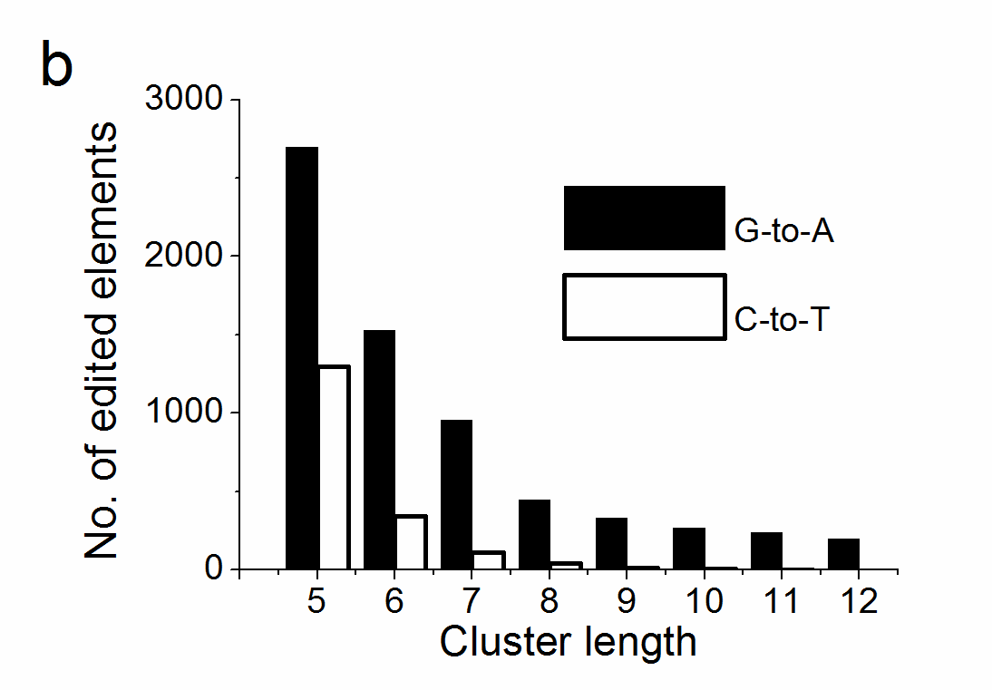
The results
Mouse IAP

Slide 13
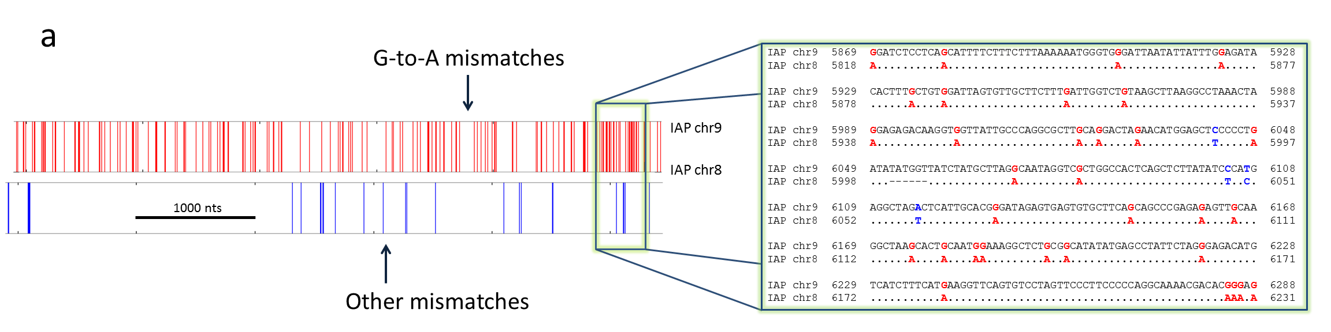
An example
Mouse chr8:28575443-28581824 (6,382 nts) vs. chr9:114987516-114993954.
176 G→A mismatches and only 26 other mismatches.

Slide 14
More examples
Mouse IAP
Query 4059 AAAACTGGCATAGGTGCCTATGTGGCTAATGGTAAAGTGGTATCCAAACAATATAATGAA 4118
Sbjct 960 ............A..................A.........................A.. 1019
Query 4119 AATTCACCTCAAGTGGTAGAATGTTTAGTGGTCTTAGAAGTTTTAAAAACCTTTTTAAAA 4178
Sbjct 1020 ..................A........A........A....................... 1079
Query 4179 CCCCTTAATATTGTGTCAGATTCCTGTTATGTGGTTAATGCAGTAAATCTTTTAGAAGTG 4238
Sbjct 1080 .........................A............................A..... 1139
Query 4239 GCTGGAGTGATTAAGCCTTCCAGTAGAGTTGCCAATATTTTTCAGCAGATACAATTAGTT 4298
Sbjct 1140 ...A........................................................ 1199
Query 4299 TTGTTATCTAGAAGATCTCCTGTTTATATTACTCATGTTAGAGCCCATTCAGGCCTACCT 4358
Sbjct 1200 .....................A...................................... 1259
Query 4359 GGCCCCATGGCTCTGGGAAATGATTTGGCAGATAAGGCCACTAAAGTGGTGGCTGCTGCC 4418
Sbjct 1260 ..............AAA..........A................................ 1319
Query 4419 CTATCATCCCCGGTAGAGGCTGCAAGAAATTTTCATAACAATTTTCATGTGACGGCTGAA 4478
Sbjct 1320 .....................A...................................A.. 1379
Query 4479 ACATTACGCAGTCGTTTCTCCTTGACAAGAAAAGAAGCCCGTGACATTGTTACTCAATGT 4538
Sbjct 1380 .......A.........................A.......................... 1439
Mouse MusD
Query 1381 GCCGCACGCCGTGCTTGGGGAAGGTTGCCTGTCAAAGGAGAGATTGGTGGAAGTTTAGCT 1440
Sbjct 1381 ...A................................A...........AA..A....... 1440
Query 1441 AGCATTCGGCAGAGTTCTGATGAACCATATCAGGATTTTGTGGACAGGCTATTGATTTCA 1500
Sbjct 1441 .A...................A...................................... 1500
Query 1501 GCTAGTAGAATCCTTGGAAATCCGGACACGGGAAGTCCTTTCGTTATGCAATTGGCTTAT 1560
Sbjct 1501 .......A.......AA......AA................................... 1560
Query 1561 GAGAATGCTAATGCAATTTGCCGAGCTGCGATTCAACCGCATAAGGGAACGACAGATTTG 1620
Sbjct 1561 ..............................................A............. 1620
Query 1621 GCGGGATATGTCCGCCTTTGCACAGACATCGGGCCTTCCTGCGAGACCTTGCAGGGAACC 1680
Sbjct 1621 .......................................................A.... 1680
Query 1681 CACGCGCAGGCAATGTTCTCAAGGAAACGAGGGAAAAATGTATGCTTTAAGTGTGGAAGT 1740
Sbjct 1681 .........A......................A........................... 1740

Slide 15
More examples
Human HERV
Query 235 TCCTTTAAACAAGGAACAGGTTAGACAAGCCTTTATCAATTCTGGTGCATGGA-AGATTG 293
Sbjct 1256 ............AA....AA...A.....................AAT..-A.C.A.... 1314
Query 294 ATCTTGCTGATTTTGT-GAGAATTATTGACAGTCATTACCCAAAAACAAAAATCTTCCAG 352
Sbjct 1315 G....A..A.....A.AA.A...........A............................ 1374
Query 353 TTTTAAAAATTGACTACTTGGATTTTACCTAAAAATGCCAGACATAAACCTTTAGAAAAT 412
Sbjct 1375 ....T..............AA.............T.A...A.............A..... 1434
Query 413 GCTCTGACGGTATTTACTGATGGTTCCAGCAATGAAAAAGCAACTTACACCAGGCCAAAA 472
Sbjct 1435 A....A.....G......A..A......A....A.....A.............A...... 1494
Query 473 GAACGAGTCCTTGAAACTCAATGTCACTCGGCTCAAAGAGCAGAGTT-GTTGTTGTCAAT 531
Sbjct 1495 A...A....A..A...............TAA......A.A..A.A..A.C.AC....-.. 1553
Query 532 T-CAGTGTTACAAAATTTTAATCAGCCTATTAACATTGTATCAGATTCTGCATATGTAGT 590
Sbjct 1554 .A..A.A....................................A.....A.....A..A. 1613
Human SVA
Query 300 TGCCGGGATTGCAGACGGAGTCTGGTTCGCTCGGTGCTCGGTGGTGCCCAGGCTGGAGTG 359
Sbjct 412 ............................A...A......AA................... 471
Query 360 CAGTGGCGTGGTCTCGGCTCGCTGCAGCCTCCATCTCCCGGCCGCCTGCCTTGGCCGCCC 419
Sbjct 472 ..........A....A.......A..A............A................T... 531
Query 420 AGAGTGCCGAGATTGCAGCCTCTGCCCGGCCTCCACCCCGTCTGGGAGGTGGGGAGCGTC 479
Sbjct 532 .A......A......................A...............A..AA........ 591
Query 480 TCTGCCTGGCCGCCCATCGTCTGGGACGTGGGGAGCCCCTCTGCCTGGCTGCCCAGTCTG 539
Sbjct 592 ..........T...................A............................. 651
Query 540 GAGGGTGGGGAGCATCTCTGCCCGGCCGCCATCCCGTCTGGGAGGTGGGGAGCGCCTCTT 599
Sbjct 652 ..AA...A.....G.....................A...A...A...A............ 711
Query 600 CCCGGCAGCCATCCCATCTGGGAGGTGGGGAGCGTCTCTGCCCGGCCGCCCATCGTCTGA 659
Sbjct 712 .......................A...A................................ 771

Slide 16
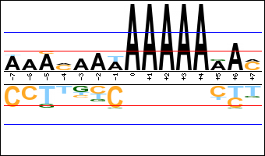
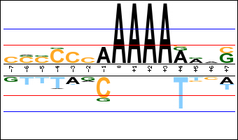
Editing Motifs
Motifs were evaluated statistically based on the nucleotide composition of the RTs.
Total 446 elements.
IAP | A | C | G | T
2 nts upstream | 4 | 7 | 0 | 0
1 nt upstream | 10 | 0 | 0 | 0
1 nt downstream | 10 | 0 | 0 | 12
2 nts downstream | 43 | 0 | 13 | 0
GxA→AxA motif
Mouse LINE- GG→AG
Human SVA- AG→AA
IAP
MusD

Slide 17
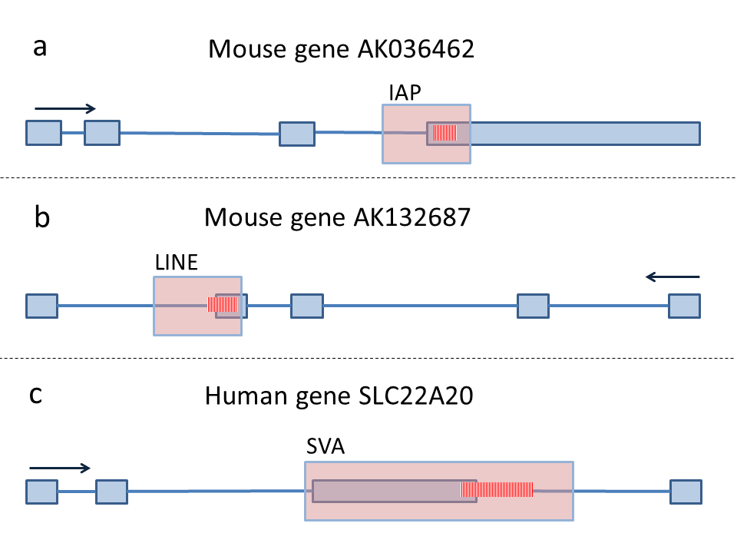
Are edited RTs expressed?
8% (35) of edited IAPs are in exons, but only 3.5% in all IAPs.
Could be facilitated by the increase in the weak A-T pairs.
24 exons are alternative.
Editing modified the 5’-splice site from the consensus G|GT to A|GT.

Slide 18
Other mammalians
Animal | Elements | P-value | Minimal cluster length | Number of G→A clusters | Number of G→A nucleotides | Number of C→T clusters | Number of C→T nucleotides
Rat | ERV | 10⁻⁸ | 8 | 877 | 12173 | 30 | 289
Orangutan | HERV | 10⁻⁷ | 7 | 182 | 2126 | 8 | 61
Rhesus | HERV | 10⁻⁷ | 7 | 146 | 1959 | 4 | 29
Marmoset | HERV | 10⁻⁷ | 7 | 38 | 410 | 7 | 53
But in organisms that have no APOBEC3…
Retrotransposon family | Total no. of elements in family | No. of edited elements- high confidence | No. of edited nucleotides- high confidence | No. of edited elements- low confidence | No. of edited nucleotides- low confidence
Fly LTR | 15925 | 17 | 119 | 17 | 119
Yeast Ty1 | 267 | 4 | 29 | - | -
Chicken LTR | 36318 | 1 | 13 | - | -
Frog LTR | 10493 | - | - | - | -
Zebreafish LTR | 133895 | - | - | - | -
Worm LTR | 617 | - | - | - | -

Slide 19
Editing is ongoing
SVA RTs are hominoid-specific
Largest fraction of elements are edited (690, 20%)
262 human-specific edited elements
16 polymorphic elements

Slide 20
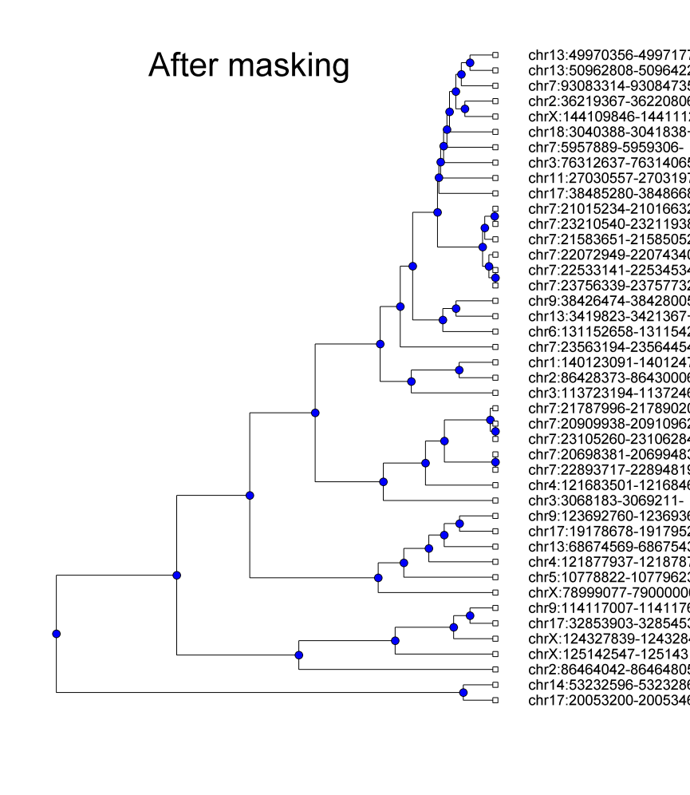
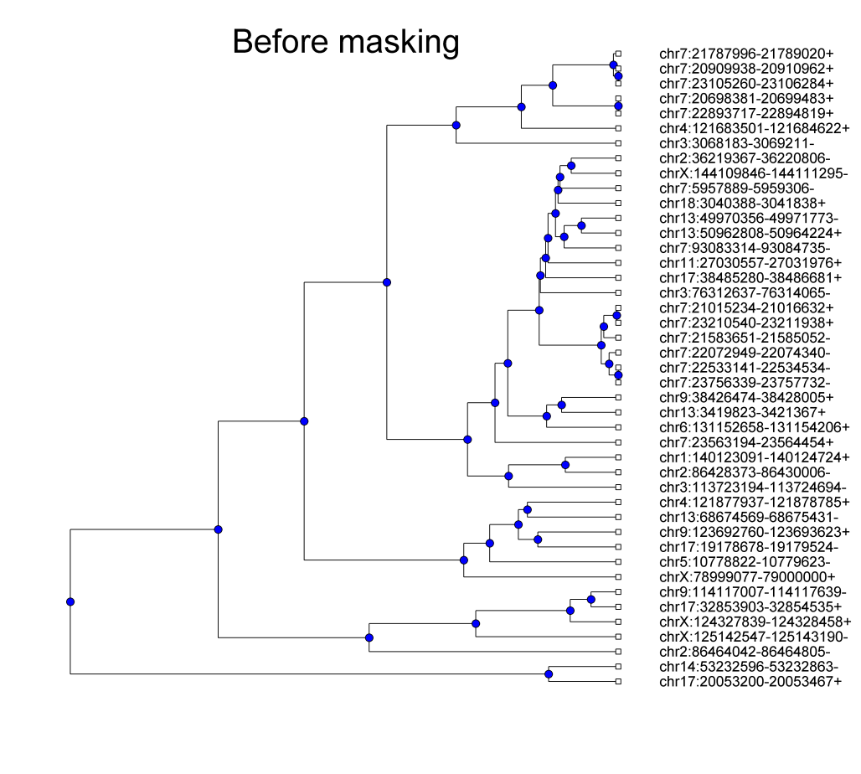
Phylogenetics
The molecular clock paradigm is wrong!
Editing must be masked to construct phylogenetic trees.
IAPLTR4_I

Slide 21
Tracing evolution
Editing is directed.
Order of replication events can be reconstructed.
Editing event
(1)
G G G
(2)
A G G
G A G
(3)
(4)
A G A
A A A
(5)

Slide 22
Tracing evolution
Create an edge connecting a sequence with G to a sequence with A.
Eliminate short circles.
For each RT, keep only the edge to the common ancestor that is genetically nearest (based on non G→A mismathces).
(1)
(1)
(2)
(3)
(2)
(3)
(4)
(5)
(4)
(5)

Slide 23
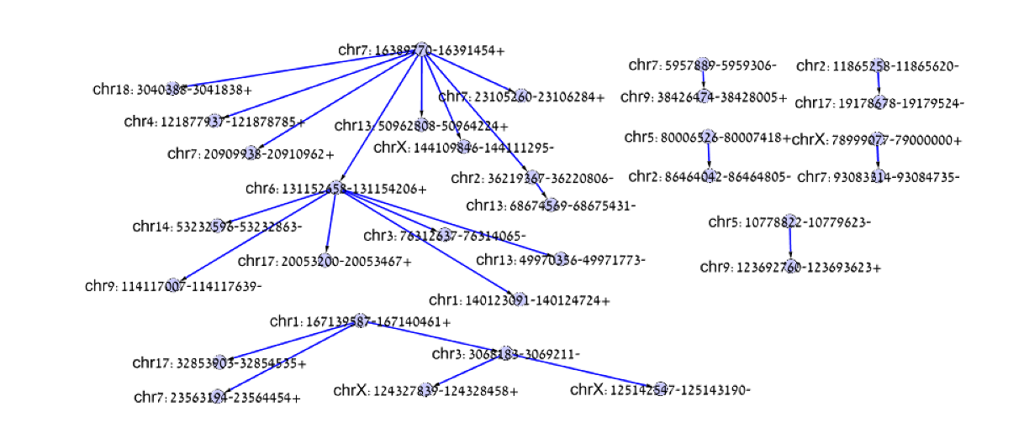
Tracing evolution
IAPLTR4_I

Slide 24
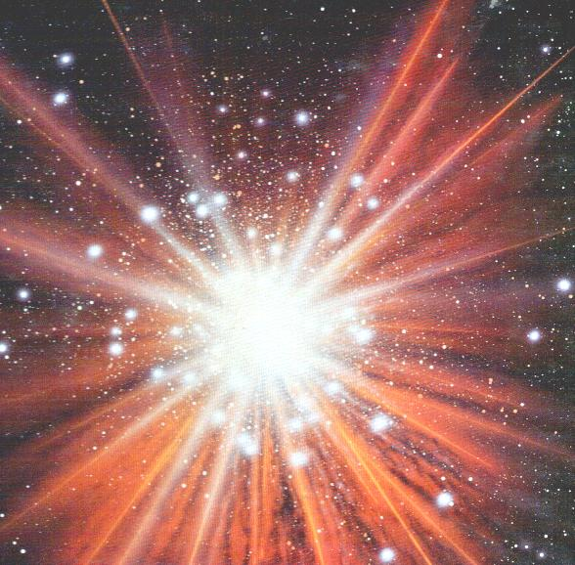
Discussion
Editing can explain the successful exaptation of RTs
Editing accelerates evolution- demonstrated for HIV
Our method detects only a small fraction of edited elements
De novo genes from edited RTs probably not here yet

Slide 25
Future directions
An editing-based algorithm to reconstruct the history of retrotransposon evolution.
A comprehensive survey of editing in the reference genome.
A systematic search for functions of edited elements (expression with RNA-seq, positive selection).
Searching for editing in non-reference DNA:
  Different individuals (polymorphism).
  Different tissues (somatic editing).

Slide 26
Thank you
CGACAAGAGTGTACGATGACGTC
|||||*||||||*|||||*||||
CGACCGGAGTGTGCGCTGGCGTC

