Slide 1



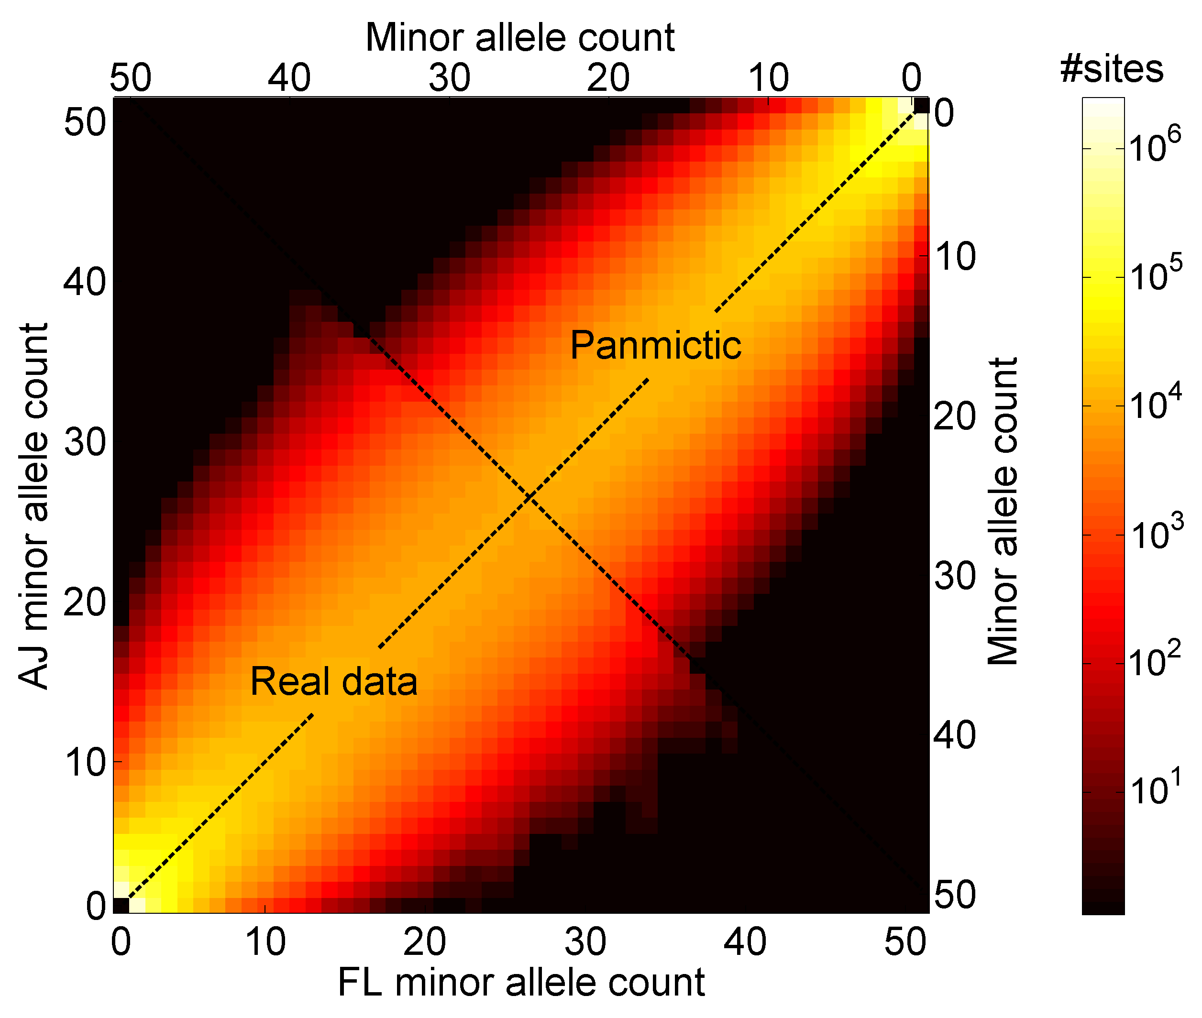
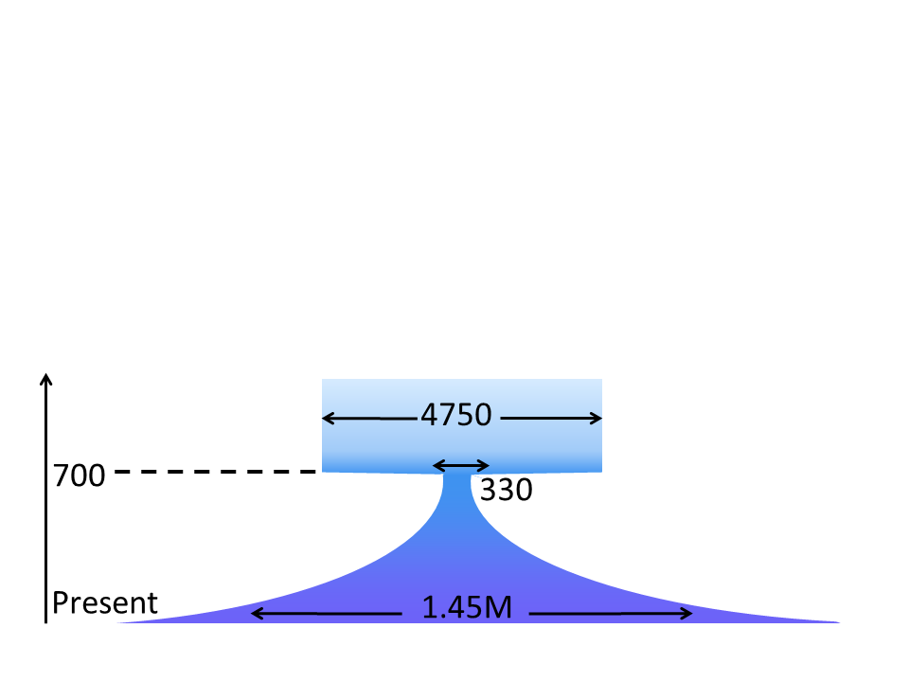
Sequencing an Ashkenazi Jewish Reference Cohort for Medical Genetics and Implications for Ashkenazi History
Shai Carmi
Department of Computer Science
Columbia University
Itsik Pe’er’s lab
2015

Slide 2
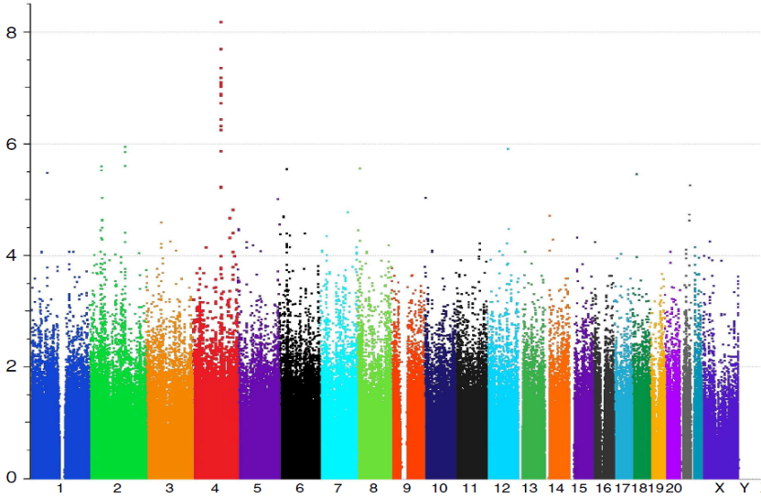
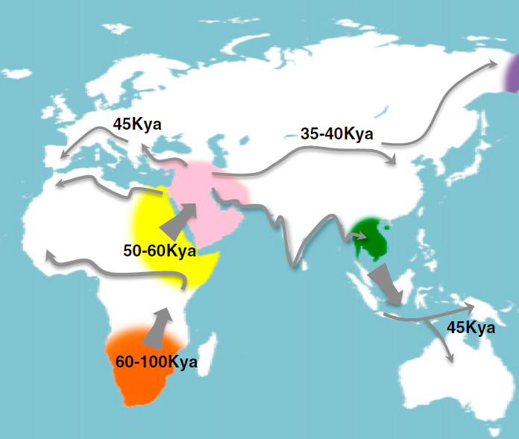
Population/Statistical Genetics
Find disease genes
Predict genetic risk
Understand molecular genetics and evolution
Learn about ancestry and history
Lencz et al., 2013
Schizophrenia study in Ashkenazi Jews
-log₁₀(P)
Chromosome
Henn et al., 2012

Slide 3
Outline
Ashkenazi Jewish Genetics: Background
The Ashkenazi Genome Sequencing Project
Segment Sharing and the Founder Event
Future Directions

Slide 4
Outline
Ashkenazi Jewish Genetics: Background
The Ashkenazi Genome Sequencing Project
Segment Sharing and the Founder Event
Future Directions

Slide 5



Ashkenazi Jewish (AJ) Genetics: Significance
Medical genetics
  Large founder population
  Mendelian disorders
  Complex diseases
    Breast cancer, Parkinson’s, Crohn’s
Population genetics
  Debated origins
  Segment sharing
Why do we need to sequence genomes?
mtDNA: Behar et al., 2004; Behar et al., 2006
Y chr: Behar et al., 2003; Behar et al., 2004
Disease genes: Risch et al., 2003; Slatkin, 2004
SNP arrays: Gusev et al., 2012; Palamara et al., 2012
Review: Ostrer and Skorecki, 2013

Slide 6
Founder Populations: Opportunities
Past
Non-founder population
Founder population
Recent successes
Crete
  Tachmazidou et al., 2013; HDL
Finland
  Kurki et al. 2014; aneurysm
Iceland
  Many papers; most recently Steinthorsdottir et al., 2014; T2D
Ashkenazi Jews
  Hui et al., in preparation; Crohn’s
Bottleneck
See also:
Hatzikotoulas et al., 2014
Zuk et al., 2014
Present
Population size
Disease alleles

Slide 7
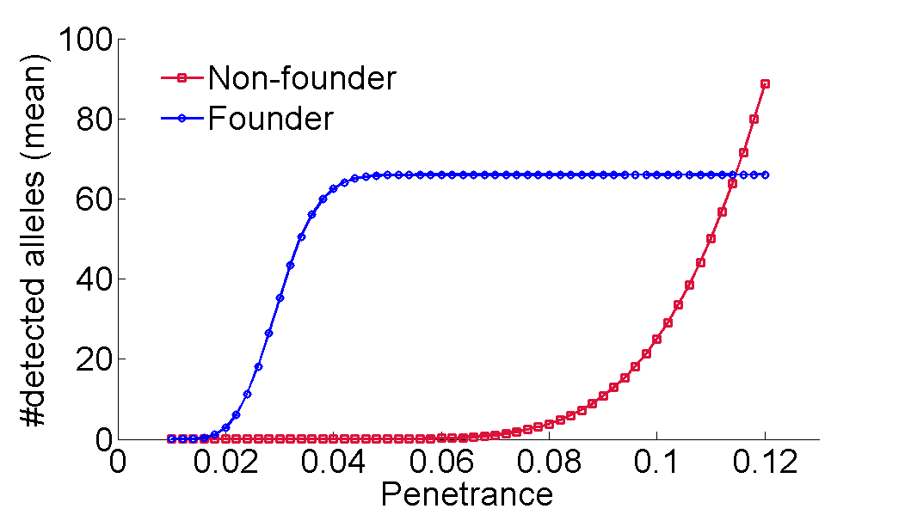
Founder populations
Disease prevalence: 1%
Bottleneck effective size: 330
Number of disease alleles: 1000
Sample size: 5000 cases/controls
Allele frequency: 1/10,000
P-value cutoff: 10-4

Slide 8
Opportunities: Reduced Haplotypic Diversity
Chromosomes in the sample
Observed data
Inferred sequence
Imputation
Full sequence
Partial sequence (SNP array, low-coverage sequence)
Inferred sequence
Problem: The Ashkenazi population is missing a reference panel of complete sequences

Slide 9
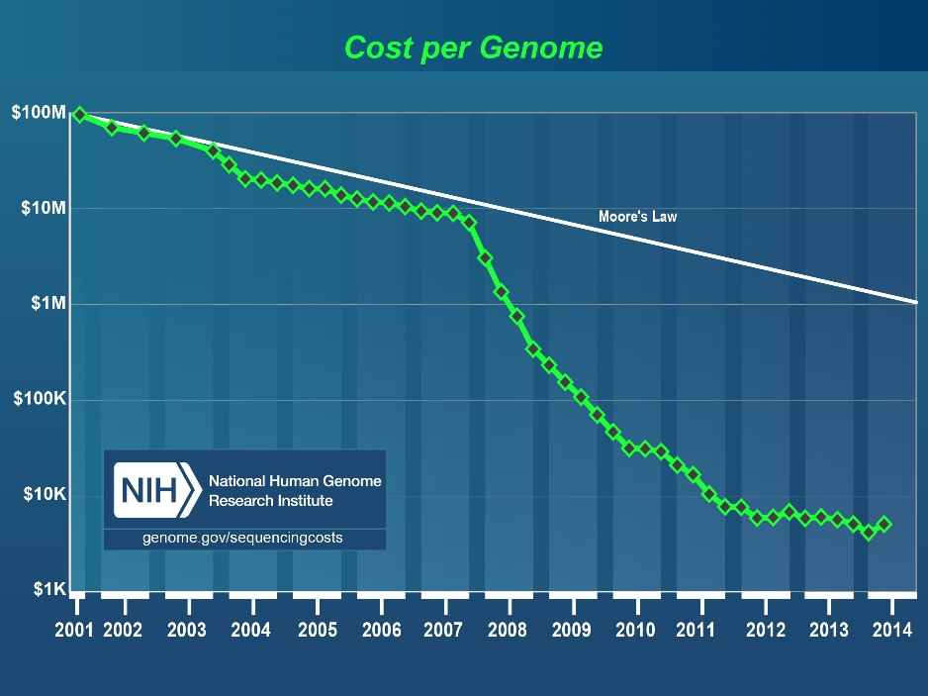

Opportunities: Personal Genomics in AJ
Personal clinical genomics is here
  But genomes are hard to interpret
Problem: The Ashkenazi population is missing a reference panel of complete sequences

Slide 10
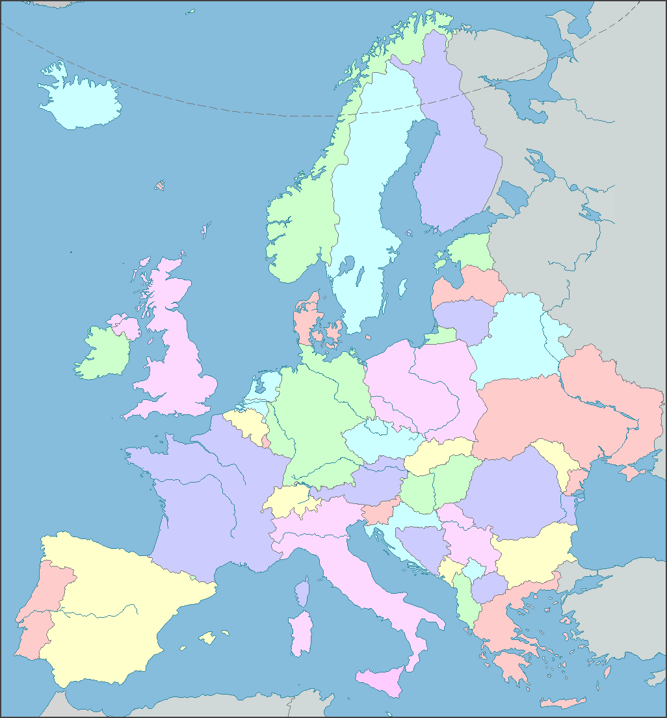
The Documented Ashkenazi History
Ca. 1000:
Small communities in
Northern France, Rhineland
Migration east
Expansion
Migration to US and Israel

Slide 11
Ashkenazi History: Questions
Origin?
Founder event?
European gene flow:
  Where?
  When?
  How much?
Relation to other Jews?
Whole-genomes?

Slide 12
Outline
Ashkenazi Jewish Genetics: Background
The Ashkenazi Genome Sequencing Project
Segment Sharing and the Founder Event
Future Directions

Slide 13








The Ashkenazi Genome Consortium
NY area labs interested in specific diseases
Large cohorts of AJ cases
Phase I: 128 whole genomes (completed*)
Phase II: ≈500 whole genomes (NYGC; under way)
* Carmi et al., Nat Commun, 2014
Quantify utility and use in medical genetics
Learn about population history

Slide 14
Technical Details
Samples:
Controls of Parkinson’s, longevity studies
  Some phenotypes exist
  Ashkenazi ancestry verified
Platform:
Complete Genomics
  Uniform QC measures
QC measure | Genome (exome)
Coverage | ≈56x
Fraction called | 96.7±0.3% (98.1%)
Concordance with arrays | 99.67±0.25%
Ti/Tv ratio | 2.14±0.004 (3.05)
hets
roh
QC: Remove indels, poly-allelic variants, Hardy-Weinberg violations, low call rate
  Error rate estimates using a duplicate and runs-of-homozygosity
Error rate after QC: ≈1.7∙10⁻⁶ per base pair

Slide 15
Sequencing Statistics (Raw Data)
Statistic | Per genome (exome)
SNVs | 3.4M (22k)
Novel SNVs | 3.8% (4.1%)
Het/hom ratio | 1.65 (1.67)
Insertions | 220k (242)
Deletions | 235k (223)
Multi-nucleotide variants | 83k (374)
Synonymous SNVs | 10,536
Non-synonymous SNVs | 9706
Nonsense SNVs | 72
Other disrupting | 255
CNVs | 302
SVs | 1480
MEIS | 4090

Slide 16
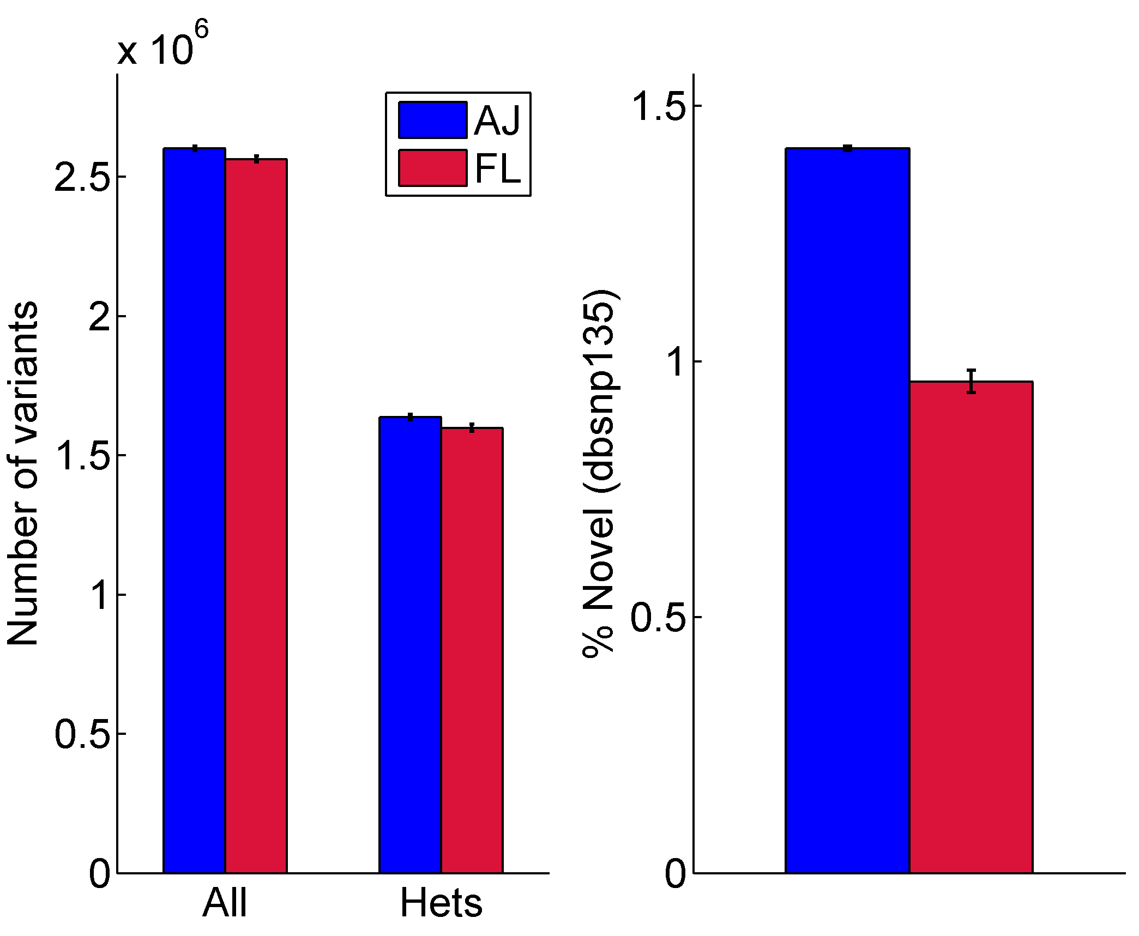
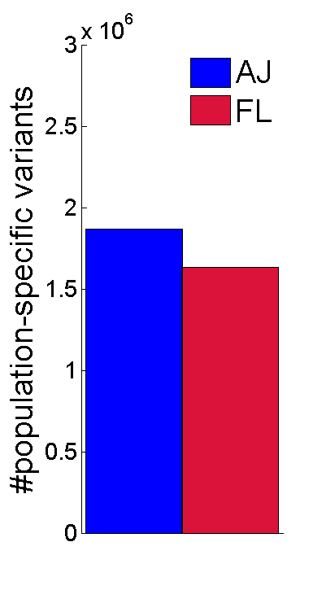

Comparison to Europeans
Main comparison panel: 26 Flemish from Belgium (platform-matched)
Variants per genome
Novel variants per genome (%)
(dbSNP)
Population-specific variants
(25x25 genomes)
Carmi et al., Nat Commun, 2014

Slide 17
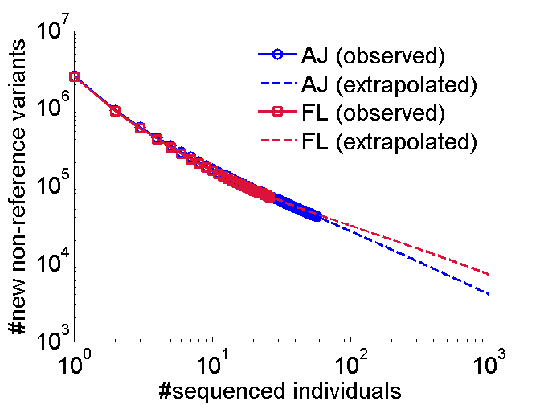
Variant Discovery Rate
Heterozygosity paradox?
Variants per genome
Overall discovered variants

Slide 18
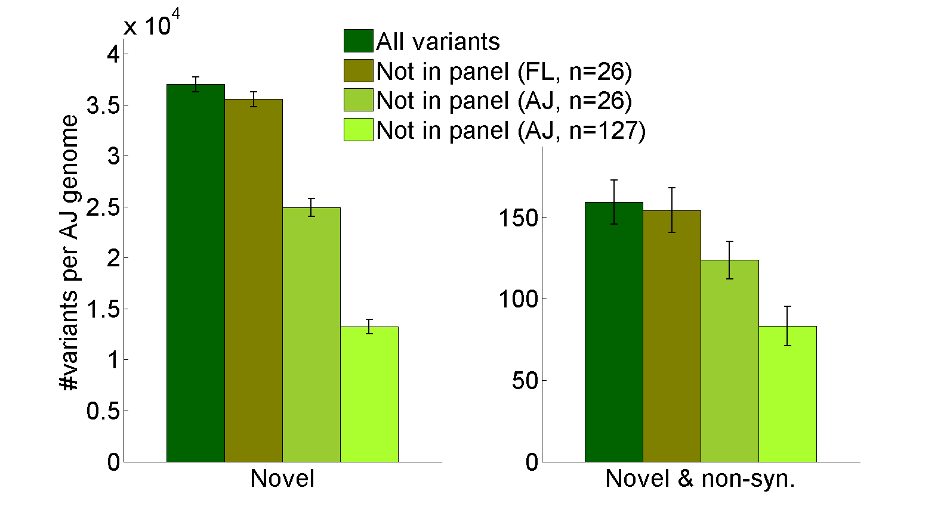
AJ Clinical Genomics
An Ashkenazi reference panel filters more likely benign variants from an AJ genome than a European panel
Carmi et al., Nat Commun, 2014

Slide 19
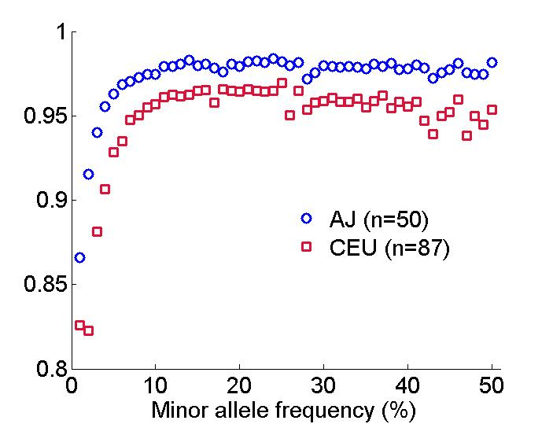
Imputation in AJ
An Ashkenazi reference panel improves imputation accuracy of AJ SNP arrays compared to the standard European panel
Correlation between imputed and real genotypes
Rare variants (≤1%) accuracy:
87% vs 65%
Carmi et al., Nat Commun, 2014

Slide 20
Improving Carrier Screening
Databases of disease-causing mutations (OMIM/ClinVar)
TAGC genomes
Exist in AJ but not common
1000 Genomes
Assessment of clinical validity and utility
A new panel with ≈170 mutations
Mendelian disorders
Predisposition
Baskovich et al., submitted

Slide 21
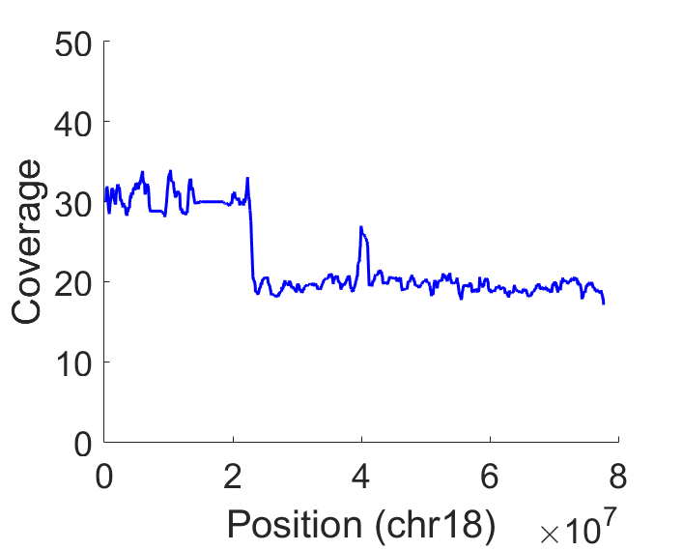
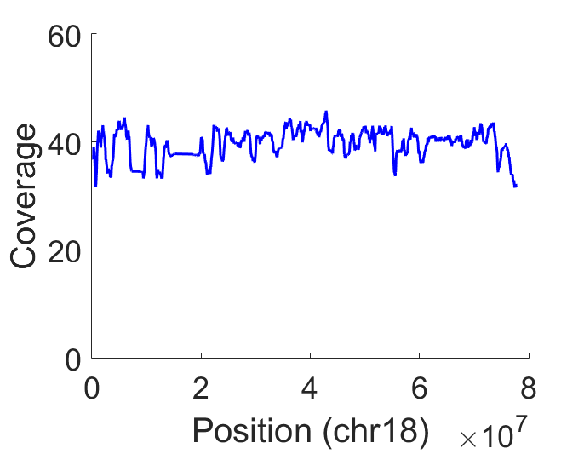
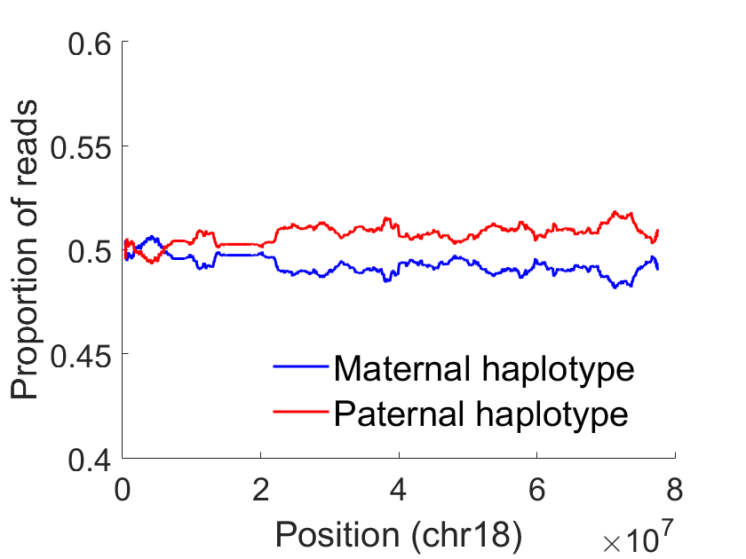
Low Frequency CNV in Tumors
  Sequence coverage can identify high frequency CNVs
    But not low frequency
30% deletion
?
  Resolve parental haplotypes
    Using TAGC genomes and a hidden Markov model
2% deletion
Backenroth et al., in preparation

Slide 22
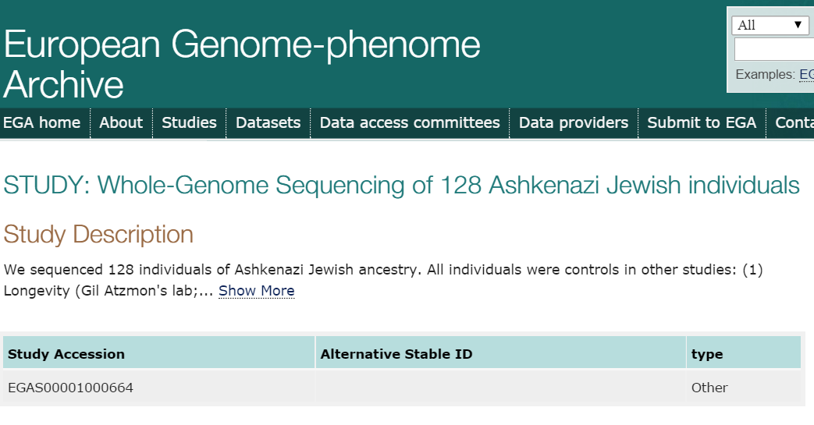

Other Medical Genetics Studies
  Our consortium:
    Association studies: schizophrenia, Parkinson’s, Crohn’s, longevity, cancer
Other groups:
  Data available on EGA
  Clinical frequency lookups (retinal degeneration, epilepsy, …)
  Population genetics, imputation, …

Slide 23
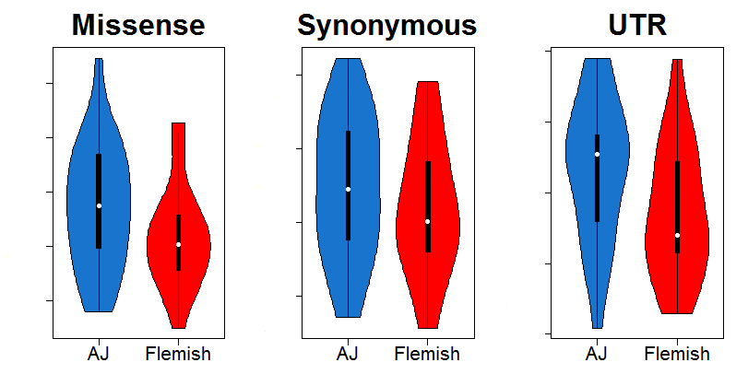
Mutation Burden in AJ
Do AJ have more deleterious mutations than Europeans?
Fraction of variants per genome
0.46%
1.33%
0.52%
1.32%
0.45%
1.31%
0.51%
Enrichment is ≈0.5-1% (P>0.01)
No disease category is significantly enriched
Carmi et al., Nat Commun, 2014

Slide 24
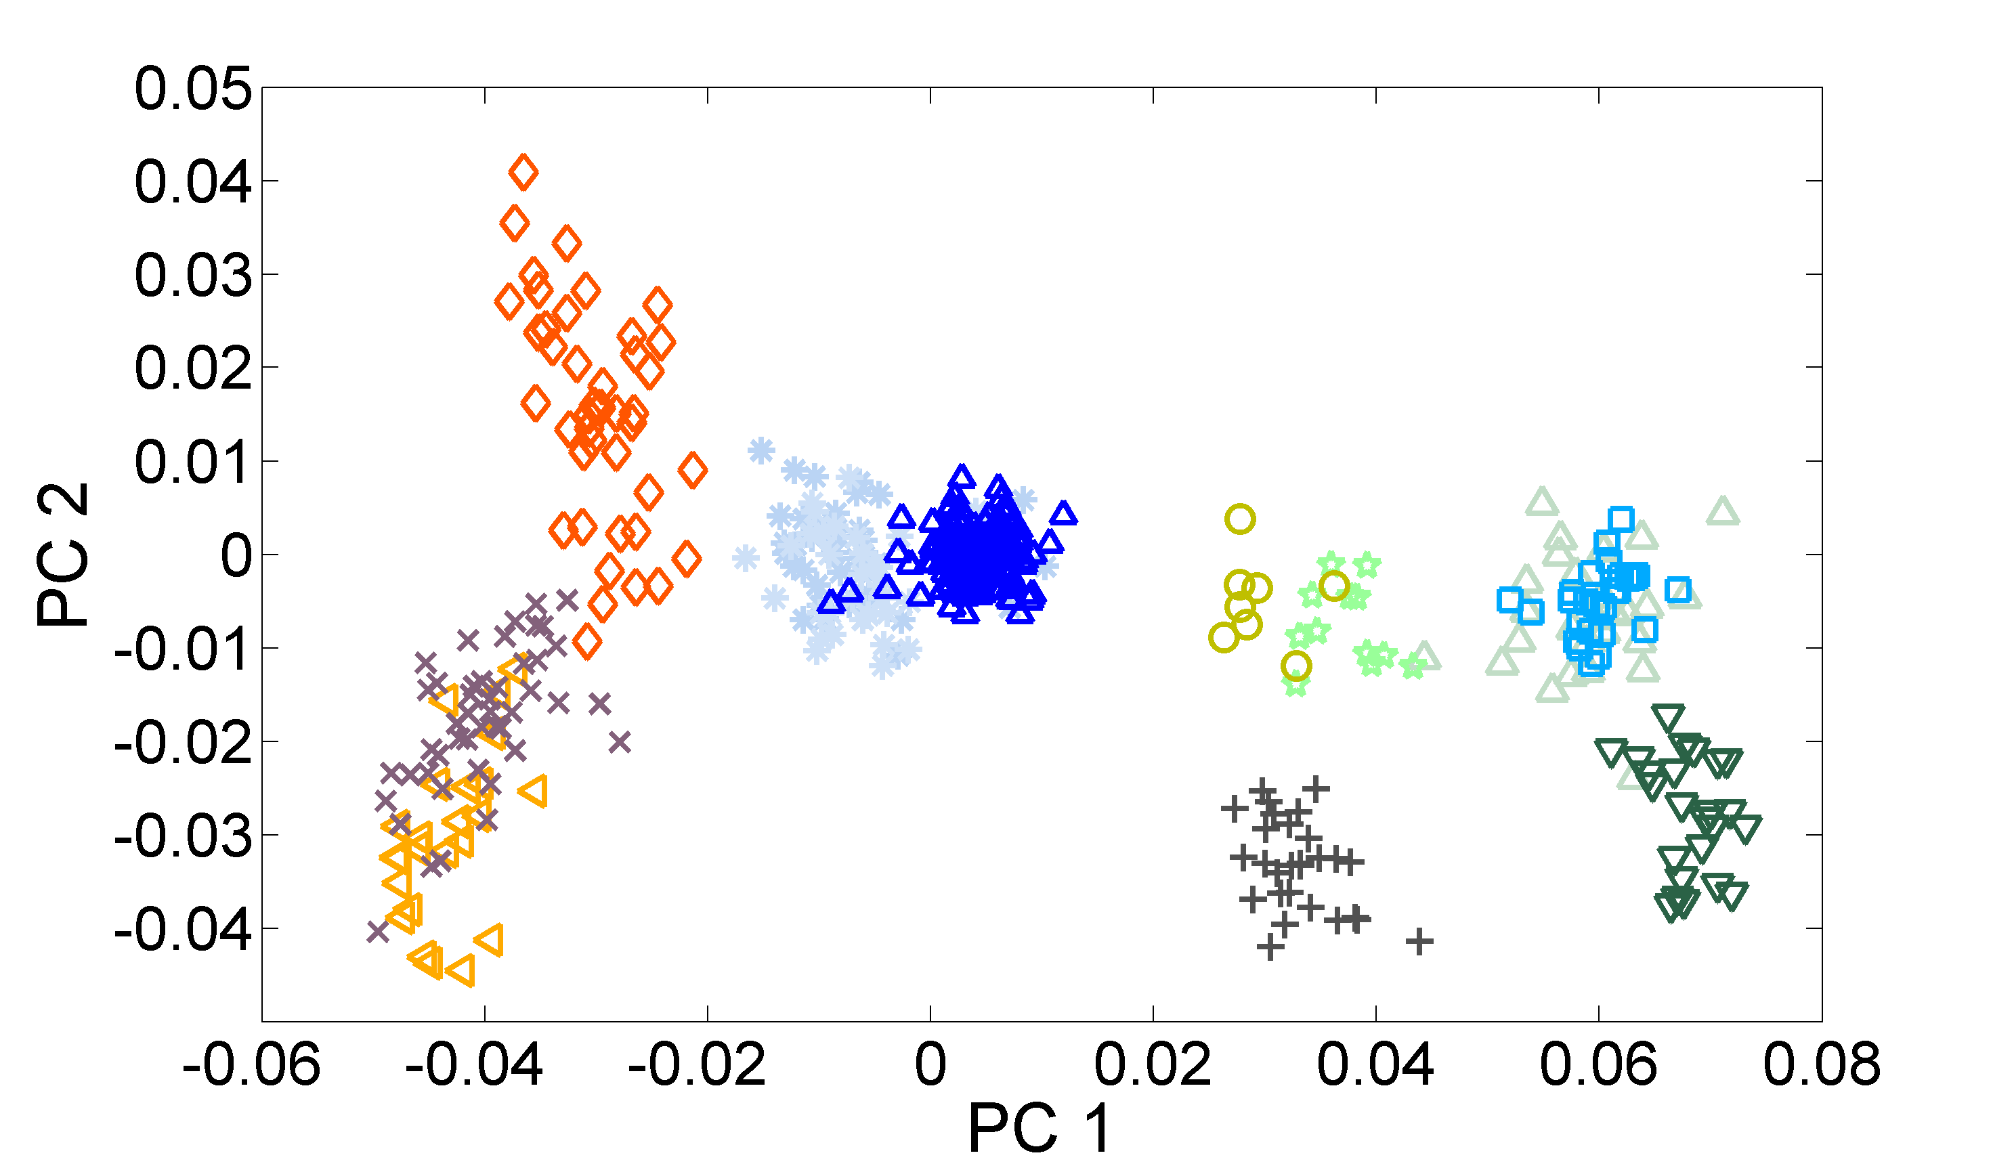
Principal Component Analysis (PCA)
Middle-East
Ashkenazi Jews (TAGC)
Europe
Druze
French
Tuscans
Palestinians
Flemish
Italians
Sephardi Jews
(Italy, Turkey)
Bedouins
Sardinians
Basque
Price et al., 2008; Olshen et al., 2008; Need et al., 2009; Kopelman et al., 2009; Atzmon et al., 2010; Behar et al., 2010; Bray et al., 2010; Guha et al., 2012; Behar et al., 2014, Carmi et al., 2014; O’connor et al., 2015

Slide 25

The Documented Ashkenazi History
Origin?
Founder event?
European gene flow:
  Where?
  When?
  How much?
Relation to other Jews?

Slide 26
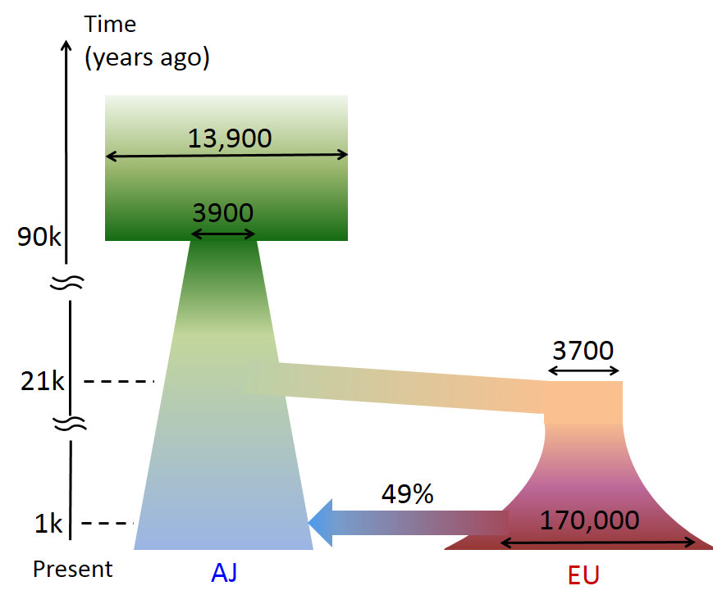
A Model for Ancient History
Out-of-Africa
25x25 genomes
Middle-East
European gene flow
into AJ
Carmi et al., Nat Commun, 2014

Slide 27
The Documented Ashkenazi History
Origin?
Founder event?
European gene flow:
  Where?
  When?
  How much?
Relation to other Jews?

Slide 28
Outline
Ashkenazi Jewish Genetics: Background
The Ashkenazi Genome Sequencing Project
Segment Sharing and the Founder Event
Future Directions

Slide 29


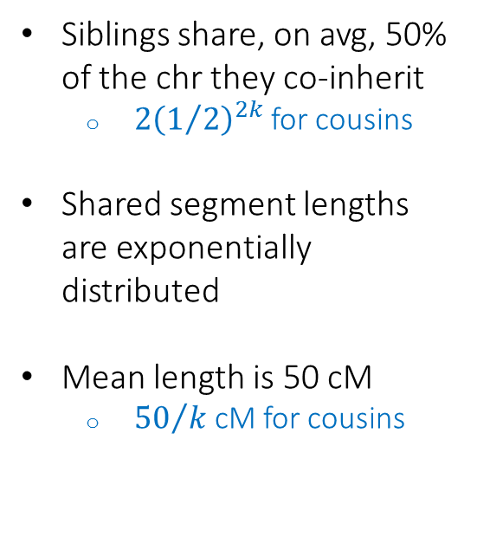

Genetic Segment Sharing
Siblings
$k$^{th}-generation cousins
Siblings share, on avg, 50% of the chr they co-inherit
  ${2\left(1/2\right)}^{2k}$ for cousins
Shared segment lengths are exponentially distributed
Mean length is 50 cM
  ${50}/k$ cM for cousins
k
Shared segments
Shared segment

Slide 30


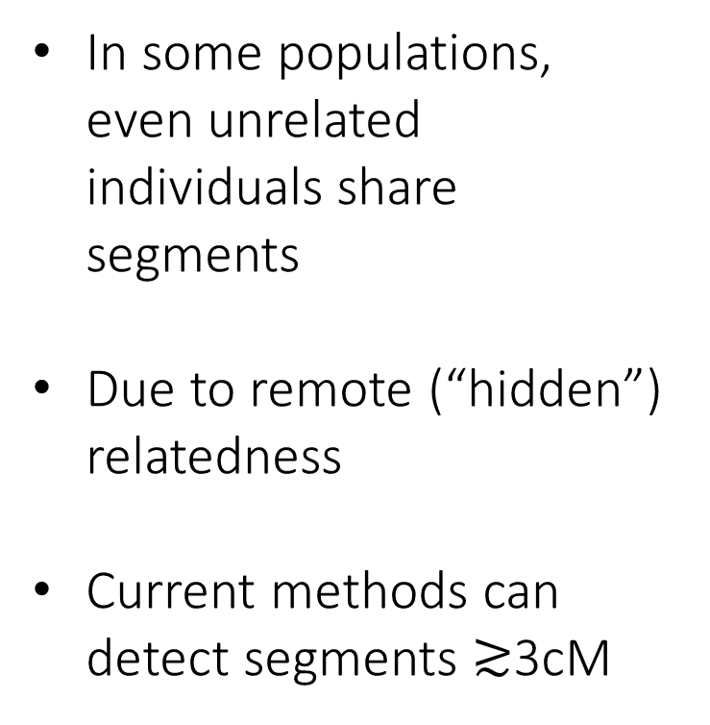
Genetic Segment Sharing
Time
In some populations, even unrelated individuals share segments
Due to remote (“hidden”) relatedness
Current methods can detect segments $≳$3cM
Shared segment

Slide 31
Importance
Segments are rare but long, hence observable
A segment indicates recent co-ancestry
Methods and theory
Shared segment detection
  Gusev et al., 2009
  Yang, Carmi, et al., 2015
Disease mapping
  Gusev et al., 2011, 2012
Pedigree reconstruction
  Henn et al., 2012
Demographic inference
  Palamara et al., 2012, 2013
  Carmi et al., 2013, 2014
Population histories
Ashkenazi Jews
  Gusev et al., 2012
  Carmi et al., 2014
Other Jews
  Atzmon et al., 2010
  Campbell et al., 2012
Druze
  Zidan, Ben-Avraham, Carmi, et al., 2014
Netherlands
  Francioly et al., 2014
Disease/trait mapping
Cholesterol, Micronesia
  Kenny et al., 2009, 2010
Parkinson’s, AJ
  Vacic et al., 2014
Schizophrenia, AJ
  Mukherjee et al., 2014

Slide 32
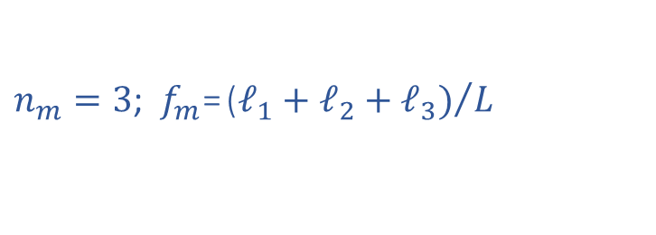
Segment Sharing Theory
Model:
  A population with a constant effective size N
  Two chromosomes of length L (Morgans)
  A minimal segment length m (Morgans)
The number of shared segments n_{m}?
The fraction of the chromosome in shared segments f_{m}?
ℓ₁
ℓ₂
ℓ₃
m
L
$n_{m}=3$; $f_{m}\text{=}{\text{(}ℓ_{1}+ℓ_{2}+ℓ_{3})}/L$

Slide 33
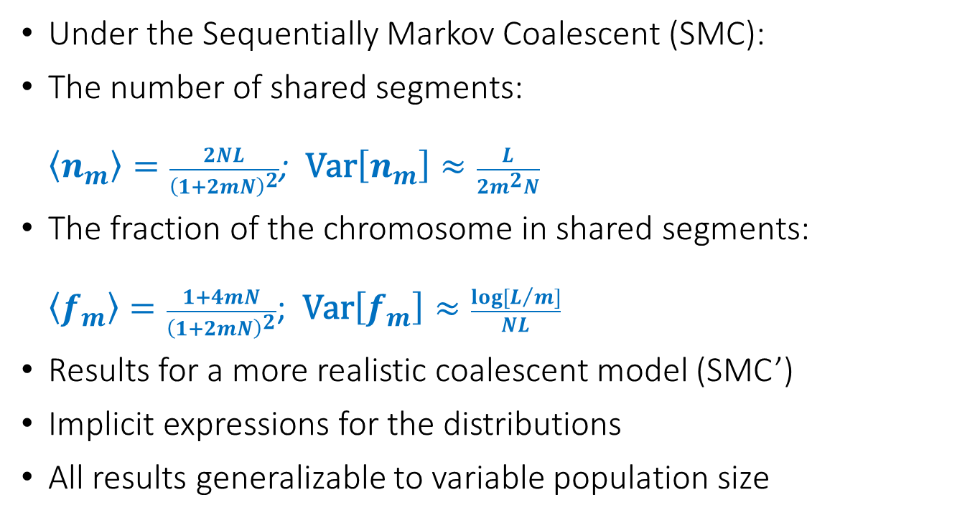
Results overview
Under the Sequentially Markov Coalescent (SMC):
The number of shared segments:
$\left\langle n_{m}\right\rangle =\frac{2NL}{{\left(1+2mN\right)}^{2}}$; $\text{Var}\left[n_{m}\right]≈\frac{L}{2m^{2}N}$
The fraction of the chromosome in shared segments:
$\left\langle f_{m}\right\rangle =\frac{1+4mN}{{\left(1+2mN\right)}^{2}}$; $\text{Var}\left[f_{m}\right]≈\frac{log⁡[L/m]}{NL}$
Results for a more realistic coalescent model (SMC’)
Implicit expressions for the distributions
All results generalizable to variable population size
Palamara et al., 2012; Carmi et al., 2013; Carmi et al., Theor Popul Biol, 2014

Slide 34
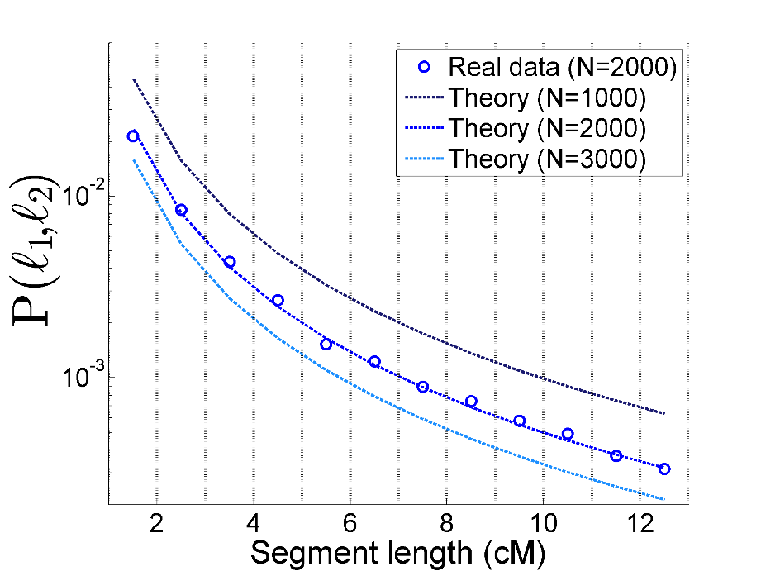

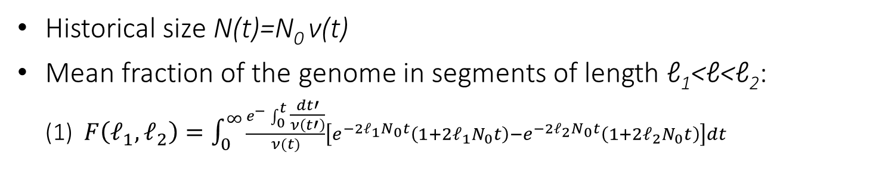
Demographic Inference
Historical size N(t)=N₀ ν(t)
Mean fraction of the genome in segments of length ℓ₁<ℓ<ℓ₂:
(1) $F\left(ℓ_{1},ℓ_{2}\right)=\int_{0}^{∞}{\frac{e^{−}\int_{0}^{t}{\frac{dt′}{ν\left(t′\right)}}}{ν(t)}\left[e^{−2ℓ_{1}N_{0}t}\left(1+2ℓ_{1}N_{0}t\right)−e^{−2ℓ_{2}N_{0}t}\left(1+2ℓ_{2}N_{0}t\right)\right]dt}$
Hypothetical example
Method:
Record shared segments in each length bin
Using Eq. (1), find the history N(t) that fits best
$$F\left(ℓ_{1},ℓ_{2}\right)$$
Palamara et al., 2012

Slide 35
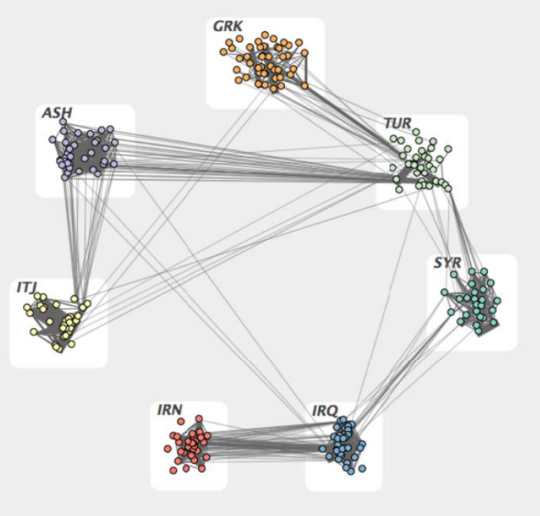
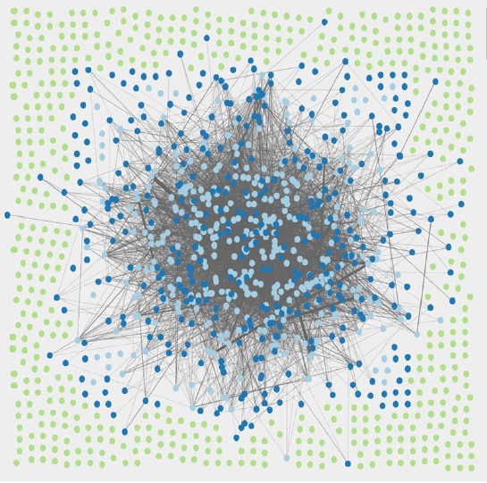
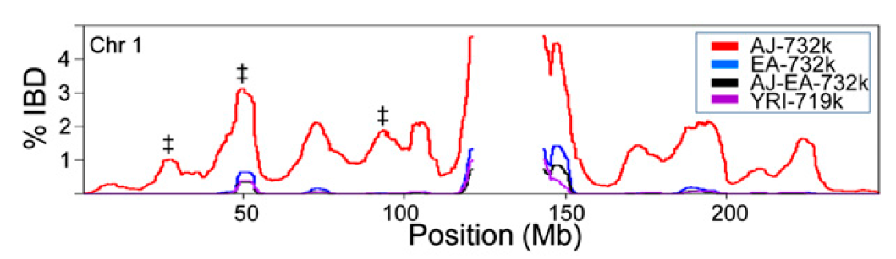
Segment Sharing in Ashkenazi Jews
Atzmon et al., 2010
Gusev et al., 2012
AJ
EU
Bray et al., 2010
% Sharing

Slide 36
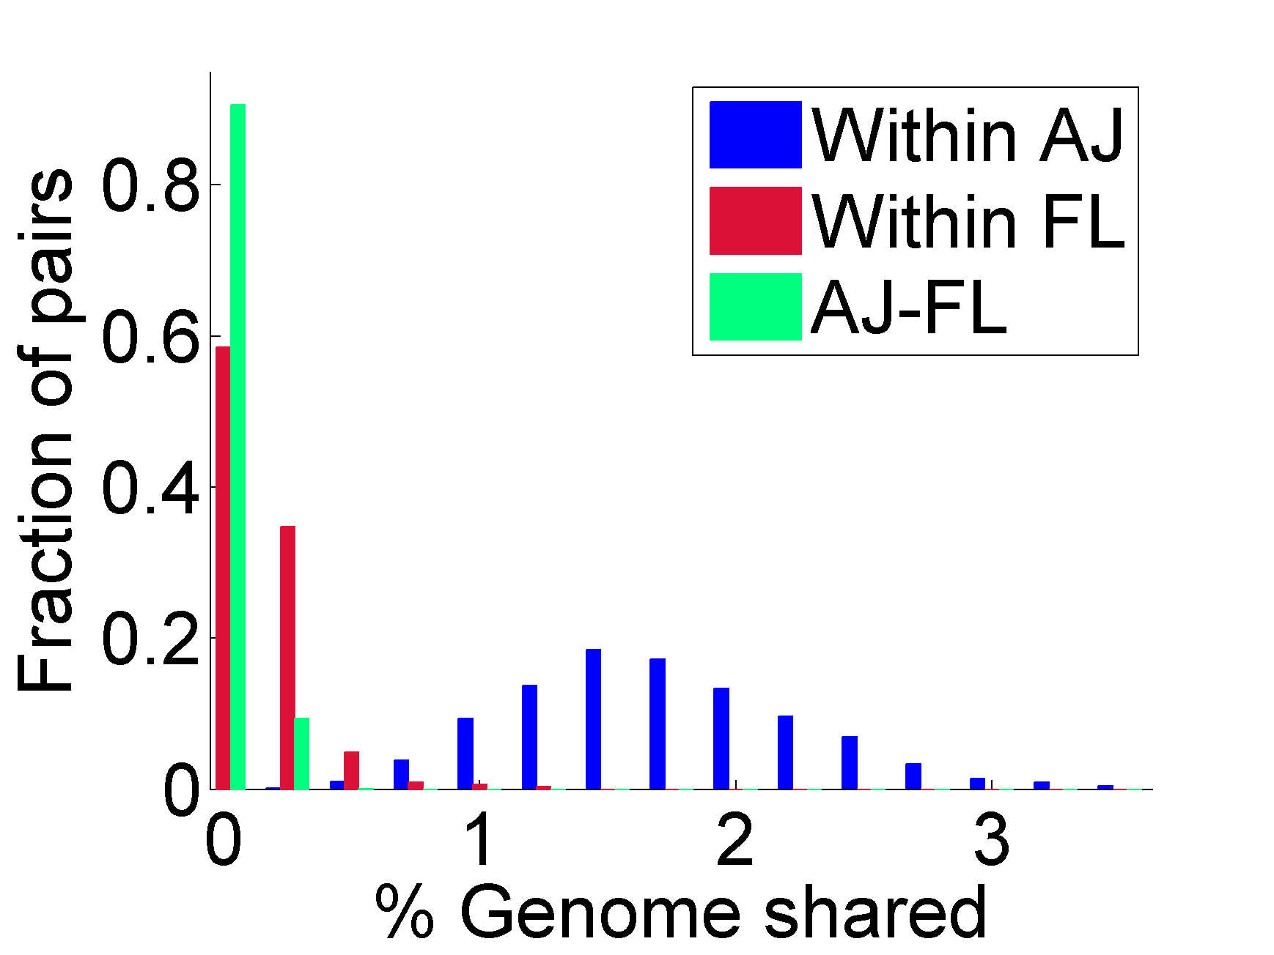
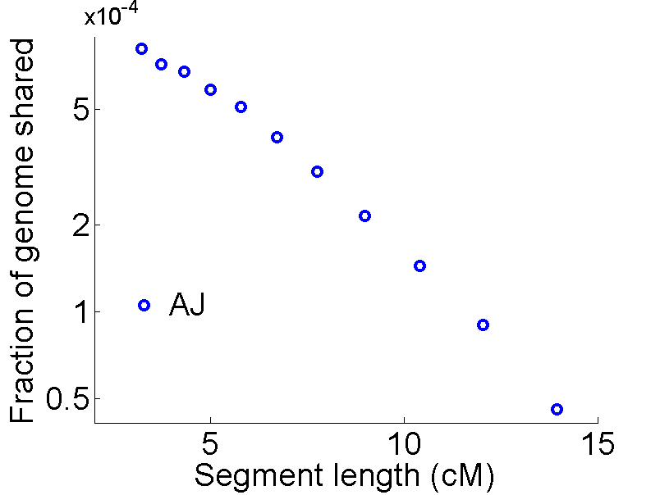
Segment Sharing in Ashkenazi Jews
A pair of AJ individuals shares 1-2% of their genome (≈50cM) in ≈10-15 long segments (>3cM)
Carmi et al., Nat. Commun., 2014
See also: Atzmon et al., 2010, Gusev et al., 2012, Palamara et al., 2012

Slide 37
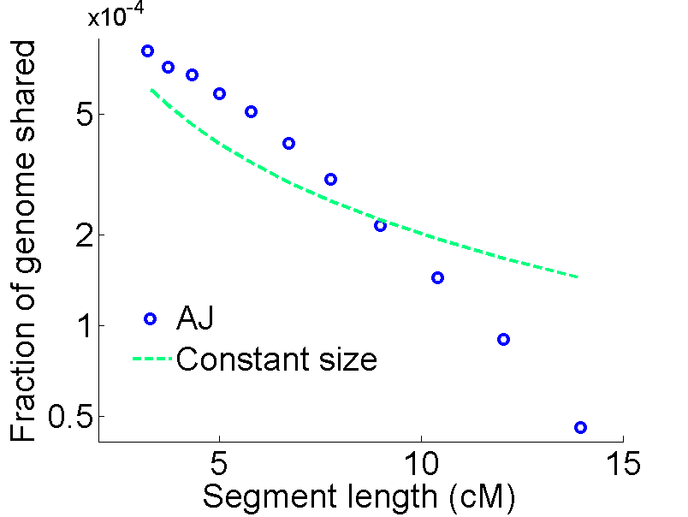
Segment Sharing in Ashkenazi Jews
Carmi et al., Nat. Commun., 2014
See also: Atzmon et al., 2010, Gusev et al., 2012, Palamara et al., 2012

Slide 38
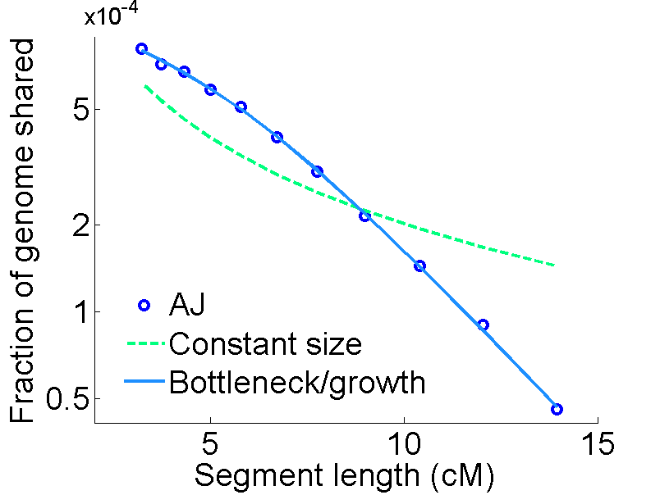
Segment Sharing in Ashkenazi Jews
Time (years)
Carmi et al., Nat. Commun., 2014
See also: Atzmon et al., 2010, Gusev et al., 2012, Palamara et al., 2012

Slide 39
Robustness
Potential confounders:
  Phasing, sequencing, and segment detection errors
  Model specification and assumptions
  Good resolution only for ≈10-50 generations ago
Parameter | 95% confidence interval
Bottleneck size | 249-419
Bottleneck time (years) | 625-800
Results consistent with previous studies
Time confirmed using lengths of haplotypes around doubletons
  Mathieson and McVean, 2014

Slide 40
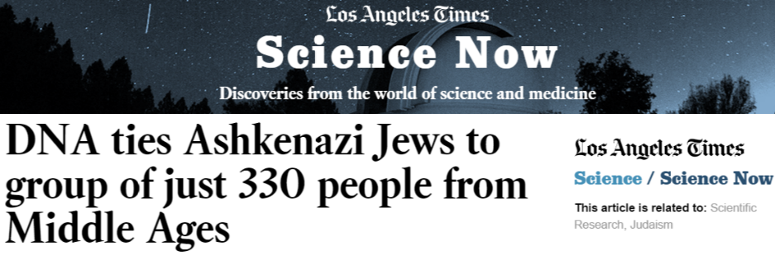
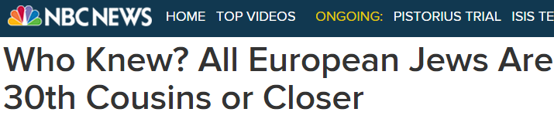

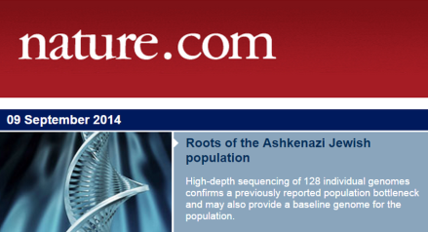

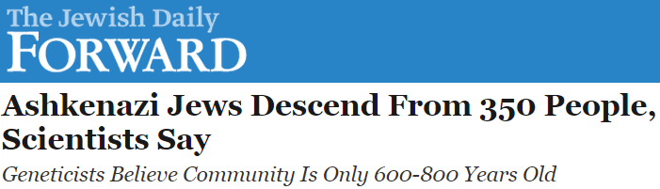

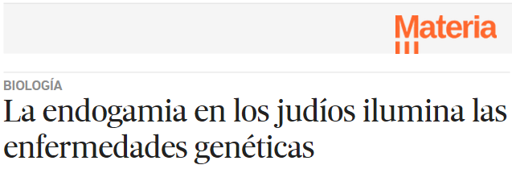
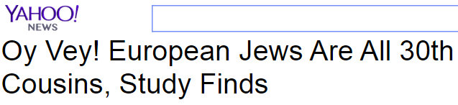

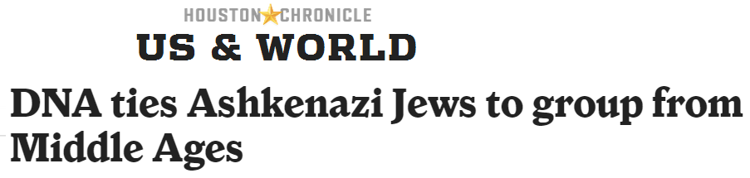

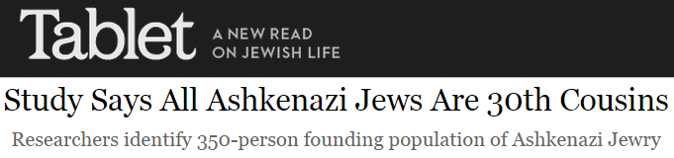
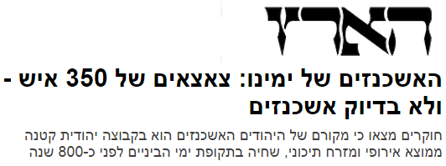

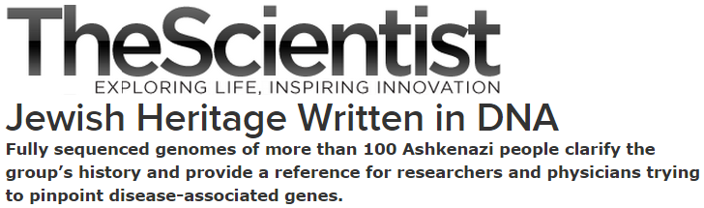
Media Coverage

Slide 41

Ashkenazi History
Origin?
Founder event?
European gene flow:
  Where?
  When?
  How much?
Relation to other Jews?

Slide 42
The Place and Time of European Gene Flow
“Most of these theories … are myths or speculation … based on some vague or misunderstood references. … It will probably be impossible to say definitely where the ... Jews in Poland … came from.”
B. Weinryb, The Jews of Poland, 1972

Slide 43
Approach
EU
ME
An Ashkenazi genome
EU
x
x
x
x
x
x
x
ME
x
x
x
x
o
x
o
o
x
o
x
o
PC2
x
o
x
x
x
x
x
x
x
x
x
x
x
AJ
x
PC1
ME
x
x
x
x
x
x
x
x
EU
x
x
x
x
x
o
x
x
o
x
x
x
x
o
x
x
o
o
x
x
o
x
o
o
o
x
x
x
o
x
o
o
PC2
PC2
x
x
x
x
x
x
x
x
x
x
x
x
x
x
x
x
x
x
x
x
x
x
x
x
x
x
PC1
PC1
Johnson et al., 2011; Moreno-Estrada et al., 2013

Slide 44
Preliminary Results
Used European and Middle-Eastern SNP array reference data
Origin in the Levant
Gene flow predominantly from South Europe
  Some from East Europe
  ≈30-40 generations ago
Sex-imbalanced history?

Slide 45
Outline
Ashkenazi Jewish Genetics: Background
The Ashkenazi Genome Sequencing Project
Segment Sharing and the Founder Event
Future Directions

Slide 46
Coverage by Shared Segments
A sequenced reference panel
What fraction of the genome can we cover with segments shared with the panel?
Partly sequenced genome
Impute
Full sequence
Partial sequence
Inferred sequence

Slide 47
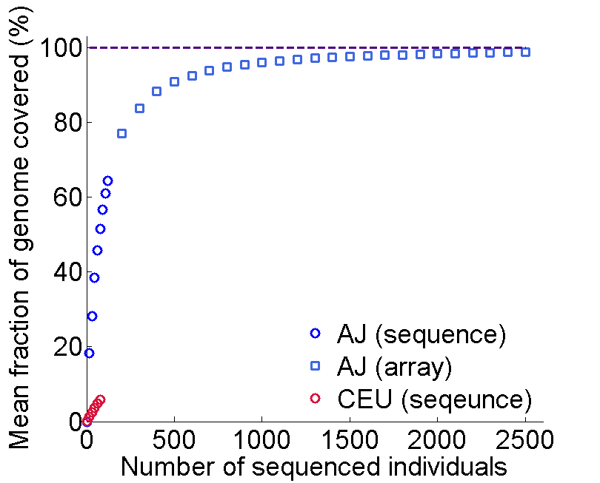
Coverage by Shared Segments: AJ
Segments >3cM
Mine public data?
Other studies?
Phase II
See Carmi et al., 2013 for a theoretical analysis

Slide 48
The Era of Near-Complete Coverage
Segments >3cM
Mine public data?
Other studies?
Phase II
Now
Every locus in a new genome has a fully sequenced “relative”
Opportunities:
  Interpretation of personal genomes
  Cost-effectively implementing large-scale association studies
  Historical inference
Methods to be developed!

Slide 49
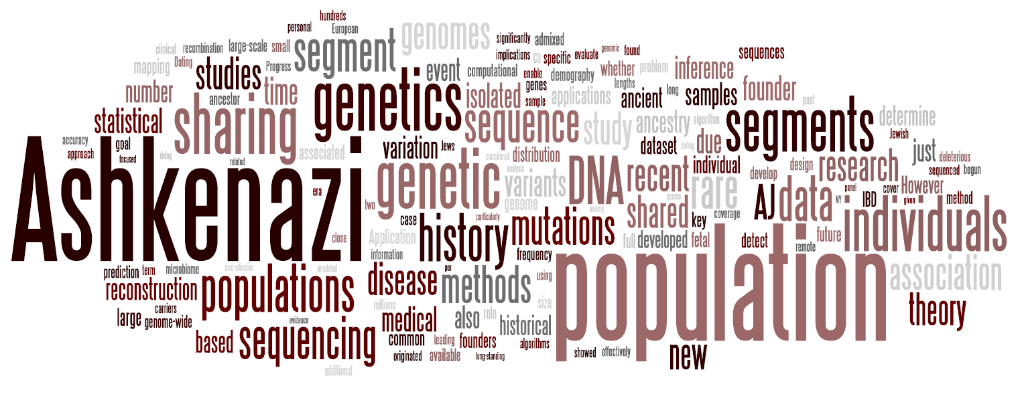
Summary
Ashkenazi genetics is interesting
We sequenced 128 whole-genomes
Useful for personal genomics and imputation
Segment sharing reveals a founder event and suggests opportunities
My research statement

Slide 50
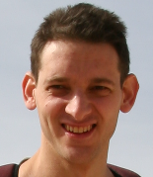







Acknowledgements
Itsik Pe’er’s lab:
James Xue, Ethan Kochav, Shuo Yang, Pier Palamara, Vladimir Vacic
TAGC consortium members:
Todd Lencz, Semanti Mukherjee (LIJMC)
Lorraine Clark, Xinmin Liu (CUMC)
Gil Atzmon, Harry Ostrer, Carole Oddoux,
Brett Baskovich, Danny Ben-Avraham (AECOM)
Inga Peter, Judy Cho (ISMMS)
Ariel Darvasi (HUJI)
Joseph Vijai (MSKCC)
Ken Hui (Yale)
VIB Ghent, Belgium
Harvard University:
Peter Wilton, John Wakeley
Sheba Medical Center:
Eitan Friedman
Columbia University Medical Center:
Daniel Backenroth, Yufeng Shen
Thank you for your attention!
Funding:

